Slide 1
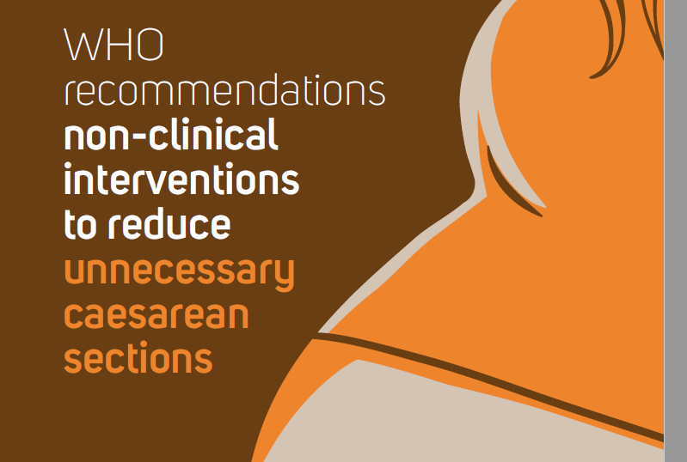

The guideline recommendations are available at

Slide 2

Table of contents
01
04
RECOMMENDATIONS
BACKGROUND
02
05
IMPLEMENTATION OF THE RECOMMENDATIONS
METHODS
03
06
RESEARCH PRIORITIES
EVIDENCE BASE

Slide 3
Background
Caesarean section as a mode of delivery
    Caesarean section increasing worldwide
Non-clinical factors contributing to rising caesarean section rates
Non-clinical interventions for reducing unnecessary caesarean sections
Scope of the guideline
Target audience

Slide 4
Caesarean section as a mode of delivery
Caesarean section is a surgical procedure that can effectively prevent maternal and newborn mortality when used for medically indicated reasons.
    There is no evidence showing the benefits of caesarean delivery for women or infants who do not require the procedure.
    As with any surgery, caesarean sections are associated with short and long term risk which can extend many years beyond the current delivery and affect the health of the woman, her child, and future pregnancies.
    These risks are higher in women with limited access to comprehensive obstetric care.
Every effort should be made to provide caesarean sections to women in need, rather than striving to achieve a specific rate

Slide 5
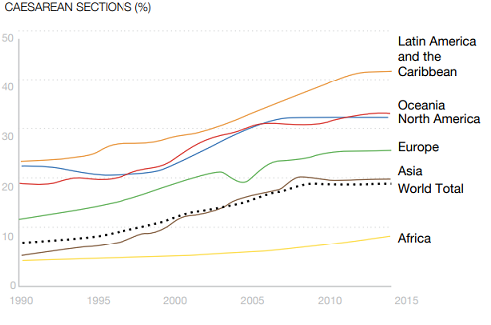
Caesarean section rates increasing worldwide
The optimal caesarean section rate is unknown but it varies between facilities because of differences in the obstetric populations attended.
    Over the last decades birth by caesarean section has increased in a sustainable and continuous manner to unprecedented levels worldwide
    Governments and clinicians have expressed concern about the rise in the numbers of caesarean section births and the potential negative consequences for maternal and infant health.
    Source: Betrán AP, Ye J, Moller AB, Zhang J, Gülmezoglu AM, Torloni MR. The Increasing Trend in Caesarean Section Rates: Global, Regional and National Estimates: 1990-2014. PLoS One. 2016 Feb 5;11(2):e0148343.

Slide 6
Non-clinical factors contributing to rising caesarean section rates
    Factors associated with caesarean births include:
      changes in the characteristics of the population such as increase of obesity, of multiple pregnancies, of nulliparous women or of older women.
    These changes are unlikely, however, to explain the large increases and wide variations in caesarean section rates across countries. Other non-clinical factors have all been implicated in this increase:
    women increasingly wanting to determine how and when their child is born
    generational shifts in work and family responsibilities
    physician factors
    increasing fear of medical litigation
    organizational, economic and social factors

Slide 7
SCOPE OF THE GUIDELINE
The guideline recommendations relate to the use of CS in women with low-risk pregnancies, (specifically, healthy women with term, singleton, cephalic pregnancies), which represents majority of the obstetrical population.
The guideline specifically considered those settings with high rates of caesarean section, where large numbers of caesareans are assumed to be unnecessary.
Women with complications or particular obstetric risk factors (such as breech or multiple pregnancy) are not considered within the guideline.
The guideline does not specify what clinical indications constitute a medically necessary CS, as the decision regarding medical necessity is according to the judgement of the treating clinician.

Slide 8
Primary audience of this guideline
Target audience include:
health-care professionals responsible for developing regional, national and local health protocols and policies
obstetricians, midwives, nurses, general medical practitioners
managers of maternal and child health programmes
public health policy-makers

Slide 9
Methods
Guideline development methods
Technical groups involved in developing guideline
    Priority questions and outcomes
    Quality assessment and synthesis of evidence

Slide 10

GUIDELINE DEVELOPMENT METHODS
A systematic evidence-based approach
Development of a guideline proposal for the WHO Guidelines Review Committee
Formation of technical groups
Declaration and management of interests
Formulating priority questions and outcomes
Retrieval and synthesis of evidence
Grading of the quality of the evidence
Formulating the recommendations
Planning for dissemination, implementation, evaluation and updating of the guideline

Slide 11
Technical groups involved in developing guideline
WHO Steering Group
    This comprises staff members from the WHO Departments of Reproductive Health and Research (RHR); Maternal, Newborn, Child and Adolescent Health (MCA), who managed the guideline development process.
    Guideline Development Group
    This consists of external experts and stakeholders from the six WHO regions. Members were identified in a way that ensured geographic representation and gender balance, and they had no important conflicts of interest.
    The group examined and interpreted the evidence and formulated the final recommendations at a face-to-face meeting, September 2017.
Technical Working Group
    This comprises guideline methodologists and systematic review team leads, who worked closely with WHO Steering Group to synthesize the evidence and other considerations for development of the recommendations.
    External Review Group
    These are external experts and stakeholders from the six WHO regions, who peer-reviewed the final guideline document to identify any factual errors and comment on clarity of the language, contextual issues and implications for implementation.
    External partners and observers
    Representatives of FIGO, ICM, RCOG, UNFPA and USAID

Slide 12
Priority guideline questions
Interventions targeted at women, the community or the public
1a. Do non-clinical educational interventions (e.g. educational games, materials, meetings) reduce caesarean rates in groups of low-risk women compared with usual care? 1b. Does the mode or format of communication affect the effectiveness of non-clinical education (e.g. information and communication technology, written, radio, television)? Does the use of opinion leaders reduce caesarean rates in groups of low-risk women compared with usual care? Does public dissemination of caesarean rates reduce caesarean rates in groups of low-risk women compared with usual care?
Interventions targeted at the health-care professional
Do educational interventions targeted at health-care professionals that aim to improve adherence to evidence-based clinical practice reduce caesarean rates in groups of low-risk women compared with usual care? Does the implementation of a policy of second opinion for caesarean indication reduce caesarean rates in groups of low-risk women compared with usual care? Does audit and feedback and peer review reduce caesarean rates in groups of low-risk women compared with usual care?

Slide 13
Priority guideline questions
Interventions targeted at the health organization or system
7a. Do different types of nurse/midwife staffing models reduce caesarean rates in groups of low-risk women compared with usual care? 7b. Do different types of physician staffing models reduce caesarean rates in groups of low-risk women compared with usual care? Does changing the physical or sensory environment of labour and delivery reduce caesarean rates in groups of low-risk women compared with usual care? Do targeted financial strategies for health-care professionals or health-care organizations reduce caesarean rates in groups of low-risk women compared with usual care? Does goal setting for caesarean rates reduce caesarean rates in groups of low-risk women compared with usual care? Do policies that limit financial/legal liability in case of litigation of health-care professionals or organizations reduce caesarean rate in groups of low-risk women compared with usual care? Do strategies to change the organizational culture reduce caesarean rates in groups of low-risk women compared with usual care?

Slide 14
Priority guideline outcomes
Critical outcomes
Rate of caesarean section and rate of all other modes of delivery (spontaneous vaginal birth, caesarean section before labour, emergency caesarean section, instrumental vaginal birth)
Perineal/vaginal trauma (e.g. vaginal tears, episiotomy)
Birth trauma (e.g. fractured skull, haematoma, cerebral haemorrhage)
Perinatal asphyxia (e.g. low Apgar score at 5 minutes, cord blood acidosis, needed major resuscitation)
Maternal birth experience (e.g. maternal satisfaction with care)
Important outcomes
Maternal morbidity (e.g. peripartum infection, postpartum haemorrhage)
Long-term infant outcomes (e.g. breastfeeding, childhood disability)
Serious maternal morbidity (e.g. organ failure, obstetric hysterectomy, sepsis)
Long-term maternal outcomes (e.g. urinary or faecal incontinence, obstetric fistula)
Health-care resource utilization (e.g. length of hospital stay, maternal readmission/rehospitalization)
Full PICO questions and outcomes are presented in the full guideline (Annex 1)

Slide 15
QUALITY ASSESSMENT AND SYNTHESIS OF THE EVIDENCE
Confidence in the quantitative evidence was assessed using Grading of Recommendations Assessment, Development and Evaluation (GRADE)
        benefits and harms
        resource requirement
        cost-effectiveness
Confidence in the qualitative evidence was assessed using Confidence in the Evidence from Reviews of Qualitative research (CERQual)
      values and preferences
      acceptability
      resource requirement
      equity
      feasibility
GRADE Evidence-to-Decision (EtD) Framework was used to integrate evidence on benefits and harms of interventions, values, acceptability, resource use, equity, and feasibility.

Slide 16
Evidence base
Systematic review of quantitative evidence
    Systematic reviews of qualitative evidence

Slide 17
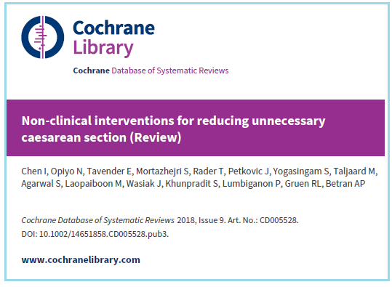
Systematic review of quantitative evidence
Evidence on the effectiveness of interventions was derived from an updated Cochrane review of 29 studies:
19 randomised trials, 1 controlled before-after study and 9 interrupted time series studies.
Most of the studies were conducted in high-income countries. None of the studies was done in a low-income country.
The studies enrolled a mixed population of pregnant women, including nulliparous women, multiparous women, women with a fear of childbirth, women with high levels of anxiety and women having undergone a previous caesarean section.

Slide 18
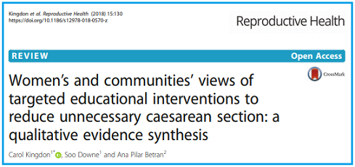
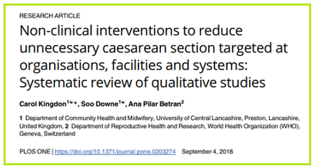
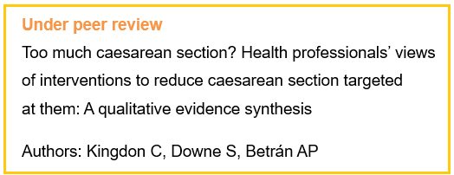
SYSTEMATIC REVIEWs OF QUALITATIVE EVIDENCE
Judgements about values, acceptability, equity, resource implications and feasibility of interventions were informed by three systematic reviews of 49 qualitative studies.

Slide 19
Recommendations
Formulating recommendations
    Interventions targeted at women
Interventions targeted at healthcare professionals
Interventions targeted at health organizations or systems

Slide 20
FORMULATING RECOMMENDATIONS
The Guideline Development Group (GDG) convened in September 2017 in Geneva, Switzerland, to review the summarized evidence and formulate recommendations. The GDG made three types of recommendations.
Recommended | The benefits of implementing this option outweigh the possible harms. This option can be implemented, including at large scale.
Context-specific recommendation | Recommended only in the context of rigorous research: This option indicates that there are important uncertainties about an intervention. In such instances, the implementation can still be undertaken at a large scale, but only as research that is able to address unanswered questions and uncertainties related both to the effectiveness of an intervention and its acceptability and feasibility. Recommended only with targeted monitoring and evaluation: This option indicates uncertainty about the effectiveness or acceptability of an intervention, especially regarding particular contexts or conditions. Interventions classified as such can be considered for implementation (including at large scale), provided they are accompanied by targeted monitoring and evaluation.
Not recommended | This option should not be implemented.

Slide 21
INTERVENTIONS TARGETED AT WOMEN
Recommendation 1 Health education for women is an essential component of antenatal care. The following educational interventions and support programmes are recommended to reduce caesarean births only with targeted monitoring and evaluation (Context-specific recommendation, low-certainty evidence)
Childbirth training workshops | content includes sessions about childbirth fear and pain, pharmacological pain-relief techniques and their effects, non-pharmacological pain-relief methods, advantages and disadvantages of caesarean sections and vaginal delivery, indications and contraindications of caesarean sections, among others).
Nurse-led applied relaxation training programme | content includes group discussion of anxiety and stress-related issues in pregnancy and purpose of applied relaxation, deep breathing techniques, among other relaxation techniques.
Psychosocial couple-based prevention programme | content includes emotional self-management, conflict management, problem solving, communication and mutual support strategies that foster positive joint parenting of an infant).
Psychoeducation | for women with fear of pain; comprising information about fear and anxiety, fear of childbirth, normalization of individual reactions, stages of labour, hospital routines, birth process, and pain relief [led by a therapist and midwife], among other topics.
When considering the educational interventions and support programmes, no specific format (e.g. pamphlet, videos, role play education) is recommended as more effective. (Low- to moderate-certainty evidence)

Slide 22
INTERVENTIONS TARGETED AT WOMEN
The following are according to the systematic review of qualitative studies. Women think that learning new information about birth can be empowering. Women want educational tools (childbirth training workshops, booklets, decision-aids) and welcome multiple formats (although information on paper is ultimately needed for reflection with family, friends and healthcare professionals). The content of educational materials should not provoke anxiety and needs to be consistent with advice from health-care professionals and provide the basis for more informed dialogue with them. Women want emotional support alongside the communication of facts and figures about birth.

Slide 23
INTERVENTIONS TARGETED AT healthcare professionals
Recommendation 2.1 Implementation of evidence-based clinical practice guidelines combined with structured, mandatory second opinion for caesarean section indication is recommended to reduce unnecessary caesarean sections in settings with adequate resources and senior clinicians able to provide mandatory second opinion for caesarean indication. (Context-specific recommendation, High-certainty evidence)
The guideline development group emphasized that this recommendation is for settings with adequate resources and senior clinicians (obstetrician-gynaecologists) able to provide mandatory second opinion for caesarean indication. The guideline development group noted that, although the effect size for this intervention is small, it might still translate into important impact on caesarean section rates, particularly in settings with adequate resources and high caesarean section rates. The following were components of the clinical practice guideline plus mandatory second opinion intervention. Clinical practice guidelines were prepared as decision flow charts for six primary indications for caesarean section. Mandatory second opinion was provided by the attending physician before caesarean section. The physician providing the second opinion had to be a person with clinical qualifications equal to or higher than those of the attending physician, working at the same hospital, selected by the obstetrics department and who agreed to follow the clinical guideline.

Slide 24
INTERVENTIONS TARGETED AT healthcare professionals
Recommendation 2.2 Implementation of evidence-based clinical practice guidelines, caesarean section audits and timely feedback to healthcare professionals are recommended to reduce unnecessary caesarean sections. (Recommended, High-certainty evidence)
The following were components of the evidence-based clinical practice guidelines and audit and feedback intervention. Onsite training in evidence-based clinical practice, facilitation of implementation by a local opinion leader (obstetrician-gynaecologist) and supportive supervision. Audits of indications for caesarean births and provision of feedback to physicians and nurses involved in the decision-making process for deliveries. The audits were conducted by a local audit committee comprising two obstetrician-gynaecologists, one general practitioner and one nurse. The evidence supported audits of indications for caesarean sections; however, the guideline development group emphasized the need to assess all aspects of caesarean sections in audits (such as underlying healthcare professional factors, women factors (e.g. maternal request) and organizational factors).

Slide 25
INTERVENTIONS TARGETED AT healthcare professionals
The following are according to the systematic review of qualitative studies. There is no clear consensus between healthcare professionals as to what constitutes a definite clinical indication for caesarean across time (e.g. breech presentation), place (i.e. availability and access) or parity (i.e. women with a previous caesarean), with health-care professionals drawing on different evidence to support their underpinning belief about vaginal birth as normal or as inherently pathological. The extent to which healthcare professionals value lowering caesarean rates locally is influenced by: fear of blame and recrimination, including fear of litigation for not intervening the value they attach to personal financial reward associated with caesarean any preference for caesarean as a convenient, efficient birth method that can be scheduled their beliefs about women, including shifts in beliefs about women’s preparedness for labour and to give birth vaginally, among others.

Slide 26
INTERVENTIONS TARGETED AT HEALTH ORGANIZATIONS OR SYSTEMS
Recommendation 3.1 For the sole purpose of reducing caesarean section rates, collaborative midwifery-obstetrician model of care (i.e. a model of staffing based on care provided primarily by midwives, with 24-hour back-up from an obstetrician who provides in-house labour and delivery coverage without other competing clinical duties) is recommended only in the context of rigorous research. (Context-specific recommendation, Low-certainty evidence)
The collaborative midwifery-obstetrician staffing model comprised a midwife and an obstetrician being present in-house 24 hours a day, working collaboratively to provide primary labour care for all private and public patients. This staffing model was compared with labour care provided by an on-call private physician or a covering partner. This recommendation is based on evidence from one interrupted time series study conducted in the United States. There are uncertainties about the effectiveness, feasibility and acceptability of the intervention in other settings. Thus, the intervention should be implemented only in the context of well designed studies examining the impact on caesarean sections and exploring the acceptability to key stakeholders and the feasibility of implementation. This model of care primarily addresses intrapartum caesarean sections.

Slide 27
INTERVENTIONS TARGETED AT HEALTH ORGANIZATIONS OR SYSTEMS
Recommendation 3.2 For the sole purpose of reducing unnecessary caesarean sections, financial strategies (i.e. insurance reforms equalizing physician fees for vaginal births and caesarean sections) for healthcare professionals or healthcare organizations are recommended only in the context of rigorous research. (Context-specific recommendation, Very low-certainty evidence)
The guideline development group noted that only two interrupted time series studies assessed this intervention, conducted in countries with different healthcare systems and resource capacities (Taiwan [China], the United States) – applicability in other settings is therefore uncertain. The certainty of evidence for caesarean section outcome was judged as very low in both studies (the effect on caesarean section rates is therefore uncertain). Despite these uncertainties, the guideline development group noted that financial incentive remains a major determinant of caesarean births in all settings. Given the uncertainties in the impact of financial strategies and their importance in caesarean births, the guideline development group recommended the implementation of financial strategies equalizing physician fees for vaginal births and caesarean sections only in the context of rigorous research examining the impact on caesarean births and exploring their acceptability to key stakeholders and the feasibility of their implementation.

Slide 28
INTERVENTIONS TARGETED AT HEALTH ORGANIZATIONS OR SYSTEMS
The following are according to the systematic review of qualitative studies. Findings indicate that some healthcare professionals are outspoken about the economic incentives for caesareans, particularly in private healthcare facilities. Some doctors considered caesareans to involve more work, which justified the payment, others blamed the system, while still others reported personally valuing the extra income. Some doctors and midwives were critical of the insufficient monetary reward to staff by comparison for labour and vaginal birth. Dysfunctional teamwork within the medical profession and lack of communication are important barriers that need to be addressed in the context of fostering change. Marginalization of midwives recurs across settings and acts as an important barrier to reducing caesareans. Collaborative staffing models can address this issue.

Slide 29
Implementation of the recommendations
Barriers to implementation and strategies to address them

Slide 30
IMPLEMENTATION OF THE RECOMMENDATIONS
Barrier or constraint
Implementation strategy
Lack of understanding of the value of recommended practices among women seeking maternity care, families or communities
    Community-level sensitization activities should be undertaken to disseminate information about the risks of unnecessary caesarean sections and the benefits of adhering to recommended practices.
Resistance of health-care providers to changing their entrenched caesarean section practices; lack of understanding of the value of newly recommended interventions
    Involve local opinion leaders; identify champions to promote the implementation of the recommendation.
    Involve training institutions and professional bodies in the introduction of the guideline so that pre-service and in-service training curricula can be updated with the recommendations.

Slide 31
IMPLEMENTATION OF THE RECOMMENDATIONS
Barrier or constraint
Implementation strategy
Patients may make demands that hinder adherence
    Provide tailored patient education materials.
    Train targeted health-care professionals to provide patient education.
Lack of human resources with the necessary expertise and skills to implement, supervise and support recommended practices (e.g. senior clinicians to provide second opinion for caesarean section indication)
    Redistribute health-care resources; task shifting.
    Pragmatic consideration of what is feasible; gradual change; shifting resources from elsewhere in the health-care budget; increasing the health-care budget.
    Strategic long-term planning and budgeting to provide the necessary resources.
Dysfunctional teamwork among health-care professionals (e.g. lack of communication between maternity and theatre staff).
    Organize teams in which roles are defined and they have a shared goal.

Slide 32
IMPLEMENTATION OF THE RECOMMENDATIONS
Barrier or constraint
Implementation strategy
Lack of physical space (e.g. a venue for birth preparation classes and counselling sessions, training workshops)
    Adapt implementation strategies to work within the constraints of the existing systems.
    Strategic long-term planning and budgeting to provide the necessary resources.
Lack of essential supplies (locally adapted information, education and communication materials to support training, and support programmes, e.g. booklets or pamphlets in local languages)
    Devise strategies to improve supply chain management according to local requirements, such as developing protocols for obtaining and maintaining the stock of supplies.
    Adapt implementation strategies to work within the constraints of the existing systems.
Lack of health information management systems designed to document and monitor recommended practices (e.g. electronic records, registers)
    Provide appropriate incentives to record the needed information.
    Strategic long-term planning and budgeting to provide the necessary resources for health information management systems.

Slide 33
RESEARCH PRIORITIES
The Technical Working Group and Steering Group identified areas where further studies are needed based on four broad considerations:
uncertainty in the effects of the interventions due to evidence of very low or low certainty.
concerns with the applicability of the evidence (particularly as most interventions were assessed in single studies; the interventions would benefit from replication in other settings).
lack of studies for predefined guideline questions.
promising interventions not specifically designed to reduce caesarean births that would benefit from examination in areas with high caesarean section rates (e.g. continuous one-to-one intrapartum support).

Slide 34
RESEARCH PRIORITIES
Future research should focus on the following areas
Population | Healthy women seeking antenatal, labour and delivery care in health-care facilities (term, singleton, cephalic pregnancies with or without a previous caesarean).
Study designs | Pragmatic randomized controlled trials or cluster-randomized trials (involving clusters of practices, hospitals, birth centres, labour units). Where these are not feasible, interrupted time series designs should be used. Multi-site studies are encouraged to increase the sample size and generalizability of findings. Mixed-methods studies integrating quantitative and qualitative data within a single investigation are encouraged. The qualitative component can help to provide insight into effects of interventions to reduce caesarean births.
In particular, the guideline development group emphasized that future intervention trials should be preceded with formative research to define locally relevant determinants of caesarean births.

Slide 35
RESEARCH PRIORITIES
Future research should focus on the following areas
Interventions | Multifaceted (rather than single-component) interventions tailored to local determinants (barriers and facilitators) of caesarean section practices are recommended. The certainty of evidence for caesarean section outcome was low to very low for the following interventions. Further studies are needed to address the uncertainty in the effect of these interventions. Educational interventions targeted at women Audit and feedback using the Robson classification Insurance reforms equalizing physician fees for vaginal births and caesarean sections. Collaborative midwifery-obstetrician model of care.
Outcomes | Studies should address both short-term and long-term maternal outcomes (e.g. urinary incontinence, obstetric fistula, utero-vaginal prolapse) and infant outcomes (e.g. breastfeeding, childhood disability).

Slide 36
ACKNOWLEDGEMENTs
WHO Steering Group
  Ana Pilar Betrán, Mercedes Bonet, Maurice Bucagu, A. Metin Gülmezoglu, Frances McConville, Olufemi Oladapo, Anayda Portela, João Paulo Souza, Joshua Vogel
Guideline Development Group
  Hany Abdel-Aleem, Fernando Althabe, Guillermo Carroli, Karen Daniels, Sylvia Deganus, Tao Duan, Alexandre Dumont, Aparajita Gogoi, Anne-Beatrice Kihara, Ana Langer, Barbara Levy, Pisake Lumbiganon, Abedini Mehrandokht, Rintaro Mori, Tomas Pantoja, Sadequa Shahrook, William Stones, Elizabeth Sullivan, Maria Regina Torloni, Petr Velebil
WHO Regional Advisors
  Mavjuda Babamuradova, Karima Gholbzouri, Bremen De Mucio, Mari Nagai, Leopold Ouedraogo
Technical Working Group
  Soo Downe, Carol Kingdon, Simon Lewin, Newton Opiyo
External Review Group
  Justus Hofmeyr, Ingela Lundgren, Catherine Spong, Johanne Sundby, Jim Zhang, Agustin Zongo
Observers
  Diogo Ayres-de-Campos [FIGO]); Mechthild M. Gross [ICM]); Petra ten Hoope-Bender [UNFPA]; Mary Ellen Stanton [USAID], Alison Wright [RCOG]
  Funders
  USAID; UNDP-UNFPA-UNICEF-WHO-World Bank Special Programme of Research, Development and Research Training in Human Reproduction (HRP)

Slide 37

CONTACT DETAILS FOR ADDITIONAL INFORMATION
You can also contact WHO:
    Email: Department of Reproductive Health and Research:
    reproductivehealth@who.int
    Twitter:
    @HRPresearch
    Facebook:
    World Health Organization

