Slide 1



RLS: tools
Michela Tanzini
Center for Clinical Risk Mangment and Patient Safety, Tuscany Region

Slide 2

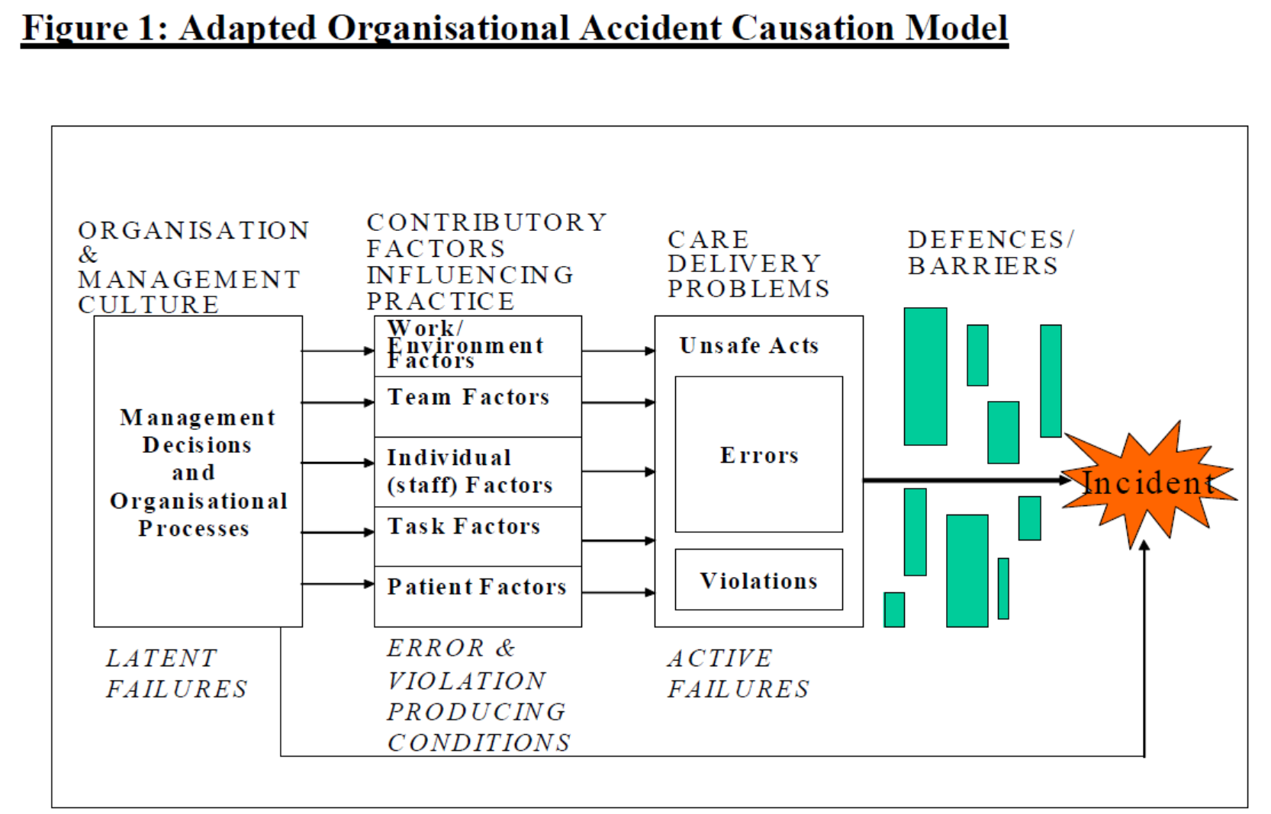
London Protocol – Organisational Accident Causation Model
https://www.imperial.ac.uk/patient-safety-translational-research-centre/education/training-materials-for-use-in-research-and-clinical-practice/the-london-protocol/

Slide 3
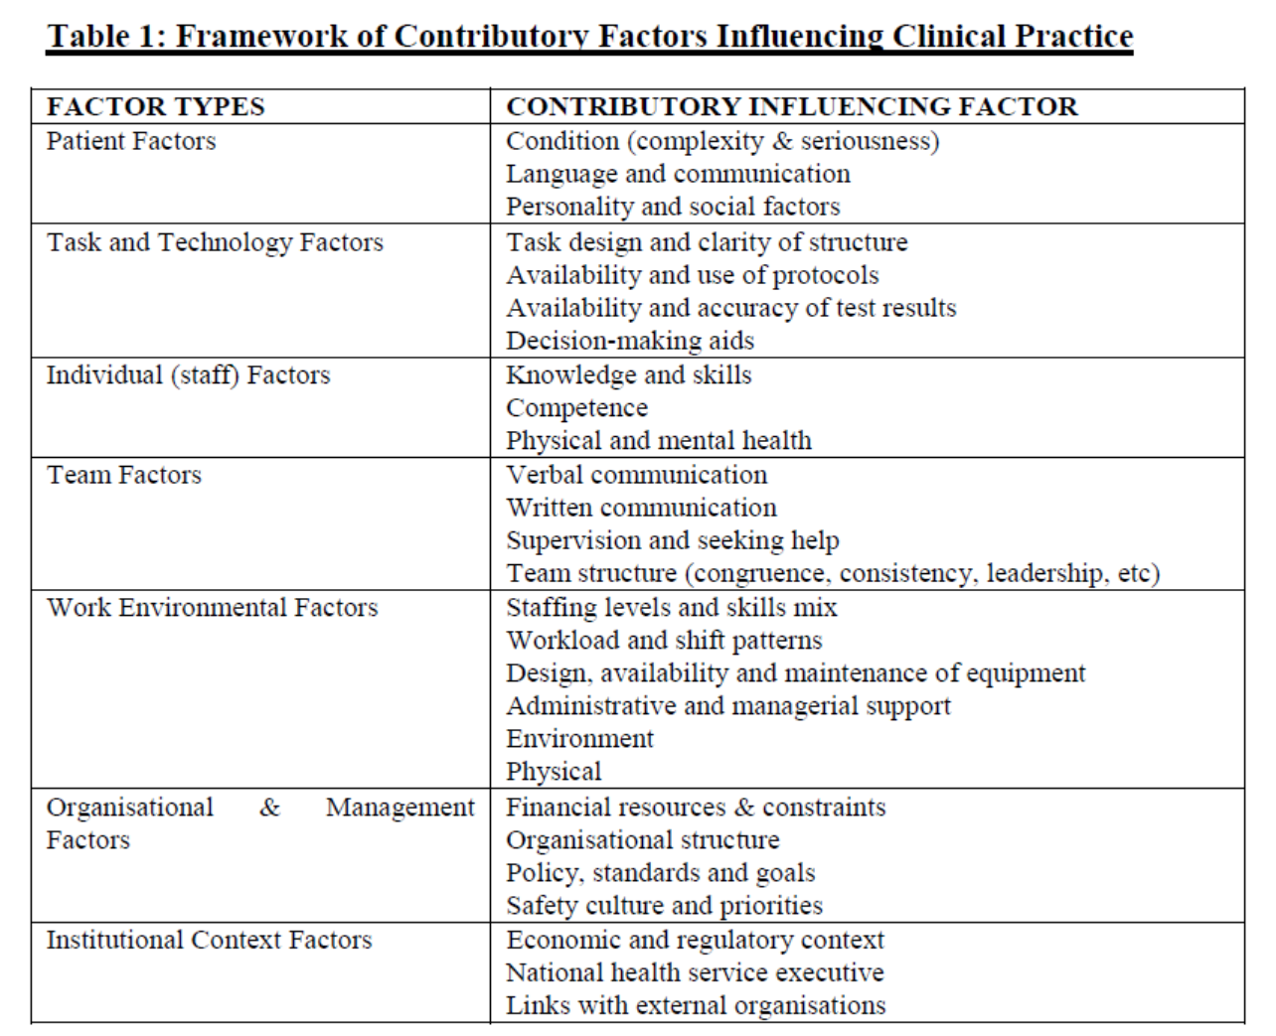
London Protocol – Contibutory factors
https://www.imperial.ac.uk/patient-safety-translational-research-centre/education/training-materials-for-use-in-research-and-clinical-practice/the-london-protocol/

Slide 4
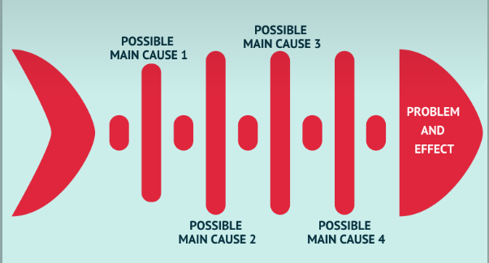
Fishbone Diagram
The fishbone Diagram is a driagra-based technique used in brainstorming
To identify potential causes for a problem, thu it is a visual representation
Of cause and effect.
The problem or effect serves as the head of the fish.
Possibile causes of the problem are listed on the individual «bones» of the fish.
This encourages problem-solving teams to consider a wide range of alternatives.

Slide 5
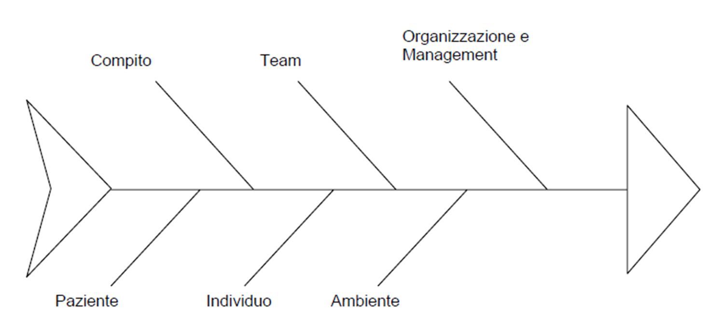
Fishbone Diagram
Task & Technology
Factors
Organisational & Management
Factors
Team Factors
Patient Factors
Individual Factors
Work Envirnoment Factors

Slide 6
Event Timeline
The Event Timeline tracks the incident and allows the experts to discover any parts of the process where problems may have occurred.
Time | Description

Slide 7
Ameliorating Actions
Each ameliorating action should include this information
Ameliorating Actions
Description | what kind of preventive solution is to be implemented
Level of application | Healthcare trust, ward Director, Risk Manager, etc.
Person in charge | People who is committed to ensuring that the solution is implemented
Application time ameliorating action | within 3 months; within 6 months; within 12 months
Evaluation measures | indicator that measures the effectiveness of the hypothesized solution
Day of the measure | moment in which it is intended to detect the outcome of the solution
Frequency of evaluation measures | type of monitoring (monthly, quarterly, half-yearly, yearly, etc.)
Management involvement | Si/No

Slide 8
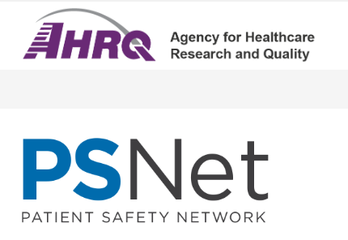
Glossary
Active error or Active Failure
The terms active and latent as applied to errors were coined by Reason.
Active errors occur at the point of contact between a human and some aspect of a larger system
(e.g., a human machine interface). They are generally readily apparent (e.g., pushing an incorrect button,
ignoring a warning light) and almost always involve someone at the frontline.
Active failures are sometimes referred to as errors at the sharp end, figuratively referring to a scalpel.
In other words, errors at the sharp end are noticed first because they are committed by the person closest to the patient.
This person may literally be holding a scalpel (e.g., an orthopedist operating on the wrong leg) or figuratively be
administering any kind of therapy (e.g., a nurse programming an intravenous pump) or performing any aspect of care.
Latent errors (or latent conditions), in contrast, refer to less apparent failures of organization or design that contributed
to the occurrence of errors or allowed them to cause harm to patients. To complete the metaphor, latent errors are
those at the other end of the scalpel, the blunt end referring to the many layers of the health care system that affect
the person "holding" the scalpel.
Latent error or Latent Condition
The terms active and latent as applied to errors were coined by Reason. Latent errors (or latent conditions) refer to
less apparent failures of organization or design that contributed to the occurrence of errors or allowed them
to cause harm to patients. For instance, whereas the active failure in a particular adverse event may
have been a mistake in programming an intravenous pump, a latent error might be that the institution
uses multiple different types of infusion pumps, making programming errors more likely. Thus, latent
errors are quite literally "accidents waiting to happen." Latent errors are sometimes referred to
as errors at the blunt end, referring to the many layers of the health care system that affect the
person "holding" the scalpel. Active failures, in contrast, are sometimes referred to as errors
at the sharp end, or the personnel and parts of the health care system in direct contact with patients.

Slide 9
Glossary
Adverse Event
Any injury caused by medical care.
Examples:
pneumothorax from central venous catheter placement
anaphylaxis to penicillin
postoperative wound infection
hospital-acquired delirium (or "sundowning") in elderly patients
Identifying something as an adverse event does not imply "error," "negligence," or poor quality care.
It simply indicates that an undesirable clinical outcome resulted from some aspect of diagnosis or therapy,
not an underlying disease process. Thus, pneumothorax from central venous catheter placement counts
as an adverse event regardless of insertion technique. Similarly, postoperative wound infections count
as adverse events even if the operation proceeded with optimal adherence to sterile procedures,
the patient received appropriate antibiotic prophylaxis in the perioperative setting,
and so on. (See also iatrogenic).

Slide 10
Glossary
Blunt End
The blunt end refers to the many layers of the health care system not in direct contact with patients,
but which influence the personnel and equipment at the sharp end who do contact patients.
The blunt end thus consists of those who set policy, manage health care institutions, and design medical
devices, and other people and forces, which, though removed in time and space from direct patient care,
nonetheless affect how care is delivered. Thus, an error programming an intravenous pump would
represent a problem at the sharp end, while the institution's decision to use multiple different types
of infusion pumps, making programming errors more likely, would represent a problem at the blunt end.
The terminology of "sharp" and "blunt" ends corresponds roughly to active failures and latent conditions.
Sharp End
The sharp end refers to the personnel or parts of the health care system in direct contact with patients.
Personnel operating at the sharp end may literally be holding a scalpel (e.g., an orthopedist who operates
on the wrong leg) or figuratively be administering any kind of therapy (e.g., a nurse programming an intravenous
pump) or performing any aspect of care. To complete the metaphor, the blunt end refers to the many layers
of the health care system that affect the scalpels, pills, and medical devices, or the personnel wielding,
administering, and operating them. Thus, an error in programming an intravenous pump would represent
a problem at the sharp end, while the institution's decision to use multiple types of infusion pumps
(making programming errors more likely) would represent a problem at the blunt end.
The terminology of "sharp" and "blunt" ends corresponds roughly to active failures and latent
conditions.

Slide 11
Glossary
Error
An act of commission (doing something wrong) or omission (failing to do the right thing) that leads to an undesirable
outcome or significant potential for such an outcome. For instance, ordering a medication for a patient with
a documented allergy to that medication would be an act of commission. Failing to prescribe a proven medication
with major benefits for an eligible patient (e.g., low-dose unfractionated heparin as venous thromboembolism
prophylaxis for a patient after hip replacement surgery) would represent an error of omission.
Errors of omission are more difficult to recognize than errors of commission but likely represent a larger problem.
In other words, there are likely many more instances in which the provision of additional diagnostic, therapeutic,
or preventive modalities would have improved care than there are instances in which the care provided quite
literally should not have been provided. In many ways, this point echoes the generally agreed-upon view in the
health care quality literature that underuse far exceeds overuse, even though the latter historically received greater
attention. (See definition for Underuse, Overuse, Misuse.) In addition to commission vs. omission, three other
dichotomies commonly appear in the literature on errors: active failures vs. latent conditions, errors at the sharp end
vs. errors at the blunt end, and slips vs. mistakes.

Slide 12
Glossary
Error Chain
Error chain generally refers to the series of events that led to a disastrous outcome, typically uncovered
by a root cause analysis. Sometimes the chain metaphor carries the added sense of inexorability, as many of the
causes are tightly coupled, such that one problem begets the next. A more specific meaning of error chain,
especially when used in the phrase "break the error chain," relates to the common themes or categories of causes
that emerge from root cause analyses. These categories go by different names in different settings, but they generally
include (1) failure to follow standard operating procedures, (2) poor leadership, (3) breakdowns in communication
or teamwork, (4) overlooking or ignoring individual fallibility, and (5) losing track of objectives.
Used in this way, "break the error chain" is shorthand for an approach in which team members continually address
these links as a crisis or routine situation unfolds. The checklists that are included in teamwork training programs
have categories corresponding to these common links in the error chain (e.g., establish a team leader, assign roles
and responsibilities, and monitor your teammates).

Slide 13
Glossary
Near Miss
An event or situation that did not produce patient injury, but only because of chance. This good fortune
might reflect robustness of the patient (e.g., a patient with penicillin allergy receives penicillin, but has no reaction)
or a fortuitous, timely intervention (e.g., a nurse happens to realize that a physician wrote an order in the wrong chart).
This definition is identical to that for close call.
Never Event
The list of never events has expanded over time to include adverse events that are unambiguous, serious, and usually
preventable. While most are rare, when never events occur, they are devastating to patients and indicate serious
underlying organizational safety problems.
https://psnet.ahrq.gov/primer/never-events
Safety culture
High-reliability organizations consistently minimize adverse events despite carrying out intrinsically hazardous work.
Such organizations establish a culture of safety by maintaining a commitment to safety at all levels, from frontline
providers to managers and executives.
https://psnet.ahrq.gov/primer/culture-safety

