Slide 1

DISENTANGLING THE ROLE OF NUTRITION IN PRIMARY HEALTH CARE
Primary Health Care Webinar Series
Presenter: JP Peña-Rosas, MD, PhD, MPH
Notes:
Thank you very much to the organizers and participants of this primary health care webinar series for the opportunity to share with you some key points related to the role of nutrition in primary health care.
Nutrition is a key determinant of healthier populations, and malnutrition in all its forms is a key risk factor, with serious impact on morbidity and human capital across the life-course. Malnutrition involves undernutrition (including wasting, stunting and micronutrient deficiencies, as well as overweight, obesity and diet-related non-communicable diseases.
The Global Burden of Disease Study 2013 identified “dietary risks” as the largest risk factor responsible for disease with child and maternal malnutrition, and high body mass index not far behind. To illustrate these dietary risks are responsible for 11.3 million deaths, while maternal malnutrition is responsible for 1.7 million deaths and high body mass index is responsible for 4.4 million deaths.
It is estimated that approximately 45% of mortality in children aged under 5 years of age is linked to any form of malnutrition.
In order to help understand the relevance of nutrition it is essential that have a common understanding of what we mean when we speak about nutrition, and what is its role in Primary Health Care

Slide 2
Nutrition is the intake of food, considered in relation to the body’s dietary needs. Good nutrition – an adequate, well balanced diet combined with regular physical activity – is a cornerstone of good health.
Source: https://www.who.int/topics/nutrition/en/
Notes:
Nutrition is the intake of food, considered in relation to the body’s dietary needs. Good nutrition – an adequate, well-balanced diet combined with regular physical activity – is a cornerstone of good health.
Poor nutrition can lead to reduced immunity, increased susceptibility to disease, impaired physical and mental development, and reduced productivity.
Thus, the field of nutrition addresses the role of nutrients such as carbohydrates, proteins, fats, water vitamins, minerals, trace elements and other substances in food in relation to essential functions in our bodies.
Our bodies consist of several biological systems that carry out specific functions necessary for everyday living. These functions in our bodies are essential for life, health and wellbeing and include and include the circulatory system to move blood, nutrients, oxygen, hormones and enzymes around the body; the digestive system, the endocrine system, the immune system, the lymphatic system, the nervous system, the muscular system, the reproductive system, the skeletal system, the respiratory system, even the integumentary system that include the skin, hair, and nails. Nutrition plays a role in all them.
The diets we eat, are mostly determined by the avail ability and palatability of foods in our environment, but also to what we have access to.
So, acknowledging the role of nutrition and diet in health and wellbeing. What is the role of nutrition in primary health care?

Slide 3
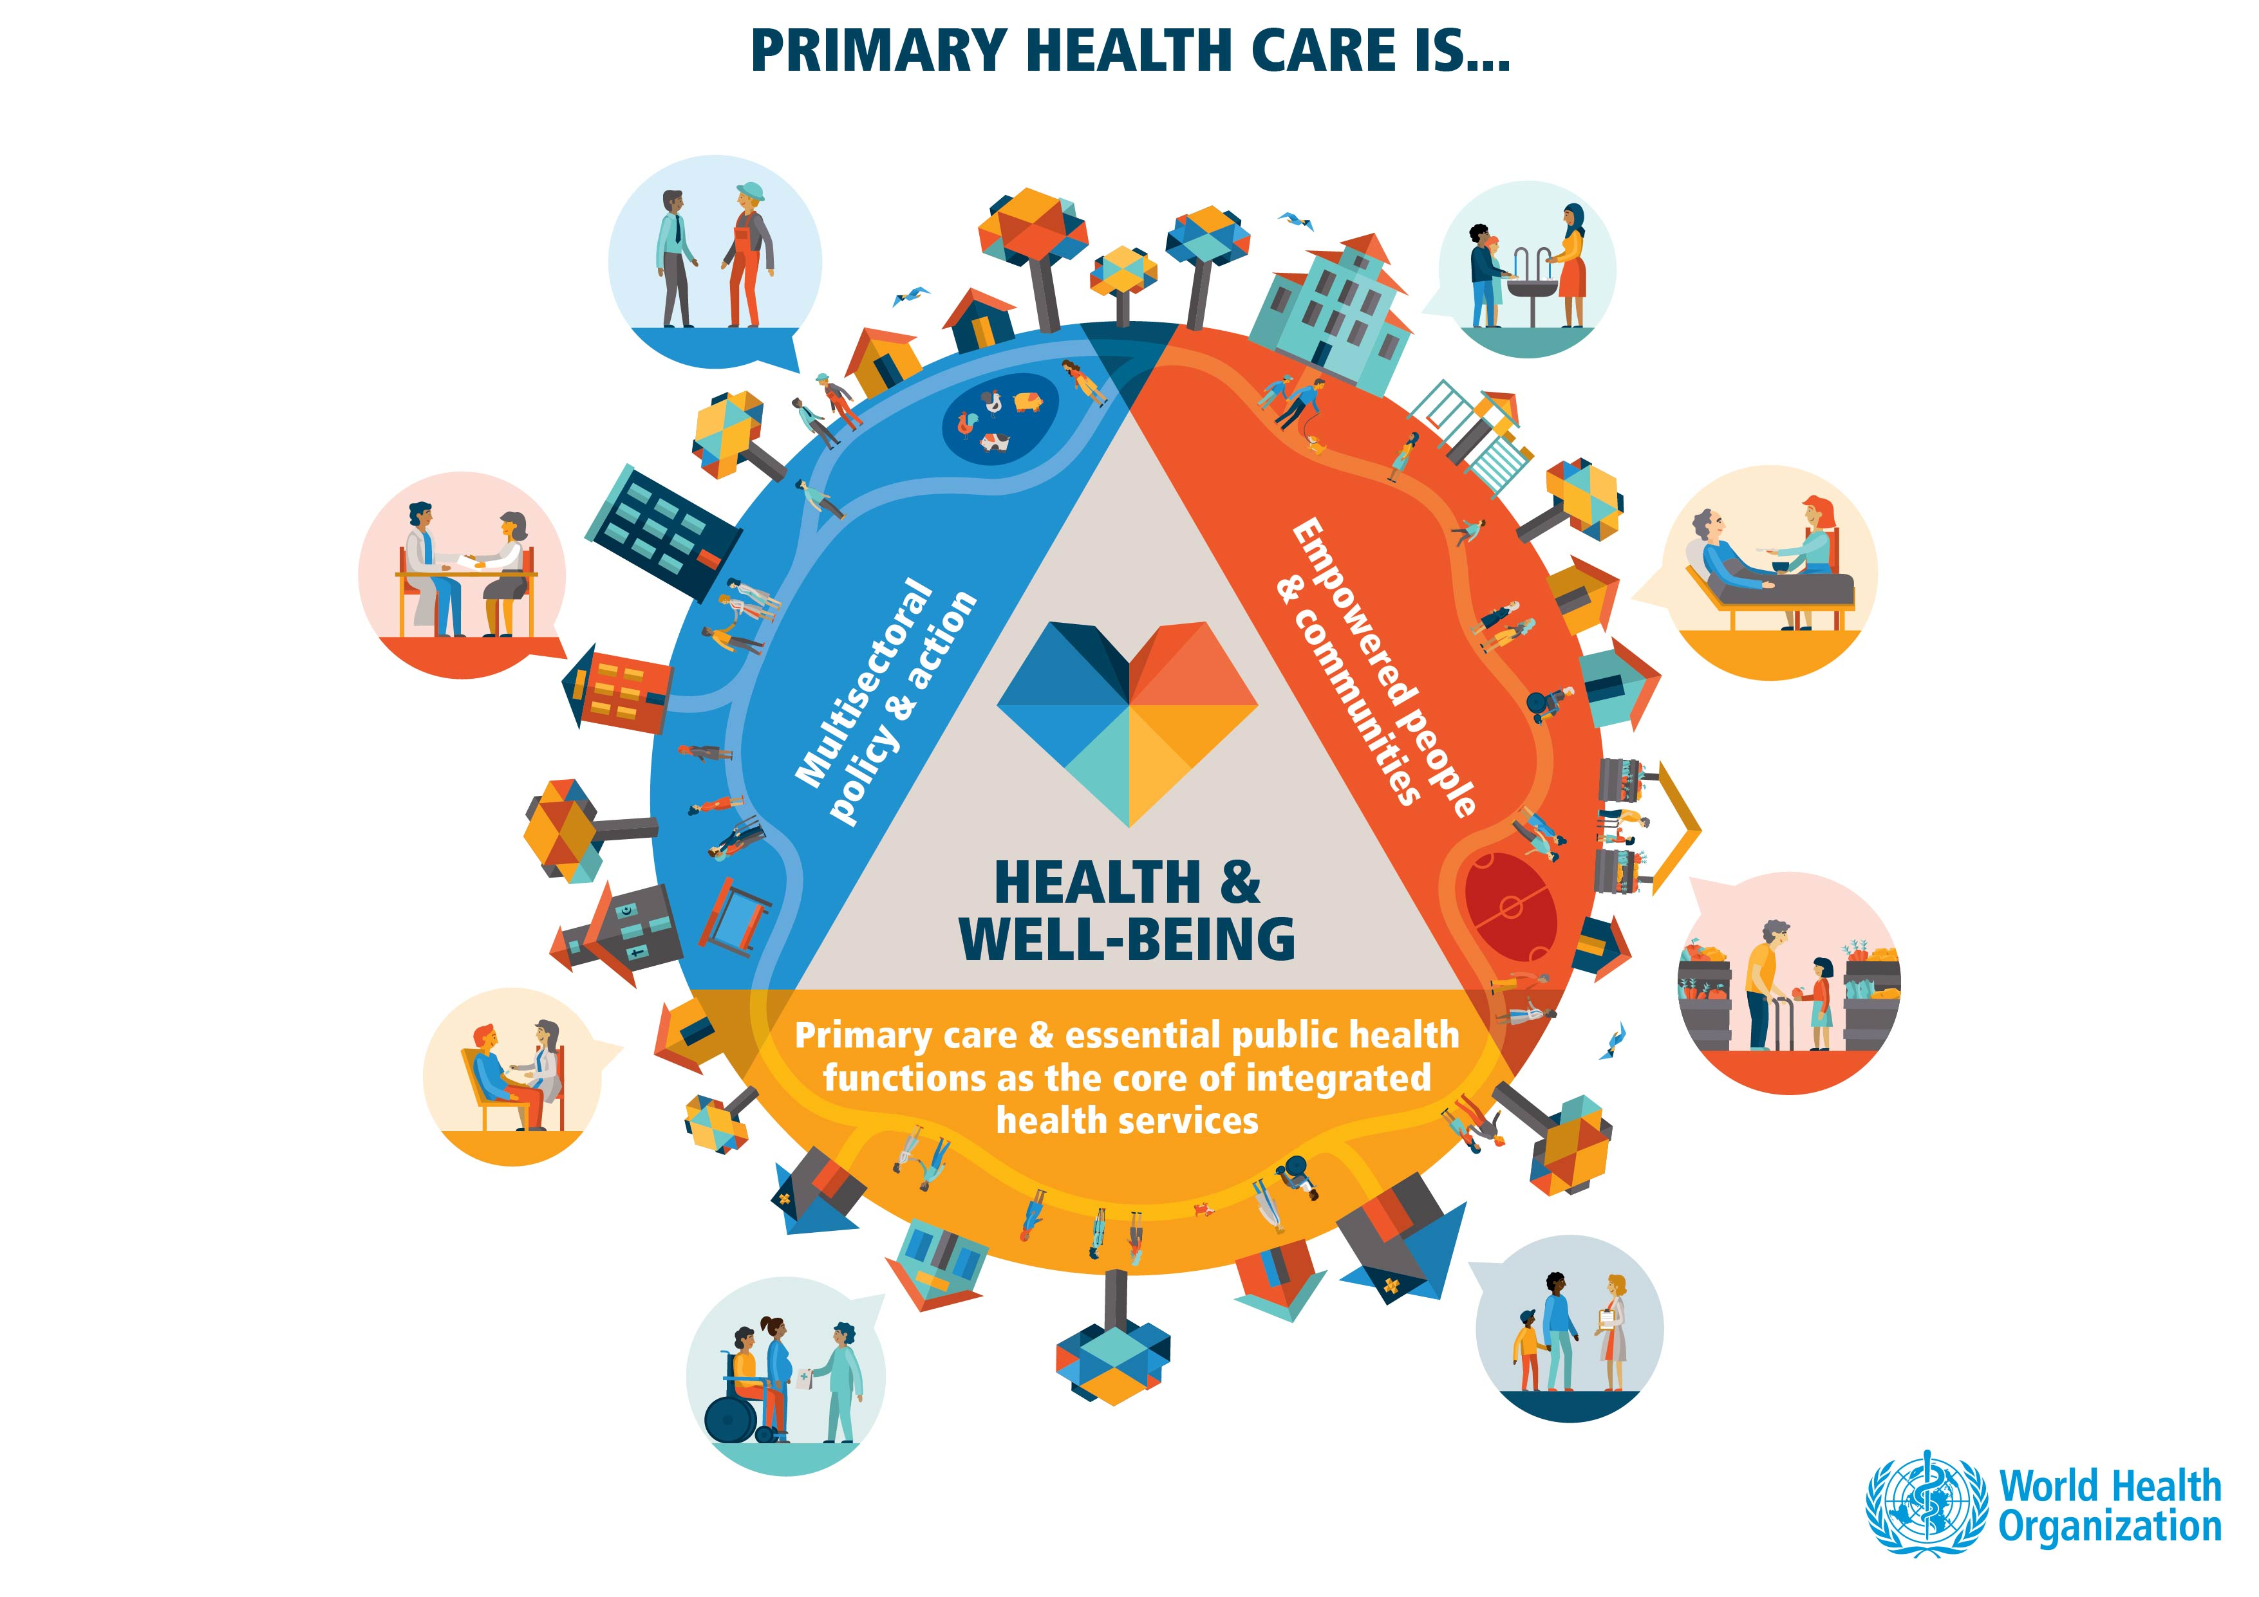
Source: https://www.who.int/westernpacific/news/multimedia/infographics/primary-health-care
27 September 2019
| Disentangling the role of nutrition in primary health care
Notes:
Primary health care is the foundation of universal health coverage and its mean for achieving this target. Primary health care is a whole-of-society approach to health and well-being, centred on the needs and preferences of individuals, families and communities. It addresses the broader determinants of health and focuses on the comprehensive and interrelated aspects of physical, mental and social health and well-being.
Nutrition and healthy diets have an important role in all domains of primary health care. With health promotion and prevention services we expect we are not only dealing with “patients” but with empowered individuals and communities that we as primary health care practitioners, and other important stakeholders, will accompany and support.
The integrated health services that we refer to here, include both personal (or individual) and population-based health services. It includes the full spectrum of essential, quality health services, from health promotion to prevention, treatment, rehabilitation and palliative care.
Thus, individuals and communities are empowered to be healthy and well, and primary health care practitioners are encouraged to maintain the status of health and wellbeing of populations.

Slide 4
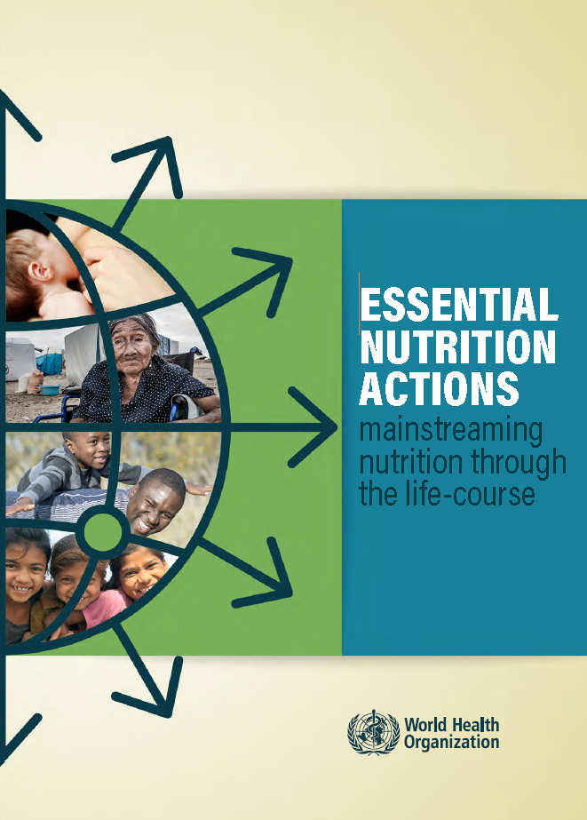
Goal: Optimal nutrition through the life-course
Health Promotion
Prevention
Therapeutic (Curative)
Rehabilitation
Palliative Care
Source: Essential nutrition actions: mainstreaming nutrition through the life-course. Geneva: World Health Organization; 2019. Licence: CC BY-NC-SA 3.0 IGO
Notes:
A recent WHO publication entitled essential nutrition actions provides a compilation of actions to address malnutrition in all its forms.
The aims of this reference are to assist in decision-making processes and in the integration of nutrition interventions in national health policies, strategies, and plans based on country-specific needs and global priorities. This of course includes primary care and the essential public health functions of integrated health services.
While many of the original essential nutrition actions in the first 1000 days (e.g. exclusive breastfeeding, appropriate complementary feeding), we now include preventive actions that explicitly address these conditions at the opposite end of the malnutrition spectrum.
The 2019 edition of essential nutrition actions promotes the implementation of essential nutrition actions not only as a response to malnutrition in all its forms but as part of comprehensive and coordinated efforts from multiple sectors.
Many essential nutrition actions are direct nutrition actions such as nutritional counselling, provision of micronutrient supplementation, or recommendations on infant feeding.
Other essential nutrition actions address underlying causes of malnutrition and include those implemented by other sectors that have significant implications for nutritional status (e.g. water, sanitation and hygiene; infectious disease control; and reproductive health).

Slide 5
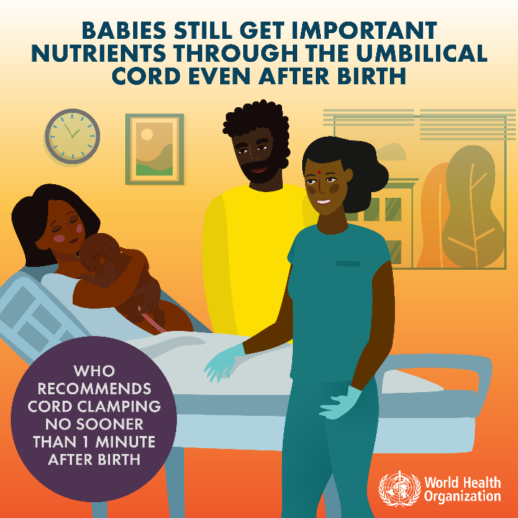
Prevention
Newborns
Source: WHO Guideline: Delayed umbilical cord clamping for improved maternal and infant health and nutrition. outcomes. Geneva: World Health Organization; 2014.
Notes:
To illustrate the role of nutrition and healthy diets in primary health care, considering the life course, we can use some examples from the infographics of the recent publication.
CORD CLAMPING IN INTRAPARTUM CARE
At the time of birth, the infant is still attached to the mother via the umbilical cord, which is part of the placenta. The infant is usually separated from the placenta by clamping the cord. This clamping is one part of the third stage of labour (the time from birth of the baby until delivery of the placenta) and the timing can vary according to clinical policy and practice.
There are important advantages of delayed cord clamping in healthy term infants, such as higher birthweight, early haemoglobin concentration, and increased iron reserves up to six months after birth.

Slide 6
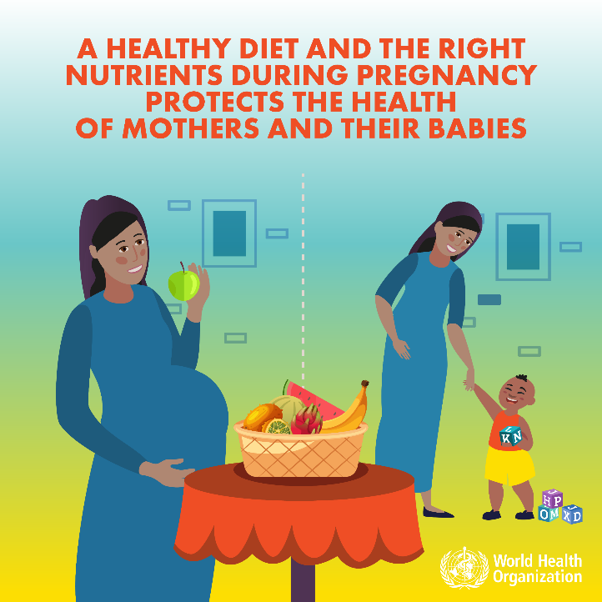
Health Promotion
Prevention
Pregnant women
Source: WHO recommendations on antenatal care for a positive pregnancy experience. Geneva: World Health Organization; 2016.
Notes:
The World Health Organization envisions a world where every pregnant woman and newborn receives quality care throughout the pregnancy, childbirth and the postnatal period.
Within the continuum of reproductive health care, antenatal care provides a platform for important health-care functions, including health promotion, screening and diagnosis, and disease prevention.
It has been established that by implementing timely and appropriate evidence-based practices, antenatal care can save lives.
Antenatal care is defined as the care provided by skilled health-care professionals to pregnant women and adolescent girls to ensure the best health conditions for both mother and baby during pregnancy.
Women see pregnancy as a normal event in their lives they want a positive pregnancy experience from antenatal care.
A positive pregnancy experience is defined as maintaining physical and sociocultural normality, maintaining a healthy pregnancy for mother and baby (including preventing or treating risks, illness and death), having an effective transition to positive labour and birth, and achieving positive motherhood (including maternal self-esteem, competence and autonomy).
Nutrition has an important role in antenatal care for health promotion and prevention, identifying risk factors such as anaemia, or dealing with interventions for common physiological symptoms such as constipation, nausea and vomiting or leg cramps as examples.
Some examples of task shifting include the distribution of recommended nutritional supplements, such as iron and folic acid supplements routinely recommended or calcium supplements in areas of low calcium intake, or multiple micronutrients supplements in areas at risk of undernutrition. These tasks are shifting to a broad range of cadres, including auxiliary nurses, nurses, midwives and doctors in these guidelines. Counseling on nutritious foods, and health diets is part of the routine antenatal care.

Slide 7
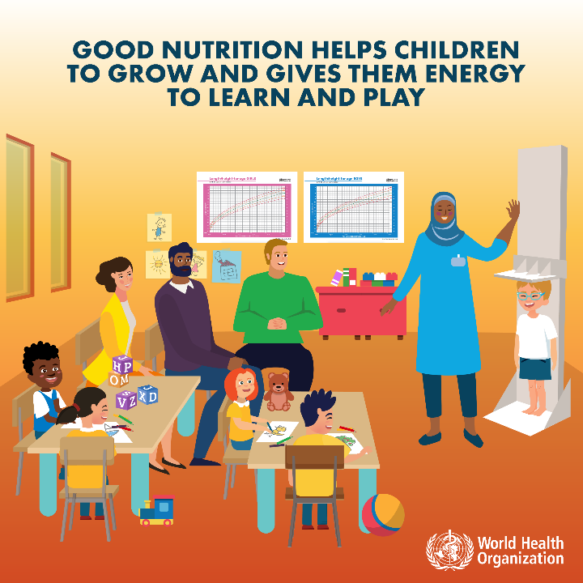
Health Promotion
Prevention
Infants and children
Source: https://www.who.int/nutrition/topics/ENA-infographics/en/

Slide 8
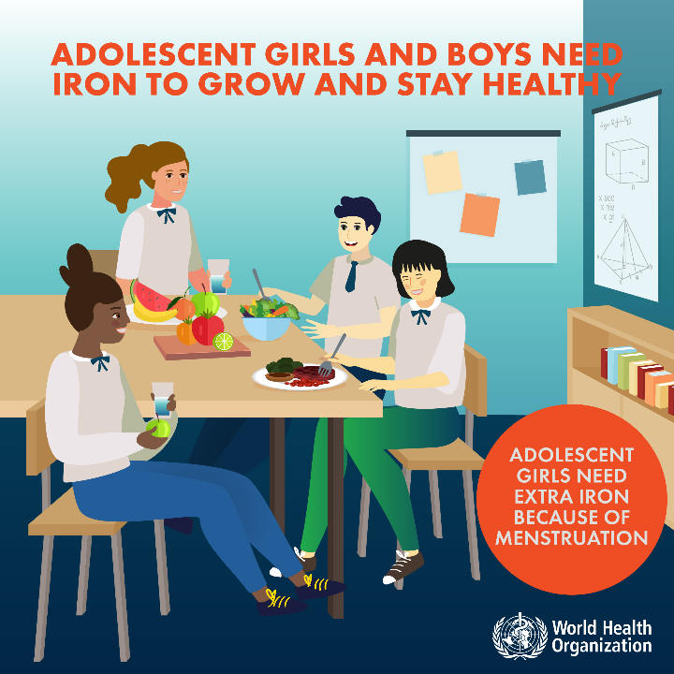
Prevention
Adolescents
Source: https://www.who.int/nutrition/topics/ENA-infographics/en/

Slide 9
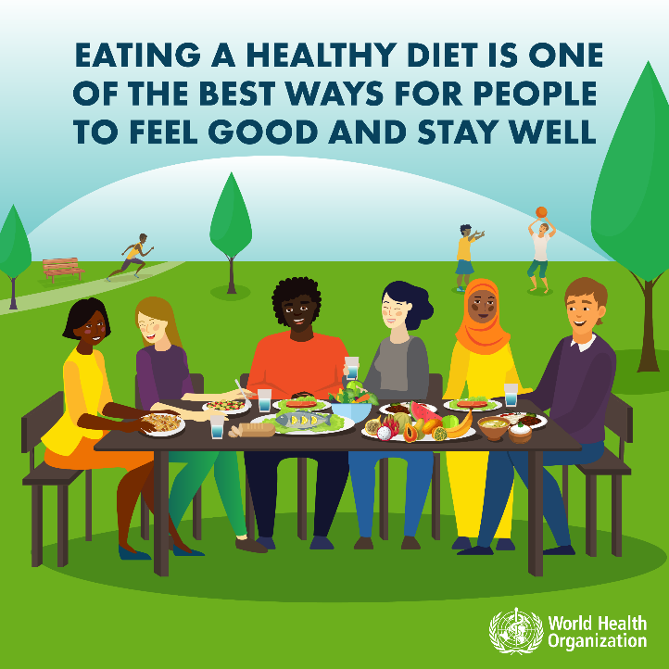
Health Promotion
Everyone
Source: https://www.who.int/nutrition/topics/ENA-infographics/en/

Slide 10
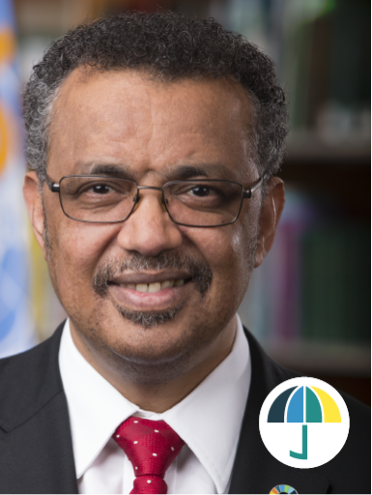
United Nations General Assembly
Political Declaration on Universal Health Coverage
« Our vision is not health for some.
It’s not health for most.
It’s Health For All: rich and poor, able and disabled, old and young, urban and rural, citizen and refugee.
Everyone, everywhere »
Dr. Tedros Adhanom Ghebreyesus
Director-General, World Health Organization
Notes:
I would like to close this presentation with a statement of our Director General; Dr Tedros.
This week, on 23 September 2019, the United Nations General Assembly held the first high-level meeting on universal health coverage.
Our Director-General Dr. Tedros announced the approval by world leaders of the most comprehensive health declaration in history. His announcement included a message that strikes to the core of the World Health Organization values and vision in the face of the development challenges.
He said:
« Our vision is not health for some. It’s not health for most. It’s Health For All: rich and poor, able and disabled, old and young, urban and rural, citizen and refugee. Everyone, everywhere »
The declaration also recognized that primary health care brought people into first contact with the health system and is the most inclusive, effective and efficient approach to enhance people’s physical and mental health as well as social wellbeing.
Now, let’s keep this image generously drawn by Dr. Tedros, and imagine the role of nutrition in this Titanic endeavour.
With empowered communities and a renewed effort to strengthen primary health care with a focus on health promotion and prevention, optimal nutrition and healthy diets will continue to be a reference point to achieve health for all, as has been envisioned!
Thank you for your kind attention

