Slide 1



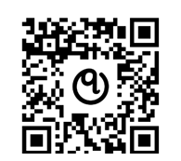
WHO QualityRights e-training on
Mental Health, Recovery and Community Inclusion
Join over 100,000 learners on this innovative online course and
earn an official certificate from the World Health Organization!
This training will help you:
Understand and improve your own mental health and wellbeing
Learn how to support friends, family & members of the community who experience mental health difficulties
Gain the knowledge and skills to tackle stigma, discrimination, abuses & coercive practices
Learn how to provide mental health support to people with a mental health condition or experiencing a crisis
Learn how to actively engage people in their own treatment, care and support plan, providing tools & empowering them to overcome challenges
Gain valuable expertise & skills to lead reform towards a person-centred, rights-based, recovery approach
Sign-up FOR FREE at
who.int/teams/mental-health-and-substance-use/policy-law-rights/qr-e-training
This training is for everyone:
Persons with lived experience, the health & social care workforce, first responders, members of the justice system (for ex. police officers, prison officers, judges), teachers, family or community members, policy makers, employees of government, private and not- for-profit sectors.

