Slide 1
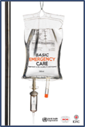

Trauma
Basic Emergency Care Course
Notes:
Welcome to the trauma module of the Basic Emergency Care course.

Slide 2
Objectives
By the end of this presentation, you will be able to:
Know how to perform the trauma primary survey (ABCDE approach to trauma)
Recognize life-threatening injuries
Identify critical actions for high-risk conditions
Recognize key history findings suggestive of high-risk trauma
Recognize physical exam findings suggestive of high-risk trauma
Know how to perform the trauma secondary survey (head-to-toe trauma exam)
Recognize and manage important conditions based on history and secondary survey
Identify special considerations for pregnant trauma patients
Identify special considerations for paediatric trauma patients
Consider disposition of trauma patients
Notes:
By the end of this presentation, you will be able to know how to perform the trauma primary survey, recognise life-threatening injuries and identify critical actions for life-threatening conditions. We will cover how to recognise key history and examination findings suggestive of high-risk trauma. You will know how to perform the trauma secondary survey, and how to recognise and manage important conditions based on the history and secondary survey. You will be able to identify special considerations for pregnant and paediatric trauma patients and consider the disposition of trauma patients.

Slide 3





Essential skills
Intravenous (IV) line placement
IV fluid resuscitation
Direct pressure/ deep wound packing for haemorrhage control
Tourniquet for haemorrhage control
Pelvic binding
Fracture immobilization
Skin pinch test
Overall
Assessing ABCDE
Trauma Secondary Survey
Cervical spine immobilization
Head-tilt and chin-lift/jaw thrust
Airway suctioning
Management of choking
Recovery position
Nasopharyngeal (NPA) and oropharyngeal airway (OPA) placement
Full spine immobilization
AVPU, GCS assessment
Glucose administration
Oxygen administration
Bag-valve-mask ventilation
Needle-decompression for tension pneumothorax
Three-sided dressing for chest wound
Wound and burn management
Snake bite management
Log roll
Notes:
The essential skills for this module are listed here. Each skill will be introduced in the presentations and taught during the practical sessions of this course.

Slide 4
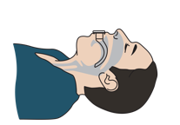
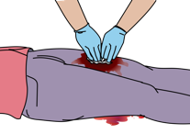
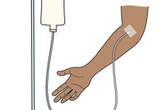
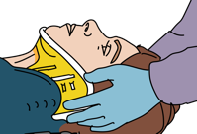
Goals
The goal of initial assessment is to identify life-threatening injuries.
The goal of acute management is to prevent secondary injury from poor oxygenation and decreased perfusion, to control pain and to plan ongoing care.
Early priorities for an injured person include:
  Managing airway and breathing emergencies
  Controlling bleeding
  Treating shock
  Immobilizing the spine if needed
Notes:
The goal of the initial assessment is to identify life threatening injuries. The goal of acute management is to prevent secondary injury from poor oxygenation and decreased perfusion, to control pain and to plan for ongoing care. In trauma the early priorities for an injured person include managing airway and breathing emergencies, controlling bleeding, treating shock and immobilizing the spine if needed.

Slide 5
The Approach to Trauma
ABCDE Trauma Primary Survey
SAMPLE History
Trauma Secondary Survey
If any life-threatening problems are identified
STOP and MANAGE them.
Then, return to ABCDE.
  The Trauma Secondary Survey is a complete head-to-toe examination looking for injuries not identified during the trauma primary survey.
Notes:
The approach to trauma occurs in 3 different phases. The first phase is the trauma primary survey, using the ABCDE approach. This is followed by the second phase or the SAMPLE history. Remember that sample stands for signs and symptoms, allergies, medications, past medical history, last oral intake, and events surrounding injury. The third phase is the trauma secondary survey, which is a complete head to toe examination, looking for any injuries not identified during the trauma primary survey.

Slide 6
The ABCDE Approach
!
REMEMBER …………
People who initially appear uninjured may have hidden life-threatening injuries, such as internal bleeding. It is very important to re-assess trauma patients multiple times and, in particular, any time the patient’s condition worsens.
Notes:
Remember at any point during your assessment, if you identify a life-threatening problem, stop and manage that life threat. After any management, be sure to do a repeat assessment using the ABCDE approach. People who initially appear uninjured may have hidden life, threatening injuries such as internal bleeding. It is very important to reassess patients often, and if the patient's condition worsens.

Slide 7
Trauma
Part 1: The Primary Survey and Important Conditions
Notes:
In this first part, we will look in more detail at the primary survey and important conditions. We will start with the primary survey.

Slide 8
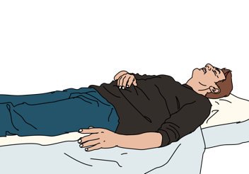
Introduction: Trauma Primary Survey
The ABCDE Approach should be done within the first 5 minutes and repeated anytime the patient’s condition worsens.
Always suspect head and spine injury in a patient with altered mental status.
Notes:
The initial trauma primary survey using the ABCDE approach should be done immediately upon the patient's arrival to care, within the first 5¬7 minutes. It should also be repeated anytime the patient's condition worsens. In any patient with altered mental status be sure to think of trauma, and suspect head and spine injuries.

Slide 9

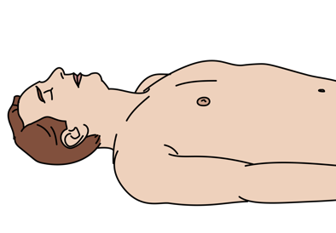
Airway Assessment
Look for vomit, tongue or other objects obstructing the airway.
Look for burned nasal hairs or soot around the nose or mouth.
Look for head or neck trauma.
Look for expanding neck haematoma (bleeding under the skin).
Assess for altered mental status.
Listen for abnormal airway sounds.
  Gurgling
  Snoring
  Stridor
  Noisy breathing
Notes:
The first step of our trauma ABCDE primary survey is the airway assessment. Look for vomit or other objects obstructing the airway, burned nasal hairs or soot around the nose or the mouth, and any signs of head, or neck trauma. Look for an expanding neck hematoma, which can appear as bleeding under the skin or significant swelling of the neck tissues. Assess the patient for altered mental status and remember that the tongue can obstruct the airway if there is a decreased level of consciousness. Listen for abnormal airway sounds such as gurgling, snoring, stridor, or noisy breathing.

Slide 10
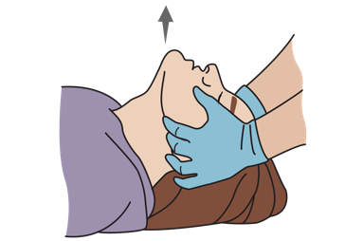

Airway Management with Cervical Spine Immobilization
STABILIZE the cervical spine.
Open airway using JAW THRUST (not head-tilt / chin lift).
SUCTION airway secretions and remove any visible
foreign objects.
Place ORAL AIRWAY if necessary.
Avoid nasal airway in facial trauma.
Plan for rapid HANDOVER/TRANSFER if:
  Evidence of airway burns
  Expanding neck haematoma
Notes:
In the ABCDE approach, management follows any abnormal assessment findings. The first step of airway management in trauma is immobilization of the cervical spine. You can stabilize the cervical spine using available local materials. If needed, open the airway, using the jaw thrust. The head tilt-chin lift must not be used in trauma patients, as this can cause further injury to the cervical spine.
Suction any airway secretions and remove any visible foreign objects. If necessary, place an oral or a nasal airway. However, if the patient has significant facial trauma, you should not use a nasal airway. If there is evidence of airway burns or an expanding neck haematoma, these are signs of severe trauma to the airway. Plan for rapid handover or transfer.

Slide 11

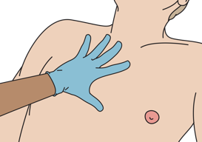
Breathing Assessment
Look for increased work of breathing.
Look for abnormal chest wall movement.
Look for tracheal shift.
Look for sucking chest wounds.
Look for cyanosis.
Look for abrasions, bruising or other signs of injury to chest.
Look for circumferential burns to chest or abdomen.
Listen for absent/decreased breath sounds.
Listen for dull sounds or hyperresonance with percussion.
Feel for crepitus, cracking and popping with palpation.
Notes:
As part of the initial breathing assessment, look, listen and feel. Look for increased work of breathing, abnormal chest wall movement, tracheal shift, sucking chest wounds, cyanosis, abrasions, bruising or other signs of injury to the chest. Check for any circumferential burns to the chest or abdomen. Next, listen for absent or decreased breath sounds, and for dull sounds or hyperresonance with percussion of the lung fields. Finally feel for crepitus. Crepitus is a cracking or popping sensation under the skin and is caused by air in the skin and soft tissues. This can be caused by a pneumothorax.

Slide 12
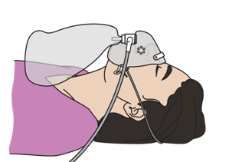
Breathing Management
Give OXYGEN.
NEEDLE DECOMPRESSION, OXYGEN and IV FLUIDS for tension pneumothorax.
THREE-SIDED DRESSING for sucking chest wound.
If breathing is not adequate or patient is hypoxic on oxygen → assist breathing with BAG-VALVE-MASK VENTILATION.
For chest or abdomen burns restricting breathing, plan for rapid HANDOVER/TRANSFER for escharotomy.
Notes:
The first step in breathing management is to give oxygen. If you identify signs of a tension pneumothorax, perform a needle decompression, give oxygen, and give IV fluids.
If you identify any penetrating and sucking chest wounds, cover the wound with a 3-sided dressing. If during your breathing assessment, you find the breathing is inadequate, or the patient remains hypoxic, assist their breathing with bag–valve-mask ventilation. Circumferential chest or abdominal burns may restrict breathing and you should plan for early handover and transfer for possible escharotomy.

Slide 13

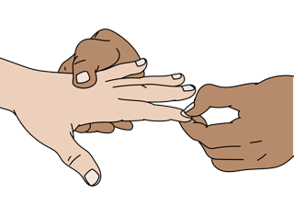
Circulation Assessment
Look for capillary refill greater than 3 seconds.
Look for pale extremities.
Look for distended neck veins.
Look for external and internal bleeding.
  Common sites: chest, abdomen, pelvis, femur, amputations, large external wounds, burns
  Look for burns (size and depth).
Feel for cold extremities.
Feel for weak pulse or tachycardia.
Notes:
For the circulation assessment, look, listen, and feel. Look for a capillary refill time greater than 3 seconds, pale extremities, distended neck veins and signs of external and internal bleeding. Common sites of bleeding include the chest, abdomen, pelvis, femur, amputations, large external wounds. Look for burns and assess both size and depth. Feel for cold extremities, weak or thready pulses or a fast heart rate.

Slide 14
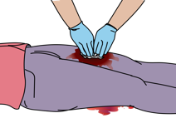
Circulation Management
Apply DIRECT PRESSURE or DEEP WOUND PACKING to control active bleeding.
Apply TOURNIQUET to amputated limbs or uncontrolled bleeding.
  Start IV and plan for urgent TRANSFER to a surgical unit.
If ongoing blood loss/poor perfusion → start 2 large IVs and give IV FLUID.
If burn injury → start IV FLUIDS according to burn size.
SPLINT suspected femur fracture.
BIND suspected pelvic fracture.
LEAVE penetrating objects, stabilize the object and prepare for TRANSFER
Place pregnant patients on left side while maintaining spinal immobilization
Notes:
If you find any abnormal circulation assessments, be sure to manage the problem immediately. Apply direct, firm pressure to any active bleeding. If you are unable to control bleeding with direct pressure and the wound is deep, perform deep wound packing. If you are still unable to control bleeding with direct pressure and the bleeding is from an extremity, apply a tourniquet above the level of bleeding. Tourniquets are indicated for major haemorrhage from a limb. If you place a tourniquet, you must note the time of placement and plan for urgent transfer to a surgical specialist.
If the patient has signs of poor perfusion or shock, or has ongoing blood loss, start 2 large IV lines and give intravenous fluid. If the patient has a significant burn injury start intravenous fluids. If there is a suspected femur fracture, apply a splint to reduce internal bleeding from the fracture. If you suspect a pelvic fracture, apply a pelvic binder. If there are any penetrating objects, leave them in place, and apply dressing materials around to stabilize the object. Prepare the patient for transfer to a surgical specialist.
If a patient is more than 20 weeks pregnant, place in the left lateral position to improve perfusion. Once the circulation assessment is adequate, you can then move on to the disability assessment.

Slide 15

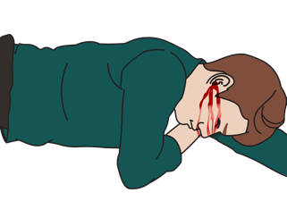
Disability Assessment
Look for confusion, lethargy or agitation.
Look for seizures/convulsions.
Look for unequal or poorly reactive pupils.
Look for deformities of the skull .
Look for blood or fluid from ears or nose.
Check AVPU or GCS.
Check movement and sensation in all extremities.
Check blood glucose in the confused or unconscious patient.
Notes:
Several important signs should be assessed. Look for confusion, lethargy or agitation, seizures or convulsions, unequal or poorly reactive pupils, deformities of the skull, and blood or fluid from the ears or nose. Check AVPU or the GCS, movement of the extremities, and blood glucose in the confused or unconscious patient.

Slide 16
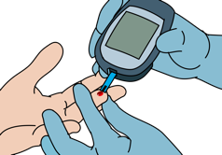
Disability Management
If GCS < 9 (or children AVPU score P or U) → plan for rapid HANDOVER/TRANSFER
If patient is lethargic or unconscious → RE-ASSESS airway frequently
THINK spine injury or closed head injury in any trauma patient with altered mental status.
Give OXYGEN.
If low blood glucose or unable to check → give GLUCOSE
If seizing → give a BENZODIAZEPINE
Notes:
If you find any critical problems in the disability assessment, manage the problem immediately. If the GCS Is less than 9, or for a child the AVPU score is P for pain response or U for unresponsive, then plan for rapid handover and transfer. Be sure to frequently reassess the airway if the patient has a decreased level of consciousness or is lethargic, as they may not adequately protect their airway. Always think of spinal injury or a closed head Injury in any trauma patient with altered mental status. Give oxygen to maintain oxygenation to the brain. If the blood glucose is low, or you are unable to check, give glucose. If the patient is seizing or convulsing, give a benzodiazepine.

Slide 17

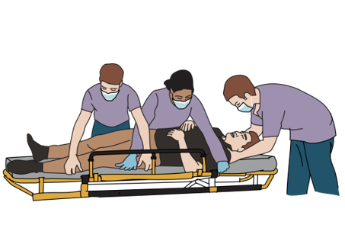
Exposure Assessment
Remove all clothing.
Examine entire body for evidence of injury.
  Including back, groin and underarms
Assess the patient’s back and spine using the log-roll manoeuvre.
Notes:
The first step in the exposure assessment is to remove all of the patient’s clothing. Next, examine the entire body for evidence of injury. This includes the back, groin and underarms. Assess the patient’s back and spine using the log-roll manoeuvre.

Slide 18
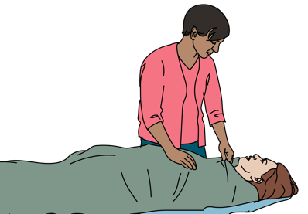
Exposure Management
If spinal injury is suspected → perform log roll manoeuvre to examine the back.
Remove restrictive clothing and all jewellery.
Remove any wet clothes and dry patient thoroughly.
Cover the patient as soon as possible to prevent hypothermia.
Respect the patient and protect modesty during exposure.
Notes:
If not already done, remove restrictive clothing and all jewellery. Remove any wet clothes and dry the patient thoroughly. Cover the patient as soon as possible to prevent hypothermia and remember to respect the patient and protect their privacy during exposure.

Slide 19
Workbook Question 1
A middle-aged man is brought in after being hit by a car. List the immediate management for the assessment findings below:
Primary Survey Finding: | Immediate Management:
On airway assessment: Gurgling airway sounds and obvious head trauma
On circulation assessment: Weak pulses and capillary refill > 3 seconds Evidence of pelvic fracture
Notes:
Workbook Question 1: Approach to Trauma [page 43 in participant workbook]
A middle-aged man is brought in after being hit by a car. Using the workbook section above, list the immediate management for the assessment findings below.
Answers:
Airway Immediate Management 1. Stabilize the cervical spine. 2. Open airway using jaw thrust NOT head-tilt or chin-lift if suspected spine injury. 3. Suction airway secretions, blood and/or vomit. Remove any visible foreign objects from the airway. 4. Place oral airway C
Circulation Immediate Management: 1. Establish 2 large bore IVs. 30 2. Give 1 litre of Normal Saline or Ringer’s Lactate and re-assess. 3. Bind pelvic fracture.
Image
Title: Deep thought
Creator:GDL
Source: https://openclipart.org/detail/221707/deep-thought
Copyright information: Creative Commonz Zero 1.0 Public Domain License

Slide 20
Trauma
Part 1: The Primary Survey and Important Conditions
Notes:
Now we will look at important conditions to be identified and managed.

Slide 21

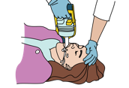
Critical AIRWAY Conditions: Airway Obstruction
Signs and Symptoms | Management
Visible blood, secretions, vomit, tongue, foreign body in airway Changes in voice Abnormal airway sounds (stridor, snoring, gurgling) Neck haematoma Burns to head and neck Mental status changes Poor chest rise Injury causing airway swelling | Monitor altered patients for potential aspiration. SUCTION airway as needed. Open the airway using JAW THRUST. Maintain CERVICAL SPINE IMMOBILIZATION. Plan for rapid HANDOVER/TRANSFER for advanced airway management.
Notes:
The first critical airway condition is airway obstruction. Several important signs and symptoms to check for include: visible blood, secretions, vomit, foreign body in the airway, changes in voice, abnormal airway sounds (stridor, snoring, gurgling), neck haematoma, burns to the head and neck, mental status changes, poor chest rise, and injury causing airway swelling. The tongue is a common cause of obstruction. The management of airway obstruction includes opening the airway using the jaw thrust manoeuvre, suctioning the airway if any liquids and monitoring patients with altered mental status for potential aspiration. Maintain cervical spine immobilization for those with suspected spinal injury. Lastly, plan for rapid handover and transfer for advanced airway management.

Slide 22

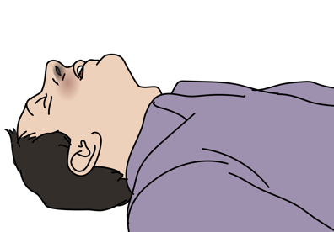
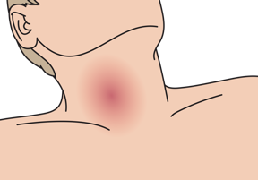
Critical AIRWAY Conditions: Airway Obstruction
Head and neck injuries may result in airway obstruction by blood, secretions, vomit, foreign body or swelling.
Penetrating neck wounds can cause expanding haematomas.
Inhalation injuries from burns can cause airway swelling.
Notes:
Three key points to remember are: 1) head and neck injuries may result in airway obstruction by blood, secretions, vomit, foreign body or swelling. 2) penetrating neck wounds can cause expanding haematomas and 3) inhalation injuries from burns can cause airway swelling.

Slide 23

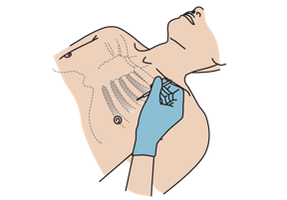
Critical BREATHING Conditions: Tension Pneumothorax
Signs and Symptoms | Management
Hypotension with difficulty breathing and any of the following: Distended neck veins Absent breath sounds on affected side Hyperresonance with percussion on affected side May have tracheal shift away from affected side | Perform NEEDLE DECOMPRESSION, give OXYGEN and IV FLUIDS. Plan for HANDOVER/TRANSFER. Arrange for urgent chest tube.
Any pneumothorax can become a tension pneumothorax!
Notes:
Tension pneumothorax is a life-threatening condition. Air in the space between the lungs and the chest wall can expand to collapse the lung, and place tension on the contents of the chest. Any pneumothorax can become a tension pneumothorax so remember to re-evaluate all patients with suspected pneumothorax regularly. Signs and symptoms are: hypotension with difficulty breathing and any of the following: distended neck veins, absent breath sounds on affected side and hyperresonance with percussion on affected side. Patients may have tracheal shift away from the affected side, although this is a late sign. Initial management includes performing needle decompression and giving oxygen and IV fluids. Patients should be transferred to a centre that can perform definitive chest thoracostomy (placement of a chest tube).

Slide 24

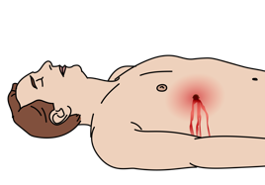
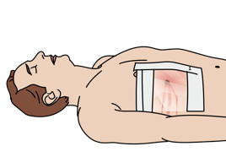
Critical BREATHING Conditions: Sucking Chest Wound
Signs and Symptoms | Management
Open wound to chest wall with air passing though. Bubbling or sucking noises from chest Difficulty in breathing Chest pain | Give OXYGEN. Place a THREE-SIDED DRESSING. Observe continuously to prevent dressing occlusion (tension pneumothorax). Plan for rapid HANDOVER/TRANSFER for placement of a chest tube.
Notes:
Sucking chest wounds are an open wound to the chest wall with air passing though. You may notice bubbling or sucking noises. The patient will have difficulty breathing and chest pain. Give oxygen to the patient and place a three-sided dressing over the wound. Observe continuously to prevent occlusion of the dressing, which can lead to tension pneumothorax. Plan for rapid transfer for placement of a chest tube.

Slide 25

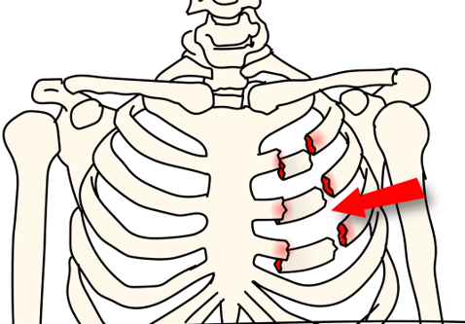
Critical BREATHING Conditions: Flail Chest
Flail chest segments occur when ribs are broken in multiple places.
  At least three ribs next to each other, each broken in two or more places
The free section moves abnormally with breathing and prevents the lung from expanding.
Likely damage to underlying lung tissue
Notes:
A flail chest occurs when ribs are broken in multiple places. The free section moves abnormally with breathing and prevents the lung from expanding. In most cases there may be underlying damage to the lung tissue as well. The diagram here shows the fracture patterns necessary to cause a flail chest as opposed to a normal fracture pattern. The red lines in this image of the chest correspond to areas of fracture.

Slide 26

Critical BREATHING Conditions: Flail Chest
Signs and Symptoms | Management
Difficulty breathing Chest pain Part of chest wall moving in the opposite direction of the rest of the chest when breathing | Give OXYGEN and pain control. MONITOR for difficulty breathing and hypoxia. Plan for rapid HANDOVER/TRANSFER to provider capable of chest tube placement and an advanced airway.
Notes:
Flail chest causes difficulty in breathing and chest pain. On examination, you will find that part of the chest wall moves in the opposite direction to the rest of the chest during breathing. Management of flail chest includes oxygen, pain control, and monitoring for worsening breathing and hypoxia. Plan for rapid handover and transfer to specialists for chest tube placement and potentially advanced airway support.

Slide 27

Critical BREATHING Conditions: Haemothorax
Signs and Symptoms | Management
Difficulty breathing Decreased breath sounds on affected side Dull sounds with percussion on affected side Large haemothorax may cause shock | Give OXYGEN and IV FLUIDS. Plan for rapid HANDOVER/TRANSFER to centre capable of surgery.
Haemothorax occurs when there is blood in the space between the lungs and the chest wall.​
Notes:
Haemothorax occurs when there is blood in the space between the lungs and the chest wall. Patients will have difficulty breathing, and on examination there will be decreased lung sounds and dullness to percussion of the chest wall on the affected side. A large haemothorax may lead to excessive bleeding or signs of shock. Give oxygen and intravenous fluids for shock. Plan for rapid handover and transfer to a centre capable of chest tube placement and possible operative management if there is continued bleeding.

Slide 28

Critical CIRCULATORY Conditions:
Hypovolaemic Shock
Signs and Symptoms | Management
Tachycardia, tachypnoea Pale skin Cold extremities Slow capillary refill May have dizziness/confusion/ altered mental status External or internal bleeding (chest, abdomen, pelvis, femur, blood vessels) | CONTROL BLEEDING. Direct pressure Deep wound packing if wound is deep, open (gaping wound) Tourniquet for uncontrolled bleeding Splint fractures, bind pelvis as needed Start 2 large IVs, give IV FLUIDS. Plan for rapid HANDOVER/TRANSFER if large haemothorax/internal haemorrhage.
Shock can result from rapid blood or fluid loss (burns). ​Suspect hypovolaemic shock if there is severe bleeding and signs of poor perfusion. ​
Children with shock may have a normal blood pressure for a long time before decompensating. Always check for other signs of shock!
Notes:
Moving on to critical circulatory conditions. Shock can result from rapid blood or fluid loss such as in a patient with burns. A patient in shock may have a normal blood pressure for a long time before decompensating. Suspect hypovolaemic shock if there is severe bleeding and signs of poor perfusion, tachycardia, tachypnoea, pale skin, cold extremities or slow capillary refill. Patients may have dizziness, confusion, or altered mental state. External or internal bleeding, whether in the chest, abdomen, pelvis, femur, or from direct injury to the blood vessels can lead to significant bleeding loss and signs of shock. The first step is to try and control the bleeding. For external injuries, apply direct pressure and deep wound packing if the wound is deep or gaping. A tourniquet can be applied to uncontrolled bleeding from a limb that does not respond to direct pressure. Splint fractures and apply a pelvic binder if necessary. Start 2 large IV lines, give intravenous fluids and plan for rapid handover and transfer.

Slide 29
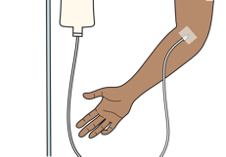
Critical CIRCULATORY Conditions: Pericardial Tamponade
Signs and Symptoms | Management
Signs of poor perfusion Tachycardia, tachypnoea, hypotension, pale skin, cold extremities, capillary refill >3 seconds Distended neck veins Muffled heart sounds Dizziness, confusion, altered mental status | Give IV fluids to improve heart filling. Plan for rapid HANDOVER/TRANSFER for provider capable of draining the fluid.
IV FLUIDS
Pericardial tamponade occurs when fluid builds up in the sac around the heart.​
This can collapse the chambers and prevent the heart from filling. ​
Notes:
Pericardial tamponade occurs when fluid builds up in the sac around the heart. The amount of fluid and the associated pressure can collapse the chambers of the heart, preventing the heart from filling. This leads to signs of poor perfusion or shock. Associated symptoms include tachycardia, tachypnoea, hypotension, pale skin, cold extremities, and capillary refill time greater than three seconds. Additional signs include distended neck veins caused by the back pressure exerted on the heart and veins, muffled heart sounds from the fluid decreasing the ability of sound to resonate, as well as dizziness, confusion, and altered mental status. The initial management includes intravenous fluids to improve heart filling and rapid handover and transfer to a centre capable of draining the fluid via a procure called a pericardiocentesis.

Slide 30

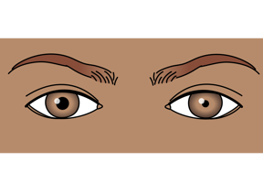
Critical DISABILITY Conditions: Severe Head Injury
Signs and Symptoms | Management
Visual changes Memory loss Seizures/convulsions Vomiting Headaches Altered mental status, other neurologic deficit Scalp wound and/or skull deformity Bruising to head (especially around eyes or behind ears) Blood or fluid from ears or nose Unequal pupils | IMMOBILIZE the spine, use LOG-ROLL technique to examine the back. Use GCS (AVPU in children) to assess. Frequently reassess ABCDE. If concern for open skull fracture → give IV ANTIBIOTICS per protocol. CHECK glucose, give as needed. Do not give food/drink by mouth. Plan for rapid HANDOVER/TRANSFER.
Notes:
Severe head injury is a critical disability condition. Signs and symptoms of head injury include visual changes, memory loss, seizures and convulsions, vomiting, headache, altered mental status or other neurological deficit, scalp wound and/or skull deformity, bruising to the head (especially around the eyes or behind ears), blood or fluid from the ears or nose, and unequal pupils. Managing head trauma can be complex especially in patients with altered mental state who may not understand the goals of care. Begin by immobilizing the spine and use the log-roll technique to examine the back. Mental status can be assessed using GCS (or AVPU in children). Frequently reassess patients and their ABCDEs. Antibiotics should be given if there is concern for open skull fractures. Check glucose in all patients with altered mental status and give as needed. Do not give other food or drink by mouth. Plan for handover and transfer to a centre capable of advanced care.

Slide 31
Severe Head Injury
!
REMEMBER …………
The skull is rigid and bleeding will cause increased pressure on the brain.
Once the pressure is too high, it will prevent blood from entering the skull and perfusing the brain. Eventually it will squeeze part of the brain through the base of the skull, causing death.
Notes:
Remember brain injuries can range from mild bruising to severe bleeding in or around the brain. Because the skull is rigid, the bleeding cannot expand, and this causes increased pressure on the brain. If the pressure becomes too high, it will prevent blood from entering the skull and perfusing the brain and can squeeze part of the brain through the base of the skull, causing death. Any trauma to the brain can have cause significant impact on function.

Slide 32
Trauma Primary Survey
!
REMEMBER …………
People who initially appear uninjured may have hidden life-threatening injuries such as internal bleeding.
It is very important to reassess trauma patients frequently using the primary survey (repeat frequently).
Vital signs should be checked at the end of the primary survey but do not delay interventions for vital signs.
Notes:
Remember people who initially appear uninjured may have hidden life-threatening injuries such as internal bleeding. It is very important to reassess trauma patients frequently using the primary survey. Vital signs should be checked at the end of the primary survey but do not delay interventions for vital signs.

Slide 33
Workbook Question 2
Using the workbook section above, list five important conditions to recognize in the primary survey:
1.
2.
3.
4.
5.
Notes:
Workbook question 2: Approach to Trauma [page 48 in participant workbook]
Using the workbook section above, list five important conditions to recognize in the primary survey:
Answers:
1. Airway obstruction 2. Tension pneumothorax 3. Sucking chest wound 4. Flail Chest 5. Hemothorax 6. Hypovolemic shock 7. Severe bleeding 8. Pericardial Tamponade 9. Severe head Injury
Image
Title: Deep thought
Creator:GDL
Source: https://openclipart.org/detail/221707/deep-thought
Copyright information: Creative Commonz Zero 1.0 Public Domain License
Image
Title: Deep thought
Creator:GDL
Source: https://openclipart.org/detail/221707/deep-thought
Copyright information: Creative Commonz Zero 1.0 Public Domain License

Slide 34
Trauma
Part 2: The SAMPLE History and Secondary Examination Survey
Notes:
This is the second part of the trauma module. We will look at the SAMPLE history for injured patients, and the secondary examination survey. We will start with the SAMPLE history.

Slide 35
S: Signs and Symptoms
ASK:
  Are there changes in the person’s voice such as a hoarse or raspy voice?
  Does the person have any difficulty with breathing?
THINK
  Changes in voice in association with injury to the head, neck or with burns may suggest airway swelling.
  Problems with breathing may develop over time and may not be obvious in the ABCDE survey.
    May suggest injury to lungs, ribs, muscles, chest wall or spinal injury
Notes:
The first step in the SAMPLE approach is S, which stands for signs and symptoms. Begin by asking if there is a history of hoarse or raspy voice, or any other voice changes. Changes in voice in the setting of injury to the head and neck, or with burns, may suggest that the airway is swelling and at risk of obstruction. Ask the patient is there is any difficulty in breathing. Problems with breathing may develop over time and might not be present in the initial primary survey. Difficulty in breathing may suggest that the person has an injury to the lungs, ribs, muscles, or chest wall or spine.
Image:
Title: Brain activity – Métacognition
Creator:benoitpetit
Source: https://openclipart.org/detail/193152/brain-activity-metacognition
Copyright information: Creative Commonz Zero 1.0 Public Domain License

Slide 36
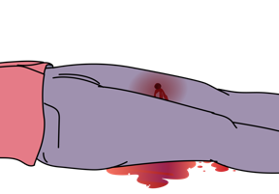
S: Signs and Symptoms
ASK:
  About any previous bleeding before arrival.
  How long has there been bleeding?
  How many bandages have been soaked?
  Is the bleeding getting better or worse?
THINK
  Patients may have a difficult time estimating blood loss so using length of time or bandages soaked may be more useful.
Notes:
Next, ask about any bleeding before arrival. To help estimate blood loss, find out for how long there has been bleeding and the estimated amount - for example how many bandages have been soaked. Trends in severity are important and ask if the bleeding is getting better or worse.
Image:
Title: Brain activity – Métacognition
Creator:benoitpetit
Source: https://openclipart.org/detail/193152/brain-activity-metacognition
Copyright information: Creative Commonz Zero 1.0 Public Domain License

Slide 37
S: Signs and Symptoms
ASK:
  Is there any confusion or unusual sleepiness?
THINK
  This may be a sign of head injury
  A head injury can cause bleeding or increased pressure on the brain leading to confusion, lethargy and coma.
  Shock causes decreased blood flow to the brain.
Notes:
Ask if there is any confusion or unusual sleepiness, either from the patient or accompanying persons. Confusion after injury may be a sign of head injury, lack of oxygen or shock with decreased blood flow to the brain. A head injury can cause bleeding or increased pressure on the brain leading to confusion, lethargy (increased sleepiness) and coma.
Image:
Title: Brain activity – Métacognition
Creator:benoitpetit
Source: https://openclipart.org/detail/193152/brain-activity-metacognition
Copyright information: Creative Commonz Zero 1.0 Public Domain License

Slide 38
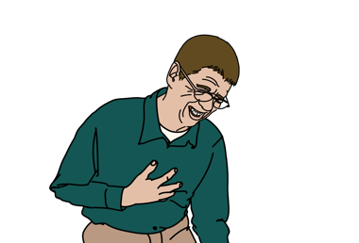
S: Signs and Symptoms
ASK
  Is there any pain?
  Where is the pain?
  What does it feel like and how severe is it?
  THINK
  Pain is a sign of underlying injury!
  Headache may suggest the person has an injury to the skull or brain.
  Pain along the spine may suggest injury that could damage the spinal cord.
  Pain in the chest or abdomen may suggest damage to heart, lungs or organs.
  Pain in the pelvis or hips may suggest a fracture (bleeding).
  Pain may be the first suggestion of injury even if there is no external sign!
Notes:
Patients should be asked whether they have any pain. Qualifying questions on location and severity of pain can help to identify the underlying injury. Pain may be the first sign of an internal injury even if there is no external sign.
For example, a headache may suggest that the person has an injury to the skull or the brain. Pain along the spine can suggest an injury that may progress to cause damage to the spinal cord. Pain in the chest or abdomen may suggest damage to the heart, lungs or other organs. Pain in the pelvis or hips may suggest a fracture in the pelvis which can cause serious bleeding and shock.
Image:
Title: Brain activity – Métacognition
Creator:benoitpetit
Source: https://openclipart.org/detail/193152/brain-activity-metacognition
Copyright information: Creative Commonz Zero 1.0 Public Domain License

Slide 39
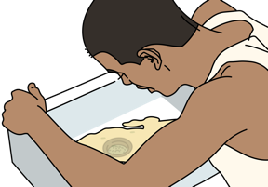
S: Signs and Symptoms
ASK
  Is there nausea or vomiting?
  Is there reported numbness or weakness?
  Any vision changes?
THINK
  Nausea and vomiting may indicate a head or abdominal injury.
  Numbness and weakness may indicate a spinal injury.
  Vision changes can be caused by direct trauma to the eye, fractures around the eye or head injuries.
Notes:
Ask if there is nausea or vomiting, as this may indicate an abdominal or head injury. Reported numbness or weakness may indicate a spinal injury. Ask the patient if there are any changes to their vision. Direct trauma to the eye, fractures of bones around the eye and head injuries can all cause vision changes.
Image:
Title: Brain activity – Métacognition
Creator:benoitpetit
Source: https://openclipart.org/detail/193152/brain-activity-metacognition
Copyright information: Creative Commonz Zero 1.0 Public Domain License

Slide 40
A: Allergies
ASK
  Are there any allergies to medications?
THINK
  Patient may require medications during their care.
Notes:
The A in SAMPLE is for allergies. Ask about allergies as patients may require medications to help with pain or other procedures.
Image:
Title: Brain activity – Métacognition
Creator:benoitpetit
Source: https://openclipart.org/detail/193152/brain-activity-metacognition
Copyright information: Creative Commonz Zero 1.0 Public Domain License

Slide 41
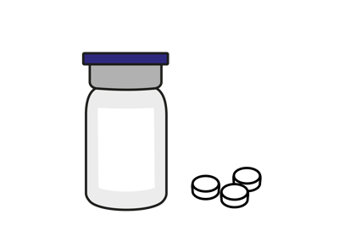
M: Medications
ASK
  Currently taking any medications?
  Any new medications or recent dose changes?
  Obtain a full list of medications.
THINK
  Medications that affect blood clotting can make bleeding more difficult to control and increase the risk of delayed bleeding.
  Blood pressure medications can make it difficult to manage shock.
Notes:
The M in SAMPLE stands for medications. Ask about current or recent changes to medications. Medications that affect blood clotting (such as aspirin, warfarin, and clopidogrel) can make bleeding more difficult to control and increase the risk of delayed bleeding. Blood pressure medications can make it hard to manage shock. Obtain a full list of medications if possible or ask family members to bring in medications.
Image:
Title: Brain activity – Métacognition
Creator:benoitpetit
Source: https://openclipart.org/detail/193152/brain-activity-metacognition
Copyright information: Creative Commonz Zero 1.0 Public Domain License

Slide 42
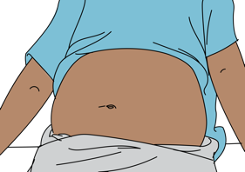
P: Past Medical History
ASK
  Is the patient pregnant?
  Ask women of childbearing age the date of
  their last menstrual period.
THINK
  Pregnancy causes some of the organs to be moved out of their usual position.
  Pregnancy changes the body’s response to trauma.
  If more than 20 weeks gestation, place on left lateral side while maintaining c-spine immobilization.
    This position ensures blood can flow from lower body back to heart.
Notes:
Several elements of a patient’s past medical history are also important. All women of child-bearing age should be asked if they are or could be pregnant, asking for the date of their menstrual period. Pregnancy causes some of the organs to be moved out of their usual position and changes the body’s response to trauma. If more than 20-weeks gestation, place the patient on their left lateral side while maintaining c-spine immobilization. This decreases compression of the inferior vena cava by the pregnant uterus and ensures blood can flow from the lower body back to the heart.
Image:
Title: Brain activity – Métacognition
Creator:benoitpetit
Source: https://openclipart.org/detail/193152/brain-activity-metacognition
Copyright information: Creative Commonz Zero 1.0 Public Domain License

Slide 43
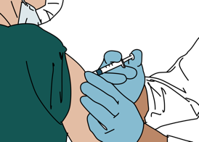
P: Past Medical History
ASK
  When was their last tetanus vaccination?
THINK
  If the person has not had a tetanus vaccination within the past five years and has a skin penetrating injury, they need an updated vaccination.
Notes:
Ask the patient when their last tetanus vaccination was. If the person has not had a tetanus vaccination within the past five years and has a skin penetrating injury, they need to have their vaccination updated. Follow local protocols.
Image:
Title: Brain activity – Métacognition
Creator:benoitpetit
Source: https://openclipart.org/detail/193152/brain-activity-metacognition
Copyright information: Creative Commonz Zero 1.0 Public Domain License

Slide 44
P: Past Medical History
ASK
  About previous medical history that puts patients at a higher risk for poor outcomes.
THINK
Some conditions put patients at a higher risk for poor outcomes after an injury:
    Age less than 5 years or greater than 55 years
    Heart or lung disease
    Diabetes
    Liver failure (cirrhosis)
    Severely overweight
    Pregnant
    Immunosuppression (including HIV)
    Bleeding disorders or taking blood thinners
Notes:
Ask about current and past medical illnesses that may put individuals at a higher risk for poor outcomes after an injury. These conditions include: age less than 5 years or greater than 55 years, heart or lung disease, diabetes, liver failure or cirrhosis, obesity, pregnancy, immunosuppression (including HIV), bleeding disorders or taking blood thinners.
Image:
Title: Brain activity – Métacognition
Creator:benoitpetit
Source: https://openclipart.org/detail/193152/brain-activity-metacognition
Copyright information: Creative Commonz Zero 1.0 Public Domain License

Slide 45
L: Last Oral Intake
ASK
  When did the patient last eat or drink?
THINK
  A full stomach increases the risk of vomiting and possible choking.
  This is very important when an advanced airway(intubation) is possible.
Notes:
The L in SAMPLE prompts us to ask when the patient last ate or drank. A full stomach increases the risk of vomiting and possible choking. This is very important when intubation is possible or if the patient needs emergency surgery.
Image:
Title: Brain activity – Métacognition
Creator:benoitpetit
Source: https://openclipart.org/detail/193152/brain-activity-metacognition
Copyright information: Creative Commonz Zero 1.0 Public Domain License

Slide 46
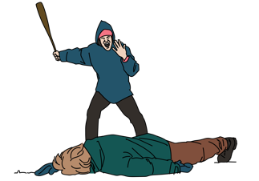
E: Events Surrounding Illness
ASK
  About the mechanism of injury
  Ask about seatbelts in road traffic accidents
  For assaults, ask about the type of weapon(s).
  Was there drugs or alcohol involved?
  For burns ask about the type of burn
  (flame, scald due to hot liquid, electrical, chemical)
THINK
  Certain mechanisms are a high risk even if the patient does not appear to be significantly injured or ill. Consider hidden injuries!
Notes:
The last step in the SAMPLE approach is to ask about the events surrounding illness. Begin by assessing the mechanism of injury. If there was a road traffic accident, ask whether the patient was wearing a seatbelt. For assaults ask about the type of weapons used. Were drugs or alcohol involved? For burns, ask about the cause of the burn. Certain mechanisms are high risk even if the patient does not appear to be significantly injured or ill. Always consider hidden injuries.
Image:
Title: Brain activity – Métacognition
Creator:benoitpetit
Source: https://openclipart.org/detail/193152/brain-activity-metacognition
Copyright information: Creative Commonz Zero 1.0 Public Domain License

Slide 47
E: Events Surrounding Illness - Fall
ASK
  Was there a fall from 3 meters or more?
  Or twice their height in children?
  A greater distance fallen increases the chance of serious injury.
  Falls in adults are often associated with older age, alcohol intoxication, or failure of workplace equipment .
  Falls in children are often from trees, windows or balconies.
  THINK
Notes:
If there was a fall, ask the height fallen from. Falls from a greater distance increases the chance of serious injury, especially from 3 meters or more or from a height twice the height of a child. Check the events surrounding the fall. Falls in adults are often associated with older age, alcohol intoxication, or failures of workplace equipment and safety. Falls in children are often from trees, windows or balconies

Slide 48
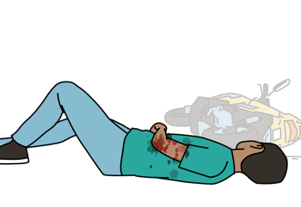
E: Events Surrounding Illness - Road Crash
ASK
  Was a pedestrian or cyclist hit by a vehicle?
  Were they on a motorcycle?
    Were they thrown? How far?
    Were they wearing a helmet?
THINK
    Pedestrian or cyclists are always at high risk for serious injury.
    Young children may be less able to report events.
    Always consider possible unwitnessed trauma in young children.
    Consider multiple injuries from direct impact and secondary impact if thrown.
    Common injury sites for motorcycle accidents are head, spine, chest, abdomen and pelvis (hitting handlebars) limbs and skin (hitting road).
Notes:
For road crashes involving pedestrians or cyclists, ask if they were hit by a vehicle. If on a motorcycle, ask if they were thrown or ejected and how far. Check if a helmet was worn. Pedestrians or cyclists are always at high risk for serious injury. Young children may be less able to report events and always consider possible unwitnessed trauma in young children. Consider multiple injuries from direct impact and secondary impact if the patient was thrown. Common injury sites for motorcycle collisions are head, spine, chest, abdomen and pelvis especially if the rider hit the handlebars, limbs and skin if the rider was ejected and hit or skinned across the road.
Image:
Title: Brain activity – Métacognition
Creator:benoitpetit
Source: https://openclipart.org/detail/193152/brain-activity-metacognition
Copyright information: Creative Commonz Zero 1.0 Public Domain License

Slide 49
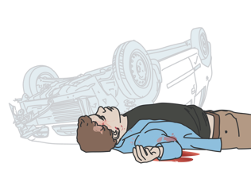
E: Events Surrounding Illness – Road Crash
ASK
  Was there a road traffic crash at high speed?
  Was the person thrown from or trapped inside a vehicle?
  Did any occupants die in the crash?
  Was the person wearing a seatbelt?
THINK
    In higher-speed crashes, greater force is transmitted increasing injury risk.
    Injury may occur from impact with the windscreen or steering wheel.
    Injury may occur from sudden stopping of the vehicle.
    A person thrown is at high risk for injury.
    Check if any part was trapped and for how long, consider crush injury.
    A death at the scene suggests significant force .
    Consider injury patterns if a person was or was not wearing a seatbelt.
Notes:
Ask about the speed of any road traffic crash and whether the patient was able to self-extricate or was trapped or thrown. Ask if any occupants died in the crash. Ask again, was the person wearing a seatbelt or was an airbag deployed. In higher-speed crashes, greater force is transmitted increasing injury risk. Injury may occur from impact with the windscreen or steering wheel. Injury may also occur from the deceleration or sudden stopping of the vehicle.
A person thrown or ejected from a vehicle is at high risk for injury. If a person was trapped, find out what part was trapped and for how long and consider the risk of crush injury. A death at the scene suggests significant force and puts others at risk for significant injury. Consider common injury patterns if a person was or was not wearing a seatbelt.
Image:
Title: Brain activity – Métacognition
Creator:benoitpetit
Source: https://openclipart.org/detail/193152/brain-activity-metacognition
Copyright information: Creative Commonz Zero 1.0 Public Domain License
Image:
Title: Brain activity – Métacognition
Creator:benoitpetit
Source: https://openclipart.org/detail/193152/brain-activity-metacognition
Copyright information: Creative Commonz Zero 1.0 Public Domain License

Slide 50
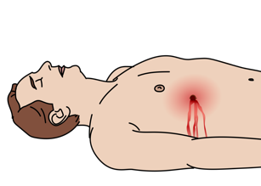
E: Events Surrounding Illness - Assault
ASK
  Was a weapon used?
  What type of weapon?
THINK
    A gunshot or stab wound patient may have multiple wounds.
    Always check the entire body for wounds.
      A bullet may not follow a direct path in the body.
      Many internal organs can be injured by one bullet.
      Consider length of blade used for stab wound.
    Injuries from blunt objects can cause damage to organs as well as bruises, lacerations and fractures .
Notes:
In the setting of assaults, ask whether a weapon was used and what type. A gunshot or stab wound patient may have multiple wounds so always check the entire body. A bullet may not follow a direct path in the body and wounds may not always appear to make logical sense. Many internal organs can be injured by one bullet. In stab wounds ask about the length of the blade if known. Injuries from blunt objects can cause damage to organs as well as bruises, lacerations and fractures.
Image:
Title: Brain activity – Métacognition
Creator:benoitpetit
Source: https://openclipart.org/detail/193152/brain-activity-metacognition
Copyright information: Creative Commonz Zero 1.0 Public Domain License

Slide 51
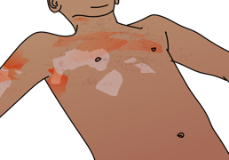
E: Events Surrounding Illness - Burn
ASK
  Was there a burn?
  What type of burn was it?
  Was first aid provided at the scene?
THINK
    Flame burns in an enclosed space may cause inhalation or airway injury.
    Scald burns are common in children.
    Injuries from electrical burns may appear small but can cause extensive tissue and muscle damage.
    For chemical burns, use the correct decontamination method and protect yourself from chemical exposure.
Notes:
Assess whether there was injury from a burn and the type of burn that may have occurred. Burns from fires, or flame burns, are the most common. A history of flame burn in an enclosed space can also suggest inhalation or airway injury. Scald burns due to hot liquids are more common in children. Electrical injuries often come from high-voltage sources such as overhead electrical wires coming into contact with the body. On the surface these electrical injuries may look small, but they can cause extensive underlying tissue and muscle damage. The electrical current often crosses the body, taking the shortest path from the point of contact with the skin to the ground, often leaving entry and exit burn marks. In the case of chemical burns, information about the specific chemical may be needed to remove it properly.
In the setting of burns it is also important to ask about any first aid provided. It is important to know if the burning process was stopped, and in the event of chemical exposure, if decontamination was performed. If there is a history of chemical exposure, protect yourself from the chemical and ensure that it is properly removed from the skin.
Image:
Title: Brain activity – Métacognition
Creator:benoitpetit
Source: https://openclipart.org/detail/193152/brain-activity-metacognition
Copyright information: Creative Commonz Zero 1.0 Public Domain License

Slide 52
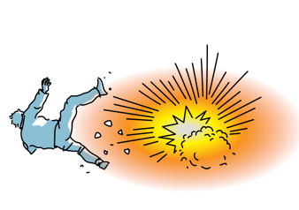
E: Events Surrounding Illness – Crush or Blast
ASK
  Did the person sustain a crush injury? How long was the body part crushed?
    Is there pain or numbness?
    Is there dark urine?
  Did the person sustain a blast injury?
THINK
    Crush injuries damage skin, muscle, blood vessels and bone.
    Dark urine can signify dangerous amounts of myoglobin released from muscle.
    Swelling can build up pressure limiting blood flow to the muscles and nerves (compartment syndrome).
    Blast injuries can involve all body systems, especially hollow organs commonly lungs, intestines and ears.
    Consider foreign body injuries, burns, chemical injury, toxin or radiation exposure
Notes:
The last element that we will cover here is crush or blast injury. Questions to ask in a crush injury include whether the patient has pain or numbness and if there are changes or discoloration to the urine. Crush injuries may damage skin, muscle, blood vessels and bone. Damaged muscle can release a muscle by-product called myoglobin that can build up and damage the kidneys. It is important to know how long a body part was crushed for. If a person with a crush injury has dark urine, this may be a sign of build-up of myoglobin in the kidneys. Tissue damage and swelling from crush injury can also cause a build-up of pressure, particularly in limb-crush injuries, that can limit blood flow to the muscles and nerves causing compartment syndrome.
In blast injuries or injuries from explosions, all systems of the body can be affected especially the hollow organs. Common blast injuries include damage to the lungs, intestines and ears. Patients involved in explosions need to be checked carefully and repeatedly because these injuries are easily missed. Blasts may also be associated with foreign bodies in the skin and eyes, burns or chemical injury, and toxin or radiation exposure.
Image:
Title: Brain activity – Métacognition
Creator:benoitpetit
Source: https://openclipart.org/detail/193152/brain-activity-metacognition
Copyright information: Creative Commonz Zero 1.0 Public Domain License

Slide 53
Workbook Question 3
Using the workbook section above, list five questions you would ask when taking a SAMPLE history from a person injured in a road traffic crash
1.
2.
3.
4.
5.
Notes:
Workbook question 3: Approach to trauma [page 52 in participant workbook]
Using the workbook section above, list five questions you would ask when taking a SAMPLE history from a person injured in a road traffic crash:
Answers:
1. Was a pedestrian or a cyclist hit by a car? 2. Was there a road traffic crash at high speed? 3. Was the person thrown from or trapped inside a vehicle? Did any vehicle occupants die in this crash? 4. In a motor vehicle crash was the patient wearing a seatbelt? 5. In a motorcycle crash, was the rider was thrown from the motorcycle? 6. Was there a burn? If so, what type of burn was it? For burns, was first aid provided at the scene? 7. Did the person sustain a crush injury? Is there severe pain/numbness at the site? Is there dark urine?
Image
Title: Deep thought
Creator:GDL
Source: https://openclipart.org/detail/221707/deep-thought
Copyright information: Creative Commonz Zero 1.0 Public Domain License

Slide 54
Trauma
Part 2: The SAMPLE History and Secondary Examination Survey
Notes:
This is the second part of the trauma module. We will look at the SAMPLE history for injured patients, and the secondary examination survey. We will start with the SAMPLE history.

Slide 55
Trauma Secondary Survey
!
Look, listen and feel
REMEMBER you should have ALREADY completed the ABCDE Exam and treated life-threatening conditions BEFORE doing this extensive examination
Perform a detailed head-to-toe examination of the patient.
Remember that very painful or frightening injuries may distract from others.
If the secondary exam identifies an ABCDE condition, STOP AND RETURN IMMEDIATELY TO ABCDE to manage it!
Notes:
The secondary survey is a detailed head-to-toe examination designed to identify any additional injuries or issues requiring intervention. The secondary survey gives the provider an organized way to assess the entire body for signs of trauma that may not have been obvious on the primary survey or immediately life-threatening. Remember that very painful or frightening injuries may distract both patients and providers from recognizing other injuries. Always examine the entire body. If the secondary survey identifies an ABCDE condition, stop and return immediately to the primary survey to manage it.

Slide 56
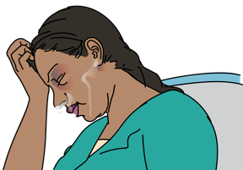
Secondary Exam Survey:
Head, Eyes, Ears, Nose, Throat (HEENT)
Look for:
Look for:
Scalp wounds or bruising
Skull deformities
Blood in the mouth or throat
Unequal or unresponsive pupils indicating head injury
Vision loss or changes
Eye injuries and problems with eye movements
  Blood or fluid from ear or nose indicating injury or open skull fracture
  Tooth injury or poor alignment
  Signs of airway burns: ash, singed nasal hairs or new or worsening lip or mouth swelling
Notes:
The first assessment of the secondary survey is of the head, eyes, ears, nose and throat. In order not to miss any part, take a systematic approach.
Look for the following: scalp wounds or bruising; skull deformities; blood in the mouth or throat; vision loss or changes and eye injuries; and eye movement abnormalities. Unequal or unresponsive pupils may indicate a severe head injury. Look for blood or fluid from the ear or nose indicating injury or open skull fracture; tooth injury or poor alignment; signs of airway burns such as ash, singed nasal hairs or new or worsening lip or mouth swelling.
.

Slide 57
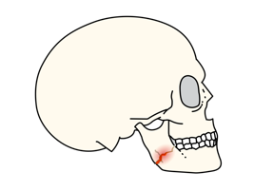
Secondary Exam Survey:
Head, Eyes, Ears, Nose, Throat (HEENT)
Listen for:
Feel for:
Stridor which could indicate airway obstruction
Gurgling indicating fluid in the airway
Changes in voice, which can indicate airway or vocal cord injury
Tenderness or abnormal movement of facial bones
Loose teeth that could accidentally be inhaled
Defects or crepitus in the skull or facial bones suggesting fracture
Notes:
After looking, listen for the following: stridor which could indicate airway obstruction; gurgling indicating fluid in the airway; changes in voice, which can indicate airway or vocal cord injury. After both looking and listening, feel for: tenderness or abnormal movement of the facial bones; loose teeth that could accidentally be inhaled; and defects or crepitus in the skull or facial bones suggesting fracture.

Slide 58

Secondary Exam Survey: Neck
Look for:
  Reduced ability to move neck or pain
  on movement
  Bruising, bleeding or swelling
  Haematoma that may eventually cause airway obstruction
  Penetrating neck wounds
  Distended neck veins (may indicate tension pneumothorax or tamponade)
Feel for:
  Air in the skin or soft tissue (concern for pneumothorax)
  Tenderness or deformity along the spine
Notes:
The neck should be examined next. Look for any reduced ability to move the neck or pain on movement, bruising, bleeding or swelling, any haematoma that may eventually cause airway obstruction, penetrating neck wounds; and distended neck veins. Distended neck veins may indicate tension pneumothorax or tamponade. If concern return to the primary survey. Next feel for air in the skin or soft tissue which may indicate pneumothorax, and any tenderness or deformity along the spine.

Slide 59
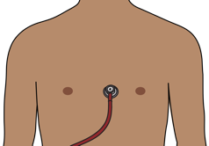
Secondary Exam Survey: Chest
Look for:
  Bruising, deformity or wounds
  Uneven chest wall movement (concern for pneumothorax or flail chest)
  Burns around the entire chest (circumferential) which can cause difficulty in breathing
Listen for:
  Breath sounds (decreased, unequal, absent, wheezing or rhonchi)
  Muffled heart sounds (concern for pericardial tamponade)
Feel for:
  Tenderness
  Crepitus (concern for fracture or pneumothorax)
Notes:
Regarding the chest, look for bruising, deformity, wounds and circumferential burns. Uneven chest wall movement may be concerning for pneumothorax or flail chest. Listen for decreased, unequal, absent or other abnormal breath sounds. Muffled heart sounds can be a sign of pericardial tamponade. Feel for tenderness and crepitus, which may be concerning for fracture or pneumothorax.

Slide 60
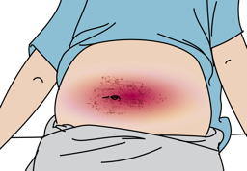
Secondary Exam Survey: Abdomen
Look for
  Abdominal distension
  Visible wounds, bruising or abrasions
  Bruising on back or sides which may indicate bleeding into the abdomen
  Circumferential burns to the abdomen (concern for breathing problems)
Feel for
  Rebound tenderness or guarding
  Abdominal tenderness in all quadrants which may
  indicate organ or blood vessel injury
Notes:
The abdomen should be examined next. Look for abdominal distension, visible wounds, bruising or abrasions, bruising on the back or sides which may indicate bleeding into the abdomen, and circumferential burns to the abdomen. Feel for rebound tenderness or guarding. Abdominal tenderness in all quadrants may indicate peritonitis from internal organ or blood vessel injury.

Slide 61
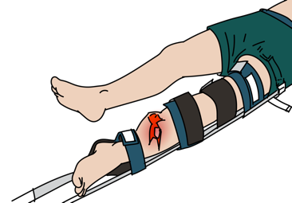
Secondary Exam Survey: Extremities
Look for:
  Swelling or bruising
  Deformity
  Open fractures
  Amputations
  Circumferential burns
  Pale skin(could indicate loss of blood flow)
Feel for:
  Absent or weak pulses
  Cold extremities (could indicate loss of blood flow)
  Tenderness
  Abnormally firm, painful muscular compartments (could indicate compartment syndrome)
Notes:
Extremity trauma should include an assessment of swelling or bruising, deformity, open fractures, amputations, circumferential burns, and assessment of the skin. If the limb is pale this could indicate loss of blood flow. Feel for absent or weak pulses, tenderness and cold or cool extremities which could indicate loss of blood flow. Abnormally firm, painful muscular compartments can be a sign of compartment syndrome.

Slide 62

Secondary Exam Survey: Spine
LOG ROLL the person with assistance, then:
Look for:
  Bruising
  Deformity
Feel for:
  Tenderness, crepitus and alignment along the entire spine (upper neck to lower back)
  Tenderness, crepitus or misalignment over any other areas with visible evidence of trauma.
If concern for spinal injury, check and document the level where the findings start.
Notes:
Examination of the spine should be done with assistance while maintaining spinal immobilization and log-rolling the patient. Assess for bruising and deformity and feel for tenderness, crepitus and alignment along the entire spine from upper neck to lower back. Be sure to take time to assess the rest of the back for tenderness, crepitus or misalignment over any other non-midline spinal areas for trauma. If there is concern for spinal injury, check and document the level where the physical exam findings start.

Slide 63
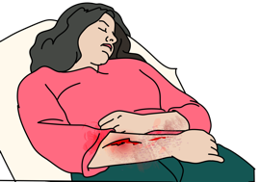
Secondary Exam Survey: Skin
Look for:
  Bruising
  Abrasions
  Lacerations
  Burns
    Circumferential burns on the chest can cause difficulty in breathing.
    Extremity burns can cause compartment syndrome.
Feel for:
  Peripheral pulses in all extremities
Notes:
During the skin examination look for bruising, abrasions, lacerations, and burns. Circumferential chest wall burns can cause difficulty in breathing. Burns to the extremities can cause compartment syndrome. Feel for peripheral pulses in all extremities.

Slide 64
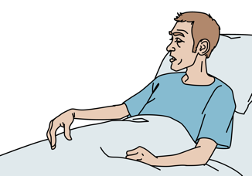
Secondary Exam Survey: Neurologic
Check for:
  Decreasing level of consciousness (AVPU or GCS)
  Agitation or seizures/convulsions (consider serious head injury)
  Movement and strength in each limb
  Sensation on face, chest, abdomen and limbs.
  Priapism (consider spinal injury)
  If decreased movement and/or strength consider spinal injury.
  If there is a neurologic deficit, identify the level it begins.
Notes:
The last component of the secondary survey is the neurologic exam. Check the level of consciousness via the AVPU scale or GCS, and check for any decrease. Agitation, seizures (or convulsions) should make you think of a serious head injury. Check for movement and strength in each limb. Sensation at all body levels should be assessed and if there is a deficit identify the level at which it begins. Decreased sensation, decreased strength or priapism can be signs of spinal injury.

Slide 65
Workbook Question 4
Using the workbook section above, list one way that you ASSESS the following systems
 | Listen for | Look for | Feel for
Head/eyes/ears/ nose/throat
Chest
Pelvis and Genitourinary
Notes:
Workbook question 4: [page 56 in participant workbook]
Using the workbook section above, list one way that you would ASSESS the following systems.
Head, ears, eyes, nose, throat:
Listen for: 1. Stridor, which could indicate that the airway will obstruct soon 2. Gurgling, indicating fluid in the airway
Look for: 1. Scalp wounds or bruising 2. Skull deformities 3. Blood in mouth or throat 4.. Unequal or unresponsive pupils indicating head injury 5. Vision loss or changes and eye injuries 6. Blood or fluid from ear or nose indicating injury or open skull fracture with fluid leakage from around the brain 7. Tooth injury or poor alignment of teeth 8. Signs of airway burns: ash, singed nasal hairs, or new or worsening lip or mouth swelling
Feel for: 1. Tenderness or abnormal movement of facial bones--this can happen with facial bone fracture 2. Loose teeth that might be accidentally inhaled 3. Defects or crepitus in the skull or facial bones concerning for fracture
Chest:
Look for: 1. Bruising, deformity 2. Uneven chest wall movement--concerning for a pneumothorax 3. Burns around the entire chest (such as circumferential), which can cause difficulty in breathing
Listen for: 1. Breath sounds (decreased, absent, wheeze, crepitations) 2. Muffled heart sounds--concerning for pericardial tamponade
Feel for: 1. Tenderness 2. Crepitus--concerning for fracture or pneumothorax
Pelvis and genitourinary:
Look for: 1. Bruising/lacerations to pelvis 2. Blood at the opening of the penis or vagina 3. Vaginal lacerations or bleeding--these could indicate open pelvic fracture or may be a source of bleeding that may need to be controlled 4. Penile lacerations 5. Priapism--this can indicate spinal injury 6. Urine color (dark color or visible blood) that might indicate muscle breakdown or kidney injury
Feel for: 1. Bony pelvis for tenderness or instability
Image
Title: Deep thought
Creator:GDL
Source: https://openclipart.org/detail/221707/deep-thought
Copyright information: Creative Commonz Zero 1.0 Public Domain License

Slide 66
Trauma
Part 3: Important conditions to Recognize and Manage Based on History and Secondary Survey
Notes:
This is the third part of the trauma module. We will look at important conditions to recognise and manage based on the history and secondary survey

Slide 67
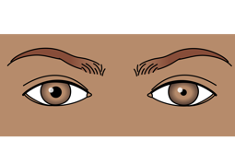
Head Injury
Signs and Symptoms | Management
Headache Altered mental status Abnormal pupils Scalp lacerations and/or skull fractures Bruising around eyes or behind ears Blood or clear fluid from nose or ears Weakness on one side of the body Seizures Visual changes Loss of memory Vomiting | MONITOR level of consciousness using GCS. IMMOBILIZE SPINE. Any patient with significant head injury is at risk for spine injuries. MONITOR for vomiting and possible aspiration. Elevate head of the bed. If concern for open skull fracture → give ANTIBIOTICS Check blood glucose. Give GLUCOSE if less than 3.5mmol/L or unable to measure. If possible, any patient with GCS less than 9 should have a CT scan within two hours of injury.
Because the brain is encased in the rigid skull, any swelling or bleeding caused by brain injury can become life-threatening!
Notes:
Head injuries are noted by the following signs and symptoms: Headache, altered mental status, abnormal pupils, scalp lacerations and/or skull fractures, bruising around eyes or behind ears, blood or clear fluid from nose or ears, weakness on one side of the body, seizures, visual changes, loss of memory, and vomiting. Management of the patient with head injury should include frequent monitoring of the patient’s level of consciousness using GCS. Remember to immobilize the spine if significant head injury, as there is risk for associated spinal injuries. Monitor the head-injured patient for vomiting and possible aspiration. Give antibiotics if there is a concern for an open skull fracture. If blood glucose is less than 3.5mmol/L or unable to measure, give glucose. Any patient with GCS less than 9 should ideally have a CT scan within two hours of injury. If CTs are not available refer/transfer to the nearest available centre. Because the brain is encased in the rigid skull, any swelling or bleeding caused by brain injury can become life-threatening so emergent transfer for definitive treatment is necessary.

Slide 68
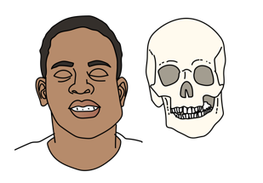
Facial Fractures
Signs and Symptoms | Management
Deformities or unusual movements in the facial bones Jaw not closing properly Problems with eye movement | Give ANTIBIOTICS for open facial fractures. Update TETANUS vaccination if needed. Suspect head injury or c-spine injury and IMMOBILIZE the c-spine. Position patient to keep blood from entering airway. Avoid nasal airways and nasogastric tubes if suspected facial fracture.
Notes:
Facial fractures usually present with deformities or unusual movements in the facial bones. Fractures of the jaw can be assessed by checking movement of the jaw and its alignment. Orbital fractures may present with abnormal or restricted eye movement or pain behind the eye. Facial fractures should be treated with antibiotics if there is an overlying open wound or laceration, and update tetanus vaccination if needed. If you suspect a head injury or c-spine injury immobilize the cervical spine. If there is active bleeding from the face, position the patients head so that blood does not enter the airway. Avoid nasal airways and nasogastric tubes if there is a suspected facial fracture.

Slide 69
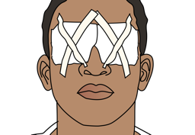
Penetrating Eye Injury
Signs and Symptoms | Management
Object stuck in the eye Painful red eye or a reported feeling of something in eye Problems with vision Abnormally shaped pupil Clear liquid draining from the eye Signs of trauma around the eye | Do not push on the eye. Do not remove objects penetrating the eye. Give ANTIBIOTICS. Update TETANUS vaccination if needed. Elevate the head of the bed and place a patch over both eyes. Plan for HANDOVER/TRANSFER.
Notes:
Penetrating eye injuries should be evaluated for a foreign body in the eye, a painful red eye or a reported feeling of something in the eye, problems with vision, an abnormally shaped pupil, clear liquid draining from the eye, or signs of trauma around the eye such as bruising or lacerations. Remember do not push onto the eye as this can cause more damage. Do not remove foreign bodies or other penetrating objects. Give antibiotics and update tetanus. Elevate the head of the bed and patch both eyes regardless of whether there are unilateral or bilateral eye injuries. Plan for handover and transfer to a centre with specialist care.

Slide 70
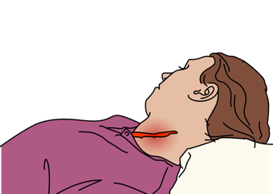
Penetrating Neck Wound
Signs and Symptoms | Management
Lacerations or punctures to the neck Swelling (suggesting haematoma) Look carefully | Maintain CERVICAL SPINE PRECAUTIONS. Stabilize but do not remove object. APPLY firm pressure to bleeding sites. (Do not block airway.) Do not insert anything into the wound. Plan for rapid HANDOVER/TRANSFER to a centre with advanced airway management and surgical capabilities.
Patients with penetrating neck wounds are at risk of airway obstruction!
Neck wounds may cause significant bleeding.
Notes:
Penetrating injuries to the neck are at risk of airway obstruction. Injuries should be assessed carefully, by looking for lacerations or punctures to the neck. Swelling may suggest a haematoma, and it is important to reassess any swelling for changes in size. If the haematoma is rapidly expansive, pulsatile or occluding, there is risk of airway obstruction.
If a penetrating foreign body is present do not remove the object. Stabilize the area of injury. Neck wounds may cause significant bleeding. Apply firm pressure to bleeding sites, being careful not to press too hard and occlude the airway. Do not insert anything into the wound directly. Be sure to maintain cervical spine precautions. Plan for rapid handover and transfer to a centre with advanced airway management and surgical capabilities.

Slide 71
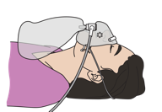
Chest injury
Signs and Symptoms | Management
Difficulty in breathing Crepitus or tenderness with palpation to the ribs Uneven chest wall movements or unequal breath sounds | For patients with pneumothorax, give OXYGEN and monitor for signs of tension pneumothorax. If suspected rib fractures (crepitus or tenderness), consider underlying chest or abdominal injury. Plan for rapid HANDOVER/TRANSFER for chest tube in pneumothorax or advanced airway and breathing management .
Difficulty in breathing due to lung injury can develop over time, monitor closely!
Simple pneumothorax can develop into a tension pneumothorax over time.
Notes:
Chest injuries can present with difficulty in breathing. Crepitus or tenderness with palpation to the ribs may also be present. Uneven chest wall movements or unequal breath sounds may be a sign of rib fracture or pneumothorax. For patients with pneumothorax, give oxygen and monitor for signs of tension pneumothorax. If there are suspected rib fractures, consider underlying chest or abdominal injury. Plan for rapid handover and transfer for chest tube if pneumothorax, or for advanced airway and breathing management. Difficulty in breathing due to lung injury can develop over time so monitor frequently and closely. Additionally, a simple pneumothorax can develop into a tension pneumothorax over time.

Slide 72

Abdominal Injury
Signs and Symptoms | Management
Abdominal pain or vomiting Tender, firm or distended abdomen Strong abdominal wall muscle contractions when touched (guarding) Few or no bowel sounds Rectal bleeding Obvious injury or exposed bowel Bruising around umbilicus or over flanks (suggest internal bleeding) | If you suspect abdominal injury→ give IV FLUIDS. Do not give food or drink. If bowel is visible →Leave outside the body. →Cover with STERILE GAUZE soaked in sterile saline. →Give ANTIBIOTICS. If there is concern for any abdominal injury, plan for rapid HANDOVER/TRANSFER to surgical centre.
Severe pain or bruising is concerning for organ injury and internal bleeding
Notes:
Abdominal injuries can present with the following signs and symptoms: abdominal pain or vomiting, tender, firm or distended abdomen, or strong abdominal wall muscle contractions when touched which is called guarding. Patients may also have decreased or no bowel sounds, rectal bleeding, obvious injury or exposed bowel. Bruising around the umbilicus or over flanks may be suggestive of internal bleeding. If you suspect an abdominal injury, give intravenous fluids. Do not give food or drink to the patient as they may need emergency surgery. If bowel is visible; leave outside the body, cover with sterile gauze soaked in sterile saline, and give antibiotics. If there is concern for any abdominal injury plan for handover and transfer to a surgical centre. Remember that severe pain or bruising is concerning for organ injury and internal bleeding.

Slide 73

Spinal Cord Injury
Signs and Symptoms | Management
Midline spinal pain/tenderness Movement problems Paralysis Weakness Decreased reflexes Sensation problems “pins and needles” Loss of control of urine or stool Priapism May have hypotension or bradycardia Crepitus to spinal bones Spinal bones not aligned Difficulty in breathing (upper c-spine injury) | Provide SPINAL IMMOBILIZATION if there is a history of trauma and the patient is unconscious or is conscious and has neck pain, cervical spine tenderness, numbness or weakness. Use a rolled sheet or neck collar to IMMOBILIZE the cervical spine. Keep the patient lying flat. Provide ongoing airway monitoring. Use LOG-ROLL MANOEUVRE when examining or moving. Monitor blood pressure and give IV FLUIDS if hypotension. Plan for rapid HANDOVER/TRANSFER.
Notes:
Patients with potential spinal cord injuries should be assessed for midline spinal pain/tenderness. Paralysis, weakness, decreased reflexes and decreased sensation may also be present. Loss of control of urine or stool or similarly urinary or bowel retention may be a sign of spinal injury. Priapism may also be seen. Spinal cord injuries can lead to signs of shock with hypotension and or bradycardia. On exam there may be crepitus over the spinal bones, spinal step offs or malalignment and difficulty in breathing which may denote an upper c-spine injury. Start by immobilizing the spine if there is a history of trauma and the patient is unconscious, or is conscious and has neck pain, cervical spine tenderness, numbness or weakness. If you do not have access to a premade cervical collar, you can use a rolled sheet to immobilise the cervical spine. Keep the patient lying flat, use the log-roll manoeuvre when examining, give intravenous fluids and plan for the rapid transfer of the patient.

Slide 74

Spinal Cord Injury
!
Spinal trauma is not always obvious. Fractured bones can injure the spinal cord, causing paralysis.
  Always document exam findings so future providers can evaluate for changes
Spinal injuries can cause shock. The risk is higher if there is also blood loss.
Spinal boards are only to move patients. Do not leave patients on spinal boards. It can cause pressure sores.
Notes:
Spinal trauma is not always obvious. Sometimes fractured bones can injure the spinal cord, causing paralysis. Be sure to document exam findings so future providers can evaluate for changes in the neurologic exam. Spinal injuries can also lead to shock. The risk is higher if there is also blood loss and loss of perfusion to the spinal cord. If the patient was transported on a hard spinal board, they need to be taken off the board as soon as possible to prevent pressure sores. Spinal boards should only be used to move patients.

Slide 75

Internal Bleeding (not seen on primary survey)
Signs and Symptoms | Management
Bruising around umbilicus or over flanks Pelvic fracture Femur fracture Decreased breath sounds on one side of the chest Signs of poor perfusion Hypotension Tachycardia Pale skin Diaphoresis | STOP THE BLEEDING if possible. BIND pelvis fracture. SPLINT femur fracture. Give IV FLUIDS. Plan for rapid HANDOVER/TRANSFER for ongoing surgical management and blood transfusion if needed.
Notes:
Internal bleeding is an important cause of morbidity and mortality in trauma. Signs and symptoms include bruising around the umbilicus or over flanks, evidence of pelvic or femur fractures, or decreased breath sounds on one side of the chest. Additionally, signs of poor perfusion or shock, including hypotension, tachycardia, pale skin, and diaphoresis represent significant signs of haemorrhage. The priority is to stop the bleeding. Bind the pelvis in open book pelvic fractures and splint femur fractures. Give intravenous fluids and plan for rapid transfer and handover for ongoing surgical management and blood transfusion.

Slide 76
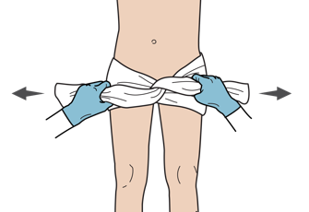
Pelvic Fracture
Signs and Symptoms | Management
Pain with palpation of the pelvis Instability or abnormal movement of the bones in the pelvis Blood at the opening of the penis or rectum Unstable pelvis when compressed gently on exam. | Give IV FLUIDS. Give PAIN CONTROL. STABILIZE the pelvis with a sheet or binder. Plan for rapid HANDOVER/TRANSFER for blood transfusions.
PELVIC BINDER
Do not open and rock the pelvis or perform repeat exams on pelvis!
Notes:
Patients with pelvic fracture may have pain with palpation of the pelvis, instability or abnormal movement of the bones in the pelvis, and/or blood at the opening of the penis or rectum. Management begins by giving intravenous fluids and pain control. Compress the pelvis gently to check for stability. Do not rock the pelvis or perform repeat exams as this may worsen an underlying injury. Stabilize the pelvis with a sheet or binding and plan for rapid handover and transfer of these patients especially if concern for internal and continued bleeding.

Slide 77

Extremity Fracture with Poor Perfusion
Signs and Symptoms | Management
Deformity or crepitus of the bone Absent pulses beyond the fracture Capillary refill time of greater than 3 seconds beyond fracture Cold extremities with blue or gray coloration of skin beyond the fracture | If weak pulses or poor perfusion, REDUCE and SPLINT the fracture. Always check pulses, capillary refill and sensation before and after any reduction Give PAIN MEDICATIONS. Plan for rapid HANDOVER/TRANSFER to specialized unit.
Notes:
Extremity fractures may have a notable deformity or crepitus of the bone. Absent pulses, delayed capillary refill greater than three seconds, and/or cold extremities with blue or gray coloration of skin beyond the fracture are all signs of poor perfusion. Reassess the extremity frequently; feel the pulse, check capillary refill and observe skin colour and pallor. If weak pulses or poor perfusion, reduce and splint the fracture. Always check pulses, capillary refill and sensation before and after any reduction. Treat pain accordingly and transfer to a specialized unit.

Slide 78

Open Fracture
Signs and Symptoms | Management
Deformity or crepitus of the bone with overlying laceration or abrasion | Control bleeding with DIRECT PRESSURE. Perform immediate REDUCTION and SPLINTING if there is poor perfusion. IRRIGATE the wound well. Dress the wound. Give ANTIBIOTICS and TETANUS vaccination. SPLINT the wound. Plan for rapid HANDOVER/TRANSFER to a specialized unit.
Consider any patient to have an open fracture if there is a wound (more than just a skin
abrasion) near a fracture site.
Open fractures are emergencies as they can lead to severe bone infections.
Notes:
An open fracture is a special kind of fracture that requires additional care and management. Deformity or crepitus of the bone with overlying laceration or abrasion can be seen and felt. In these fracture types it is important to control bleeding with direct pressure. Perform immediate reduction and splinting if there is poor perfusion to an extremity. Irrigate the wound well, dress the wound, give antibiotics and update tetanus vaccination. Splint the wound and immobilize for rapid transfer and handover to a specialized unit.

Slide 79

Open Wound
Signs and Symptoms | Management
Lacerations Abrasions Check for blood pooling under patient around axillae, genital area, buttocks or back Pumping or squirting blood suggests arterial bleeding | Control bleeding with DIRECT PRESSURE. CLEAN wounds with soap and water or antiseptic. Remove any debris. DRESS wounds with sterile gauze. Check perfusion beyond the wound before and after dressing wounds. SPLINT large lacerations to help with healing. Stabilize but do not remove penetrating objects. For snake bites, IMMOBILIZE extremity. For animal bites, consult expert for risk of infection and rabies exposure. Give TETANUS vaccination if needed.
Notes:
Open wounds, such as lacerations and abrasions, should be assessed for rapid or pulsating bleeding. Check for blood pooling under the patient around the axillae, genital area, buttocks or back. Pumping or squirting blood suggests arterial bleeding. Control external bleeding with direct pressure. Irrigate and clean wounds with clean soap and water or antiseptic. Remove debris. Check distal perfusion beyond the wound and then dress with clean sterile gauze. Larger lacerations may be splinted to help with healing. If penetrating objects are present, stabilize the item and do not remove. If snake bite is suspected, immobilize the extremity appropriately. For animal bites, consult an expert to assess risk of infection and rabies exposure, and need for prophylaxis. Tetanus vaccination should be given if needed.

Slide 80


Crush Injury
Signs and Symptoms | Management
Fractures Bruising Soft tissue injury Evidence of compartment syndrome Small amounts of red-brown urine | MONITOR urine output for red-brown colour. Give IV FLUIDS to help maintain urine output. SPLINT fractures to reduce further damage. Plan for rapid HANDOVER/TRANSFER if compartment syndrome is suspected May have systematic problems related to muscle damage
Compartment syndrome is a build-up of pressure within the muscle compartments that can limit blood supply to muscles and nerves and cause kidney damage due to by-products of muscle injury.
Notes:
Crush injuries often present with associated fractures, bruising, soft tissue injury. On exam there may be evidence of compartment syndrome, and urine may appear red or brown in appearance, suggestive of rhabdomyolysis (or muscle breakdown). Management includes monitoring urine output for changes in colour or decreased output. Give IV fluids to help maintain urine output and prevent renal failure. Splinting fractures reduces compartment and muscle damage. Plan for rapid handover and transfer if compartment syndrome or renal failure is suspected. Compartment syndrome is a build-up of pressure within the muscle compartments that can limit blood supply to muscles and nerves and cause kidney damage due to by-products of muscle injury. Patients may also have systematic problems related to muscle damage so watch for other signs of organ failure.

Slide 81

Blast Injury
Signs and Symptoms | Management
Injuries to gas-filled organs - lung, stomach and bowel Delayed symptoms of cough (with or without blood), tachypnoea, hypoxia or chest pain Abdominal pain, nausea or vomiting (with or without blood) Tympanic membrane rupture, hearing loss, ringing in ears, pain or ear bleeding Burns Exposure to toxins Other injuries | Examine carefully for pneumothorax. Give OXYGEN if there is difficulty breathing. Update TETANUS if needed. Manage IV FLUIDS for burns by calculating burn area. Dress burns. If the patient has abdominal pain → Consider bowel perforation →Give IV FLUIDS →Plan for rapid HANDOVER/TRANSFER for surgery
Notes:
Blast injuries from explosions can lead to injuries to gas-filled organs, including the lungs, stomach and bowel. There can be delayed symptoms of cough (with or without blood), tachypnoea, hypoxia or chest pain. Patients may also present with abdominal pain, nausea or vomiting (with or without blood), tympanic membrane rupture, hearing loss, ringing in ears, pain or ear bleeding. Depending on the cause of the blast there may be associated burns or other injury patterns. Examine carefully for pneumothorax. Give oxygen if there is difficulty breathing. Update tetanus if needed and give intravenous fluids according to area of the burn if indicated. Dress wounds and burns appropriately. If the patient has abdominal pain, consider bowel perforation. Give intravenous fluids and plan for the rapid handover and transfer of these patients to advanced care.

Slide 82

Blast Injury
An explosive blast causes injuries in three ways:
Visible injuries from shrapnel or burns from heat or chemicals released
Internal injuries from the change in pressure caused by the blast: commonly the stomach, bowel, lungs and ears
Additional blunt injuries that result when the body is thrown from the blast
Notes:
An explosive blast causes injuries in three main ways. There can be visible injuries from shrapnel or burns from heat or chemicals released. Internal injuries result from the change in pressure caused by the blast, commonly injuring the stomach, bowel, lungs and ears. Additional blunt injuries result when the body is thrown from the blast.

Slide 83

Burn Injury
Signs and Symptoms | Management
Skin colour can range from pink, red, pale or black depending on depth of burn Signs of inhalation injury: Soot (ash) or singed (burned) nasal hairs Swelling to lips or mouth Voice changes | MONITOR for airway obstruction. Remove all jewellery. Give IV FLUIDS according to burn area and depth. Give TETANUS. Give PAIN RELIEF. CLEAN and DRESS all wounds carefully Plan for HANDOVER/TRANSFER if the following: Serious burns to >15% of the body Hands, face, groin, joints or circumferential burns Inhalation injury Burns with other trauma Burns in very young or elderly Significant pre-burn illness (such as diabetes)
Burns are high risk for infection! Clean and dress the wound carefully.
Notes:
Burns may present in a variety of ways depending on the cause, mechanism and depth of the burn. The burned skin colour can range from pink, red, pale or black depending on the depth of the burn. If there is risk of inhalation injury, look for soot (ash) or singed (burned) nasal hairs, swelling to the lips or mouth, and voice changes. Management includes monitoring the ABCDEs, especially A for airway obstruction. Give intravenous fluids according to the burn area and depth. Update tetanus vaccination if needed and treat pain appropriately. Overlying clothing and jewellery should be removed, and all wounds irrigated, cleaned and dressed to reduce the risk of infection. Plan for rapid handover or transfer if any of the following are present: serious burns to >15% of the body, burns to hands, face, groin, joints or circumferential burns, inhalation injury, burns with other trauma, burns in very young or elderly, or significant pre-burn co-morbid illnesses.

Slide 84


Burn surface area assessment
Adult
Child
Notes:
The following diagrams provide an overall assessment of the surface area of adults and children. As an example, a burn to a single upper extremity on an adult is equivalent to a 4.5% body surface area burn. In comparison to adults, infant and children’s heads make up a significantly higher proportion of body surface area. For further detail on assessment of burn area, refer to the Basic Emergency Care manual.

Slide 85
Workbook Question 5
Using the workbook section above, list what you would DO to manage the following injuries
Pelvic Fracture
Burn injury in an adult
Abdominal injury
Notes:
Workbook question 5: Approach to trauma [page 64 in participant workbook]
Using the workbook section above, list what you would DO to manage the following injuries:
Answers
Pelvic fracture -Give IV fluids and pain control. -Stabilize the pelvis with a sheet or pelvic binder. -Plan for early transfer/handover to a unit with blood transfusion capabilities.
Burn injury in an adult -Calculate the percentage of body surface area (BSA) that was burned. Use the BSA to calculate IV fluid requirements using the Parkland formula. -Give tetanus and pain relief for burn injuries. -Remove all jewelry and elevate the burned limb if possible. -Clean and dress the wound carefully.
Abdominal injury -Give intravenous fluids. -Do not give the patient anything to eat or drink. -If bowel is visible, leave it outside the body, cover it with sterile gauze soaked in sterile saline, give antibiotics -If there is any concern for abdominal injury, plan for rapid handover/transfer to surgical care
Image
Title: Deep thought
Creator:GDL
Source: https://openclipart.org/detail/221707/deep-thought
Copyright information: Creative Commonz Zero 1.0 Public Domain License

Slide 86
Trauma
Part 4: Special Populations and Disposition
Notes:
This is the fourth part of the trauma module. We will look at important special considerations for pregnant and paediatric trauma patients, and the disposition of trauma patients.

Slide 87

Special Populations: Trauma in Pregnancy
Any female trauma patient between the ages of 10-50 years old should have a pregnancy test.
Pregnancy causes many changes in maternal physiology.
  Even minor trauma may result in harm to the mother and fetus.
  Women in their third trimester are at risk for placental abruption, uterine rupture and premature labour.
Keeping the mother alive is the best way to keep the baby alive.
When taking your SAMPLE history ask about gestational age and any pregnancy complications.
Notes:
Any female trauma patient between the ages of 10-50 years old should have a pregnancy test. Pregnancy causes many changes in maternal physiology. Even minor trauma may result in harm to the mother and fetus. Remember keeping the mother alive is the best way to keep the baby alive-so maintain focus on the mother. When taking your SAMPLE history ask about gestational age and any pregnancy complications .
Image:
Title: Pregnant woman icon
Creator:GDL
Source: https://openclipart.org/detail/235128/pregnant-woman-icon-mark-ii
Copyright information: Creative Commonz Zero 1.0 Public Domain License

Slide 88

Special Considerations: Trauma in Pregnancy
Primary Survey
Airway: Pregnancy makes airway obstruction more likely.
Breathing: Diaphragm is pushed up by the uterus, leaving less lung space
Circulation: Check vaginal bleeding. Place patient in LEFT LATERAL POSITION.
Disability: Always consider eclampsia if seizures.
Exposure: Keep the patient warm.
Plan for early HANDOVER/TRANSFER to a specialist centre with obstetric care!
Notes:
In pregnant trauma patients the primary survey should take note of the following issues. Pregnancy makes airway obstruction more likely. The diaphragm is pushed up by the uterus, leaving less lung space which makes breathing more problematic. Check for vaginal bleeding especially if there is a circulation issue and place the patient in the left lateral position to lift the fetus off the mother’s main blood vessels. Consider eclampsia in patients with altered mental status, seizures or with high blood pressure. Keep the patient warm. Plan for early handover and transfer to a specialist centre with obstetric and trauma care.
Image:
Title: Pregnant woman icon
Creator:GDL
Source: https://openclipart.org/detail/235128/pregnant-woman-icon-mark-ii
Copyright information: Creative Commonz Zero 1.0 Public Domain License

Slide 89

Special Considerations: Trauma in Pregnancy
Common conditions caused by trauma:
Preterm (early) labour
  With or without premature rupture of membranes (loss of fluid surrounding the baby)
Placental abruption or uterine rupture causing blood loss and shock
Seizures/convulsions
Notes:
There are several common conditions caused by trauma in pregnancy. Preterm (or early) labour may occur with or without premature rupture of membranes (loss of fluid surrounding the baby). Placental abruption is when the placenta separates from the wall of the uterus. The uterus can also rupture causing blood loss and shock. Seizures or convulsions can result from trauma but consider eclampsia as an alternate cause.
Image:
Title: Pregnant woman icon
Creator:GDL
Source: https://openclipart.org/detail/235128/pregnant-woman-icon-mark-ii
Copyright information: Creative Commonz Zero 1.0 Public Domain License

Slide 90

Special Considerations: Trauma in Pregnancy
Special management considerations
If the uterus can be felt at the level of the umbilicus, this generally indicates that the patient is at least 20 weeks pregnant.
If greater than 20 weeks → place patient on the side to prevent compression of inferior vena cava.
Plan for early HANDOVER/TRANSFER to a specialized unit with obstetric care.
Prepare for neonatal resuscitation as well when trauma occurs in late pregnancy.
LATERAL POSITION
Notes:
Management of the pregnant patient with trauma should include the following considerations. If the uterus can be felt at the level of the umbilicus this generally indicates that the patient is at least 20 weeks pregnant. If greater than 20 weeks, place patient on the left lateral side to prevent compression of the inferior vena cava. Plan for early handover and transfer to a specialized unit with obstetric and trauma care. Prepare for neonatal resuscitation, especially if there is concern for imminent delivery as well, when trauma occurs in late pregnancy
Image:
Title: Pregnant woman icon
Creator: GDL
Source: https://openclipart.org/detail/235128/pregnant-woman-icon-mark-ii
Copyright information: Creative Commonz Zero 1.0 Public Domain License

Slide 91
Workbook Question 6
Using the workbook section above, list the common conditions in pregnant woman that can be caused by trauma
1.
2.
3.
4.
5.
Notes:
Workbook question 6: Approach to trauma [page 66 in participant workbook]
Using the workbook section above, list the common conditions in a pregnant woman that can be caused by trauma.
Answers:
1. Preterm (early) labor +/- premature rupture of membranes (loss of the fluid surrounding the baby) 2. Abruption (placental separation from the uterus wall leading to bleeding) or uterine rupture causing blood loss and shock 3. Amniotic fluid that travels to the lungs and blocks blood supply to the lungs 4. Seizures/convulsions
Image
Title: Deep thought
Creator:GDL
Source: https://openclipart.org/detail/221707/deep-thought
Copyright information: Creative Commonz Zero 1.0 Public Domain License

Slide 92

Special Populations: Paediatric Trauma
Children can look well for a long time before deteriorating quickly
They have different injury patterns
  Can have serious internal organ injuries without overlying skull or rib fractures
Common management problems
  Over- or under-resuscitation
  Medication errors
  Failure to recognize hypothermia or hypoglycemia
Notes:
The ABCDE approach is used, with special considerations for paediatric trauma patients. Children can look well for a long time before deteriorating quickly. They have different injury patterns and can have serious internal organ injuries to the head or chest without overlying skull or rib fractures. Common management problems include both over-and under-resuscitation. Medication errors tend to happen more frequently given the need for weight-based dosing. Failure to recognize hypothermia or hypoglycemia occurs more common in paediatric patients.
Image: Adult and child icon. Microsoft Office Clipart Open Access.

Slide 93


Paediatric AIRWAY Considerations
When neck trauma or cervical spine injury is suspected, use JAW THRUST to manually open the airway while maintaining cervical spine immobilization
Children have relatively big heads and large tongues and may obstruct their airways more easily
Young children and infants may require a pad under their shoulders to align the airway and create a neutral position
JAW THRUST
Notes:
Regarding paediatric airway considerations. When neck trauma or cervical spine injury is suspected, use jaw thrust to manually open the airway while maintaining cervical spine immobilization. Children have relatively big heads and large tongues and may obstruct their airways more easily. Young children and infants may require a pad under their shoulders to align the airway and create a neutral position.
Image: Adult and child icon. Microsoft Office Clipart Open Access.

Slide 94


Paediatric BREATHING Considerations
If the child is not breathing adequately after opening the airway → assist breathing with BAG-VALVE-MASK with OXYGEN if available
  Give a breath every 4 seconds in older children
  Give a breath every 3 seconds in infants
Normal Paediatric Respiratory Rate
Age | Respiratory Rate
< 2months | 40-60 breaths per minute
2-12 months | 25-50 breaths per minute
1-5 years | 20-40 breaths per minute
Notes:
If the child is not breathing adequately after opening the airway, assist breathing with bag-valve-mask ventilation with oxygen if available. Give a breath every 4 seconds in older children and a breath every 3 seconds in infants. The normal respiratory rates in children vary with age, with those aged less than two months varying from 40-60 breaths per minute. Two- to 12-month-olds breathe 25-50 times per minute, while those one to five years-old, breathe 20-40 times per minute.
Image: Adult and child icon. Microsoft Office Clipart Open Access.

Slide 95


Paediatric CIRCULATORY Considerations
For ongoing blood loss or evidence of poor perfusion in children with normal nutritional status
  Establish IV ACCESS.
  Give IV FLUIDS.
  REASSESS immediately after fluids
  If no improvement → repeat IV FLUIDS.
For malnourished children, fluids must be adjusted!
For severe burn injury, initial bolus is with dextrose-containing fluids.
For significant haemorrhage, plan for rapid HANDOVER TRANSFER to a specialized unit for possible BLOOD TRANSFUSION.
Notes:
Ongoing blood loss or evidence of poor perfusion in children with normal nutritional status, requires emergency management. Establish IV access, give intravenous fluids per weight, and reassess after fluid resuscitation. If there is no or minimal improvement repeat intravenous fluid boluses. For malnourished children, fluids must be adjusted. For severe burn injury the initial fluid bolus is with dextrose-containing fluids. For significant haemorrhage, plan for rapid handover and transfer to a specialized unit for possible blood transfusion.
Image: Adult and child icon. Microsoft Office Clipart Open Access.

Slide 96


Paediatric DISABILITY Considerations
Monitor a child’s level of consciousness with the AVPU scale
  Alert
  Response to verbal stimuli
  Response to painful stimuli
  Unresponsive
Assess for and manage convulsions/seizures.
Assess for and manage hypoglycaemia (low blood sugar)
Notes:
When assessing disability monitor a child’s level of consciousness with the AVPU scale. As for adults, the A stands for alert, the V for response to verbal stimuli, P is response to painful stimuli and U is unresponsive. Assess for and manage convulsions/seizures and treat accordingly. Assess for and manage hypoglycaemia.
Image: Adult and child icon. Microsoft Office Clipart Open Access.

Slide 97


Paediatric EXPOSURE Considerations
Undress completely but watch for hypothermia
Protect the child’s modesty.
Use log-roll to assess remainder of child’s back and head.
Estimate weight in children based on age
Weight in kilograms = [age in years + 4] x 2
(or use weight-estimation tools such as PAWPER tape, Mercy tape, Broselow tape, etc)
Notes:
When assessing exposure, be sure to undress the child completely but watch for and prevent hypothermia. Protect children’s privacy and use log-roll to assess the remainder of the child’s back and head if concern for spinal injury. An estimated weight in kilograms can be calculated based on the age of the child plus 4, all multiplied by 2. Otherwise make use of weight estimation tools such as PAWPER, Mercy, or Broselow tapes. Weight estimation is essential for paediatric management.
Image: Adult and child icon. Microsoft Office Clipart Open Access.

Slide 98

Special Considerations: Paediatric Trauma
Head injuries
  Common cause of death in children from trauma
  If a paediatric patient has signs of brain injury → plan for rapid HANDOVER/TRANSFER.
Chest injuries
  Children require less force for more serious internal injuries
  Ribs are more flexible than in adults so there can be
  underlying trauma without fractures .
Notes:
In general, young children may be less able than adults to report events, even when they have been hit or run over by a vehicle. Always consider the possibility of unwitnessed trauma in young children. Head injuries are a common cause of death in children from trauma. Children frequently suffer from acute brain swelling after a severe head injury. If a paediatric patient has signs of traumatic brain injury, transport urgently to a facility with critical care and/or surgical capacity. Additionally, children require less force for more serious internal injuries. The ribs are more flexible than in adults, and there may be extensive chest injuries without rib fractures. Head and chest injuries can be life threatening. Act quickly!
Image: Adult and child icon. Microsoft Office Clipart Open Access.

Slide 99

Special Considerations: Paediatric Trauma
Abdominal injuries
  Abdomen is relatively larger and commonly injured.
  Splenic injuries from blunt trauma and liver injuries from penetrating trauma are common.
  Abdomen injuries should be considered in all paediatric trauma.
Burns
  Require close observation for fluid resuscitation and ongoing airway swelling.
  Ongoing pain relief for dressing changes.
  Plan for early HANDOVER/TRANSFER to specialized unit.
Notes:
The abdomen is relatively larger than in adults and commonly injured in children. Splenic injuries from blunt trauma and liver injuries from penetrating trauma are especially common. Abdominal injury should be considered in all paediatric trauma patients as these injuries can be life-threatening and cause severe internal bleeding.
Burns in children can be difficult to manage. They require close observation for fluid resuscitation and ongoing airway swelling. Burns also require ongoing pain relief for dressing changes. Plan for early handover and transfer to a specialist burns unit if available.
Image: Adult and child icon. Microsoft Office Clipart Open Access.

Slide 100
Workbook Question 7
Using the workbook section above, list the circulation considerations in children who suffer trauma
1.
2.
3.
List the disability considerations in children who suffer trauma
1.
2.
3.
Notes:
Using the workbook section above, list the circulation considerations in children who suffer trauma.
Answers
1. For resuscitation of children with normal nutritional status [see SKILLS for malnourished children]: First, give 20 ml/kg of Normal Saline or Ringer’s Lactate. Re-assess vital signs immediately after fluid bolus has been given. n If no improvement, repeat 20 ml/kg with one of the above fluids.
2. For burn injury: Use the Parkland Formula - Initial bolus for severe burns is with dextrose-containing fluids
3. If significant hemorrhage, Arrange for blood transfusion or rapid handover/transfer to a center capable of blood transfusion.
List the disability considerations in children who suffer trauma:
Answers
1. Monitor child’s level of consciousness with the AVPU scale. GCS is not usable in young children.
2. Assess and manage convulsions/seizures
3. Assess and manage hypoglycemia
Image
Title: Deep thought
Creator:GDL
Source: https://openclipart.org/detail/221707/deep-thought
Copyright information: Creative Commonz Zero 1.0 Public Domain License

Slide 101
Disposition Considerations
Trauma patients can have complex injuries and get worse or die very quickly.
The following high-risk conditions always require HANDOVER/TRANSFER to a specialist unit for ongoing care:
  Airway problem requiring intervention
  Signs of shock
    Tension pneumothorax: perform a NEEDLE DECOMPRESSION prior to transfer. Arrange for urgent chest tube.
    Pericardial tamponade: ensure IV FLUIDS are started and continued during transfer
  Altered mental status, drowsiness or lethargy
  Trauma in pregnancy: place on left side for transport (needs specialist care)
  Child with ABCDE problem, burn or any head, chest or abdominal injury
  Any serious burn injury: assess burn and begin fluid resuscitation
Notes:
The eventual disposition of the patient with trauma is important to consider carefully and early. Trauma patients can have complex injuries and get worse or die very quickly. Consider early referral of critically ill trauma patients if there are: airway problems that require intervention, signs of shock, a tension pneumothorax with needle decompression prior to transfer, pericardial tamponade with ongoing intravenous fluids for transfer, altered mental status, drowsiness or lethargy. If the patient is pregnant place on the left side for transport. If the patient is a child with an ABCDE problems, or a head, chest or abdominal injury transfer to a specialist unit. Transfer any serious burn injuries while beginning fluid resuscitation.

Slide 102

Disposition Considerations
Remember that if a patient required oxygen, arrange to continue it during transport and handover.
If an injured person is displaying signs of shock, ensure treatment with IV fluids is continued on transfer.
Ensure bleeding is controlled.
Communicate injuries, important medical problems and what has been done for the patient during handover/transfer.
Notes:
Remember that if a patient has required oxygen be sure to continue it during transport and handover. If an injured person is displaying signs of shock, ensure treatment with intravenous fluids is continued on transfer. Ensure bleeding is controlled and be sure to communicate all injuries, important medical problems, and what management has been done for the patient during handover and transfer to a new team or health facility.

Slide 103

Questions
Notes:
Do you have any questions?

Slide 104

Quick Cards
Notes:
There are Quickcards for Trauma.

Slide 105
Notes:
Check the Quickcards for trauma. These cover the ABCDE approach.

Slide 108
Notes:
There are sections for high-risk mechanisms and injuries, and for special considerations in children.

Slide 109
Notes:
The Quickcards cover patient disposition.

Slide 110
Summary
In this presentation, we have covered:
How to perform the trauma primary survey (ABCDE approach to trauma)
Signs and symptoms of life-threatening injuries
Critical actions for high-risk conditions
The key history findings suggestive of high-risk trauma
The physical exam findings suggestive of high-risk trauma
How to perform the trauma secondary survey (head-to-toe trauma exam)
Recognition and management of important conditions based on history and secondary survey
Identification of special considerations for pregnant trauma patients
Identification of special considerations for paediatric trauma patients
Disposition of trauma patients
Notes:
. In this presentation we have covered how to perform the trauma primary survey, signs and symptoms of life-threatening injuries, and critical actions for high-risk conditions. We have looked at the key history and physical examination findings suggestive of high-risk trauma, and how to perform the trauma secondary survey. We have covered recognition and management of important conditions based on the history and secondary survey. We have identified special considerations for pregnant and paediatric trauma patients and considered the disposition of trauma patients.

