Slide 1


Transfer and Handover
Basic Emergency Care Course
Notes:
Welcome to the module on Transfer and Handover.

Slide 2
Objectives
By the end of this presentation, you will be able to:
Understand the steps in transferring patients including destination planning, transport and handover
Use the SBAR model for patient handover
Notes:
By the end of this presentation you will be able to: understand the steps in transferring patients including destination planning, transport and handover and use the SBAR model for patient handover.
We will discuss key issues that come up in the transfer of patient care between medical teams and the movement of patients between facilities. Patient transfer can be a very dangerous time because of misunderstandings or miscommunications between teams, and a patient’s condition can worsen during movement between facilities. It is very important to have a clear communication style and approach to transfer and handover.

Slide 3
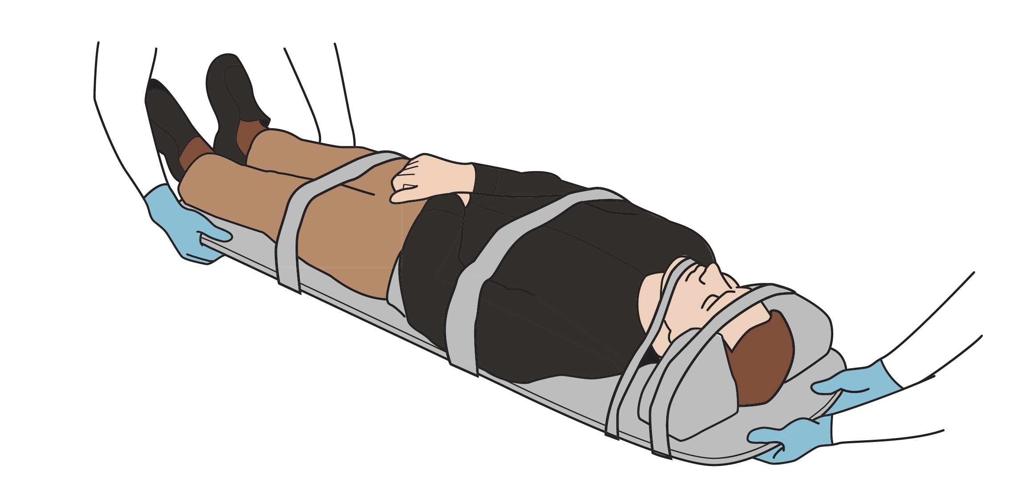
Transferring Patients
BEC is a course for providers working in the field, on ambulances and in health care facilities.
  Patients will require transfer from scene to first facility or between facilities.
Steps in transferring patients:
  Destination planning
  Transport
  Handover
Notes:
The Basic Emergency Care course is developed for use in the field, in ambulances and in health care facilities. Many of you will be transferring patients to a higher-level facility for additional care or resources, and this is why we must spend time on how to properly and safely transfer patients. There are three key steps to transferring the patient. The first is destination planning – or deciding where the most appropriate place is for a patient— second is the actual/physical transport itself, and third is the handover to the new team who will take over patient care.

Slide 4
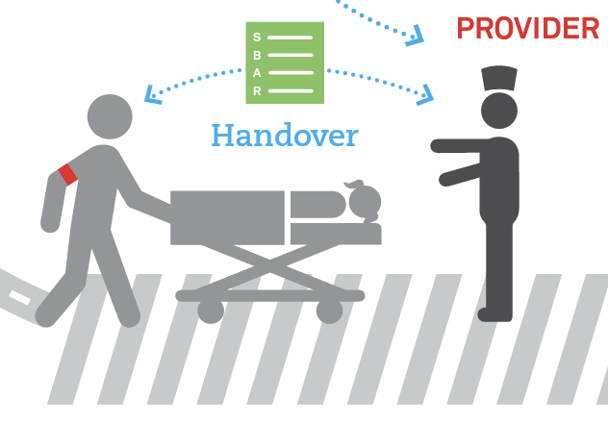
Destination Planning
Patient need to be transported from the field but also between health facilities.
Patients are also transferred within a facility (e.g., pregnant women from emergency unit to obstetrics).
Notes:
When planning your destination, it is important to be sure that you are going to the correct and most appropriate place. If you are a field provider, this may be the nearest healthcare facility that can provide emergency care. If you are a facility-based provider, this may be another facility with specialty care or resources such as cardiac care, obstetric care, or neurosurgical care. The destination could also be a different level of general care within the same facility. Examples might include: transferring a patient to an ICU within the same hospital, a pregnant woman who needs to go from the emergency unit to the obstetrics unit, or a critical patient in the emergency department who needs to go to the operating theatre.
It is our job to make sure that that transfer – even if it's short or within the same facility— happens safely.

Slide 5
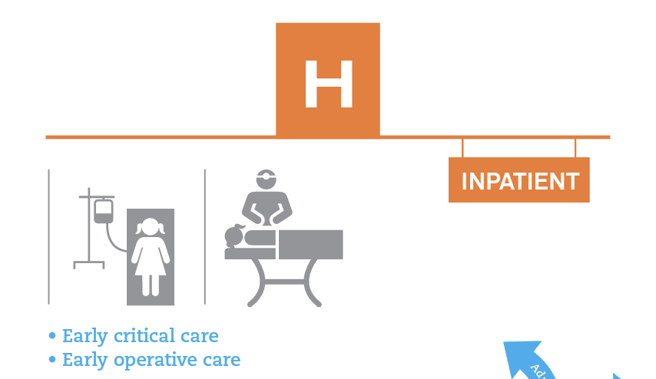
Destination Planning
Ensure level of services at destination facility match needs of patient (there is an operating theatre if surgery is needed).
Ensure expected resources are available (operating theatre is running, blood for transfusion).
Ensure destination can be reached in the necessary time-frame given patient’s condition.
Notes:
When considering destination planning, always make sure that the level of services at the destination facility match the needs of the patient. For example, if the patient needs a surgical procedure, make sure that there is an operating theatre at the destination, and make sure that a surgeon and the surgical team are available. Transferring a patient takes a lot of time and effort and unnecessary transfers, when a resource is not available, is unsafe and will delay proper patient care. You also need to make sure that necessary resources are available at the transfer destination; if your patient will need a blood transfusion, make sure that that the destination facility has blood available. Finally, consider the distance and time required for the transfer. If this is a very unstable patient, do you think that they will survive the transfer? Should they go to a closer facility who can stabilize them further? Once you have picked the destination, you should call to make sure that they are able to accept the patient.

Slide 6
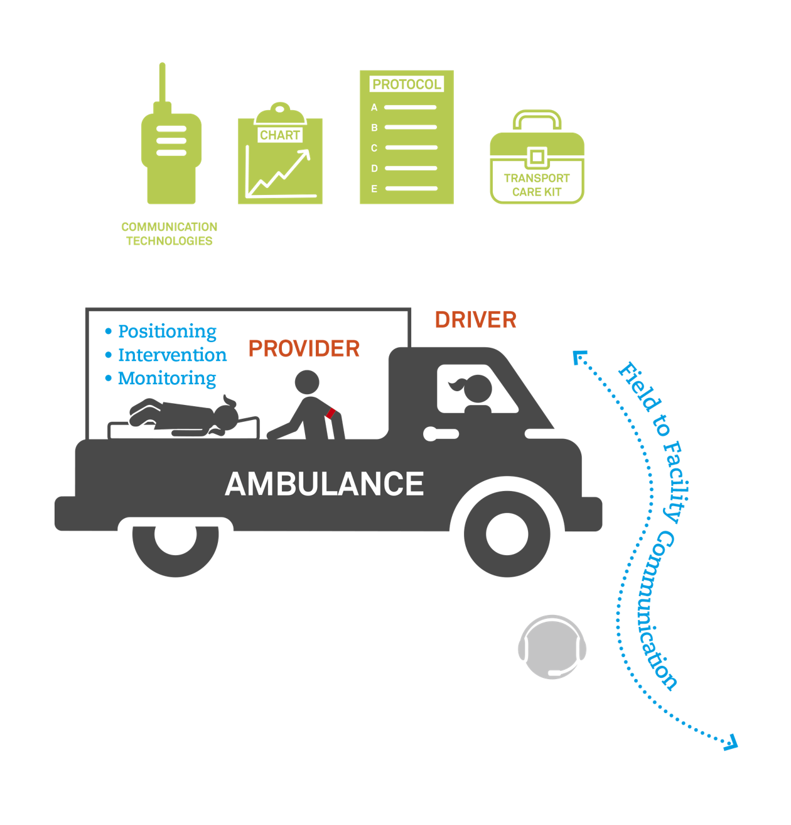
Transport
Goal of transport
  Transporting patient
  Caring for patient during transfer
Both goals CANNOT be done by one person
  Provider with patient at all times during transport providing continual monitoring
  Another person transports patient
Anticipate patient’s needs during transport (IV fluids, medications).
Ensure family and patient are aware of transfer.
Notes:
Now you need to initiate the actual transportation. The goals of transportation are: (1) physically transporting the patient from point A to point B, and (2) caring for the patient during the transfer period. It is important to recognize that these two goals cannot be achieved by the same person. The person driving or transporting has to focus on safely driving the vehicle, they cannot be responsible for monitoring the patient. A second person needs to be at the patient’s side at all times to monitor and provide care. You should anticipate the patient's needs during transportation. A patient might need additional IV fluids, or specific medications that may need to be re-dosed. A patient might have complicated needs such as cardiac monitoring or BVM, they might require re-positioning and suctioning, or they might just need occasional vital sign checks. It is easy to care for the patient during transfer as long as you are there at the bedside; problems occur when the provider is not in the back of the ambulance or when someone is not specifically tasked to monitor and care for the patient.
If possible, make sure there is also communication with the receiving facility during transfer. It is important to let them know you are coming, when you might arrive, and if there's any updates or changes in the patient during transfer. It is also important to chart or document changes and interventions during transfer, so that it becomes part of the patient’s medical record.
There might also be protocols for the providers during transfer. Sometimes this might be specific to the patient and the sending facility. You might tell them what to expect, possible complications the patient might suffer, and what to do to. For example, if your patient needed a three-sided dressing for a sucking chest wound, it is important to explain to the transferring providers how to check for blood clotting and dressing failure, and how to remove/replace the dressing. Also, make sure that the ambulance has the appropriate equipment to care for your patient during transfer.
Always make sure the patient consents to be transferred, is aware that they are being transferred, why they are being transferred, and where they are being transferred to. If the patient is incapacitated, it is your responsibility to discuss the transfer with the patient’s family. Make sure they are aware of the transfer, consent to the transfer, and know where the patient is going.

Slide 7
Handover
Formal handover should be given anytime care is transferred to a new provider
  Between providers within a facility
  To or from transport providers
  Remotely from a sending facility to receiving facility
Verbal and written report for each patient
Notes:
Once you arrive at the receiving facility, the patient needs to be formally handed over to the accepting team. Any time care is transferred from one team to another team, or from one provider to another provider, a formal handover needs to occur. This can occur when; patients are transferred between facilities, between levels of care or settings within the same facility, when patients are admitted, or when you are finishing your shift. The slide lists examples of handovers that occur during patient transfer from one facility to another. Handover should occur remotely from the sending provider to the accepting facility, so both teams know what resources are needed and what to expect, and handover also occurs to and from the transporting providers.
The care of a patient with a life-threatening injury or illness is a continuum that begins at the incident and ends at definitive care. As you can imagine, transfer of care might occur many times throughout a patient’s journey. Because it is a high-risk time for error and miscommunication, there should be a policy in place for a standardized method of handover that always occurs. Formalized handover needs to occur at each transfer of care. There should be a verbal and a written report for every patient.
When accepting a patient at the receiving facility, facilities should have a designated reception area so that they can take handover. This may involve triage screening and registration of the patient. Providers and other clerical staff should be trained in how to accept handover and deliver handover. Care must be taken to ensure that hard copies of all records, patient charts, treatments given, lab and imaging results are transferred over with the patient. In cases when imaging was performed, ideally a soft copy of the imaging data should be transferred with the patient so that the receiving facility can review those images.

Slide 8

Handover: What is SBAR?
SBAR is a structured method for communicating critical information between providers
SBAR improves communication between providers and safety of patients
SBAR has 4 steps
  Situation
  Background
  Assessment
  Recommendation
Notes:
There are many different ways to handover a patient. Every facility or system should have an agreed-upon, standardized method that all providers use. For the Basic Emergency Care course, we recommend using the SBAR method. SBAR is a structured method for communicating critical information between providers. It has been shown to improve communication between teams and improve the safety of patients. SBAR has four steps: Situation, Background, Assessment, and Recommendation.

Slide 9
Why Use SBAR?
Reduce the barrier to effective communication across different disciplines and levels of staff.
SBAR creates a shared mental model around all patient handovers and situations and critical exchange of information.
SBAR is a memory prompt; easy to remember and encourages prior preparation for communication.
SBAR reduces the incidence of missed communications.
Notes:
We recommend using SBAR because it is simple and easy to remember, it allows effective communication across different disciplines, levels of training, and levels of staff. SBAR creates a shared mental model around all patient handovers, patient situations, and critical exchange of information. SBAR is a memory prompt that encourages prior preparation for communication to the next team. This prior preparation, planning, and thought. Information is then presented in a precise way that reduces the incidence of miscommunication and medical errors

Slide 10
How Can SBAR Help Me?
Easy to remember
Clarifies what information needs communicating quickly
Points to action
Notes:
SBAR can help you care for your patients and transfer patients to the next team. It's easy to remember, it clarifies what information needs to be clearly and quickly communicated to the next team, and it points to critical actions.

Slide 11
S - Situation
Identify yourself
Identify the patient by name, sex, age
Chief complaint (patient’s initial description of problem)
Goal
To describe the specific situation including the patient's name, patient location (and severe vital sign abnormality).
Notes:
The S in SBAR stands for situation. Begin by identifying yourself, your role and your level of training. Identify the patient by their name, sex, and their age. Then state the patient’s chief complaint - which is why the patient presented- and their initial description of their problem.
The goal of “S” is to describe the immediate specific situation— including the patient's name, location, and abnormal vital signs. This provides context to the receiving provider and prepares them to understand more about the patient.

Slide 12
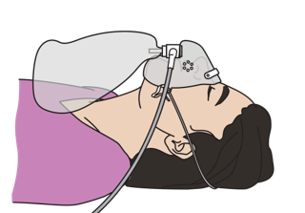
B-Background
Give the patient's reason for transfer.
Explain significant medical history.
  Two to four most important and relevant aspects of the case (elements from history, physical exam, testing results)
Include any important ABCDE findings/interventions.
Include vital signs.
Notes:
The B in SBAR stands for Background. Give the patient’s reason for transfer and explain significant and pertinent medical history. This should only be aspects that are specifically relevant to the immediate situation today. You should not list all the patient’s medical history. Next, list two-to-four of the most important and relevant aspects of this case. These generally will be elements from the history, physical exam, and pertinent testing results. Last, you must include any important findings from your ABCDE survey, and any interventions that were performed. A full set of vitals should be included in this step. The goal is to be brief and concise, yet still communicate key features of the patient’s illness or injury and the care they received thus far. Focus on the most important and useful information for the receiving provider.

Slide 13
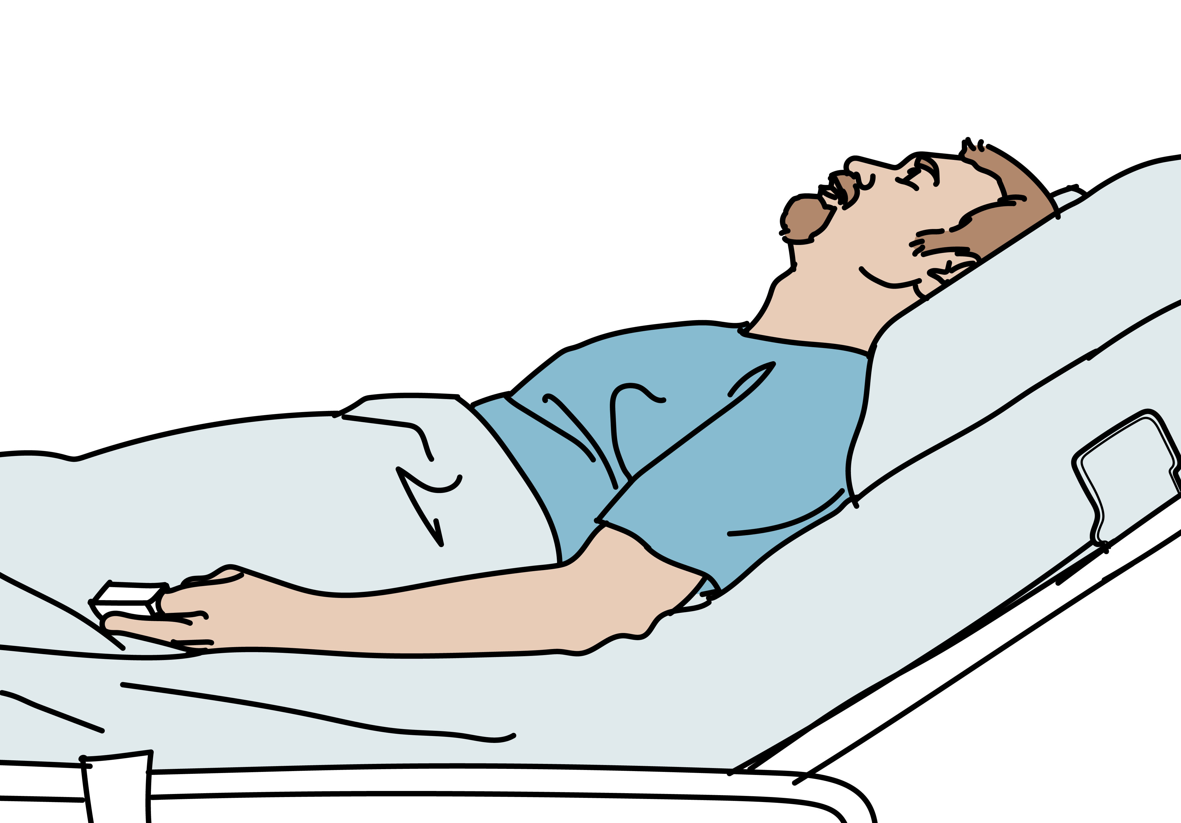
A-Assessment
What do you think is wrong with the patient?
Reason for transfer
Includes:
  Clinical impressions, concerns
Notes:
After Situation and Background, the A in SBAR stands for Assessment. You should state what you think is wrong with the patient, and discuss the reason why they are being transferred. Specifically include any clinical impressions or a quick differential diagnosis, and also discuss concerns that you have about the patient moving forward. You might also include the need for reassessment of specific interventions that you have performed.

Slide 14

R-Recommendations
Specific things the new provider should prepare for:
  Next steps in treatment plan
  Potential worsening of the patient’s condition (e.g., need for close airway observation)
  Caution regarding previous therapies (e.g., last adrenaline dose, 3-way dressing monitoring)
Notes:
The last portion of SBAR is Recommendations. Here you list the specific things that the new provider should prepare for. After explaining your clinical impression, you should discuss the treatments and interventions already initiated, as well as the next steps in the treatment plan. Specifically list concerns for potential worsening of the patient's condition. For example, the patient might need close airway observation, or if the patient had low blood pressure initially, the next team might need to monitor vital signs frequently and give another fluid bolus if the blood pressure falls again. Finally, you want to specifically draw attention to previous therapies that might need monitoring or additional interventions. Examples would include: time the last dose of adrenaline or naloxone was given, the placement of a three-way dressing that needs to be monitored for clotting or failure, or hemorrhage control that might need to be re-assessed for any continued bleeding.

Slide 15
Cases

Slide 16
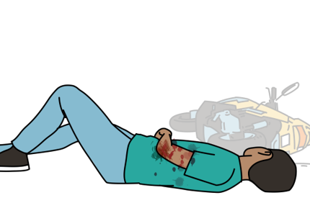
Case 1
A 22 year-old man was riding a motorcycle when he crashed into another vehicle at high speed. He was thrown from his motorcycle and was not wearing a helmet.
His airway is open; he has normal breath sounds on both sides of his chest; his pulses are strong and around 90 beats per minute; he is only responsive to pain and has a femur fracture with bone visible in an open wound; there are abrasions on his forehead.
You have immobilized his spine, started an IV and splinted the fracture. You and your colleague have transported him from the scene of injury and are handing him over to a hospital provider.
Notes:
Let’s practice. In our first case, we have a 22-year-old man who was riding a motorcycle when he crashed into another vehicle at high speed. He was thrown from his motorcycle and was not wearing a helmet. His airway is open; he has normal breath sounds on both sides of his chest; his pulses are strong and around 90 beats per minute; he is only responsive to pain and has a femur fracture with bone visible in an open wound; there are abrasions on his forehead. You have immobilized his spine, started an IV and splinted the fracture. You and your colleague have transported him from the scene of injury and are handing him over to a hospital provider.

Slide 17
Case 1
A 22 year-old man was riding a motorcycle when he crashed into another vehicle at high speed. He was thrown from his motorcycle and was not wearing a helmet.
His airway is open; he has normal breath sounds on both sides of his chest; his pulses are strong and around 90 beats per minute; he is only responsive to pain and has a femur fracture with bone visible in an open wound; there are abrasions on his forehead.
You have immobilized his spine, started an IV and splinted the fracture. You and your colleague have transported him from the scene of injury and are handing him over to a hospital provider.
Notes:
Consider the key components of a SBAR handover that you would provide to the new team as you hand over this patient’s care. Remember to report the Situation, provide Background information, describe your Assessment, and provide Recommendations. This slide highlights some of the key features of this case.

Slide 18
Practice SBAR
Describe the Situation
Provide Background
What is your Assessment
Provide Recommendation
Notes:
Please take a moment and consider the key components of a SBAR handover that you would provide to the new team as you hand over this patient’s care. Remember to report the Situation, provide Background information, describe your Assessment, and provide Recommendations. Before moving onto the next slide, take a few moments and write down an SBAR that you would provide to the new team as you hand over this patient’s care.

Slide 19
Example SBAR
'This is a 22-year-old man who was in a motorcycle crash, was not wearing a helmet and was thrown from his motorcycle; he is only responsive to pain and has an open femur fracture but is currently protecting his airway and has no evidence of shock.
We are concerned for his altered mental status, and open femur fracture, but are unable to tell if he has a spinal injury. He needs transfer for surgical management and further neurological assessment. Spinal immobilization should be maintained, and he should be monitored for worsening bleeding and mental status changes.'
Notes:
The key components of an SBAR handover might include the following: This is a 22-year-old man who suffered a motorcycle crash while traveling at a high speed. He was not wearing a helmet and was thrown from his motorcycle. He is only responsive to pain, has signs of trauma to his head, and has an open femur fracture. He is currently protecting his airway, has no difficulty in breathing, and has no evidence of shock. We have immobilized his spine, started and IV, and splinted his fracture. We are concerned about increased intracranial pressure because of his altered mental status, we are unable to tell if he has a spinal injury, and we are concerned about complications from his open femur fracture. We are transferring him for surgical management and further neurologic assessment. Spinal immobilization should be maintained, his airway and mental status should be monitored closely, and he should be monitored for worsening bleeding or signs of shock. This SBAR example summarizes the patient’s situation, provides a concise background, and then provides an assessment of the patient. This is followed by recommendations which might include an explanation of the need for transfer, interventions that were performed, concerns about the patient, and recommendations for specific ongoing monitoring.

Slide 20
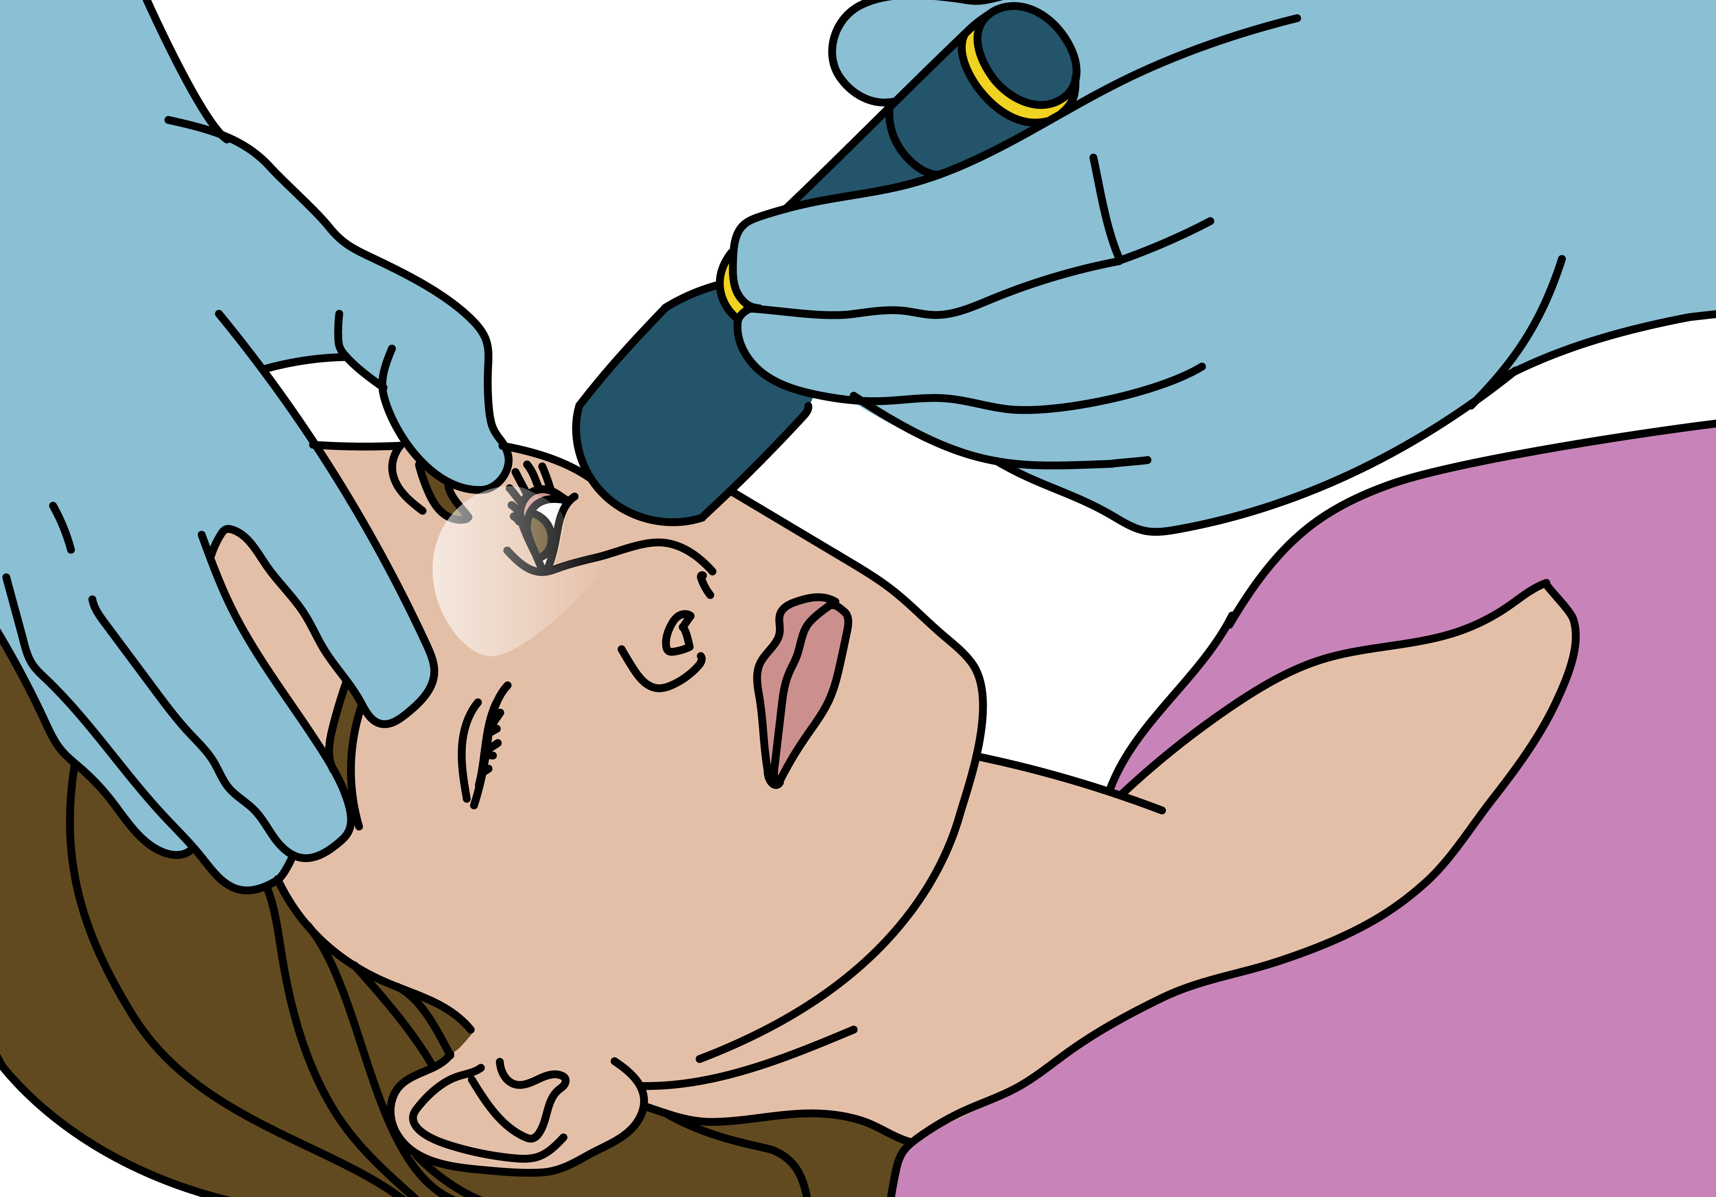
Case 2
A 14-year-old girl had a seizure/convulsion at school. She was brought to you by her teachers because she did not stop seizing.
You administered a benzodiazepine, which caused the seizures to stop. After, you were able to perform the ABCDE survey and then a complete
head-to-toe exam.
She does not have a fever; she has a normal heart rate, blood pressure, and respiratory rate. She responds to voice. Her tongue is bitten and she urinated on herself; she has no other injuries or rashes.
Notes:
Let's practice another case. A 14-year-old girl had a seizure/convulsion at school. She was brought to you by her teachers because she did not stop seizing.
You administered a benzodiazepine, which caused the seizures to stop. After, you were able to perform the ABCDE survey and then a complete
head-to-toe exam. She does not have a fever; she has a normal heart rate, blood pressure, and respiratory rate. She responds to voice. Her tongue is bitten and she urinated on herself; she has no other injuries or rashes.

Slide 21
Case 2
A 14-year-old girl had a seizure/convulsion at school. She was brought to you by her teachers because she did not stop seizing.
You administered a benzodiazepine, which caused the seizures to stop. After, you were able to perform the ABCDE survey and then a complete
head-to-toe exam.
She does not have a fever; she has a normal heart rate, blood pressure, and respiratory rate. She responds to voice. Her tongue is bitten and she urinated on herself; she has no other injuries or rashes
Notes:
Consider the key components of a SBAR handover that you would provide to the new team as you hand over this patient’s care. Remember to report the Situation, provide Background information, describe your Assessment, and provide Recommendations. This slide highlights some of the key features of this case.

Slide 22
Practice SBAR
Describe the Situation
Provide Background
What is your Assessment
Provide Recommendation
Notes:
Please take a moment and consider the key components of a SBAR handover that you would provide to the new team as you hand over this patient’s care. Remember to report the Situation, provide Background information, describe your Assessment, and provide Recommendations. Before moving onto the next slide, take a few moments and write down an SBAR that you would provide to the new team as you hand over this patient’s care.

Slide 23
Example SBAR
'This is a 14-year-old girl who had a prolonged convulsion and was convulsing on arrival; her seizures were stopped with one 10 mg dose of diazepam and now she remains sleepy, has normal vital signs and no fever. She is being transferred for further evaluation of her seizure. Monitor the airway as she has received sedating medications (diazepam).'
Notes:
The key components of an SBAR handover might include the following: This is a 14-year-old girl who had a prolonged convulsion and was convulsing on arrival; her seizures were stopped with one 10 mg dose of diazepam and now she remains sleepy, has normal vital signs and no fever. She is being transferred for further evaluation of her seizure. Monitor the airway as she has received sedating medications (diazepam).

Slide 24

Case 3
A 75-year-old man had chest pain while walking home from the market. He was brought to you by taxi. He says that the chest pain started 30 minutes ago and felt like a lot of pressure in the centre of his chest. He has no allergies. He takes a blood pressure medication but cannot recall the medication’s name. He had a heart attack 2 years ago that felt very much like the pain he was having today. His last meal was 6 hours ago. The pain started while he was walking home carrying several heavy bags, though he now has no pain. His vital signs, ABCDE survey, and head-to-toe examination are normal. You have given aspirin and started an IV line and will now handover to the senior healthcare worker.
Notes:
Let's practice another case. A 75-year-old man had chest pain while walking home from the market. He was brought to you by taxi. He says that the chest pain started 30 minutes ago and felt like a lot of pressure in the centre of his chest. He has no allergies. He takes a blood pressure medication but cannot recall the medication’s name. He had a heart attack 2 years ago that felt very much like the pain he was having today. His last meal was 6 hours ago. The pain started while he was walking home carrying several heavy bags, though he now has no pain. His vital signs, ABCDE survey, and head-to-toe examination are normal. You have given aspirin and started an IV line and will now handover to the senior healthcare worker.

Slide 25
Case 3
A 75-year-old man had chest pain while walking home from the market. He was brought to you by taxi. He says that the chest pain started 30 minutes ago and felt like a lot of pressure in the centre of his chest. He has no allergies. He takes a blood pressure medication, but cannot recall the medication’s name. He had a heart attack 2 years ago that felt very much like the pain he was having today. His last meal was 6 hours ago. The pain started while he was walking home carrying several heavy bags, though he now has no pain. His vital signs, ABCDE survey, and head-to-toe examination are normal. You have given aspirin and started an IV line and will now handover to the senior healthcare worker.
Notes:
Consider the key components of a SBAR handover that you would provide to the new team as you hand over this patient’s care. Remember to report the Situation, provide Background information, describe your Assessment, and provide Recommendations. This slide highlights some of the key features of this case.

Slide 26
Practice SBAR
Describe the Situation
Provide Background
What is your Assessment
Provide Recommendation
Notes:
Please take a moment and consider the key components of a SBAR handover that you would provide to the new team as you hand over this patient’s care. Remember to report the Situation, provide Background information, describe your Assessment, and provide Recommendations. Before moving onto the next slide, take a few moments and write down an SBAR that you would provide to the new team as you hand over this patient’s care.

Slide 27
Example SBAR
'This is a 75-year-old man with a history of a heart attack who has had chest pain similar to his prior heart attack. The pain started while he was walking and lasted for more than 30 minutes, but is now gone. He has received aspirin and has an IV line. I am concerned he might have problems with his heart. He should be monitored for change in ABCDE or return of the chest pain.'
Notes:
The key components of an SBAR handover might include the following: This is a 75-year-old man with a history of a heart attack who has had chest pain similar to his prior heart attack. The pain started while he was walking and lasted for more than 30 minutes, but is now gone. He has received aspirin and has an IV line. I am concerned he might have problems with his heart. He should be monitored for change in ABCDE or return of the chest pain.

Slide 28

Questions
Notes:
Do you have any questions on transfer or handoer?

Slide 29
Conclusion
Transferring patients is an important and vital part of your job.
Destination planning is important to ensure adequate resources at the destination site.
Transport should have a minimum of 2 people ensuring 1 person is always with the patient providing continual monitoring.
Handover is a crucial part in providing appropriate care to the patient therefore use the SBAR method.
Notes:
Transferring patients is an important and vital part of your job as an emergency care provider. Appropriate destination planning is important to ensure adequate resources are available at the destination. Ideally, you should be able to contact the destination site and accepting team for a discussion. There needs to be a minimum of two people for patient transport; one person driving and another person who is always with the patient providing continual monitoring and potential intervention. A well-organized and concise handover is crucial to providing appropriate care to the patient. Handovers should be done in a standardized way using the SBAR method, which is Situation, Background, Assessment, and Recommendations.

