Slide 1
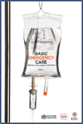

Shock
Basic Emergency Care Course
Notes:
Welcome to the Shock module.

Slide 2
Objectives
By the end of this presentation, you will be able to:
Recognize signs of shock and poor perfusion
Apply a SAMPLE history to a patient with shock
Describe how to perform a secondary exam for a patient with shock
Assess fluid status
Select appropriate fluid administration based on patient’s age, weight and condition
Recognize malnourishment, anaemia and burns and adjust fluid resuscitation accordingly
List the high-risk causes of shock
Describe critical actions to manage patients with shock
Describe special paediatric considerations for shock
Consider the disposition and transport of patients with shock
Notes:
By the end of this presentation you will be able to recognize signs of shock and poor perfusion, apply a SAMPLE history to a patient with shock and describe how to perform a secondary exam for a patient with shock. We will cover how to assess fluid status, how to select appropriate fluids based on the patient’s age, weight and condition, and recognize malnourishment, anaemia and burns and adjust fluid resuscitation accordingly. We will cover the high-risk causes of shock, critical actions to manage patients with shock and special paediatric considerations. Finally we will consider the disposition and transport of patients with shock

Slide 3





Essential skills
Intravenous (IV) line placement
IV fluid resuscitation
Direct pressure/ deep wound packing for haemorrhage control
Tourniquet for haemorrhage control
Pelvic binding
Fracture immobilization
Skin pinch test
Uterine massage
Assessing ABCDE
Secondary survey
Overall
Cervical spine immobilization
Head-tilt and chin-lift/jaw thrust
Airway suctioning
Management of choking
Recovery position
Nasopharyngeal (NPA) and oropharyngeal airway (OPA) placement
Full spine immobilization
AVPU and Glasgow Coma Scale assessment
Glucose administration
Oxygen administration
Bag-valve-mask ventilation
Needle-decompression for tension pneumothorax
Three-sided dressing for chest wound
Wound and burn management
Snake bite management
Log roll
Notes:
The essential skills for this module are listed here. Each skill will be introduced in the lectures, and taught during the practical sessions of this course.

Slide 4
What is shock?
Poor perfusion
  The body is not able to get enough oxygen-carrying blood to vital organs.
SHOCK = Uncorrected poor perfusion
  The organs stop working properly when there is a lack of oxygen to cells and tissue.
Infants, children and older adults are more likely to be severely affected by shock.
!
Shock can rapidly lead to death
Notes:
First, let's define shock. What is shock? Shock is presented by poor perfusion and occurs when the body is not able to get enough oxygen-carrying blood to vital organs. If uncorrected, poor perfusion can lead organs to stop working, given the lack of oxygen to cells and tissue. Infants, children, and older adults are more likely to be severely affected by shock. Shock can rapidly lead to death

Slide 5
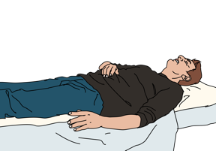
Causes of poor perfusion
Loss of blood
  Haemorrhage
Loss of fluid
  Diarrhoea
  Vomiting
  Extensive burns
  Excessive urination
  Poor fluid intake
Abnormal relaxation and enlargement of blood vessels
  Severe infection
  Spinal cord injury
  Severe allergic reaction
Poor filling of the heart
Failure of the heart to pump effectively
  Cardiogenic shock
Notes:
There are several causes of poor perfusion and shock. These causes include: blood loss or haemorrhage, fluid losses (including diarrhea, vomiting, extensive burns, and excessive urination such as in a patient with diabetic ketoacidosis or DKA). The next category is poor or decreased fluid intake. Abnormal relaxation and enlargement of the blood vessels or increased dilation of the blood vessels can also occur in the following three circumstances—severe infections, such as sepsis, spinal cord injuries, and severe allergic reactions. These types of reasons are also referred to as distributive shock. Cardiac causes, or cardiogenic shock, includes poor filling of the heart and failure of the heart to pump effectively.

Slide 6
Goals
The goal of initial assessment is to identify shock and any reversible causes of shock.
The goal of acute management is to restore perfusion (oxygen delivery to the organs) and address ongoing fluid loss where possible.
Notes:
The goal of the initial assessment is to identify shock and potential reversible causes. After recognizing shock, the goal of acute management is to restore perfusion (oxygen delivery to the organs) and address ongoing fluid or blood loss where possible.

Slide 7
The ABCDE Approach
!
REMEMBER …………
Always start with the ABCDE Approach AND treat life-threatening conditions.
Then, take a SAMPLE history.
Then, do a Secondary Exam.
Notes:
The initial assessment of shock is similar to approach to all emergency care patients. Remember to always start with the ABCDE approach, treat life-threatening conditions. Afterward, take a SAMPLE history, and then perform a secondary exam.

Slide 8


Key Elements in the ABCDE Approach
Airway
  Check for face or mouth swelling (allergic reaction).
    Severe allergic reaction can cause shock.
Breathing
  Wheezing can indicate allergic reaction.
    Severe allergic reaction can cause shock.
  Shock and absent breath sounds on one side (tension pneumothorax).
  DIB or increased respirations can be caused by poor perfusion
  Heart failure can cause poor perfusion and DIB
  Severe infections associated with lung inflammation can cause DIB.
Notes:
Recall that the key elements in the ABCDE approach include the following. First assess the airway. Begin by checking the face or mouth for swelling which can indicate anaphylaxis or an allergic reaction. Severe allergic reactions can cause shock. Second, assess breathing. Wheezing, for example, can be an early indication of a severe allergic reaction. Again, this is a cause of shock. Absent breath sounds on one side of the chest with shock often can occur from a tension pneumothorax. Difficulty in breathing and increased respirations (or tachypnoea) can also be caused by both poor perfusion, heart failure, or be related to severe lung infections (such as pneumonia) and lung inflammation.

Slide 9



Key Elements in the ABCDE Approach
Circulation
Check for bleeding.
    From the stomach and intestines
    After childbirth
    Injuries to chest, abdomen, pelvis, long bones, bleeding wounds
Check for fluid loss from vomiting, diarrhoea, extensive burns, excess urination.
Disability
Check for confusion.
  Confusion in a person with poor perfusion suggests severe shock.
Paralysis may indicate a spinal cord injury causing shock.
Exposure
Check for signs of bleeding, trauma, moist, cool skin.
Look for rash or hives suggesting allergic reaction or infection.
Keep the patient warm.
Notes:
Next check the circulation. Shock can be caused by many types of bleeding; for example from the stomach or intestines, or after childbirth. Both internal and external haemorrhage can occur from traumatic injuries to chest, abdomen, pelvis or long bones. Bleeding wounds can cause shock. Shock can also result from fluid loss associated with diarrhoea, vomiting, extensive burns, or excess urination (such as caused by high blood sugar).
Next check disability. Confusion in a person with poor perfusion may be suggestive of severe shock, while paralysis or motor weakness may indicate a spinal cord injury causing shock.
Lastly, in the ABCDE algorithm is exposure. Remember to expose the patient and examine for signs, protecting their dignity and protecting them from hyper or hypothermia. Assess for signs of bleeding, trauma, and for skin changes, including dry or excessively moist skin, and rashes that may be suggestive of an allergic reaction. Once all elements of the ABCDE approach are assessed and all life-threatening conditions managed, take a SAMPLE history.

Slide 10
Shock
Part 1:The SAMPLE history
Notes:
In the first part of this module we will look at the SAMPLE history for patients with shock.

Slide 11
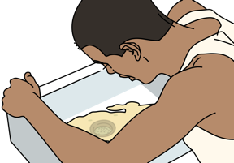
S: Signs and Symptoms
ASK
  Is there vomiting and/or diarrhoea?
  For how long?
THINK
    Fluid losses from vomiting and diarrhoea can be severe and lead to shock.
    Knowing the amount can help you estimate how much fluid the patient will need.
Notes:
The SAMPLE history consists of 6 components. The S in Sample stands for signs and symptoms. Recall that one of the primary reasons individuals may have shock is from fluid losses. Ask about the presence and duration of vomiting and diarrhoea. Fluid losses from vomiting and diarrhoea can be severe, leading to shock. Being able to accurately assess fluid losses can help you estimate how much fluid the patient will need.

Slide 12
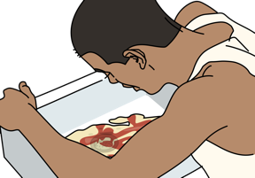
S: Signs and Symptoms
ASK
  If the person has blood in their vomit or stool
THINK
  Bleeding in the stomach and/or intestines can be severe before it is visible.
  A person can lose a significant portion of their blood volume in the intestines.
  Digested blood appears black in the vomit or stool.
Notes:
Ask has the patient had blood in their vomit or stool. This should make you think about bleeding in the stomach or intestines that can be quite severe before it is visible. A person can lose a significant portion of their blood volume into their gastrointestinal (GI) tract. Digested blood appears black in the vomit or stool, and is sometimes referred to as “coffee ground emesis” or melena.

Slide 13
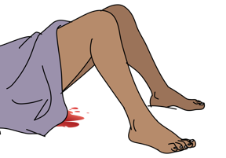
S: Signs and Symptoms
ASK
  If there has been any vaginal bleeding
  Is the patient pregnant or has she been pregnant?
  When was the last menstrual period?
  Any missed periods?
THINK
  Vaginal bleeding may be related to pregnancy.
  A woman may not know she is pregnant in early pregnancy.
  All women are at risk for an ectopic pregnancy (pregnancy outside the uterus).
    Ectopic pregnancy rupture can happen before a woman knows she is pregnant.
  Vaginal bleeding could also be caused from a mass in the cervix or uterus.
Notes:
Has the patient had vaginal bleeding? Is the patient pregnant, were they recently pregnant or is there the possibility that they might be pregnant (even if they don’t think so)? Assess their last menstrual period and any missed periods. Vaginal bleeding may be related to pregnancy, and a woman may not know she is pregnant in early pregnancy. All women are at risk for an ectopic pregnancy (a pregnancy outside the uterus). Ectopic pregnancy rupture can happen before a woman knows she is pregnant. Vaginal bleeding could also be caused from a mass in the cervix or uterus

Slide 14

S: Signs and Symptoms
ASK
  If the person has had chest pain
THINK
  Chest pain may suggest a heart attack.
  Muscle damage to the heart can reduce pumping ability which can cause shock.
Notes:
Ask if the patient has had chest pain and think if this chest pain could be from a myocardial infarction or heart attack. Significant cardiac muscle damage can reduce the pumping ability causing shock

Slide 15
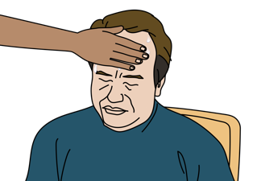
S: Signs and Symptoms
CHECK
  For fever
THINK
  Fever suggests an infection.
  Severe infection causes abnormal relaxation (dilation) and leakiness of the blood vessels which causes fluid loss into the tissues.
  This lowers blood pressure, causing shock.
Notes:
Assess for fever. Fever suggests an infection. Severe infections can cause abnormal relaxation, dilation and leakiness of the blood leading to fluid loss into tissues, so called third spacing. Again, the loss of fluid out of blood vessels leads to decreased blood pressure and shock.

Slide 16
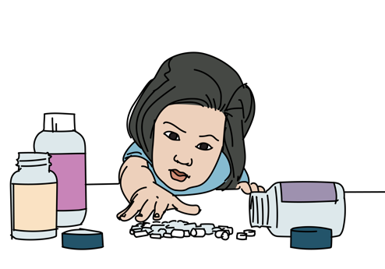
S: Signs and Symptoms
ASK
  Was there any exposure to toxins, medications, insect stings or other substances?
THINK
  Severe allergic reactions can lead to shock.
  Overdose of many medications including blood pressure and seizure medications can cause shock.
Notes:
Ask about exposures to toxins, medications, insects, or other substances that may be harmful. Allergens can lead to anaphylaxis, while medication overdoses including blood pressure and anti-epileptic (anti-seizure) medications lower the blood pressure acutely and can cause shock.

Slide 17
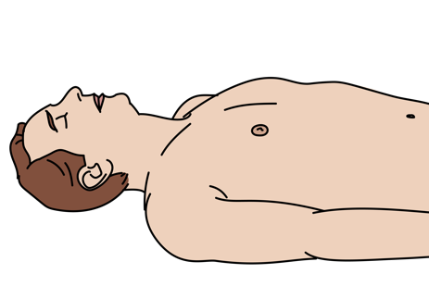
S: Signs and Symptoms
ASK
  Is there altered mental status?
  Is there unusual sleepiness?
THINK
  The brain is one of the last organs to be affected by poor perfusion.
  If the brain does not have enough blood flow and oxygen to function, this is a sign of severe shock.
Notes:
Lastly, is there altered mental status or is the patient unusually sleepy? The brain is usually able to compensate for changes in perfusion and as such is one of the last organs to be affected by poor perfusion. If the brain lacks adequate blood flow and oxygen this can cause confusion, a sign of shock.

Slide 18
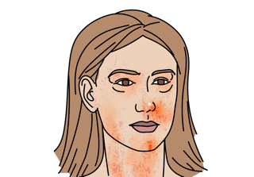
A: Allergies
ASK
  Are there any allergies to medications?
THINK
  Severe allergic reactions can lead to shock by causing abnormal relaxation of the blood vessels.
Notes:
The A in the sample history stands for allergies. Ask if there are any allergies to medications. Severe allergic reactions can lead to anaphylactic shock by causing dilatation or abnormal relaxation of the blood vessels.

Slide 19
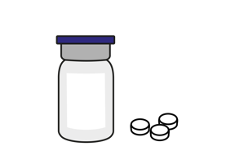
M: Medications
ASK
  Currently taking any medications?
  Any new medications or recent dose changes?
THINK
  Overdose of some blood pressure or seizure/convulsion medications can cause shock.
  Medications that thin the blood can worsen bleeding.
  New medications or changes to medications can cause allergic reaction or unexpected side effects.
Notes:
M stands for medications. Is the patient taking any medication, newly started any medications, or have there been recent dose changes. Overdoses and even small changes in long term medications can lead to shock. Overdose of some blood pressure or seizure/convulsion medications can cause shock. Medication that thins the blood, anticoagulants, can worsen bleeding in patients. New medications or changes to medication recently can cause allergic reactions or have unexpected side effects causing shock.

Slide 20
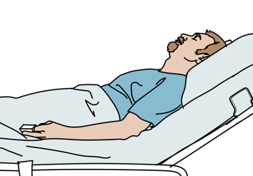
P: Past Medical History
ASK
  History of pregnancy or recent delivery?
  History of recent surgery?
  History of heart disease (heart attack or heart valve problem)?
  History of HIV?
  THINK
  Shock can be from postpartum hemorrhage or ruptured ectopic pregnancy.
  Internal bleeding or infection after surgery can cause shock.
  Patients with heart disease are at risk of worsening heart function.
  HIV can increase the risk of infection .
Notes:
The P in the sample history stands for past medical history. Does the patient have a history of pregnancy, or have they recently delivered? Have they had surgery recently. Do they have a cardiac history suggestive of a prior heart attack or valvular problem? Do they have HIV? Each of these historical elements should make you think about different kinds of shock. Shock can be from postpartum hemorrhage or ruptured ectopic pregnancy. Internal bleeding or infection after surgery can cause shock. Patients with heart disease are at risk of worsening heart function leading to shock. Untreated HIV can increase the risk of infection leading to septic shock

Slide 21
L: Last Oral Intake
ASK
  When did the patient last eat or drink?
THINK
  A person who is not eating or drinking well can develop severe dehydration.
Notes:
L stands for last oral intake. Ask the patient when they last ate or drink. This is helpful for a few reasons. A patient who is not eating or drinking well could develop severe dehydration leading to shock. If the patient is going to require an intervention such as surgery that requires sedation, it is important to understand when they ate or drank anything for anaesthesia purposes

Slide 22
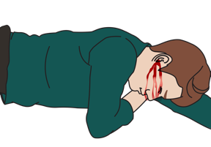
E: Events Surrounding Illness
ASK
  Was there any recent trauma?
THINK
  Trauma can cause
    Hidden internal bleeding
    Tension pneumothorax
    Bruising or bleeding around the heart.
  Trauma to the neck or back can cause spinal cord injury
    Leading to problems with blood vessels’ ability to maintain blood pressure.
Notes:
Finally, the last part of the sample history is E—the events surrounding the illness. Ask if there was any recent trauma. Trauma can lead to hidden internal bleeding, cause a tension pneumothorax, or cause bruising or bleeding around the heart leading to a pericardial effusion and potential pericardial tamponade. Trauma to the back of the neck or back may cause a spinal cord injury leading to problems with blood vessels’ ability to maintain blood pressure.
Image:
Title: Brain activity – Métacognition
Creator:benoitpetit
Source: https://openclipart.org/detail/193152/brain-activity-metacognition
Copyright information: Creative Commonz Zero 1.0 Public Domain License

Slide 23
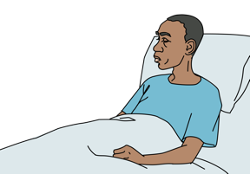
E: Events Surrounding Illness
ASK
  Has there been any recent illness?
THINK
  Any infection can cause a blood infection that leads to shock.
Notes:
Additionally in regard to E. Have there been any recent illnesses, especially any infections, leading up to their presentation? A local infection has the potential to infect the blood leading to bacteremia, sepsis and shock.

Slide 24
Workbook Question 1
Using the workbook section above, list the six questions about signs and symptoms you would ask when taking a SAMPLE history
1.
2.
3.
4.
5.
6.
Notes:
Workbook Question 1: Shock [page 101 in participant workbook]
Using the workbook section above, list six questions about signs and symptoms you would ask when taking a SAMPLE history.
Answers: 1. Has there been any vomiting and/or diarrhea? For how long? 2. Has there been fever? 3. Has there been altered mental status or unusual sleepiness? 4. Was there any exposure to toxins, medications, insect stings, or other substances? 5. Is there possible trauma? 6. Has the person had blood in his/her stool or vomit? 7. Has the patient had any vaginal bleeding (if female)
Image
Title: Deep thought
Creator:GDL
Source: https://openclipart.org/detail/221707/deep-thought
Copyright information: Creative Commonz Zero 1.0 Public Domain License

Slide 25
Shock
Part 2: Secondary Exam Findings and Possible Causes
Notes:
In the second part of the Shock module we will look at secondary examination findings and their possible causes. We will start with the secondary examination findings.

Slide 26
REMEMBER
!
Shock happens when there is poor perfusion.
This can happen before the blood pressure falls !
Low blood pressure with poor perfusion is a very bad sign.
The initial ABCDE approach identifies and manages life-threatening conditions.
The secondary exam looks for changes in the patient’s condition or less obvious causes that might have been missed on the initial survey.
Notes:
The secondary exam looks for changes in the patient’s condition or less obvious causes that might have been missed on the initial survey. Some of these may be very early signs of shock. Always remember that shock happens when there is poor perfusion. This can happen before the blood pressure falls. This is especially true in the young. Low blood pressure with associated poor perfusion is a very bad sign. The initial ABDE approach manages life-threatening conditions.

Slide 27
Look, listen and feel
Remember: You should have ALREADY completed the ABCDE Exam and treated life-threatening conditions BEFORE doing this extensive examination.
If the secondary exam identifies an ABCDE condition, STOP AND RETURN IMMEDIATELY TO ABCDE to manage it.
Remember: Children have different normal vital sign ranges. Their vital signs may remain normal until they are very ill.
!
Notes:
The secondary exam looks for changes in the patient’s condition or less obvious causes that may have been missed during ABCDE. If the secondary examination identifies an ABCDE condition, STOP AND RETURN IMMEDIATELY TO ABCDE to manage it.
REMEMBER: Children have different normal vital signs ranges, and children with shock may not have changes in vital signs until they are very ill. Always do a careful exam for any signs of shock.

Slide 28
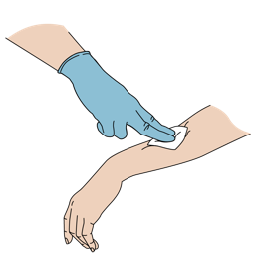
Secondary Exam Findings
CHECK breath sounds and respiratory rate.
  Abnormal or noisy breathing can indicate pneumonia.
  High sugar levels can cause chemical imbalances that the body tries to address by faster or deeper breathing.
  Note sweet or fruity smelling breath, elevated blood glucose, increased urination.
LOOK for bleeding.
  All external bleeding should be controlled with DIRECT PRESSURE.
  Arterial bleeding is high pressure.
    Person can lose significant blood volume in minutes.
    Put gloved finger on the site and hold pressure until the bleeding stops.
  Consider vaginal bleeding as a significant source of blood loss.
Notes:
Now we will go through common secondary examination signs in shock. Check for airway swelling or difficulty in breathing. Abnormal or noisy breathing can indicate pneumonia as a source for system-wide infection causing shock. High sugar levels can result in chemical imbalances (diabetic ketoacidosis) that the body tries to address by faster or deeper breathing. This condition may also result in sweet or ‘fruity’ smelling breath. Since elevated blood glucose levels cause increased urination, severe dehydration and shock can also result.
Look for bleeding. All external bleeding should be controlled with direct pressure. Arterial bleeding may appear as pulsing or high-pressure bleeding, and significant blood volume can be lost in minutes. Vaginal bleeding may be an important source of blood loss from pregnancy-related bleeding or from masses in the cervix or uterus.

Slide 29
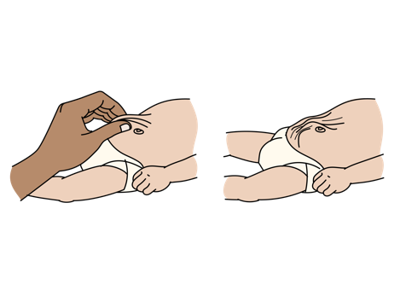
Secondary Exam Findings
CHECK fluid status.
  In dehydrated states, the patient may feel thirsty, may have dry lips and mouth, abnormal skin pinch, lethargy and delayed capillary refill.
  Patients with heart failure can be in shock with fluid overload.
    Patient may have difficulty breathing, lower body swelling (usually legs), crackles heard in the lungs and distended neck veins.
Notes:
Check for fluid status. In dehydrated states, patients may feel thirsty, may have dry lips and mouth, abnormal skin pinch, lethargy and delayed capillary refill. Patients with heart failure can be in shock with fluid overload, and may have difficulty breathing, lower body swelling (usually in both legs), crackles on lung examination, and distended neck veins.

Slide 30
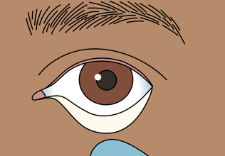
Secondary Exam Findings
CHECK conjunctiva (inside of lower eyelid).
  Everyone should have pink, most skin on the inside of the eyelid.
  Pale or white conjunctiva can indicate blood loss.
Notes:
Check the conjunctivae by looking at the inside of the lower eyelid. Normally the inside of the lower eyelid should be pink and moist, while pale, gray, or white can indicate significant blood loss or anemia.

Slide 31
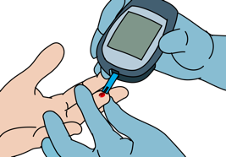
Secondary Exam Findings
CHECK mental status.
  Confusion in a patient with poor perfusion suggests severe shock.
CHECK for fever.
  Fever in a patient with shock suggests severe infection.
CHECK blood sugar.
  Low blood sugar can sometimes look like shock (without low blood pressure).
  Give GLUCOSE if less than 3.5 mmol/L.
  If you cannot check a blood glucose and the person has altered mental status, a history of diabetes or another reason to be hypoglycemic (malaria, taking quinine, is very ill or malnourished), give GLUCOSE.
Notes:
Check mental status. Confusion in a patient with poor perfusion suggests severe shock. Check for fever. Fever in a patient with shock suggests severe infection. Check blood sugar. A low blood glucose can look like shock. Give glucose if the measured glucose is less than 3.5 mmol/L. If you cannot check a blood glucose and the person has altered mental status, a history of diabetes or another reason to be hypoglycemic (malaria, taking quinine, is very ill or malnourished), give glucose. After giving glucose remember to reassess the patient’s status.

Slide 32
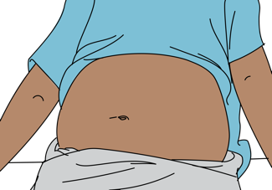
Secondary Exam Findings
CHECK: for severe abdominal pain
FEEL: for a very firm abdomen
  Pain can be a sign of bleeding or infection in the abdomen.
  In a patient that may be pregnant, this can be a sign of ectopic pregnancy.
Notes:
Next, check for severe abdominal pain and tenderness and feel for a firm abdomen. So called peritonitis can be an indication of hemorrhage in the abdominal cavity. If the patient is pregnant this can be a sign of an ectopic pregnancy.

Slide 33
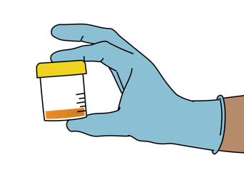
Secondary Exam Findings
CHECK urine colour and volume.
  Small amounts of darker urine may suggest dehydration.
CHECK stool.
  Significant diarrhoea can cause dehydration.
  A large amount of watery “rice water” stool suggests cholera which can lead to dehydration.
  Black, dark or reddish stool can suggest stomach or intestinal bleeding.
Notes:
Check the urine color and volume. Small amounts of darker urine may suggest dehydration. Changes in stool are also important. Diarrhoea is a common cause of dehydration. Large amounts of watery or rice water stool can suggest cholera which can lead to severe dehydration and also will require infectious disease containment procedures. Black, dark, or reddish stool can suggest stomach or intestinal bleeding this can also be referred to as melaena.

Slide 34
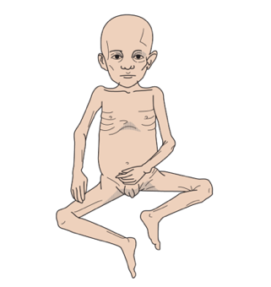
Secondary Exam Findings
CHECK for malnourishment.
  A malnourished patient requires a specialized rehydration plan.
  Be sure to ask about recent weight changes.
CHECK skin for swelling and rash.
  Swelling of mouth or body and rashes can indicate an allergic reaction.
  Other rashes can indicate systemic infection.
  Swelling of both legs (oedema) can indicate heart failure.
  Sweating may occur with moderate to severe shock.
Notes:
Check for signs of malnourishment. Malnourished patients require specialized rehydration. Overhydration or aggressive fluid resuscitation in a person with malnourishment can cause severe electrolyte abnormalities or place them into heart failure from rapid fluid overload. Be sure to always ask the patient about recent weight changes as this may be a sign of malnourishment. Check the skin for swelling and for rashes. Swelling of mouth or body and rashes can indicate an allergic reaction or anaphylaxis. Other rashes can indicate systemic infection. Swelling or oedema in the legs may indicate heart failure. Sweating or diaphoresis may occur with moderate to severe shock

Slide 35
Workbook Question 2
Using the workbook section above, list what you need to CHECK in a person with shock
1.
2.
3.
4.
5.
6.
7.
8.
9.
10.
11.
12.
Notes:
Workbook Question 2: Shock [page 103 in participant workbook]
Using the workbook section above, list what you need to check for in a person with shock.
Answers:
1. Check for airway swelling or in difficulty breathing 2. Check breathing 3. Check for severe bleeding 4. Check fluid status 5. Check mental status 6. Check for diaphoresis 7. Check for pale conjunctiva 8. Check for fever 9. Check blood sugar 10. Check for severe abdominal pain or a very firm abdomen 11. Check urine 12. Check stool 13. Check for malnourishment 14. Check skin for swelling and rash
Image
Title: Deep thought
Creator:GDL
Source: https://openclipart.org/detail/221707/deep-thought
Copyright information: Creative Commonz Zero 1.0 Public Domain License

Slide 36
Shock
Part 2: Secondary Exam Findings and Possible Causes
Notes:
Now we will look at possible causes for shock.

Slide 37
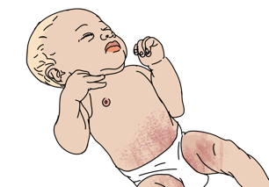
Poor Perfusion Due to Dilated Blood Vessels
Severe infection
  Fever
  Tachycardia
  Tachypnoea
  May have hypotension
  May have signs of infection
    Visible infection in the skin
    Cough and crackles in one area of the lungs (may have fast breathing)
    Burning with urination or urine that is cloudy or foul-smelling
    Any focal point pain in association with fever
Notes:
The first cause that we are going to cover is poor perfusion due to dilated blood vessels. This can happen for a variety of reasons. The first is a severe infection, often referred to as sepsis. Signs include fever, tachycardia, tachypnoea, and hypotension. Additional signs of infection could include visible infection on the skin, such as a rash or redness. Cough or crackles in an area of the lungs could indicate a pulmonary infection as might fast breathing or cough. Burning with urination or urine that is cloudy or foul smelling can indicate a urine infection as the source of the infection. Check for any focal point of pain in association with fever.

Slide 38
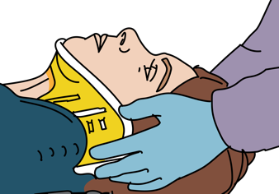
Poor Perfusion Due to Dilated Blood Vessels
Spinal cord injury
  History or signs of trauma
  Spinal pain/tenderness, vertebrae not in line
  Crepitus when you touch the spinal bones
  Movement problems including paralysis, weakness, abnormal reflexes
  Sensation problems
  Unable to control urine and stool
  Priapism (persistent, abnormal erection of the penis)
  May have hypotension or bradycardia
  Difficulty in breathing (in upper c-spine injury)
Notes:
Another cause of poor perfusion due to dilated blood vessels is spinal cord injury. Consider the history and look for signs of trauma. On examination, assess for pain or tenderness over the spine. Are the vertebrae in alignment? Do you feel crepitus when examining the spinal bones? Do you notice weakness, paralysis or abnormal reflexes? Are there sensation problems, inability to control urine and stool, priapism (or the persistent, abnormal erection of the penis), hypotension, bradycardia or difficulty in breathing? These signs may indicate a high cervical spine injury.

Slide 39

Poor Perfusion Due to Dilated Blood Vessels
Severe allergic reaction
  Swelling of the mouth
  Difficulty in breathing with stridor and/or wheezing
  Skin rash
  Tachycardia
  Hypotension
Notes:
The next cause of poor perfusion due to dilated blood vessels is severe allergic reaction. Signs of a severe allergic reaction may include: swelling of the mouth, difficulty in breathing with stridor and/or wheezing, skin rash, tachycardia, hypotension.

Slide 40

Poor Perfusion Due to Fluid Loss
Diabetic ketoacidosis (DKA)
  History of diabetes
  Rapid or deep and slow breathing
  Frequent urination
  Sweet smelling breath
  High glucose in blood or urine
  Dehydration
Notes:
The next category of poor perfusion is fluid loss. One cause of this is DKA or diabetic ketoacidosis. Signs of DKA may include a history of diabetes, although when a young person presents they may not know they have diabetes. The patient may have rapid or deep and slow breathing. Frequent urination, sweet smelling breath, high glucose in blood or urine, and dehydration from fluid shifts and losses are also common.

Slide 41
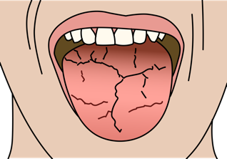
Poor Perfusion Due to Fluid Loss
Severe dehydration
  Abnormal skin pinch
  Decreased ability to drink fluids
  Increased fluid loss
    Vomiting
    Diarrhoea
    Excessive urination
  Dry mucous membranes
  Tachycardia
Notes:
Another cause of poor perfusion due to fluid loss is severe dehydration. Signs of severe dehydration may include abnormal skin pinch or tenting, decreased ability to drink fluids, increased fluid loss from vomiting and diarrhoea, excessive urination, dry mucous membranes, and tachycardia.

Slide 42
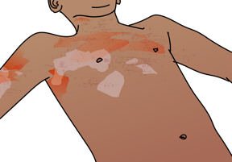
Poor Perfusion Due to Fluid Loss
Burn injury
  Red, white or black areas depending on the depth
  May have blistering
  Consider inhalation injury
  Burn injuries can cause excessive fluid losses through the damaged tissues and patients can become severely dehydrated.
Notes:
Burns cause poor perfusion due to fluid losses. Burns may appear as red, white, or black depending on the depth. There may be associated blistering. In any burn history also consider inhalation injury and the possibility of difficulty in breathing. Burn injuries can cause significant fluid losses through the damaged tissues and patients can become severely dehydrated in a very short time period.

Slide 43
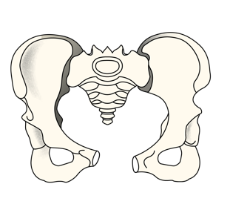
Poor Perfusion Due to Blood Loss
External bleeding
  History of injury
  Active bleeding
  Use of blood thinning medication
Large bone fractures
  History of injury
  Pain or instability of the pelvis, blood at the opening of penis or rectum (pelvic fracture)
  Deformity or crepitus of femur, shortening of the leg with injury (femur fracture)
Notes:
Poor perfusion can be due to blood loss. Bleeding can be from external wounds from an injury and can be made worse by significant active (or arterial bleeding), and the patient’s use of blood thinning medication. Large or long bone fractures from injury are also a significant cause of shock from bleeding. Assess for pain or instability of the pelvis and blood at the opening of penis or rectum (pelvic fracture). Femur fractures can lead to significant bleeding as well. In femur fractures assess for a deformity or crepitus of the femur, shortening of the leg or rotation.

Slide 44

Poor Perfusion Due to Blood Loss
Abdominal bleeding
  Bruising around the umbilicus or over the flanks (internal bleeding)
  Abdominal pain
  Very firm abdomen
Bleeding in the stomach or intestines
  Blood in vomit or stool
  Black vomit or stool
  History of alcohol use
Notes:
Abdominal bleeding is noted by bruising around the umbilicus or over the flanks. Internal bleeding is another significant cause of poor perfusion from blood loss. Assess also for abdominal pain, tenderness, and or a firm abdomen. Bleeding in the stomach or intestines can cause blood in the vomit or stool, or black vomit or stool. Check for a history of underlying alcohol use.

Slide 45
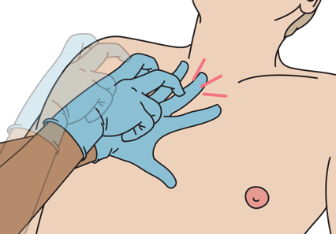
Poor Perfusion Due to Blood Loss
Haemothorax
  Difficulty in breathing
  Decreased breath sounds on the affected side
  Dull sounds with percussion on affected side
  Shock (if large amount of blood loss)
Notes:
Another type of bleeding that can occur internally is a haemothorax. Signs of haemothorax are: difficulty in breathing, decreased breath sounds on the affected side, dull sounds with percussion on affected side of the lung or chest. If a large amount of blood loss occurs into the chest, the patient can develop shock.

Slide 46
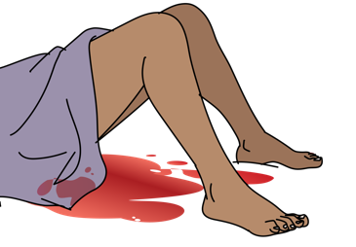
Poor Perfusion Due to Blood Loss
Ectopic pregnancy
  History of pregnancy, missed menstrual cycle, woman of child-bearing age
  Abdominal pain
  Vaginal bleeding
Post-partum haemorrhage
  Recent delivery
  Heavy vaginal bleeding
    Pad or cloth soaked <5 minutes
    Constant trickling blood
    Bleeding >250ml or delivered outside of the hospital
  Soft uterus/lower abdomen
Notes:
Significant blood loss can also occur in pregnancy. Two specific causes include ruptured ectopic pregnancies and postpartum haemorrhage. In ectopic pregnancy patients may present with significant abdominal pain and vaginal bleeding. Assess for a history of pregnancy, missed menstrual cycle in woman of child-bearing age. Post-partum haemorrhage is defined by a recent delivery, heavy vaginal bleeding, a pad or cloth soaked in less than 5 minutes, a near constant trickling blood, bleeding greater than 250 ml or delivered outside of the hospital. Assess for a soft uterus in the lower abdomen

Slide 47
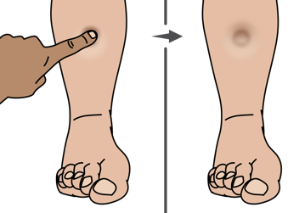
Poor Perfusion Due to Heart Problems
Heart failure
  Difficulty breathing with exertion or lying flat
  Swelling to both legs
  Distended neck veins
  Crackles may be heard in the lungs
  May have chest pain
Notes:
The last category is poor perfusion due to heart problems. Heart failure is defined by a damaged, inflamed, or stretched heart muscle that cannot pump effectively. Assess for heart failure by looking for difficulty in breathing with exertion or when lying flat, swelling to both legs, distended neck veins, crackles on lung exam, or chest pain.

Slide 48
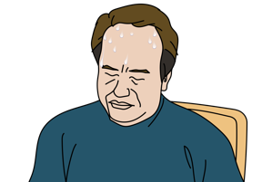
Poor Perfusion Due to Heart Problems
Heart attack
  Chest pressure, tightness or crushing in the chest
  Diaphoresis and mottled skin
  Difficulty in breathing
  Nausea or vomiting
  Pain moving to jaw or arms
  Signs of heart failure
  History of smoking, cardiac disease, hypertension, diabetes, high cholesterol, family history of heart problems
Notes:
A heart attack or myocardial infraction may also lead to poor perfusion. Patients with a myocardial infarction may present with chest pressure, tightness, or pain, have diaphoresis and mottled skin, difficulty in breathing, nausea or vomiting, pain radiating to the jaw or arms, or additional signs of heart failure. Significant factors may put individuals at risk of a heart attack, and these include a history of smoking, cardiac disease, hypertension, diabetes, high cholesterol, and a family history of heart problems.

Slide 49
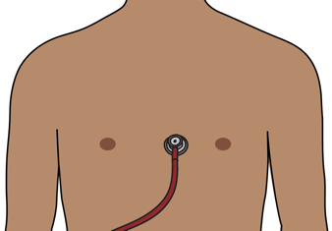
Poor Perfusion Due to Heart Problems
Abnormal rhythm
  Very fast or very slow pulse
  Irregular pulse
Heart valve problem
  Valve disease can damage the heart muscle
  or limit blood flow
  History of rheumatic fever or heart disease
  Murmur
Notes:
Abnormal rhythms or arrhythmias, such as a very fast or very slow pulse, or an irregular pulse, can cause shock as a result of decreased cardiac output. Heart valve problems can damage the heart muscle or limit blood flow through or out of the heart. This may be the result of rheumatic fever or heart disease. A murmur may be found on examination.

Slide 50
Poor Perfusion Due to Heart Problems
Pericardial tamponade
  Signs of poor perfusion
    Tachycardia, tachypnea, hypotension
    Pale skin, cold extremities
    Capillary refill greater than 3 seconds
  Distended neck veins
  Muffled heart sounds
  May have dizziness, confusion, altered mental status
  History of tuberculosis, trauma, malignancy or kidney failure
Notes:
Another severe cause of shock due to heart problems is pericardial tamponade. Pericardial tamponade occurs when the pericardial sac surrounding the heart fills with fluid/blood, leading to compression of the heart and decreased cardiac output. Signs of pericardial tamponade include tachycardia, tachypnoea, hypotension, pale skin, cold extremities and capillary refill greater than three seconds. Additional signs may include distended neck veins and muffled heart sounds. Patients may have dizziness, confusion, altered mental status, and report a history of tuberculosis, trauma, malignancy, or kidney failure.

Slide 51
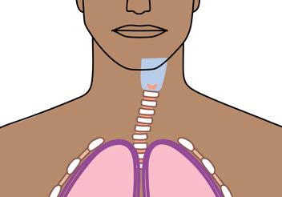
Poor Perfusion Due to Heart Problems
Tension pneumothorax
  High pressure shifts the large blood vessels in the chest, blocking blood flow and preventing filling of the heart
  Hypotension WITH the following:
    Difficulty breathing
    Absent breath sounds on affected side
    Hyperresonance with percussion on affected side
    Distended neck veins
    May have tracheal shift away from affected side
Notes:
Patients who have suffered chest wall trauma are at risk of tension pneumothorax. This occurs when a lung collapses causing high pressure in the chest cavity, leading to shifts of the large blood vessels in the chest, blocking blood flow and preventing filling of the heart.
A tension pneumothorax is defined by hypotension with the following: difficulty breathing, absent breath sounds on affected side, hyperresonance with percussion on affected side, distended neck veins and possibly tracheal shift away from affected side,

Slide 52
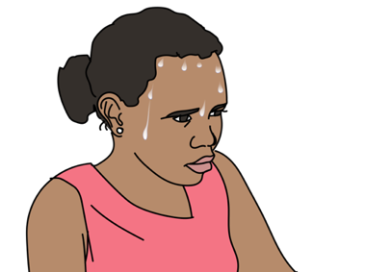
REMEMBER…Hypoglycaemia can look like shock
Hypoglycaemia
  Sweating (diaphoresis)
  Seizures/convulsions
  Low blood glucose (<3.5mmol/L)
  Altered mental status
  History of diabetes, malaria or severe infection
  In children, can occur in any severe illness
Notes:
Hypoglycaemia can also present like shock. Remember to check a blood sugar in patients in shock. Look for signs of hypoglycemia including diaphoresis, seizures or convulsions, and altered mental status. Ask about a history of diabetes, malaria, or severe infection, as certain medications can cause low blood sugar. Severe infection in children can also lead to hypoglycaemia.

Slide 53
Workbook Question 3
Using the workbook section, list the possible causes of shock next to the history and physical findings below
History and physical findings | Likely cause
35-year-old woman presents with shock, fever, burning with urination and cloudy urine
20-year-old woman presents with shock, abdominal pain, missed menstrual cycle and vaginal bleeding
A 17-year-old man presents after a motor vehicle crash with shock, bruising to the pelvis and femur fracture
Notes:
Workbook Question 3: Shock [page 107 in participant workbook]
Using the workbook section above, list the possible cause of shock next to the history and physical findings below.
A 35-year-old woman presents with shock, fever, and burning with urination, cloudy urine Answer: Severe infection
A 20-year-old woman presents with shock, abdominal pain and missed menstrual cycle, vaginal bleeding Answer: Ectopic pregnancy
A 17-year-old man presents after a motor vehicle crash with shock, bruising to the pelvis and a femur fracture Answer: Blood loss from injury
Image
Title: Deep thought
Creator:GDL
Source: https://openclipart.org/detail/221707/deep-thought
Copyright information: Creative Commonz Zero 1.0 Public Domain License

Slide 54
Shock
Part 3: Management of shock, special considerations and disposition
Notes:
In the third part of this module we will cover the management of shock, special patient considerations and patient disposition. We will start with the management of shock.

Slide 55
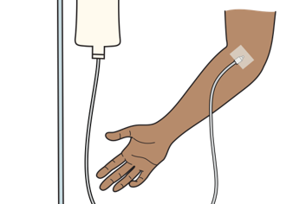
Management
For all causes of poor perfusion, establish an IV AND give IV FLUIDS
  Use Normal Saline or Ringer’s Lactate for all adult patients and children with normal nutritional status.
Then work to treat underlying causes
If you cannot place an IV consider, NASOGASTRIC tube or intraosseous line.
  If patient can safely tolerate, attempt oral fluids.
REMEMBER treat ABCDE problems and life-threatening conditions first!
Notes:
The first step in management for all causes of poor perfusion is to establish an IV line and give IV fluids. Fluids include normal saline or Ringer’s Lactate for all adult patients and children with normal nutritional status. After fluid resuscitation, work to treat the underlying causes of shock. If you cannot place an IV, consider a nasogastric tube or intraosseous line. If the patient can safely tolerate, you can attempt to provide oral rehydration fluids. Remember to treat ABCDE problems and life-threatening conditions first.

Slide 56
! CAUTION !
For severely malnourished or anaemic children, or anyone with signs of volume overload, this protocol will need to be modified.
Notes:
Here is a clinical pathway for the provision of fluids in shock for patients without malnutrition, fluid overload or severe anaemia. Patients with those conditions need to have a modification to this pathway. Start at the top left box: “is IV fluid immediately available?”. If yes move down and give IV fluids, followed by a reassessment after 30 minutes. If successful and perfusion improved, you may be able to hydrate with oral fluids from then. If perfusion did not improve, re-bolus and consider transfer of the patient to a higher level of care.
If fluids are not immediately available, but are available at a nearby facility, transfer emergently. If IV fluids are not available nearby consider ORS or NG tube fluids, reassess for perfusion improvement. Transfer those that have not improved or switch to oral maintenance fluids in those that have clinical signs of improvement.

Slide 57

Management: Postpartum haemorrhage
If vaginal bleeding after delivery (postpartum haemorrhage)
  →All patients need rapid HANDOVER/TRANSFER to an advanced obstetric provider.
  →While awaiting transport, attempt to stop the bleeding.
  →Give OXYTOCIN both IM and IV for a loading dose.
    Continue OXYTOCIN IV INFUSION until one hour after bleeding stops.
Notes:
Additional management of specific conditions will be covered next. Significant vaginal bleeding after delivery, called post-partum haemorrhage is an important cause of shock and maternal death. These patients require rapid handover and transfer to an advanced obstetric provider. While awaiting transport, attempt to stop the bleeding. The first step is to give oxytocin both intramuscularly and intravenously. Continue the oxytocin IV infusion for one hour after the bleeding stops.

Slide 58
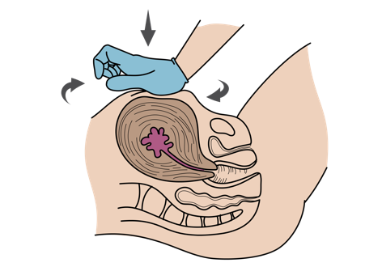
Management: Postpartum haemorrhage
Bleeding frequently happens if the uterus is not fully contracted
(does not feel hard on palpation).
  Perform UTERINE MASSAGE until the uterus is hard.
  Continue OXYTOCIN.
  If the placenta delivers, collect in a leak-proof container
  and send with patient to an advanced obstetric provider.
  LOOK for a perineal or vaginal tear. If found APPLY DIRECT PRESSURE.
  Even if the bleeding stops,
  prepare for rapid HANDOVER/TRANSFER.
Notes:
Vaginal bleeding frequently happens if the uterus is not fully contracted. You can assess uterine atony by palpating the lower abdomen and pelvis. If soft, perform uterine massage until the uterus is hard. Continue the oxytocin. If the placenta delivers, collect in a leak-proof container and send with patient to an advanced obstetric provider. On exam, look for a perineal or vaginal tear and if found apply direct pressure locally. In all cases, even if the bleeding stops, prepare for rapid transfer or handover to the appropriate specialist.
The image depicts the appropriate maneouvre for uterine massage. Apply direct pressure with the base of the palm and massage the uterus moving down and back and forth until you feel the palpable area becoming firm.

Slide 59
Notes:
This diagram summarises the steps in managing postpartum haemorrhage. The first step is to arrange transfer to an obstetric centre. The second step is to attempt to control bleeding with uterine massage until the uterus is hard, with oxytocin IM and then by IV, with resuscitative IV fluids, and empty the bladder with a urinary catheter. Third, assess as to whether the placenta has been delivered. Once the uterus is hard after massage the placenta should deliver. Collect the placenta to send with the patient. Assess also for a perineal or vaginal tear and if found, apply direct pressure. If the patient is still bleeding insert a second IV line, continue the oxytocin and IV fluids, and lastly transfer the patient as soon as possible

Slide 60

Management
If fluid loss is from burns
  → Burns disrupt the skin barrier and can cause significant fluid loss.
  → Calculate fluid replacement needs using Parkland Formula.
If suspected hyperglycaemia
  → If concern for diabetic ketoacidosis (DKA), treat with IV FLUIDS.
  → A person with DKA is extremely ill, plan for rapid HANDOVER/TRANSFER.
Notes:
Burn management is also critical. Burns disrupt the skin barrier and can cause significant fluid loss. Calculate fluid replacement needs using the Parkland Formula, which can be found in the workbook. If you suspect hyperglycemia and diabetic ketoacidosis, treat with IV fluids and plan for rapid transfer as these patients can be critically ill.

Slide 61

Management
If fever and shock
  → Give IV FLUIDS and start ANTIBIOTICS.
  → If infectious diarrhoea (like cholera) is suspected:
    Use gloves, aprons and relevant ISOLATION PRECAUTIONS.
    Always report suspected cases to local public health agency.
  → If signs of poor perfusion do not improve, prepare for rapid HANDOVER/TRANSFER.
Notes:
If the patient has both fever and shock this is concerning for sepsis. Give IV fluids and start antibiotics. If infectious diarrhoea (like cholera) is suspected. Remember to use PPE, including gloves, aprons, and relevant isolation precautions. Report to local agencies any suspicious infections as their presentation may be part of an emerging outbreak. Lastly transfer or handover all patients that have continued poor perfusion that does not improve with initial interventions.

Slide 62
Management
If suspected spinal causes
  → Give IV FLUIDS.
  → Prepare for rapid HANDOVER/TRANSFER for ongoing spinal care.
If suspected internal bleeding, stomach bleeding or intestinal bleeding
  → Give IV FLUIDS.
  → Give BLOOD or HANDOVER/TRANSFER for blood transfusion.
Notes:
In suspected spinal cases, give IV fluids to support spinal perfusion and transfer patients as quickly as possible. In suspected internal bleeding, GI or intestinal bleeding, give IV fluids or blood as appropriate and transfer especially if local capabilities for blood transfusion are not available.

Slide 63
Management
If suspected ectopic pregnancy
  → Give IV FLUIDS.
  → HANDOVER/TRANSFER for blood transfusion and obstetrical care.
If suspected postpartum haemorrhage
  → Give OXYTOCIN
  → Give IV FLUIDS
  → Plan for HANDOVER/TRANSFER to facility with obstetric care
  → Perform UTERINE MASSAGE until uterus is hard
  → COLLECT placenta for inspection by advanced provider
  → Check for perineal and vaginal tears and APPLY DIRECT PRESSURE.
Notes:
If you suspect an ectopic pregnancy, give IV fluids and prepare for handover and transfer for blood transfusion and obstetric care as quickly as possible. As discussed, for postpartum hemorrhage you will give oxytocin and IV fluids and plan for handover and transfer to a facility with obstetric care. Perform uterine massage as described until the uterus is hard, collect and save the placenta for inspection, assess for vaginal or perineal tears and apply direct pressure, and arrange transfer or handover to a specialist.

Slide 64
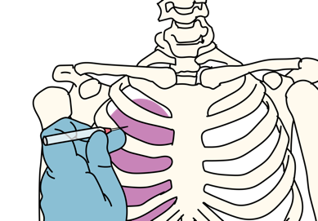
Management
If suspected tension pneumothorax
  → Perform rapid NEEDLE DECOMPRESSION.
  → Give OXYGEN.
  → Give IV FLUIDS.
  → Prepare for rapid HANDOVER/TRANSFER to a centre that can place a chest tube.
If suspected pericardial tamponade
  → Give IV FLUIDS to help fill the heart.
  → Prepare for rapid HANDOVER/TRANSFER to a centre that can drain the pericardial fluid.
Notes:
If you suspect a tension pneumothorax perform a rapid needle decompression. Give the patient oxygen and IV fluids and prepare for rapid transfer and handover to a centre that can place a chest tube. If signs of pericardial tamponade, provide IV fluids aggressively to help fill the heart and counteract the pressure from fluid in the pericardium to help increase the cardiac output. At the same time prepare for rapid handover and transfer to a facility that can manage this condition by draining the pericardial fluid with a procedure called a pericardiocentesis.

Slide 65

Management
If suspected heart attack
  → Give ASPIRIN if indicated.
  → Give IV FLUIDS, reassess frequently.
  → Give OXYGEN initially.
  → Plan for rapid HANDOVER/TRANSFER.
If suspected heart failure
  → Give IV FLUIDS slowly, check lungs for crackles .
  → Stop IV fluids if overload develops.
    DIB, crackles, increased respiratory rate, increased heart rate
  → Plan for rapid HANDOVER/TRANSFER.
Notes:
If you suspect a heart attack, give aspirin, IV fluids if indicated, and oxygen. Prepare for rapid handover and transfer to a facility that can monitor and treat this condition and that can perform an ECG and other tests. If you suspect heart failure, give IV fluids very slowly or avoid them if signs of volume overload. Stop IV fluids if overload develops, this may include difficulty in breathing, crackles on lung exam, tachypnea, tachycardia or worsening oedema. IV fluids may worsen a patient’s condition with heart failure. Lastly plan for rapid handover and transfer of these patients for more complete management

Slide 66
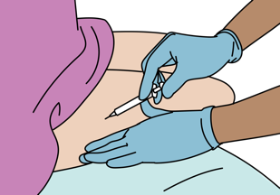
Management
If suspected severe allergic reaction
  → Give intramuscular ADRENALINE.
  → Establish IV ACCESS.
  → MONITOR closely as adrenaline can wear off .
    You may need a second dose
  → If airway is swollen or if there is difficulty in breathing, consider HANDOVER/TRANSFER.
If suspected traumatic injury or blood loss
  → Stop the bleeding.
  → Give IV FLUIDS.
  → Conduct a thorough trauma assessment.
  → Plan for rapid HANDOVER/TRANSFER for blood transfusions or surgical care.
Notes:
If you suspect a severe allergic reaction leading to anaphylaxis, give intramuscular adrenaline as soon as possible. Establish IV access and monitor closely as the adrenaline may wear off before the effects of the allergen and the patient may require a second dose of adrenaline if symptoms persist. If the airway is swollen or there is difficulty in breathing be aware for the possibility of airway compromise. Consider rapid handover and transfer of these patients to a provider who can manage the airway. If suspected traumatic injury stop the bleeding, give IV fluids or blood products, conduct a thorough trauma assessment to find any areas of external bleeding that may have been missed and plan for rapid handover or transfer for blood transfusions or surgical care. Additional management of traumatic injuries in covered in the trauma module of this course.

Slide 67
Workbook Question 4
Using the workbook section above, list what you would do to manage these patients:
A 6-year-old boy is brought in with fever. He is in shock and does not appear malnourished. Your facility has supplies to put in an IV. | 1. 2. 3.
A young man is brought in after a motorcycle crash. He has a large cut to arm that is bleeding and there is a large pool of blood under him. He is in shock when you examine him. | 1. 2. 3.
A 30-year-old is brought in after accidentally eating prawns. She has a known shellfish allergy, her body is covered in a red, itchy rash and she is in shock | 1. 2. 3.
Notes:
Workbook Question 4: Shock [page 111 in participant workbook]
Using the workbook section above, list what you would DO to manage these patients:
A 6-year-old boy is brought in with fever. He is in shock and does not appear malnourished. Your facility has supplies to put in an IV.
Answers: 1) Establish IV access 2) Give IV fluids (20mL/kg) 3) Give antibiotics 4) Transfer to higher level of care
A young man is brought in after a motorcycle crash. He has a large cut to his arm that is bleeding and there is a large pool of blood under him. He is in shock when you examine him.
Answers: 1) Stop the bleeding 2) Give IV fluids 3)Perform a trauma assessment 4) Plan for blood transfusion or transfer
A 30-year-old woman is brought in after accidentally eating prawns. She has a known shellfish allergy, her body is covered in a red, itchy rash and she is in shock.
Answers: 1) Give IM adrenaline 2) Give IV fluids 3)May have to give a second dose of adrenaline
Image
Title: Deep thought
Creator:GDL
Source: https://openclipart.org/detail/221707/deep-thought
Copyright information: Creative Commonz Zero 1.0 Public Domain License

Slide 68
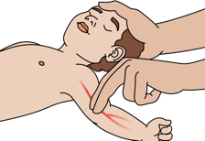
Special Paediatric Considerations: Shock
Shock from dehydration can occur rapidly in children and is life threatening.
  Children have a relatively large surface area from which to lose fluids.
  Infants and young children are particularly at risk and are unable to say when they are thirsty and cannot drink more on their own.
Assessing shock in children:
  Clinical definition based on WHO guidelines: Cold extremities, capillary refill >3 seconds, weak and fast pulse
  Other important signs of poor perfusion include low blood pressure, fast breathing, altered mental status, decreased urination, signs of dehydration.
Notes:
In the last section of this course, we are going to cover special considerations in paediatric patients. Shock can present differently in young children. Shock from dehydration can occur very rapidly in children and is life threatening. Children have a relatively large surface area from which to lose fluids. Infants and young children are particularly at risk and are unable to say when they are thirsty and cannot drink more on their own. When assessing shock in children consider the WHO guidelines for the care of critically ill children. The guidelines use the presence of three clinical features: cold extremities, capillary refill greater than 3 seconds, and a weak and fast pulse. Other important signs of poor perfusion include low blood pressure, fast breathing, altered mental status, decreased urination, and other signs of dehydration.

Slide 69
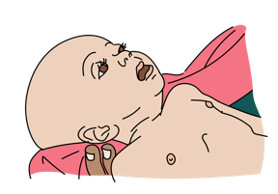

Signs of Dehydration in Children: Danger Signs
!
Very dry mouth and lips
Lethargy (excessive drowsiness, slow to respond, child not interactive)
Sunken eyes
Small amounts of dark urine
Sunken fontanelles in infants under 1 year
Delayed capillary refill (greater than 3 seconds)
Skin pinch is abnormal
Pallor (pale skin)
Notes:
Signs of dehydration in children to be particularly concerned about include. Very dry mouth and lips, lethargy defined by excessive drowsiness, slow to respond, child not interactive, sunken eyes, decreased or darker urine, sunken fontanelles in infants under 1-year, delayed capillary refill (greater than 3 seconds), abnormal skin pinch, and skin pallor.

Slide 70
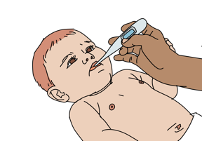
Special Paediatric Considerations: Common causes
Gastroenteritis causes sudden onset of vomiting and diarrhoea with some abdominal pain and fever.
Vomiting without diarrhoea may be suggestive of increased pressure on the brain (trauma or tumor or brain swelling) or intestinal blockage.
  It is important to examine the child for signs of trauma.
  Vomiting associated with fever may suggest infection.
Overwhelming infection
  Fever can make children lose fluids rapidly and become dehydrated quickly.
  Overwhelming infection can make the blood vessels enlarge just as with adults, making the shock much worse.
Notes:
There are several common causes of shock in children. Vomiting and diarrhoea, or gastroenteritis, causes sudden onset of vomiting and diarrhea with associated abdominal pain or cramping, with or without fever. A large amount of watery diarrhoea may suggest cholera and needs to be reported to public health authorities. If the patient has vomiting without diarrhoea this may be suggestive of increased pressure on the brain (trauma or tumour or brain swelling) or intestinal blockage. It is important to examine the child for signs of trauma. Vomiting associated with fever may suggest infection. Lastly, overwhelming infection or sepsis in children can lead to rapid fluid losses, and dehydration. Overwhelming infection can make the blood vessels enlarge just as with adults, making the shock much worse.

Slide 71


Special Paediatric Considerations: Malnutrition
  If shock → give specialized IV FLUIDS if available.
    Malnourished children are at high risk for hypoglycaemia and will need sugar in addition to fluids.
  Give less IV FLUIDS more slowly and reassess often.
    Listen for crackles in the lungs and signs of fluid overload every 5 minutes.
  Stop IV fluids if overload develops.
  Switch to ORAL FLUIDS as soon as signs of poor perfusion improve.
  Prepare for rapid HANDOVER/TRANSFER to an advanced provider.
Notes:
In patients with malnutrition there are some special concerns for management. Malnourished children are at risk for hypoglycemia and need sugar in addition to fluids. Give specialized IV fluids if they are available in your facility and give IV fluids more slowly with continual reassessment of clinical signs or fluid overload. Listen closely for crackles in the lungs or other signs of volume overload, every five minutes. Immediately stop IV fluids if there is concern. If there is clinical improvement of perfusion switch to oral fluids. Prepare for rapid handover and transfer to a provider or facility that is able to fully care for a malnourished patient.

Slide 72
Workbook Question 5
Using the workbook section above, list signs of severe dehydration in children
1.
2.
3.
4.
5.
6.
7.
8.
Notes:
Workbook Question 5: Shock [page 113 in participant workbook]
Using the workbook section above, list signs of severe dehydration in children.
Answers: 1. Very dry mouth and lips 2. Lethargy (extreme drowsiness and slowness to respond), child not interactive 3. Sunken eyes 4. Small amounts of dark urine (ask about number of nappies) 5. Sunken fontanelles in infants under 1 year 6. Delayed capillary refill (normal is less than 3 seconds) 7. Abnormal skin pinch 8. Pallor (pale skin – anemia makes dehydration even more difficult to treat)
Image
Title: Deep thought
Creator:GDL
Source: https://openclipart.org/detail/221707/deep-thought
Copyright information: Creative Commonz Zero 1.0 Public Domain License

Slide 73
Disposition of the Patient
People with shock can worsen or die quickly and must be closely monitored.
Illnesses that cause shock can also cause problems with the body’s ability to manage fluids, monitor closely for DIB.
Shock patients may be confused or anxious; ensure safety in transport.
Patients may need HANDOVER/TRANSFER for blood transfusion, general/obstetric surgery.
  Communicate with receiving facility to ensure these resources are available.
Notes:
The last step in the management of patients with shock is disposition. People with shock can worsen or die quickly and they must be closely monitored. Illnesses that cause shock can also cause problems with the body's ability to manage fluids, leading to difficulty in breathing if the lungs start to take on fluid or become fluid overloaded. Shock patients may be confused or anxious. While this may be a normal sign in shock, it leads to challenges in being able to safely care for these patients. Ensure the patient’s safety especially in transport. Shock patients will require handover and transfer and may need blood transfusions or surgical procedures from a general or obstetric surgeon or ongoing obstetric care. When arranging handover and transfer of patient remember to choose the destination that has the resources to manage the patient. Communicate with the receiving facility to ensure that they are aware and available to accept the patient.

Slide 74

Questions
Notes:
Do you have any questions about shock?

Slide 75
Quick Cards
Notes:
Remember to refer to the BEC Quickcards. These are found in your manual.

Slide 76
Notes:
There are key ABCDE, SAMPLE history and secondary examination findings.

Slide 77
Notes:
Critical actions for high-risk and for specific conditions are listed.

Slide 78
Notes:
There are reminders for special considerations in children.

Slide 79
Notes:
You will find the fluid in shock flowchart and key points on disposition.

Slide 80
Summary
In this presentation, we have covered:
The signs of shock and poor perfusion
The SAMPLE history for a patient with shock
How to perform a secondary exam for a patient with shock
Assessment of fluid status
Appropriate fluid administration based on patient’s age, weight and condition
Recognition of malnourishment, anaemia and burns, and adjust fluid resuscitation accordingly
The high-risk causes of shock
Critical actions to manage patients with shock
Special paediatric considerations for shock
Disposition and transport of patients with shock
Notes:
In this presentation we have covered the signs of shock and poor perfusion, the SAMPLE history for a patient with shock and how to perform a secondary exam for a patient with shock. We have reviewed how to assess fluid status, how to select appropriate fluids based on the patient’s age, weight and condition and how to recognise malnourishment, anaemia and burns and adjust fluid resuscitation accordingly. We have reviewed the critical actions for patients with shock, special paediatric considerations for shock, and considered the disposition of patients.

