Slide 1


Introduction
Basic Emergency Care Course
Approach to the acutely ill and injured patient

Slide 2

Introductions
Your full name
Where you work
What you do
What does emergency care mean for you

Slide 3
House Rules
Please sanitise your hands frequently and after using equipment.
Please follow any necessary local procedures for infection prevention and control.
Please do not talk when the presenters are talking.
Please do not use your cell phones during class.
Please be on time.
Please keep the room tidy.

Slide 4
House Rules
In order to have a safe and effective teaching environment, you must follow appropriate standards of professional and ethical behaviour.
Make sure you review WHO Code of Conduct and follow it.
Please do not hesitate to share any concerns with a facilitator.

Slide 5
Goals of the BEC
Designed for first contact prehospital or facility-based health workers who manage acute life-threatening conditions with limited resources
Designed to provide a systematic initial approach to managing acute, potentially life-threatening conditions even before a diagnosis is known

Slide 6

Aims
To ensure participants use an ABCDE approach to assess the emergency patient
To ensure participants are able to identify and provide interventions for life-threatening conditions
To ensure participants understand when to call for help and when to refer a patient for higher level care

Slide 7
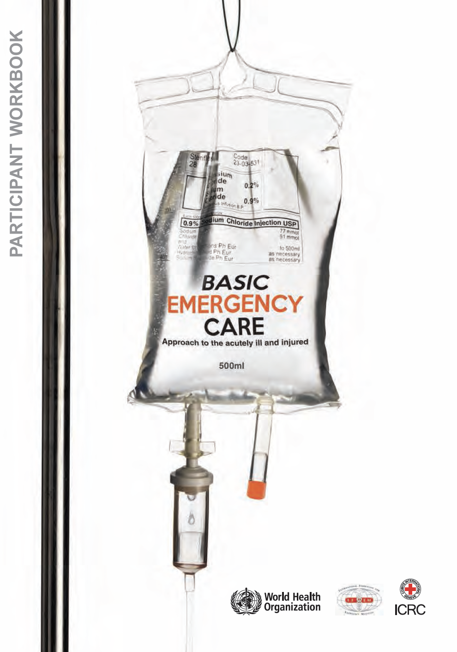
BEC Resources
Your workbook includes:
  Introduction
  ABCDE and SAMPLE history approach
  Approach to trauma
  Approach to difficulty in breathing
  Approach to shock
  Approach to altered mental status
  Skills modules
  Quick cards

Slide 8
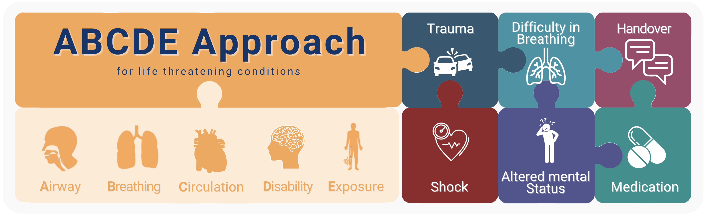
BEC course

Slide 9
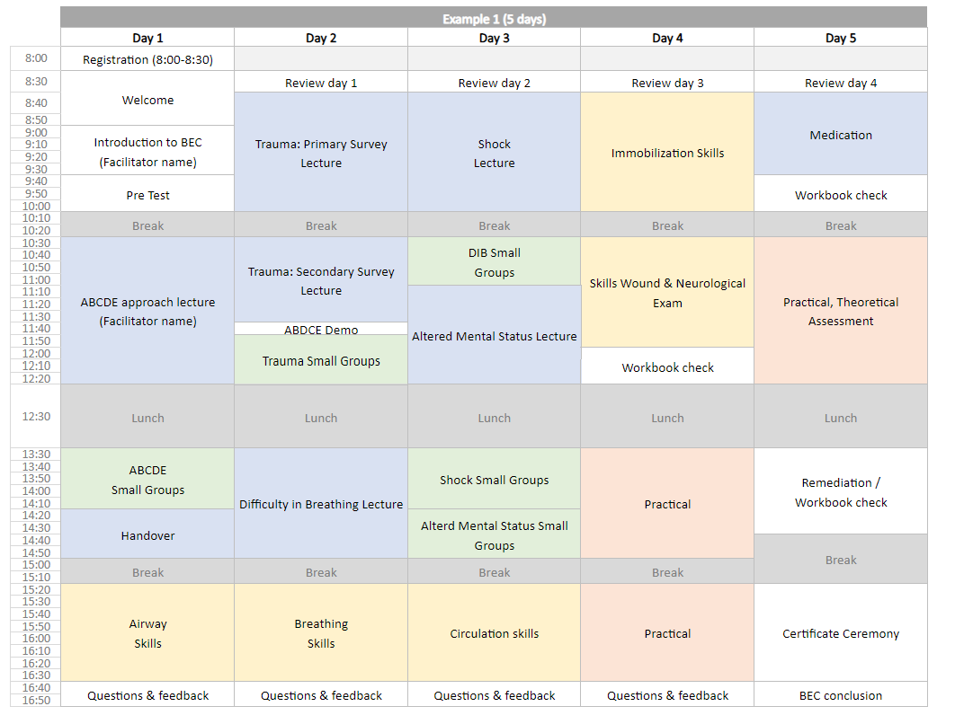
Suggested Schedule
Notes:
Suggested schedule. Coordinator to adapt as needed: can delete and insert course schedule.

Slide 10
Requirements
To be awarded a Certificate of Achievement participants must:
  Complete the pretest
  Attend all sessions each day
  Complete the key terms and workbook questions by the end of the four days
  Pass ALL skills station assessments
  Successfully lead a case scenario
  Score greater than 75% on the final written exam

Slide 11
Questions?

