Slide 1
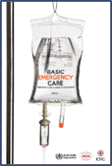

Difficulty in Breathing
Basic Emergency Care Course
Notes:
Welcome to the Difficulty in Breathing module.

Slide 2
Objectives
By the end of this presentation, you will be able to:
Understand key elements from a SAMPLE history for a patient with difficulty in breathing
Recognize key history findings suggestive of different causes of difficulty in breathing.
Describe how to perform a secondary exam for a patient with difficulty in breathing
Recognize the signs of difficulty in breathing
List the high-risk causes of difficulty in breathing
Describe critical actions to manage patients with difficulty in breathing
Identify essential skills for high-risk causes of difficulty in breathing
Describe special paediatric considerations for difficulty in breathing
Consider the disposition and transport of patients with difficulty in breathing
Notes:
By the end of this presentation, you will be able to understand key elements from a SAMPLE history for a patient with difficulty in breathing and recognize key history findings suggestive of different causes of difficulty in breathing. You will be able to describe how to perform a secondary exam for a patient with difficulty in breathing and recognize the signs of difficulty in breathing. We will highlight the high-risk causes and describe critical actions to manage patients including essential skills.
You will be able to describe special paediatric considerations for difficulty in breathing, and consider the disposition and transport of patients with difficulty in breathing

Slide 3





Essential skills
Overall
Assessing ABCDE
Intravenous (IV) line placement
IV fluid resuscitation
Direct pressure/ deep wound packing for haemorrhage control
Tourniquet for haemorrhage control
Pelvic binding
Fracture immobilization
Skin pinch test
Cervical spine immobilization
Head-tilt and chin-lift/jaw thrust
Airway suctioning
Management of choking
Recovery position
Nasopharyngeal (NPA) and oropharyngeal airway (OPA) placement
Full spine immobilization
AVPU and Glasgow Coma Scale assessment
Glucose administration
Oxygen administration
Bag-valve-mask ventilation
Needle-decompression for tension pneumothorax
Three-sided dressing for chest wound
Wound management
Snake bite management
Log roll
Notes:
The key essential skills for this module are listed here. Each skill will be introduced in the presentation and taught during the practical sessions of this course.

Slide 4
Goals
The goal of initial assessment is to identify reversible causes of difficulty in breathing, and to recognize conditions that require urgent intervention or rapid transfer.
The goal of acute management is to ensure the airway stays open and breathing is adequate to deliver oxygen to the organs.
Notes:
The goal of INITIAL ASSESSMENT is to identify reversible causes of difficulty in breathing, and to recognize conditions that require urgent intervention or rapid transfer.
The goal of ACUTE MANAGEMENT is to ensure the airway stays open and breathing is adequate to deliver oxygen to the organs.

Slide 5
The ABCDE Approach
!
REMEMBER
Always start with the ABCDE Approach AND treat life-threatening conditions.
Then, take a SAMPLE history.
Then, do a Secondary Exam.
Notes:
Start with the ABCDE approach with every patient to identify life-threatening conditions. Once life-threatening conditions have been addressed, take a SAMPLE history and perform a secondary exam.

Slide 6

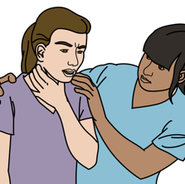

Key Elements in the ABCDE Approach
Airway
Swelling (allergic reaction)
Choking (foreign body obstruction)
Listen for stridor (serious airway narrowing).
Breathing
Signs/ symptoms of tension pneumothorax
  Absent breath sounds on one side with hypotension
  Distended neck veins
  Tracheal shifting
Listen: wheezing may indicate asthma or allergic reaction.
Notes:
In patients presenting with difficulty in breathing, it is important to be aware of the following serious conditions that should be identified in the ABCDE approach.
The first step is to assess the airway. Look at the airway to evaluate for swelling caused by a severe allergic reaction (anaphylaxis) or choking (obstruction from a foreign body). Listen for stridor, a high-pitched sound on inspiration, which is a sign of critical airway narrowing.
Next assess breathing. Evaluate for hypotension with absent breath sounds on one side – especially with distended (swollen or enlarged) neck veins or tracheal shift – which may indicate tension pneumothorax. Listen for wheezing which may indicate asthma or severe allergic reaction.

Slide 7



Key Elements in the ABCDE Approach
Circulation
Check capillary refill, heart rate, rate of breathing and blood pressure for signs of poor perfusion.
  Shock, heart attack, heart failure or severe infection can present with poor perfusion and difficulty in breathing.
Check for leg swelling or lung crackles which may be signs of heart failure.
Disability
Check level of consciousness with AVPU.
  Patients with decreased level of consciousness may not be able to protect their airway.
  Drugs/infection/injury can affect the part of the brain that controls breathing.
Check for paralyzing conditions that can affect breathing muscles.
Exposure
Look at chest wall movement.
Check for penetrating trauma.
Notes:
Circulation is next. Shock, heart attack, heart failure and severe infection can all present with poor perfusion and difficulty in breathing. Poor perfusion sends signals to the brain to increase the rate of breathing, which can feel and look like difficulty in breathing. Check for signs of shock by checking capillary refill, heart rate and blood pressure. Swelling in the legs or crackles in the lungs can indicate heart failure and fluid overload as a cause of difficulty in breathing.
Then, assess disability. Patients with decreased level of consciousness may not be able to protect their airways. Check the level of consciousness with the AVPU scale: A stands for Alert; V is whether the patient responds to Voice; P is responds to Pain; and U is Unresponsive.
Drugs, infection or injury can directly affect the part of the brain that controls breathing. Assess for paralyzing conditions affecting the breathing muscles.
Lastly, assess Exposure. Expose the patient fully to assess for abnormal chest wall movement and any signs of trauma. Penetrating trauma to the back, chest, underarms or abdomen may cause lung injury. These injuries are often missed.

Slide 8
Difficulty in Breathing
Part 1: The SAMPLE history
Notes:
In the first part of this module we will cover the SAMPLE history for patients with difficulty in breathing.

Slide 9
S: Signs and Symptoms
?
ASK
  When did the symptoms start?
  Was the onset sudden?
  Do they come and go?
  How long do they last?
  Have they changed over time?
  Any similar episodes?
Notes:
Evaluate signs and symptoms of difficulty in breathing by asking: When did the symptoms start and was the onset sudden? Do they come and go? How long do they last? Have they changed over time and has there been a similar episode previously?

Slide 10
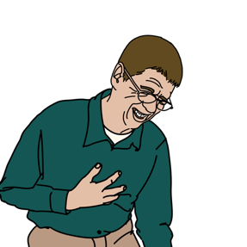
For SUDDEN onset shortness of breath, THINK:
  Obstruction of the airway
    Foreign body
    Swelling of the airway
    Trauma to the airway, lung, heart or chest wall
    Toxic inhalation
  Sudden heart problems
    Heart attack
    Abnormal rhythm
    Valve problems
  Rapid deep breathing
    Poisoning
    High acid levels (diabetic ketoacidosis)
    Anxiety
Notes:
Sudden difficulty in breathing can suggest airway obstruction such as by a foreign body, swelling of the airway from allergic reaction or infection, trauma to the airway, lungs, heart or chest wall, or inhalation of hot gases or smoke.
Acute heart problems such as heart attack, abnormal heart rhythm or valve problems can also cause rapid onset of difficulty in breathing.
Rapid or deep breathing may suggest poisoning, high acid levels in the blood, which can be due to infection or diabetic ketoacidosis, or anxiety.
Image:
Title: Brain activity – Métacognition
Creator:benoitpetit
Source: https://openclipart.org/detail/193152/brain-activity-metacognition
Copyright information: Creative Commonz Zero 1.0 Public Domain License

Slide 11
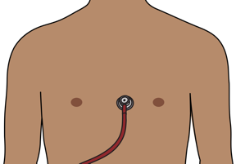
For SLOWER onset shortness of breath THINK:
  Infections
  Fluid in the lungs
    TB and heart failure
  Fluid around the heart
    TB or kidney disease
  Lung cancer
  Diseases affecting muscles of chest wall
  Asthma or COPD
Notes:
Difficulty in breathing that starts slowly is more common with infection and chronic conditions with a gradual build-up of fluid around the lungs (as occurs in TB and heart failure), fluid around the heart (from TB or kidney disease), lung cancer or diseases affecting the function of the chest wall. Recurrent difficulty in breathing associated with wheeze may suggest asthma or COPD.
Image:
Title: Brain activity – Métacognition
Creator:benoitpetit
Source: https://openclipart.org/detail/193152/brain-activity-metacognition
Copyright information: Creative Commonz Zero 1.0 Public Domain License

Slide 12
S: Signs and Symptoms
ASK
  Was there anything that triggered the difficulty in breathing?
  What makes it better or worse?
THINK
    Allergies can cause airway blockage from swelling
    Inhalation (fire or chemicals) can cause airway swelling
    Chemicals and pesticides cause fluid in lungs or muscle weakness
    If lying flat worsens breathing, this suggests fluid in the lungs.
Notes:
It is also important to ask: Was there anything that triggered the difficulty in breathing and what makes it better or worse?
A history of allergies with an exposure to the allergen prior to the start of the difficulty in breathing suggest that the airway is blocked by swelling due to a severe allergic reaction.
Inhaling smoke or hot gas (such as in fires) or some chemicals may cause difficulty in breathing through upper airway injury and swelling. Exposure to some chemicals (such as certain pesticides) can cause fluid to build up in the airways and can cause weakness in the muscles involved in breathing.
Difficulty in breathing that gets worse when the person lies flat can be due to fluid in the lungs.
Image:
Title: Brain activity – Métacognition
Creator:benoitpetit
Source: https://openclipart.org/detail/193152/brain-activity-metacognition
Copyright information: Creative Commonz Zero 1.0 Public Domain License

Slide 13
S: Signs and Symptoms
ASK
  Is there any tongue or lip swelling or voice changes?
THINK
  Swelling to mouth, lips, tongue, upper throat and voice changes suggest severe allergic reaction and inflammation in the airway.
!
      WATCH CLOSELY
Notes:
Is there any tongue or lip swelling or voice changes? These signs suggest a severe allergic reaction or other inflammation of the airway. It is very important to watch these patients closely for any deterioration!
Image:
Title: Brain activity – Métacognition
Creator:benoitpetit
Source: https://openclipart.org/detail/193152/brain-activity-metacognition
Copyright information: Creative Commonz Zero 1.0 Public Domain License

Slide 14
S: Signs and Symptoms
LISTEN
  Are there any abnormal breath sounds?
THINK
  Stridor (high pitched ”squeaking” sound during inhalation)
    UPPER AIRWAY swelling or blockage
  Wheezing (high pitched sound during exhalation)
    LOWER AIRWAY narrowing or spasms in the lungs
    Asthma, COPD, heart failure, allergic reactions
  Gurgling: (low pitched bubbling)
    Mucous or fluid in the airway
Notes:
Listen to hear if there are any abnormal breath sounds. High-pitched or ‘squeaking’ sounds when breathing IN may be stridor, which is caused by narrowing of the upper airway and may suggest severe allergic reaction or other airway obstruction. Wheezing – a high-pitched sound with breathing OUT – is caused by narrowing or spasm of the lower airways in the lungs and can suggest asthma, COPD, heart failure or allergic reactions. Gurgling sounds with breathing suggest that there is mucus, blood or other fluid in the airway.
Title: Stethoscope Plain
Creator: Rejon
Source: https://openclipart.org/detail/38473/stethoscope-plain
Copyright information: Creative Commonz Zero 1.0 Public Domain License
Image:
Title: Brain activity – Métacognition
Creator:benoitpetit
Source: https://openclipart.org/detail/193152/brain-activity-metacognition
Copyright information: Creative Commonz Zero 1.0 Public Domain License
Title: Brain activity – Métacognition
Creator:benoitpetit
Source: https://openclipart.org/detail/193152/brain-activity-metacognition
Copyright information: Creative Commonz Zero 1.0 Public Domain License

Slide 15
S: Signs and Symptoms
ASK
  Is there any pain associated with the difficulty breathing?
THINK
  If the patient has chest pain with difficulty in breathing:
    Heart attack
    Pneumothorax
    Pneumonia
    Trauma to lungs, ribs or muscles
  Pleuritic pain (worse with deep breaths)
    Infection
    Blood clot in lung (pulmonary embolism)
Notes:
Is there pain associated with the difficulty in breathing? Difficulty in breathing with chest pain can suggest heart attack, pneumothorax, pneumonia or trauma to the lungs, ribs or ribcage muscles. In particular, pain that is worse with deep breaths (pleuritic pain) may suggest infection or blood clot in the lung (pulmonary embolism).
Image:
Title: Brain activity – Métacognition
Creator:benoitpetit
Source: https://openclipart.org/detail/193152/brain-activity-metacognition
Copyright information: Creative Commonz Zero 1.0 Public Domain License

Slide 16
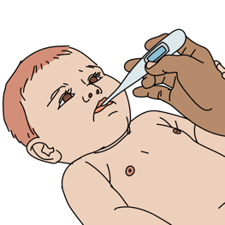
S: Signs and Symptoms
CHECK
  Is there a fever?
  Is there a cough?
THINK
  Fever suggests an infection.
  Cough with fluid sounds could be pneumonia or oedema.
  Cough with a wheeze suggests asthma or COPD.
Notes:
Fever and difficulty in breathing suggest infection. Lung infection and any severe infection may cause fluid in the lungs.
A cough may indicate fluid in the lungs from infection of the lungs, pneumonia, or oedema. Cough and wheezing may suggest asthma or chronic obstructive pulmonary disease.
Image:
Title: Brain activity – Métacognition
Creator:benoitpetit
Source: https://openclipart.org/detail/193152/brain-activity-metacognition
Copyright information: Creative Commonz Zero 1.0 Public Domain License

Slide 17
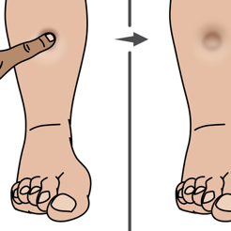
S: Signs and Symptoms
CHECK
  Foot and leg swelling
  For recent pregnancy
THINK
  Oedema to both feet and legs suggests heart failure.
  Swelling and pain to one leg suggests a blood clot that could travel to lung (pulmonary embolism).
  Pregnancy is a risk factor for both pulmonary embolism and heart failure.
Notes:
Difficulty in breathing with swelling, or oedema, of both feet or legs can suggest heart failure with fluid back-up to the lungs and body.
Difficulty in breathing with swelling and pain in one leg may suggest a blood clot in a leg vein that has travelled to the lung, called a pulmonary embolism.
Pregnancy is a risk factor for both pulmonary embolism and heart failure. Difficulty in breathing in a pregnant or early post-pregnancy patient should raise concern for these dangerous complications.
Image:
Title: Brain activity – Métacognition
Creator:benoitpetit
Source: https://openclipart.org/detail/193152/brain-activity-metacognition
Copyright information: Creative Commonz Zero 1.0 Public Domain License

Slide 18
A: Allergies
ASK
  Allergies to medications or other substances?
  Recent insect bites or stings?
THINK
  Severe allergic reactions can cause airway swelling and difficulty breathing.
  People can have allergic reactions to almost anything
    Food
    Plants
    Medications
    Insect bites/stings.
Notes:
Severe allergic reactions may cause difficulty in breathing due to airway swelling which can worsen rapidly. People can have severe allergic reactions to almost anything, but food, plants, medications and insect bites/stings are the most common. Adrenaline is the treatment and will be discussed later in the course.
Image:
Title: Brain activity – Métacognition
Creator:benoitpetit
Source: https://openclipart.org/detail/193152/brain-activity-metacognition
Copyright information: Creative Commonz Zero 1.0 Public Domain License

Slide 19
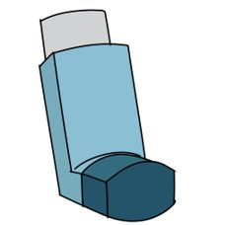

M: Medications
ASK
  Currently taking any medications?
THINK
  New medications or change in dosages can cause allergies and difficulty breathing.
  Accidental overdose of some medications can slow or stop breathing.
Notes:
Ask about new medications and changes in doses. New medications can cause allergies with associated difficulty in breathing. Accidental overdose of some medications, especially opioids, can slow or stop breathing.
Image:
Title: Brain activity – Métacognition
Creator:benoitpetit
Source: https://openclipart.org/detail/193152/brain-activity-metacognition
Copyright information: Creative Commonz Zero 1.0 Public Domain License

Slide 20
P: Past Medical History
ASK
  History of asthma or chronic obstructive pulmonary disorder (COPD)?
  History of heart disease or kidney disease?
  History of tuberculosis or cancer?
  THINK
  Asthma and COPD cause episodes of DIB.
  Heart or kidney failure can cause a fluid build-up in the lungs.
  Heart attacks may present with difficulty in breathing.
  Pericardial effusions and pleural effusions can be caused by cancer, tuberculosis or kidney problems.
Notes:
Is there a history of asthma or Chronic Obstructive Pulmonary Disease (COPD)? Asthma and COPD often cause episodes of DIB, often with wheezing. A history of prior hospitalization or intubation for these conditions suggests a high-risk patient who may worsen quickly. Is there a history of heart disease or kidney disease? People with a history of heart or kidney failure may have fluid in the lungs, called pulmonary oedema. Heart attack may present with DIB which is often rapid in onset and may be associated with chest pain. Is there a history of tuberculosis or cancer? Conditions such as tuberculosis and cancer can cause build-up of fluid in the sac around the heart (pericardial effusion) or build-up of fluid in the chest, outside the lung (pleural effusion), both of which can cause difficulty in breathing.
Image:
Title: Brain activity – Métacognition
Creator:benoitpetit
Source: https://openclipart.org/detail/193152/brain-activity-metacognition
Copyright information: Creative Commonz Zero 1.0 Public Domain License

Slide 21
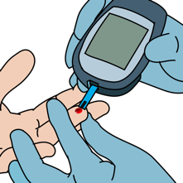
P: Past Medical History
ASK
  History of diabetes?
  History of smoking?
  History of HIV?
THINK
    Diabetics can have fast breathing from diabetic ketoacidosis.
  Smoking increases the risk of asthma, COPD, lung cancer, heart attack.
  HIV increases the risk of infection.
Notes:
Is there a history of diabetes? Diabetes can cause diabetic crisis (diabetic ketoacidosis or DKA). DKA causes fast, deep breathing that may be reported as difficulty in breathing. Is there a history of smoking? Smoking increases the risk of asthma, COPD, lung cancer and heart attack. Is there a history of HIV? HIV infection increases the risk of other infections. Consider Pneumonia but also think about tuberculosis since patients with HIV are at high risk for co-infection.
Image:
Title: Brain activity – Métacognition
Creator:benoitpetit
Source: https://openclipart.org/detail/193152/brain-activity-metacognition
Copyright information: Creative Commonz Zero 1.0 Public Domain License

Slide 22
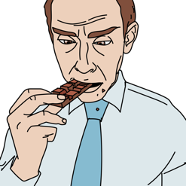
L: Last Oral Intake
ASK
  When did the patient last eat or drink?
THINK
  Full stomach puts the patient at risk for vomiting and aspiration.
Notes:
Ask when the patient’s last oral intake of food or drink was. Recall that a full stomach puts the patient at risk for vomiting and aspiration
Image:
Title: Brain activity – Métacognition
Creator:benoitpetit
Source: https://openclipart.org/detail/193152/brain-activity-metacognition
Copyright information: Creative Commonz Zero 1.0 Public Domain License

Slide 23
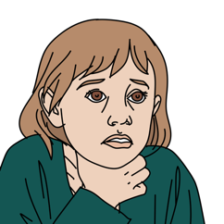
E: Events Surrounding Illness
ASK
  What was the person doing when the difficulty in breathing started?
THINK
  If difficulty in breathing after eating, think choking.
  If difficulty in breathing with exercise and chest pain, think heart attack.
Notes:
Consider vomiting and aspiration as a cause of difficulty in breathing those with intoxication, altered mental status, the elderly and those with diseases that cause weakness. Always consider choking if DIB started while eating or drinking. Rapid onset of DIB with exercise might be due to heart attack, especially when there is also chest pain.
Image:
Title: Brain activity – Métacognition
Creator: benoitpetit
Source: https://openclipart.org/detail/193152/brain-activity-metacognition
Copyright information: Creative Commonz Zero 1.0 Public Domain License

Slide 24
E: Events Surrounding Illness
ASK
  Was the patient found in or near water?
THINK
  Consider drowning (inhalation of water) if a person is found in or near water.
  Even a small amount of inhaled water can cause serious lung damage, which can worsen over time.
!
      WATCH CLOSELY
Notes:
Was the patient found in or near water? Always consider drowning (inhalation of water) in a person found in or near water, especially children. Even a small amount of inhaled water can cause serious lung damage, which can worsen over time. Watch the patient closely.
Image:
Title: Brain activity – Métacognition
Creator:benoitpetit
Source: https://openclipart.org/detail/193152/brain-activity-metacognition
Copyright information: Creative Commonz Zero 1.0 Public Domain License

Slide 25
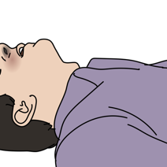
E: Events Surrounding Illness
ASK
  Has there been any exposure to pesticides or inhaled chemicals?
THINK
  Pesticides used in farming can be absorbed through the skin and cause fluid in the airways and lungs.
  Exposure to gases from a fire can cause chemical inhalation.
Notes:
Has there been exposure to pesticides or other chemicals? Inhaled chemicals can cause DIB by irritating the airways and lungs. Some pesticides used in farming can be absorbed through the skin, causing fluid build-up in the airways and lungs. If a patient has been exposed to a house or structure fire consider burns to the airway causing swelling, and exposure to gases from a fire leading to chemical inhalation.
Image:
Title: Brain activity – Métacognition
Creator:benoitpetit
Source: https://openclipart.org/detail/193152/brain-activity-metacognition
Copyright information: Creative Commonz Zero 1.0 Public Domain License

Slide 26
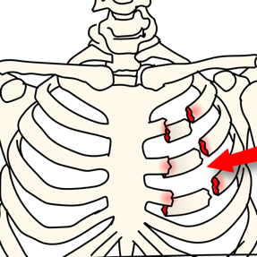
E: Events Surrounding Illness
ASK
  Has there been any recent trauma?
THINK
  Rib fractures
  Pneumothorax
  Haemothorax
  Heart or lung bruising
Notes:
Has there been any recent trauma? Trauma can cause injuries that lead to difficulty in breathing including rib fractures, bruising to the heart or lungs, pneumothorax which is air in the chest compressing the lung, and haemothorax which is blood in the chest compressing the lung.
Image:
Title: Brain activity – Métacognition
Creator:benoitpetit
Source: https://openclipart.org/detail/193152/brain-activity-metacognition
Copyright information: Creative Commonz Zero 1.0 Public Domain License

Slide 27
Workbook Question 1
Using the workbook section above, list 5 questions about PAST MEDICAL HISTORY you would ask when taking a SAMPLE history
1.
2.
3.
4.
5.
Notes:
Workbook Question 1: Difficulty in Breathing [page 82 in participant workbook]
Using the workbook section above, list five questions about past medical history you would ask when taking a SAMPLE history.
Answers:
1. Is there a history of asthma? 41 2. Is there a history of COPD? 3. Is there a history of heart disease? 4. Is there a history of kidney disease? 5. Is there a history of TB? 6. Is there a history of cancer? 7. Is there a history of diabetes? 8. Is there a history of smoking? 9. Is there a history of HIV?
Title: Deep thought
Creator:GDL
Source: https://openclipart.org/detail/221707/deep-thought
Copyright information: Creative Commonz Zero 1.0 Public Domain License

Slide 28
Difficulty in Breathing
Part 2: Secondary exam findings and possible causes
Notes:
In the second part of the Difficulty in Breathing module, we will look at the secondary examination and high-risk causes of difficulty in breathing. We will start with the secondary exam findings.

Slide 29
Secondary Exam Findings
Look, listen and feel
Difficulty in breathing may present with:
  Changes in the respiratory rate
  Changes in the respiratory effort
  Low oxygen levels in the blood
Remember you should have ALREADY completed the ABCDE Exam and treated life-threatening conditions BEFORE doing this extensive examination.
If the secondary exam identifies an ABCDE condition
STOP AND RETURN IMMEDIATELY TO ABCDE to manage it.
!
Notes:
Always assess ABCDE first. The initial ABCDE approach identifies and manages life-threatening conditions. The secondary exam looks for changes in the patient’s condition or less obvious causes which may have been missed during ABCDE. The secondary exam uses the approach of look, listen, and feel to identify more subtle findings which may indicate an emergency condition. If the secondary examination identifies an ABCDE condition, STOP AND RETURN IMMEDIATELY TO ABCDE to manage it.
When assessing a patient with difficulty in breathing, look for changes in respiratory rate, respiratory effort, or low oxygen saturation which may not have been appreciated during the initial ABCDE approach.

Slide 30
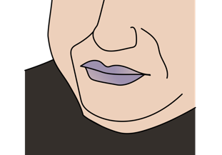
Secondary Exam Findings
Look for signs of respiratory failure.
  Accessory muscle use and increased work of breathing
  Difficulty speaking in full sentences
  Inability to lie down or lean back
  Diaphoresis and mottled skin
  Confusion, irritability, agitation
  Poor chest wall movement
  Cyanosis
Notes:
Look carefully for signs of respiratory failure including: accessory muscle use and increased work of breathing, and indrawing of the muscles above the clavicles and between the ribs. Look for difficulty speaking in full sentences or saying more than a few words at a time, inability to lie down or lean back, diaphoresis (excessive sweating) and mottled skin. Patients may have confusion, irritability, agitation, poor chest wall movement, cyanosis (or blue discoloration of the skin) especially the lips and fingertips. Be aware that this may be more difficult to detect depending on the skin tone.

Slide 31
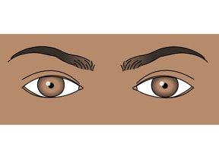
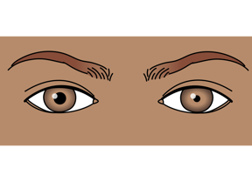
Secondary Exam Findings
Look at pupil size and reactivity.
  Small pupils suggest possible medication overdose or exposure to chemicals (usually pesticides).
  Unequal or abnormally shaped pupils suggest head injury which can cause abnormal breathing.
Notes:
Look at the patient’s eyes and evaluate their pupils. Very small pupils suggest possible opioid overdose or exposure to chemicals including pesticides. Unequal or abnormally shaped pupils suggest head injury which can cause abnormal breathing due to damage to the part of the brain controlling respirations.

Slide 32
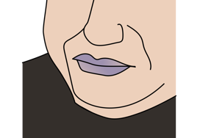
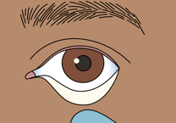
Secondary Exam Findings
Look at the face, nose and mouth.
  Cyanosis around the lips or nose suggests low oxygen levels in the blood.
  Pale lower eyelids may suggest anaemia.
  Swelling of the lips, tongue and back of mouth suggest allergic reaction.
  Soot around the mouth or nose, burned facial hair or facial burns suggests smoke inhalation.
  Bleeding, swelling or abnormal airway shape may be due to trauma.
Notes:
Look at the eyes, nose and mouth to identify abnormalities that may be linked to specific cause of difficulty in breathing. Cyanosis, or blue discoloration, around the lips or nose suggests low oxygen levels in the blood. Pale inner surface of lower eyelids suggests severe anaemia. Swelling of the lips, tongue and mouth suggests a severe allergic reaction which can rapidly worsen. Soot around the mouth or nose, burned facial hair or facial burns suggest smoke inhalation and airway burns, which can also cause airway swelling. Look for bleeding or swelling of the airway in a patient presenting with trauma.

Slide 33
Secondary Exam Findings
Look at the neck and chest.
    Distended neck veins suggests heart failure, tension pneumothorax or pericardial tamponade.
  Excessive muscle use of neck and chest suggests significant respiratory difficulty.
  Tracheal shift suggests tension pneumothorax or tumour.
  Swelling of the neck suggests infection or trauma.
  Examine the entire neck and chest carefully for signs of trauma.
Notes:
Continue the secondary exam moving head to toe by looking at the neck. Notice distended neck veins which can be due to a back-up of blood from heart failure, tension pneumothorax or pericardial tamponade. Look for tracheal deviation, or shifting of the airway to one side, which is concerning for tension pneumothorax. Examine the entire neck and chest carefully for bruising, wounds or other signs of trauma. Also look for swelling or redness of the neck or chest suggests infection or trauma. Look for excessive muscle use in the neck and chest which suggests significant respiratory difficulty.

Slide 34
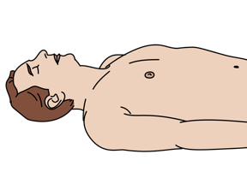
Secondary Exam Findings
Look at the rate and pattern of breathing.
  People with wheeze may take longer to breathe out because of narrowing of the lower airways in the lung.
  Fast breathing
    Dehydration
    Severe infection
    Chemical imbalances in the blood
    Poisoning
    Anxiety
  Slow and shallow breathing may be due to opioid overdose.
  Chest wall injury cause pain that limits the ability to take deep breaths.
    Flail chest occurs with multiple rib fractures.
Notes:
Look at the chest to evaluate the rate and pattern of breathing. People with wheeze due to asthma or COPD may take longer to breathe out because of narrowing of the lower airways in the lung. Fast breathing can be due to dehydration, severe infection, chemical imbalance in the blood, poisoning or anxiety. Slow and shallow breathing might be due to opioid overdose. Look for very small pupils and altered mental status.
Chest wall injury is often associated with pain that limits the ability to take deep breaths. A flail chest occurs when multiple ribs are fractured in more than one place, causing a segment of the rib cage to be separated from the rest of the chest wall. The segment may appear to be moving in the opposite direction from the rest of chest wall during breathing. This can cause severe pain and difficulty in breathing.

Slide 35
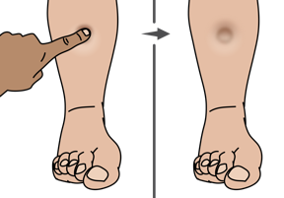
Secondary Exam Findings
Look at both legs.
  Swelling to both legs (heart failure)
  Swelling to one leg with pain (blood clot)
Look at the skin.
  Bites (allergic reaction)
  Rashes such as hives (allergic reaction or systemic infection)
  Pale skin or pallor (anaemia)
  Burns that wrap around torso can restrict chest wall expansion.
Notes:
Look at the legs to identify any swelling, or oedema. Swelling to both of the lower legs suggests heart failure, which may be the cause of the difficulty in breathing due to back-up of fluid in the lungs. Swelling to one leg may be due to a blood clot in the leg. If there is also difficulty in breathing, this may mean that part of the clot has traveled to the lung, called a pulmonary embolism.
Carefully look at the skin. Bites can be a source of allergic reaction or envenomation causing airway swelling or weakness of the respiratory muscles. Rashes can indicate allergic reaction or severe widespread infection. Pale skin can indicate anaemia. In a patient with burns look carefully for circumferential burns (burn that go entirely around a body part). Burns that wrap around the torso can restrict chest wall expansion and limit breathing.

Slide 36
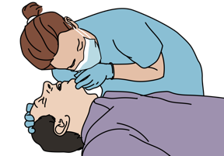
Secondary Exam Findings
Listen to breath sounds.
Stridor - Partial upper airway obstruction
    Foreign body
    Swelling
    Trauma
    Infection
Decreased breath sounds - Something preventing air from entering the lung
    Pneumothorax
    Haemothorax
    Fluid
    Foreign body
    Infection inside the lungs or tumour
Notes:
Listen carefully to the patient’s breath sounds. Stridor is a high-pitched noise made when breathing in. It suggests partial upper airway obstruction, which may be due to a foreign object, mass, or swelling from trauma or infection. Decreased or absent breath sounds suggest abnormal air movement in the lungs. This can be due to air or fluid around the lung in the cases of pneumothorax, haemothorax, or pleural effusion. It can also be caused by narrowing or foreign body blockage of the airways, and infection or tumour in or around the lung.

Slide 37

Secondary Exam Findings
Listen to breath sounds
  Wheezing - Lower airway obstruction
      Asthma/COPD
      Allergic reaction
      Tumour
      Foreign object
  Crackles - Fluid build-up in the airways of the lungs
Try to listen to breath sounds often so you can know what is normal and what is not!
Notes:
Listen for wheezing which suggests lower airway obstruction such as from asthma, COPD, allergic reaction, tumour or foreign body. Crackles or crepitations suggest fluid build-up in the airspaces of the lung. Try to listen to breath sounds often so you can know what is normal and what is not!

Slide 38
Secondary Exam Findings
Listen to heart sounds.
  Abnormal heart rhythms can cause the heart to pump blood abnormally
    Poor perfusion and difficulty breathing
  Heart murmurs with difficulty breathing
  Heart valve disease or injury
  Muffled or distant heart sounds with low blood pressure, fast heart rate and distended neck veins suggests pericardial tamponade.
Notes:
Also listen to the patient’s heart sounds. Abnormal heart rhythms can cause the heart to pump blood abnormally, leading to poor perfusion and a feeling of difficulty in breathing. Difficulty in breathing accompanied by heart murmurs can suggest damage to the heart valves. Muffled or distant heart sounds accompanying low blood pressure, fast heart rate and distended neck veins suggest pericardial tamponade.

Slide 39
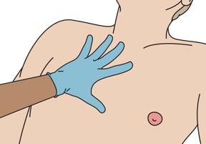
Secondary Exam Findings
Feel the chest wall (ribs).
  Deformities or abnormal movements suggests rib fractures
  Crepitus suggests underlying fracture or pneumothorax
  Unequal chest expansion
    Pneumothorax, haemothorax, flail chest
Percuss the chest wall.
  Hollow sounds (hyperresonance) - Pneumothorax
  Dull sounds - Fluid or blood
Notes:
Feel the chest wall for deformities and abnormal movement when pressing on the chest wall which can suggest rib fracture. Crepitus, meaning a feeling of crackling or popping when pressing on the skin of the chest wall, may also suggest underlying rib fracture. Crepitus can also indicate air under the skin, which can be associated with pneumothorax. Unequal expansion of the chest wall suggests pneumothorax, haemothorax, or flail chest.
Percuss the chest wall. Hollow sounds (hyperresonance) on one side when tapping the chest wall suggest pneumothorax. Dull sounds when tapping the chest wall may indicate fluid or blood either inside the airspaces of the lungs or between the lungs and the chest wall.

Slide 40
Workbook Question 2
Using the workbook section above, List 3 signs you should LOOK for in a patient with difficulty in breathing:
1.
2.
3.
Notes:
Workbook Question 2: Difficulty in Breathing [page 85 in participant workbook]
Using the workbook section above, list three signs you should LOOK for in a patient with difficulty in breathing.
Answers
1. Altered mental status 2. Fatigue or getting tired from breathing 3. Poor chest wall movement 4. Cyanosis (blue color of the skin, especially at the fingertips and around the mouth
Title: Deep thought
Creator:GDL
Source: https://openclipart.org/detail/221707/deep-thought
Copyright information: Creative Commonz Zero 1.0 Public Domain License

Slide 41
Workbook Question 2
List 4 things you should LISTEN for in a patient with difficulty in breathing:
1.
2.
3.
List 3 things you should FEEL the chest wall for in a patient with difficulty in breathing:
1
2.
3.
Notes:
Workbook Question 2: Difficulty in Breathing [page 85 in participant workbook]
List four things you should LISTEN for in a patient with difficulty in breathing.
Answers
1. Decreased or quiet breath sounds suggest there is something preventing air from entering the lung. This can be due to pneumothorax, hemothorax, fluid, or infection inside the lungs or tumor. 2. Stridor suggests upper airway obstruction which may be due to something blocking the airway, swelling, trauma, or infection in the upper part of the airway. 3. Wheezing suggests lower airway obstruction, such as asthma, swelling due to an allergic reaction, foreign body obstruction in the lower airways in the lung (e.g. food), or tumor. 4. Crackles suggest fluid buildup inside the airways of the lungs. 5. Abnormal heart rhythms can cause the heart to pump blood poorly, leading to poor perfusion. 6. Heart murmurs in the setting of difficulty in breathing can suggest heart disease or injury. 7. Muffled or distant heart sounds in the setting of low blood pressure, fast heart rate, and distended neck veins suggest pericardial tamponade.
List three things you should FEEL the chest wall for in a patient with difficulty in breathing.
Answers
1. Feel the ribs. A flail chest occurs when rib fractures cause a segment of the rib cage to be separated from the rest of the ribs and often appears to be moving in an opposite direction from the chest wall 2. Deformities and crepitus (crunching under your fingers when you push on the bones) of the chest wall suggest rib fracture. 3. Unequal expansion of the chest wall suggests pneumothorax, hemothorax, or flail chest. 4. Hollow sounds (hyperresonance) when tapping the chest wall suggests pneumothorax. 5. Dull sounds with chest wall tapping may indicate fluid or blood either inside the airspaces of the lungs or outside of the lungs between the lungs and the chest wall.
Title: Deep thought
Creator:GDL
Source: https://openclipart.org/detail/221707/deep-thought
Copyright information: Creative Commonz Zero 1.0 Public Domain License

Slide 42
Difficulty in Breathing
Part 2: Secondary exam findings and possible causes
Notes:
We will now look at the possible causes of difficulty in breathing.

Slide 43

Key AIRWAY causes of Difficulty in Breathing
Foreign body obstruction
  Acute difficulty breathing
  Visible secretions, vomit or foreign body
  Abnormal sounds from the airway (stridor, snoring, gurgling)
  Coughing
  Drooling
Severe allergic reaction
  Swelling of lips, tongue and mouth
  Stridor and/or wheezing
  Rash or hives
  May have tachycardia and hypotension
  Exposure to known allergen
Notes:
Foreign bodies can obstruct the airway, leading to rapid onset of difficulty in breathing, possibly after an episode of choking. The patient may be coughing or drooling. Look for visible secretions, vomit, or foreign body in the airway. Listen for abnormal sounds from the airway (such as stridor, snoring, gurgling).
Severe allergic reactions can also lead to airway obstruction due to swelling of the lips, tongue and mouth. This is often associated with difficulty breathing with stridor or wheezing. Looking at the skin may reveal rash or hives, which are patches of pale or red, itchy, warm, and swollen skin. Severe allergic reactions may lead to tachycardia and hypotension. It is important to ask about history of allergies and exposure to known allergens.

Slide 44
Key AIRWAY causes of Difficulty in Breathing
Airway swelling (inflammation or infection)
  Stridor
  Hoarse voice
  Drooling or difficulty swallowing (indicates severe swelling)
  Unable to lie down
  May have fever (with infection)
Notes:
Airway swelling can also be caused by infection and associated inflammation, especially when fever is also present. Listen for stridor and hoarse voice. Look for drooling and difficulty swallowing secretions, which can indicate severe swelling. Patients may have difficulty lying flat.

Slide 45
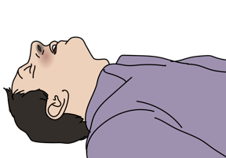
Key AIRWAY causes of Difficulty in Breathing
Airway burns
  History of exposure to chemical or fire
  Facial burns (singed facial hair)
  Stridor
  Change in voice
Notes:
Airway burns are another cause of difficulty in breathing due to airway swelling. Ask about exposure of fire or chemicals, either inhaled or ingested. Listen for stridor and voice changes. Look for burns to the face, including burnt facial or nasal hairs.

Slide 46

Key LUNG causes of Difficulty in Breathing
Pneumonia
  Fever and cough
  Gradually increasing work of breathing
  Worsening pain with breathing (pleuritic)
  Abnormal lung exam (LISTEN for crackles)
Notes:
Pneumonia can cause difficulty breathing due to infection of the lungs. Patients may present with fever and cough. The difficulty in breathing will typically worsen gradually over time. They may have pleuritic pain - pain that is worse with breathing. Listen for abnormal breath sounds, especially crackles.

Slide 47
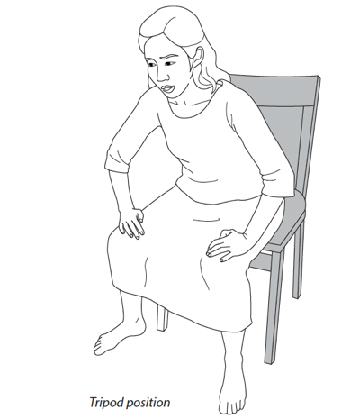
Key LUNG causes of Difficulty in Breathing
Asthma/ COPD
  Wheezing
  Cough
  Accessory muscle use
  Tripod position
  May have history of smoking or allergies
Notes:
A patient with asthma or COPD may present with difficulty in breathing, wheezing cough and accessory muscle use. They may want to sit forward in the tripod position, as pictured. Ask about history of smoking or allergies.

Slide 48
Key LUNG causes of Difficulty in Breathing
Pneumothorax
  Decreased breath sounds on one side
  Sudden onset
  Hyperresonance with percussion on affected side
  Pain worse with breathing
  May have history of trauma or evidence of rib fracture
  Hypotension, distended neck veins and decreased breath sounds on one side indicate tension pneumothorax.
!
An untreated pneumothorax can develop into a tension pneumothorax!
Notes:
A pneumothorax, or air between the chest wall and lung causing the lung to collapse, causes difficulty in breathing with decreased breath sounds on the affected side. This will be sudden in onset. There may be pain with breathing. Ask about history of chest trauma and examine for evidence of rib fractures.
Untreated pneumothorax can develop into tension pneumothorax, where air trapped in the chest increases in pressure compressing the lungs and decreasing blood return to the heart. Hypotension with distended neck veins and decreased breath sounds on one side indicate tension pneumothorax.

Slide 49
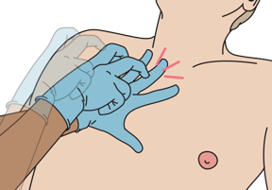
Key LUNG causes of Difficulty in Breathing
Haemothorax
  Decreased breath sounds on affected side
  Dull sounds with percussion
  May have history of trauma, cancer or tuberculosis
  May have symptoms of shock if large haemothorax
Notes:
Haemothorax is blood in the chest outside of the lung. Patients with haemothorax will present with decreased breath sounds on the affected side and dullness to percussion. Ask about history of trauma, cancer or tuberculosis.

Slide 50
Key LUNG causes of Difficulty in Breathing
Pleural effusion
  Decreased breath sounds on one or both sides
  Dull sounds with percussion
  May have history of cancer, tuberculosis, heart disease or kidney disease
  Acute or chronic difficulty breathing
Notes:
Fluid in the chest outside of the lung is called a pleural effusion. Difficulty in breathing may be acute or chronic, worsening slowly over time. Like haemothorax there will be decreased breath sounds and dullness to percussion. Pleural effusions may be seen in patients with history of cancer or tuberculosis.

Slide 51

Key LUNG causes of Difficulty in Breathing
Acute chest syndrome (sickle cell patients)
  History of sickle cell disease
  Chest pain
  Fever
  Hypoxia
Notes:
Acute chest syndrome is a life-threatening complication of sickle cell disease caused by abnormal red blood cells blocking small blood vessels in the lungs. Patients presents with symptoms similar to pneumonia, including chest pain, fever and hypoxia.

Slide 52


Key CARDIAC causes of Difficulty in Breathing
Heart attack
  Chest pressure, tightness or crushing feeling in the chest
  Diaphoresis and mottled skin
  Nausea or vomiting
  Signs of heart failure
  History of smoking, cardiac disease, hypertension, diabetes, high cholesterol, family history of heart problems
Notes:
Next we will cover cardiac causes of DIB. Heart attacks can cause acute onset difficulty in breathing. Patients often have chest pressure, tightness or a crushing feeling in the chest. They may also have diaphoresis, nausea or vomiting. There may be signs of heart failure such as distended neck veins or oedema in the legs. Ask about history of smoking, cardiac disease, hypertension, diabetes, high cholesterol and family history of heart problems.

Slide 53
Key CARDIAC causes of Difficulty in Breathing
Heart failure
  Difficulty in breathing with exertion
  Difficulty in breathing when lying flat
  Swelling to both legs
  Distended neck veins
  Crackles may be heard in the lungs
  May have chest pain
Notes:
Another cardiac cause of difficulty in breathing is heart failure. Difficulty in breathing is often chronic and worse with exertion or lying flat, however it can acutely worsen. Signs of heart failure include swelling to both legs, distended neck veins, crackles may be heard in both lungs and the patient may have chest pain

Slide 54
Key CARDIAC causes of Difficulty in Breathing
Cardiac tamponade
  Signs of poor perfusion (shock)
    Tachycardia, tachypnoea, hypotension, pale skin, cold extremities, capillary refill greater than 3 seconds
  Distended neck veins
  Muffled heart sounds
  May have dizziness, confusion or altered mental status
  May have history of tuberculosis, trauma, cancer, kidney failure
Notes:
Cardiac tamponade occurs when fluid or blood builds up in the fibrous sac around the heart. Low blood pressure with distended neck veins and muffled heart sounds is concerning for cardiac tamponade. Decreased ability of the heart to fill with blood leads to signs of shock, or poor blood flow to tissues, including tachycardia, tachypnoea, hypotension, pale skin, cold extremities, capillary refill greater than 3 seconds, and confusion or altered mental status.

Slide 55


Key SYSTEMIC causes of Difficulty in Breathing
Anaemia
  Pale skin and inner lower eyelids
  Tachycardia
  Tachypnoea
  History of haemorrhage, malnourishment, cancer,
  pregnancy, infections (tuberculosis or malaria), renal failure
Opioid overdose
  Clinical or recreational opioid use
  Altered mental status
  Change in pupil size
  Slow, shallow breathing
Notes:
Systemic illness can also cause difficulty in breathing. Anaemia is one common cause. Aanemic patients may present with tachycardia and tachypnoea, pale skin and conjunctival pallor, or pale inner lower eyelids. Ask about haemorrhage, malnourishment, cancer, pregnancy, infections (tuberculosis or malaria) or renal failure which are common causes. Signs of opioid overdose includeilow, shallow breathing, altered mental status and small pupils, often with a history of clinical or recreational opioid use

Slide 56

Key SYSTEMIC causes of Difficulty in Breathing
Diabetic Ketoacidosis (DKA)
  History of diabetes
  Rapid or deep and slow breathing (Kussmaul breathing)
  Frequent urination
  Sweet smell to breath
  High glucose in blood or urine
  Dehydrated
Notes:
Diabetic ketoacidosis (DKA) is a life-threatening complication of diabetes. There will be high glucose in the blood or urine. Patients will often have rapid, deep breathing, sweet smelling breath and signs of dehydration due to frequent urination.

Slide 57
Workbook Question 3
Using the workbook section above, list the possible cause of Difficulty In Breathing next to the history & physical findings below:
History and Physical Findings: | Likely Cause:
A 20-year-old male presents with difficulty breathing, wheeze and: Swelling of lips, tongue and mouth Rach or hives (patches of pale or red, itchy, warm, swollen skin) Tachycardia and hypotension History of allergies Exposure to known allergen
A 50-year-old woman presents with difficulty breathing, signs of poor perfusion (tachycardia, tachypnoea, hypotension, pale skin, cold extremities, capillary refill greater than 3 seconds) and: Distended neck veins Muffled heart sounds History of tuberculosis
Notes:
Workbook Question 3: Difficulty in Breathing [page 88 in participant workbook]
Using the workbook section above, list the possible cause of difficulty in breathing next to the history and physical findings below.
Answers
HISTORY AND PHYSICAL FINDINGS
A 20-year-old man presents with difficulty in breathing, wheezing, and: • Swelling of lips, tongue and mouth • Rash or hives (patches of pale or red, itchy, warm, swollen skin) • Tachycardia and hypotension • History of allergies • Exposure to known allergen
LIKELY CAUSE
Severe allergic reaction
HISTORY AND PHYSICAL FINDINGS
A 50-year-old woman presents with difficulty in breathing, signs of poor perfusion (tachycardia, tachypnoea, hypotension, pale skin, cold extremities, capillary refill >3 seconds) and: • Distended neck veins • Muffled heart sounds • History of tuberculosis
LIKELY CAUSE
Pericardial tamponade
Title: Deep thought
Creator:GDL
Source: https://openclipart.org/detail/221707/deep-thought
Copyright information: Creative Commonz Zero 1.0 Public Domain License

Slide 58
Difficulty in Breathing
Part 3: Management, Special Paediatric Considerations and Disposition
Notes:
In the third part of the Difficulty in Breathing module, we will look at critical management actions, special paediatric considerations and the disposition of patients.

Slide 59
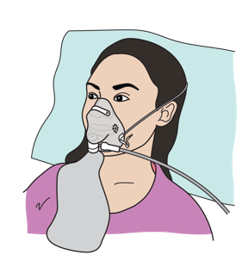
Management
If suspected airway inflammation or burns
  → Keep patient calm.
  → Give OXYGEN, avoid distress.
  → If patient is alert without other injuries, the seated position may be more comfortable.
  →Consider early advanced airway management
    Airway can swell and block quickly; delays may make intubation more difficult.
  → Plan for rapid HANDOVER/TRANSFER.
Notes:
In the case of suspected airway inflammation or burns keep the patient calm. Give oxygen if you can do this without distressing the patient. If the patient is fully alert and no spinal injury is suspected, the seated position may be more comfortable. A person with airway inflammation or burns requires urgent transfer/ handover. Patients with airway burns may require early intubation as the airway can swell and block quickly; delays may make intubation more difficult.

Slide 60
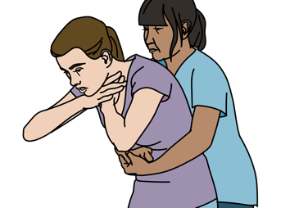
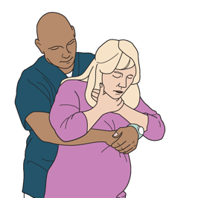
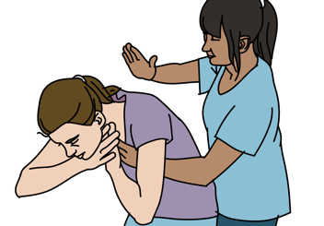
Management
If suspected choking
  → Use age-appropriate chest thrusts/abdominal thrusts/back blows.
BACK BLOWS
ABDOMINAL THRUSTS
CHEST THRUSTS IF PREGNANT
Notes:
If the patient is choking use age-appropriate chest thrusts or abdominal thrusts, alternated with back blows. For a conscious adult use abdominal thrusts in an attempt to expel the foreign body and open the airway. In pregnancy place your hands above the gravid abdomen and perform chest thrusts.

Slide 61
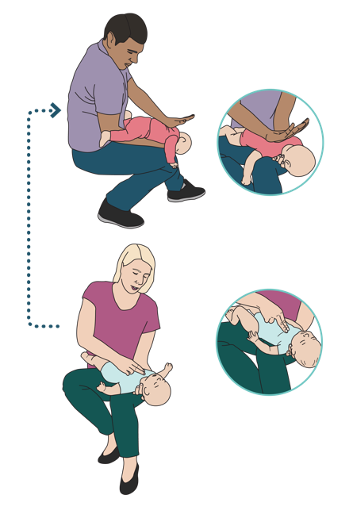
Management
BACK BLOWS
If suspected choking in infants
  Alternate between 5 back blows and 5 chest thrusts.
CHEST THRUSTS
Notes:
For a choking infant perform back blows and chest thrusts. Alternate between five back blows and five chest thrusts. These skills are described in detail in the Basic Emergency Care manual.

Slide 62
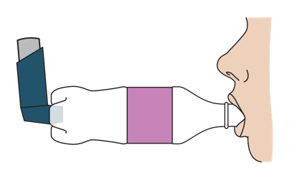
Management
If suspected allergic reaction
  → Remove allergen.
For severe allergic reaction with difficulty breathing:
  → Give intramuscular ADRENALINE without delay.
  → Give OXYGEN.
If suspected asthma/COPD
  → Give SALBUTAMOL.
  → Give OXYGEN if indicated.
If suspected difficulty in breathing and fever
  → Give ANTIBIOTICS as soon as possible.
  → If signs of poor perfusion, give IV FLUIDS.
Notes:
If an allergic reaction is suspected, first ensure that the allergen is removed from the patient. For severe allergic reactions with difficulty in breathing give intramuscular ADRENALINE as soon as possible. Oxygen can be used in severe cases.
In a patient presenting with difficulty in breathing and wheezing, suspect asthma or COPD. Treat the patient with salbutamol. Using a spacer to administer salbutamol from an inhaler can make administration much more effective. A spacer can be made out of a plastic water bottle.
Suspect pneumonia or other infection in patients with difficulty in breathing and fever. Give antibiotics as soon as possible. If the patient has signs of poor perfusion, or shock, give intravenous fluids.

Slide 63

Management
If suspected heart attack
  → Give ASPIRIN
  → Give OXYGEN with symptoms of shock or difficulty breathing.
  → If patient has NITROGLYCERIN, assist them in taking it.
If suspected chronic, severe anaemia
  → Give IV FLUIDS slowly.
  → Listen frequently for crackles in the lungs (fluid overload)
  → Prepare for handover/transfer for possible BLOOD TRANSFUSION.
If suspected diabetic ketoacidosis (DKA)
  → Give IV FLUIDS.
  → Prepare for urgent transfer.
Notes:
If you suspect a heart attack, give aspirin. While oxygen is no longer recommended in all patients with heart attack, it should initially be given to patients with shock or difficulty in breathing. For those patients who already have nitroglycerin, you can assist them in taking it if perfusion is adequate.
Patients with chronic, severe anemia may need a blood transfusion– arrange for handover/transfer for blood transfusion. If IV fluids are needed for poor perfusion give them more slowly and check the lungs for crackles, a sign of fluid overload, frequently.
If DKA is suspected give IV fluids to help lower the blood glucose and treat dehydration. A person with DKA is extremely ill and requires urgent transfer to a referral centre.

Slide 64
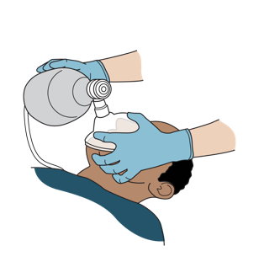
Management
If suspected opioid overdose
  →Support breathing with a BAG-VALVE-MASK as needed.
  →Give NALOXONE.
If suspected large pleural effusion or haemothorax
  →Give OXYGEN.
  →Arrange for urgent HANDOVER/TRANSFER.
  →Patient requires CHEST TUBE or drain.
Notes:
In a patient with slow shallow breathing due to opioid overdose, support breathing with a BAG-VALVE-MASK as needed. Give naloxone to reverse the opioids. Be aware that naloxone does not last as long as many opioids and monitor for the patient’s breathing to worsen again.
If a large pleural effusion or hemothorax is causing difficulty in breathing, arrange for handover/transfer immediately as many of these patients will need a chest drain. Give oxygen and continue it during transport.

Slide 65
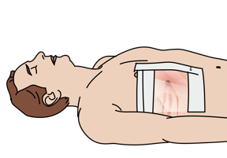
Management
If suspected trauma
  → Give OXYGEN.
  → If tension pneumothorax is suspected, perform NEEDLE DECOMPRESSION as soon as possible
    Prepare for rapid transfer for chest tube insertion.
  → If tension pneumothorax or cardiac tamponade, give IV FLUIDS.
  → Treat sucking chest wounds with a 3-sided occlusive dressing.
    Prepare for rapid transfer for chest tube insertion.
Notes:
Trauma can cause difficulty in breathing due to a number of different injuries. All trauma patients with difficulty in breathing should be given oxygen. IV fluid should be given to help fill the heart if either pericardial tamponade or tension pneumothorax is suspected.
Needle decompression should be performed if tension pneumothorax is suspected. The procedure is described in the BEC manual. Treat sucking chest wounds with a 3-sided dressing. The patient will need urgent transfer/handover for a chest tube if needle decompression is performed or if a 3-sided dressing is applied.

Slide 66

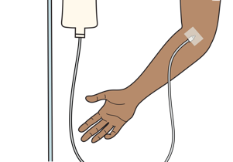
Management
If suspected acute chest syndrome (sickle cell patients)
  → Give OXYGEN.
  → Give IV FLUIDS.
  → May need HANDOVER/TRANSFER
Notes:
In a patient with sickle cell disease with suspected acute chest syndrome, give oxygen, IV fluids and antibiotics. Consider handover/transfer for advanced management.

Slide 67
Workbook Question 4
Using the workbook section above, list what you would DO to manage a person who presents with:
DIB, coughing and you suspect choking
1.
2.
DIB, high fever, cough and you suspect serious infection
1.
2.
Notes:
Workbook Question 4: Difficulty in Breathing [page 90 in participant workbook]
Using the workbook section above, list what you would DO to manage a person who presents with:
Answers:
DIB, coughing. You suspect choking.
1) Give 5 abdominal thrusts 2) Give 5 back blows (repeat until foreign body removed)
DIB, high fever, cough. You suspect serious infection.
1) Give antibiotics 2) Give IV fluids
Image:
Title: Deep thought
Creator:GDL
Source: https://openclipart.org/detail/221707/deep-thought
Copyright information: Creative Commonz Zero 1.0 Public Domain License

Slide 68
Workbook Question 4
Using the workbook section above, list what you would DO to manage a person who presents with:
DIB, hoarse voice and stridor on breathing in. You suspect airway inflammation
1.
2.
3.
Notes:
Answers:
DIB, hoarse voice and stridor on breathing in. You suspect airway inflammation.
1) Calm the patient 2) Give oxygen 3) Plan for advanced airway management
Title: Deep thought
Creator:GDL
Source: https://openclipart.org/detail/221707/deep-thought
Copyright information: Creative Commonz Zero 1.0 Public Domain License

Slide 69
Special Paediatric Considerations: Danger Signs
!
Signs of airway obstruction (unable to swallow, drooling, stridor)
Increased breathing effort
Cyanosis
Altered mental status
Poor feeding
Vomiting everything
Seizures/Convulsions
Low body temperature
Notes:
It is very important to recognize danger signs of respiratory distress in pediatrics including: signs of airway obstruction, such as being unable to swallow saliva/drooling or hearing stridor, increased breathing effort with fast breathing, nasal flaring, grunting, chest indrawing or retractions, cyanosis, or blue colour of the skin, especially at the lips and fingertips; Altered mental status, which in a child can present as lethargy or unusual sleepiness, or agitation; poor feeding or drinking; vomiting everything; seizures/convulsions, or wow temperature.

Slide 70
Special Paediatric Considerations:
!
Wheezing in children can be a viral infection or a foreign object.
Stridor can be caused by airway swelling or a foreign object.
Rapid breathing may be the only sign of pneumonia.
Rapid breathing can indicate diabetic ketoacidosis (DKA) as the first sign of diabetes in children.
Notes:
Wheezing in children can be caused by viral infection, asthma or an inhaled object blocking the airway. Stridor in children can be caused by a foreign object stuck in the upper airway OR airway swelling. Children may present with rapid breathing as the only sign of pneumonia. Rapid breathing can also indicate diabetic crisis (DKA), which may be the first sign of diabetes in a child.

Slide 71
Workbook Question 5
Using the workbook section above, list the paediatric danger signs:
1.
2.
3.
4.
5.
6.
7.
8.
Notes:
Workbook Question 5: Difficulty in Breathing [page 91 in participant workbook]
Using the workbook section above, list the pediatric danger signs.
Answers: 1. Signs of airway obstruction (unable to swallow saliva/drooling or stridor) 2. Increased breathing effort (fast breathing, nasal flaring, grunting, chest indrawing or retractions) 3. Cyanosis (blue color of the skin, especially at the lips and fingertips) 4. Altered mental status (lethargy or unusual sleepiness, agitation) 5. Poor feeding or drinking 6. Vomiting everything 7. Seizures/convulsions 8. Low temperature (hypothermia)
Title: Deep thought
Creator:GDL
Source: https://openclipart.org/detail/221707/deep-thought
Copyright information: Creative Commonz Zero 1.0 Public Domain License

Slide 72
Disposition of the Patient
Ongoing Monitoring
  Inhaled medications such as salbutamol only last approximately 3 hours.
  A severe allergic reaction can return when adrenaline wears off.
  Naloxone only lasts about 1 hour and may require repeat doses.
    Most opioid medications last longer than this.
  Following submersion injuries, a person may develop breathing problems later.
Remember these patients need to be monitored closely!
Notes:
Consider early on whether the patient will be; sent home, will need further monitoring with admission to the ward, or will need to be transferred for a higher level of care. The patient may require ongoing monitoring. Keep in mind that the effects of inhaled medications such as salbutamol last for only approximately 3 hours. Patients need to be monitored closely and may need repeat does. If a patient with a severe allergic reaction is given adrenaline, the reaction can return when the adrenaline wears off, requiring careful observation and repeat dosing. Naloxone only lasts about 1 hour. Most opioid medications last longer than this, so patients may need repeat naloxone doses. Following immersion in water (drowning), a person may develop worsening difficulty breathing hours later. These patients should be observed for at least 6 hours before discharge home.

Slide 73
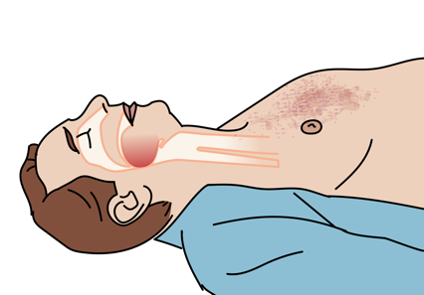
Transport Considerations
Never leave a patient who might need definitive airway placement unmonitored during handover/transfer.
Make transfer arrangements as early as possible for any patient who may require assisted ventilation.
An unmonitored airway can easily obstruct!
Notes:
Plan for a safe transfer by ensuring a patient who might need definitive airway placement is never unmonitored during handover/transfer. Never leave a patient unmonitored who might need definitive airway placement. Make transfer arrangements as early as possible for any patient who may require assisted ventilation.

Slide 74
Remember
Perform ABCDEs first
Treat life-threatening conditions
Take a SAMPLE history
Do an extended physical examination
Think about causes
Think about considerations in children
Think about disposition and transport
Notes:
When caring for a patient with difficulty in breathing remember to perform the ABCDE’s first to identify and treat life-threatening conditions. Then take a SAMPLE history and perform a secondary exam. Use the information that you find to think about possible causes for the difficulty in breathing. Provide simple but life-saving treatments. Make sure to think about the special considerations in children since they can worsen quickly with difficulty in breathing. Think about disposition and transport early to ensure that you can get the patient to a higher level of care if needed.

Slide 75

Questions
Notes:
Do you have any questions?

Slide 76
Quick Cards
Notes:
Please check the Difficulty in Breathing Quickcards in the BEC manual.

Slide 77
Notes:
The key ABCDE findings are outlined in the Quickcard.

Slide 78
Notes:
Key findings from the SAMPLE history and secondary exam are found in the Quickcard.

Slide 79
Notes:
Critical actions for high-risk conditions are summarised.

Slide 80
Notes:
The Quickcards highlight special considerations including paediatric danger signs, and key points on disposition.

Slide 81
Summary
In this presentation, we have covered:
The SAMPLE history for a patient with difficulty in breathing
Key history findings suggestive of different causes of difficulty in breathing.
How to perform a secondary exam for a patient with DIB
The signs of difficulty in breathing (DIB)
The high-risk causes of DIB
Critical actions to manage patients with DIB
Essential skills for high-risk causes of difficulty in breathing
Special paediatric considerations for DIB
Disposition and transport of patients with DIB
Notes:
In this presentation we have covered the SAMPLE history and key history findings for patients with difficulty in breathing. We have covered how to perform a secondary exam, the signs of difficulty of breathing and the high-risk causes. We have covered critical actions to manage patients with difficulty in breathing, listed essential skills for high-risk causes of difficulty in breathing, identified special paediatric considerations and considered the disposition of patients.

