Slide 1


Altered Mental Status
Basic Emergency Care Course
Notes:
Welcome to the Altered Mental Status module.

Slide 2
Objectives
By the end of this presentation, you will be able to:
Apply a SAMPLE history to a patient with altered mental status
Recognize key history findings suggestive of different causes of altered mental status
List high-risk causes of altered mental status in adults and children
Describe how to perform a secondary exam in a patient with altered mental status
Recognize key examination findings suggestive of different causes of altered mental status
Describe critical actions to manage a patient with altered mental status (AMS)
Identify essential skills to manage for high-risk causes of altered mental status
Describe special paediatric considerations for altered mental status
Consider the disposition and transport of patients with altered mental status
Notes:
By the end of this presentation, you will be able to apply a SAMPLE history to a patient with altered mental status, recognize key history findings suggestive of different causes of altered mental status and list the high-risk causes of altered mental status in adults and children. You will be able to describe how to perform a secondary exam in a patient with altered mental status and recognize key examination findings. We will cover critical actions to manage a patient with altered mental status, identify essential skills to manage for high-risk causes of altered mental status and describe special paediatric considerations. We will consider the disposition and transport of patients with altered mental status.

Slide 3





Essential skills
Intravenous (IV) line placement
IV fluid resuscitation
Direct pressure/ deep wound packing for haemorrhage control
Tourniquet for haemorrhage control
Pelvic binding
Fracture immobilization
Skin pinch test
Overall
Assessing ABCDE
Cervical spine immobilization
Head-tilt and chin-lift/jaw thrust
Airway suctioning
Management of choking
Recovery position
Nasopharyngeal (NPA) and oropharyngeal airway (OPA) placement
Full spine immobilization
AVPU and GCS
Glucose administration
Oxygen administration
Bag-valve-mask ventilation
Needle-decompression for tension pneumothorax
Three-sided dressing for chest wound
Wound and burns management
Snake bite management
Log roll
Notes:
The essential skills for this module are listed here. Each skill will be introduced in the lecture and taught during the practical sessions of this course.

Slide 4

Overview
Altered mental status is a term used for a range of presentations.
  Sudden or gradual changes in behaviour
  Disorientation
  Confusion
  Coma
May be due to conditions that affect the brain or the brain itself
Can be chronic psychiatric problems or dementia but must rule out other life-threatening causes first
Delirium always requires a full assessment.
  Ask family about baseline mental status when possible.
Notes:
Overall, we are using the term “altered mental status” to describe a broad range of patient presentations, including sudden or gradual changes in behavior, disorientation, confusion, and even coma. These changes in mental status or in the level of consciousness may be due to systemic conditions that affect the brain, such as low oxygen or glucose levels, or conditions within the brain itself such as infection or injury. Though chronic problems like psychiatric disease or dementia may cause presentations of altered mental status, life-threatening causes must always be considered first. Delirium, a rapidly changing state of confusion that is often accompanied by agitation, loss of focus, or inability to interact appropriately, always requires a full assessment as it can be life-threatening. Because we as emergency providers often only see a brief snapshot of a patient’s condition, it is very helpful to ask family or friends about the baseline mental status of the patient whenever possible.

Slide 5
Goals: Altered Mental Status
The goal of initial assessment is to identify rapidly reversible causes of altered mental status, and to recognize dangerous conditions requiring transfer.
The goal of acute management is to ensure that blood, oxygen and glucose reach the brain; and to protect the brain from additional injury.
Notes:
As with all our core BEC patient presentations, the goal of our initial assessment is to identify rapidly reversible causes and to recognize dangerous conditions that require transfer. Our goal for the acute management of altered mental status is to ensure that adequate blood, oxygen, and glucose reach the brain, as well as to protect the brain from additional injury.

Slide 6
The ABCDE Approach
!
REMEMBER …………
Always start with the ABCDE approach AND treat life-threatening conditions.
Then, take a SAMPLE history.
Then, do a Secondary Examination.
Notes:
To begin, we will always start with our ABCDE approach, treat life-threatening conditions, then take a sample history followed by a secondary examination.

Slide 7
The ABCDE Approach
Airway
May not be able to protect their airway and may be at risk for choking on vomit
Breathing
Hypoxia can cause altered mental status.
Look for signs of difficulty in breathing or cyanosis.
Fast, deep breathing can reflect diabetic ketoacidosis or poisoning.
Circulation
Lack of perfusion to the brain
Look for and manage signs of shock
Low blood pressure
Elevated heart rate
Delayed capillary refill
Notes:
So to begin our ABCDE approach, we must remember that patients with altered mental status may not be able to protect their airways and may be at risk of choking. In regard to breathing, we mentioned that hypoxia can be an underlying cause of altered mental status, so it will be critical to look for signs of difficulty in breathing, such as abnormal muscle use during breathing or the blue coloring of the skin known as cyanosis. Abnormal breathing patterns can also point to underlying causes like diabetic ketoacidosis or poisoning. Turning to circulation, we know that lack of perfusion to the brain is a common cause of altered mental status, so we must always check for signs of shock, such as low blood pressure, elevated heart rate, and delayed capillary refill.

Slide 8

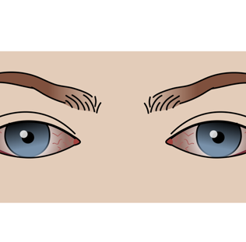
The ABCDE Approach
Disability
      Check AVPU or GCS (trauma).
      Check glucose.
        Hypoglycaemia, hyperglycaemia (diabetic ketoacidosis) can cause altered mental status.
      Check pupils
        Very small pupils: possible opioid overdose or pesticide poisoning
        Very dilated pupils: possible stimulant drug use
        Unequal pupils: possible head injury (increased intracranial pressure)
      Check strength and sensation.
        Weakness or loss of sensation to one side: possible tumor, bleeding or blockage of blood vessel, brain infection
        General muscle weakness: possible salt imbalance
      Look for abnormal repetitive movements or shaking on one or both sides (seizure).
Notes:
The disability portion of our ABCDE assessment is especially important during the evaluation of a patient with altered mental status. We will discuss two scales that can be used to describe the level of altered mental status, the AVPU scale and the GCS scale, shortly. We will need to remember that we must check blood glucose, as both very low and very high glucose levels can lead to AMS. Pupil size can also help us identify possible underlying causes: very small pupils could be a sign of opioid overdose, while very dilated pupils could indicate stimulant drug use, and unequal pupils could be found in patients with significant head injury and increased intracranial pressure. It is also important to assess both strength and sensation on both sides of the body, as loss of these things on one side could suggest a tumor, bleeding, blockage of blood vessel leading to stroke, or infection. If strength or sensation is abnormal on both sides of the body or more globally, these findings might suggest a cause like an electrolyte or salt imbalance. Abnormal or repetitive movements might be due to seizure or convulsion.

Slide 9
The ABCDE Approach
Exposure
      Look for signs that might cause altered mental status.
      Check for infection, rashes, trauma, bites or stings.
      Check arms for needle marks.
!
REMEMBER …..
Altered patients may not report the history accurately.
Notes:
Finally, during exposure, skin must be inspected closely for signs of infection, trauma, and toxicologic exposure, especially given that patients with altered mental status may not be able to provide an accurate history.

Slide 10
Altered Mental Status
Part 1: The SAMPLE history
Notes:
During the first part of this presentation, we will consider the SAMPLE history for a patient with altered mental status.

Slide 11
S: Signs and Symptoms
ASK
  How does the current condition compare to baseline mental status?
THINK
    Ask family/friends about baseline when possible, to establish normal behaviour.
Notes:
Beginning with signs and symptoms, we can ask about how the patient’s current condition compares to their baseline mental status. Ask family / friends or those who know the patient about their baseline when possible, to establish normal behaviour.

Slide 12
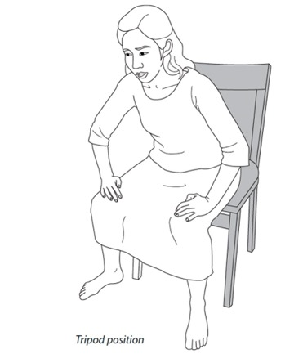
S: Signs and Symptoms
ASK
  Is there difficulty breathing?
THINK
  Altered mental status with difficulty in breathing may indicate lack of oxygen to the brain.
Notes:
We can ask about any associated difficulty in breathing, as low oxygen levels can impact the brain’s normal functioning.

Slide 13
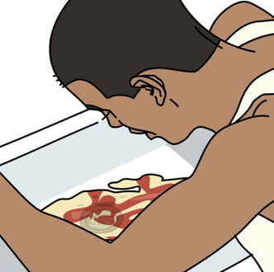
S: Signs and Symptoms
ASK:
  Is there a headache?
  Is there vomiting/ diarrhoea?
THINK
    Headache with AMS can indicate infection, tumor or bleeding.
    Vomiting without diarrhoea can be a sign of increased pressure in the brain.
    Any source of dehydration can cause AMS from poor perfusion.
    Vomiting and diarrhoea can cause hypoglycaemia.
Notes:
We can ask about headache, as altered mental status with an associated headache could increase our suspicion of intracranial infection, tumour, or bleeding. We can ask about vomiting, as this could be a sign of increased pressure on the brain or poisoning. Vomiting, diarrhoea, or both could be signs of infection. They could cause dehydration that might lead to poor perfusion of the brain or hypoglycemia that could be the underlying cause of AMS.

Slide 14
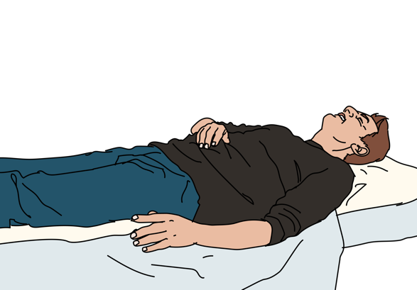
S: Signs and Symptoms
ASK
  Has there been any dizziness or fainting?
  THINK
    This could be a sign of poor perfusion to the brain.
Notes:
We can ask about associated dizziness or fainting, both of which could also signal poor perfusion of the brain.

Slide 15
S: Signs and Symptoms
?
ASK
  When did the symptoms start?
  How long do they last?
  Have they changed over time?
THINK
    Rapid onset think infection, inflammation, bleeding or drugs/toxins
    Gradual onset think less acute causes such as tumour or slow bleeding in the brain
    Intermittent onset think seizures or psychiatric disease
Notes:
It is extremely important to ask about the timing of symptoms. If the symptoms started, rapidly we can consider infection, inflammation, bleeding, poisoning or toxic exposure. If the symptoms were gradual in onset over weeks or months, we might consider space occupying lesions in the brain, like tumours, that tend to grow more slowly. If the symptoms come and go with periods of normal status between the episodes, then seizures or convulsions or psychiatric disease could be a cause.

Slide 16
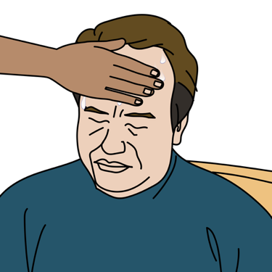
S: Signs and Symptoms
ASK
  Any recent fevers?
THINK
    Brain infections
    Serious infections in children and elderly can cause AMS
    Exposures
      Prolonged outdoor (heat) exposure
      Poisons
      Medications
      Drugs
    High fevers can cause AMS
Notes:
If symptoms are associated with fever, it should raise our concern about an infection. Brain infections can definitely cause fever and altered mental status, but other types of severe infections like those in the urine, lungs, or blood can too. Small children and the elderly are particularly at risk of having altered mental status from these types of severe infections. However in addition to infection, certain poisons, recreational drugs, and medications can also cause altered mental status accompanied by fever. Prolonged environmental exposures can also cause AMS – this AMS may be accompanied by fever when there has been a significant heat exposure or hypothermia in the case of cold exposure. Importantly, an extremely high fever itself can be the primary cause of AMS.

Slide 17
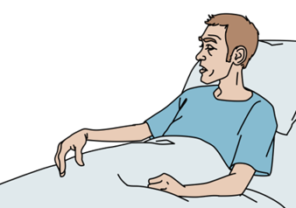
S: Signs and Symptoms
ASK:
  Any weakness, clumsiness or difficulty walking?
THINK
  Consider stroke or tumour.
ASK:
  Any neck pain or stiffness?
THINK
  Consider bleeding, inflammation or infection in cerebral spinal fluid.
Notes:
We’ve mentioned that both space occupying lesions like tumors and strokes can cause altered mental status. Some symptoms that might increase our suspicion for these types of conditions as the underlying cause are weakness, clumsiness, or difficulty walking. If the AMS is accompanied by neck pain or stiffness in moving the neck, we should think more about infections like meningitis, or bleeding around the brain like subarachnoid hemorrhage.

Slide 18
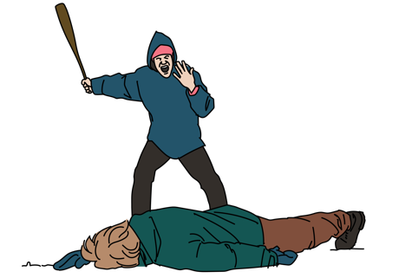
S: Signs and Symptoms
ASK:
  Any recent history of trauma or falls?
THINK
  Bleeding in or around the brain can cause AMS even days after injury.
  Chronic alcohol drinkers and the elderly
    More prone to brain bleeding
    May not remember falls
  Always consider unwitnessed trauma in a patient found altered with no known cause.
Notes:
If there has been a recent fall or trauma, we should consider all types of intracranial bleeding, remembering that altered mental status can occur up to days after an initial injury. People with chronic alcohol use and the elderly may be especially at risk of both falls and intracranial bleeding from those falls, though they may not be able to provide historical information about the fall. And so, even in patients who do not report trauma, we will have to consider it as a cause.

Slide 19
S: Signs and Symptoms
ASK:
  Any recent depression or changes in behaviour?
THINK
  Drug and alcohol use or psychiatric problems
  Consider possibility of suicide attempt by poisoning
Notes:
Both accidental and non-accidental toxicological causes should be considered for patients with AMS. With symptoms of recent depression reported by the patient or noted by family, friends or contacts, we should think about the possibility of concurrent substance use, like alcohol or drugs, or suicide attempts.

Slide 20
S: Signs and Symptoms
ASK:
  Does anyone else from the same family or location have symptoms?
THINK
  Gaseous poisoning
    Carbon monoxide is usually seen in cold climates with indoor heating.
Notes:
If multiple people from one location have similar symptoms, an accidental toxicologic exposure such as carbon monoxide poisoning from indoor heating without adequate ventilation, should be considered.

Slide 21
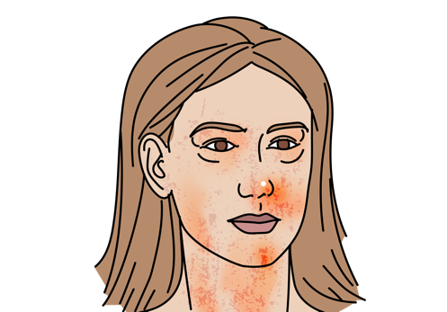
A: Allergies
ASK
  Allergies to medications or other substances?
  Recent exposures to known allergens?
THINK
  Severe allergic reactions can present with altered mental status due to
    Low blood oxygen levels
    Poor blood circulation due to shock
Notes:
After we’ve asked about associated symptoms, we need to gather information about allergies. Severe allergic reactions can cause hypoxia and poor perfusion or shock which could result in altered mental status directly. We also must be sure that we don’t give any medications which the patient is allergic too during our initial management of their AMS.

Slide 22

M: Medications
ASK
  Currently taking any medications?
    Collect medication list
  Any new medications or changed doses?
THINK
  Medication interactions
  Medication side effects
    Pain medications (opioids such as morphine, pethidine, heroin)
    Sleeping medications
    Seizure medications
Notes:
Gathering information about the patient’s list of home medications, particularly new or changed medications, is also important to assess for possible medication side effects or interactions. Medicines given for pain, sleeping, muscle relaxation, seizures, and anxiety can all cause AMS. The medication list or home medication containers may also provide information about the patient’s underlying chronic medical problems if the patient is unable to communicate them.

Slide 23
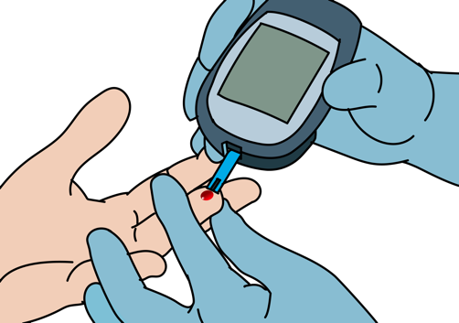
P: Past Medical History
ASK
  History of diabetes?
THINK
  Low blood sugar
  Diabetic Ketoacidosis (DKA)
    Increased urine output
    Increased thirst
    Fast or deep breathing
Notes:
If the patient, family, friend, or other contact is able to provide information about their past medical history, diabetes is a particularly critical and common condition to ask about. Hypoglycemia (low blood sugar) and diabetic ketoacidosis (high blood sugars) can both cause AMS. It may be helpful to ask about medication adherence or changes, as well as changes in thirst, hunger, urination, and breathing to better differentiate the type of diabetic crisis.

Slide 24
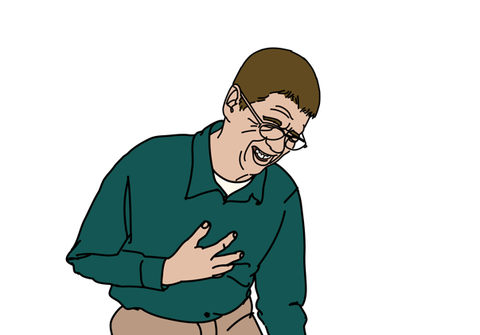
P: Past Medical History
ASK
  History of heart disease?
  History of stroke?
  History of high blood pressure?
THINK
  Heart attacks can decrease blood flow and oxygen to the brain.
  Heart disease increases risk of stroke.
  AMS with a stroke history may indicate a new stroke or brain bleeding.
  Old stroke symptoms may return with severe illness.
  High blood pressure increases the risk for brain bleeding.
Notes:
Cardiac or heart disease can cause AMS by directly lowering the oxygen or perfusion levels needed for the brain to function. Cardiac disease, high blood pressure, diabetes, and high cholesterol all increase the risk of stroke. In a person who has a history of a prior stroke, a new stroke should be considered as well as complications from a prior stroke. A recent ischemic stroke may increase risk for intracranial bleeding. Symptoms of an old stroke may also return or worsen when there is a severe illness of any kind. High blood pressure increases the risk for brain bleeding.

Slide 25
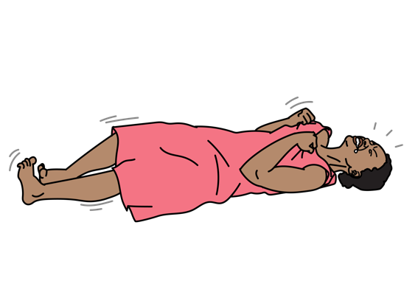
P: Past Medical History
ASK
  History of seizure?
    Do they take regular medications?
    Any medication changes or missed doses?
    If they had a witnessed convulsion, ask about fall or head trauma
THINK
  Recovering from convulsion (postictal period)
  usually takes half hour to several hours at the most.
  If altered mental status persists longer → consider other causes.
Notes:
A history of prior seizures is important because both an active seizure and the post-ictal period immediately after a seizure can cause AMS. Though it can take anywhere from minutes to several hours for a person to fully recover after a seizure, AMS lasting longer than this is worrisome and alternate causes should be considered.

Slide 26
P: Past Medical History
ASK
  History of HIV infection?
  History of tuberculosis?
  History of liver or kidney failure?
THINK
  With history of HIV or tuberculosis, consider infection around brain.
  With liver or kidney failure, consider problems clearing toxins and waste.
Notes:
A past medical history of conditions such as HIV or tuberculosis may suggest CNS or brain infections, while a past medical history of conditions like liver or kidney failure may suggest buildup of toxins within the blood stream that would typically be cleared by these organs.

Slide 27
P: Past Medical History
ASK
  History of long standing alcohol use?
  History of drug abuse?
THINK
  Alcohol intoxication and alcohol withdrawal can present with altered mental status.
  Alcoholics have a high risk for head injury and low blood sugar levels.
  Sedatives and opiates can cause altered mental status.
Notes:
A history of substance use disorder, such as alcohol or drug abuse, is important to ask about, as acute intoxication and withdrawal can both cause AMS. We also know that this population may be at increased risk of falls or hypoglycemia, which we’ve discussed as additional independent causes of AMS. In particular, sedatives and opiates can cause altered mental status.

Slide 28
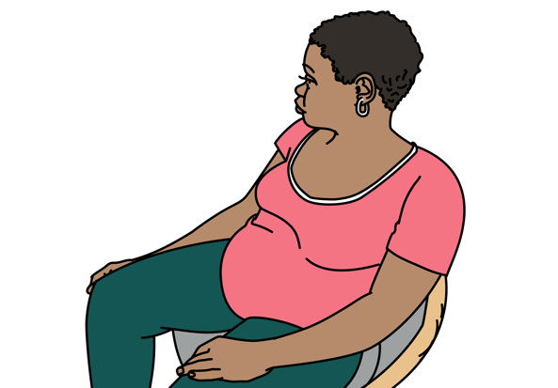
P: Past Medical History
ASK
  History of pregnancy?
THINK
  High blood pressure during pregnancy can lead to eclampsia (seizures/convulsions).
Notes:
It is extremely important that pregnancy or recent childbearing is considered in any female patient with seizure or altered mental status. Eclampsia is a life- threatening diagnosis that needs to be treated differently from other types of seizure.

Slide 29
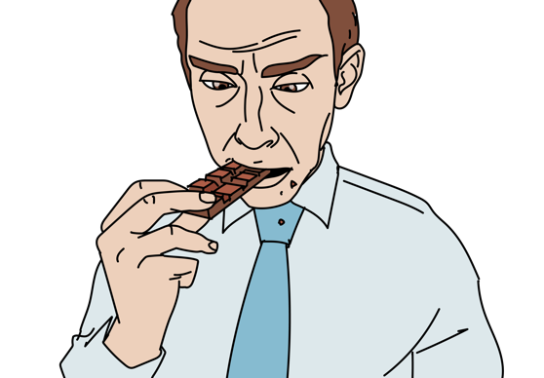
L: Last Oral Intake
ASK
  When did the patient last eat or drink?
THINK
  Low blood sugar levels and dehydration can cause AMS.
Notes:
The last oral intake is important to know if a patient has a potential surgical emergency requiring anaesthesia. It is also important because poor eating or drinking could indicate dehydration, hypoglycemia, or vitamin deficiencies.

Slide 30

E: Events Surrounding Illness
ASK
  Was there any recent trauma?
  Any recent travel?
THINK
  Trauma can cause poor perfusion and AMS.
  Specific infections acquired during travel can lead to altered mental status.
    Malaria is a key consideration
Notes:
To finish our SAMPLE history, we will need to ask about the events that surrounded this presentation. We’ve talked about how identifying recent trauma may suggest potential brain injury. Another recent event to ask about is travel, as specific infections may be more common in certain locations, for example malaria.

Slide 31
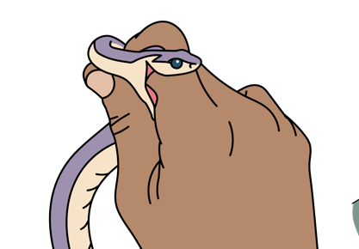
E: Events Surrounding Illness
ASK
  Recent exposures: sick person, recent bites, chemical exposures, exposure to hot or cold…?
  Drugs or alcohol?
THINK
  Sick contacts may suggest infection.
  Chemical exposure (pesticides) may suggest poisoning.
  Bites may suggest envenomation.
  Exposure to extreme temperatures suggests hyper/hypothermia.
  Drug ingestions can cause agitation or lethargy.
  Alcohol intoxication and withdrawal can cause AMS.
Notes:
Other exposures, such as to sick persons, animals and bites, certain chemicals, drugs or alcohol, or environments, may be key to uncovering the cause of altered mental status. These exposures can lead to infection, poisoning, envenomation, hyper or hypothermia, agitation or lethargy, and AMS.

Slide 32
Workbook Question 1
Using the workbook section above, list 7 questions about SIGNS AND SYMPTOMS you would ask when taking a SAMPLE history
1.
2.
3.
4.
5.
6.
7.
Notes:
Workbook Question 1: [page 126 in participant workbook] List seven questions about signs and symptoms you would ask when taking a SAMPLE history.
Answers:
1. Is there difficulty breathing? 2. Is there a headache? 3. Is there vomiting/diarrhea? 4. Has there been dizziness or fainting? 5. When did the symptoms start? How long do they last; do they come and go; and have they changed over time? 6. Has there been any recent fever? 7. Is there any weakness, clumsiness, or difficulty walking? 8. Is there neck pain or stiffness? 9. Is there a recent history of trauma or falls? 10. Has there been any recent changes in behavior or depression?
Image
Title: Deep thought
Creator:GDL
Source: https://openclipart.org/detail/221707/deep-thought
Copyright information: Creative Commonz Zero 1.0 Public Domain License

Slide 33
Altered Mental Status
Part 2: The Secondary Exam and Causes of Altered Mental Status
Notes:
In the second part of this module we will consider the secondary exam and causes of altered mental status. We will start with the components of the secondary exam.

Slide 34
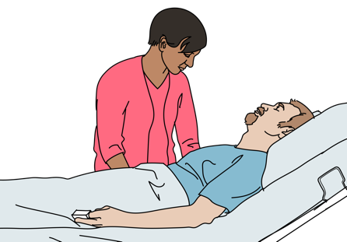
When caring for patients with altered mental status, always check for safety!
Agitated and violent behaviour is common.
Determine cause, prioritize the safety of the patient and providers.
Keep calm, work as a team.
Ensure the space is safe from weapons and you have an escape route.
Avoid making the patient feel threatened.
Do not sit too close and speak in a calm, sympathetic voice.
Explain what is happening.
Approach as a group or call for help if necessary.
Check vital signs, temperature and glucose; treat abnormalities.
Call for help early.
Notes:
As a reminder for all patients, but especially for patients with altered mental status, agitated and violent behavior is unfortunately common. The safety of both the patient and the providers caring for that patient must be prioritized alongside identification and treatment of the underlying cause. Keeping calm, speaking in clear, sympathetic tones, explaining everything that is occurring, and avoiding actions that might make the patient feel threatened, like sitting too close or standing over them, will be critical to minimizing danger. However, you should be sure that there are no potential weapons in the treatment space and that you always have an escape route. For example, standing close to the door or exit, as opposed to in a far corner of the space will prevent your escape from being blocked. Evaluating and managing this scene safety, as well as calling for help early to work with a team, is vital. Don’t forget to check vital signs, temperature, and glucose and treat abnormalities as soon as possible.

Slide 35
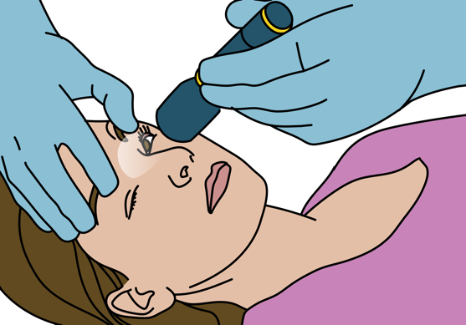
Secondary Exam Findings
Check level of consciousness with AVPU scale.
Check Glasgow Coma Scale in trauma.
Check blood glucose.
Check pupils for small, dilated or unequal.
Check orientation.
  Name?
  Where are you?
  What time is it?
  What day of the week is it?
Notes:
Once we’ve established that it is safe to do so, our detailed secondary exam should include an evaluation of the level of consciousness of the patient. The AVPU scale can be used to describe a patient’s ability respond to stimuli. The “A” refers to a patient that is alert – they are fully awake and responding to all stimuli. However, a person who is not fully alert can be classified as “V” if they respond to verbal stimuli, such as opening their eyes when their name is called, or “P” if they only respond to painful stimuli, such as moaning or moving when pinched. If there is no response to verbal or painful stimuli, the person can be described as “U” or unresponsive. In patients who have suffered trauma, the Glasgow Coma Scale can be used to describe the level of consciousness in slightly more detail, based on the eye, verbal, and motor responses to stimuli. A glucose level should be checked in all trauma and non-trauma patients with altered mental status, as well as the pupillary size and response. Very small pupils could suggest causes suggest as opioid overdose or organophosphate poisoning, Dilated, large pupils could suggest causes like stimulant drug intoxication or anticholinergic poisoning. Unequal pupils could suggest increased intracranial pressure on the brain. If the patient is alert and able to verbally respond, simple questions should be used to assess their orientation to person, place, and time.

Slide 36
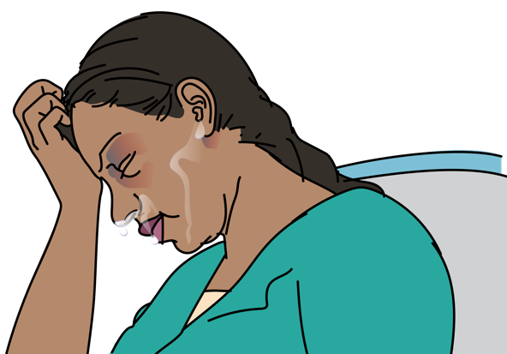
Secondary Exam Findings
Check for trauma.
  Head injuries
  Check for bruising around the eyes, behind the ears or leaking of clear fluid from the nose or mouth.
Check temperature.
  Infectious causes, poisoning, alcohol withdrawal
  and changes in body hormones can cause fever.
  Hypothermia may mean sepsis, cold exposure
  or low body hormone levels (thyroid).
Check for stiff neck.
  Infection
  Bleeding in the brain
  Trauma (immobilize spine, do not move neck)
Notes:
Because we know that patients with AMS may not be able to recall trauma, our secondary exam should look for subtle findings of trauma, including bruising around the eyes or ears, bleeding or leakage of clear fluid from the nose or ears, and oral or dental injury. Abnormal temperatures can indicate many different causes of AMS. Sepsis or severe infection can result in either fever or hypothermia. Certain environmental exposures, poisonings, or drug withdrawals may also cause high or low temperature findings. Severely elevated thyroid hormone levels may cause fever, while low thyroid hormone levels can cause hypothermia. And again, a stiff neck may indicate infection or bleeding. The spine should be immobilized if there is any concern for trauma to prevent any potential further injury.

Slide 37
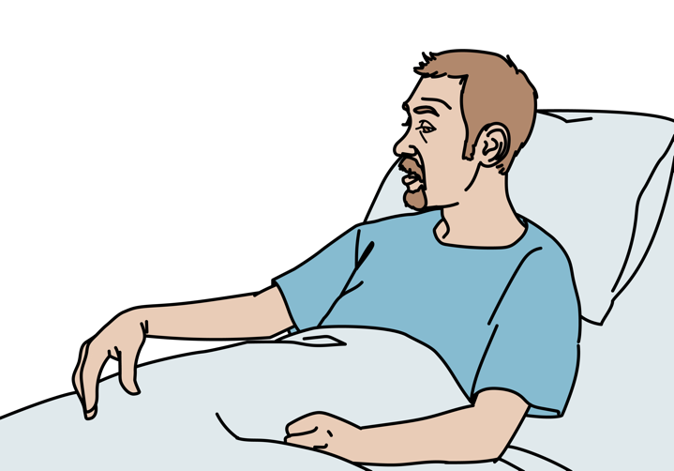
Secondary Exam Findings
Check for strength and sensation.
Ask the patient to follow commands.
  Test for strength in face, arms and legs.
Look for generalized or one-sided weakness.
  Suggests a mass, bleeding or blockage in vessel
  Consider hypoglycaemia.
  Generalized weakness suggests salt imbalance.
Notes:
If the patient is able to follow commands or communicate, then strength and sensation should be tested in the face, arms, and legs. We discussed that one-sided or unilateral findings could suggest a cause like stroke. Hypoglycemia can also mimic these findings so it is important to check a level and treat hypoglycemia in patients with altered mental status. Generalized weakness may suggest electrolyte imbalances, in particular sodium, potassium, or calcium abnormalities.

Slide 38
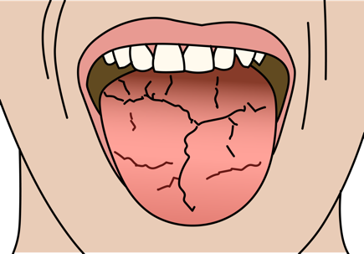
Secondary Exam Findings
Check for signs of dehydration.
  Dry mouth
  Abnormal skin pinch
  Consider diabetic ketoacidosis
Feel the abdomen.
  Enlarged liver (liver disease)
Check the skin.
  Cool, pale, moist skin: Suggests hypoglycaemia
  Jaundice (yellow) skin: Suggests liver disease
  Check for rashes, bites, stings
Monitor for changes in mental status - patients can worsen quickly!
Notes:
Our secondary exam should also assess for signs of dehydration, such as dry mucous membranes in the mouth or an abnormal skin pinch test. Clinical signs of dehydration paired with abnormal breathing may suggest conditions like diabetic ketoacidosis. An enlarged liver on palpation of the abdomen may suggest underlying liver disease. A skin assessment is very helpful when evaluating for underlying causes of AMS. Cool, pale, moist skin can be found in hypoglycemia. Yellow-coloured skin or eyes can be found in jaundice from liver disease. Bruising can suggest trauma or blood disorders. Rashes can be found in infection or toxic exposures. Bites and stings could suggest envenomation. Because patients can worsen quickly, we will need to monitor their mental status closely.

Slide 39
Workbook Question 2
Using the workbook section above, list 5 SECONDARY exam findings you would check for in a patient with altered mental status:
1.
2.
3.
4.
5.
Notes:
Workbook Question 2: [page 128 in participant workbook]
List five secondary examination findings you would check for in a patient with altered mental status.
Answers:
1. Abnormal level of consciousness 2. Low or high blood glucose level 3. Very small or very large pupils 4. Abnormal orientation 5. Signs of trauma such as unequal pupils, bruising 6. Fever or hypothermia 7. Stiff neck 8. Loss of strength and sensation 9. Signs of dehydration 10. Enlarged liver 11. Yellow skin, bites/stings, signs of poor perfusion
Image
Title: Deep thought
Creator:GDL
Source: https://openclipart.org/detail/221707/deep-thought
Copyright information: Creative Commonz Zero 1.0 Public Domain License

Slide 40
Altered Mental Status
Part 2: The Secondary Exam and Causes of Altered Mental Status
Notes:
Now we will consider the causes of altered mental status in more detail.

Slide 41
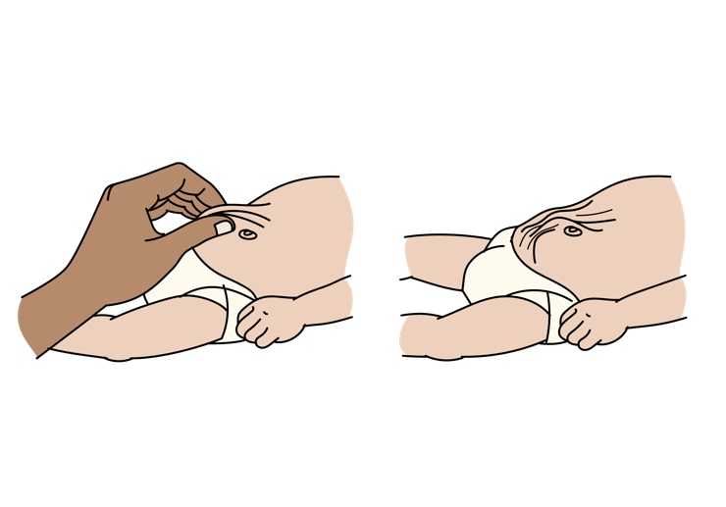

Rapidly Reversible Causes of Altered Mental Status
Hypoglycaemia signs/symptoms
Sweating
Seizures/convulsions
Blood glucose <3.5mmol/L
History of diabetes, malaria or severe infection
Children with any illness
Responds quickly to glucose
Severe dehydration signs/symptoms
Signs of poor perfusion
  Tachycardia
  Low blood pressure
Abnormal skin pinch
Decreased ability to drink fluids
Dry mucous membranes
Notes:
Hypoglycemia can cause symptoms ranging from mild dizziness, sweating, and nausea to confusion to unconsciousness to seizures or convulsions. Though it most commonly occurs in people with diabetes, it can also occur in patients with malaria or other severe infections. Children are particularly at risk of hypoglycemia. Once recognized, symptoms should improve quicky with glucose administration. Severe dehydration resulting in poor perfusion can be identified by findings of dry mucous membranes, abnormal skin pinch, elevated heart rate, and, in the most severe cases, low blood pressure. Patients may report difficulty tolerating oral fluids or losses from vomiting, diarrhea, or excessive urination.

Slide 42
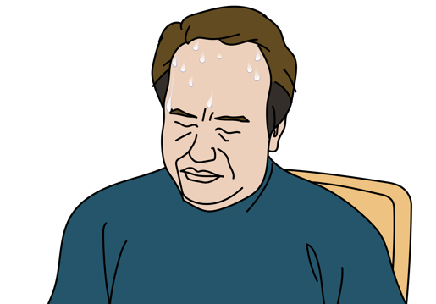
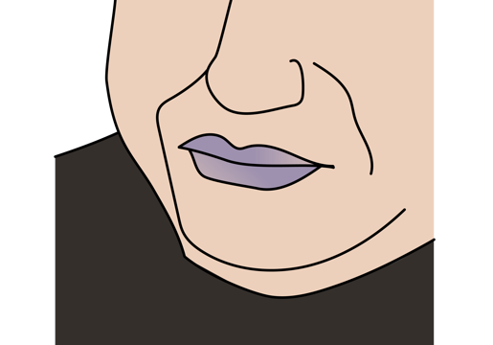
Rapidly Reversible Causes of Altered Mental Status
Heat Stroke signs/symptoms
Prolonged heat and sun exposure
High body temperature
Very warm skin
May or may not be sweating
Hypoxia signs/symptoms
Shortness of breath
Low blood oxygen levels
Cyanosis
Notes:
Heat stroke, the more severe version of heat illness, characterized by extremely elevated body temperature over 40 degrees Celsius causing altered mental status, most commonly occurs from prolonged exposure to heat, though it can also occur after severe exertion. Skin will be hot to the touch and patients may or may not have sweating. Hypoxia, causing altered mental status due to inadequate oxygenation of the brain, may be diagnosed in patients with shortness of breath, rapid or slowed respiratory rates, and signs of cyanosis such as blue lips or fingertips. All four of these conditions: hypoglycemia, severe dehydration, heat stroke, and hypoxia are rapidly reversible and require both early diagnosis and treatment.

Slide 43
Infectious Causes of Altered Mental Status
Cerebral malaria signs and symptoms
Fever
Rapid malaria test or smear positive
In or from an area with malaria
Inflammation/infection around the brain (meningitis, encephalitis, brain abscess, bleeding)
Fever
Neck stiffness
Rash
Eye pain/ sensitivity to light
Headache
Known infectious epidemic or exposure
History of HIV or TB infection
Notes:
A variety of infections can cause altered mental status, most of which are characterized by fever and altered mental status. The diagnosis of cerebral malaria requires exposure, most commonly with the patient living in or having visited an endemic area, and with rapid malaria test or smear positive (if available). Other infections occurring within the central nervous system, such as meningitis, encephalitis, and brain abscesses, often present with fever and AMS, but may also have associated stiff neck, rash, eye pain and light sensitivity, and headache. There may be a known infectious epidemic or exposure, or the patient may have a past medical history of causing immunocompromise.

Slide 44
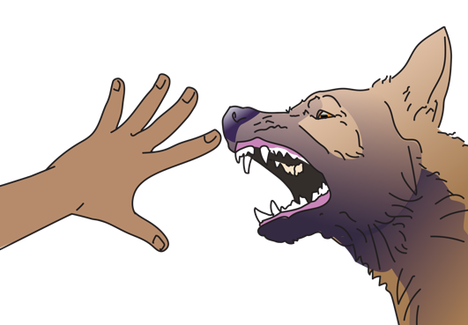
Infectious Causes of Altered Mental Status
Severe infection signs and symptoms
Fever
Tachycardia
Tachypnoea
May have hypotension
Sign of infection
  Skin infection
  Cough
  Crackles in lungs
  Urinary symptoms
Rabies signs and symptoms
Agitation
Fear of drinking (hydrophobia)
Drooling
Weakness
History of animal bite
Notes:
Infection occurring outside of the central nervous system may present with fever, tachycardia, and hypotension. There may be pain or other signs of infection to point toward infection of the bloodstream, urine, lungs, skin, or abdomen. Rabies is classically described as abnormal behavior that includes agitation, hydrophobia, or fear of water, drooling, and weakness with a history of animal bite.

Slide 45

Metabolic Causes of Altered Mental Status
Diabetic ketoacidosis signs and symptoms
History of diabetes
Rapid or deep and slow breathing
Frequent urination
Sweet smelling breath
High glucose in blood or urine
Dehydration
Notes:
Beyond infectious causes, there are a variety of metabolic causes of AMS. We’ve discussed hypoglycemia as a rapidly reversible cause of AMS. However, diabetic ketoacidosis can also cause altered mental status with elevated glucose levels, rapid, deep breathing, frequent urination, sweet smelling breath, and dehydration.

Slide 46
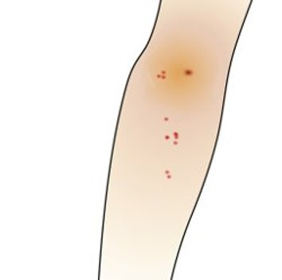
Toxic Causes of Altered Mental Status
Alcohol or drug intoxication or withdrawal signs and symptoms
Known alcohol or drug use
Injection marks; drugs found on patient
Alcohol
  Acutely intoxicated (drunk)
  Withdrawal (convulsions, confusion, tachycardia)
  Chronic use (balance problems, confusion, tachycardia)
Opioids
  Acutely intoxicated (lethargy, very small pupils and slow breathing)
  Withdrawal (agitation, sweating, diarrhoea, vomiting)
Other drugs may cause large pupils, agitation, sweating and fever
Notes:
There are many toxic causes of AMS, but alcohol or drug-related causes are among the most common. Acute intoxication or withdrawal from these substances can cause AMS. Exam findings depend on the substance used. For example, with alcohol, acute intoxication may be characterized by slurred speech, confusion, and impaired decision making. Chronic use can cause balance and memory problems and withdrawal can cause tachycardia, agitation, and convulsions. In contrast, acute opioid intoxication may cause lethargy, extreme sleepiness, pinpoint or small pupils, and slowed respirations. Withdrawal can cause agitation, enlarged pupils, sweating, diarrhea, and vomiting.

Slide 47

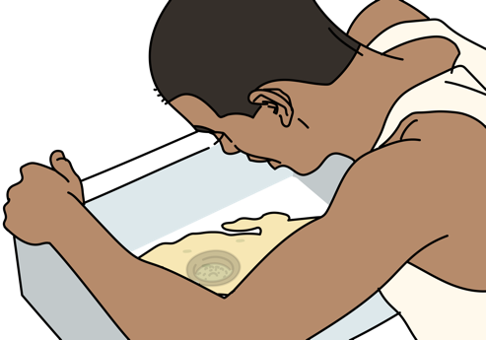
Toxic Causes of Altered Mental Status
Pesticide poisoning
History of exposure
Very small pupils
Diarrhoea
Vomiting
Diaphoresis
Snake bite
Snake bite history
Bite marks in setting with venomous snakes
Oedema
Blistering of the skin
Bruising
Hypotension
Paralysis
Seizure
Bleeding from wounds
Notes:
Pesticide or organophosphate poisoning is diagnosed in known or suspected exposures with findings of small pupils, diarrhoea, vomiting and sweating (diaphoresis). Findings of bradycardia (or slow heart rate), bronchorrhoea, or excessive respiratory secretions, and bronchospasm, or airway tightening with wheezing, are particularly worrisome findings and can be life-threatening. Snake bites are also diagnosed in known or suspected exposures, and can have a variety of associated symptoms depending on the type of snake. Findings may include bite marks, oedema, skin blistering, abnormal bruising or bleeding, hypotension, paralysis, and seizures or convulsions.

Slide 48

Toxic Causes of Altered Mental Status
Medication reaction or dosing issue
New medications or recent change in dose
Gaseous poisoning
History consistent with possible exposure
Multiple people with symptoms
Headache
Notes:
As mentioned previously, new or changed medications can cause side effects ranging from mild confusion to unresponsiveness. Gaseous poisonings often present as multiple patients from one location with similar vague symptoms, such as headache.

Slide 49
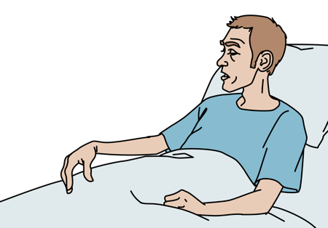
Other Causes of AMS
Seizures signs and symptoms
Known history
Bitten tongue
Urinated on self
Gradual improvement over minutes/hours
If pregnant, consider eclampsia
Increased pressure on the brain
(tumour, trauma, stroke or brain swelling)
Headache
Seizures/convulsions
Nausea and vomiting
Unequal pupils
Weakness on one side
Speech problems
Notes:
Seizures or convulsions can present with evidence of oral trauma, such as a bitten tongue, incontinence, and gradually improving mental status in the minutes/hours after an initial event. Again, it is especially important to identify women with ongoing or recent pregnancy in patients with seizure, as this could be due to eclampsia. Increased pressure on the brain from a tumor, bleeding, or brain swelling can present as altered mental status with headache, convulsions, vomiting, unequal pupils, weakness on one side, or speech problems.

Slide 50
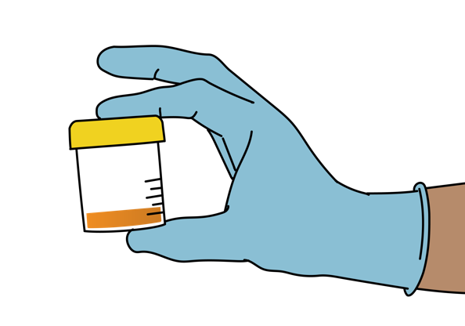
Other Causes of Altered Mental Status
Liver disease signs and symptoms
History of alcohol abuse or liver disease
Enlarged abdomen with thin arms
Yellow coloring of skin and eyes (jaundice)
Hypoglycaemia
Kidney disease
High blood pressure
Oedema or swelling in legs
Decreased or no urine if severe
Notes:
Patients with liver disease may have altered mental status for a variety of reasons, including hypoglycemia, build-up of toxins in their bloodstream that would typically be metabolized by the liver, bleeding with poor perfusion, or infection. Sometimes there can be a history of alcohol abuse or known liver disease. Exam findings can include an enlarged liver or distended abdomen despite thin arms. Yellowing of the skin or eyes is known as jaundice. Similarly, kidney disease can cause buildup of toxins in the blood stream causing altered mental status. Exam findings may include elevated blood pressure, oedema in the legs, and decreased or absent urine output. If the patient receives dialysis, they may have evidence of an abdominal or venous catheter or an AV fistula on an extremity.

Slide 51
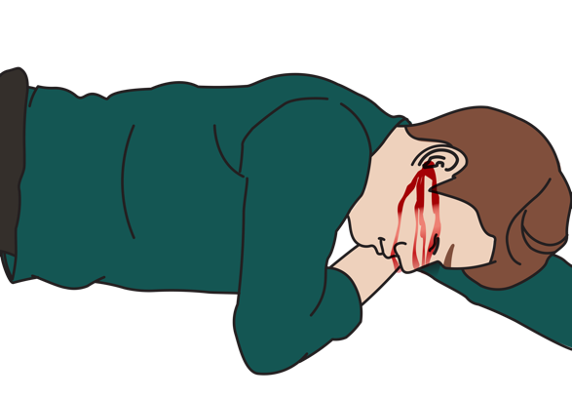
Other Causes of Altered Mental Status
Head trauma signs and symptoms
Visual changes
Loss of memory
Vomiting
Headache
History of recent trauma
Scalp laceration and/or skull deformity
Bruising to head
Blood or clear fluid from nose or ears
Unequal pupils
Weakness to one side of the body
Seizure/convulsions
Notes:
In patients with head trauma, we have discussed a variety of exam findings, including lacerations, abrasions, bruising, or deformities to the head, bleeding or leakage of fluid from the ears or nose, unequal pupils, weakness on one side of the body, and convulsions. They may also complain of visual changes, memory loss, vomiting, and headache.

Slide 52
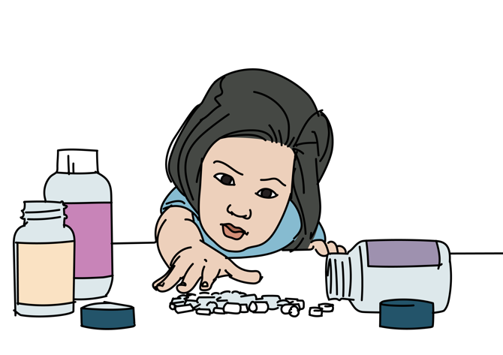
Considerations in Children
!
Ingestions of chemicals or toxins are common in younger children.
Check for a history of medications or substances found around the child.
Notes:
As an important note, ingestions of chemicals or toxins are common in young children, so it will be important to ask family or other caregivers about any medications or substances found around the child.

Slide 53
Workbook Question 3
Using the workbook section above, list the possible causes of altered mental status from the history and physical findings below:
History and physical findings: | Likely cause:
A 15-year-old girl presents with AMS and; Fever Neck stiffness Eye pain with looking at light/ light sensitivity Headache
A 45-year-old man presents with AMS and: Deep and rapid breathing Frequent urination Sweet smelling breath High glucose in blood or urine Dehydration
Notes:
Workbook Question 3: [page 132 in participant workbook]
List the possible cause of altered mental status from the history and physical findings below.
15 year old girl with AMS, fever, neck stiffness, eye pain when looking at light, and headache. Answer: Infection around the brain
45 year old man with AMS, deep, rapid breathing, frequent urination, sweet-smelling breath, high glucose, dehydration. Answer: Hyperglycemia
Image
Title: Deep thought
Creator:GDL
Source: https://openclipart.org/detail/221707/deep-thought
Copyright information: Creative Commonz Zero 1.0 Public Domain License

Slide 54
Altered Mental Status
Part 3: Management, special paediatric considerations and disposition
Notes:
This is the third part of the module on Altered Mental Status. Remember to always treat ABCDE conditions first! We will look at management, special paediatric considerations and disposition of patients.

Slide 55
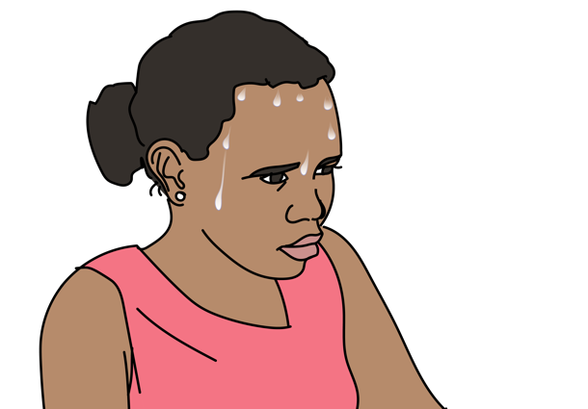
Management
If suspected hypoxia
  → Give OXYGEN.
  → Look for underlying cause.
If suspected hypoglycaemia
  → Give GLUCOSE.
If suspected hyperglycaemia
  → Give IV FLUIDS.
  → Plan for rapid TRANSFER as these patients can become extremely ill
If suspected fever and AMS
  → Give ANTIBIOTICS.
  → TEST for malaria in endemic areas.
  → Consider poisoning and envenomation
  → Treat fever with PARACETAMOL
  → For severe temperature elevation, spay with cool mist, give IV FLUIDS, avoid shivering.
Notes:
In suspected hypoxia, oxygen should be administered first, followed by further evaluation to identify an underlying cause. In hypoglycemia, glucose should be administered by whatever means possible. In hyperglycemia, hydration with IV fluids should be initiated prior to planning for early transfer or handover, as these patients can become extremely ill. In patients with both fever and AMS, empiric treatment for infection should be started with administration of antibiotic though poisoning and envenomation should also be considered as possible causes. In endemic areas, malaria testing should occur. Paracetamol can be given for fever. However, in severely elevated temperatures such as in patients with heat stroke, the temperature should be rapidly lowered. This can occur through a variety of cooling methods, including spraying the patient with a cool mist, giving IV fluids. Avoid shivering.

Slide 56
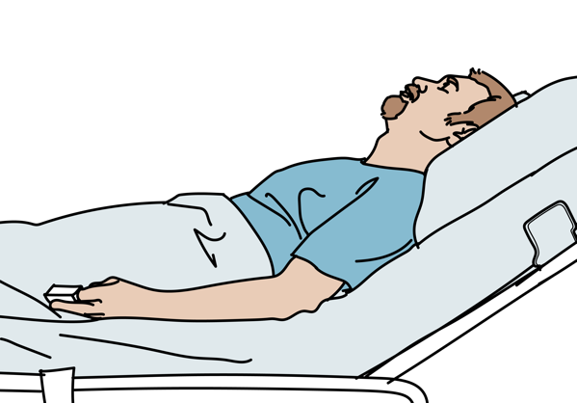
Management
If suspected hypothermia
  → Move to warm environment.
  → Remove wet clothing.
  → Warm with blankets.
  → Give warm IV FLUIDS.
If suspected bleeding or increased pressure on the brain
  → ELEVATE the head of the bed 30 degrees if no trauma.
  → If trauma is suspected, ensure SPINAL IMMOBILIZATION.
Notes:
In patients found to have hypothermia, or severely low body temperature, the mainstay of treatment is re-warming. All wet clothing should be removed, the patient should be moved to a warm environment, blankets should be applied, and warm IV fluidsadministered. For suspected intracranial bleeding or increased pressure, the head of the bed should be elevated to 30 degrees as long as no spinal trauma is suspected.

Slide 57

Management
If suspected opioid overdose
  → Give NALOXONE by IV or IM.
    Naloxone only lasts one hour while most opioids last longer.
    Consider the need for re-dosing.
If active seizure/convulsions
  → Treat with BENZODIAZEPINE, monitor closely for slow breathing.
  → CHECK glucose or give GLUCOSE if unable to check.
  → Place patient in the recovery position (if no trauma).
  → If patient continues to seize or does not wake up, TRANSFER and MONITOR airway.
Notes:
In the case of opioid overdose, naloxone can be administered IV, IM, or intranasally to rapidly reverse respiratory depression. However, patients should then be monitored for recurrence of symptoms of toxicity and any need for redosing of the antidote - as some opioids can outlast the effects of naloxone. In active seizures or convulsions, benzodiazepines should be administered. Glucose levels should be checked, as we know hypoglycemia can cause convulsions, and repeted if necessary. Once seizures have stopped, the patient’s respiratory status should be monitored and they should be placed in the recovery position. If seizures do not stop or the patient does not return to normal after a typical post-ictal period, they should be transferred or handed over for advanced care.

Slide 58
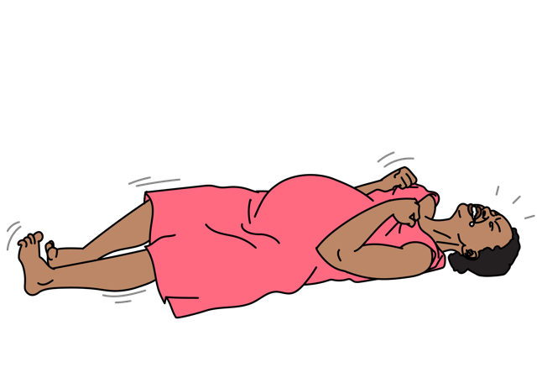
Management
If pregnant with active seizure/convulsion
  → This could be eclampsia.
  → Arrange for rapid TRANSFER/HANDOVER to specialist unit.
  → Give MAGNESIUM SULPHATE.
  → MONITOR closely for magnesium toxicity.
    Hypotension, abnormal heart rhythm, coma, respiratory depression, muscle weakness, confusion, nausea, vomiting, flushing
      If these occur, do not give additional magnesium.
If suspected alcohol withdrawal with seizure/convulsion
  → Always check glucose and give as needed.
  → Give a BENZODIAZEPINE.
Notes:
In active seizures or convulsions in a pregnant woman, empiric treatment for eclampsia should be immediately administered with magnesium sulphate. After treatment with magnesium, the patient will need to be monitored for signs of toxicity, such as weakness, slowed respirations, and low blood pressure. Additionally, these patients require emergent transfer or handover to a specialist unit. Patients with alcohol withdrawal can also present with active seizures or convulsions that should be treated similarly with benzodiazepines and glucose monitoring.

Slide 59

Management
If suspected poisoning or envenomation
  → Try to identify the poison.
  → Arrange for HANDOVER/TRANSFER to centre that can manage poisoning and advanced airway.
  → If pesticide poisoning suspected, decontaminate and monitor airway for secretions.
  → Snake bites should be treated per WOUND MANAGEMENT and referred for possible ANTIVENOM.
If suspected rabies
  → There is no specific treatment for rabies.
  → Symptomatic rabies is almost always fatal.
Notes:
For poisoning or envenomation, the management varies based on the exposure. This is why it is important to try to identify the poison, to monitor the patient closely for signs of airway or circulatory collapse, and to arrange for transfer or handover to a center that can manage poisonings and advanced support. For pesticide poisoning, the patient should be decontaminated. For snake bites, the affected area should be immobilized to limit the spread of the venom. If possible, a picture of the snake should be sent with the patient to whatever facility will be providing advanced care so that antivenom can be given if available. Unfortunately, rabies has no specific treatment and is almost always fatal once symptoms occur.

Slide 60
Management
If the patient is agitated or violent
  → Protect the patient from harming self, you or others.
  → Ensure you have an escape/exit route.
  → Remove potential weapons/unsafe objects.
  → Call for help.
  → Speak in a calm, soft, non-threatening tone; explain what is happening.
  → Do not confront or judge.
  → Consider causes - check glucose and vital signs; treat abnormalities.
  → Arrange for a safe HANDOVER/TRANSFER to an advanced provider.
If suspected trauma
  → Assess GCS.
  → IMMOBILIZE the spine.
  → CHECK for signs of increased pressure on the brain.
Notes:
Because patients with altered mental status may become agitated or even violent, management includes the same principles of prioritizing safety for both patients and staff as in our evaluation section. Finally, for patients with suspected trauma, we must remember to immobilize the spine and check for signs of increased pressure on the brain.

Slide 61
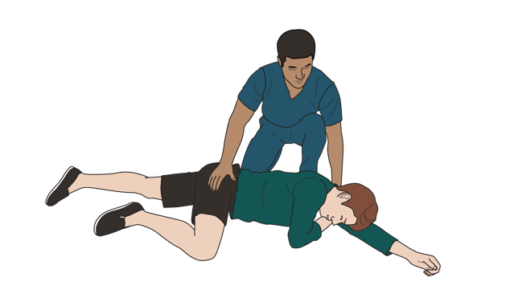
Special Considerations
  If pregnant and seizing → give MAGNESIUM SULPHATE.
  If no response → give another dose of BENZODIAZEPINE up to 3 doses.
  If the patient does not wake between seizure/convulsions → consider this a life-threatening condition.
    Arrange for rapid HANDOVER/TRANSFER to an advanced provider
  If the seizures /convulsions stop → place patient in RECOVERY POSITION and monitor closely.
Management of active convulsions
  Check ABCDE.
  Maintain the airway (nothing in the mouth.)
  Give OXYGEN if concern for hypoxia or prolonged convulsion.
  Place patient on their side.
  Protect the patient from harm or further injury.
  Check glucose or give GLUCOSE if unable to check.
  Give a BENZODIAZEPINE.
Notes:
Since active convulsions are a common and life-threatening cause of altered mental status, let’s review one more time how we might approach this patient. First, we will conduct our ABCDE evaluation, maintaining the airway open to allow adequate airflow. This means nothing should be put in the mouth. Oxygen can be administered if there is concern for underlying hypoxia or for prolonged seizures to support breathing. While we protect both the patient and ourselves from injury or harm, we will check a glucose to ensure there is no hypoglycemia. If we are unable to check a glucose for any reason, glucose can be empirically administered or given as the benefit outweighs the risk. Benzodiazepines should be administered for active seizures. If there is no response to the initial benzodiazepine, up to three repeated doses can be given. However, if the patient is pregnant or recently postpartum, magnesium sulphate should be given for suspected eclampsia. Once the seizures have stopped, the patient can be placed in the recovery position. Notably, if the patient does not wake up after or between seizures or convulsions, this should be considered life-threatening. Rapid handover or transfer should be arranged.

Slide 62
Workbook Question 4
Using the workbook section above, list what you would do to manage these patients:
Condition | Management
A 3-year-old child presents with altered mental status and a blood glucose of 2 mmol/L | 1.
A 25-year-old woman is bought in with jerking movements and you suspect an active seizure/convulsion | 1. 2. 3.
A 50-year-old man is bought in following a fall from a roof. He has a headache and altered mental status. | 1. 2.
Notes:
Workbook Question 4: [page 134 in participant workbook] List what you would do to manage these patients.
1. 3-year-old child with altered mental status and blood glucose of 2 mmol/L.
Answer: - Give glucose
2. 25-year-old woman with jerky movements and you suspect seizure.
Answer: Treat with benzodiazepine and monitor - check glucose - place in recovery position - obtain pregnancy history
3. 50-year-old man brought in after falling from a roof with headache and altered mental status.
Answer: immobilize spine and evaluate for signs of increased pressure on the brain
Image
Title: Deep thought
Creator:GDL
Source: https://openclipart.org/detail/221707/deep-thought
Copyright information: Creative Commonz Zero 1.0 Public Domain License

Slide 63
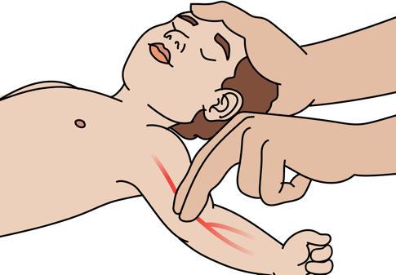
Special Paediatric Considerations
!
REMEMBER that children with altered mental status may have mild signs such as sleeping more or being less interactive.
Manage ABCDE first, then look for cause of altered mental status.
REMEMBER that very ill or injured children may have normal vital signs until they rapidly deteriorate.
Notes:
Several special considerations exist for the evaluation and management of children with altered mental status. Signs of AMS can be subtle in children, such as increased sleepiness or less interactivity. It is especially important to gather information from the parent or other caregiver about the child’s baseline mental status, level of alertness, interactivity, and normal behaviour. As with all patients, ABCDE evaluation should occur first. However, children may have normal vital signs for longer than adult patients followed by a very rapid deterioration.

Slide 64
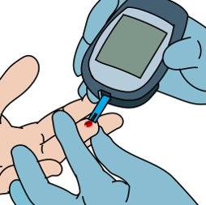
Special Paediatric Considerations
Hypoglycaemia
  Occurs frequently in severely ill children
  Common cause of AMS in children
  Check glucose or give GLUCOSE if unable to check.
Hypoxia
  Can occur as a result of many conditions
  Respiratory infections and shock
  Birth hypoxia is a consideration in newborns
Notes:
Hypoglycaemia can occur frequently in children with severe illness, causing AMS, so checking a glucose level is critical. If unable to check a level, glucose should be given to paediatric patients with severe illness. Hypoxia can occur as a result of many conditions including respiratory infections and shock, in children of all ages. Newborns are at particular risk from birth complications, infections or there may be rare underlying heart problems.

Slide 65
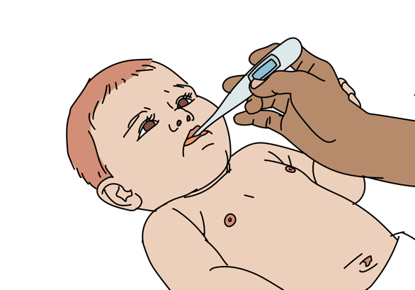
Special Paediatric Considerations
Hyperthermia with AMS
Infection
Environment or heat exposure
Exercise
Seizure/convulsion
Hormonal imbalance
Poisoning
Hypothermia with AMS
Can also suggest infection, especially in infants
Drug intoxication
Exposure to cold
Hormonal imbalance
Young infants are more likely to be affected
  Use blankets, hats, skin-to-skin contact with family member
Notes:
As with adults, hyperthermia with AMS can indicate infection, heat exposure, exertion, seizure or convulsion, hormonal imbalance, or poisoning as underlying causes. Hypothermia with AMS is also associated with infection in children, as well as with drug intoxication, cold exposure, and hormonal imbalance. Young infants are more likely to be affected by hypothermia and temperature variation, so care should be taken to ensure that heat loss is prevented using coverage with blankets and hats, or skin-to-skin contact.

Slide 66
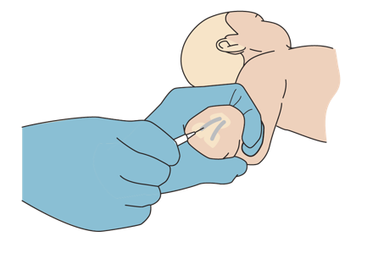
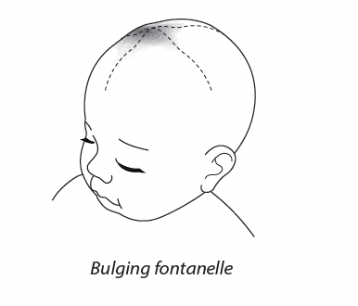
Special Paediatric Considerations
Seizures/convulsions
  Can be due to fever alone
  Can also suggest infection, hypoglycaemia or hyponatremia
  Do not delay giving ANTIBIOTICS to children with suspected serious bacterial infection.
  Always consider trauma.
Infection in the brain
  Check for bulging or swollen fontanelle in children under 1 year.
  Check for possible rash to legs and lower abdomen.
  Do not delay giving ANTIBIOTICS to children with suspected serious bacterial infection.
Notes:
Though seizures or convulsions in children can be associated with infection, hypoglycemia, hyponatremia, and poisoning similar to adults, they can also occur due to fever alone in this population. Importantly, accidental and non-accidental trauma should always be considered in children with convulsions. Brain or central nervous system infections may present with bulging of the fontanelle in children under 1 year old or with rash on the legs/abdomen in children of all ages. Antibiotics should not be delayed in any children suspected serious bacterial infection.

Slide 67
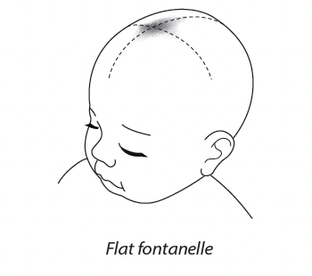
Special Paediatric Considerations
Poor perfusion
  Children can become dehydrated very quickly.
  Check for signs of dehydration.
    Abnormal skin pinch
    Dry mucous membranes
    Irritability
    Sunken or depressed fontanelle (in child under 1 year)
    Slow capillary refill (greater than 3 seconds)
    Cold extremities
    Tachycardia
    Hypotension
  Give IV FLUIDS and REASSESS frequently!
Notes:
Children can become dehydrated very quickly, leading to poor perfusion and altered mental status in severe cases. Paediatric exam findings for dehydration, include abnormal skin pinch, dry mucous membranes, nonspecific irritability, sunken or depressed fontanelle in children under 1 year old, slow capillary refill, cool or cold extremities, tachycardia, and hypotension. IV fluid should be administered with frequent reassessment in this case.

Slide 68
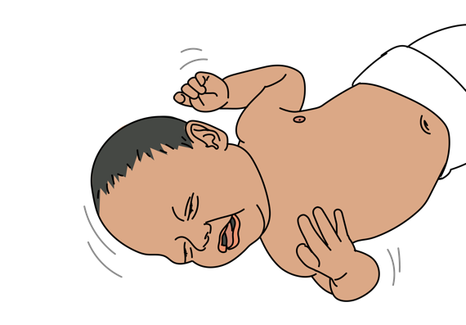
Special Paediatric Considerations
Malaria
  May be more severe in children than adults
  May present with
    Severe anaemia
    Seizures/convulsions
    Coma
    Hypoglycaemia
Notes:
Malaria can also present more severely in children compared to adults with findings of severe anaemia, convulsions, unconsciousness or coma, and hypoglycemia.

Slide 69

Special Paediatric Considerations
Ingestion of chemicals or drugs
  Common in children (especially ages 1-3)
  Try to identify the poison; talk to parents (get package or photograph)
  CONSULT advanced provider immediately.
    Ask about signs and symptoms depending on substance ingested
      Take a thorough history from the family.
      Determine what time it took place.
      Ensure that no other children were involved.
    Examine the bottles of the ingested substance or medicine.
    Check for
      Signs of burns in or around the mouth
      Stridor suggesting chemicals that damage airway or cause swelling
      MONITOR closely.
      Consider HANDOVER/TRANSFER to a referral unit.
Notes:
Ingestions are also quite common in children, especially children under six years old. Any additional information from family or from direct inspection of the materials will be helpful to identify the substance, timing, and quantity of ingestion. A focused exam should check for signs of burns in and around the mouth, as well as for stridor or other evidence of difficulty in breathing or swallowing. Patients should be monitored very closely and consultation with advanced provider should be pursued immediately given the severity of poisonings in children.

Slide 70
Workbook Question 5
How would you assess for brain infection in a child?
_________________________________________________________
_________________________________________________________
Why does hypoglycemia occur frequently in severely ill children?
_________________________________________________________
_________________________________________________________
Seizures/convulsions in a young child can be a sign of what?
_________________________________________________________
_________________________________________________________
Notes:
Workbook Question 5: [page 136 in participant workbook]
How would you assess for brain infection in a child?
Answer: Look for bulging or swollen fontanelle (if less than 1 year old) and/or rash to the legs and lower abdomen.
Why does hypoglycemia occur frequently in severely ill children?
Answer: Due to increased use to glucose in the body when the patient is ill, decreased food/drink intake and decreased glucose stores in the body.
Seizures/convulsions in young children can be a sign of what?
Answer: Can be a sign of serious infection or hypoglycemia (or due to the fever itself).
Image
Title: Deep thought
Creator:GDL
Source: https://openclipart.org/detail/221707/deep-thought
Copyright information: Creative Commonz Zero 1.0 Public Domain License

Slide 71
Disposition of the Patient
Disposition depends on the cause.
Causes that are not rapidly corrected or may return need management in a hospital.
Monitor closely for airway problems.
Consider HANDOVER/TRANSFER for advanced airway.
In hypoglycaemia, consider the cause and potential for it to develop again.
In opioid overdose, consider the need for repeat doses of Naloxone.
Notes:
Ultimately, disposition of the patient depends on the underlying cause of altered mental status. As a general rule, causes that are not rapidly corrected or may return despite initial correction such as with hypoglycemia or opioid overdose, need management in a hospital. Patients with AMS should be monitored closely for airway problems. Handover or transfer should be considered.

Slide 72
Questions
?
Notes:
Do you have any questions on altered mental status?

Slide 73
Quick Cards
Notes:
Review the Quickcards in the BEC manual.

Slide 74
Notes:
There is a section for key ABCDE findings in the patient with altered mental status.

Slide 75
Notes:
There are key findings from the SAMPLE history and secondary exam.

Slide 76
Notes:
Critical actions for high-risk conditions, paediatric considerations and disposition considerations for patients with altered mental status are also highlighted.

Slide 77
Summary
In this presentation we have covered:
How to apply a SAMPLE history to a patient with altered mental status (AMS)
Key history findings suggestive of different causes of AMS
The high-risk causes of altered mental status in adults and children
How to perform a secondary exam in a patient with AMS
Key examination findings suggestive of different causes of AMS
Critical actions to manage a patient with AMS
Essential skills for high-risk causes of AMS
Special paediatric considerations for AMS
Disposition of patients with AMS
Notes:
In this presentation we have covered how to apply a SAMPLE history to a patient with altered mental status (AMS), the key history findings suggestive of different causes and the high-risk causes. We have discussed how to perform a secondary exam in a patient with AMS and key examination findings suggestive of different causes. We have outlined the critical management actions, essential skills for high-risk causes of AMS, special paediatric considerations and the disposition of patients with AMS.

