Slide 1
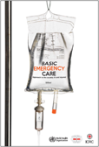

The ABCDE and SAMPLE History Approach
Basic Emergency Care Course
Notes:
The ABCDE and SAMPLE history approach is used throughout the Basic Emergency Care course. This module provides an overview of the different elements in the ABCDE approach and SAMPLE history. We will then explore these elements in more detail throughout the presentation series.

Slide 2
Objectives
By the end of this presentation, you will be able to:
List the hazards and elements that must be considered when approaching an ill or injured person safely
Describe the components of the systematic ABCDE approach to emergency patients
Assess each element of the ABCDE approach
Identify critical actions for each element of the ABCDE approach
Describe the signs and symptoms of acute life-threatening conditions
Identify critical ABCDE actions for acute life-threatening conditions
Describe special paediatric considerations for the ABCDE approach
List the elements of and perform a relevant SAMPLE history
Consider disposition of emergency patients for handover / transfer
Notes:
The objectives of this first presentation on the ABCDE approach are; to list the hazards and elements that must be considered when approaching an ill or injured patient, to describe the components of the ABCDE approach to emergency patients, to assess each element of the ABCDE approach and to identify and critical actions for each element of the ABCDE approach.
You will learn about the elements of a SAMPLE history and how to perform this history taking.

Slide 3
The ABCDE and SAMPLE history approach
Part I: Introduction to the ABCDE approach
Notes:
The ABCDE and SAMPLE history approach is used throughout the Basic Emergency Care course. This module provides an overview of the different elements in the ABCDE approach and SAMPLE history. We will then explore these elements in more detail throughout the presentation series.

Slide 4
Why the ABCDE approach?
Approach every patient in a systematic way
Recognize life-threatening conditions early
DO the most critical interventions first; fix problems before moving on!
The ABCDE approach is very quick in a stable patient.
Goals:​
​
Identify life-threatening conditions rapidly​
Ensure the airway stays open​
Ensure breathing and circulation are adequate to deliver oxygen to the body ​
Notes:
Life-threatening conditions must be recognised early in order to save the lives of patients.
The ABCDE approach is used to rapidly identify life-threatening conditions, in order of the highest priority to manage.
The most critical interventions are performed first, and it is important to fix identified problems before moving on.
Following the ABCDE approach ensures that the airway stays open and that breathing and circulation are adequate to deliver oxygen to the body.
Every patient is approached in the same, systematic way and healthcare providers can use the common language of ABCDE in communication.

Slide 5
What is a SAMPLE history?
Categories of questions to obtain a patient’s history
  Signs and Symptoms
  Allergies
  Medications
  Past medical history
  Last oral intake
  Events
Immediately follows the ABCDE approach
Allows providers to easily communicate
Goal:
Rapidly gather history critical to the management of the acutely ill patient
Notes:
It is important to quickly gather any history critical to the management of the acutely ill patient, but without delaying resuscitation. The ABCDE should be followed by a rapid history taking using the SAMPLE approach. The SAMPLE approach is a standard way of gathering the key history related to an illness or injury. Sources of information include: the ill/injured person, family members, friends, bystanders, or prior providers. SAMPLE has six parts, one for each letter; signs and symptoms, allergies, medications, past medical history and pregnancy, last oral intake and events surrounding the illness or injury. Using the standard SAMPLE approach allows healthcare providers to collect key information quickly and to easily communicate about acutely ill or injured patients.

Slide 6
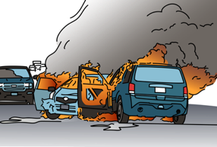
ABCDE: Initial Approach
The most important step is to stay safe.
Ask for help early.
Scene safety: Consider hazards, violence and infectious disease risk
Examples of hazards
  Fire
  Motor vehicle crash
  Building collapse
  Chemical spill
  Multiple patients
  Make arrangements for transfer if needed
  Know who to call for infectious outbreaks or hazardous exposures
Notes:
The most important part of the approach to any ill or injured patient is keeping you, your patient and others safe.
When approaching a patient you must consider scene safety first. If you become ill or injured you will be unable to assist others and instead become an extra patient for other responders to treat.
Scene safety involves checking for scene hazards, violence and infectious disease risk. Hazards include fire, chemical spills and motor vehicle accidents, which could all affect your personal safety and your ability to care for the patient.
Remember to ask for help early with severely ill or injured patients, multiple patients, when making arrangements for transfer or in the event of infectious outbreaks or hazardous exposures.

Slide 7
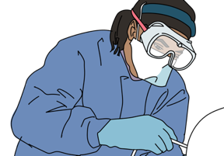
Safety considerations
Personal protective equipment
Cleaning and decontamination
Consider appropriate PPE for situation
  Gloves
  Gown
  Mask
  Goggles
  Hand washing
  Use PPE and wash your hands before and after every patient contact (or alcohol gel cleanser).
  Clean/disinfect surfaces
  Refer to local decontamination protocols for chemical exposures.
Notes:
To protect yourself from infectious risks, put on appropriate personal protective equipment before assessing the patient.
Consider the appropriate personal protective equipment for each situation. This could include gloves, eye protection, a gown and mask.
Cleaning and decontamination is important. Use PPE and wash your hands before and after every patient contact, or use alcohol gel cleanser. Clean or disinfect surfaces and refer to local decontamination protocols for chemical exposures.

Slide 8
Workbook Question 1:
Safety
A person walks into your health post vomiting, bleeding from the mouth and complaining of abdominal pain
Describe what is needed to safely approach this patient:
Notes:
Workbook Question 1: [page 15 in participant workbook]
A person walks into your health post vomiting, bleeding from the mouth, and complaining of abdominal pain. Using the workbook section above, describe what is needed to safely approach this person:
Answers: 1. Make sure the scene is safe 2. Use personal protective equipment 3. Ask for more help if needed

Slide 9



ABCDE Approach: Elements
Airway with cervical spine immobilization
  Check for obstruction.
  If trauma, immobilize cervical spine.
Breathing plus oxygen if needed
  Ensure adequate movement of air into the lungs.
Circulation with bleeding control and IV fluids
  Determine if there is adequate perfusion.
  Check for life-threatening bleeding
Notes:
Here is an overview of the elements in the ABCDE approach. The order of the letters just happens to be alphabetical in English, but actually it represents the order of priority to find life-threatening conditions.
A is for airway. In your approach, you need to check for and relieve any obstruction to movement of air to the lungs. A life-threatening condition affecting the airway could cause death within minutes, which is why we consider the airway first. If there is trauma, immobilise the cervical spine to prevent further injury which could be life-threatening.
B is for breathing. You need to ensure there is adequate movement of air into the lungs.
C is for circulation. Here, evaluate whether there is adequate perfusion to deliver oxygen to the organs, and check for signs of life-threatening bleeding.

Slide 10


ABCDE Approach: Elements
Disability
  Assess and protect brain and spinal functions.
  Check AVPU/GCS, pupils and glucose.
Exposure and keep warm
  Identify all injuries and environmental threats.
  Avoid hypothermia.
!
This stepwise approach is designed to ensure that life-threatening conditions are identified and treated early, in order of priority.
A problem discovered (A-B-C-D-E) must be addressed immediately
before moving on to the next step.
Notes:
D is for disability. Here, you assess and protect brain and spinal functions. You will learn about AVPU and GCS, how to check pupils and how to treat low blood glucose.
E is for exposure. You need to expose the patient carefully to identify all injuries, signs of illness and environmental threats. It is important to avoid hypothermia. This stepwise approach is designed to ensure that life-threatening conditions are identified and treated early. If a problem is discovered at any step it must be addressed immediately before moving on to the next step. For each element of the ABCDE approach there are essential assessment and management considerations.

Slide 11





Essential skills
Overall
Assessing ABCDE
Intravenous (IV) line placement
IV fluid resuscitation
Direct pressure/ deep wound packing for haemorrhage control
Tourniquet for haemorrhage control
Pelvic binding
Fracture immobilization
Skin pinch test
Cervical spine immobilization
Head-tilt and chin-lift/jaw thrust
Airway suctioning
Management of choking
Recovery position
Nasopharyngeal (NPA) and oropharyngeal airway (OPA) placement
Full spine immobilization
AVPU (alert, voice, pain, unresponsive) assessment
Glucose administration
Oxygen administration
Bag-valve-mask ventilation
Needle-decompression for tension pneumothorax
Three-sided dressing for chest wound
Wound management
Snake bite management
Log roll
Notes:
The essential skills for this module are listed here. Each skill will be introduced in the lectures, and taught during the practical sessions of this course.

Slide 12
REMEMBER…
!
Always check for signs of trauma in each of the ABCDE sections and reference the trauma module as needed.
Notes:
Don’t forget to always check for signs of trauma in each of the ABCDE sections. There is a specific module on trauma to guide you.

Slide 13
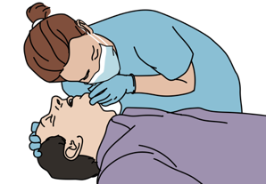
Airway Assessment
Can the patient talk normally?
Look for foreign body, swelling around the airway
Look for altered mental status
Listen for abnormal sounds suggesting obstruction
Look and listen for fluid in the airway
Look to see if the chest wall is moving in or out
Listen and feel for air movement from the mouth and nose
Problem identified
Manage airway
Normal
LOOK, LISTEN, FEEL for air movement
Breathing Assessment
Notes:
When assessing a patient’s airway, a simple way to begin is by asking if they can talk normally. If they can talk normally, then the airway is open. If the patient is not talking normally, check for any reasons why. Listen for abnormal sounds suggesting airway obstruction and look and listen for fluid in the airway. Look for any foreign body, any swelling around the airway and ask the patient if they can swallow their saliva. Check for any signs of altered mental status, for example confusion or drowsiness. If the patient is unable to talk then look to see if their chest wall is moving, and listen and feel for any air movement from the mouth or nose. If you identify any problems, immediately start management. You will notice we are using a ‘look, listen and feel approach’ in our assessment, and this will be the same for all elements of the ABCDE approach.

Slide 14
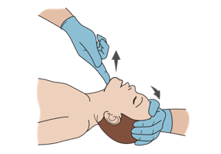
Airway Management
If the patient is unconscious and not breathing normally:
  If no concern for trauma
  → open airway using HEAD-TILT / CHIN-LIFT manoeuvre.
  If trauma suspected
  → maintain C-SPINE IMMOBILISATION and use JAW-THRUST manoeuvre.
Consider placing an AIRWAY DEVICE to keep the airway open
  Oropharyngeal airway
  Nasopharyngeal airway
Notes:
If the patient is unconscious and not breathing normally you must open their airway. If there is no concern for trauma, you can open the airway using the head-tilt/chin-lift manoeuvre. Cervical spine immobilisation and the jaw-thrust manoeuvre must be used if there is concern for trauma. The jaw thrust maneouvre avoids movement of the cervical spine. If the patient has a reduced level of consciousness, consider placing an airway device to keep the airway open. Airway devices include an oropharyngeal and nasopharyngeal airways.

Slide 15
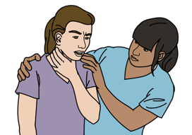
Airway Management: Choking
If foreign body is suspected:
  If there is a visible foreign body → carefully REMOVE IT
  If the patient is able to cough or make noise
  → keep the patient calm and ENCOURAGE to cough.
  If the patient is choking (unable to cough/make sounds)
  → use age-appropriate CHEST THRUSTS/ABDOMINAL THRUSTS/
  BACK BLOWS.
  If the patient becomes unconscious while choking → follow CPR PROTOCOLS.
Notes:
Choking occurs when the airway is obstructed, and action must be taken quickly to relieve the blockage. If a foreign body is suspected, check inside the mouth and carefully remove if visible. Encourage the patient to cough if they are able to and keep the patient calm. If the patient is unable to cough or make sounds, use age-appropriate chest thrusts, abdominal thrusts and back blows to dislodge the blockage. If the patient becomes unconscious then follow CPR protocols.

Slide 16
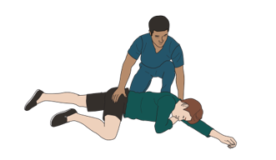
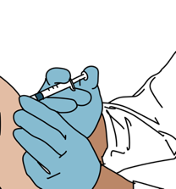
Airway Management
If secretions are present:
  → SUCTION airway or wipe clean
  → Consider RECOVERY POSITION if the rest of the ABCDE is normal and no trauma
If the patient has swelling, hives, or stridor → consider a severe allergic reaction (anaphylaxis)
  Give intramuscular ADRENALINE
Allow patient to stay in position of comfort.
Prepare for HANDOVER/TRANSFER to a
location capable of advanced airway management.
RECOVERY POSITION
Notes:
Secretions can obstruct an airway, so if secretions are present gently suction the airway or wipe clean. If there is no trauma and the rest of the ABCDE is normal, consider placing the patient in the recovery position on their side which helps to keep the airway open and allows secretions to drain more freely.
If you see swelling or hives, or hear a high-pitched noise known as stridor, then consider a severe allergic reaction or anaphylaxis. Intramuscular adrenaline is the priority treatment for severe allergic reaction. Allow the patient to stay in a position of comfort to aid their breathing. As these patients can become unwell quickly, prepare early for handover or transfer to a centre capable of advanced airway management.

Slide 17

Questions
Airway

Slide 18
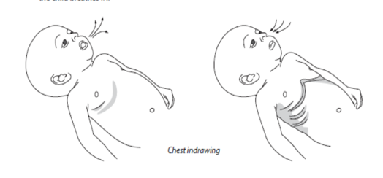
Breathing: Assessment
Look, listen and feel to see if the patient is breathing
Assess if the breathing is very fast, very slow or very shallow.
Look for increased work of breathing.
  Accessory muscle work
  Chest indrawing
  Nasal flaring
  Abnormal chest wall movement
Listen for abnormal breath sounds.
REMEMBER with severe wheezes there may be no audible breath sounds because of severe airway narrowing .
Notes:
Assessment of breathing follows the same steps as assessment of airway; look, listen and feel. First look, listen and feel to see if the patient is breathing, and assess if the breathing is very fast, very slow or very shallow. Look for signs of increased work of breathing. These signs include accessory muscle use, chest indrawing, nasal flaring and abnormal chest wall movements. Listen carefully for abnormal breath sounds. Remember that a quiet chest may not be normal, as with severe wheezing there may be no audible breath sounds because of severe airway narrowing.

Slide 19
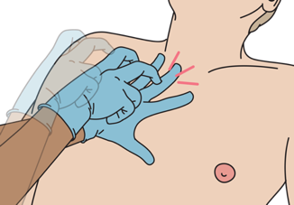
Breathing: Assessment
Listen to see if breath sounds are equal.
Check for the absence of breath sounds on one side.
  If dull sound with percussion to the same side
    THINK large pleural effusion or haemothorax.
    If hyperresonance on percussion on same side
    THINK simple pneumothorax.
  If also hypotension, distended neck veins or
  tracheal shift.
    THINK tension pneumothorax.
Check oxygen saturation.
PERCUSSION
Notes:
Listen to both sides of the chest to see if breath sounds are equal. If breath sounds are absent on one side, percuss the chest and listen to the sound. If there is a dull sound with percussion to the same side as the absent breath sounds, think if there could be a large pleural effusion or haemothorax. If there is hyper-resonance together with hypotension, distended neck veins or tracheal shift think of a tension pneumothorax. If a pulse oximeter is available, check the oxygen saturation.

Slide 20
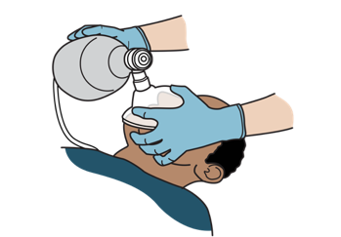
Breathing: Management
If unconscious with abnormal breathing → perform BAG-VALVE-MASK-VENTILATION with OXYGEN and follow CPR PROTOCOLS.
If not breathing adequately (too slow or too shallow) → begin BAG-VALVE-MASK-VENTILATION with OXYGEN
  If oxygen is not immediately available, do not delay ventilation.
  Plan for immediate TRANSFER for airway management.
Notes:
Abnormalities with breathing must be identified and managed quickly. If the patient is unconscious with abnormal or no breathing, start bag-mask-ventilation with oxygen if available and follow CPR protocols. If the patient’s breathing is not adequate, either too slow or too shallow, begin bag-mask-ventilation with oxygen. If oxygen is not immediately available, do not delay ventilation. Plan for immediate transfer for airway management.

Slide 21
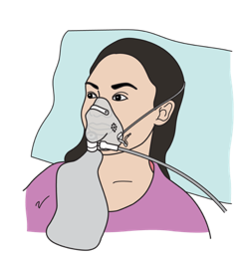
Breathing: Management
NOT BREATHING ADEQUATELY
If breathing fast or hypoxia → give OXYGEN.
If wheezing → give SALBUTAMOL .
If concern for anaphylaxis → give intramuscular ADRENALINE.
If concern for tension pneumothorax
→ perform NEEDLE DECOMPRESSION, give OXYGEN, give IV FLUIDS.
  Plan for immediate transfer for chest tube.
If concern for pleural effusion or haemothorax → give OXYGEN.
  Plan for immediate transfer for chest tube.
If cause unknown → consider trauma.
Notes:
If the patient is breathing too quickly or has hypoxia, give oxygen and if there is wheezing give salbutamol. Wheezing can be found in anaphylaxis, and if there is concern then give intramuscular adrenaline. If there is concern for tension pneumothorax, perform needle decompression, give oxygen and IV fluids. Plan for immediate transfer for a chest tube. Oxygen and a chest tube are interventions for a pleural effusion or haemothorax. If the cause of breathing abnormality is not clear, think about the possibility of trauma. .

Slide 22

Questions
Breathing

Slide 23
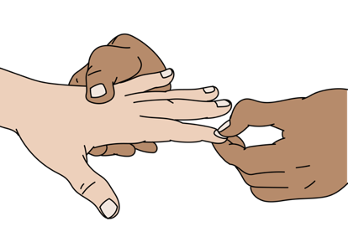
Circulation: Assessment
Look, listen and feel for signs of poor perfusion.
  Cool, moist extremities
  Delayed capillary refill
  Diaphoresis
  Low blood pressure
  Tachypnoea
  Tachycardia
  Absent pulses
Notes:
Assess the patient’s circulation using the look, listen and feel approach. Look at the patient’s skin and feel their extremities for signs of poor perfusion. These signs include cool, moist hands and feet, and a capillary refill greater than three seconds. Check for low blood pressure, rapid breathing (tachypnoea), rapid heart rate (tachycardia) and absent pulses.

Slide 24
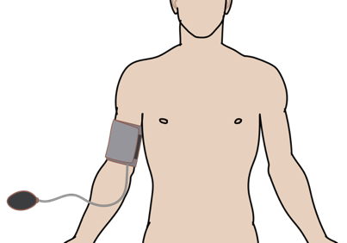
Circulation: Assessment
Look for internal and external signs of bleeding.
  Chest
  Abdomen
  From stomach or intestines
  Pelvic fracture
  Femur Fracture
  From wounds
Check for pericardial tamponade.
    Hypotension
    Distended neck veins
    Muffled heart sounds
Check pulse, capillary refill, blood pressure.
Notes:
Bleeding can be from external wounds and internal sources, and patients are at risk of haemorrhagic shock. Look for signs of internal and external bleeding. Look for bleeding in the chest, the abdomen, for signs of bleeding from the stomach or intestines, from a pelvic fracture, from a femur fracture, and from wounds. Hypotension, distended neck veins and muffled heart sounds may indicate pericardial tamponade. Check the patient’s blood pressure.

Slide 25
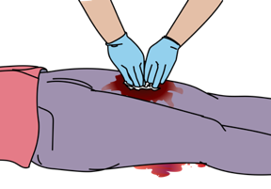
Circulation: Management
For cardiopulmonary arrest, follow relevant CPR PROTOCOLS.
If poor perfusion → GIVE IV FLUIDS.
  If external bleeding → APPLY DIRECT PRESSURE .
  If internal bleeding or pericardial tamponade
  → plan HANDOVER / TRANSFER to centre with surgical capabilities.
If unknown cause → remember trauma.
  Apply BINDER for pelvic fracture or SPLINT for femur fracture with compromised blood flow.
Notes:
If the patient is in cardiopulmonary arrest, follow your relevant CPR protocols. If you find signs of poor perfusion, give intravenous fluids and oxygen. For external bleeding, apply direct pressure or use other bleeding control techniques. For patients with uncontrolled external bleeding, or if internal bleeding or pericardial tamponade is suspected, call for experienced help and refer rapidly to a centre with surgical capabilities. Definitive control of any bleeding source is required. Apply an external binder to pelvic fractures and splint femur fractures, or fractures with compromised blood flow. If the cause of poor perfusion is unknown, remember the possibility of trauma.

Slide 26

Questions
Circulation

Slide 27
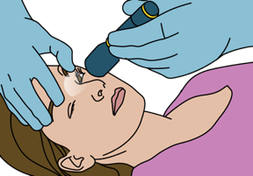
Disability: Assessment
Assess level of consciousness.
  AVPU or GCS in trauma
Check for low blood glucose (hypoglycaemia).
Check pupils (size, reactivity to light and if equal).
Check movement and sensation in all four limbs.
Look for abnormal repetitive movements or shaking.
  Seizures/convulsions
Notes:
The patient’s level of consciousness is assessed using the AVPU (Alert, Voice, Pain, Unresponsive) scale or the Glasgow Coma Scale in trauma cases. Hypoglycaemia is a common cause of altered mental status. Always check the glucose level in confused or unconscious patients. As part of your disability assessment, check for any pupil abnormalities in size, reactivity to light or equality, and check if there is movement and sensation in all limbs. During your assessment, look for abnormal repetitive movements or shaking which could be seizures or convulsions, on one or both sides of the body.

Slide 28
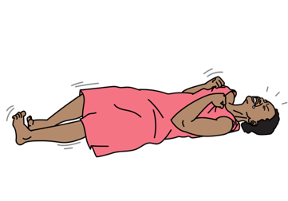
Disability: Management
If altered mental status, no trauma, ABCDEs otherwise normal
  → Place in RECOVERY POSITION.
If altered mental status, low glucose (<3.5mmol/L or <60 mg/dL) or if unable to check glucose
  → Give GLUCOSE.
If actively seizing
  → Give BENZODIAZEPINE.
If pregnant and seizing
  → Give MAGNESIUM SULPHATE.
Notes:
Based on your assessment findings, you can start to manage the patient. If there is altered mental status, no trauma and there are no other abnormalities found in the ACBDE check, the patient can be placed in the recovery position. If the blood glucose is low, or you are unable to check and the patient has altered mental status, give glucose to correct hypoglycaemia. If the patient is actively seizing, give a benzodiazepine. Think of eclampsia if the patient is pregnant and having seizures and give magnesium sulphate.

Slide 29
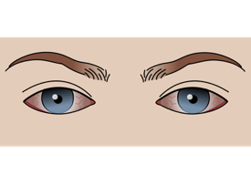
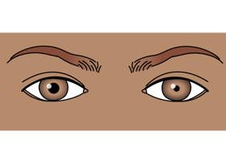
Disability: Management
If small pupils and slow breathing, consider opioid overdose
  → Give NALOXONE.
If unequal pupils, consider increased pressure in the brain
  → RAISE HEAD OF BED 30 DEGREES if no concern for spinal injury.
  → Plan for early TRANSFER/REFERRAL.
If unknown cause of altered mental status, consider trauma
  → IMMOBILIZE the cervical spine.
Notes:
Opioid overdose can cause altered mental status, small pupils and slow breathing. Naloxone is the antidote for opioid overdose. Increased pressure in the brain can cause unequal pupils. Raising the head of the bed by 30 degrees can help to reduce the pressure, if there is no concern for spinal injury. Plan for early transfer and referral of patients with signs of increased pressure in the brain. If the cause of altered mental status is unknown, consider trauma, and if concerned immobilise the cervical spine.

Slide 30

Questions
Disability

Slide 31
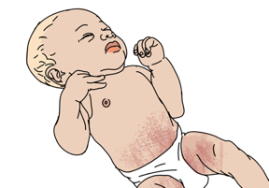
Exposure: Assessment
Examine the entire body for hidden injuries, rashes, bites or other lesions.
  Rashes, such as hives, can indicate an allergic reaction
  Other rashes can indicate infection
Notes:
During the exposure assessment you need to expose your patient in order to detect any hidden injuries, rashes, bites or other lesions. Be sure to maintain the patient’s dignity and check the entire body carefully. Look and feel for rashes such as hives which can indicate an allergic reaction, or rashes which could indicate infection.

Slide 32
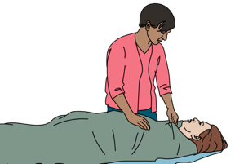
Exposure: Management
If snake bite is suspected
  →IMMOBILIZE the bitten extremity.
  →Take a picture of the snake (if possible and safe) to send to referral hospital.
General exposure considerations.
  REMOVE constricting clothing and jewelry
  COVER the patient to prevent hypothermia
    Acutely ill patients may be unable to regulate body temperature
  PREVENT hypothermia
    Remove wet clothing and dry patient thoroughly
  Respect the patient’s modesty
If cause unknown → remember trauma
  LOG ROLL for suspected spinal cord injury.
Notes:
Snake bite can be a life-threatening condition. If a snake bite is suspected, immobilise the limb. Do not risk additional bites to catch the snake but is possible and safe, take a picture of the snake to send to the referral hospital. Be sure to remove any constricting clothing and jewellery, this is especially important if there is limb injury or burns which can swell. Acutely ill or injured patients may be unable to regulate their body temperature. Avoid hypothermia by keeping the patient covered, and by removing wet clothing and drying the patient. Respect the patient and protect modesty during exposure. If there is suspicion of trauma or spinal cord injury, turn the patient using the log roll technique.

Slide 33

Questions
Exposure

Slide 34
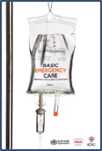
The ABCDE and SAMPLE history approach
Part 2: In-depth Acute Life-Threatening Conditions
Notes:
In the second part of the ABCDE presentation, we will look in-depth at acute, life-threatening conditions.

Slide 35





In-Depth, Acute, Life-Threatening Conditions
Obstruction: foreign body Obstruction: burns Obstruction: anaphylaxis Obstruction: trauma | Tension pneumothorax Opiate overdose Asthma/COPD Large pleural effusion/ haemothorax | Pulselessness Shock Severe bleeding Pericardial Tamponade | Hypoglycaemia Increased pressure on the brain Seizures/ convulsions | Snake bite
Notes:
This table shows a list of acute, life-threatening conditions which can affect each ABCDE element. We will go through each condition in-depth. The next slides will highlight the signs and symptoms of each condition, and the appropriate initial management. The content of these slides will be reviewed in more detail during the Trauma, Difficulty in Breathing, Shock and Altered Mental Status modules.

Slide 36
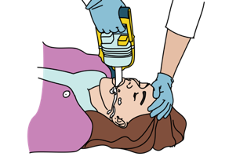
Airway Obstruction: Foreign Body
Signs and Symptoms | Management
Visible secretions, vomit or foreign body Abnormal sounds from airway Stridor, snoring, gurgling Mental status changes leading to airway obstruction from tongue Poor chest rise | REMOVE or SUCTION visible foreign body/fluid if possible. Do not push further into airway. If completely obstructed → Use age-appropriate CHEST THRUSTS/ABDOMINAL THRUSTS/ BACK BLOWS For obstruction due to tongue → Open the airway using HEAD-TILT and CHIN LIFT or JAW THRUST (trauma) Place OPA or NPA as needed. Plan for HANDOVER/TRANSFER.
Notes:
Foreign bodies can cause airway obstruction. During your assessment of the airway, look for visible secretions, vomit or a foreign body in the airway. Listen for any abnormal sounds including stridor, snoring and gurgling, and look for poor chest rise. Mental state changes can lead to airway obstruction from the tongue.
If there is a visible foreign body or fluid, gently remove or suction is possible but be careful not to push a foreign body further into the airway and do not try to remove a foreign body if it is not clearly visible. If the patient is choking, use age-appropriate chest thrusts, abdominal thrusts or back blows to dislodge the obstruction from the airway. The tongue may obstruct the airway in patients with a decreased level of consciousness. Open the airway using a head-tilt and chin-lift maneouvres, or jaw thrust if there is concern for trauma, and place an oral or nasopharyngeal airway as needed. These patients may also be unable to protect their airway, and need to be monitored for vomiting and aspiration. Plan for rapid handover and transfer to an advanced provider capable of advanced airway management.
an advanced provider capable of advanced airway management if the obstruction cannot be removed.

Slide 37
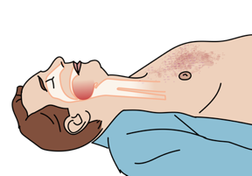
Airway Obstruction: Burns
Signs and Symptoms | Management
Burns to head and neck Burned nasal hairs/soot Abnormal sounds from airway Stridor, snoring, gurgling Poor chest rise Rapid airway swelling | Give OXYGEN to all patients with burn injuries. Open the airway using HEAD-TILT and CHIN LIFT or JAW THRUST (trauma). Place OPA or NPA as needed. Maintain C-SPINE IMMOBILIZATION if there is trauma. Plan for HANDOVER/TRANSFER.
Burns can cause airway swelling due to inhalation injuries.
Notes:
In patients with burns, check for signs and symptoms of airway burns. Burns can cause airway swelling due to inhalation injuries. Look for burns to the head and neck, burned hair around the face, mouth and nose, and the presence of soot. Listen for abnormal signs from the airway including stridor which is a sign of upper airway obstruction, snoring and gurgling. Look for poor chest rise. Even if there are no signs of hypoxia, give oxygen to all patient with suspected airway burns in case of deterioration. If the patient has a reduced level of consciousness, the airway should be opened with the head-tilt and chin-lift manoeuvre, or jaw thrust is trauma. Place an oral or nasopharyngeal airway as needed. Burns patients may have sustained trauma, and if there is concern maintain cervical spine immobilisation avoiding additional pressure on the neck. The airway can swell and close off very quickly in burn patients, so it is important to call for experienced help early and plan for rapid handover / transfer to a provider capable of advanced airway management.nt to call for experienced help early and plan for rapid handover / transfer to a provider capable of advanced airway management.

Slide 38
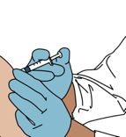
Airway Obstruction:
Severe Allergic Reaction
Signs and Symptoms | Management
Mouth, lip and tongue swelling Difficulty breathing Stridor and/or wheezing Rash or hives Tachycardia and hypotension Abnormal sounds from airway Stridor, snoring, gurgling Poor chest rise | MONITOR for airway obstruction. Give ADRENALINE for airway obstruction, severe wheezing or shock. Can wear off in minutes, may need additional doses Give OXYGEN. Start IV/ give IV FLUIDS. REPOSITION AIRWAY as needed. Sit patient upright (no trauma). If severe or not improving →plan for HANDOVER/TRANSFER
Notes:
Severe allergic reactions can cause swelling of the airway that can lead to obstruction. Look for mouth, lip and tongue swelling. Listen for difficulty in breathing, stridor and / or wheezing. Patients may have a rash or hives, with are patches of pale or red, itchy, warm, swollen skin. Check for tachycardia and hypotension. Listen for abnormal sounds from the airway including stridor, snoring or gurgling and look for poor chest rise.
Monitor the patient carefully for airway obstruction. Initial management of a severe allergic reaction requires intramuscular adrenaline for airway obstruction, severe wheezing or shock. Adrenaline can wear off in minutes so be prepared to give additional doses. Give oxygen, place an intravenous line and give intravenous fluids to improve perfusion. Reposition the airway as needed and sit the patient upright if no concern for trauma. If the reaction is severe or not improving prepare for rapid handover/transfer for advanced airway management.

Slide 39
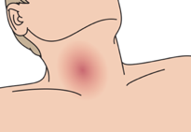
Airway Obstruction: Trauma
Signs and Symptoms | Management
Neck haematoma Abnormal sounds from airway Stridor, snoring, gurgling Change in voice Poor chest rise | SUCTION to remove any blood. Open airway using JAW THRUST. Place an OPA as needed. Do not use NPA with facial trauma Maintain SPINE IMMOBILIZATION. Plan for HANDOVER/TRANSFER.
In head/neck injuries obstruction can be from blood or due to the trauma itself.
Penetrating wounds to neck cause obstruction from expanding hematoma.
Notes:
Airway obstruction may result from injuries to the head or neck. Blood, bone or damaged tissue may block the airway. Penetrating wounds to the neck may also cause obstruction due to swelling or expanding haematoma. In your airway assessment, look for signs of a neck haematoma. Abnormal sounds may be heard from the airway, there could be a change in voice when the patient talks, or you may see poor chest rise with breathing. Ensure the airway is kept clear, by using suction to remove any blood and by opening the airway using a jaw thrust manoeuvre. Place an oral airway as needed but do not use a nasopharyngeal airway if there is facial trauma. Maintain spine immobilisation. Trauma patients with airway obstruction should be handed over or transferred rapidly to an advanced provider capable of advanced airway management or surgical intervention.

Slide 40

For any abnormal airway sounds, REASSESS the airway frequently as partial obstruction might worsen to completely block the airway.
!
Notes:
Reassess
For any abnormal airway sounds, reassess the airway frequently as partial obstruction might worsen to completely block the airway.

Slide 41
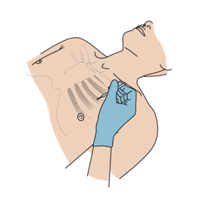
Breathing Conditions: Tension Pneumothorax
Signs and Symptoms | Management
Hypotension with difficulty breathing and any of the following: Distended neck veins Absent breath sounds on affected side Hyperresonance with percussion on affected side May have tracheal shift away from affected side | Perform NEEDLE DECOMPRESSION, give OXYGEN and IV FLUIDS Arrange for urgent chest tube. Plan for HANDOVER/TRANSFER
Any pneumothorax can become a tension pneumothorax.
Notes:
Any pneumothorax can become a tension pneumothorax. Air in the cavity between the lungs and the chest wall can collapse the lung, this is called a simple pneumothorax. A large pneumothorax can cause pressure – or tension – to build, displacing and blocking flow from the main vessels back to the heart. This causes shock and the condition of tension pneumothorax. Signs include hypotension with difficulty in breathing and any of the following: distended neck veins, absent breath sounds, hyperresonance on the affected side, or tracheal shift away from the affected side. This is a life-threatening condition.
Perform immediate needle decompression, and give oxygen and intravenous fluids to improve perfusion. The patient will need a chest tube, so arrange for rapid handover or transfer to an advanced provided capable of placing and monitoring the chest tube. Diagnosis and management of tension pneumothorax is covered in detail in the Difficulty in Breathing lecture.

Slide 42
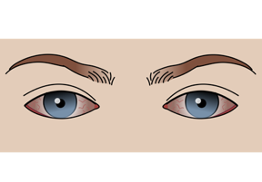
Breathing Conditions: Suspected Opiate Overdose
Signs and Symptoms | Management
Slow respiratory rate (bradypnoea) Hypoxia Very small pupils | Give NALOXONE to reverse opioid medications. MONITOR closely; Naloxone may wear off before opiate. Give OXYGEN.
SMALL PUPILS
Opioid drugs (such as morphine, pethidine, oxycodone and heroin) can decrease the body’s drive to breathe.
Notes:
Opioid medications and drugs (such as morphine, pethidine, oxycodone and heroin) can decrease the body’s drive to breathe. Signs of slow respiratory rate, hypoxia, and bilateral very small pupils are seen. Naloxone reverses opiates, however close monitoring is needed as the naloxone dose may wear off before the opiate. Repeat doses of naloxone may be needed. Oxygen should be provided to correct the hypoxia.

Slide 43
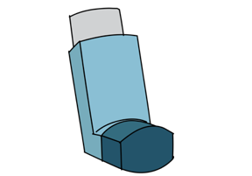
Breathing Conditions: Asthma/ COPD
Signs and Symptoms | Management
Wheezing Cough Accessory muscle use May have history of asthma/COPD, allergies or smoking | Give SALBUTAMOL as soon as possible. Give OXYGEN if indicated.
Asthma and COPD are conditions causing spasm in the lower airway.
Notes:
Asthma and COPD are conditions causing spasm in the lower airways, resulting in narrowing and difficulty in breathing. Signs and symptoms are wheezing and coughing. You may see accessory muscle use. The patient may have a history of asthma or COPD, allergies or smoking. Bronchospasm can be life-threatening and the initial management is administration of salbutamol as soon as possible, to relieve the spasm in the air passages. Provide oxygen if indicated and use carefully in patients with COPD.

Slide 44
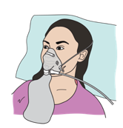
Breathing Conditions:
Large Pleural Effusion/ Haemothorax
Signs and Symptoms | Management
Difficulty in breathing Decreased breath sounds on affected side Dull sounds with percussion on affected side With large amount of fluid could have tracheal shift | Give OXYGEN. Plan for HANDOVER/TRANSFER. Patient may need a chest tube.
Pleural effusion occurs when fluid builds up in the space between the lung and the chest wall or diaphragm limiting the expansion of the lungs.
Notes:
A pleural effusion occurs when fluid builds up in the space between the lung and the chest wall or diaphragm. Blood in this space is called a haemothorax. As the fluid or blood builds up, it limits expansion of the lungs. The patient experiences difficulty in breathing, and breath sounds are decreased on the affected side. The affected side sounds dull to percussion. With a large amount of fluid there could be tracheal shift.
The initial management is to provide oxygen. Arrange for handover and transfer as many of these patients will need a chest tube or drainage.

Slide 45
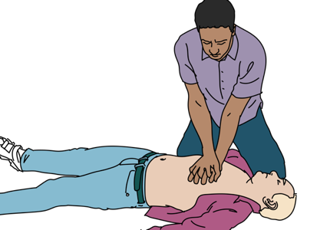
Circulation Conditions: Pulselessness
Signs and Symptoms | Management
No pulse Unconscious Not breathing | Follow relevant CPR PROTOCOLS.
Notes:
If the patient is unconscious, has no pulse or is not breathing, follow relevant CPR protocols immediately. CPR is not covered in the Basic Emergency Care course as this is a specific area of focus. It is important to familiarize yourself with local protocols and undergo regular training.

Slide 46
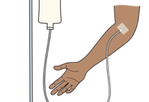
Circulation Conditions: Shock
Signs and Symptoms | Management
Rapid heart rate (tachycardia) Rapid breathing (tachypnoea) Pale and cool skin Capillary refill >3 seconds Sweating (diaphoresis) May have: Dizziness Confusion Altered mental status Hypotension | LAY FLAT if tolerated. Give OXYGEN. STOP and CONTROL any bleeding. Give IV FLUIDS. If sign of infection → give ANTIBIOTICS. Plan for HANDOVER/TRANSFER.
Poor perfusion is failure to deliver enough oxygen-carrying blood to vital organs
Shock is when organ function is affected which can lead to death
Notes:
Poor perfusion is the failure to deliver enough oxygen-carrying blood to the vital organs. When poor perfusion continues until organ function is affected, this is called shock and can lead rapidly to death. There are different causes of shock, which are covered in the Shock presentation.
On assessment you need to check for signs and symptoms of poor perfusion. These include rapid heart rate, rapid breathing, pale and cool skin especially in the peripheries, a capillary refill time more than 3 seconds, and sweating. Patients may feel dizzy, have anxiety, confusion or other altered mental status. Hypotension is a late sign of poor perfusion. Manage the patient by lying them flat if tolerated, give oxygen and stop and control any bleeding. Give intravenous fluids and if there are signs of infection, give antibiotics. Prepare for rapid handover and transfer of the patient.
intravenous fluids and if there are signs of infection, start antibiotics. Prepare for rapid handover and transfer of the patient.

Slide 47
Circulation Conditions: Severe Bleeding
Signs and Symptoms | Management
Bleeding wounds Bruising around the umbilicus, over the flanks can be sign of internal bleeding Vomiting blood, blood per rectum or vagina Pelvic or femur fractures Decreased breath sounds on one side Signs of poor perfusion Hypotension, tachycardia, pale skin, diaphoresis | Stop bleeding depending on source. DIRECT PRESSURE Use DEEP WOUND PACKING if large and gaping. TOURNIQUET- Only for uncontrolled bleeding not responding to direct pressure BIND pelvis or SPLINT femur fracture. Give IV FLUIDS. REFER for blood transfusion and on-going surgical management .
If severe bleeding is not controlled, it can lead to shock. Large amounts of blood can be lost in the chest, pelvis, thigh, abdomen and externally.
Notes:
If severe bleeding is not controlled, the patient can lose a significant amount of blood, which can lead to shock. Blood may be lost externally from bleeding wounds or internally. A large quantity of blood can also be lost into the chest, pelvis, thigh, and into the abdomen, and therefore it is important to have a systematic approach to check for signs of injury and bleeding. Signs and symptoms of severe bleeding include bleeding wounds, bruising around the umbilicus or over the flanks which can be a sign of internal bleeding, vomiting blood, blood per rectum or vagina, pelvic or femur fractures or decreased breath sounds on one side. Signs of poor perfusion include hypotension, tachycardia, pale skin and diaphoresis.
The priority is to stop bleeding, and management depends on the source. Control external bleeding using direct pressure or deep wound packing if the wound is large and gaping, Use a tourniquet only if a limb has uncontrolled bleeding not responding to direct pressure. Bleeding can be reduced from pelvic fractures with a binder, and from a femur fracture by splinting. Perfusion can be improved with intravenous fluids, but the patient must be referred for urgent blood transfusion and on-going surgical management.

Slide 48
Circulation Conditions:
Pericardial Tamponade
Signs and Symptoms | Management
Signs of poor perfusion Tachycardia, tachypnea, hypotension, pale skin, cold extremities, capillary refill >3 seconds Distended neck veins Muffled heart sounds May have dizziness, confusion, altered mental status | Treatment is drainage by pericardiocentesis IV FLUIDS to counter the pressure from fluid in heart sac Plan for HANDOVER/TRANSFER Needs facility capable of draining fluid
Pericardial tamponade occurs when there is a fluid build-up in the sac around the heart. Pressure build-up keeps the heart from filling properly.
Notes:
Pericardial tamponade occurs when fluid builds up in the sac around the heart. The pressure from this fluid can collapse the chambers of the heart and keep them from filling properly, limiting blood flow to the tissues and causing shock. Pericardial tamponade can be caused by trauma, if blood builds up in the sac around the heart. Assess the patient for signs of poor perfusion and signs of tension which include distended neck veins, muffled heart sounds and hypotension. The patient may have dizziness, confusion and altered mental status.
Treatment is by drainage of the fluid or blood by pericardiocentesis. To counter the pressure until the fluid around the heart is drained, give intravenous fluids to ensure that as much volume as possible enters the heart. The patient must be referred rapidly to a facility capable of draining the fluid.

Slide 49
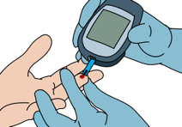
Disability Conditions: Hypoglycaemia
Signs and Symptoms | Management
Sweating (diaphoresis) Altered mental status Seizures/convulsions Blood glucose <3.5mmol/L or <60 mg/dL History of diabetes, malaria or severe infection Responds quickly to glucose | Give GLUCOSE immediately. If they can speak/swallow → give oral GLUCOSE. If they cannot speak or is unconscious → give IV GLUCOSE. If unavailable → give buccal (inside of cheek) glucose.
Notes:
Hypoglycaemia is a blood glucose level of less than 3.5 mmol/L. Patients with hypoglycaemia have sweating, anxiety, confusion or other signs of altered mental state, and may have seizures. There can be a history of diabetes, malaria or severe infection. If the person can speak and swallow, give oral glucose immediately. If they are unconscious, give intravenous glucose. Buccal glucose, given inside the cheek, is an alternative if intravenous glucose is not possible or available. Patients usually respond quickly to treatment with glucose.

Slide 50
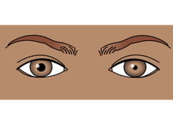
Disability Conditions:
Increased Intracranial Pressure
Signs and Symptoms | Management
Headache Seizure/convulsions Nausea, vomiting Altered mental status Unequal pupils Weakness on one side of the body | RAISE the head of the bed 30 degrees. If trauma → MAINTAIN CERVICAL SPINE IMMOBILIZATION. Check glucose. If seizures → give BENZODIAZEPINE. Plan for HANDOVER/TRANSFER. Pressure must be reduced as soon as possible which requires neurosurgery
Increased ICP can occur from trauma, tumors, increased fluid, bleeding or infection.
Any swelling, fluid or mass increases pressure around the brain, and limits blood flow.
Notes:
Increased pressure on the brain can occur from trauma, tumors, increased fluid, bleeding or infections. Because the skull is rigid, any swelling, fluid, or mass increases the pressure around the brain, limiting blood flow and possibly displacing brain tissue, causing death. Signs and symptoms of increased intracranial pressure include headache, seizure or convulsions, nausea, vomiting, altered mental status, unequal pupils or weakness on one side of the body.
The head of the bed can be raised to 30 degrees to relieve pressure. If trauma is suspected, maintain cervical spine immobilization and you may not be able to raise the head. If there are seizures, give a benzodiazepine and don’t forget to check and correct hypoglycaemia. The pressure must be reduced as soon as possible so plan for rapid handover and transfer

Slide 51
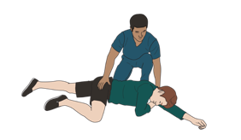
Disability Conditions: Seizure/ Convulsions
Signs and Symptoms | Management
Active seizure Repetitive movements Fixed gaze to one side or alternating rhythmically Not responsive Recent seizure Bitten tongue Urinated on self Known history of seizures Confusion gradually returning over minutes or hours If cause unknown, consider trauma. | Prevent hypoxia and injury. Protect from falls/dangerous objects.. Do not stick anything in their mouth SUCTION as needed . Give OXYGEN. Check glucose. Give GLUCOSE if needed. Give a BENZODIAZEPINE . Monitor breathing. Place in RECOVERY POSITION (if no trauma) Give MAGNESIUM SULPHATE if pregnant or recently pregnant .
Notes:
There are many causes of seizures, including trauma. During an active seizure patients can have repetitive movements, a fixed gaze to one side, a rhythmically alternating gaze or be unresponsive. The patient may bite their tongue and be incontinent of urine. Confusion after a seizure can resolve over minutes to hours. The goal in managing a seizure is to prevent hypoxia and injury. Protect the seizing patient from falls and from any hazardous objects around them. Never place anything in the mouth of a person with active seizing, except to gently suction the airway. Give oxygen and check for and correct hypoglycaemia. Benzodiazepine treatment is given to stop a seizing, but it is important to monitor for slow breathing after giving. Place the patient into the recovery position if there are no concerns for spinal trauma. If the patient is pregnant or has recently given birth, give magnesium sulphate for eclampsia.

Slide 52
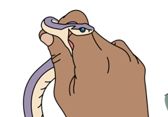
Exposure Conditions: Snake Bite
Signs and Symptoms | Management
History of snake bite Bite marks may be seen Oedema Blistering of skin Bruising Hypotension Paralysis Seizures Bleeding from wounds | Limit the spread of venom and the effects on the body IMMOBILIZE THE BITTEN EXTREMITY. Take a picture of the snake to send with the patient if possible and safe. If evidence of shock → give IV FLUIDS. Monitor closely for airway obstruction and signs of shock. Plan for RAPID HANDOVER/TRANSFER.
Notes:
Without a history of snake bite, the condition can be more difficult to recognize. Bite marks may be seen on the skin, or there can be surrounding oedema, blisters or bruising. Depending on the type of snake, the patient may have systemic signs of hypotension, paralysis, seizures of bleeding from wounds. The goal of managing snake bites is to limit the spread of the venom and the effects of venom on the body. A bitten extremity should be immobilized. If safe to do so, take a picture of the snake and send with the patient. Manage shock with IV fluids and anticipate delayed shock or airway problems. Patients should be monitored closely for deterioration and plan early for handover or transfer.

Slide 53
Reassess ABCDEs Frequently
The ABCDE approach is designed to quickly identify reversible life-threatening conditions.
Vital signs should be checked at the end of the ABCDE approach.
Once you find an ABCDE problem and manage it, you need to GO BACK and repeat the ABCDE again to identify any new problems that have developed and make sure that the management provided worked.
Ideally, the ABCDE approach should be repeated every 15 minutes or with any change in condition.
!
Notes:
The ABCDE approach is designed to quickly identify reversible life-threatening conditions. After finding and managing an ABCDE problem, you need to go back to the beginning and repeat your ABCDE assessment again. In this way you can assess the effect of your intervention and identify any new problems. A full set of vital signs should be checked at the end of the ABCDE approach, but do not delay ABCDE interventions. The ABCDE approach should be repeated with any change in patient condition, and ideally every 15 minutes for critical cases.

Slide 54
Workbook Question 2
Using the workbook section above, list the management for airway blocked by a foreign body.
Notes:
Workbook question 2: ABCDE approach [page 26 in participant workbook]
Using the workbook section above, list the management for airway blocked by a foreign body.
Answers: 1. Remove or suction the foreign body/fluid if possible. 2. Patients with a decreased level of consciousness may have airway obstruction due to the tongue. 3. Open the airway using a head-tilt and chin lift maneuver or jaw thrust (if concern for trauma); and place an oral or nasopharyngeal airway as needed. [See SKILLS} 4. These patients may also not be able to protect their airway and need to be watched for vomiting and aspiration. 5. Plan for rapid handover/transfer to advanced provider capable of advanced airway management if the obstruction cannot be removed.

Slide 55

The ABCDE and SAMPLE history approach
Part 3: Special Paediatric Considerations, SAMPLE history and Disposition
This learning content has been developed in collaboration with the WHO Academy.
Notes:
This is the third and final part of the ABCDE approach presentation. We will look at special paediatric considerations, explore the SAMPLE history and consider patient disposition.

Slide 56
Special Paediatric Considerations
Notes:
While the ABCDE approach is used in both adults and children, there are some aspects of assessing and managing children that are different from adults. The “Paediatric considerations” sections throughout the BEC manual highlight these differences. In the next section we will look at some special paediatric ABCDE considerations.

Slide 57

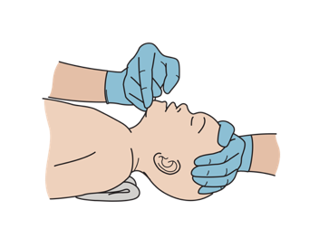
Paediatric Airway Considerations
Compared to adults, children have:
Bigger tongues
  Use “sniffing” position
Shorter necks, softer airway
  Easier to block off
  Avoid over-extending or flexing the neck
A larger head compared to body
  Watch closely for airway obstruction
  Use jaw thrust
  Correct head position with padding under shoulders to open airway
Excessive drooling, stridor, airway swelling, unwillingness to move neck are high-risk signs in children.
Notes:
There are important anatomical differences between children and adults. Compared to adults, children have bigger tongues, shorter necks, softer airways and a larger head compared to the body. Special management is needed to accommodate these differences. Children should be placed in the ‘sniffing position’ as the tongue is bigger. Avoid over-extending or flexing the neck as the softer airway and short neck make it easier to block off the airway. Use the jaw thrust position to open the airway. Placing padding below an infant’s shoulders, as shown in the image, keeps the larger head in a neutral position. Excessive drooling, stridor, airway swelling and unwillingness to move the neck are all high-risk signs in children. Look carefully in the airway for foreign bodies, burns or obstruction, and allow the child to remain in a position of comfort.

Slide 58

Paediatric Breathing Considerations
Look for signs of respiratory distress :
  Nasal flaring
  Head bobbing
  Grunting
  Chest indrawing or retractions
  Cyanosis, a blue/gray discoloration around lips, mouth or fingertips is a danger sign
Look at the lower ribs
  Chest indrawing is when the lower chest wall goes IN when the child breathes IN.
  In normal breathing the whole chest and abdomen move OUT when the child breathes IN.
Notes:
Signs of respiratory distress in children can be subtle and you need to assess carefully. Look for nasal flaring, head bobbing and grunting. Chest indrawing is a common presentation of paediatric accessory muscle use, as shown in the diagram. Here the lower chest wall goes in as the child breathes in, compared to the whole chest and abdomen moving out in normal breathing. Cyanosis results from lack of oxygen and is a danger sign. Look for blue/gray discolouration around the lips, mouth or fingertips.

Slide 59
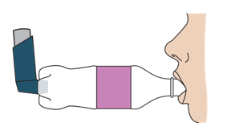
Paediatric Breathing Considerations
Listen
  Silent chest is a sign of severe distress in a child
    Severe spasms and airway narrowing cause limited airway movement and few or no breath sounds may be heard.
    Give SALBUTAMOL and OXYGEN.
    Reassess frequently.
  Stridor is a sign of severe airway compromise
    Allow child to stay in position of comfort.
    Plan for rapid HANDOVER/TRANSFER.
    Give nebulized ADRENALINE. If unable to transfer immediately, consider
    IM ADRENALINE (allergic reaction protocol).
Notes:
When assessing a child’s breathing, listen for abnormal breath sounds, a silent chest or stridor. A silent chest is when there are no breath sounds when you listen to the chest and a sign of severe respiratory distress. With severe spasm and narrowing of the airways, there may be limited air movement and few breath sounds on exam. Give salbutamol and oxygen and re-assess frequently. Stridor signals severe airway compromise, and there are many possible causes. Children with stridor should be allowed to stay in a position of comfort and transferred immediately to an advanced provider. Further treatment will often include nebulized adrenaline. If immediate transfer is not possible, consider intramuscular adrenaline as per severe allergic reaction treatment.

Slide 60
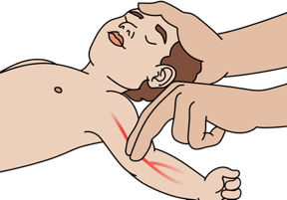
Paediatric Circulation Considerations
Low blood pressure in a child is a sign of severe shock.
  Children will maintain a normal blood pressure longer than adults but then decompensate quickly.
  Always monitor other signs of poor perfusion.
    Decreased urine output
    Sunken fontanelle, poor skin pinch, lethargy,
    altered mental status (severe signs)
Rate, volume and type of IV fluid administered depends on body weight, the cause of poor perfusion and the child’s nutritional status.
Malnourished children require careful fluid management!
Notes:
Children can keep a normal blood pressure for longer than adults when in shock, so low blood pressure in a child is a sign of severe shock. To detect shock earlier, always monitor other signs of poor perfusion including poor skin pinch, sunken fontanelle, decreased urine output and altered mental status. When managing poor perfusion, consider the cause and condition of the child including nutritional status. For malnourished children both the rate and fluid administration and the types of fluid are different.

Slide 61


Paediatric Disability Considerations
Low blood glucose is a common cause of altered mental status in a sick child.
  When possible, check blood glucose with altered mental status.
  When not possible, give GLUCOSE .
Always check blood glucose with seizures/convulsions .
It may be difficult to determine if a small child is acting normally. Ask family/friends who know the child to provide this information.
Notes:
Low blood glucose is a common cause of altered mental status in a sick child. Always check glucose if the child has seizures, or is severely unwell. When it is not possible to check blood glucose, give glucose and assess the response. Assessing mental status and normal behaviour in infants can be difficult, so always ask the person caring for the child if this is normal.

Slide 62

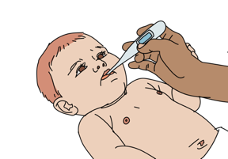
Paediatric Exposure Considerations
Infants/children have trouble maintaining temperature and can become hypothermic or hyperthermic quickly.
  Remove wet clothing and dry skin thoroughly.
  Provide skin-to-skin contact for infants.
  If concerned about hypothermia →Cover very small children’s heads
  If concerned about hyperthermia →Unbundle tightly wrapped babies
Notes:
Infants and children have difficulty maintaining body temperature, and their temperature can very quickly become too high or too low. To avoid hypothermia, be sure to remove wet clothes, dry the skin, cover including the head for small children, and place infants skin-to-skin where possible. To avoid hyperthermia, remove excess clothing and unbundle tight wrapping. Adjust the room environment where possible for a more suitable temperature.

Slide 63
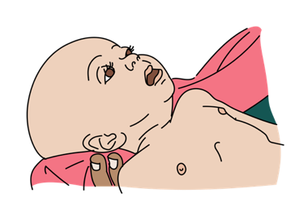
Assess all children for the presence of danger signs.
A child with danger signs needs urgent attention!
!
Signs of airway obstruction
Increased breathing effort
Cyanosis
Altered mental status
Moves only when stimulated or no movement (AVPU other than ”A”)
Not feeding well/ cannot drink or breastfeed
Vomiting everything
Seizures/convulsions
Low body temperature (hypothermia)
Notes:
In addition to performing a thorough ABCDE approach, all paediatric patients should be evaluated for the presence of danger signs. Children with danger signs need urgent attention and referral/ handover to a provider able to give advanced paediatric care. Paediatric danger signs include signs of airway obstruction such as stridor, drooling and unable to swallow saliva. Increased effort of breathing and cyanosis are danger signs. Altered mental status including lethargy or unusual sleepiness, confusion, disorientation, moving only when stimulated or no movement at all. This is any other score on AVPU than A. Check if the child is not feeding well, or cannot drink or breastfeed, or is vomiting. Seizures and hypothermia are other danger signs as is low body temperature. There is a special Basic Emergency Quickcard for reference which lists the danger signs.

Slide 64
Workbook Question 3
Using the workbook section:
One paediatric airway consideration ______________________________
One paediatric breathing consideration ____________________________
One paediatric circulation consideration ___________________________
One paediatric disability consideration _____________________________
One paediatric exposure consideration ____________________________
Notes:
Workbook question 3: ABCDE approach [page 30 in participant workbook]
Using the workbook section above, list one of each of the following:
A pediatric airway consideration
Answers: • Shorter necks with airways that are softer and easier to block off. • Bigger tongue as compared to airway size. • A larger head compared to the rest of the body. A pediatric breathing consideration Answers: • Children display difficulties in breathing in different ways than adults: o Retractions o Nasal flaring o Head bobbing o Grunting o Chest indrawing • CYANOSIS, a blue/gray discoloration around the lips, mouth, or fingertips, is due to lack of oxygen and is a danger sign. • CHEST INDRAWING is a common presentation of pediatric accessory muscle use.
A pediatric circulation consideration Answers: • LOW BLOOD PRESSURE IN A CHILD IS A SIGN OF SEVERE SHOCK. Children are able to keep a normal blood pressure for longer than adults when in shock. • The amount of IV fluid given is different than adults. • IN MALNOURISHED CHILDREN, both the rate of fluid administration and the type of fluid used is different (we will discuss this in shock and skills). • Danger signs in children include sunken fontanelle, poor skin pinch (we will discuss this in shock and skills), lethargy, altered mental status A pediatric disability consideration Answers: • LOW BLOOD GLUCOSE is a very common cause of altered mental status in sick children. • It is sometimes difficult to determine if an infant is acting normally. The person caring for the child can often provide this information. • Seizures/convulsions.
A pediatric exposure consideration Answers: • INFANTS AND CHILDREN HAVE DIFFICULTY MAINTAINING THEIR TEMPERATURE and can become hypothermic (low body temperature) or hyperthermic (high body temperature) very quickly

Slide 65
ABCDE Approach: Summary
 | Airway with cervical spine immobilization
 | Breathing plus oxygen if needed
 | Circulation IV fluids and bleeding control
 | Disability AVPU/GCS, pupils and glucose
 | Exposure and keep warm
Notes:
To summarise the ABCDE approach, we need to work systematically through the elements of airway with cervical spine immobilization, breathing, circulation, disability and exposure, and intervene as soon as we detect problems. The ABCDE approach will help us identify and intervene in life-threatening conditions in a timely way.

Slide 66
REMEMBER
!
If you find a problem with any of the ABCDEs, STOP and CORRECT the problem.
Then, GO BACK and REASSESS the ABCDEs again to identify any new problems that have developed and make sure that the management provided worked.
Notes:
If you find a problem with any of the ABCDE elements, you must stop, correct the problem and then go back to the beginning and reassess ABCDE again.

Slide 67
Elements of the SAMPLE history
S | Signs and symptoms | Patient/family’s report of signs and symptoms is an essential assessment
A | Allergies | Important to prevent harm; may also suggest anaphylaxis
M | Medications | Obtain a full list and note recent medication or dose changes
P | Past Medical History | May help in understanding current illness and change management choices
L | Last Oral intake | Note whether solid or liquid; vomiting/choking risk for sedation; intubation or surgical procedures
E | Events surrounding the injury/illness | Helpful clues to the cause, progression and severity of current illness
Notes:
S is for signs and symptoms, as reported by the patient or others. This is essential to assessment and management. A is for allergies. It is important to be aware of medication allergies so that treatments do not cause harm. Allergies may also suggest anaphylaxis as the cause of acute symptoms. M is for Medications. Obtain a full list of medications that the person currently takes and ask about recent medication or dose changes. These may affect treatment decisions and are important to understanding the person’s chronic conditions. P is for Past medical history. Knowing prior medical conditions may help in understanding the current illness and may change management choices. Also ask about pregnancy. L is for last oral intake. Record the time of last oral intake and whether solid or liquid. A full stomach increases the risk of vomiting and subsequent choking, especially with sedation or intubation that might be required for surgical procedures. E is for the events surrounding the injury or illness. Knowing the circumstances around the injury or illness may be helpful in understanding the cause, progression and severity. With practice, the SAMPLE history becomes quick and easy to follow, and is used in communication with other healthcare providers.

Slide 68
Workbook Question 4
Using the workbook section above, list what the letters in SAMPLE stand for:
S
A
M
P
L
E
Notes:
Workbook question 4: SAMPLE history [page 31 in participant workbook]
Using the workbook section above, list what the letters in SAMPLE stand for:
S: signs and symptoms A: allergies M: medications P: past medical history L: last oral intake E: events surrounding the injury or illness

Slide 69
Disposition Considerations
A good handover includes:
  Brief identification of the patient
  Relevant elements of the SAMPLE history
  Physical exam findings
  Record of interventions given
  Plans for future care
  Things you may be concerned about
Disposition (destination of the patient) should be considered after ABCDE approach, SAMPLE history and complete physical exam based on the specific condition.
If you intervene in any of the ABCDE categories, immediately plan for HANDOVER/TRANSFER to a higher level of care.
Notes:
Disposition is the destination of the patient. If you have to intervene in any of the ABCDE categories, immediately plan for handover/ transfer to a higher level of care. Disposition is the next phase after you have completed the ABCDE approach, taken a SAMPLE history and completed a physical secondary examination based on the specific condition. A good handover summary to the next provider requires a brief identification of the patient, relevant elements of the SAMPLE history, physical examination findings, a record of interventions given, plans for care needed next and other concerns you may have. Handovers should be verbal and written.

Slide 70

Questions

Slide 71
Quick Cards
Notes:
Slide 66:
We are now at the end of the ABCDE module.
Take some time to review the content of this presentation and read through the ABCDE section in your workbook.
At the end of your workbook you will find the Basic Emergency Care Quickcards which summarise essential information on ABCDE assessment and management. These can be used for rapid reference.

Slide 72
Notes:
This Quickcard summarises the ABCDE approach linking assessment findings to immediate management.
For example if wheeze is a breathing assessment finding, then the immediate management is to give salbutamol, and if concern for anaphylaxis to give intramuscular adrenaline.
Have a read through the Quickcards and practice using them as we go through the course.

Slide 73
Notes:
This Quickcard summarises the ABCDE approach linking assessment findings to immediate management.
For example if wheeze is a breathing assessment finding, then the immediate management is to give salbutamol, and if concern for anaphylaxis to give intramuscular adrenaline.
Have a read through the Quickcards and practice using them as we go through the course.

Slide 74
Notes:
Danger signs in children are highlighted in this table on the Quickcard, along with a formula for estimating weight in kilograms for children aged 1-10 years old.
This brings us to the end of the ABCDE presentation.

Slide 75
Summary
In this presentation, we have covered:
The hazards and elements that must be considered when approaching an ill or injured person safely​
The components of the systematic ABCDE approach to emergency patient​
Assessment of each element of the ABCDE approach​
Critical management actions for each element of the ABCDE approach​
The signs and symptoms of acute life-threatening conditions
The critical ABCDE actions for acute life-threatening conditions
Special paediatric considerations for the ABCDE approach
The elements of a relevant SAMPLE history and how to perform
Disposition considerations for handover/transfer of emergency patients

