Slide 1
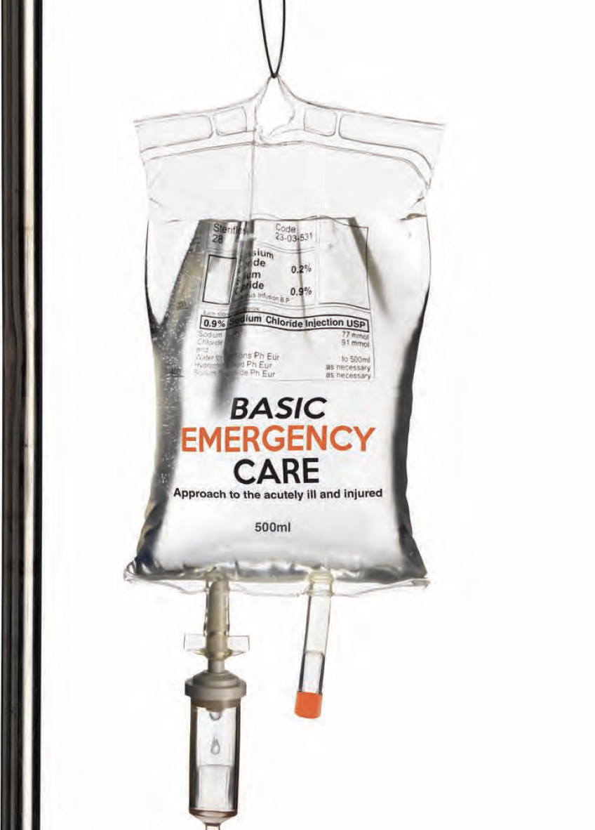
Basic Emergency Care
Approach to the acutely ill and injured
Conflict Related Injury module
Burn Injuries​
Notes:
Welcome to the Basic Emergency Care Course – Portable Learning Laboratory.

Slide 2
Objectives
By the end of this presentation, you will be able to:
Describe the trauma primary survey approach for conflict trauma
Identify signs and symptoms of acute life-threatening conditions caused by burn injuries
Identify critical CABCDE actions for burn injuries
Notes:
By the end of this presentation, you will be able to: describe the trauma primary survey approach for conflict trauma, identify signs and symptoms of acute life-threatening conditions caused by burn injuries, and identify critical CABCDE actions for burn injuries.

Slide 3
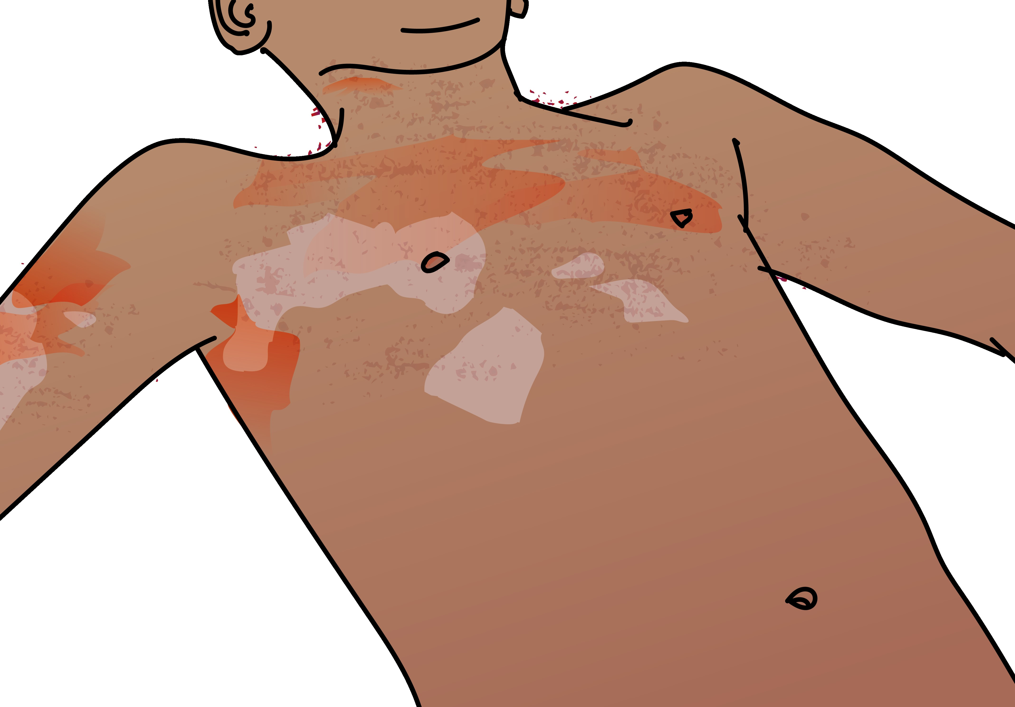
Burn Injury in Conflict Settings
Burns from fires (flame burns) are the most common type of burn injury.
A history of flame burn in an enclosed space can also suggest an inhalation or airway injury.
Electrical burn injuries can be caused by high-voltage sources. This may occur in conflict settings such as if overhead electrical wires are damaged.
Patients with burns may have sustained additional trauma e.g., blast injury, penetrating injury, or falls.
In order to identify and manage acute, life-threatening injuries, a systematic CABCDE approach is required for all patients with burn injuries.
Notes:
Burns from fires, or flame burns, are the most common type of burn injury. Burns can occur in conflict situations from direct exposure to explosions or fire. A history of flame burn in an enclosed space can also suggest an inhalation or airway injury. Electrical burn injuries can be caused by high-voltage sources. This may happen during conflict e.g., if overhead electrical wires are damaged. Note, burns from chemical or radiological exposures are not included in this module.
Patients with burns may have sustained additional trauma e.g., blast injury, penetrating injury, or falls. In order to identify and manage acute, life-threatening injuries, a systematic CABCDE approach is required for all patients with burn injuries.

Slide 4





Acute, Life-Threatening Conditions
These life-threatening conditions may be caused by burn injury.
Obstruction: airway burns | Inhalational injury Circumferential burns to chest or abdomen | Cardiac arrest Shock (hypovolaemia) | Altered mental status (due to toxic exposure or trauma) | Extensive burns
REMEMBER! Patients can sustain significant trauma trying to escape a fire. Always look for hidden trauma in burn patients!
Notes:
These life-threatening conditions may be caused by burn injury. Let’s look at each element of ABCDE. For A, there may be obstruction by a foreign body, or swelling of burned tissue. For B, there may be inhalational injury or circumferential burns to the chest or abdomen. For C there may be cardiac arrest or shock from hypovolaemia. For D, there may be altered mental status from hypoxia, poor perfusion or toxic exposure. For E, a high surface area of burns can be life-threatening. Remember there may be more than one life-threatening condition. Patients can sustain significant trauma trying to escape a fire. Always look for hidden trauma in burns patients. You can revise the assessment and management of these conditions in the core BEC course modules.

Slide 5
Trauma Primary Survey
REMEMBER …………
People who initially appear uninjured may have hidden life-threatening injuries such as internal bleeding.
It is very important to reassess trauma patients frequently using the primary survey (repeat often).
Vital signs should be checked at the end of the primary survey but do not delay interventions for vital signs.
!
Notes:
Remember, people who initially appear uninjured may have hidden, life-threatening problems such as internal bleeding. It is very important to reassess trauma patients frequently using the primary survey. Vital signs should be checked at the end of the primary survey, if not already done, but do not delay interventions for vital signs. If you find a problem with any of the CABCDE elements, you must stop, correct the problem and then go back to the beginning and reassess CABCDE again.

Slide 6
Assessment and management of burns
Notes:
Now we will look at the assessment and management of burns.

Slide 7
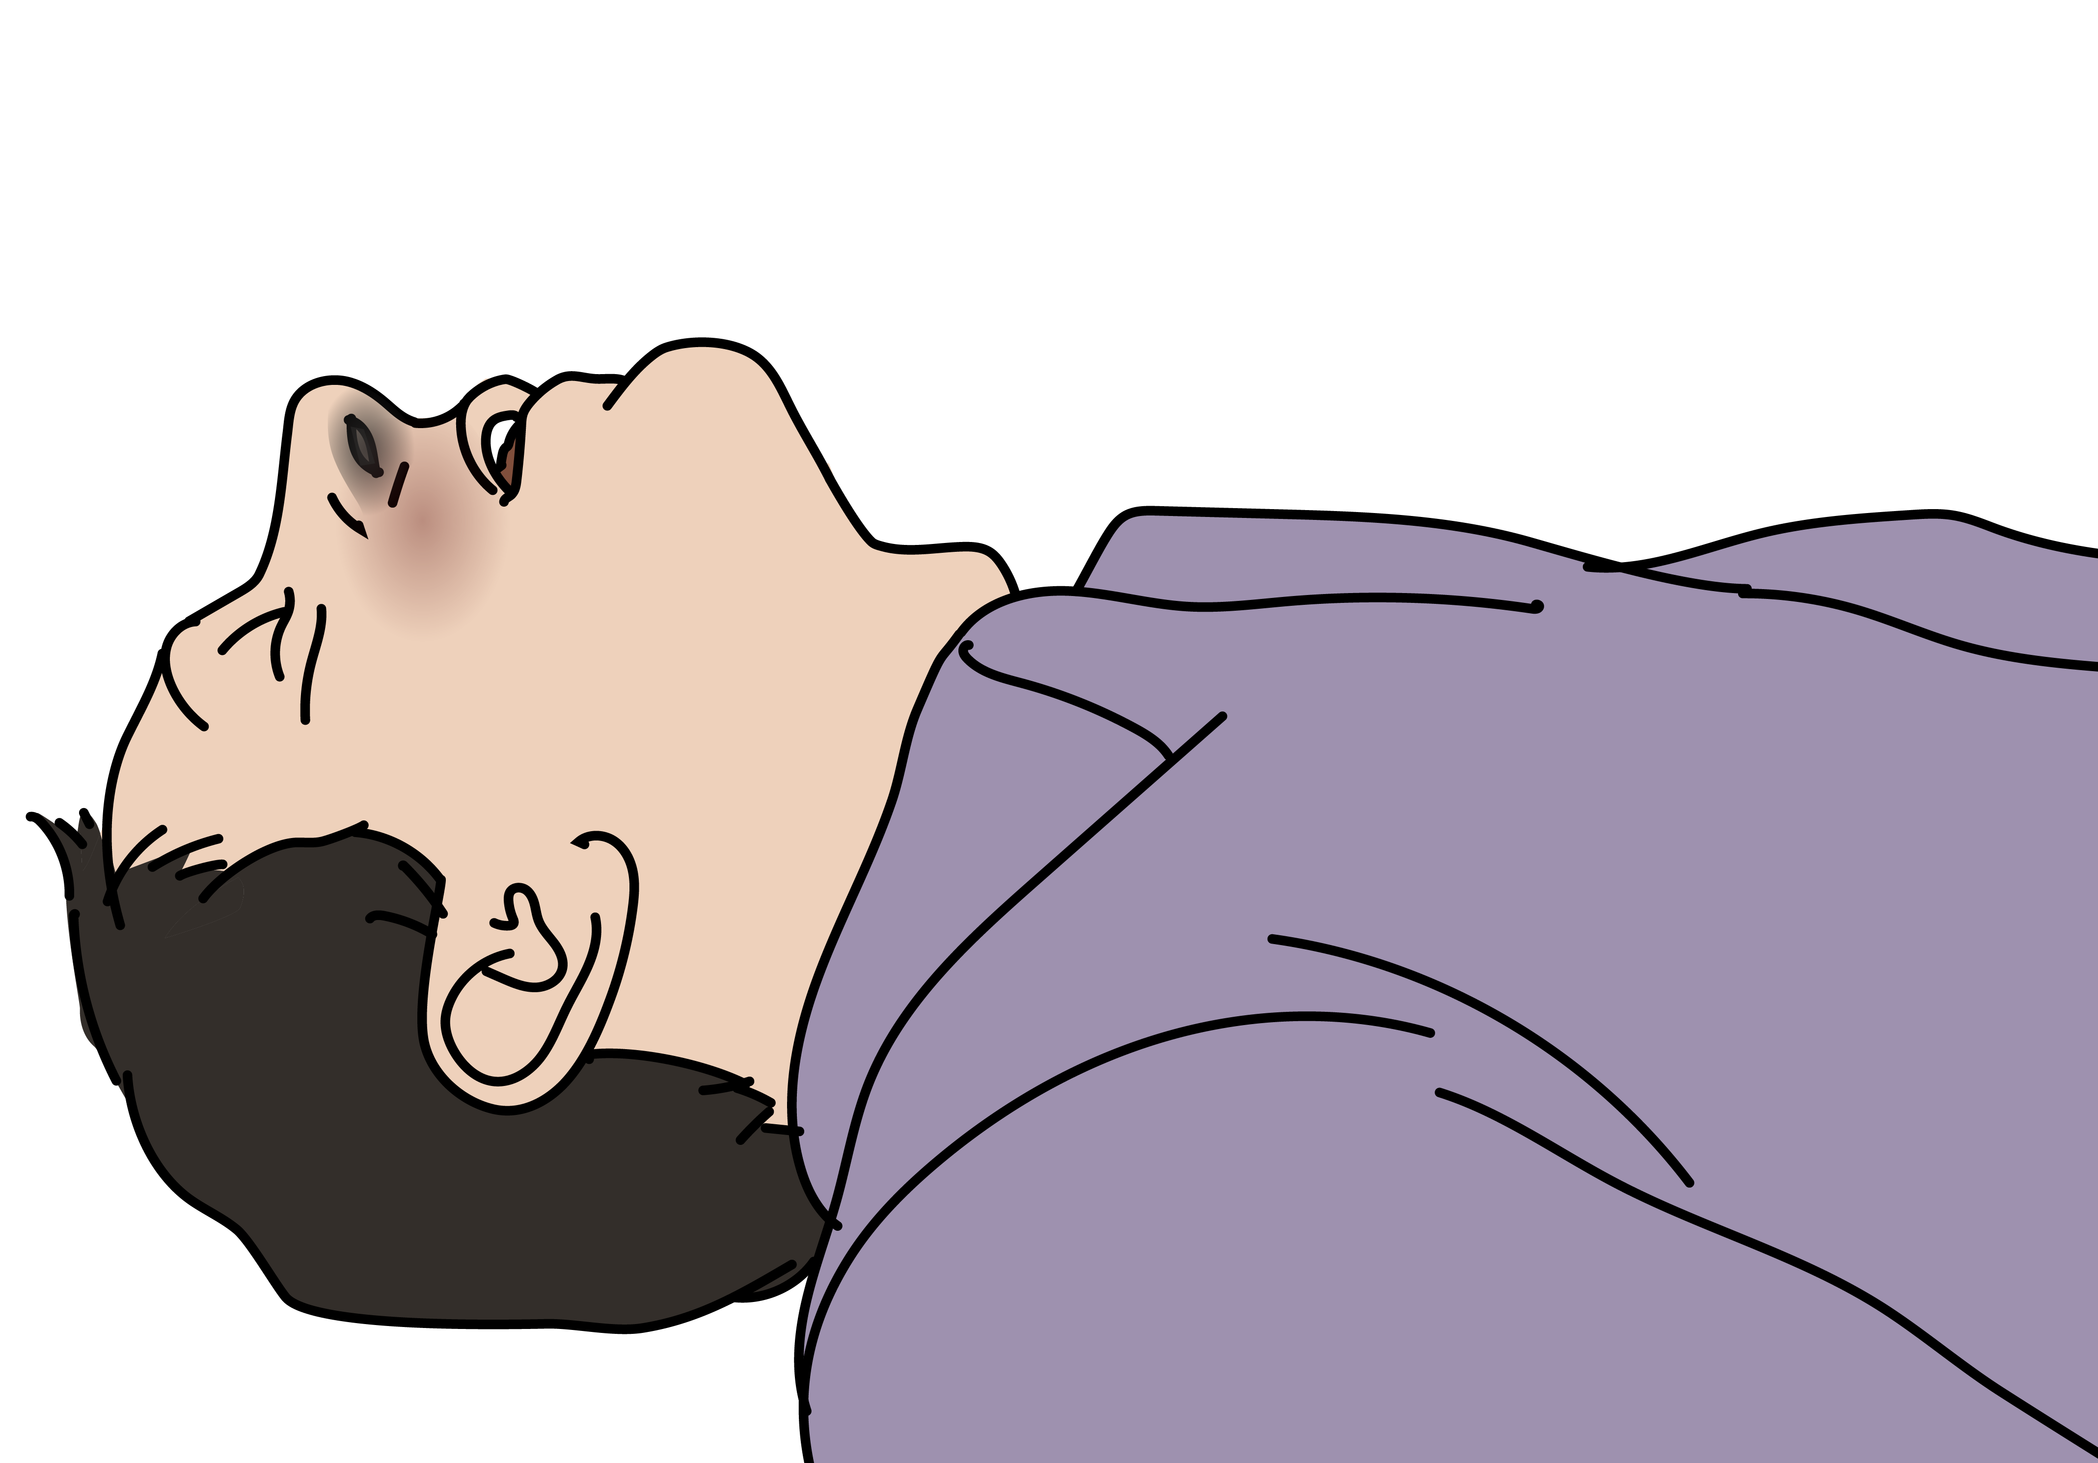
Airway burns and inhalational injury
Signs and Symptoms | Management
Check for burns to the head and neck (Colour change, blisters, swelling) Check for circumferential burns to the chest and abdomen LOOK, LISTEN and FEEL for signs of inhalation injury: Soot (ash) or singed (burned) nasal and facial hairs Swelling to lips or mouth Voice changes Increased work of breathing, stridor or hoarseness | If signs of airway burns and/or inhalation injury → give OXYGEN If airway obstruction → HEAD-TILT/CHIN LIFT (if no trauma) or JAW THRUST. Place ORAL/NASAL AIRWAY if necessary (avoid NASAL AIRWAY in facial trauma) Plan for rapid HANDOVER/TRANSFER to an advanced provider capable of advanced airway management. MONITOR closely for airway obstruction.
Notes:
Airway burns and inhalational injury are life-threatening conditions. Check for burns to the head and neck, look for colour change, blisters and swelling. Look, listen and feel for signs of inhalation injury including soot (ash) or singed (burned) nasal and facial hairs, swelling to lips or mouth and voice changes. Stridor may be heard. If signs of airway burns and/or inhalation injury → give OXYGEN
If airway obstruction, first perform head-tilt/chin lift (if no trauma) or jaw thrust if trauma is suspected. Place oral/nasal airway if necessary to maintain the airway (avoid NASAL AIRWAY in facial trauma). Plan for rapid HANDOVER/TRANSFER to an advanced provider capable of advanced airway management.. Monitor closely as progressive swelling in the airway can lead rapidly to obstruction.

Slide 8
Burns
Signs and Symptoms | Management
Burned skin colour can range from pink, red, pale or black depending on depth of burn Severe pain from burns Check for signs of inhalation injury LOOK for circumferential burns: neck, chest, abdomen and limbs | MONITOR for airway obstruction. Remove all tight clothing and jewellery. Give IV FLUIDS according to surface area of burn, and depth (if able to assess) Give PAIN RELIEF early. Give TETANUS vaccination. CLEAN and DRESS all wounds carefully. Plan for HANDOVER/TRANSFER
Burns are high risk for infection! Clean and dress the wound carefully.
Notes:
Burned skin colour can range from pink, red, pale or black depending on the depth of the burn. Signs of inhalation injury include soot (ash), or singed (burned) nasal and facial hairs, swelling to the lips or mouth, and voice changes. Stridor is a late sign of airway swelling. For management, monitor closely for airway obstruction. Remove all jewellery as burned areas can swell quickly. Give IV fluids according to the burn area and depth. Give tetanus vaccination, give pain relief and clean and dress all wounds carefully. Burns are high risk for infection. Plan for handover/transfer if any of the following are present: serious burns to > 15% of the body, burns to the hands, face, groin, joints of circumferential burns, inhalation injury, burns with other trauma, burns in the very young or elderly, or if significant pre-burn illness such as diabetes.

Slide 9
Burn depth
Burn Depth | Skin Findings
Superficial | Painful, red or pink color Intact, no blisters When pressed, skin is pink with quick capillary refill
Partial thickness | Painful, red or mottled red Intact or broken blisters, wet When pressed, may temporarily turn white then red colour returns
Full thickness | White or black, leathery and dry No sensation When pressed, no change in colour
Notes:
The depth of the burn can be assessed by the skin findings. Superficial burns are painful, and red or pink or colour. The skin is intact with no blisters. When pressed, the skin is pink with quick capillary refill.
Partial thickness burns are painful, and red or mottled red colour. There are intact or broken blisters, and the skin can look wet. When pressed, the skin may temporarily turn white then the red colour returns. Full thickness burns extend deep through the skin. The appearance is white or block, and the skin feels leathery and dry. There is no sensation, and when pressed, no change in colour. Patients may present with a mixture of different burn depths.

Slide 10
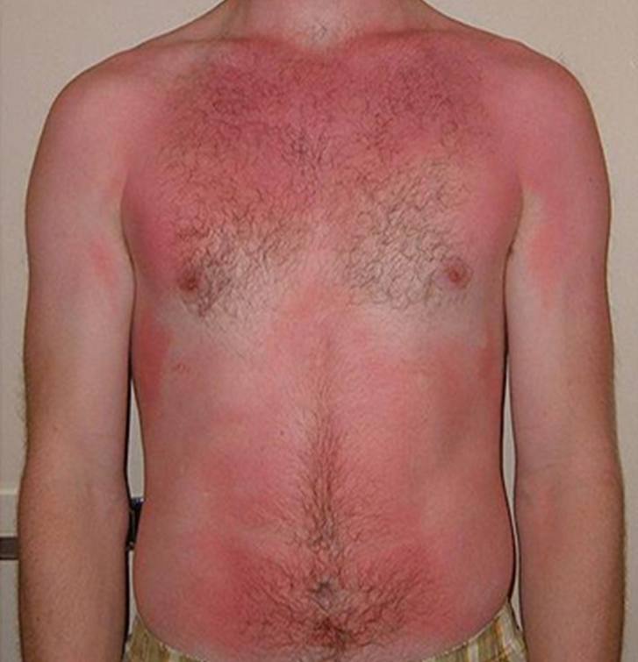
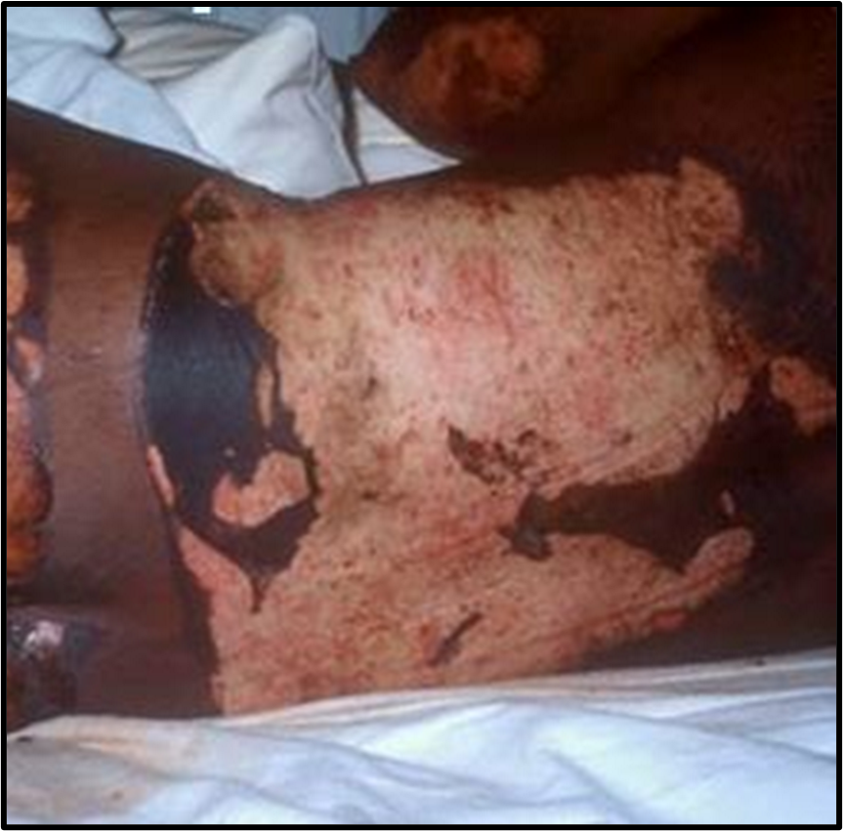
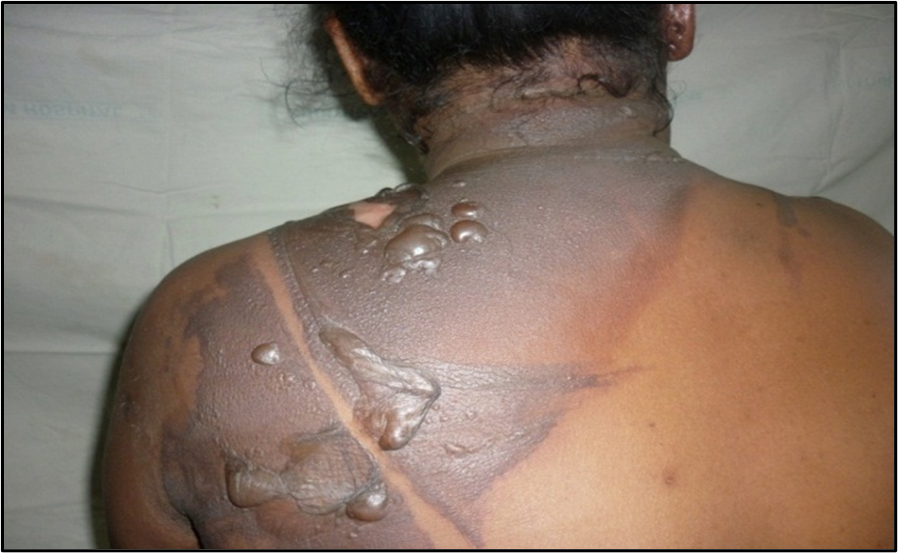
Burn depth examples
Superficial burns
Partial thickness burns
Full thickness burns
Photos used with permission from Interburns
Notes:
Here are some examples of superficial burns, partial thickness burns and full thickness burns.

Slide 11
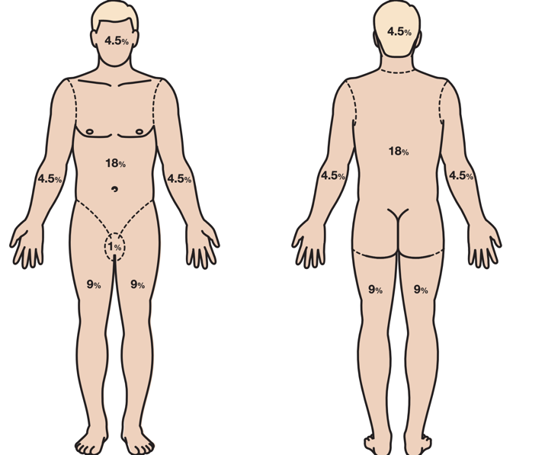
Calculating Burn Area
In adults, the body is divided into sections that are each 9% of the total body surface area (TBSA)
The patient’s hand (palm + fingers) is about 1% of their total body surface area TBSA
TBSA burned* = % Partial thickness burn
+ % Full thickness burn
*Note: % Superficial burn is not used in fluid calculations
Notes:
The burn area can be estimated by using body surface area formulae, and this is important for treatment and fluid calculations. In adults, the body is divided into sections that are each mainly 9% of the total body surface area or TBSA. The patient’s hand, the palm and fingers, is about 1% of their total body surface area. The total body surface area burned is equal to the percentage of partial thickness burned plus the percentage of full thickness burns. Note that the percentage of superficial burns is not used in fluid calculations.

Slide 12
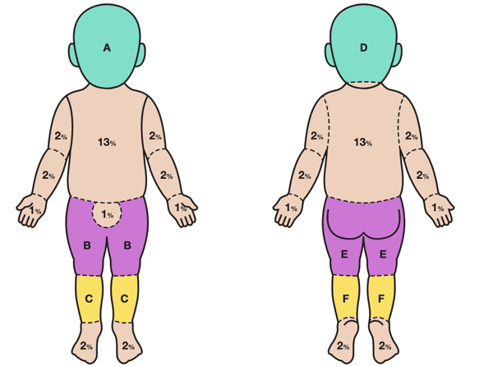
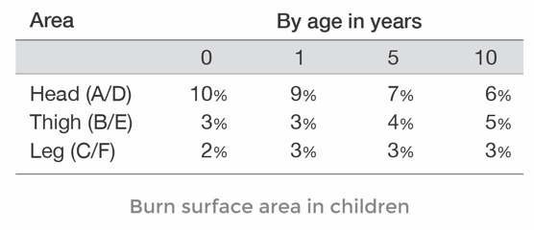
Special considerations: Paediatrics
Children have different percentages due to the different body proportions, such as a larger head and smaller limbs
Notes:
There are special considerations for paediatrics. Children have different percentages due to the different body proportions such as a larger head and smaller limbs, and this varies with the age of the child. The chart shows the different body areas of children, labelled A to F. The table shows the different body surface area percentages by age in years. Younger children have a proportionally large head than older children.

Slide 13
IV Fluids for Burns (single patient)
Total volume in the first 24 hours from time of injury =
2-4 ml IV FLUID x Weight in kilograms x % Total Body Surface
Area Burned*
Use crystalloids (Normal saline or Ringer’s Lactate).
Give half of the total volume in the first 8 hours from time of injury
Give the second half of fluids over the next 16 hours
For children: use a dextrose-containing fluid (Ringer’s Lactate with 5% dextrose or normal saline with 5% dextrose for initial resuscitation).
Watch for volume overload! Goal of resuscitation is normalization of vital signs and adequate urine output.
* Note: % Superficial burn is not used in fluid calculation
Notes:
IV fluids for a patient with burns can be calculated based on the patient’s weight and total body surface area burned. The formula shown estimates the total volume of fluid required in the first 24 hours from the time of injury. This equals 2-4ml IV fluid times the weight in kilograms times the total percentage of burn surface area. Use crystalloid fluids and begin with an initial amount on the lower end of volume calculation. Give half of the total volume in the first eight hours from injury and give the second half of fluids over the next sixteen hours.
For children, use a dextrose-containing fluid e.g., Ringer’s Lactate with 5% dextrose, or normal saline with 5% dextrose for initial resuscitation. Watch for volume overload. The goal of resuscitation is normalisation of vital signs and adequate urine output.

Slide 14
IV fluids for Burns (MCIs)
Calculating IV fluids for multiple burn patients at one time during a Mass Casualty Incident may not be practical, so the following guidance may be used:
% TBSA | Fluid Recommendation
< 20% | Oral fluids to thirst. No IV fluids recommended
20 – 40 % | Support with Oral Rehydration Solution as soon as is practicable at a volume of 100mls/kg/24 h. Consider IV fluid as appropriate*
> 40% | 100mls/kg/24 h intravenous crystalloids and drink as able*
*Consider the need for more fluids in children < 15 kg
Recommendations from WHO Emergency Medicine Team Initiative for use during MCI
Hughes A, et al. Burns. 2021 Mar;47(2):349-370.
Notes:
Calculating IV fluids for multiple burn patients at one time during a Mass Casualty Incident may not be practical as it is time-consuming, so the following guidance may be used.
If the percentage total burned surface area is less than 20%, give oral fluids matched to thirst. No IV fluids are recommended.
For burns of 20-50% support with oral rehydration solution as soon as it practicable, at a volume of 100ml per kilogram body weight per 24 hours/ Consider IV fluid as appropriate and consider the need for more fluids in children under 15 kg.
For burns greater than 40%, the fluid recommendation in a Mass Casualty Incident is 100ml per kilogram body weight per 24 hours intravenous crystalloids, and drink as able. Consider the need for more fluids in children under 15 kilograms.

Slide 15
Electrical burns
Electrical injuries can be caused by high-voltage sources coming in contact with the body.
Electricity often crosses the body, taking the shortest path from the point of contact with the skin to the ground, often leaving entry and exit burn marks.
On the surface, electrical injuries may look small but can cause extensive tissue and muscle damage including to cardiac muscle.
Muscle damage can lead to rhabdomyolysis and renal failure. It is important to begin IV fluids early.
Most high voltage electrical injuries will also require fasciotomy. Refer early to a surgeon.
Follow a systematic CABCDE approach and HANDOVER / TRANSFER to an advanced provider.
Notes:
Electrical burn injuries can be caused by high-voltage sources coming in contact with the body. The electrical current often crosses the body, taking the shortest path from the point of contact with the skin to the ground, often leaving entry and exit burn marks. On the surface, electrical injuries may look small, but they can cause extensive underlying tissue and muscle damage including to cardiac muscle. It is important to start IV fluids as muscle damage can lead to rhabdomyolysis and renal failure.
Remember, there may also be associated traumatic injuries from falls.
Follow a systematic CABCDE approach and handover/transfer to an advanced provider.

Slide 16
Disposition Considerations
Refer all deep burns for surgical review. Plan for HANDOVER / TRANSFER to a specialised unit if any of the following:
  Serious burns to >15% of the body, full thickness burns > 5%
  Hands, face, groin, joints or circumferential burns
  Inhalation injury
  Burns with other trauma
  Burns in very young or elderly
  Significant pre-burn illness (such as diabetes)
If an injured person is displaying signs of shock, ensure treatment with IV FLUIDS is continued on transfer.
Communicate injuries, important medical problems and what has been done for the patient during handover/transfer. Use the SBAR approach in handover.
Notes:
Trauma patients can have complex injuries and get worse or die very quickly. High-risk conditions always require handover / transfer to a specialist unit for ongoing care.
Plan for handover/transfer to a specialised burns unit if any of the following: serious burns to more than 15% of the body, burns to the hands, face, groin, joints or circumferential burns, burns with other trauma, burns in the very young or elderly and if significant pre-burn illness such as diabetes.
Remember that if a patient required oxygen, arrange to continue it during transport and handover. If an injured person is displaying signs of shock, ensure treatment with IV fluids is continued on transfer. Communicate injuries, important medical problems and what has been done for the patient during handover/transfer including IV fluids given and pain relief.

Slide 17
REMEMBER
The goal of initial assessment is to manage CABCDE and identify life-threatening conditions.
The goal of acute management is to prevent secondary injury from poor oxygenation and decreased perfusion, control pain and plan ongoing care.
Notes:
Remember the goal of initial assessment is to manage CABCDE and identify life-threatening conditions. The goal of acute management is to prevent secondary injury from poor oxygenation and decreased perfusion, control pain and plan ongoing care.

Slide 18
Summary
In this presentation, we have covered:
The trauma primary survey approach for conflict trauma
The signs and symptoms of acute life- and limb- threatening conditions resulting from burn injury
Critical CABCDE actions for acute life-threatening conditions resulting from burn injury
Notes:
In this presentation, we have covered: the trauma primary survey approach for conflict trauma, the signs and symptoms of acute life-and limb-threatening conditions resulting from burn injury, and critical CABCDE actions for acute life-threatening conditions resulting from burn injury. This is the end of the Burn Injury module.

