Slide 1
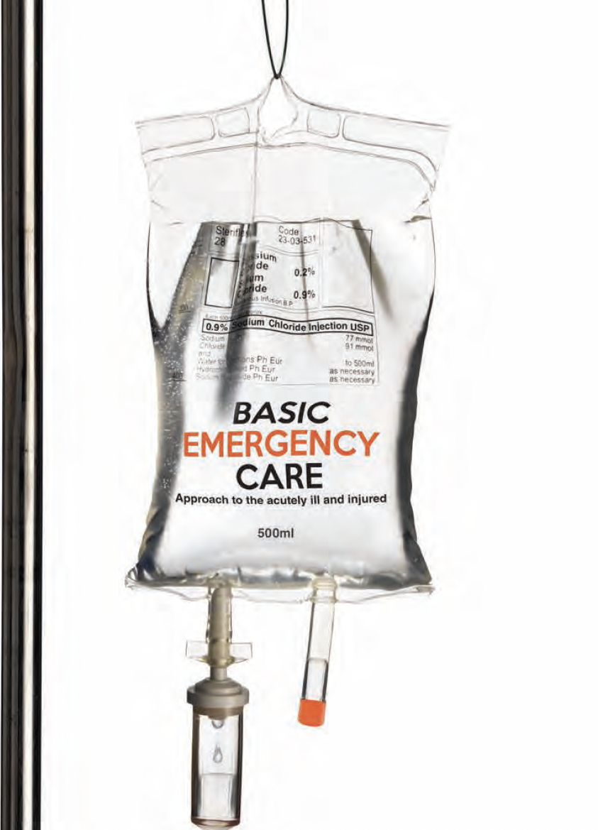
Basic Emergency Care
Approach to the acutely ill and injured
Conflict Related Injury module
Blast Injuries​
Notes:
Welcome to the Basic Emergency Care Course – Portable Learning Laboratory.

Slide 2
Objectives
By the end of this presentation, you will be able to:
Describe the trauma primary survey approach for conflict trauma
Identify signs and symptoms of acute life-threatening conditions
Identify critical CABCDE actions for blast injuries
Notes:
By the end of this presentation, you will be able to: describe the trauma primary survey approach for conflict trauma, identify signs and symptoms of acute life-threatening conditions and identify critical CABCDE actions for blast injuries.

Slide 3
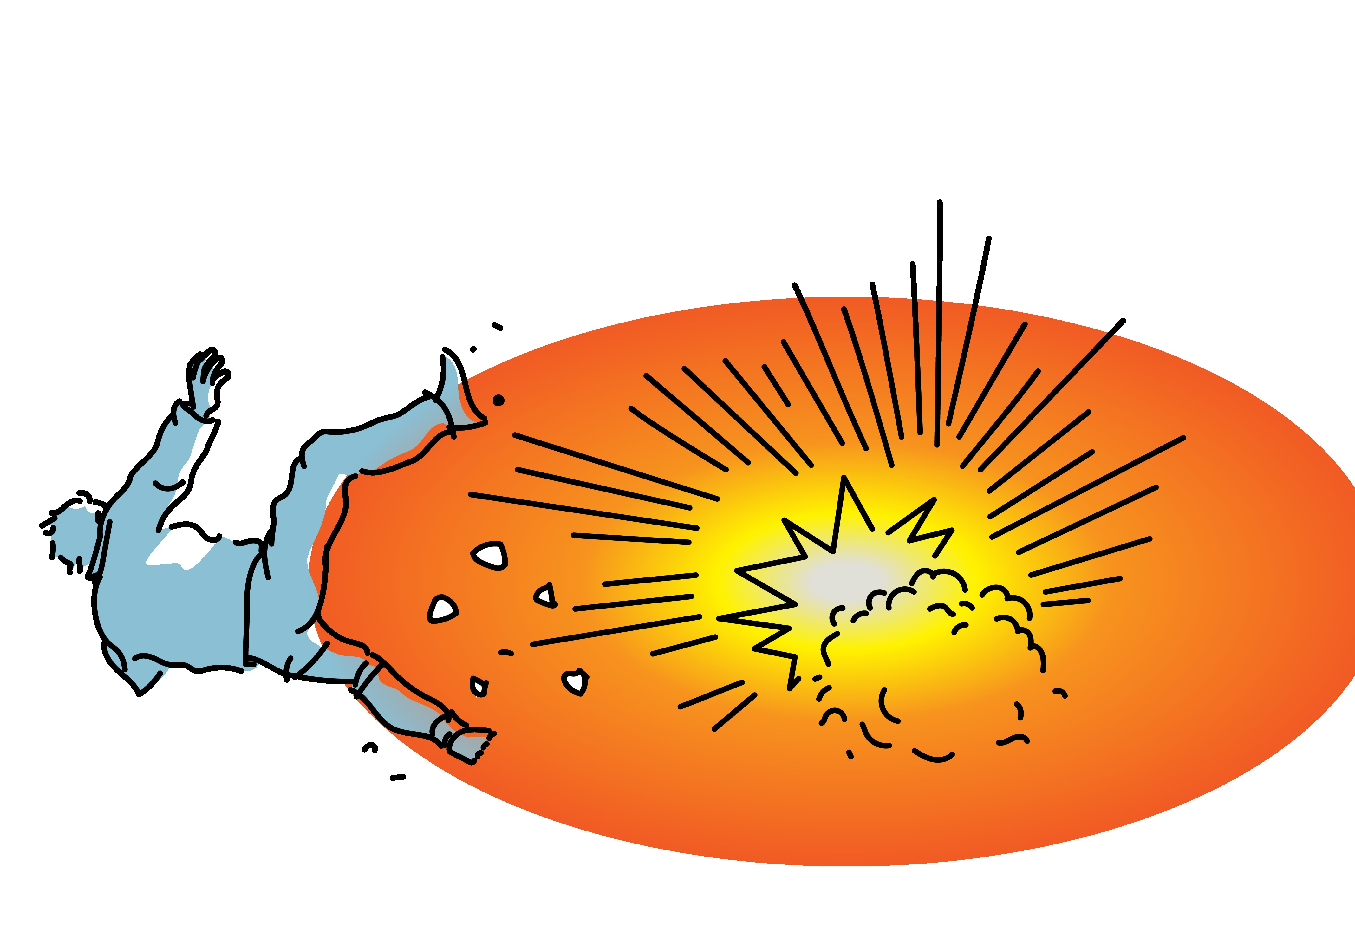
Blast Injury
Blast refers to a destructive wave of highly compressed air which spreads out from an explosion.
Blast injuries (from explosions) can involve all systems of the body, especially the hollow organs. Common blast injuries include damage to the lungs, intestines and ears.
Blasts may also be associated with foreign bodies in the skin and eyes, burns or chemical injury, and toxin or radiation exposure. See local guidance for chemical, toxin or radiation exposure.
In order to identify and manage acute, life-threatening injuries, a systematic CABCDE approach is required for all patients with blast injuries​.
Notes:
Blast refers to a destructive wave of highly compressed air which spreads out from an explosion. Blast injuries (from explosions) can involve all systems of the body, especially the hollow organs. Common blast injuries include damage to the lungs, intestines and ears. Blasts may also be associated with foreign bodies in the skin and eyes, burns or chemical injury, and toxin or radiation exposure.
In order to identify and manage acute, life-threatening injuries, a systematic CABCDE approach is required for all patients with blast injuries.

Slide 4




Life-Threatening Conditions
These life-threatening conditions may be caused by blast trauma!
Catastrophic Bleeding | Obstruction: foreign body Obstruction: trauma Obstruction: neck haematoma | Tension pneumothorax Large haemothorax Blast lung injury Flail chest Pulmonary contusion Arterial air embolism | Cardiac arrest Shock Major bleeding Pericardial Tamponade | Increased pressure on the brain (head injury) Seizures/ convulsions (head injury) Cervical spine injury
Notes:
These life-threatening conditions may be caused by blast trauma. Let’s look at each element of CABCD. For C, there may be catastrophic bleeding. For A, there may be obstruction by a foreign body, traumatic injury or a neck haematoma. For B, there may be a tension pneumothorax, large haemothorax, blast lung injury, flail chest, pulmonary contusion or arterial air embolism. For C there may be cardiac arrest, shock, major bleeding or pericardial tamponade. For D, there may be increased pressure on the brain or seizures / convulsions. Blast injury can cause cervical spine injury. Remember there may be more than one life-threatening condition. These are some examples, and you can review the assessment and management of these conditions in the core BEC course modules.

Slide 5
Trauma Primary Survey
REMEMBER …………
People who initially appear uninjured may have hidden life-threatening injuries such as internal bleeding.
It is very important to reassess trauma patients frequently using the primary survey (repeat often).
Vital signs should be checked at the end of the primary survey but do not delay interventions for vital signs.
!
Notes:
Remember, people who initially appear uninjured may have hidden, life-threatening problems such as internal bleeding. It is very important to reassess trauma patients frequently using the primary survey. Vital signs should be checked at the end of the primary survey, if not already done, but do not delay interventions for vital signs. If you find a problem with any of the ABCDE elements, you must stop, correct the problem and then go back to the beginning and reassess ABCDE again.

Slide 6
Secondary Exam Survey: Extremities*
Look for:
  Active bleeding
  Amputations
  Swelling or bruising
  Deformity
  Wounds, open fractures
  Circumferential burns
  Colour: Pale skin could indicate loss of blood flow
Feel for:
  Pulses: Absent or weak pulses
  Temperature: Cold extremities could indicate loss of blood flow
  Tenderness
  Altered sensation
  Abnormally firm, painful muscular compartments (could indicate compartment syndrome)
*Remember: The secondary survey includes a complete head to toe exam!
This is review of only some key findings.
Notes:
During the secondary survey examination, ensure you perform a careful assessment of the extremities. Look for active bleeding, amputations, swelling or bruising, deformity, wounds, open fractures and circumferential burns. Look at the skin colour as pale skin could indicate loss of blood flow. Feel for pulse, are they absent or weak? Check the skin temperature, as cold extremities could indicate loss of blood flow. Feel for tenderness, crepitus indicating fracture, and altered sensation. Abnormally firm, painful muscular compartments could indicate compartment syndrome.

Slide 7
Injury Patterns and Conditions
Notes:
Now we will look at blast injury patterns and conditions.

Slide 8
Blast Injury Patterns
An explosive blast causes injuries in three main ways:
Direct injuries from shrapnel or burns from heat or chemicals released
Internal injuries from the change in pressure caused by the blast.
  Commonly the stomach, bowel, lungs and ears
Additional injuries that result when the body is thrown from the blast
Patients involved in explosions need to be checked carefully and repeatedly because these injuries are easily missed.
Notes:
An explosive blast causes injuries in three main ways. Direct injuries from shrapnel or burns from heat or chemicals released. Internal injuries from the change in pressure caused by the blast, commonly affected the hollow organs: stomach, bowel, lungs and ears. Additional injuries that result when the body is thrown from the blast. Patients involved in explosions need to be checked carefully and repeatedly because these injuries are easily missed.

Slide 9
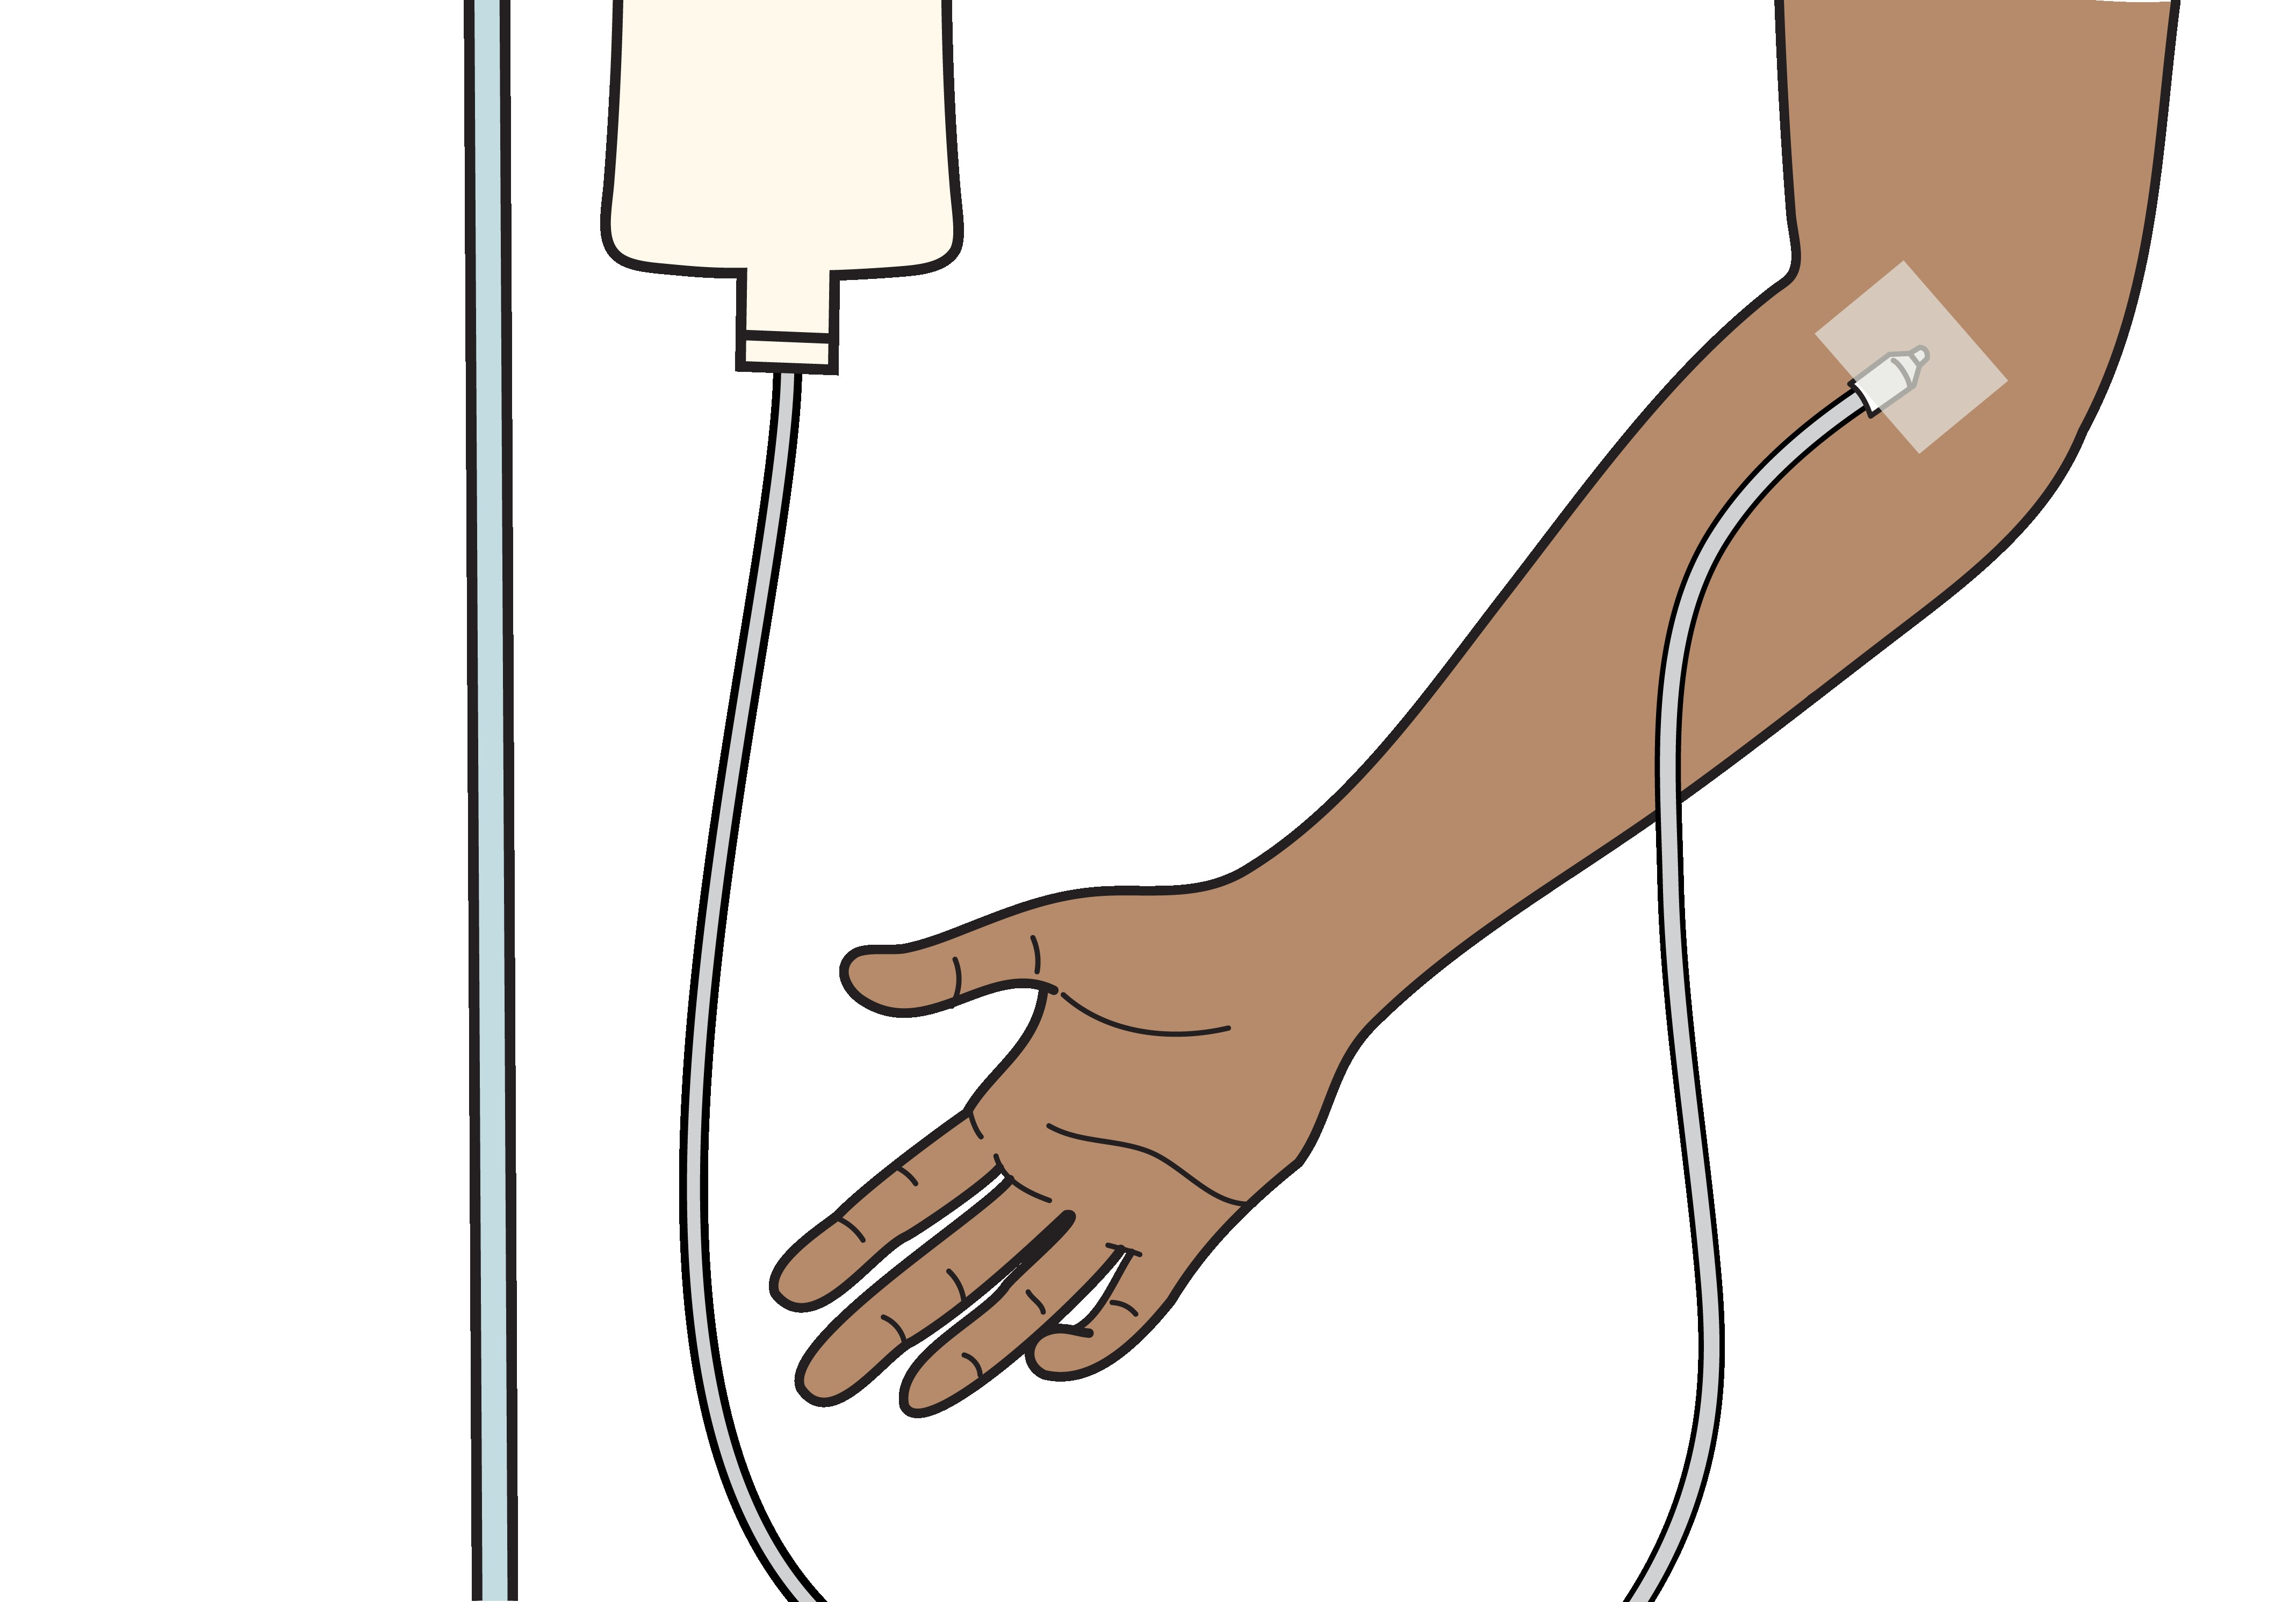
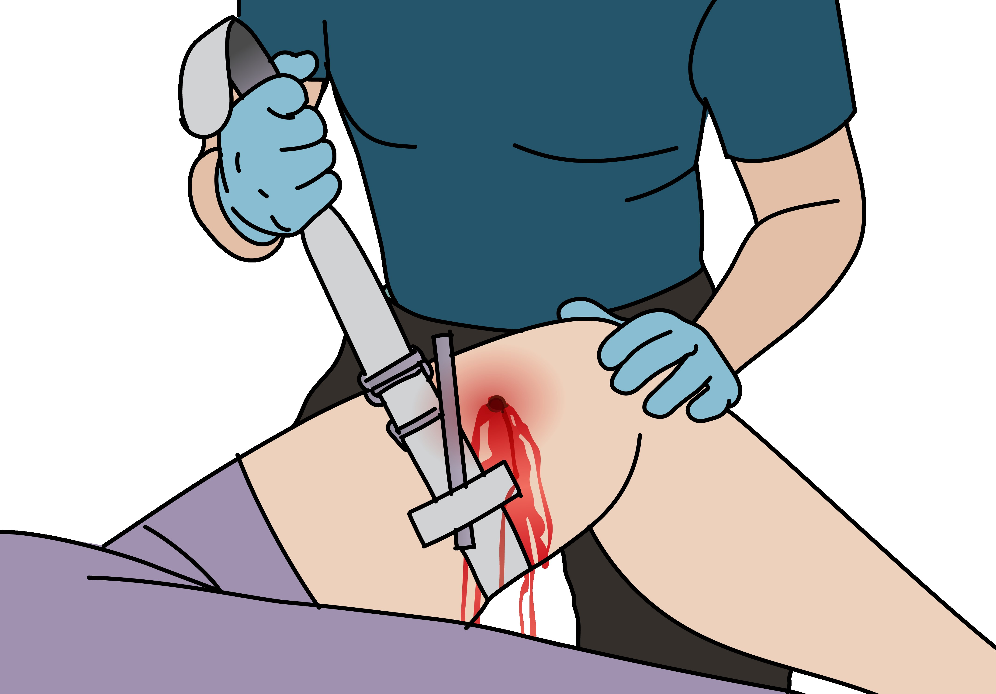
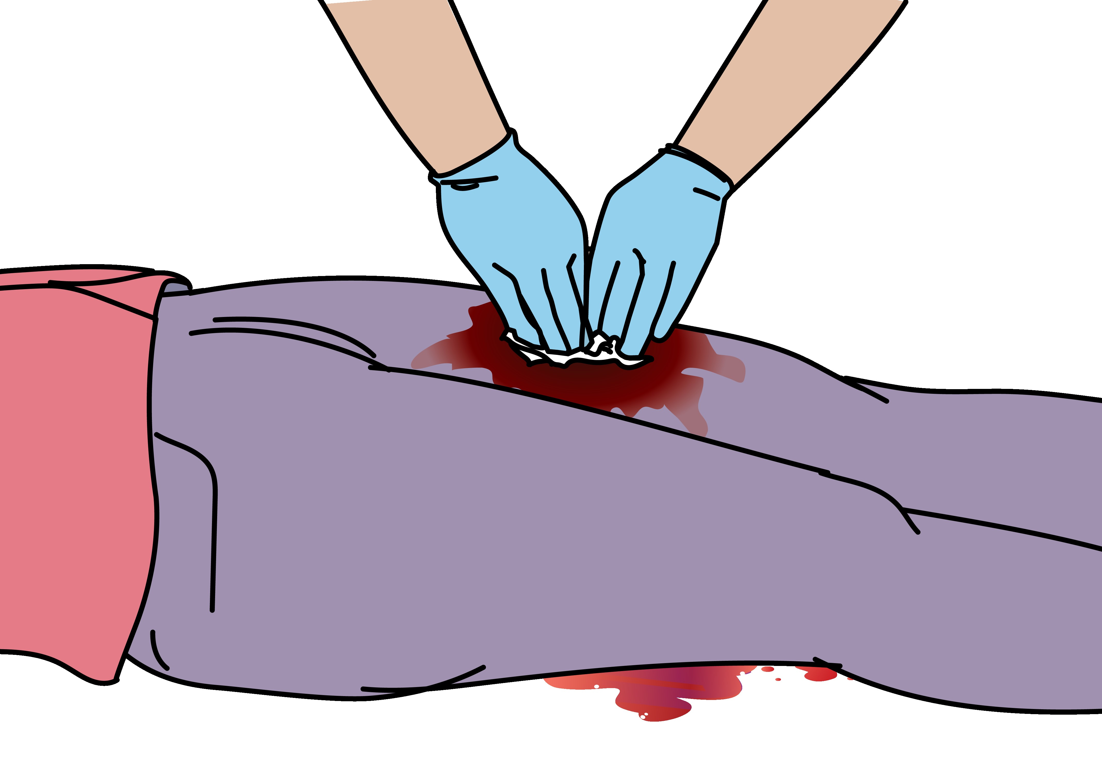
Catastrophic haemorrhage
Signs and symptoms | Management
Catastrophic*haemorrhage is blood that is spraying, pouring or pooling Signs of shock: Pale, sweating Delayed capillary refill, hypotension Altered mental status *major or massive | Apply DIRECT PRESSURE or DEEP WOUND PACKING to control active bleeding. If bleeding not controlled with direct pressure→ apply a tourniquet. If signs of shock → Give IV FLUIDS Plan for rapid HANDOVER/TRANSFER to a surgeon.
Notes:
Catastrophic haemorrhage is blood that is spraying, pouring or pooling causing life-threatening blood loss. Assess for signs and symptoms of shock. The patient may be pale, sweating, have delayed capillary refill, hypotension and altered mental status. For management, immediately apply direct pressure or deep wound packing to control active bleeding. If the bleeding from a limb and not controllable with direct pressure, apply a tourniquet noting the time of application. If signs of shock, gain IV access and give IV fluids. Plan for rapid handover/transfer to a surgeon, and for blood transfusion.

Slide 10
Limb amputation
Signs and symptoms | Management
Partial or complete amputation of limb/s | Stop bleeding with DIRECT PRESSURE and TOURNIQUET if required. Wound should be washed with saline or clean water. Give ANTIBIOTICS and update TETANUS if needed, as early as possible. Give PAIN RELIEF. Plan for rapid HANDOVER/TRANSFER to a surgeon. If amputated body part is with patient, keep cold (not frozen) and transfer with the patient.
Notes:
Limbs can be partially or fully amputated, at different levels. There may be more than one limb amputation. For management, stop bleeding with direct pressure and tourniquet if required. The wound should be washed with saline or clean water. Give antibiotics and update tetanus vaccination if needed, as early as possible. Plan for rapid handover/transfer to a surgeon. If the amputated body part is with the patient, keep the part cold – not frozen – and transfer with the patient.

Slide 11
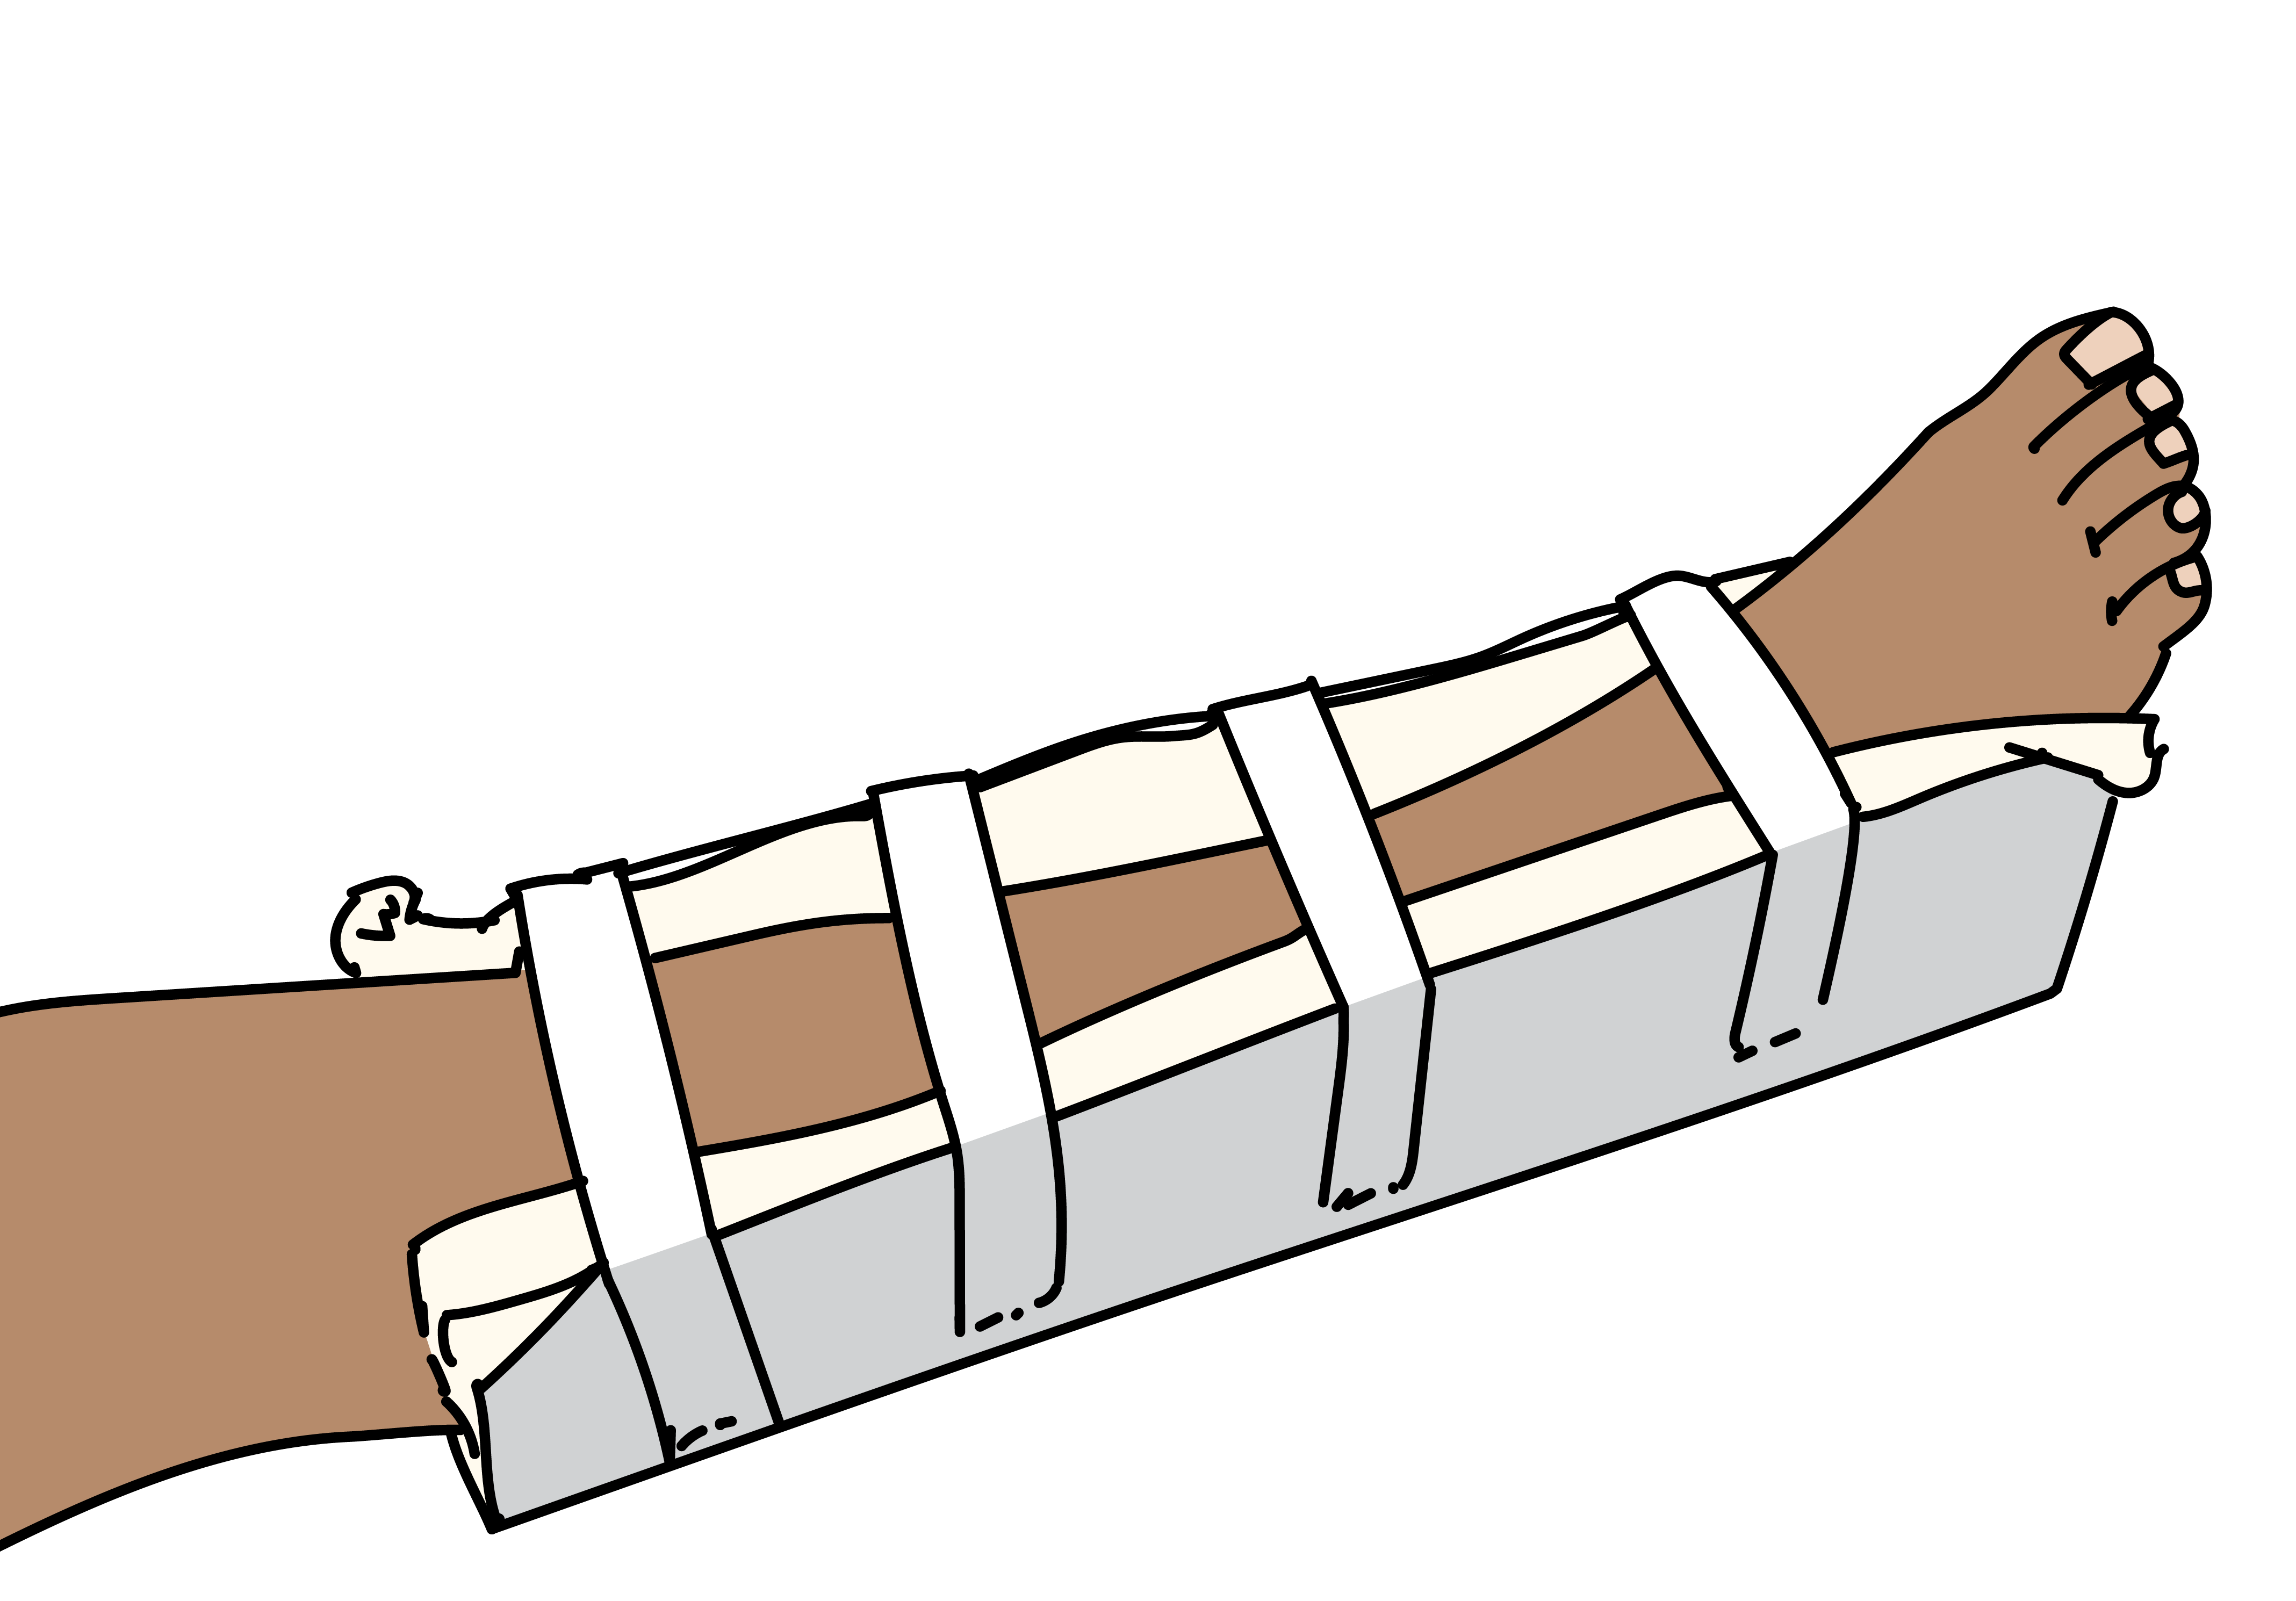
Threatened limb with fracture
Signs and symptoms | Management
Deformity or crepitus of the bone Absent pulses beyond the fracture Capillary refill time of greater than 3 seconds beyond fracture Cold extremities with blue or gray coloration of skin beyond the fracture | If weak pulses or poor perfusion →consider vascular injury and REDUCE the fracture immediately and apply a splint. Always check pulses, capillary refill and sensation before and after any reduction Give PAIN RELIEF. Plan for rapid HANDOVER/TRANSFER to a surgeon.
Consider compartment syndrome. Danger signs include severe pain, tight skin, loss of sensation and loss of pulses. Refer urgently!
Notes:
Threatened limb with fracture is a limb-threatening condition. Signs and symptoms include deformity or crepitus of the bone, absent pulses beyond the fracture, capillary refill time of greater than three seconds beyond the fracture, and cold extremities with blue or grey discolouration of the skin beyond the fracture. There be altered sensation in the limb. If there are weak or absent pulses, or signs of poor perfusion, consider vascular injury and reduce the fracture immediately and apply a splint. Always check pulses, capillary refill and sensation before and after any reduction. Give pain relief. Plan for rapid handover/transfer to a surgeon. Remember to consider compartment syndrome. Danger signs included severe pain, tight skin, loss of sensation and loss of pulses as a late sign. Refer urgently.

Slide 12
Injury to gas filled organs
Signs and symptoms | Management
Injuries can occur to gas-filled organs: lung, stomach and bowel Presents with difficulty in breathing, shock and gastrointestinal symptoms Beware delayed presentation of bowel perforation! | If there is difficulty breathing​ → give OXYGEN. If suspected tension pneumothorax → perform NEEDLE DECOMPRESSION and HANDOVER/TRANSFER for chest tube. If signs of SHOCK → give IV FLUIDS. Give PAIN RELIEF. If the patient has abdominal pain, nausea or vomiting, consider bowel perforation​ → give IV FLUIDS​, ANTIBIOTICS and plan for rapid HANDOVER/TRANSFER for surgery.
Notes:
Injuries can occur to gas-filled organs, for example the lung, stomach and bowel. Patients present with difficulty in breathing, shock and gastrointestinal symptoms. Beware delayed presentation of bowel perforation. For management, if there is difficulty in breathing, give oxygen. If suspected tension pneumothorax, perform decompression and handover/transfer for chest tube. If signs of shock, gain IV access and give IV fluids. Give pain relief. If the patient has abdominal pain, nausea or vomiting, consider bowel perforation. Give IV fluids, antibiotics and plan for rapid handover / transfer for surgery.

Slide 13
Rupture of solid organs
Signs and symptoms | Management
Rupture of solid organs can occur in the liver, spleen, testes Abdominal pain, tenderness and signs of internal bleeding / shock (liver, spleen) Presents with abdominal pain, vomiting, testicular pain, or findings of acute abdomen More common in children | Maintain a high index of suspicion. Manage as for penetrating abdominal injury. Gain IV ACCESS and give IV FLUIDS. Give ANTIBIOTICS early. Give PAIN RELIEF. Early surgical CONSULT or prepare for rapid HANDOVER / TRANSFER.
Notes:
Rupture of solid organs can occur in the liver, spleen or testes. This presents with signs and symptoms of abdominal pain, vomiting, testicular pain or findings of an acute abdomen. This injury is more common in children. Maintain a high index of suspicion for this injury pattern. Manage as for penetrating abdominal injury with early surgical consult or prepare for rapid handover / transfer.

Slide 14
Arterial air embolism
Signs and symptoms | Management
Arterial air embolism can occur to the brain or heart. Presents as stroke, blindness, spinal cord injury or limb pain with movement, or heart attack | This condition can be rapidly fatal. Place in left lateral position, tilted 45 degrees with legs elevated above head and heart. Give OXYGEN. Gain IV ACCESS and give IV FLUIDS Plan rapid HANDOVER / TRANSFER.
Notes:
Arterial air embolism can occur to the brain or heart. This can present as stroke, blindness, spinal cord injury or limb pain with movement, or heart attack. This condition can be rapidly fatal. If suspected, place the patient in the left lateral position, tilted 45 degrees with legs elevated above the head and heart. Give oxygen. Gain IV access and give IV fluids if signs of shock. Plan rapid handover / transfer.

Slide 15
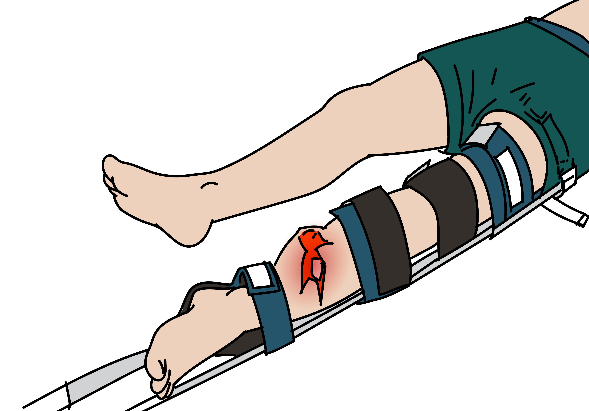
Simple and open fractures
Injury | Management
Simple fracture | SPLINT for comfort and consider straightening (reduction). Give PAIN RELIEF.
Open fracture | Control bleeding with DIRECT PRESSURE. Wound should be IRRIGATED with saline or clean water. SPLINT for comfort and consider straightening. Perform immediate REDUCTION and SPLINTING if poor perfusion. Give ANTIBIOTICS and TETANUS VACCINATION early. Give PAIN RELIEF. Plan for HANDOVER / TRANSFER to a surgeon.
Consider any patient to have an open fracture if there is a wound
(more than just a skin abrasion) near a fracture site.
Notes:
If there is a simple fracture, splint for comfort and consider straightening. Give pain relief.
Consider any patient to have an open fracture if there is a wound, more than just a skin abrasion, near a fracture site.
If there is an open fracture, control any external bleeding with direct pressure. The wound should be irrigated with saline or clean water. Splint for comfort and consider straightening.
If there is poor perfusion to the limb, perform immediate reduction and splinting.
Give antibiotics and update tetanus vaccination early. Give pain relief and plan for handover / transfer to a surgeon. If available, obtain x-rays of the affected body regions including the joint above and below the affected side.

Slide 16
Blast Injuries: Ear and Eye
Injury | Signs and symptoms | Management
Ear injury e.g., to tympanic membrane | Ear pain Bleeding or discharge from the ear Ringing in the ear, dizziness, hearing loss | If suspected →examine with otoscope for tympanic membrane rupture. Most heal spontaneously.
Eye and maxillofacial injury | Eye pain Globe rupture Abnormal pupil Orbital and facial fractures Secondary injury of eyes is possible from shattered glass. | Provide basic first aid and cover eye with protective shield. Do not remove any penetrating object. Stabilize. Give TETANUS prophylaxis for penetrating eye injuries. CONSULT ophthalmology or prepare for rapid HANDOVER / TRANSFER if acute vision loss.
Notes:
Blast Injuries to the ear and eye must be carefully looked for and managed. Ear injury, for example to the tympanic membrane, can cause signs and symptoms of ear pain, bleeding or discharge from the ear, ringing in the ear, dizziness and hearing loss. If suspected, examine with an otoscope for tympanic membrane rupture. Most heal spontaneously but refer for specialist care if concern.
Eye injuries are often associated with maxillofacial injuries. Signs and symptoms include eye pain, globe rupture, abnormal pupil, and orbital and facial fractures. Secondary injury of eyes is possible from shattered glass and other debris. For management, provide basic first aid and cover the eye with a protective shield. Do not remove any penetrating object, stabilise in place. Give tetanus prophylaxis for penetrating eye injury. Consult ophthalmology and prepare for rapid handover/transfer if acute vision loss.

Slide 17
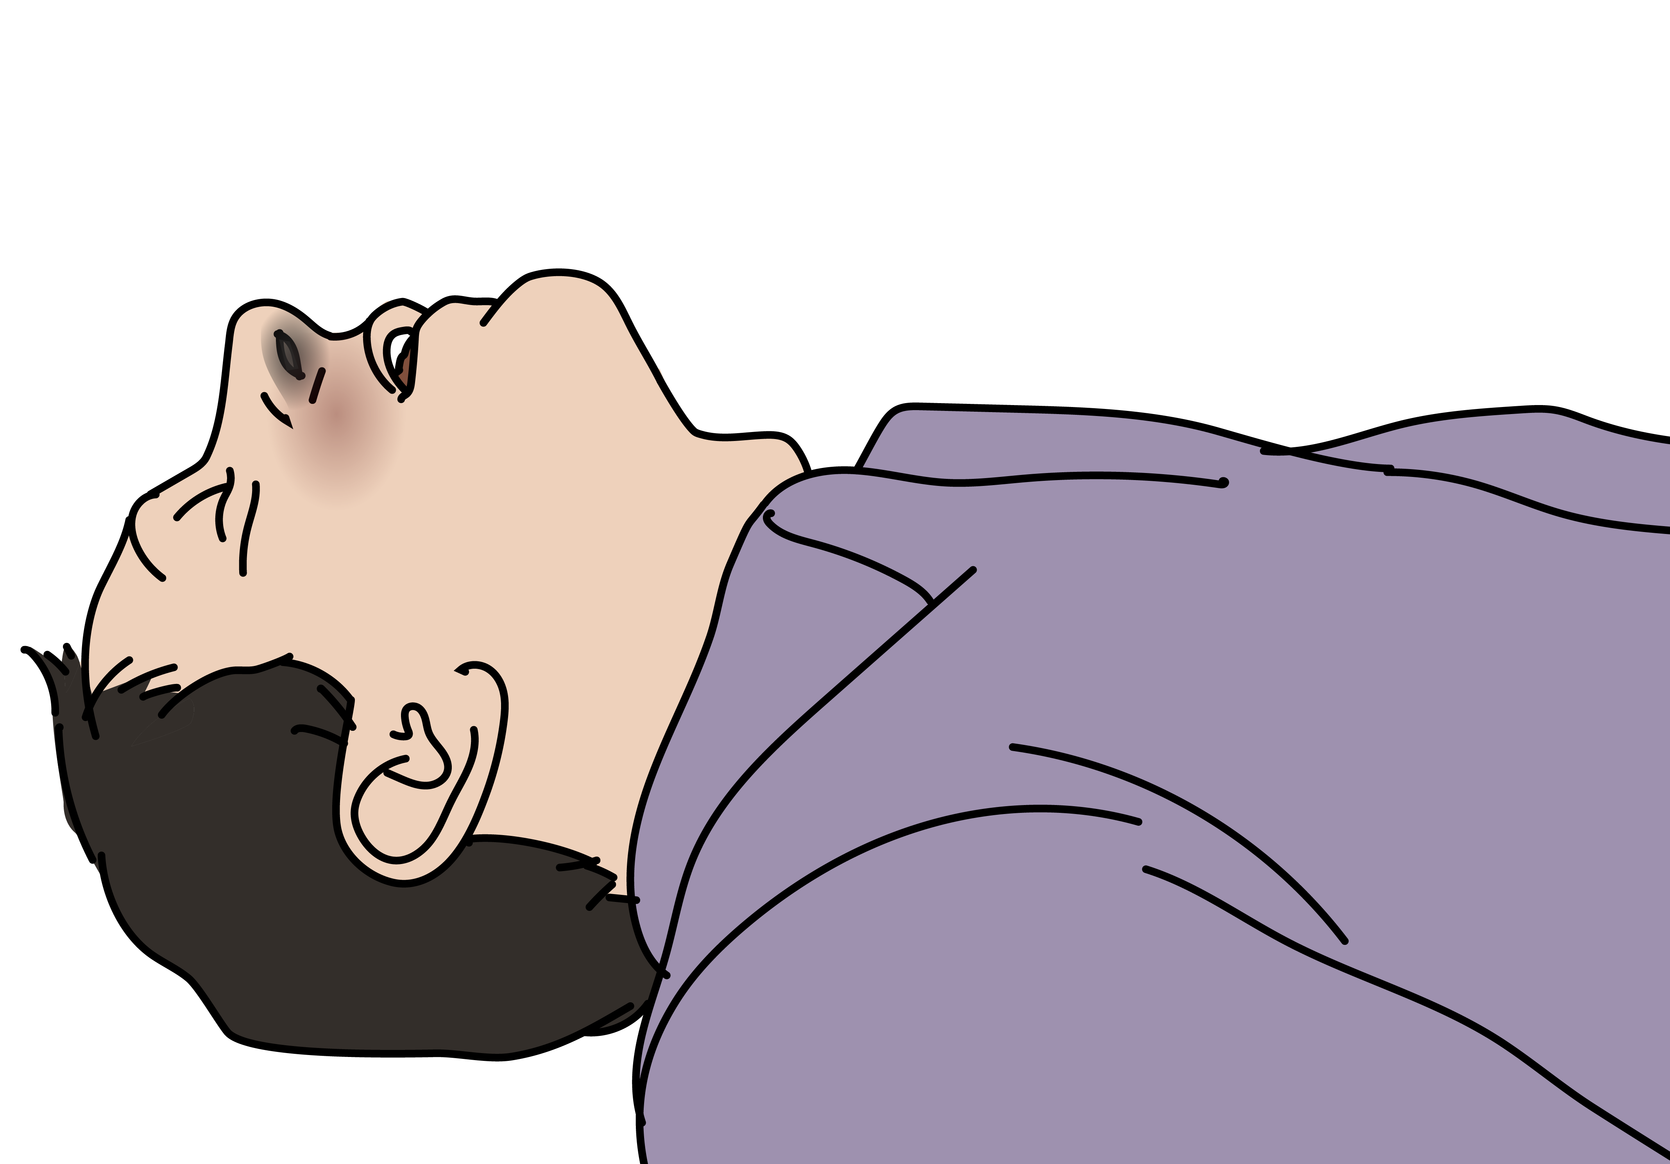
Burns
Signs and Symptoms | Management
Burned skin colour can range from pink, red, pale or black depending on depth of burn Signs of inhalation injury: Soot (ash) or singed (burned) nasal hairs Swelling to lips or mouth Voice changes | MONITOR for airway obstruction. Remove all jewellery. Give IV FLUIDS according to burn area and depth. Give TETANUS prophylaxis. Give PAIN RELIEF. CLEAN and DRESS all wounds carefully. Plan for HANDOVER/TRANSFER if the following: Serious burns to >15% of the body Hands, face, groin, joints or circumferential burns Inhalation injury Burns with other trauma Burns in very young or elderly Significant pre-burn illness (such as diabetes)
Burns are high risk for infection! Clean and dress the wound carefully.
Notes:
Burned skin colour can range from pink, red, pale or black depending on the depth of the burn. Signs of inhalation injury include soot (ash), or singed (burned) nasal and facial hairs, swelling to the lips or mouth, and voice changes. Stridor is a late sign of airway swelling. For management, monitor closely for airway obstruction. Remove all jewellery as burned areas can swell quickly. Give IV fluids according to the burn area and depth. Give tetanus prophylaxis, give pain relief and clean and dress all wounds carefully. Burns are high risk for infection. Plan for handover/transfer if any of the following are present: serious burns to > 15% of the body, burns to the hands, face, groin, joints of circumferential burns, inhalation injury, burns with other trauma, burns in the very young or elderly, or if significant pre-burn illness such as diabetes.

Slide 18
Blast lung
Signs and symptoms | Management
Blast lung can develop up to 48 hours after exposure Delayed symptoms of cough, frothy or bloody sputum Severe respiratory distress: tachypnoea, hypoxia Chest pain ​ Pneumothorax | If blast lung is suspected → give OXYGEN. SUCTION secretions. If pneumothorax → place a chest tube for a pneumothorax. If chest pain → give PAIN RELIEF. Consider prone position to improve oxygenation. HANDOVER / TRANSFER to advanced provider; may require mechanical ventilation.
Blast lung is a life-threatening condition!
Notes:
Blast lung can develop up to 48 hours after exposure. Signs and symptoms include: delayed symptoms of cough, frothy or bloody sputum, severe respiratory distress e.g., tachypnoea (fast breathing) or hypoxia, and chest pain. If blast lung is suspected, give oxygen. Suction secretions and keep the airway clear. If pneumothorax, place a chest tube. If chest pain, give pain relief. Consider prone position to improve oxygenation however always monitor the patient carefully and ensure the airway remains open. Handover/transfer to an advanced provider, the patient may require advanced ventilatory support, for example, mechanical ventilation. Blast lung is a life-threatening condition.

Slide 19
Disposition Considerations
Trauma patients can have complex injuries and get worse or die very quickly.
High-risk conditions always require HANDOVER/TRANSFER to a specialist unit for ongoing care.
Remember that if a patient required OXYGEN arrange to continue it during transport and handover.
Ensure bleeding is controlled and arrange for early blood transfusion.
If an injured person is displaying signs of shock, ensure treatment with IV FLUIDS or blood is continued on transfer.
Communicate injuries, important medical problems and what has been done for the patient during handover/transfer.
Notes:
Trauma patients can have complex injuries and get worse or die very quickly. High-risk conditions always require handover / transfer to a specialist unit for ongoing care.
Remember that if a patient required oxygen, arrange to continue it during transport and handover. Ensure bleeding is controlled. If an injured person is displaying signs of shock, ensure treatment with IV fluids is continued on transfer. Communicate injuries, important medical problems and what has been done for the patient during handover/transfer.

Slide 20
REMEMBER
The goal of initial assessment is to manage CABCDE and identify life-threatening conditions.
The goal of acute management is to prevent secondary injury from poor oxygenation and decreased perfusion, control pain and plan ongoing care.
Notes:
Remember the goal of initial assessment is to manage CABCDE and identify life-threatening conditions. The goal of acute management is to prevent secondary injury from poor oxygenation and decreased perfusion, control pain and plan ongoing care.

Slide 21
Summary
In this presentation, we have covered:
The trauma primary survey approach for conflict related trauma
The signs and symptoms of acute life- and limb- threatening conditions resulting from blast injury
Critical CABCDE actions for acute life-threatening conditions resulting from blast injury
Notes:
In this presentation, we have covered: the trauma primary survey approach for blast injury, the signs and symptoms of acute life-and limb-threatening conditions resulting from blast injury, and critical CABCDE actions for acute life-threatening conditions resulting from blast injury. This is the end of the Blast Injury module.

