Slide 1

CD-JEV Japanese Encephalitis Vaccine Introduction Training Modules for Health Care Workers
Module 1
Introduction to Japanese encephalitis and CD-JEV vaccine
(live attenuated SA 14-14-2 JE vaccine)

Slide 2


Learning objectives
At the end of the module, the participant will be able to:
  Describe the main characteristics of Japanese encephalitis.
  Describe how to prevent Japanese encephalitis.
  Describe basic characteristics of CD-JEV Japanese encephalitis vaccine.
Duration:
  15 minutes

Slide 3
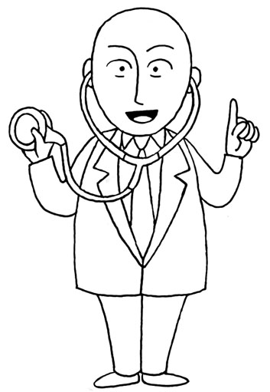
Key issues
1
What is Japanese encephalitis (JE)?
2
What are the signs and symptoms of JE?
3
How do people get JE?
4
Who is most at risk for JE?
5
What are JE prevention strategies?
Notes:
To the facilitator:
Explain to the participants the key issues raised in this module.
In this module you will learn more about Japanese encephalitis (JE) and JE vaccine.
We will provide you with answers to the following questions:
What is JE?
What are the signs and symptoms of JE?
How do people get JE?
Who is most at risk for JE?
What are JE prevention strategies?

Slide 4
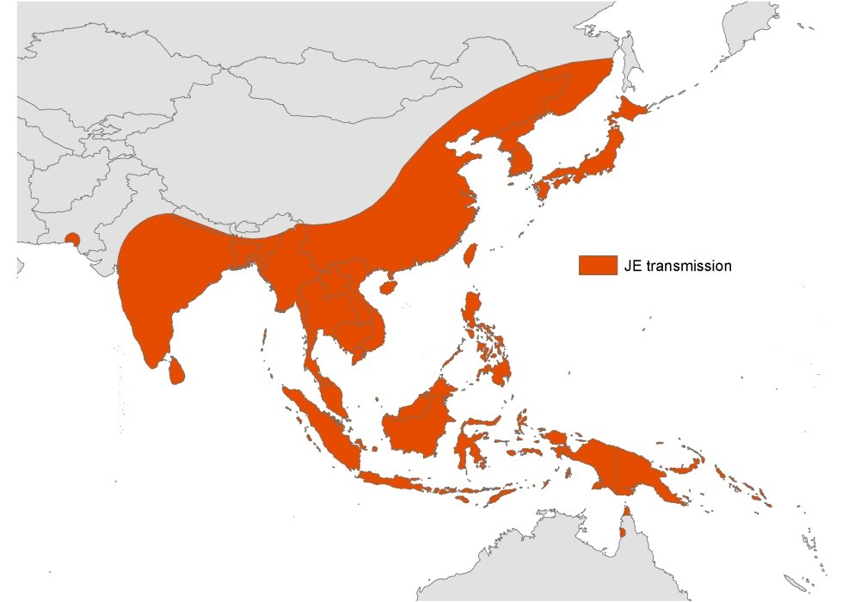
What is Japanese encephalitis? (1/2)
Japanese encephalitis (JE) is caused by a virus transmitted by certain kinds of mosquitoes.
JE is the leading cause of viral encephalitis in Asia.
It is estimated that 68,000 cases of JE typically occur each year in 24 endemic countries. (WHO Bulletin; Campbell et al; 2011.)
JE transmission
Source: Adapted from Halstead S, Tsai T. Japanese Encephalitis. In: Plotkin SA, Orenstein WA, eds. Vaccines. 4th edition. London, UK: W.B. Saunders Company; 2003:919–958.
Notes:
To the facilitator:
Explain to the participants what Japanese encephalitis is. *You may want to include information specific to your local context, such as disease burden, seasonality, etc.
Japanese encephalitis is a serious and disabling illness due to a virus transmitted by certain kinds of mosquitoes, and is the leading cause of viral encephalitis in Asia.
Recent global estimates report that approximately 68,000 cases of Japanese encephalitis typically occur each year in 24 endemic countries.

Slide 5
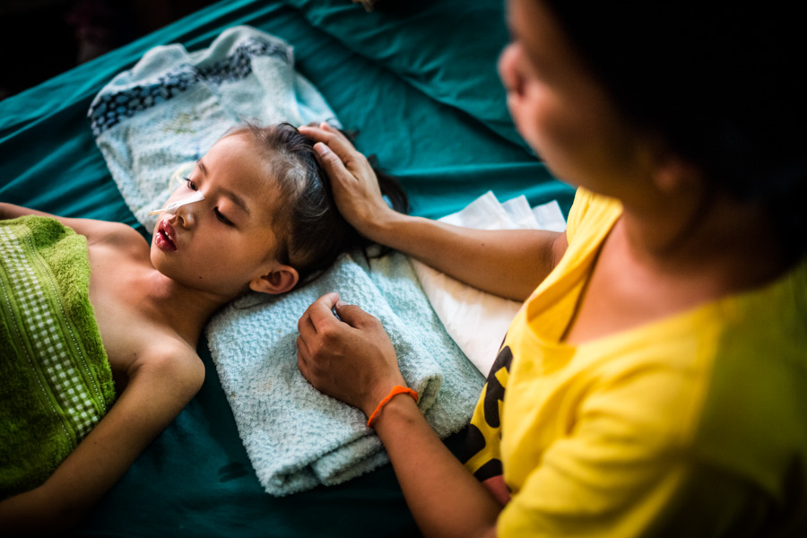
What is Japanese encephalitis? (2/2)
The virus infects the brain, causes inflammation and swelling, and can cause long-lasting brain damage leading to disabilities among survivors.
Among people who develop encephalitis, up to 30 percent die and about 40 percent suffer serious brain damage, including paralysis and mental disability.
Photo credit: PATH/Aaron Joel Santos
Notes:
To the facilitator:
Explain to the participants what Japanese encephalitis is. *You may want to include information specific to your local context, such as disease burden, seasonality, etc.
The virus infects the brain, causes inflammation and swelling, and can cause long-lasting brain damage leading to disabilities among survivors.
Among people who develop encephalitis, up to 30 percent die and about 40 percent suffer serious brain damage, including paralysis and mental disability.

Slide 6
What are the signs and symptoms of Japanese encephalitis?
Most people who get infected with JE virus do not develop any symptoms, and they then become immune to JE.
Symptoms usually start with a flu-like illness, including fever, chills, tiredness, headache, abdominal pain, nausea, and vomiting. Confusion and agitation can also occur in the early stage.
The illness can progress to encephalitis (infection of the brain). At this stage, patients may experience symptoms like seizures, paralysis, coma, and/or the loss of speech.
Severe disease develops in about 1 of 250 JE infections.
Notes:
To the facilitator:
Describe to the participants the signs and symptoms of JE.
Most people who get infected with JE virus do not develop any symptoms, and they then become immune to JE.
Symptoms usually start with a flu-like illness, including fever, chills, tiredness, headache, abdominal pain, nausea, and vomiting. Confusion and agitation can also occur in the early stage.
The illness can progress to encephalitis (infection of the brain). At this stage, patients may experience symptoms like seizures, paralysis, coma, and/or the loss of speech.
Severe disease can develop in about 1 of 250 JE infections.
6

Slide 7
How is Japanese encephalitis diagnosed and treated?
Patients with JE may present with fever and altered mental status, but clinical symptoms are not enough to confirm diagnosis of JE since there is no way to differentiate JE from other types of encephalitis.
A confirmed JE diagnosis requires laboratory tests to look for antibodies to JE virus.
Diagnosis of JE infection is based on tests of blood and cerebrospinal fluid (CSF). CSF is fluid around the brain and spinal cord and is obtained by lumbar puncture.
There is no specific treatment for JE. However, supportive care is important to reduce the risk of death or disability.
Notes:
To the facilitator:
Explain to the participants how JE is diagnosed.
Patients with JE may present with fever and altered mental status, but a confirmed diagnosis requires laboratory analysis tests to look for antibodies to JE virus.
Diagnosis of JE infection is based on tests of blood and cerebrospinal fluid (CSF). CSF is fluid around the brain and spinal cord and is obtained by lumbar puncture.
7

Slide 8
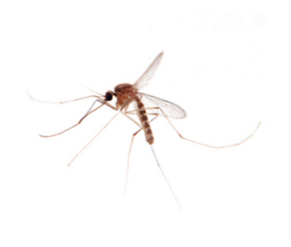
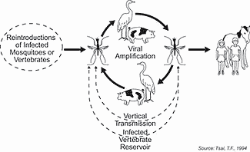
How is Japanese encephalitis transmitted?
JE virus is transmitted to humans by mosquitoes found in rural rice-growing and pig-farming regions of Asia. They can also be found at the outskirts of cities.
The mosquito picks up the virus mainly from wading birds and pigs, and then transmits it to humans.
JE cannot be directly transmitted from one person to another.
After infection, if the body’s immune system is unable to control virus replication, the virus invades the central nervous system.
Culex tritaeniorhynchus mosquito
Notes:
To the facilitator:
Explain to the participants how JE is transmitted.
JE virus is transmitted to humans by certain types of mosquitoes (most commonly, Culex tritaeniorhynchus). These mosquitoes are usually found in rural rice-growing and pig-farming regions of Asia. They can also be found at the outskirts of cities. When a mosquito feeds on an animal like this, it becomes infected with virus. Mosquitoes prefer to just feed on large domestic animals and birds. But if an infected mosquito bites a human, illness in the human can occur. JE infection is not transmitted directly from person to person.
The mosquito picks up the virus from a number of different animals, primarily wading birds and pigs, and then transmits it to humans. JE cannot be directly transmitted from one person to another.
After infection, if the body’s immune system is unable to control the replication of the virus, the virus invades the human central nervous system, including the brain and spinal cord.

Slide 9
Who is most at risk?
People who live in rural, farming areas of South and Southeast Asia where JE virus is common are at higher risk of getting infected.
Children less than 15 years of age are at higher risk of JE than adults in most areas, largely because over time, most people living in areas with JE virus will be infected by the virus and develop immunity that protects them in adulthood.
Sometimes adults can have JE, particularly when the JE virus enters new areas where the population (including adults) has not been exposed to JE before, or when adults move to areas with JE for the first time.
Notes:
To the facilitator:
Explain to the participants who is most at risk.
People who live in rural, farming areas of South and Southeast Asia where JE virus is common are at higher risk of getting infected.
Children less than 15 years of age are at higher risk of JE than adults in most areas, largely because over time, most people living in areas with JE virus will be infected by the virus and develop immunity that protects them in adulthood.
Sometimes adults can have JE, particularly when the JE virus enters new areas where the population (including adults) has not been exposed to JE before, or when adults move to areas with JE for the first time.

Slide 10
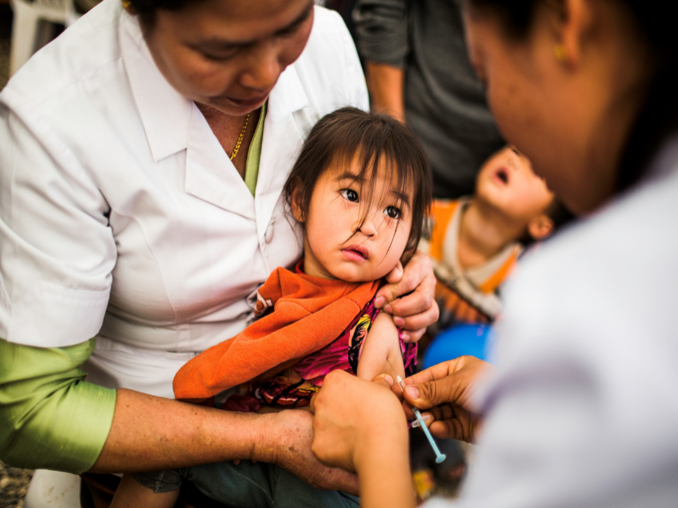
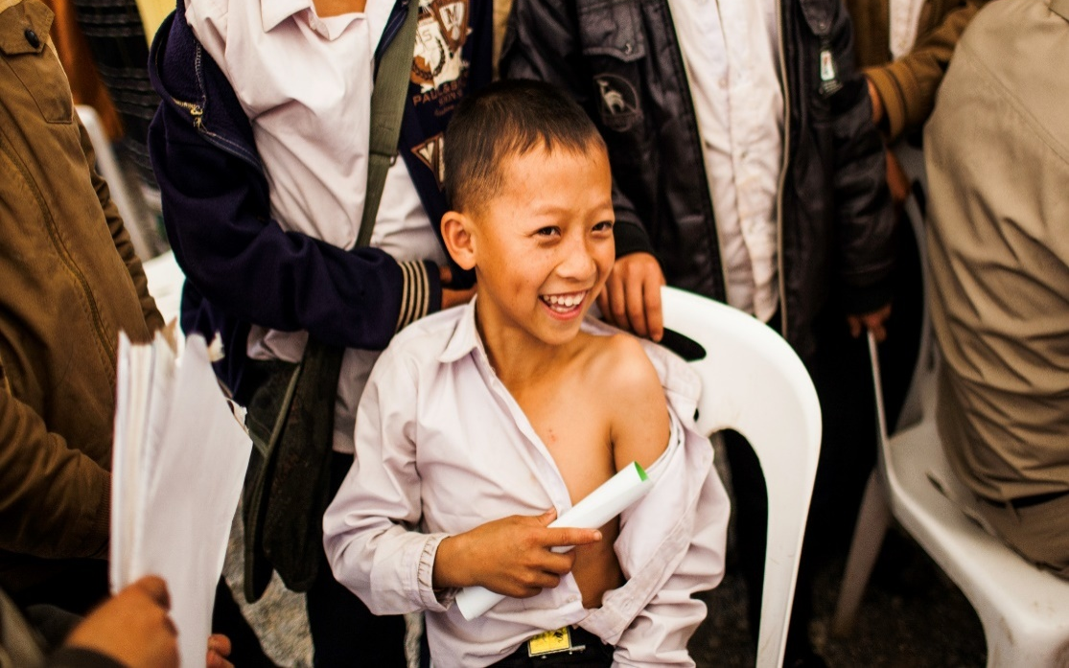
What can be done to prevent Japanese encephalitis?
  Vaccination is the most effective and most cost-effective way to prevent Japanese encephalitis.
Photo credits: PATH/Aaron Joel Santos
  Using bednets and vaccinating animals have not been found to prevent JE.

Slide 11
What vaccines are currently available to protect against Japanese encephalitis?
WHO-prequalified JE vaccines | WHO-recommended doses in primary series
Inactivated Vero cell-based SA 14-14-2 (JEEV®) | 2
Live attenuated SA 14-14-2 (CD-JEV) | 1
Live recombinant SA 14-14-2 (IMOJEV®) | 1
Notes:
To the facilitator
These three vaccines, including the live attenuated SA 14-14-2 (CD-JEV), are WHO prequalified, which means leaders of country immunization programs and groups that fund vaccine purchases can be confident that the vaccine meets international quality and safety standards.

Slide 12
What is live attenuated SA 14-14-2 (CD-JEV)?
  CD-JEV is a live attenuated vaccine used to prevent JE.
  CD-JEV will only prevent brain infections caused by JE virus, not brain infections caused by other viruses.
  CD-JEV is a WHO-prequalified vaccine, which means it has been assessed by the WHO and successfully meets quality, safety, and efficacy standards for the target population.
  0.5 mL of CD-JEV is given in a single dose as a subcutaneous injection.

Slide 13
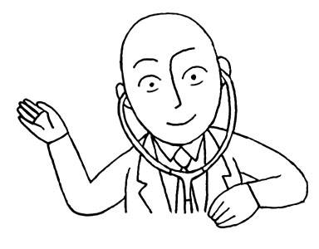
Key messages (1/2)
Japanese encephalitis (JE) is a serious and disabling illness due to a virus transmitted by certain kinds of mosquitoes that infects the brain, causes inflammation and swelling, and can cause long-lasting brain damage leading to disabilities among survivors.
It is estimated that 68,000 cases of Japanese encephalitis typically occur each year in 24 endemic countries.
Most people who get infected with JE virus do not develop any symptoms, and then they become immune to JE.
Patients with JE may present with fever and altered mental status, but a confirmed JE diagnosis requires laboratory analysis for presence of antibodies to JE virus.
Among people who develop encephalitis, up to 30 percent die and about 40 percent suffer serious brain damage, including paralysis and mental disability.

Slide 14
Key messages (2/2)
People who live in rural, farming areas of South and Southeast Asia where JE virus is common are at higher risk of getting infected.
Children less than 15 years of age are at higher risk of JE than adults in most areas, largely because over time, most people living in areas with JE virus will be infected by the virus and develop immunity that protects them in adulthood.
Vaccination is the most effective and most cost-effective way to prevent Japanese encephalitis.
CD-JEV is a live attenuated vaccine used to prevent JE.
CD-JEV is a WHO-prequalified vaccine, which means it has been assessed by the WHO and successfully meets quality, safety and efficacy standards for the target population.
0.5 mL of CD-JEV is given in a single dose as a subcutaneous injection.

Slide 15
Next modules of this training will explain how to:
  Store the vaccine
  Determine vaccine eligibility
  Administer the vaccine
  Record and monitor vaccine uptake
  Monitor adverse events following immunization (AEFIs)
  Communicate with caregivers about the vaccine
Notes:
To the facilitator:
Introduce to the participants to the content of the training related to JE vaccine introduction.
We are about to introduce CD-JEV into our routine immunization programme. In order to ensure the best conditions for the vaccine introduction, you will be trained on how to:
Store the vaccine
Determine the eligibility of the vaccine
Administer the vaccine
Record and monitor vaccine uptake
Monitor AEFIs
Communicate with caregivers about the vaccine
During the course, issues and questions will be raised and discussed in a group in order to anticipate the situations that you will be facing at the workplace.
At the end of the course, you will be provided with a pocket guide on the training. The guide is intended to remind you of key information in routine practice.
15

Slide 16

End of module
Thank you
for your attention!
Next is Module 2: CD-JEV attributes and storage conditions
Notes:
To the facilitator:
This is the end of the module.
You have been introduced to the “Introduction to Japanese encephalitis and CD-JEV vaccine” module.
The following module is titled “CD-JEV attributes and storage conditions.”
Thank you for your attention!

