Slide 1






Presentation slides
Clinical management of rape and intimate partner violence in emergencies
Training curriculum for health workers

Slide 2

Session 9.
Clinical care for survivors of sexual
assault, part 1:
Informed consent and history-taking
9.2

Slide 3
Session objectives
Objective 3: Demonstrate clinical skills appropriate to one’s scope of practice to respond to sexual violence and IPV
Competencies:
Understand the 4-step process for informed consent
Demonstrate skills to take a clinical history, including for a child or adolescent survivor of sexual abuse
9.3

Slide 4
Steps for clinical management of rape
Step 1
Listen, inquire about needs/concerns, and validate the survivor
Step 2
Obtain informed consent and prepare the survivor
Step 3
Take the history
Step 4
Perform the physical and genito-anal exam
Step 5
Provide treatment
Step 6
Enhance safety and refer for additional support
Step 7
Assess mental health and provide psychosocial support
Step 8
Provide follow-up care
9.4
Notes:
Say: While you may be called to take a clinical history and perform a physical examination for IPV which does not involve sexual assault, this session and the next one will focus on comprehensive history-taking, examination and documentation that is indicated for clinical management of rape. In EVERY SINGLE encounter, the survivor’s history and wishes will guide the encounter and exam.
If there is no indication to conduct a genito-anal exam, do NOT do so.
It is important to remember that people of diverse genders experience sexual assault, and in times of war, conflict, displacement and other humanitarian emergencies, risk of sexual violence among men and boys increases.

Slide 5
Informed consent… an ongoing process
Considerations
Giving informed consent requires the survivor to know the consequences of their choices
Frequent and ongoing verbal informed assent is critical when caring for survivors of sexual violence
Written informed consent is recommended and usually required prior to:
        physical examination
        collection of physical evidence
        sharing of records in the course of referral
9.5

Slide 6
Information to include when seeking consent to proceed
with clinical management of rape
Certain types of information should also be provided to a client when seeking consent to proceed, including:
What will happen during the visit
The survivor’s right to pause, skip or stop any step
Options for physical examination and physical evidence collection
Any applicable mandatory reporting
The survivor’s degree of control over who has access to documentation and prosecution
Whether forensic services are available/functioning
9.6
Notes:
Facilitator’s notes:
Remind participants that knowing the policy and regulatory environment in which they are providing care is critical, as covered in Session 5. Review key context-specific policies and laws governing participants provision of care, such as:
legal age to consent to care and treatment
legal age below which mandatory reporting applies
whether the legal framework allows survivors to choose if police will investigate and seek prosecution once notified of an assault
whether there are legal restrictions on which providers can collect and submit official evidence samples and reports – if yes, counselling on need to refer and transfer care to a forensic provider is critical before proceeding, if the survivor desires those services.

Slide 7

Informed consent with child and
adolescent survivors
Know and explain any mandatory reporting laws
Seek informed assent from the survivor, even if legal consent must come from a guardian or caregiver
Help solicit the survivor’s preferences, questions and wishes in an age-appropriate manner, to inform the parent’s or guardian’s decisions around consent
Be alert to body language that suggests intimidation or coercion by the accompanying adult when seeking a child or adolescent’s assent
9.7

Slide 8
When to offer a forensic examination
Only when:
A certified forensic science lab is available
The woman has presented within 5 days of the assault
She wants to report the case to the police or reporting is mandatory
A trained provider is available
    Under no circumstance should physical evidence be gathered if the resources needed to store and analyse samples are not available
9.8
Notes:
Say: Please note that this training will strengthen your skills in physical examination and documentation, but it does not provide sufficient time, skills practice or information to qualify you as a trained forensic examiner.
If your practice setting has forensic doctors, counsel the survivor on the options and limiting factors related to their decision to pursue a forensic exam. If the survivor chooses that route, always refer to a forensic specialist.
Many types of physical evidence become non-viable after 48–72 hours. Counselling about the decreased likelihood of viable physical specimens is important for survivors who present 4–5 days after sexual assault.
Emphasize that the content and guidance in this session and in Session 10 applies to all physical exams following sexual violence or IPV, even when forensic examination or evidence collection is either not possible or not desired by the survivor.
Facilitator note: If you will be including Supplemental Session 15 on forensic examination, you may wish to mention that forthcoming content to participants.

Slide 9
Whether and when to offer forensic examination and evidence collection
Exercise 9.1
Listen to the brief scenarios
Consider if the context meets the following 4 minimum requirements for offering forensic evidence collection:
  Are forensic evidence storage and analysis processes and facilities available and functioning?
  Does the time elapsed since assault allow for collection of physical evidence?
  Is there a legal obligation to prepare a medico-legal certificate?
  Does the provider have the ability and authorization to complete a forensic exam and medico-legal reporting forms?
9.9
Notes:
Say: Many providers are challenged by the nuances and burdens of providing comprehensive examination and documentation versus a full forensic exam. This exercise is designed to help you consider how you might educate and counsel a survivor on their options.
REMEMBER – if the minimum conditions are not met, do NOT counsel, and offer the survivor the option of referral to forensic examination services.

Slide 10
Exercise 9.1
Scenario 1
Fatima is a maternal, newborn and child health nurse working at the district hospital in Anywhere Town, Nationville. Nationville has mandatory reporting for any suspected case of sexual violence against a child under age 16. Fatima has been trained in first-line response to GBV. Her normal work focuses on family planning/reproductive health services, including provision of long-acting contraception, post-abortion care, and antenatal and postpartum care. There are no GBV specialists in her hospital. There is a One-Stop Centre at the national hospital located 3 hours away. Currently, there is a travel advisory for the road between Anywhere Town and the capital due to seizure by militia forces and an armed blockade of the road.
Fatima calls in her next patient and sees two adolescent girls walk in. Bernice is a 13-year-old girl. She was brought in by her older sister (age 17), who found her crying at home. For several months – ever since their father was killed in a militia raid – their uncle has been staying with them for increased protection, and has been sexually abusing Bernice. It started as touching, then he kissed her and forced her to watch him masturbate. He threatened to harm her if she told her mother or siblings. A few weeks ago, he raped her vaginally. She has been facing sleepless nights, anxiety and nightmares, but has been terrified to say anything, fearing he would hurt her. Finally, the previous evening, she told her sister, because she is experiencing pain in her vagina and there is yellow-green discharge. Her sister brought her to the doctor first thing in the morning. She did not say anything to their mother because the man is their mother’s favourite brother.
9.10
Notes:
Facilitator’s notes:
Make these points if they are not raised by the participants:
The rape occurred more than 7 days ago. It is not possible to collect physical evidence that will be used in legal proceedings.
Fatima needs to counsel the girls on the reality of mandatory reporting, considering Bernice’s age. She would ideally bring in a child advocate, due to the absence of a parent or guardian who is reliably safe for the child survivor.
History-taking, examination and treatment should focus on comprehensive medical care/clinical management of rape. The medico-legal certificate can be completed to note extended time elapsed since the alleged rape and absence of viable physical evidence samples.

Slide 11
Exercise 9.1
Scenario 2
Princess is a physician trained in GBV response and usually works at the One-Stop Centre at the hospital in Banda Aceh, Sumatra. She was up-country with her family for Christmas when the 2004 tsunami devasted the city. She raced back to help with the response. A week after the tsunami, Princess is working at the massively damaged hospital, providing general practitioner (GP) services in the section of the hospital that has been cleared of debris. The One-Stop Centre was completely destroyed and there are no forensic labs in the province.
Cham is a 36-year-old woman. There had been renovation work at her house, which has now been completed. Five days ago, on the last day of the renovation work, one of the workers entered her bedroom and forced her to have sex while the children were playing outside. Then, two days later, the tsunami hit. She has not found her husband and believes he was killed in the initial wave.
She finally made it to the clinic today because she is scared of becoming pregnant or contracting HIV. She has no interest in going to the police and just wants to be able to take care of her surviving children and figure out where they will now live.
9.11
Notes:
Facilitator’s notes:
Make these points if they are not raised by participants:
There is a lack of survivor desire to go to police or pursue prosecution.
There is a lack of functioning forensic processing facilities.
Proceed with clinical examination and documentation.
Some participants will note that too much time has elapsed to offer post-exposure prophylaxis (PEP). If this is raised, note that discussion of treatment protocols and timeline considerations will be covered in detail in the next session. Keep the discussion focused on consideration of whether to offer forensic evidence collection and examination to the survivor.

Slide 12
Preparing to take the clinical history
Remember to provide the first three steps of LIV(ES) early and often
Active listening and care with verbal and body language are important throughout the entire exam
Ensure a second person is in the room to support the survivor
Ensure auditory and visual privacy
9.12
Notes:
Say: If working in a temporary and/or tent-based exam space, post a non-specific EXAM IN PROGRESS sign on the outside of the entryway to avoid people walking into the private space.
If the support person is a secondary provider or support staff, make every effort to match the survivor’s native language.
A latched or locking door to ensure no accidental walk-ins is encouraged where possible.
Ask participants for suggestions and ideas for how to create auditory privacy in settings where visual privacy is a simple fabric partition.

Slide 13
History-taking
  The survivor may sit or be in any position that is most comfortable for this conversation
Create a climate of trust
Plan for a lot of time and go at the survivor’s pace
Make time for silence, breaks, crying or other pauses
Document findings in official client records
9.13
Notes:
Say:
From the moment of arrival, every staff member’s words and interactions will affect whether the client believes they are in a safe place.
Begin with less painful questions and move towards more difficult details that you need to know to provide appropriate care.
Reiterate confidentiality as well as any legal limitations on your ability to give 100% confidentiality.
The detailed history and exam record should be coded using an anonymous system. Only the client code should ever be recorded in clinic registers or other places where many people view the information. Detailed client records should ALWAYS be stored in a locked and confidential location (closet, box, room, etc.).

Slide 14
History-taking with child survivors
The survivor may sit or be in any position that is most comfortable for this conversation
Younger children may remain on their parent’s/caregiver’s lap, or in any position that makes them most comfortable
Gather and document the history of the survivor’s timing, onset and stage of puberty
Gather information about the environment in which the survivor lives and the caregivers and adults/older adolescents they spend time with
Offer the child options for using pictures or toys to enact aspects of their experience/history
9.14
Notes:
Say: If the survivor is female, gather and document information about menarche onset, proximity and/or Tanner stage of development.

Slide 15

History-taking with child survivors
Remember!
Experiencing maltreatment is a potentially traumatic event
Health workers should seek to minimize additional distress by minimizing the number of assessments the survivor undergoes, including asking them the same questions more than once
Asking a child repeatedly to tell their history can be
re-traumatizing
9.15

Slide 16
Clinical history for clinical management of rape
History component | Information sought
General assault events | Date, time, location Known or unknown suspect How the violence unfolded: injuries, penetration – what type and with what body part or object – loss of consciousness, intake of drugs or toxic substances Subsequent activities that may impact evidence such as bathing, douching or changing clothing
Survivor’s general medical history or conditions | Unexplained symptoms of concern Known chronic medical conditions Current medications or supplements Current use/abuse of alcohol or drugs
9.16
Notes:
Facilitator’s notes:
Use the approved, local clinical management of rape documentation form and/or Job aid 9a to ensure you are taking a thorough history and to prevent the omission of key questions.
Direct participants to Job aid 9a. Review the importance of SOLER and not staring at your form and writing through the history-taking.
Explain that with practice, providers will become comfortable collecting several points of information while simply listening and then making notes.
Providers may wish to make rough notes first to reduce writing time, and then complete a more detailed, clean record after the survivor has departed.
In settings where two health workers are present, consider having the assisting provider enter information so the primary provider doesn’t have to write at all.

Slide 17
Clinical history for clinical management of rape (continued)
History component | Information sought
Survivor’s obstetric/ gynecological history | Currently pregnant? First day of last menstrual period Current use of contraception and the method of contraception Any pain and/or blood with urination, defecation or in the genital area
Mental health assessment | Current ability to recall events Current ability to understand what is happening Degree of distress/capacity to sleep and rest Any self-harm or suicide ideation
9.17
Notes:
Facilitator’s notes:
Use the approved, local clinical management of rape documentation form and/or Job aid 9a to ensure you are taking a thorough history and to prevent the omission of key questions.
Direct participants to Job aid 9a. Review the importance of SOLER and not staring at your form and writing through the history-taking.
Explain that with practice, providers will become comfortable collecting several points of information while simply listening and then making notes.
Providers may wish to make rough notes first to reduce writing time, and then complete a more detailed, clean record after the survivor has departed.
In settings where two health workers are present, consider having the assisting provider enter information so the primary provider doesn’t have to write at all.

Slide 18
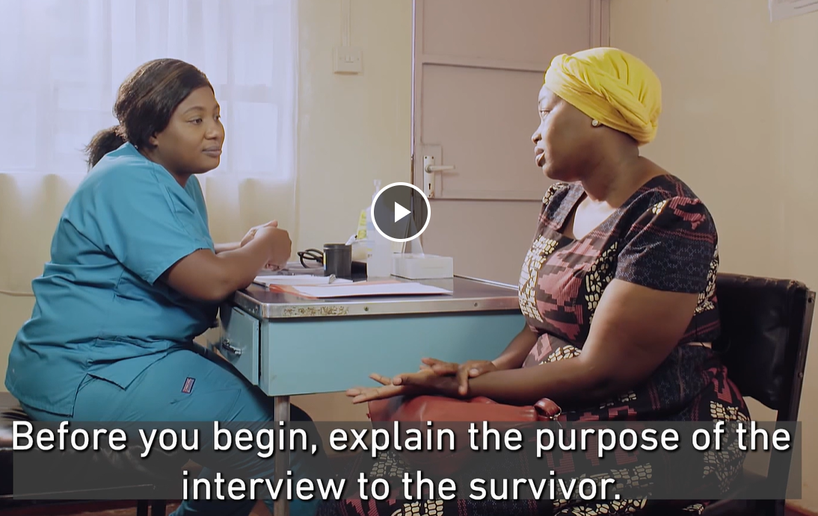
Skills in action – history-taking
Allow the survivor to tell you what happened in their own way
© International Rescue Committee and Norwegian Church Aid. 2022
9.18
Notes:
Facilitator’s notes:
Play this video: https://rescue.app.box.com/s/r5w6pfxzqdvgyg87lroagisa5i5sio03/file/1121630865687
After playing the video, invite participants to share observations about good practices. Any areas to improve? What might they have done differently?

Slide 19
Clinical history role play
Exercise 9.2
Patient:
Read the scenario to yourself.
Don’t tell the others the details. When asked, read aloud the part entitled “explain to provider”. Describe your situation and answer the provider's questions.
Health worker:
Gather a complete history, using Job aid 9a to document findings.
“Sample history and examination form” in Women IPV and sexual violence clinical handbook¹
9.19
Notes:
Facilitator’s notes:
Job aid 9a. Sample history and examination form for sexual assault (in Web Annex B. Participant job aids) is also on pp. 91–93 of the Caring for survivors of VAW clinical handbook.

Slide 20
Session 9: That’s a wrap!
Ensure the counselling for informed consent includes information about applicable laws and regulations that will impact what happens with information that is shared and/or documentation that is completed
Obtain informed consent separately for the four steps of clinical management of rape: history taking, physical examination, forensic evidence collection and documentation
History informs and shapes the examination and treatment
Thorough clinical history and examination should be offered and provided even in cases where the minimum requirements for forensic examination are not met
Obtain consent separately for each aspect of the exam; informal verbal consent should be sought throughout the physical and recto-genital exam
9.20

Slide 21
Reference
World Health Organization, United Nations Women, United Nations Population Fund (UNFPA). Health care for women subjected to intimate partner violence or sexual violence: a clinical handbook. Geneva: WHO; 2014 (https://iris.who.int/handle/10665/136101).

