Slide 1






Presentation slides
Clinical management of rape and intimate partner violence in emergencies
Training curriculum for health workers

Slide 2

Session 8.
First-line support
using LIV(ES), part 2:
Enhancing safety and providing Support
8.2

Slide 3
Session objectives
Objective 4: Demonstrate knowledge of how to access resources and support for patients and for oneself
Competencies:
Demonstrate the skills to assess immediate risk/safety and to support safety planning, including for child and adolescent sexual abuse survivors
Know what resources are available in the community and through coordinated humanitarian response
Know how to collaborate with partners to help survivors access other services and to provide referrals
Demonstrate skills to provide warm referrals, where possible
8.3
Notes:
Say: In this session, you have a chance to practise skills needed for making warm referrals, as well as other essential skills related to the final steps of first-line support, namely: Enhancing safety and providing Support.

Slide 4
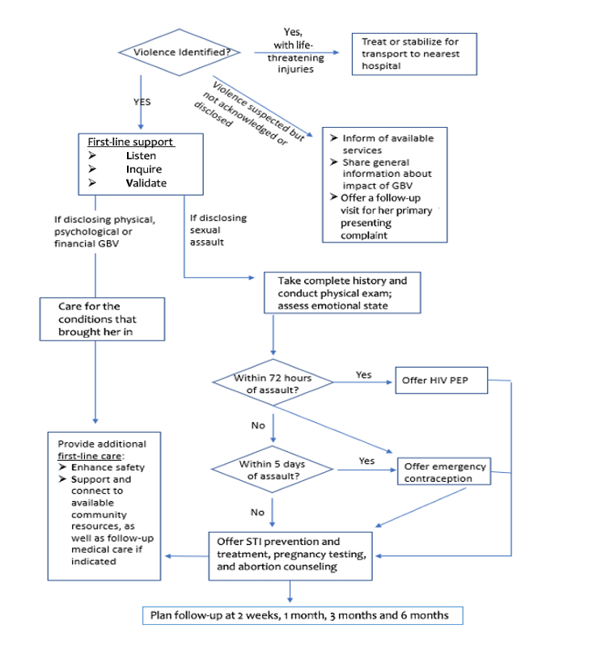
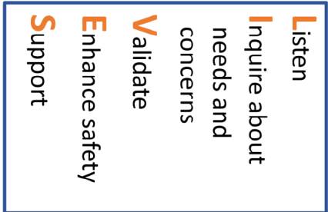
First-line support
8.4
Notes:
Say: Hopefully, by now this summary protocol and the LIV(ES) pneumonic is becoming familiar. It’s time to dive a bit deeper into the final two steps.
Remember! Always let the survivor lead the care you provide. While following this service flow helps ensure you do not miss key steps and also reduces the time it takes to identify more severe conditions, you may find yourself adjusting the order as you become more experienced and based on the client’s presentation and concerns.
Facilitator’s notes:
Remind participants of the importance of assessing for life-threatening injuries as a first step. Highlight additional service/treatment complexity in cases of sexual violence/clinical management of rape as compared to emotional or physical IPV.

Slide 5
IPV safety risk assessment
Job aid 8a
in the CMRIPV guidelines¹
  After a violent incident (physical or sexual assault), it is important to discuss and help the survivor assess whether it is safe to go home.
Affirmative (“yes”) responses to at least 3 of these questions indicates high immediate risk of severe harm
Has the violence happened more often or become worse over the past 6 months?
Has he ever used a weapon or threatened you with a weapon?
Has he ever tried to strangle you?
Do you believe he could kill you?
Has he ever beaten you when you were pregnant?
Is he violently and constantly jealous of you?
8.5

Slide 6
Enhancing safety
When elevated safety risks are identified in the survivor’s home environment, make time to:
Encourage and support development of a safety plan
Provide warm referrals to protection and/or shelter services, as well as social work or case-management services, if available
Always offer a follow-up visit to continue discussing ways to protect her, her well-being and her children
8.6
Notes:
Say: Women who are evaluated to be at especially high immediate risk should be counselled, helped to create a safety plan, and offered referrals to emergency shelter and protection services.
If you are very new to working with clients living with IPV, a relatively new graduate or simply overwhelmed by the complexity of a particular case (e.g the survivor is a child and the perpetrator is in the home), refer to or bring in a specialist.
You want to develop your comfort and confidence asking about IPV before you are the one to complete a risk-reduction plan with a survivor. Many agencies will have case managers and/or social workers trained to do this to whom you can refer.

Slide 7
Making a risk mitigation plan
Avoid putting her at additional risk
Talk about abuse only when you and she are alone
Maintain confidentiality of health records
Discuss how she will explain where she has been and what to do with any paperwork that she will take home
The survivor knows the most effective way to reduce her exposure to harm. Support her decision-making process and choices.
8.7
Notes:
Say: For many survivors of IPV, by the time they disclose to a health-care provider they have been living with abuse for months or years. It is usually a scary (if also relieving) experience to finally tell someone what has been happening. No matter what, it is a HUGE act of courage to disclose.
It is OK if a survivor is not ready to make a detailed safety plan. Remember to offer follow-up visits and to proceed at the survivor’s pace.
Facilitator note: Depending on the background, skill level and working context of your participants, you should tailor the next part of this session. See Session 8 in the Facilitator’s Guide for further guidance.

Slide 8

Facilitating social Support
Help her identify and consider her options, and what is most important to her
Discuss her social support – she may prefer to rely on her informal network
Connect her to resources through warm referrals
8.8
Notes:
Facilitator’s notes:
Review the minimum essential referral services to have in their referral directory or personal list.
Ask participants to share what they remember from Session 5.
Mental health care
Sexual and reproductive health care (MISP for SRH)
Child protection services
Shelter/housing
Police protective services

Slide 9

Facilitator demonstration, (LIV)ES
Exercise 8.1
Learning objective for this exercise:
Develop skills for providing
the E and S elements of LIVES first-line support
8.9
Notes:
Facilitator’s notes:
Call on two participants who are more experienced or who are grasping the materials quickly. Ask them to try performing the demonstration. Be sure to give lots of positive feedback if not freely given by the observers, and applause/appreciation for their courage.
Assure the group that after reviewing some special considerations for children and adolescents, we’ll again be breaking into small groups so everyone has a change to practise.

Slide 10
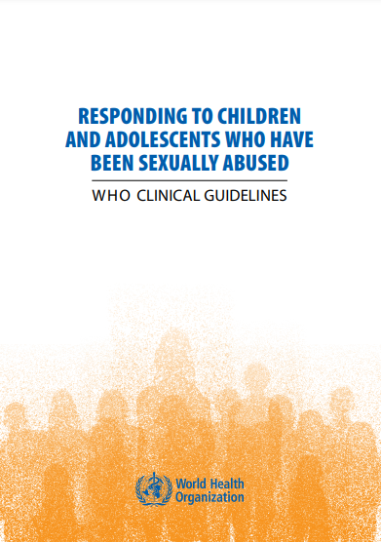
Special considerations for children and adolescents
For more information see:
Responding to children and adolescents who have been sexually abused: WHO clinical guidelines²
8.10
Notes:
Say: As noted in Session 7, there are some special considerations when providing first-line support to children and adolescents. When progressing to the final two steps of LIV(ES) – Enhancing safety and providing Support – awareness and adaptation to the decision-making capacity of the survivor and legal age of consent in your context becomes even more critical.

Slide 11

Guiding principles
Be mindful of the evolving capacities of children and adolescents
Provide information, seek informed consent, and encourage their agency and autonomy in a manner appropriate to their age and developmental stage
All service providers have a duty of care to promote the best interests of children and adolescents, especially if the child’s parents or guardians are not able to do so
Whenever possible, bring in a provider with paediatric experience when child survivors of sexual violence are identified
8.11

Slide 12
Special considerations for (LIV)ES + CC
Help the child feel safe
Strive to offer children and adolescents a choice of gender of their provider
Be mindful of word choice and use simple vocabulary:
use Child-centred communication throughout
Young children may communicate best through drawing pictures or pointing at body diagrams
Frequently reinforce that the child has done nothing wrong
Include a trusted, non-offending Caregiver in risk assessment, safety planning and linkages to social support and referral services
8.12
Notes:
Say: It is important that a provider not be alone when providing care to a child survivor. If the accompanying adult needs to be asked to leave to help with information-gathering and/or because they are involved in the violence, bring in a nurse, community health worker, child case manager or other safe adult.
The two additional “C”s to remember and incorporate into care for children and adolescents are:
Child-centred communication
Caregiver involvement.

Slide 13
Age-appropriate involvement in decision-making
Understanding the evolving capacities of children and adolescents is critical to providing age-appropriate care
Intersectional factors affecting the survivor’s maturity, their capacity to give informed consent and local regulatory requirements, all need to be taken into account
A child’s or adolescent’s capacity to be involved in decision-making can be diminished by their response to the violence they have experienced and/or other impairments, and this can make assessment difficult; in these cases, make every effort to bring in a child specialist
8.13
Notes:
Facilitator’s notes:
Participants can be directed to refer to Job aid 8d. Assessing adolescent capacity for autonomous decision-making, in Web Annex B. Participant job aids. The table provided there offers simple cues to help gauge a survivor’s development and related decision-making capacity and rights.
It is critical to remember that every individual is unique, and this information should serve as a guide only.
Take 5–10 minutes to solicit and respond to any questions from participants.

Slide 14
Role play to practise (LIV)ES, part 2
Exercise 8.2
Patient:
Read the scenario to yourself. Don’t tell the others the details. When asked, read aloud the section entitled “explain to provider”. Describe your situation and answer the provider’s questions.
Health-care provider:
Listen to the patient’s disclosure and provide first-line support – Enhance safety and access Support.
Observer:
Provide feedback to the provider.
8.14
Notes:
Facilitator’s notes:
Divide participants into groups of three.
For this skills practice, focus on the skills for enhancing safety and safety planning. Be sure to include discussion of social support and referral services in brief, to complete all steps of first-line support.
For those playing the part of the patient, you can make up details as needed when provided in the scenario. For time management purposes, you can assume you have already provided the initial steps of first-line response.

Slide 15
Session 8: That’s a wrap!
Risk assessment can help you understand a woman’s immediate safety needs
Trust your patient when she tells you she is in severe danger
Providing linkages to support services is a core activity in the response to violence
Always provide referrals that respond to her stated needs
Engage children and adolescents in identifying their own support needs as much as possible
8.15

Slide 16
References
World Health Organization, United Nations Population Fund, United Nations High Commissioner for Refugees. Clinical management of rape and intimate partner violence survivors: developing protocols for use in humanitarian settings. Geneva: World Health Organization; 2020 (https://iris.who.int/handle/10665/331535). Licence: CC BY-NC-SA 3.0 IGO.
Responding to children and adolescents who have been sexually abused: WHO clinical guidelines. Geneva: World Health Organization; 2017 (https://iris.who.int/handle/10665/259270). Licence: CC BY-NC-SA 3.0 IGO.

