Slide 1






Presentation slides
Clinical management of rape and intimate partner violence in emergencies
Training curriculum for health workers

Slide 2
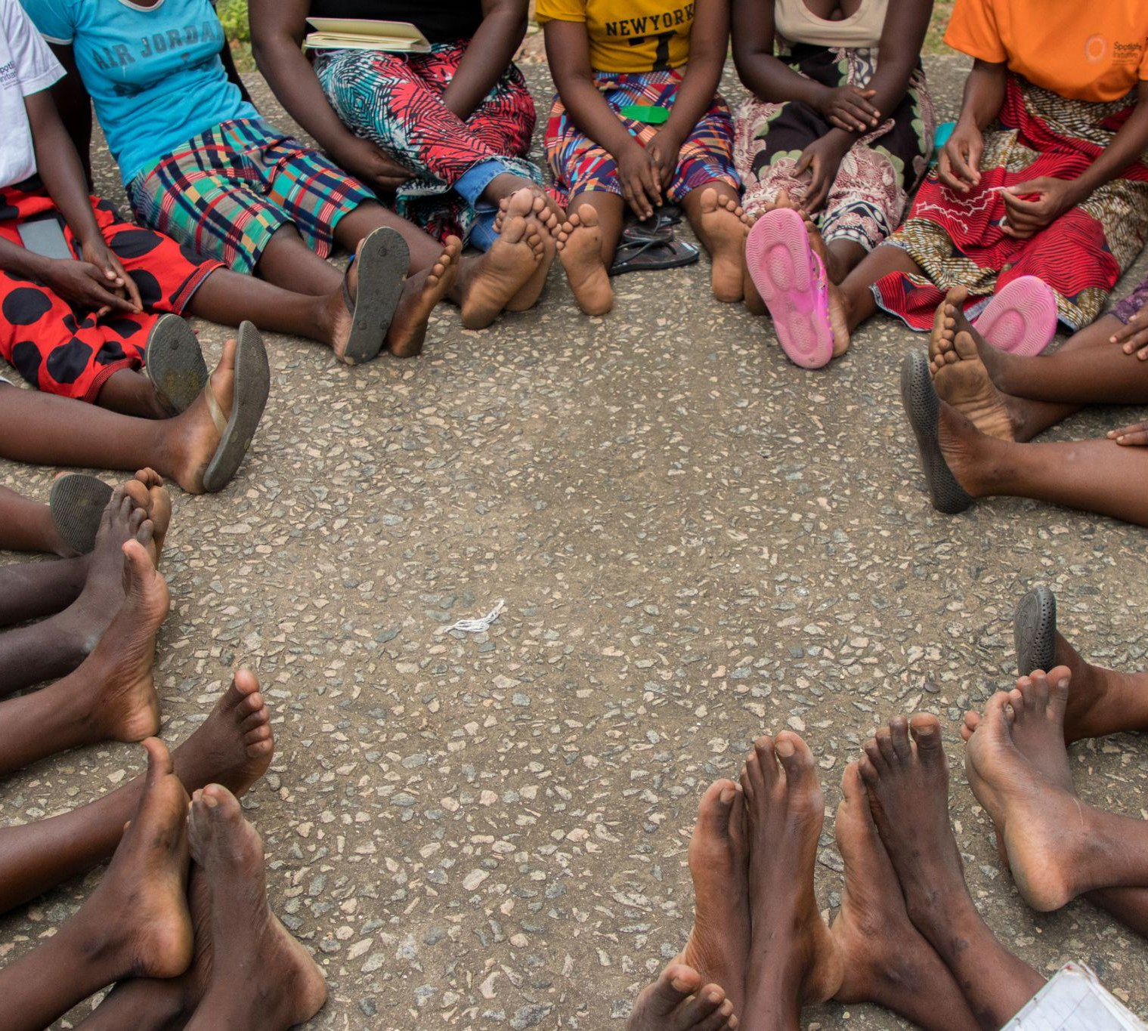
Session 16.
Conclusion
© UNFPA
16.2

Slide 3
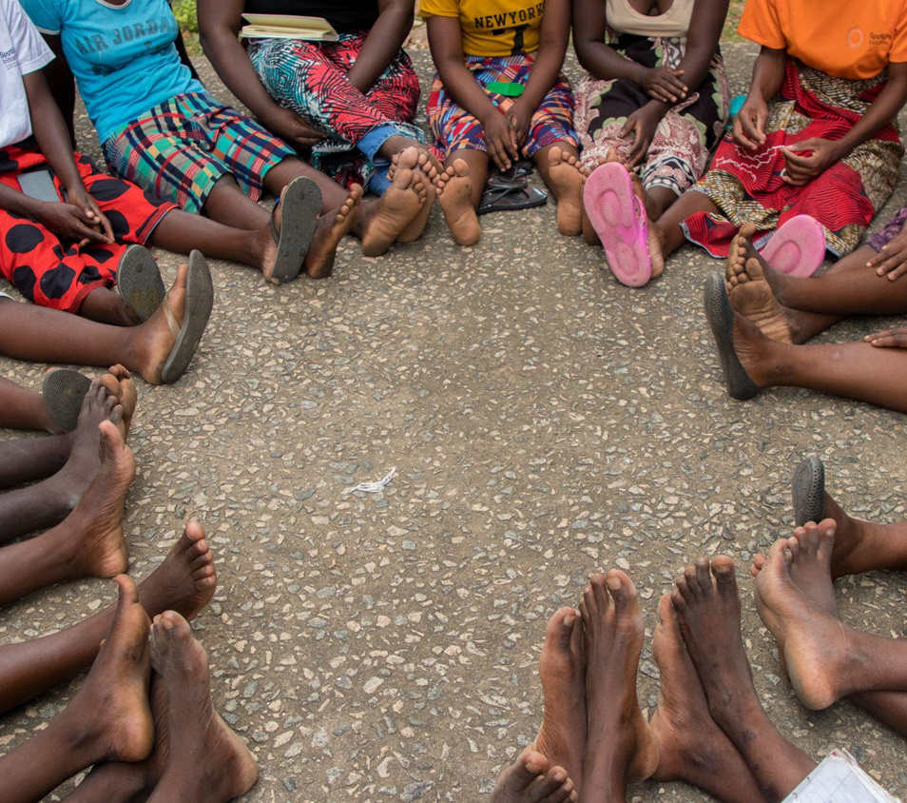
  As front-line health workers, you have a critical role to play in responding to GBV and beginning to restore power to survivors
  This training is just a beginning. Learning and skill-building is an ongoing process. Look for opportunities to:
Final thoughts
Take refresher training on challenging skills and topics
Participate in clinical case reviews
Use job aids as references and reminders
Continue self-directed study
Seek experienced clinicians as mentors
© UNFPA
16.3

Slide 4
  Do not underestimate the importance of LIV(ES) in survivor recovery and healing. It is an essential component of the clinical care package.
  WHO and IASC guidelines, national protocols and agency job aids are frequently updated to reflect the latest evidence and treatment standards. They are valuable resources.
Final thoughts
© UNFPA
16.4

Slide 5

Action planning
Exercise 16.1
Instructions
    Identify specific goals that will strengthen your personal response and/or care for survivors of sexual assault and IPV.
    Use Job aid16a (Post-training action plan) to record your goals. These may be the same as for other members of your group, and/or you may record goals unique to yourself.
    Focus on goals for which you can take actions that are
    within your control.
1
2
3
16.5
Notes:
Facilitator’s notes:
Emphasize the importance of selecting actionable goals.
Encourage a diversity of goals that touch on difference aspects of survivor-centred care.
Walk through a line of the worksheet using an example goal.

Slide 6
Session 16: That’s a wrap!
Thank you !

