Slide 1






Presentation slides
Clinical management of rape and intimate partner violence in emergencies
Training curriculum for health workers
Notes:
Facilitator’s notes: The exclamation mark-in-a-triangle icon highlights slides that require edits for contextual adaptation.
Review the slide and make the necessary adjustments (e.g., updating examples, data, or language).
Remove the icon once edits are complete
In the Notes, what you need to do is preceded by:
> Facilitator Action:

Slide 2

Session 15.
Forensic examination (optional)
15.2

Slide 3
Session objectives
Objective 3: Demonstrate clinical skills appropriate to one’s scope of practice to respond to sexual assault and IPV
Competencies:
Know-how and when to collect forensic evidence
15.3

Slide 4
Foundations in forensics
The importance of clinical examination
Medical evidence is a bridge that links the health and criminal justice systems in the care and management of survivors
Obtain separate consent for collecting forensic evidence, including any photographs
The head-to-toe physical exam is primarily for medical care, but it is also useful for documentation of forensic evidence
Documentation of injuries can provide important evidence regardless of forensic evidence
**
**
This session provides basic information about forensic evidence and documentation only. It does not qualify a provider as a forensic specialist.
15.4
Notes:
Say: Be sure to use standard forensic documentation forms and body maps. Sample forms are provided in Web Annex B. Participant Job aids if not locally available.

Slide 5

Foundations in forensics
If a survivor chooses to go to the police or seek legal action, or may want to do so in the future, it can be important to collect forensic evidence. Also, the law may require it.
The survivor’s health and emotional well-being and safety should be the primary consideration.
A good medical history and detailed description of the sexual assault will guide the physical and forensic examination and evidence collection.
Minimize distress and trauma by combining the physical examination and evidence collection.
15.5
Notes:
Say: You will recall that counselling on options, availability and likelihood of finding forensic evidence based on time elapsed since the assault should all be part of your informed consent work with the survivor (and caregiver if the survivor is a child).

Slide 6

Laws and regulations guiding medico-legal services
for clinical management of rape
Who can serve as an expert witness in court?
What is the minimum training required for a provider’s report
and specimens to be upheld in a court of law?
What are the storage and chain of evidence requirements?
15.6
Notes:
> Facilitator Action: Complete the following questions prior to this session with information specific to your participants’ training context.

Slide 7
Laws and regulations guiding medico-legal services
for clinical management of rape
What forms and labels must be completed for documentation?
At what age can a survivor consent to forensic
evidence collection?
Are there laws governing marital rape?
15.7
Notes:
> Facilitator Action: Complete the following questions prior to this session with information specific to your participants’ training context.

Slide 8
Why collect forensic evidence?
The importance of clinical examination
Medical evidence is a bridge that links the health and criminal justice systems in the care and management
of survivors
However, if there are no means to analyse this evidence, then it is not recommended to routinely collect forensic evidence
15.8

Slide 9
Guiding principles
  The survivor’s health and emotional well-being and safety should be the primary consideration. In many emergency contexts, forensic evidence collection will not be appropriate.
  The account of the assault and the activities and time elapsed since then will determine the specimens to collect.
  Careful labelling, documentation and storage (to avoid contamination) are essential for medico-legal evidence.
  It is important to not conclude whether evidence of sexual activity indicates rape or whether it does not. That is for courts to establish.
15.9
Notes:
Say: Minimize distress and trauma by combining the physical examination and evidence collection.

Slide 10
Types of evidence
  Clothing (especially underwear)
  Blood and urine samples (e.g. to assess covert or non-consenting drug administration)
  Hair, if suspicion of drug administration
  Specimens where biological material containing DNA may have been deposited: skin, hair, mouth, vagina and anus
  Photographs – to document injuries
  Visible foreign objects
  Visible foreign biological material (e.g. skin scrapings under the survivor’s nails)
15.10

Slide 11

  The provider’s job is to collect, document and store evidence thoroughly and without contamination, to enable a credible chain of evidence and forensic analysis/report. Forensic samples are transferred to specialty laboratories for analysis.
  Forensic lab reports are forwarded to the investigating officer(s) and/or legal teams and brought before a court during judicial proceedings.
  Evidence is not collected for the police but for the court as a means to access justice for the victims.
Forensic analysis
15.11
Notes:
Say: Forensic labs (usually a government chemist) must be accredited and certified.

Slide 12

When to collect
Maximum times for collecting evidence after assault:
        Skin, including bite marks – 72 hours
        Mouth – 12 hours
        Vagina – up to 5 days
        Anus – 48 hours
        Urine (toxicology) 50 ml – up to 5 days
        Blood (toxicology) 2 × 5 ml samples – up to 48 hours in tubes containing sodium fluoride and potassium oxalate
Remember:
Only medico-legal evidence that can be collected, stored and analysed should be gathered
Analysis of forensic evidence requires specialist laboratories and technicians and is not available in many contexts
15.12
Notes:
Say: Do not collect or offer to collect forensic samples if too much time has passed since the assault. As indicated by the maximum time passage before evidence becomes unreliable, survivors who present for care more than a few days after an assault will rarely qualify for biological evidence collection. Rigorous documentation of injuries and client history can still provide important records for the survivor.

Slide 13
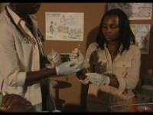
Skills in action: forensic examination
© International Rescue Committee and University of California – Los Angeles. 2008.
15.13
Notes:
Facilitator’s notes:
In advance of the session, download this video: https://www.youtube.com/watch?v=TU6vNcttaW4
As you can see, each type of sample or specimen requires a different procedure for collection. As a front-line worker who is not a forensic specialist, it is most important that you know when forensic examination may be possible, when it is required, and when to refer a survivor to a forensic clinic prior to conducting a physical examination or washing wounds yourself.

Slide 14
Collection
Deciding whether to proceed with forensic sample collection prior to beginning the examination will enable you to preserve as much evidence as possible
  Use sterile or very clean drop cloths, table drapes and absorbent sheets to ensure capture of any and all debris from the survivor’s hair or clothing
  Store all evidence in paper bags, not plastic, to preserve biological evidence
  Collect samples such as skin or nail scrapings over a clean cloth and place collection swabs or scrapers as well as the cloth in the evidence bag with that sample
  Always follow laboratory guidance and protocols regarding specific specimen collection tubes and procedures
15.14
Notes:
Say:
Only medico-legal evidence that can be collected, stored, analysed and used should be gathered, and only with the full informed consent of the survivor.
The general appearance and functioning of the survivor (demeanour, mental status, drug effects, cooperation) should be documented, as well as the identity of the examiner and the date/time/location of the examination.
Any limitations to the examination (lighting, cooperation etc.) should also be documented.
All recent and old injuries should be recorded and described in detail, recording any pertinent negative findings.
The survivor should be given a detailed explanation of the findings and their treatment and follow-up.

Slide 15
The following practices must be followed when handling/storing forensic specimens:
  Protect the exhibit from weather and contamination (i.e. a room or cupboard/closet with minimal or no human or animal traffic, humidity control, etc.)
  Use sterile instruments and containers
  Wear gloves (powder-free and sterilized) and protective gear when appropriate
  Change gloves when handling/collecting different specimens
  Package, transport and store exhibits safely and securely
  Take special care with fragile and perishable specimens
  Call on an expert if you lack adequate training to handle a particular type of specimen
Handling and preservation of evidence
15.15

Slide 16

Storage and documentation
  Each unique specimen and specimen site must be placed in a unique evidence bag
  Biological samples should be completely dry before closing and sealing the evidence bag
  Each bag must be marked with specimen information – time, date, patient name/ID number, nature and site of collection
  Document in the examination record:
any limitations to the examination (e.g. poor lighting)
each body site or injury from which a specimen was collected, and whether or not a photograph was taken
detailed descriptions of all wounds and injuries
15.16

Slide 17
Chain of custody
  This refers to the process of obtaining, preserving and conveying evidence through accountable tracking mechanisms from the community, health facility and finally to the police
  It also refers to a paper trail where the movement of evidence is traceable through the different persons in the chain of sample collection, analysis, investigation and litigation
15.17

Slide 18
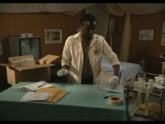
Video
Preparation, storage and dissemination of evidence
© International Rescue Committee and University of California – Los Angeles (2008)
15.18
Notes:
Facilitator’s notes:
In advance of the session, download this video: https://youtu.be/3YmAkBTq9vg
Once more, in many cases you will not be collecting forensic evidence. However, if you are called on to participate in or manage collection of forensic evidence, here is a high-level overview of principles and techniques to preserve the quality of evidence.

Slide 19
Documenting wounds and injuries
Feature | Notes
Classification | Clinical wound type: abrasion, contusion, laceration, gunshot, incised wound, etc.
Site | Anatomical position and location
Size | Measure and record dimensions (length, height, width)
Shape | Describe the shape in geometric terms (linear, curved, irregular, semicircular, etc.)
Surrounds | Note the condition of the surrounding or nearby tissues (e.g. bruised, swollen)
Colour | Particularly relevant when describing bruises, as can give indication of age
Contents | Note the presence of any foreign material in the wound (e.g. grass, glass, dirt, fingernails)
Course | Note indications of impact or infliction directionality, if trained to do so. If not, inclusion of photographs and/or careful documentation of changes in depth and borders along the length of an injury will help review by the forensic laboratory.
Age | Comment on any evidence of healing. Never try to estimate or record a quantitative age, as this is impossible to determine from physical examination by even advanced providers.
Borders | Note the characteristics of the edges of wounds (e.g. jagged, angled, vertical)
Depth | Give an indication of depth of the wound. If measurement is not possible, provide an estimate and note that it is an estimate.
15.19
Notes:
Say: Note the addition of wound course notation for full forensic documentation. Developing the skill and experience to evaluate course of impact or wound infliction is beyond the scope of this training. Unless you have separately been trained and qualified in forensic and/or medico-legal evaluation, stick to thorough description and documentation.
We covered basic wound types in Session 10. However, in the course of a full forensic examination you may be called on to document more specific injury types if assisting a forensic examiner.

Slide 20
Blunt force trauma
  Laceration-tissue bridge
  Contusion-haematoma, petechiae, bite marks
  Abrasions/glazes
  Bruises, e.g. tramline injuries, scratch, ligature marks, finger imprints
  Fracture
Sharp force trauma
  Incisional wound (cut), e.g. by use of a knife; can be superficial or deep
  Penetrating incised wound (stab)
  Chop wounds – heavy instrument with at least one cutting edge
Types of injuries
15.20
Notes:
Say: Tramline injuries reflect the object used to inflict the injury and most commonly present as areas of contusion with undamaged tissue in the middle. This can indicate blunt force trauma with an object such as a bottle, rod, rectangular implement, etc.
Ligature marks reflect strangulation or restraint with a cord, rope, chain or other tight wrapping. They are most commonly seen around the neck, wrists or ankles.
Chop wounds reflect injury inflicted with a heavy/bulky object that also has at least one sharp edge. As a result, injuries will have characteristics of both blunt force trauma and sharp trauma such as puncture or laceration/incision.

Slide 21
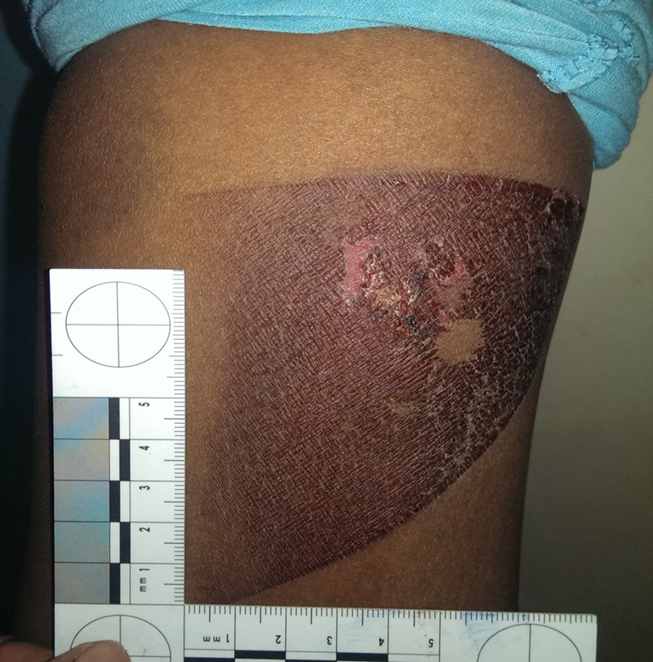
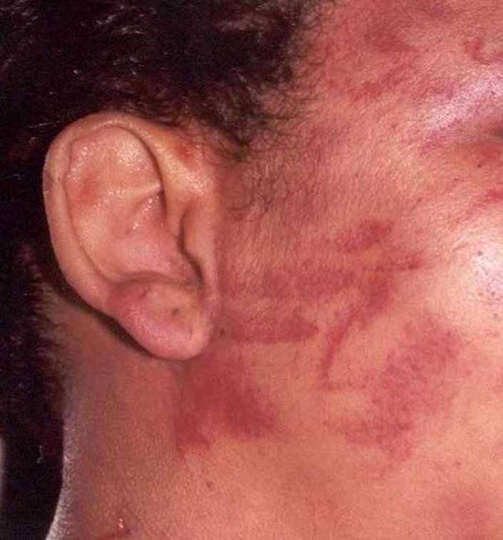
Thermal injuries could be caused by hot objects or hot liquids, radiators or irons
Corrosive injuries could be caused by chemicals
Imprint contusions could be caused by prolonged restraint or gripping with fingers, ropes or other objects
Types of injuries
15.21
Notes:
Say: You may be accustomed to seeing lacerations, contusions and abrasions. Intentional violence can leave more defined marks. Some examples that are more commonly seen following physical or sexual gender-based violence include: fingerprint contusions, burns in defined shapes matching the object used, or ligature abrasions and contusions from restraints used.

Slide 22

  Penetrative sexual activity of the vagina, anus or mouth rarely produces any objective signs of injury.
  The hymen may not appear injured even after penetration has occurred. Hence, the absence of injury does not exclude penetration. The health practitioner cannot make any comment on whether the activity was consensual or otherwise.
A note on penetration injuries
15.22
Notes:
Say:
A note on terminology:
In general forensics, the term “penetrative injury” refers to any injury deep enough to fully transcend the epidermis and compromise muscle, tendon or bone. In cases of sexual violence, the term “penetration injury” specifically refers to injuries inflicted from the act of forced penetration.
When transcribing for a forensic examiner or making your own notes, it is important to distinguish between a penetrative/penetrating injury and a penetration injury.

Slide 23
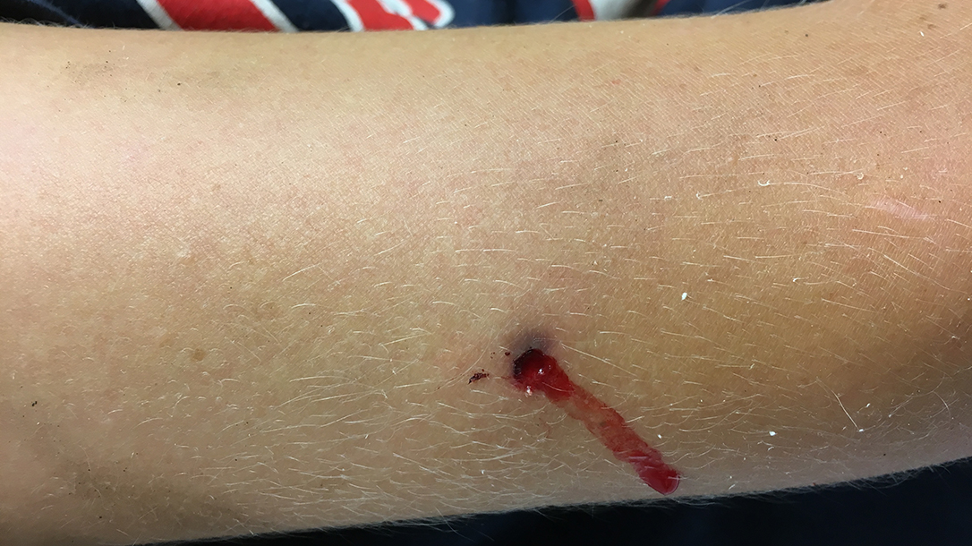
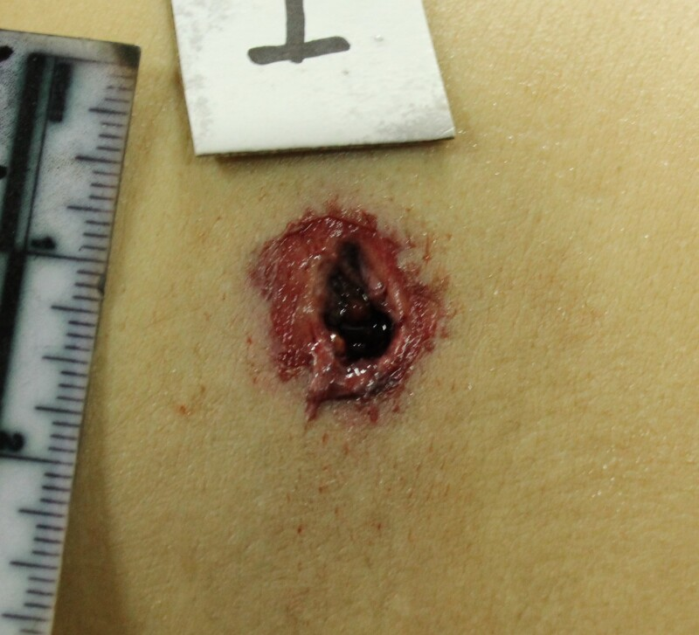
Documenting wounds and injuries
© Will Dabbs
© Shrestha et al. (2023).¹ CC BY-NC-ND 4.0.
15.23
Notes:
Say: Avoid documenting suspected causes of injury unless you have been specifically trained to do so.
For example, if you are trained to do so, you might note a bullet entry wound versus a bullet exit wound. If not trained to make such determination, you might note: compound trauma including 9 mm wide, deep puncture wound surrounded by an abrasion ring on right posterior forearm. Dark, “sooty” colouration around the edges. Border smooth. Mark site of wound on pictogram and include a photo. Collect and properly store a swab sample of the dark particulate matter. Second deep puncture wound 1 cm proximate to elbow on right anterior forearm. Irregular wound borders with tissue protrusion. Microlacerations at 2, 3 and 7 o’clock. Mark site of wound on pictogram and include a photo.
Exit wound image source: Shrestha R, Kanchan T, Krishan K. Gunshot Wounds Forensic Pathology. [Updated 2023 Apr 17]. In: StatPearls [Internet]. Treasure Island (FL): StatPearls Publishing; 2023 Jan-. [Figure, Figure 2 - Exit wound...] Available from: https://www.ncbi.nlm.nih.gov/books/NBK556119/figure/article-22464.image.f2/
Entry wound image source: Will Dabbs, MD. Retrieved from: personal collection.

Slide 24
Medical record
Photo-documentation
Ensure photographs do not allow direct identification of the individual. Use a confidential code system to allow authorized staff to identify the individual and note when photographs were taken.
Documentation type
  Not forensic evidence
  May still be submitted into judicial proceedings
  Consists of the history, observed/diagnosed injuries and pathologies, and any treatment provided
  May be considered forensic evidence
  Record details of any photos obtained (including date, time, location of photo subject) and any subsequent editing or cropping of digital images
  Make certain that notes, photographs and other records are held securely and only accessed by authorized individuals
15.24
Notes:
Say: As per the country’s laws, photographs may be used to document any injuries as long as one ensures confidentiality. This can be part of general medical records OR a forensic medical file.
Photographs intended for inclusion in the forensic examination report and/or submitted as forensic evidence will need to meet certain standards for quality, lighting, angle, credentials of photographer, etc.

Slide 25
Documentation type
  Medical certificate
  It is a legal requirement for some countries
  It is a confidential medical document
  It is often the only material evidence available
  It is completed by a clinical service provider
  One copy is offered to the survivor, and one copy is locked with the file depending on the country’s law
  Hand it over with the consent of the survivor to legal services or organizations with a protection mandate
15.25
Notes:
Say: If the survivor is living with the perpetrator, bringing home written proof of having been treated for violence may place her at further risk. Counsel carefully when offering the survivor a copy of the medical certificate or other documentation.

Slide 26
Two types of witnesses:
  A fact witness may be compelled to testify if they have some knowledge due to direct observation. A treating doctor may be compelled to testify about their contact with a patient regardless of forensic training or skill.
  A treating doctor usually has more credibility than a non-treating doctor.
  Expert witnesses are persons who have facts directly related to some science or profession beyond the scope of the average lay-person
  (e.g. blood-spatter expert).
Role of health-care professionals
in evidence presentation in court
1
2
15.26

Slide 27

In court
“If the law has made you a witness, remain a man of science. You have no victim to avenge, or guilty or innocent person to ruin or save.
You must bear testimony within the limits of science.”
– Paul Brouardel
15.27
Notes:
Facilitator’s notes:
Brouardel – French physician and one of the early champions of forensic medicine.

Slide 28
Lose your temper
Answer questions you don’t fully understand
Speak beyond the facts of the case you evaluated and treated
Allow a zealous attorney to manipulate you
Share your feelings or speculation
If called to testify in court
DO
DO
DON’T
Trust your clinical notes and experience
Remain calm and project confidence
Take time to consider your answers
Fully explain the clinical facts that
you heard, saw and treated
Stick to the science
15.28
Notes:
Say: While you may never have been called to testify in court, as a health-care provider delivering first-line support for sexual violence and IPV, it is a possibility. Particularly in cases where the assault being prosecuted took place during a humanitarian emergency, there is a high likelihood that the court day and your subpoena for testimony will occur a long time after the service encounter in which you saw the survivor.

Slide 29
Session 15: That’s a wrap!
  Collect forensic evidence ONLY when:
        The survivor wants to go to the police or it is mandatory by law
        The survivor is being examined within 5 days of the assault
        The provider is trained in forensic examination and
        A qualified forensic science laboratory is available
Separate consent is needed for a forensic examination
The assault history guides forensic evidence collection
Time elapsed and activities undertaken after the incident will determine whether evidence can be found
Storage that avoids contamination, labelling and detailed documentation are essential
Health workers may need to provide testimony; they cannot conclude whether evidence points to rape – that is for the courts to establish
15.29
Notes:
Say: Perform a head-to-toe examination, but NO vaginal/“two-finger test”.

Slide 30
Reference
Shrestha R, Kanchan T, Krishan K. Gunshot wounds forensic pathology. In: StatPearls [Internet]. Treasure Island: StatPearls Publishing; 2023 (https://www.ncbi.nlm.nih.gov/books/NBK556119/). Licence: CC BY-NC-ND 4.0.

