Slide 1






Presentation slides
Clinical management of rape and intimate partner violence in emergencies
Training curriculum for health workers

Slide 2
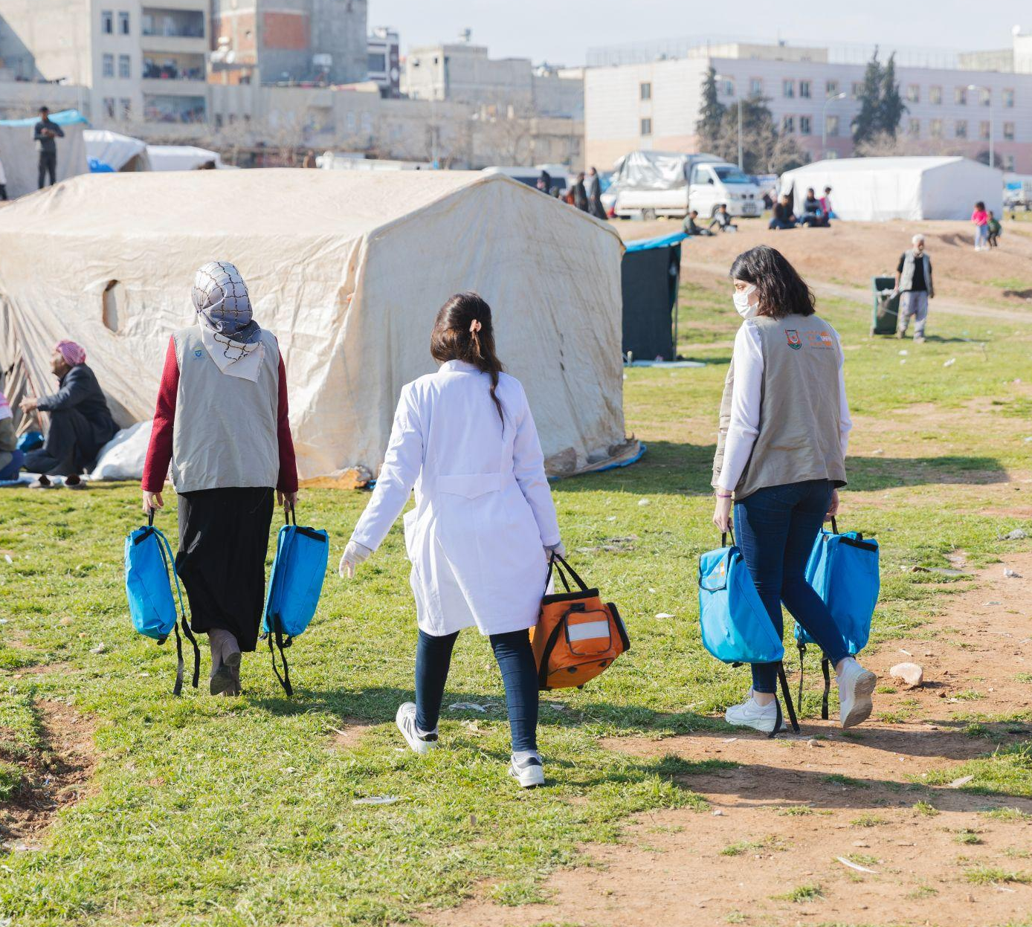
Session 14.
Clinical simulation
© UNFPA
14.2
Notes:
Facilitator’s notes:
It is recommended that you give participants advance notice about the Session 14 clinical simulation, as this helps them anticipate and prepare for it.

Slide 3
Session objectives
Objective 2: Demonstrate behaviours and understand values contributing to safe and supportive services
Objective 3: Demonstrate clinical skills appropriate to one’s scope of practice to respond to sexual assault and IPV
Competencies:
Demonstrate clinical judgement to respond to survivor wishes and needs
Demonstrate understanding of limitations to services offered to survivors in specific contexts
14.3

Slide 4
Session 14: That’s a wrap!
Developing clinical skills requires practice
The more you practise, the more comfortable and skilled you will become
It is important to continue practising and obtaining feedback from colleagues and supervisors
14.4

