Slide 1






Presentation slides
Clinical management of rape and intimate partner violence in emergencies
Training curriculum for health workers

Slide 2
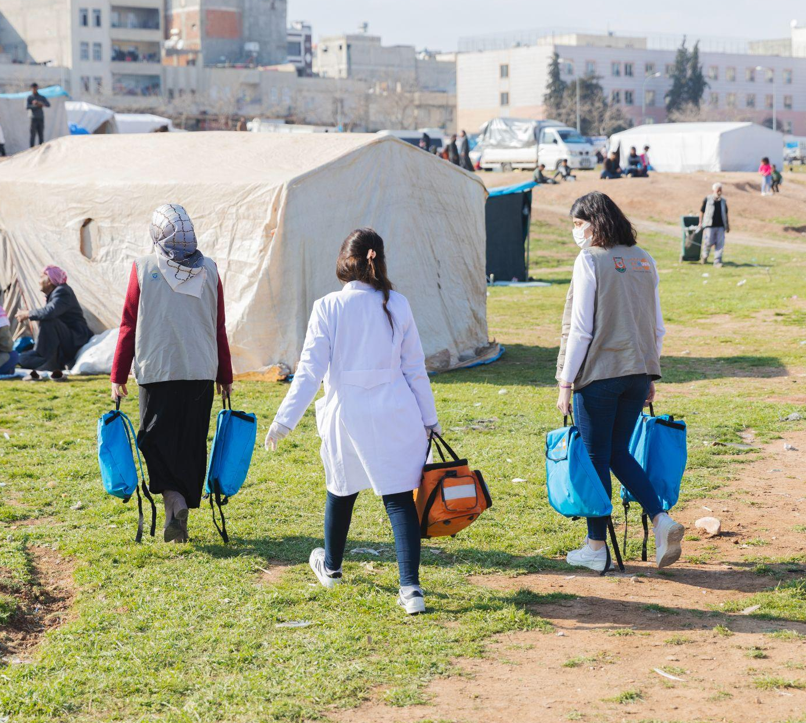
Session 13.
Self-care and
preventing burnout
© UNFPA
13.2

Slide 3
Session objectives
Objective 4: Demonstrate knowledge of how to access resources and support for patients and for oneself
Competencies:
Know how to access and practise self-care in a crisis setting
Know how to support health worker colleagues who may be facing vicarious trauma from working with survivors or emergency-related stress in their own lives
13.3

Slide 4

Self- and collective care for providers
Your emotional health is important, too
You may have strong reactions or emotions when listening to or talking with survivors about sexual violence and IPV...
…especially if you have experienced it yourself
Be aware of your own emotions
Get the help and support you need for yourself
Support colleagues in taking care of themselves, too
Be compassionate with yourself and your colleagues
13.4
Notes:
Say: Just as with survivors, the stress of responding to sexual violence and IPV is compounded by the stress of the emergency you are working in.
It’s important to note that your supervisors, health system managers, organization of employment, and others, have a critical role to play in and responsibility for preventing burnout and creating enabling environments for mental health and psychosocial support for health-care providers. However, this session will focus on individual steps you can take towards self-care as well as collective care among colleagues.

Slide 5
Work culture risks
The pressure to respond to the overwhelming needs of the population
you are caring for can lead to harmful social norms among
health-care professionals.
Common results of such norms include:
Working through breaks
One-upmanship among colleagues in relation to who
has slept the least
Minimizing personal stress or ill health in comparison
to patients
Feeling guilt or shame over engaging in pleasurable rest time and/or activities
Be compassionate with yourself and your colleagues
13.5
Notes:
Say: Just as with survivors, the stress of responding to sexual violence and IPV is compounded by the stress of the emergency you are working in.

Slide 6
Protective habits
Rejuvenating physical/sensory activities – exercise, listening
to or playing music, bathing, massage or other bodywork
Social recreation – spending time with loved ones,
shopping, playing with children, laughing
Expression of difficult experiences – talking,
drawing, collaging or writing
Spiritual meaning-making – prayer, personal ritual,
study of scripture or philosophic texts
Cognitive support – mantras, self-talk, visible affirmation in your
home, office or exam room
Be compassionate with yourself and your colleagues
13.6
Notes:
Facilitator’s notes:
Ask for a few volunteers to share habits they have cultivated that are useful for managing the stress of our jobs.

Slide 7
Signs of work stress
Disengagement
Blunted emotions, overly detached
Hopelessness
Loss of motivation
Anxiety disorders
Extreme urgency and hyperactivity
Depression
13.7

Slide 8
Responding when dysfunctional stress
and/or coping emerges
Ask for time off. A well-timed shift trade or long weekend can go a long way towards reversing early stages of dysfunctional stress reactions.
Speak up. If you notice signs of dysfunctional stress or burnout in a colleague, don’t be afraid to approach them with compassion. Ask if they are okay. Offer some social time away from work.
Reach out for help. Many organizations working in or coordinating emergency response will have in-person or tele-health mental health and psychosocial support services available for providers.
13.8

Slide 9
Making a collective care plan
Exercise 13.1
13.9
Notes:
Facilitator’s notes:
Divide participants into small groups. Group formation will vary based on participant make-up.
If multiple participants come from the same point of service and/or organization, cluster colleagues together. Otherwise, cluster them randomly using a count-off method.
Groups of 4–8 are ideal, but this can be adjusted up or down.
Explain to participants that they will have 15 minutes to work in a small group and brainstorm concrete actions they can and will take upon return home/to deployment to improve self-care and prevent collective burnout. They should take written notes for themselves.
If ideas require support from a supervisor, they should determine action steps for bringing the ideas and requests to the supervisor’s attention.

Slide 10

13.10
Notes:
Facilitator’s note: Serotonin-producing image for projection during Exercise 13.1 – Making a collective care plan. Swapping the happy sloth for a locally relevant image is an option.
See notes in the Facilitator’s Guide for this self-guided “exercise”.

Slide 11
Session 13: That’s a wrap!
Be aware of your own emotional needs
Practise self-care through stress-reduction exercises, and seek professional help when needed
Look out for your colleagues and invite them to look out for you
13.11

