Slide 1






Presentation slides
Clinical management of rape and intimate partner violence in emergencies
Training curriculum for health workers
Notes:
Facilitator’s notes: The exclamation mark-in-a-triangle icon highlights slides that require edits for contextual adaptation.
Review the slide and make the necessary adjustments (e.g., updating examples, data, or language).
Remove the icon once edits are complete
In the Notes, what you need to do is preceded by:
> Facilitator Action:

Slide 2

Session 12.
Mental health and psychosocial support (MHPSS)
© UNFPA
12.2

Slide 3
Session objectives
Objective 3: Demonstrate clinical skills appropriate to one’s scope of practice to respond to sexual assault and IPV
Objective 4: Demonstrate knowledge of how to access resources and support for patients and for oneself
Competencies:
Know how to provide basic mental health and psychosocial support (MHPSS)
Know about available referrals for MHPSS
12.3

Slide 4

MHPSS as a core need for survivors
Most survivors who have experienced sexual assault and/or IPV experience symptoms of emotional distress
Human stress responses can begin as functional, healthy coping responses, but under prolonged and/or extreme stress, reactions may negatively impact health and well-being
In most cases, transient signs of distress will improve over time if the survivor has and is receiving practical and emotional support
12.4

Slide 5

FRONT
BACK
12.5
Notes:
Ask participants to come up and place a sticky note on the part of the body where they feel stress.

Slide 6
Stress reactions
Functional
Dysfunctional
Improved focus, alertness and reaction times
Increased oxygen to the brain and large muscle groups
More awake hours to mitigate the source of stress
Hooks and triggers
Insomnia
Hypertension
Increased risk of pre-term and low-birth-weight pregnancy outcomes
Depression
Suicidal thoughts or actions
12.6
Notes:
Say: Stress reactions – both functional and dysfunctional – are physiological, affecting basic bodily processes as well as mood and behaviour.
Discussion of hooks and triggers, as well as the more extreme reactions defined on the next slide, are best reserved for training groups with more advanced skills and experience. Focus on the general concept that a physiologic reaction such as alertness can be functional (awake to deal with source of stress/risk) or dysfunctional (insomnia).

Slide 7
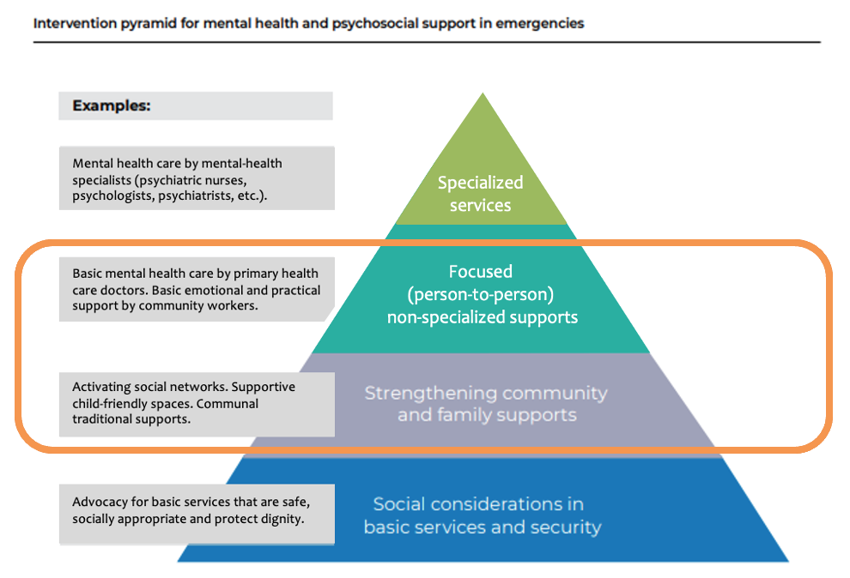
Everyone deserves support in times of chronic or severe stress
Intervention pyramid for mental health and psychosocial support in emergencies¹
© Inter-Agency Standing Committee
12.7

Slide 8
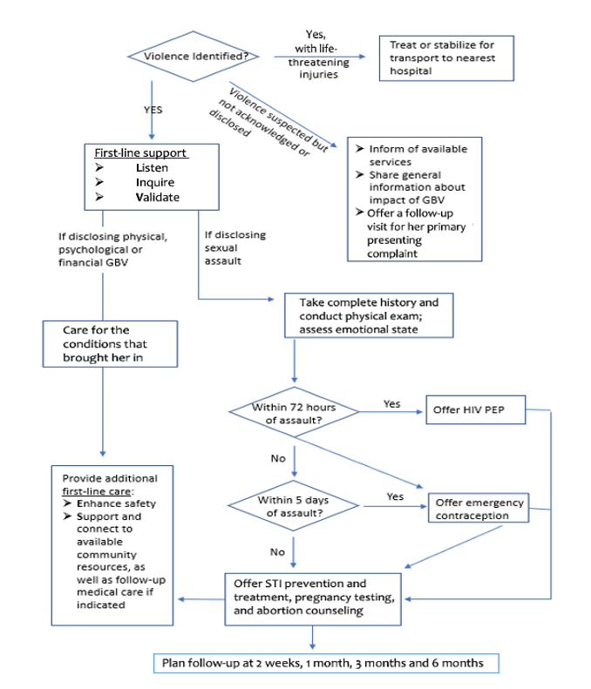
Providing MHPSS
in first-line support
The clinical history, provision of LIVES, and follow-up visits should all include assessment of mental health, provision of basic mental care, and referral for more serious conditions when needed
12.8

Slide 9
Basic mental health care and psychosocial support
More pronounced coping reactions are normal and OK until the person is in a place and time of relative safety
Help strengthen their positive coping methods
Explore the availability of social support
Teach and demonstrate stress-reduction exercises
Make regular follow-up appointments for further support
12.9
Notes:
Facilitator’s notes:
Say: There are specific ways you can offer help, and techniques you can teach to women to help them reduce stress and heal.
Mental health recovery is going to be limited until the individual is in a place of relative safety and stability.
Be mindful of multiple stressors that survivors living in emergencies are dealing with. In addition to the stress of IPV or sexual violence, they may be dealing with grief from loss of loved ones, separation or displacement, anxiety over security threats, etc.
Ask for suggestions for positive coping before moving to the next slide.

Slide 10
Strengthen positive coping
Encourage and help the survivor to:
Take small, simple steps
Build on their own strengths and abilities
Continue usual activities
Engage in relaxing activities and stress-reduction exercises
Keep a regular sleep schedule
Engage in regular physical activity
Avoid self-prescribed medications, alcohol or drugs
Return if she has thoughts of self-harm or suicide
Return if these suggestions are not helping
12.10
Notes:
Say:
Remember the Do No Harm principles.
Help the survivor to consider environmental risks that may limit their options for physical activity.
Support the survivor to identify new activities or daily routines that may help manage stress if they have been recently displaced or relocated.

Slide 11
Encourage and link to social support
Encourage and help the survivor to:
Connect with family and friends; if the survivor has been separated from family and friends, link to community support groups or other more formal social networks
Identify people who she trusts and likes – spending time with them can help her feel connected and supported
Participate in community and religious activities or other activities where she feels supported
Collaborate with social workers, community organizations or other known referrals when available
12.11

Slide 12
Observe, reflect back and support
It is important not to jump to giving advice or trying to solve every problem. Survivors are facing many challenges outside their control.
Focus on identifying the survivor’s biggest mental health and psychosocial challenges.
12.12
Notes:
Facilitator’s notes:
Say: Helping survivors identify specific MHPSS challenges begins the journey of giving them more agency and self-determination in their healing. It can also help you as a provider to identify the types of support and care that will be most helpful.
Is she struggling to take care of her hygiene, food intake or hydration?
Are her moods erratic and uncontrollable?
Is she experiencing panic attacks, hyperventilation or other signs of severe anxiety?
Is she having thoughts about hurting herself or others, or struggling with intrusive memories or flashbacks of the incident(s) of violence?
For each of these mental health and psychosocial support issues, ASK participants: What might they focus on in terms of help?

Slide 13

Stress reduction techniques
Exercise 12.1
Stress-reduction exercises offer basic psychosocial support and mental health care and can be taught to patients or used by health workers themselves
12.13

Slide 14

Stress reduction techniques
Exercise 12.1
Try to keep your eyes closed. Sit with your feet flat on the floor.
First, relax your body. Shake your arms and legs, and let them go loose. Roll your shoulders back, and move your head from side to side.
Put your hands on your belly. Think about your breath.
Slowly breathe out all the air through your mouth, and feel your belly flatten. Now breathe in slowly and deeply through your nose, and feel your belly fill up like a balloon.
Breathe deeply and slowly. You can count 1–2–3 on each breath in and
1–2–3 on each breath out.
Keep breathing like this for about 2 minutes. As you breathe, feel the tension leave your body.
12.14
Notes:
> Facilitator Action: Replace these instructions with the guidance for Option B, depending on which you choose to demonstrate in the training (both are provided in Job aid 12a, so participants can refer to that in their own time).

Slide 15
Assessing for mental health conditions
that necessitate a referral
Imminent risk of suicide or self-harm
Some health workers fear that asking about suicide may provoke the survivor to self-harm
On the contrary, talking about suicide often reduces the survivor’s anxiety around suicidal thoughts and helps her feel understood
If she has:
Current thoughts or a plan to commit suicide or to harm herself or
A history of thoughts or plans for self-harm in the past month or acts of self-harm in the past year, and she is now extremely agitated, violent, distressed or uncommunicative …
then there is immediate risk of self-harm or suicide, and she should not be left alone
Refer her immediately to a specialist or emergency health facility
12.15
Notes:
Facilitator’s notes:
Say: While the majority of your patients will not require specialized care, it is VITAL that you assess for more severe conditions that do pose imminent risk and/or necessitate referral.
Emphasize the importance of follow-up visits and care for the first few months following sexual assault or disclosure of IPV for ongoing assessment of moderate-to-severe conditions necessitating referral.
Allow a few minutes for discussion of how to manage this need for follow-up care in contexts where displacement/mobility/migration is high.

Slide 16

Assessing for mental health conditions
Depression
Depression is a common mental health condition. As health workers, you have an important role to play in overcoming the stigma and misinformation many people have about mental health disorders.
There are many management options front-line health and care workers can offer patients.
If a survivor is interested in medication, referral to a specialist is recommended.
12.16
Notes:
Facilitator’s notes:
Video available at: https://www.youtube.com/watch?v=hdR8cyx2iYU
Note: Video is in Arabic with English subtitles.

Slide 17

Assessing for mental health conditions
Depression
Assess if she has experienced the following for at least 2 weeks:
  Persistent depressed mood
  Marked diminished interest in or pleasure from activities previously enjoyed
  Sleep disturbances
  Changes in appetite
  Sense of worthlessness or guilt
  Fatigue, loss of energy
  Reduced ability to concentrate or sustain attention on tasks
  Indecisiveness
  Observable agitation or restlessness
  Talking and/or moving slower than usual
  Hopelessness about the future
  Suicidal thoughts or acts
  Difficulty functioning in daily life
12.17
Notes:
> Facilitator Action: If working with inexperienced providers, consider hiding and omitting this slide and simply encouraging referral if the provider is worried about the survivor’s mental health at the 2-week follow-up visit.
Facilitator’s notes:
If using this slide: It is important to remember that more severe mental health disturbances, including depression and PTSD, do not manifest immediately. If you are treating a survivor in the first 5–7 days after an assault, you will not be able to assess for either disorder. Mental health and psychosocial support needs assessments are often more relevant during follow-up care.
Participants can use Job aid 12b as needed to assess survivors for depression.

Slide 18
Assessing for mental health conditions
Do not routinely prescribe benzodiazepines for insomnia
Do not prescribe benzodiazepines or antidepressants
for acute distress
Cautions
12.18
Notes:
> Facilitator Action: If working with inexperienced providers, consider hiding and omitting this slide and simply encouraging referral if the provider is worried about the survivor’s mental health at the 2-week follow-up visit.
Facilitator’s notes:
If using this slide: It is important to remember that more severe mental health disturbances, including depression and PTSD, do not manifest immediately. If you are treating a survivor in the first 5–7 days after an assault, you will not be able to assess for either disorder. Mental health and psychosocial support needs assessments are often more relevant during follow-up care.
Participants can use Job aid 12b as needed to assess survivors for depression.

Slide 19
Assessing for mental health conditions
Post-traumatic stress disorder (PTSD)
      Characteristic PTSD symptoms are:
      Re-experiencing
      Avoidance
      Heightened sense of current threat
Only a fraction of sexual violence and IPV survivors will develop PTSD
Many survivors will experience these symptoms, but they will improve on their own in the weeks following an assault
PTSD cannot be assessed or diagnosed in the first month following an incident
Follow-up visits are important!
12.19
Notes:
Say: PTSD may present non-specific symptoms such as irritability, persistently anxious mood, or multiple persistent physical symptoms with no clear physical cause (e.g. headaches, pounding heart).
Re-experiencing: repeated and unwanted recollections of the violence, as though it is occurring in the here-and-now
Avoidance: deliberate avoidance of thoughts, memories, activities or situations that remind the survivor of the violence
Heightened sense of current threat: excessive concern and alertness to danger or reacting strongly to unexpected sudden movements.
If persistent symptoms consistent with PTSD are identified at the 1-, 3- or 6-month follow-up visit, or if the patient is presenting more than 1 month after an assault, make every effort to refer to a specialist.
Participants can refer to Job aid 12c regarding assessment of PTSD.

Slide 20
Treating and managing PTSD
      Educate the survivor about PTSD, including about common feelings, fears, recollections, physical problems, the role of treatment, etc.
      Strengthen her social support and teach stress management
      Consult a specialist
      Offer regular follow-up: a second appointment within 2–4 weeks and subsequent appointments depending on the course of the disorder
12.20
Notes:
Say: It is ENOUGH to provide education and offer basic mental health care. If no specialists are available at the present time, let the survivor know that specialists may become available as the emergency progresses to a recovery phase. Referrals can be made during any follow-up visit.

Slide 21
Role play on provision of basic mental health care
Exercise 12.2
A five-step approach to offering basic mental health care
Support the survivor to:
Name or identify the stress reaction or coping
manifestation that is bothering them
Describe the context of the problem
Brainstorm solutions
Prioritize solutions
Make an action plan
  ➢➢➢ Repeat for additional problems
12.21
Notes:
Say: Remember – this is not about identifying or solving the underlying cause of the stress or distress. Rather, it is about finding strategies to manage and improve their mental and emotional well-being.
Facilitator’s notes:
Remind participants that the goal of basic mental health care is not to give survivors a solution that might work for the health worker, but to help the survivor identify a healthy strategy for managing/mitigating their own distress symptoms and the impacts that are troubling them the most.

Slide 22
Role play on provision of basic mental health care
Exercise 12.2
      Form pairs
      “Provider”: Use the five-step problem-solving approach
        Practise teaching stress-reduction techniques if identified in the solution brainstorm
        Help the person determine how they will remember and seek support for following up on their action plan
      “Patient”: Seek support for a real-life stress reaction that is difficult for you to manage or disrupting your well-being
12.22
Notes:
Facilitator’s notes:
Remind participants that the focus is on problem-solving for management of dysfunctional stress reactions, not solving the underlying issue for which there may be no solution at this time.
IN PLENARY:
Ask for a few volunteers to share how it felt to provide basic mental health care. Was it hard? Did it feel like they could do this in the course of a normal clinic day?
Ask for a few volunteers to share how it felt to receive basic mental health care.

Slide 23
Session 12: That’s a wrap!
Even in emergencies, front-line providers can offer basic mental health and psychosocial support (MHPSS)
Basic psychosocial support includes stress-reduction exercises
Assess survivors with continuing mental health symptoms for suicide or self-harm risk, moderate-to-severe depression and PTSD
Manage conditions or refer survivors to mental health specialists
12.23

Slide 24
Reference
IASC Reference Group on Mental Health And Psychosocial Support in Emergency Settings. IASC guidelines on mental health and psychosocial support in emergency settings. Geneva: Inter-Agency Standing Committee; 2007 (https://interagencystandingcommittee.org/sites/default/files/migrated/2020-11/IASC%20Guidelines%20on%20Mental%20Health%20and%20Psychosocial%20Support%20in%20Emergency%20Settings%20%28English%29.pdf).

