Slide 1






Presentation slides
Clinical management of rape and intimate partner violence in emergencies
Training curriculum for health workers
Notes:
Facilitator’s notes: The exclamation mark-in-a-triangle icon highlights slides that require edits for contextual adaptation.
Review the slide and make the necessary adjustments (e.g., updating examples, data, or language).
Remove the icon once edits are complete
In the Notes, what you need to do is preceded by:
> Facilitator Action:

Slide 2

Session 11.
Clinical care for survivors of sexual
assault, part 3:
treatment and care
11.2

Slide 3
Session objectives
Objective 3: Demonstrate clinical skills appropriate to one’s scope of practice to respond to sexual violence and IPV
Competencies:
Know how to provide appropriate treatment/care to survivors of sexual assault, including child and adolescent survivors
11.3

Slide 4
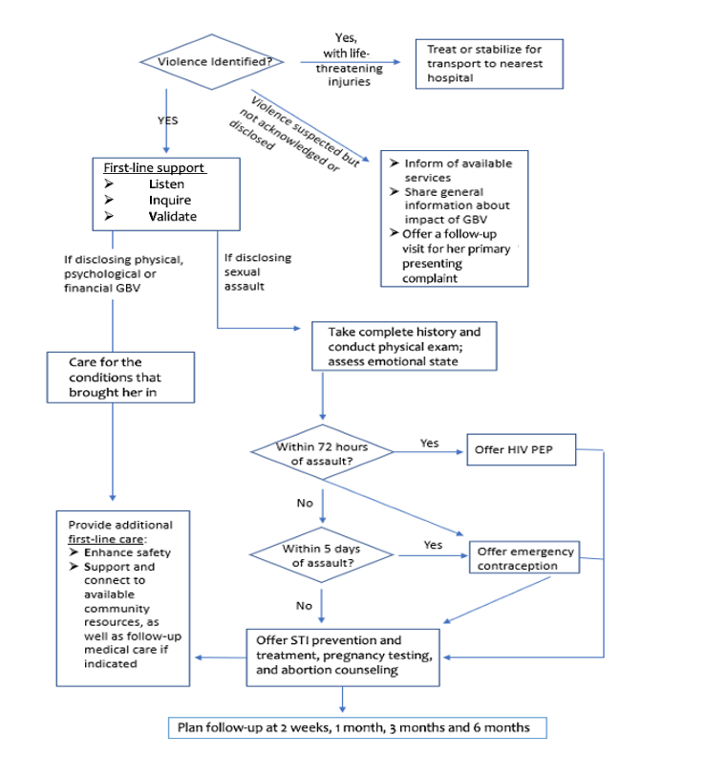
Treating injuries
Urgent hospitalization is required if there is:
Extensive injury
Neurological deficits
Respiratory distress
Swelling of joints on one side of the body (septic arthritis)
Less severe injuries can usually be treated on site
11.4
Notes:
Say: While the treatment flow shows provision of early steps in first-line support prior to treating injuries, it is critical to recognize signs of potential life-threatening conditions and stabilize and/or transfer promptly if identified.
If, during initial intake, clinical history review or at any time during the visit, you suspect a critical or life-threatening injury, stop and evaluate, stabilize and treat or transport as needed.

Slide 5
Treating injuries
Tetanus
It has an incubation period of 3–21 days but can be many months
Refer the survivor to the appropriate level of care if you see signs of a tetanus infection
If the person has not been fully vaccinated, vaccinate immediately, no matter how long it has been since the incident
If there remain major, dirty, unhealed wounds, or the survivor is HIV-positive, consider giving tetanus immunoglobulin* if it is available
  * Tetanus immunoglobulin requires cold chain without freezing, which is rarely
  available in low-resource or crisis settings
11.5
Notes:
Say: Provide indicated first aid or refer if injuries are beyond your scope of practice to treat. This may include basic cleaning and bandaging, suturing and/or provision of antibiotics to treat infections.

Slide 6
Oral emergency contraception pills (ECPs)
Offer an ECP to all women who have been raped
ECPs will not harm girls. They can be offered to girls who have attained menarche (i.e. post-menarche), as well as those in the beginning stages of puberty (i.e. Tanner stage 2 or 3; see Job aid 11a)
There is no need to screen for health conditions or test for pregnancy
Say: “Return if your next menstrual period is more than 1 week late”
ECPs are effective for up to
5 days after sexual assault
Spotting or bleeding a few days after taking an ECP is normal
ECPs can be taken at the same time as antibiotics for STIs and PEP for HIV prevention
See CMRIPV
Annex 7
11.6
Notes:
Facilitator’s notes:
May cause nausea and vomiting. If the survivor vomits within 2 hours after taking an ECP, she should return for another dose as soon as possible.
EC is EXTREMELY SAFE and will not harm an existing pregnancy. When in doubt, provide EC.
EC can be offered to girls who have attained menarche (i.e. post-menarche), as well as those who are in the beginning stages of puberty (i.e. have reached Tanner stage 2 or 3) without any restrictions, as long as they reported within 120 hours (5 days) of the rape (see CMRIPV p. 39, guideline Part 3, Step 5).

Slide 7
Counselling on oral ECPs
ECPs will not cause abortion. If she is already pregnant, ECPs will not harm the pregnancy.
ECPs will not prevent pregnancy the next time she has sex.
ECPs are not meant for regular use. More effective continuing contraceptive methods are available.
A pregnancy test may show if she was already pregnant. She can have a test if she wishes, but it is not necessary before taking an ECP.
For those who are already pregnant as a result of rape, discuss options including for accessing safe abortion to the full extent of the law.
11.7

Slide 8
Emergency contraception (EC) regimen options
Oral ECP – No need to test for pregnancy prior to administration
Copper intrauterine device (IUD) – Rule out pregnancy before insertion
Available from IARH Kit 3A or 4
  Ulipristal acetate or levonorgestrel recommended
  1.5 mg single dose
  or
  combined estrogen–progestogen – 2 doses of 100 μg ethinyl estradiol plus 0.5 mg levonorgestrel, 12 hours apart
Do no use hormonal intrauterine system (IUS) for EC
Active STIs are a contraindication
Also effective for up to 5 days (120 hours) post-incident
Requires a trained provider to perform the insertion, which requires use of a speculum
11.8
Notes:
Facilitator’s notes:
See Annex 7 of the CMRIPV Guideline.
Annex 7 of the Guidelines for developing protocols in humanitarian emergencies contains detailed protocols for EC.
If official EC packs are not available, you can provide EC doses from oral contraceptives that are likely to be present in your facility’s family planning clinic.

Slide 9
Offer PEP for HIV prevention
Test for HIV. Do not give PEP to those who test positive for HIV.
PEP should be started as soon as possible, up to 72 hours after possible exposure to HIV.
Choose drugs based on national guidelines/current WHO antiretroviral (ARV) guidelines.
A 28-day prescription of ARVs should be provided.
Available from IARH Kit 3B
11.9

Slide 10
When to test and when to give PEP
Situation | Recommended procedure
Perpetrator is HIV-positive or status unknown | Give PEP
Survivor’s HIV status is unknown | Offer HIV testing and counselling
Survivor is unwilling to test | Give PEP; plan follow-up
Survivor is HIV-positive | Do not give PEP
Survivor has been exposed to blood or semen | Give PEP
Survivor was unconscious and cannot remember what happened | Give PEP
Survivor was gang-raped | Give PEP
11.10

Slide 11
Counselling for PEP
Discuss
Whether HIV is common in that setting
Whether she knows if the perpetrator is HIV-positive
That PEP lowers the chances of HIV infection but is not 100% effective
That half of people who take PEP have side-effects (nausea, tiredness, headaches); for most, these decrease after a few days
Also:
Tell her that the medicine must be taken daily for 28 days
Encourage retesting for HIV at 3 or 6 months, or both
If the test result is positive:
    Refer her for HIV treatment and care
Ensure follow-up at regular intervals
11.11
Notes:
Facilitator’s notes:
You may also want to discuss with the survivor:
whether there was more than one perpetrator
whether the exam found lacerations.

Slide 12
Offer STI prophylaxis/treatment
Test if a lab is available, even if treating for STIs
Give antibiotics to prevent or treat these STIs: chlamydia, gonorrhea, trichomonas and, if common in the area, syphilis
Also give preventive treatment for other STIs common in the area (such as chancroid)
Give the shortest courses available in the national protocol
Available from IARH Kit 5
11.12
Notes:
Facilitator’s notes:
Say: Treatment protocols vary depending on available medications and local epidemiology trends.
Say: Ensure providers have syndromic management job aids in the work sites. If they do not prior to training, consider providing job aids and distributing them during this session.
The 2014 Clinical Handbook includes a sample template on page 53.

Slide 13

Prevent hepatitis B and offer human papillomavirus
(HPV) vaccination if age-appropriate
Has she been vaccinated against HPV?
No or does not know, age 9–14 | 1- or 2-dose schedule
No or does not know, age 15–20 | 1- or 2-dose schedule
No or does not know, immunocompromised, any age, including HIV-positive | 2- or 3-dose schedule
Yes | No need to re-vaccinate
Follow local protocols based on vaccines available in your country/setting. WHO recommendations (December 2022) provide alternate reduced dose options.¹
11.13
Notes:
Say: Hepatitis B and HPV vaccines are not always available, and not every country includes them in essential medicine formularies. If they are unavailable, proceed with other treatments as indicated.

Slide 14
Special considerations for STI prophylaxis/treatment
and PEP for children
  Tolerance of side-effects and completion of treatment regimens may be more challenging for children and adolescents
Involve a safe and trusted adult in treatment
Be mindful of whether crushing or chewing a medication is contraindicated
For adolescents with mobile phones, encourage the use of reminder alarms
Offer a follow-up in a few days to discuss the management of side-effects
Ensure they understand the instructions for missed doses
11.14

Slide 15
HPV vaccination
Offer HPV vaccination to children and adolescents aged 9–14, if they were not previously vaccinated
HPV and hepatitis B vaccinations can be administered at the same visit, ensuring that different injection sites are chosen and different syringes are used
11.15
Notes:
Say: Offer and administer HPV vaccination in accordance with national guidelines.

Slide 16
Discuss self-care and plan follow-up care
Explain the summary of examination findings and given or agreed-upon treatments
Invite her to voice questions and concerns
Explain the importance of completing the course of medication
Discuss likely side-effects and what to do about them
Care of injuries
Show how to care for any injuries
Describe signs and symptoms of wound infection; ask her to return if these signs develop
Treatment of STIs
Discuss signs and symptoms of STIs; advise her to return if they occur
Advise her to avoid sexual intercourse until STI treatments are finished
11.16

Slide 17

Plan follow-up care
Encourage follow-up visits
Important to check progress of wound healing
Re-test for STI and HIV
Rule out unintended pregnancy
Monitor emotional/psychological recovery
Safe abortion care
        In many restrictive legal environments, induced abortion is permissible in cases of rape
        Know your local laws
        If a survivor learns during an initial
        visit that she is pregnant as a result
        of sexual violence, offer a follow-up
        visit sooner than 2 weeks
Available from IARH Kit 8
11.17
Notes:
> Facilitator Action: This slide should be updated based on context-specific abortion laws.
Facilitator’s notes:
Ask participants: What are the barriers (e.g. policy requirements) that may delay women and girls from accessing abortion services?
Particularly in contexts where induced abortion is only permitted in the very early weeks of a pregnancy, timely counselling can be critical to maintain access to this rights-based service.
Counselling regarding safe, induced abortion should be provided immediately following a positive test and indication from the survivor that the pregnancy is not desired – to the limits of local laws.
Women who received a positive pregnancy test result should be offered a follow-up visit within the week to discuss and counsel further on options.
Medications used for medical abortion (i.e. misoprostol and mifepristone) are available from IARH Kit 8 – packaged for post-abortion care. Medical abortion induced with misoprostol-only is approved and indicated in settings where mifepristone is not available.

Slide 18
Accessing essential medications in emergencies²
This is primarily a responsibility of the crisis response coordinator, health-zone manager or other health system administrators
Your first-line medications and protocols may change; be on the lookout for adapted guidance
Commodities may be procured through humanitarian response mechanisms and arrive as kits from UNFPA as part of the MISP for SRH
11.18

Slide 19
Sexual assault treatment decisions – case studies
Exercise 11.1
Each group should select a rapporteur to present back to plenary
Groups have 7 minutes per case study to discuss and fill out tables describing treatments to prescribe, tests to do and referrals to make and why
After groups reconvene in plenary, rapporteurs will present one of their case studies (in 3–4 minutes) and explain their decisions
11.19

Slide 20
Session 11: That’s a wrap!
Immediate treatment includes first-line support and, as needed, referral to other mental health services, treatment of injuries, EC, HIV PEP, STI prophylaxis, hepatitis B and HPV prevention, and comprehensive abortion care to the fullest extent of applicable law
Treatment for rape/sexual assault depends on whether the survivor presents within the first 72–120 hours
Many elements of first-line support can and should still be provided after this critical window; offer LIVES, including appropriate referrals even after 5 days have elapsed
Providers need to determine the history of the assault and what has happened since then, to arrive at a decision about which tests to run and treatments to offer
11.20

Slide 21
References
Human papillomavirus vaccines: WHO position paper (2022 update). Weekly epidemiological record, no. 5. Geneva: World Health Organization; 2022 (https://iris.who.int/bitstream/handle/10665/365350/WER9750-eng-fre.pdf).
Minimum initial service package for sexual and reproductive health: Interagency field manual of reproductive health in humanitarian settings. New York: United Nations Population Fund; 2020 (www.unfpa.org/sites/default/files/resource-pdf/MISP-Reference-English.pdf).

