Slide 1






Presentation slides
Clinical management of rape and intimate partner violence in emergencies
Training curriculum for health workers

Slide 2

Session 10.
Clinical care for survivors of sexual
assault, part 2:
physical examination and documentation
10.2

Slide 3
Session objectives
Objective 3: Demonstrate clinical skills appropriate to one’s scope of practice to respond to sexual assault and IPV
Competencies:
Know how to conduct an examination of a female or male survivor of sexual assault, including awareness of special considerations for different age groups
Know how to document sexual assault in a safe and confidential manner
10.3

Slide 4
Steps for clinical management of rape
Step 1
Listen, inquire about needs/concerns, and validate the survivor
Step 2
Obtain informed consent and prepare the survivor
Step 3
Take the history
Step 4
Perform the physical and genito-anal exam
Step 5
Provide treatment
Step 6
Enhance safety and refer for additional support
Step 7
Assess mental health and provide psychosocial support
Step 8
Provide follow-up care
10.4
Notes:
Say: In EVERY SINGLE encounter, the survivor’s history and wishes must guide the encounter and exam. If there was no rape or no indication that a genito-rectal exam is needed, do NOT conduct one.
Prior to beginning the exam, ensure your examination and treatment room has all the necessary supplies.

Slide 5
Performing the physical examination
Begin by reminding the survivor that the physical exam is to help you identify all injuries or health issues that can be treated.
Say at the beginning and repeat throughout that the survivor is in control and can pause or stop the exam at any time.
Proceed in a systematic fashion: Record all your findings and observations as clearly and completely as possible on a standard examination form, using pictograms.
Keep the survivor as covered as possible at each stage. Drapes allow you to easily uncover a single part of the body at a time.
At each step, tell her what you are going to do, and ask permission before you do it.
Always look at the survivor before you touch her and pay attention to her appearance and emotional state.
Only ask the survivor to endure a single examination. Health providers designated to collect forensic evidence should minimize stress by collecting evidence during the physical examination, ensuring beforehand that survivor consent has been obtained.
10.5

Slide 6

Performing the physical examination
    If any of the following complications are identified, pause the exam and admit the person to hospital:
  Extensive injury (to genital and/or anal region, head, chest or abdomen)
  Neurological deficits (e.g. cannot speak, problems walking)
  Respiratory distress
  Swelling of joints on one side of the body
  Fever and sepsis
10.6

Slide 7
Performing the physical examination
    If a survivor presents
    more than 72 hours after an assault
Be sure to assess and record standard vitals including pulse, temperature, respiratory rate and blood pressure
Take note of the survivor’s mental and
emotional state (e.g. withdrawn, crying, calm, partial memory recall)
Measure any observed injuries:
Document location, size, type and depth as precisely as possible using pictograms;
Include notation of coloration of observed contusions
A thorough physical examination remains important for documenting and treating injuries. Assess for:
size and colour of any bruises or scars
evidence of loss of hearing, partially healed fractures, abscesses, etc.
signs of pregnancy
signs of mental illness (PTSD, depression, suicidal thoughts)
10.7
Notes:
Say: Particularly in settings where forensic services are not available or not operational, a complete exam record may be called upon in the future by the survivor and/or judicial services. It is important that all providers of clinical management of rape know the basics of thorough documentation of findings. Comprehensive documentation is also important for follow-up care and to enable monitoring of healing and recovery.
Use the survivor’s history to ensure close observation of areas of the body likely to have come into contact with the ground, the perpetrator or foreign objects or weapons used by the perpetrator(s).
Remember to look in the eyes, nose and mouth (inner aspects of lips, gums and palate, in and behind the ears, and on the neck).
Look for signs that are consistent with the survivor’s story, such as bruises, bite and punch marks, marks of restraints on the wrists, patches of hair missing from the head, or perforated eardrums, which may be a result of being slapped.
If the survivor reports being throttled or choked, look in the eyes for petechial haemorrhages and on the neck for bruises or finger marks.
Examine the body area that was in contact with the surface/ground on which the sexual violence occurred, to see if there are injuries.

Slide 8
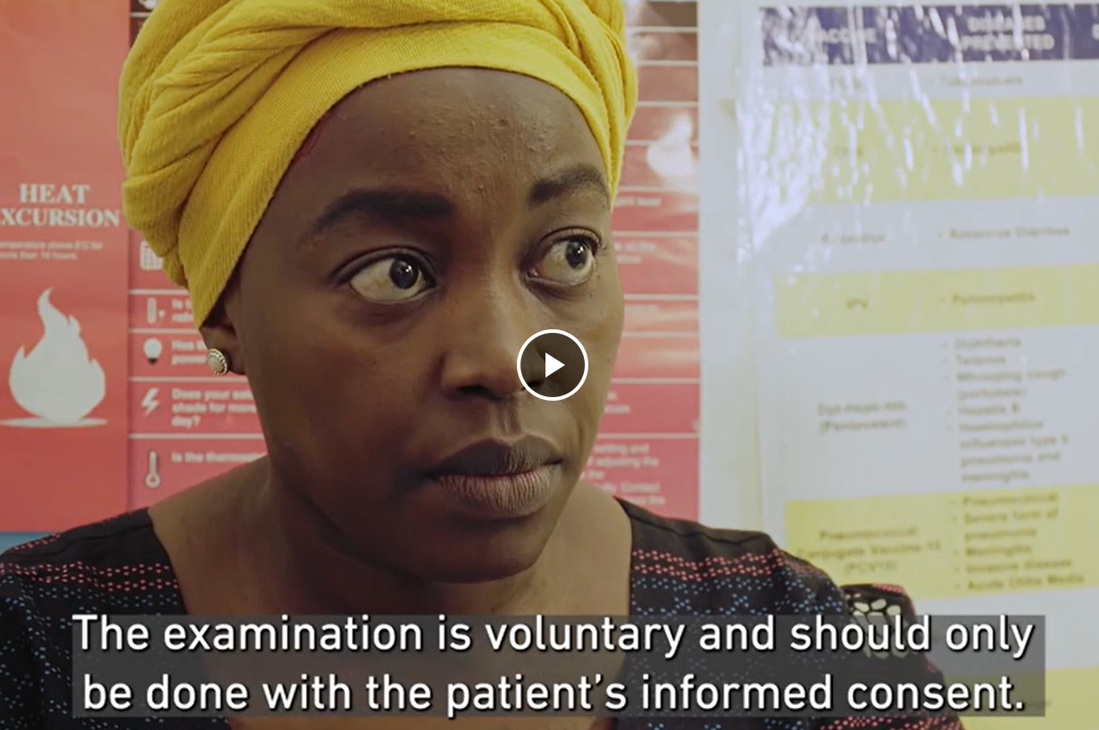
Skills in action – physical examination
Allow the survivor’s account of events to guide your examination
10.8
Notes:
Facilitator’s notes:
In advance of the session, download this video: https://rescue.app.box.com/s/r5w6pfxzqdvgyg87lroagisa5i5sio03/file/1121629627416
Play the video at this time.
Make time for questions and reflection from participants after the video ends.

Slide 9
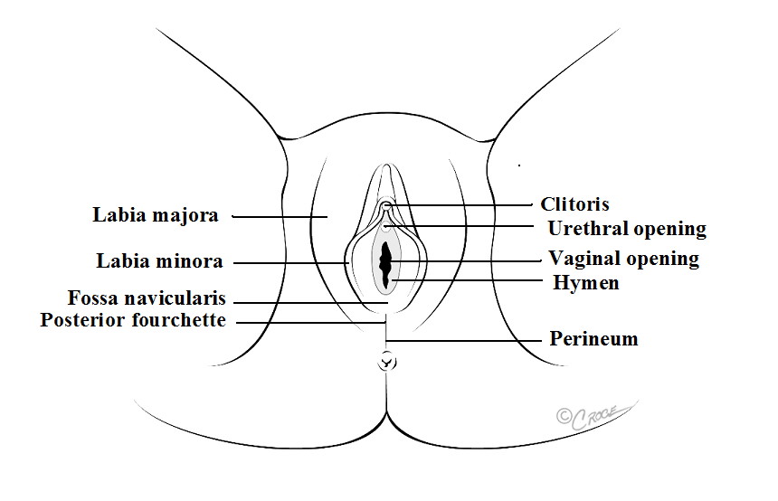
Physical examination of the genitals
Matted, sticky pubic hair may be seminal or body fluid
Be aware of injuries from blunt trauma to the external and internal genitalia, including abrasions, bruising and lacerations
Posterior fourchette is a common site of injury
(acute mounting injury)
Vaginal bleeding, other than menses, is an indication for further evaluation and possible specialist consultation
Anus
    Note: Moderate to severe genital lacerations can cause lasting and serious complications; evaluate for 3rd or 4th degree lacerations, fistula and/or anal injuries as clinical history and findings indicate
10.9

Slide 10
Physical examination of the genitals
Steps for vagino-cervical examination
  Following visual examination of external genitalia, repeat information about what an internal examination will entail and verbally reconfirm consent to proceed. Remind the survivor they can request a pause or stop at any time.
  Gently insert a speculum, preferably warm, lubricated with water or normal saline. Lubricants are not recommended as they may interfere when collecting samples.
  Under good lighting, inspect the cervix, then the posterior fornix and the vaginal mucosa for trauma, bleeding and signs of infection.
  If collecting forensic evidence, take swabs and collect vaginal secretions according to the local evidence collection protocol.
  If indicated by the history and the examination findings thus far, do a bimanual examination and palpate the cervix, uterus and adnexa, looking for signs of abdominal trauma, pregnancy or infection.
IMPORTANT!
An internal, speculum examination is very sensitive and should be done only if there has been vaginal penetration with the following indications: bleeding, pain, foul-smelling discharge and/or survivor request
1
2
3
4
5
10.10
Notes:
Facilitator’s notes:
Review reasons why hymenal state or so-called virginity testing has no scientific validity and should never be performed or commented upon in documentation.
If there is a specific injury to the hymenal ring, that should be documented just as with all other injuries to the genitalia. It holds no more or less significance than a contusion or laceration on the labia, vaginal fossa, perineum or cervix.

Slide 11
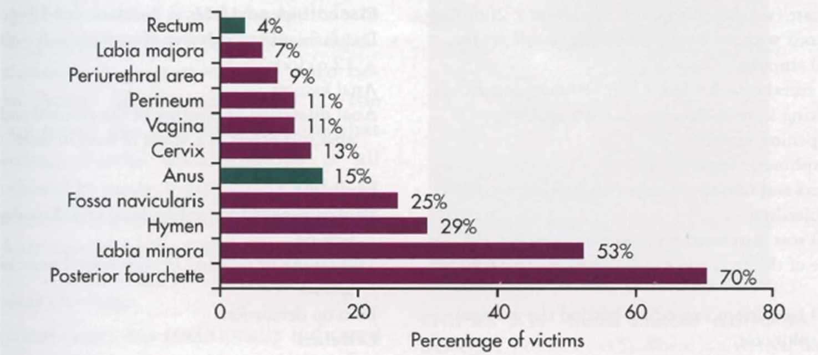
Relative frequency of injury by location in genitalia
in female assault survivors¹
10.11
Notes:
Say: As you can see, among those survivors who do present with identifiable injuries to their genitalia, the labia minora and the posterior fourchette are the two most common locations for injury.

Slide 12
Many survivors of sexual assault have no genital injuries
Possible reasons include:
Delayed examination – healing of injuries occurs quickly
Injury is very small and/or cannot be seen with the naked eye
Tissue fragility (young versus old woman)
The reason does not matter.
Ensure the survivor knows you
still believe her.
10.12
Notes:
Facilitator’s notes:
Other reasons include:
lubrication
freezing and positions (limp or unconscious)
male sexual dysfunction
nature of assault (duration and nature of object)
health and developmental status.

Slide 13
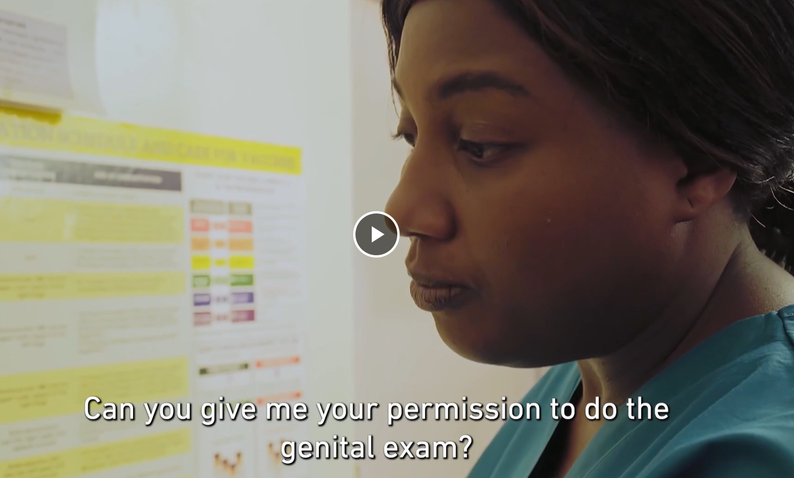
Physical examination of the genitals
If a sexual assault occurred more than 7 days ago and there are no visible injuries on the external genitalia and no client complaints, there is NO indication for internal examination
© International Rescue Committee and Norwegian Church Aid (2022)
10.13
Notes:
Facilitator’s notes:
In advance of the session, download this video: https://rescue.app.box.com/s/r5w6pfxzqdvgyg87lroagisa5i5sio03/file/1121635155164
Play the video at this time.

Slide 14
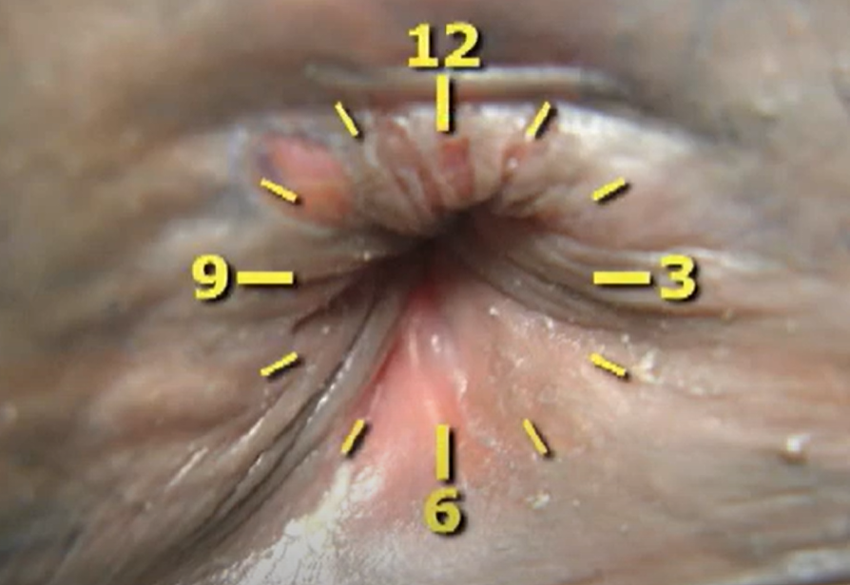
Skills in action: anal examination
Survivors may not always know if anal penetration occurred and may not be aware of injuries that are present
10.14
Notes:
Facilitator’s notes:
Prior to the session, download this video: https://www.youtube.com/watch?v=6XcM_rx4Jh4
Play the video at this time.

Slide 15
Documenting wounds and injuries
Feature | Notes
Classification | Clinical wound type: abrasion, contusion, laceration, gunshot, incised wound, etc.
Site | Anatomical position and location
Size | Measure and record dimensions (length, height, width)
Shape | Describe the shape in geometric terms (linear, curved, irregular, semicircular, etc.)
Surrounds | Note the condition of the surrounding or nearby tissues (e.g. bruised, swollen)
10.15
Notes:
Say: It is useful to record with this level of detail during any physical examination for clinical management of rape, regardless of whether forensic evidence will be sought.

Slide 16
Documenting wounds and injuries (continued)
Feature | Notes
Colour | Particularly relevant when describing bruises as can give indication of age
Contents | Note the presence of any foreign material in the wound (e.g. grass, glass, dirt, fingernails)
Age | Comment on any evidence of healing; never try to estimate or record a quantitative age as this is impossible to determine from physical exam, even by advanced providers
Borders | Note the characteristics of the edges of wound(s) (e.g. jagged, angled, vertical)
Depth | Give an indication of the depth of the wound; if measurement is not possible, provide an estimate and note that it is an estimate
10.16
Notes:
Say: It is useful to record with this level of detail during any physical examination for clinical management of rape, regardless of whether forensic evidence will be sought.

Slide 17
Wound classification
Classification | Characteristics | Common cause
Abrasion | Scraping or removal of the outer layers of skin | Dragging against a rough surface: ground, rope, cement, gravel, etc.
Contusion | Bruising, swelling, discolouration | Blunt force impacts such as slamming against an object, being hit or punched
Laceration | Separation wound extending through the epidermis | Extreme force where skin is already stretched Intentional cuts with a blade or sharp-edged object (incised laceration)
Avulsion | Tear-based wound in which extreme force removes skin and/or muscle from its attachments | May leave skin and/or tissue flaps Often inflicted during physical struggles
Puncture wound | Small visible opening in the dermis; damage below the skin varies widely; depth varies widely and may be difficult to determine | Vertically oriented objects with a sharp end or tip: teeth, screwdrivers, metal nails, glass shards, bullets
10.17
Notes:
Say: It is useful to record with this level of detail during any physical examination for clinical management of rape, regardless of whether forensic evidence will be sought.

Slide 18
Injury description
Exercise 10.1
Detailed accurate description of physical examination findings is valuable for many reasons
Your examination documentation may be the best record available for the survivor to submit should they choose to pursue judicial procedures
Self-care:
The following slides contain close-up images of injuries sustained during sexual violence or IPV
10.18
Notes:
Facilitator’s notes:
Ensure participants have Job aid 10b (Injury documentation checklist) in front of them.
The next slide contains images of injuries sustained during sexual assaults.
You will have 15 minutes to write down comprehensive descriptions of each one, using pictograms.
As you will not have the ability to physically measure these injuries, write down an estimated size, as you would if you had actually measured them.

Slide 19
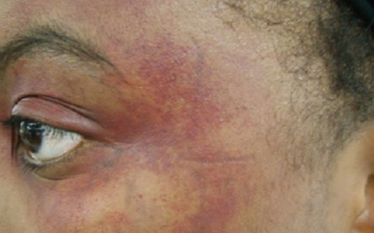
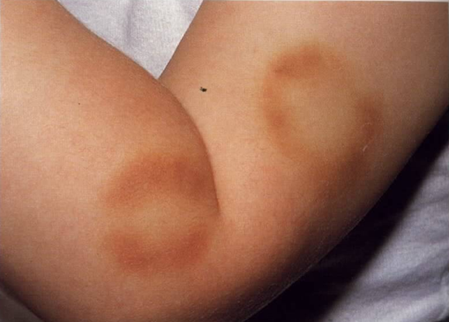
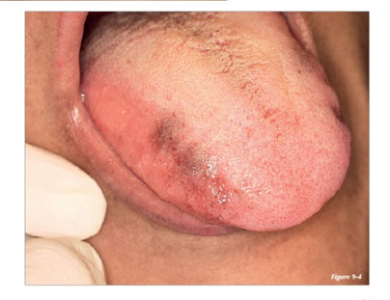
Injury description
Exercise 10.1
10.19

Slide 20
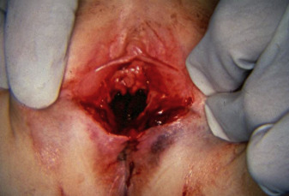
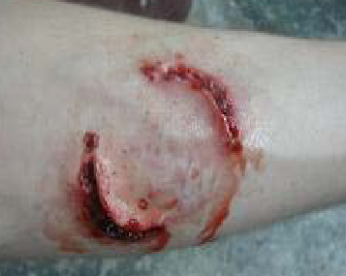
Injury description
Exercise 10.1
10.20

Slide 21

A moment of calm
10.21

Slide 22
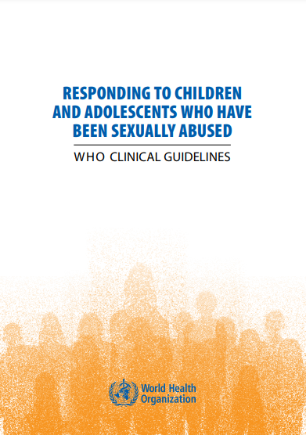
Special population considerations –
history and physical examination
For more information see WHO clinical guidelines²
10.22

Slide 23

Caring for child and adolescent survivors
of sexual violence²
Physical examination
  Have a second trusted/safe adult present for the entirety of the exam
  Use age-appropriate visuals to help explain each step before you proceed
  Offer alternative positioning for the child, including remaining in a chair, sitting on the exam table or lying on their side
  Use drapes and medical gowns to allow the child to remain as dressed/covered as possible through each stage of the exam
  The so-called “virginity” or hymenal intactness test has no scientific validity and is a violation of the survivor’s human rights
10.23
Notes:
Facilitator’s notes:
Caregivers may need education on why hymenal testing is contraindicated and will never be performed.
Hand out the optional printed resource:
Responding to child maltreatment: a clinical handbook for health professionals. Geneva: World Health Organization; 2022. https://iris.who.int/bitstream/handle/10665/361272/9789240048737-eng.pdf?sequence=1.
Direct participants to pages 32–40, either in the printed document or the online resource.

Slide 24
Caring for child and adolescent survivors
of sexual violence
Genital examination
Use paediatric examination instruments and adapted body postures to minimize physical discomfort
Supine positioning without lithotomy is most commonly appropriate when conducting genital exams in preadolescent children
Avoid digital or bimanual examination to evaluate anal sphincter tone and/or vaginal tone
Internal pelvic examination should be reserved only for specific clinical necessity in the paediatric survivor
Only if medically necessary
10.24
Notes:
Say: The genital examination of the prepubertal child is principally an external visualization. For girls, note the location of any fresh or healed tears in the vulva, introitus and vagina by holding the labia at the posterior edge between index finger and thumb and gently pulling outwards and downwards. Instrumentation is rarely necessary.
Speculums or anoscopes and bimanual examinations of the vagina or rectum of a prepubertal child are not routinely required. Do not carry out a digital examination to assess vaginal orifice size or anal sphincter tone. A speculum may be used only when you suspect a penetrating vaginal injury and internal bleeding. Depending on the setting, the child may need to be referred to a higher level of health care. If the use of a speculum is required, use the smallest size possible. Occasionally, examinations may need to be done under general anaesthesia, but this should only occur for health indications. For boys, check for injuries to the frenulum of the prepuce, and for anal or urethral discharge.

Slide 25
Male survivors of sexual violence
Special considerations
Most perpetrators of sexual violence against men and boys are men
Be aware that any laws criminalizing sodomy or homosexuality may make survivors even more fearful about seeking help
Sexual violence (especially conflict-related sexual violence) may be used as a means to undermine traditional masculinity among perceived enemy communities, e.g. forced witnessing
10.25

Slide 26
Male survivors of sexual violence (continued)
Providing first-line response
Know the importance of understanding and separating physical from sexual orientation, attraction or identity acts: male physiology can result in erection and ejaculation during sexual assault
    Note:
    Torsion of the testes is a medical emergency requiring immediate surgical referral
Remember confidentiality, the concept of “do no harm”
and other guiding principles; unless required to do so by local laws,
you should only report sexual violence against men and boys to police
if the survivor chooses that path
Recto-genital examination is still important for male survivors;
bleeding from the anus that does not resolve in a few hours may require
specialist evaluation and treatment
10.26
Notes:
Say: When a man is raped anally, pressure on the prostate can cause an erection and even orgasm, which can contribute to feelings of shame and self-blame. Reassure the survivor that, if this has occurred during the rape, it was a physiological reaction and was beyond his control.

Slide 27

Skills in action: caring for male survivors
© International Rescue Committee and University of California, Los Angeles (2008)
10.27
Notes:
Facilitator’s notes:
In advance of the session, download this video: https://www.youtube.com/watch?v=PZZSwxStgjM&feature=youtu.be
Play the video at this time.
Make time for questions and reflection from participants after the video ends.
Facilitate a brief discussion (5–10 minutes) about how this interaction went differently from the videos we have seen where the survivor was a woman. Prompts include the following:
What did you notice that was different about the survivor’s verbal behaviour?
What about differences in the survivor’s body language?
What did you notice that the provider did differently?

Slide 28
Special considerations for older women
Post-menopausal women who have been vaginally raped are at increased risk of vaginal tears and injury, and transmission of STIs and HIV
Decreased hormonal levels following menopause result in reduced vaginal lubrication and a thinner and more friable vaginal wall
Use a thin speculum for genital examination
If the only reason for the examination is to collect evidence or to screen for STIs, consider inserting swabs only without using a speculum
10.28

Slide 29
Documenting examination findings
Exercise 10.2
Use active listening and age-appropriate communication to “conduct” a physical examination
At each stage of the exam, the “survivor” will tell you their findings
Be sure to document appropriately in Job aid 10c
10.29
Notes:
Facilitator’s notes:
Conduct this exercise in plenary. Each participant should use Job aid 10c to document the findings shared by the “survivor” (the lead facilitator should take this role). ​
​
Call on participants one at a time to verbally signal what each next step of the exam should be. Encourage the use of verbal consent and active listening throughout. ​

Slide 30
Sessions 10: That’s a wrap!
Clinical history informs and shapes the examination and treatment
Obtain consent separately for each aspect of the exam, and verbal permission to proceed at each step of the physical and recto-genital exam
The absence of physical evidence does not mean that violence did not occur
Collect forensic evidence only when minimum requirements are met, and if you have the legal authority to do so in your setting
Men experience sexual violence too; the incidence increases in conflict settings
There are specific considerations for examination of children and adolescents who have experienced sexual violence
10.30

Slide 31
References
Slaughter L, Brown CR, Crowley S, Peck R. Patterns of genital injury in female sexual assault victims. Am J Obstet Gynecol. 1997;176(3):609–16 (https://doi.org/10.1016/s0002-9378(97)70556-8).
Responding to children and adolescents who have been sexually abused: WHO clinical guidelines. Geneva: World Health Organization; 2017 (https://iris.who.int/handle/10665/259270). Licence: CC BY-NC-SA 3.0 IGO.

