Slide 1






Presentation slides
Clinical management of rape and intimate partner violence in emergencies
Training curriculum for health workers
Notes:
Facilitator’s notes: The exclamation mark-in-a-triangle icon highlights slides that require edits for contextual adaptation.
Review the slide and make the necessary adjustments (e.g., updating examples, data, or language).
Remove the icon once edits are complete
In the Notes, what you need to do is preceded by:
> Facilitator Action:

Slide 2
Session 0.
Welcome and introductions
0.2

Slide 3
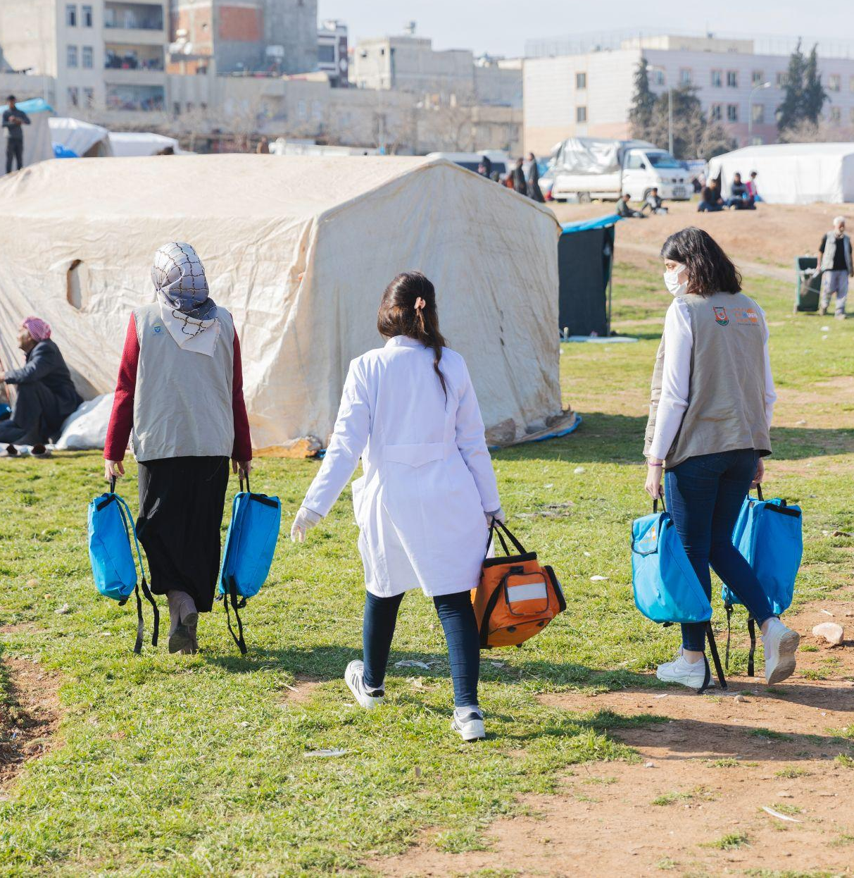

Welcome
© UNFPA
0.3
Notes:
Facilitator notes:
Introduce yourselves as facilitators.
Ask participants to form pairs with their neighbours. Ask the pairs to take 2–3 minutes to introduce themselves to their partners (that is, their name, what the name means or signifies in their culture, their clinical role and institutional affiliation). In plenary, depending on the number of participants and the time available, ask 3–4 pairs to introduce their partners to the rest of the group (1 minute per pair).

Slide 4
Introductions
Turn to your neighbour:
What is your name?
What does your name mean or signify in your culture?
What is your institutional affiliation?
Hello
What is
your name?
0.4

Slide 5
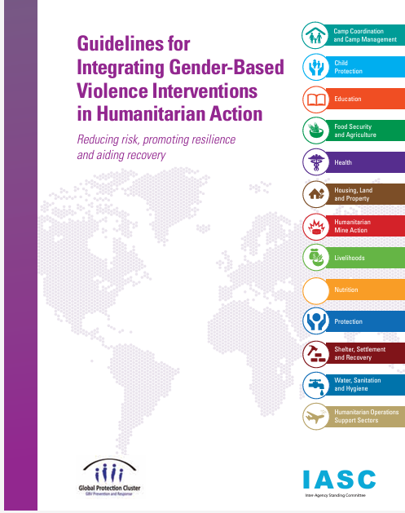
Why is this curriculum specific to humanitarian settings?
In 2013, the Inter-Agency Standing Committee adopted its statement on the “Centrality of Protection”
Addressing gender-based violence (GBV) is among the core concerns of humanitarian policy
0.5

Slide 6
Caring for survivors of sexual violence is part of the minimum initial services package (MISP) for sexual and reproductive health (SRH)
The MISP for SRH comprises a priority set of life-saving activities to be implemented at the onset of every humanitarian crisis and should be sustained and built upon throughout protracted crises and recovery
0.6

Slide 7
The MISP for SRH
The MISP for SRH covers 4 core areas of service delivery:
Preventing excess maternal and newborn morbidity and mortality
Preventing unintended pregnancies
1
3
Preventing sexual violence and responding to the needs of survivors
Preventing the transmission of and reducing morbidity and mortality due to HIV and other sexually transmitted infections (STIs)
2
4
0.7
Notes:
Say: It is important to recognize that IPV is also highly prevalent in humanitarian emergencies and results in elevated risk and incidence of several poor health outcomes targeted by the MISP for SRH: unintended pregnancy, neonatal morbidity and mortality, STI and HIV infections.

Slide 8

Supporting implementation of the MISP for SRH
MISP for SRH Objective 2
Ensure health facilities and points of care offer services for those affected by sexual violence
Make clinical care and appropriate referrals available for survivors
Ensure health facilities have confidential, private spaces where survivors can disclose and receive care
IARH Kit 3
Inter-agency emergency reproductive health (IARH) kits are available through UNFPA
0.8
Notes:
Say: While as a health worker you cannot do everything or control all the elements necessary to provide a response to survivors during emergencies, there are many elements of MISP for SRH Objective 2 for which you have a key role to play.
Commodity kits that support delivery of the MISP for SRH, and delivery of Objective 2 in particular, are available through UNFPA. The inter-agency reproductive health (IARH) guide to MISP for SRH kits was updated in 2024. You may see commodities delivered to your point of service through this mechanism.
Encourage your supervisor, facility manager and/or procurement team to check local contacts (i.e. SRH Working Group, GBV Sub-cluster or Health Cluster, if any are established) for the latest information on kit contents and procurement procedures.

Slide 9
Intimate partner violence (IPV)
38%
of female victims of homicide were killed by their intimate partners
IPV increases during times of stress and conflict
1 in 3 women
will experience physical or sexual IPV in their lifetime
IPV refers to ongoing or past violence by a current intimate partner
or ex-partner (husband, boyfriend or lover)
Women may suffer several types of IPV, including physical violence, sexual violence and emotional/psychological abuse
0.9

Slide 10

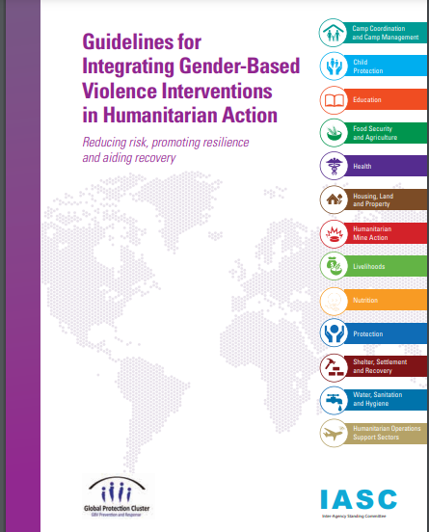
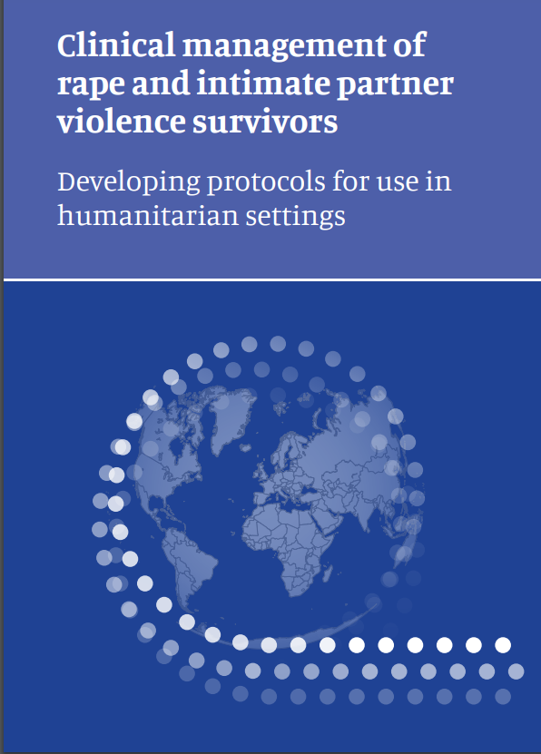
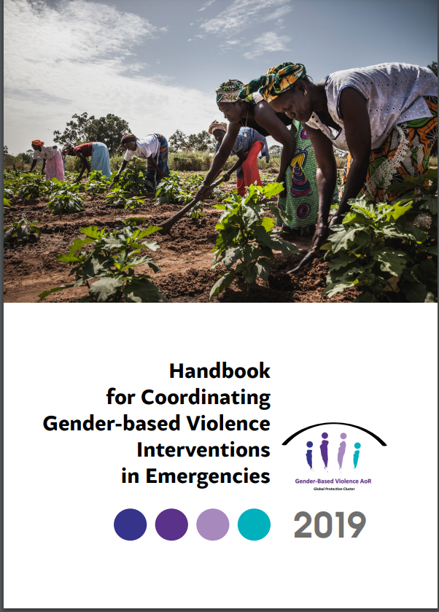
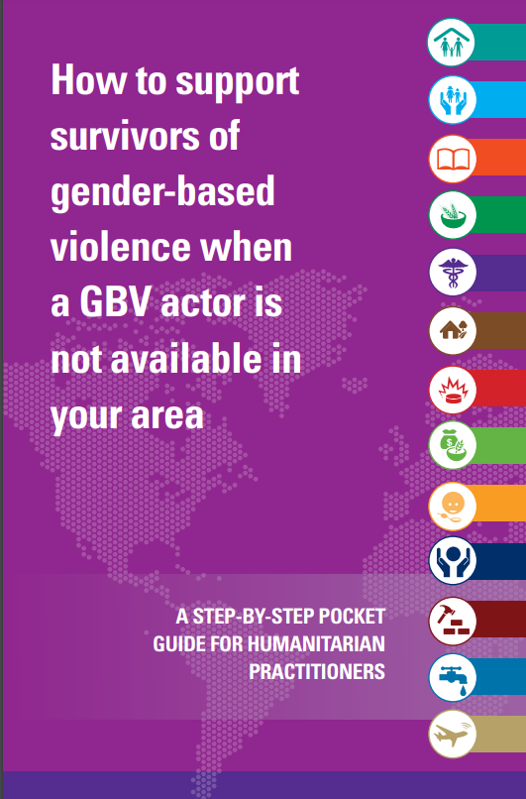
This training builds off a wealth of global guidelines and evidence
Guidelines on WHAT to do
Handbooks and tools for HOW to intervene
0.10
Notes:
Say: You may already be familiar with some of the global guidelines and standards for providing care to survivors of sexual violence and IPV, as well as the national clinical guidelines and policies where you work. If not, don’t worry. We’ll be covering all of that during this training.
It is important to know that there are specific job aids and tools and adapted minimum standards for use in humanitarian settings. In many cases, these resources have been streamlined to account for reduced health system functionality. They may also have been modified to integrate with humanitarian response mechanisms more broadly, such as implementation of the MISP for SRH, and multisectoral coordination between the Health and Protection Clusters.
While clinical issues and procedures are universal, the common risks, survivor demographics and, most significantly, the challenges faced in providing health care to survivors during emergencies, can look different from those needed and faced in the context of a stable, fully operational health system.
Hand out or direct participants to WHO’s Health care for women subjected to intimate partner violence or sexual violence: a clinical handbook and Clinical management of rape and intimate partner violence survivors: developing protocols for use in humanitarian settings. It is strongly recommended that you either provide hard copies of these two resources or send digital versions to participants’ via email, WhatsApp or other online platform.

Slide 11
Why a humanitarian-specific curriculum?
Scenario 1.
You’ve been trained to provide first-line support for GBV in the course of your work as an SRH clinical officer. You are well acquainted with the LIVES approach to providing first-line support and are comfortable making referrals to the One Stop Centre housed within the district hospital. However, the facility manager has called an all-staff meeting this morning to share the news that there was significant damage to the district hospital from flash flooding and mudslides over the past 2 days. The One Stop Centre, pharmacy, registration building and one inpatient ward are all unusable. The hospital is only receiving critical care referrals.
0.11
Notes:
Facilitator notes:
Invite participants to read the scenario presented. Take a few minutes to ask for 2–3 reflections on whether the scenario resonates, as well as eliciting reactions to the challenges, questions and worries that the health worker is facing

Slide 12
Why a humanitarian-specific curriculum?
Scenario 2.
As the physician at the local health centre, you are accustomed to treating rape survivors and feel confident in your knowledge of when to offer post-exposure prophylaxis (PEP) for HIV and emergency contraception, and how to treat any lacerations or other physical injuries.
You are summoned to a briefing by the district health coordinator to discuss the conflict that is taking place just over the border, and the increasing number of refugees who have been showing up at the health centre. As part of the briefing, the district coordinator shares that he has received a report that a wave of refugees is expected to arrive in the district in the next 2–3 days. There are many injured individuals and some of the most acutely sick and injured are being transported ahead by aid vehicles. Aid worker reports note that there are indications of mass rape among survivors, including men and children.
0.12
Notes:
Facilitator notes:
Ask by show of hands if this scenario resonates with anyone. Ask for 2–3 reflections on the challenges, questions and worries that come up as a health worker in such a situation.

Slide 13
At the end of this training, participants will have achieved the following objectives
1
Demonstrate general knowledge of sexual violence and IPV as a public health problem
Demonstrate behaviours and understand values contributing to safe and supportive services
Demonstrate clinical skills appropriate to one’s scope of practice to respond to sexual assault and IPV
Demonstrate knowledge of how to access resources and support for patients and for oneself in crisis
2
3
4
0.13

Slide 14
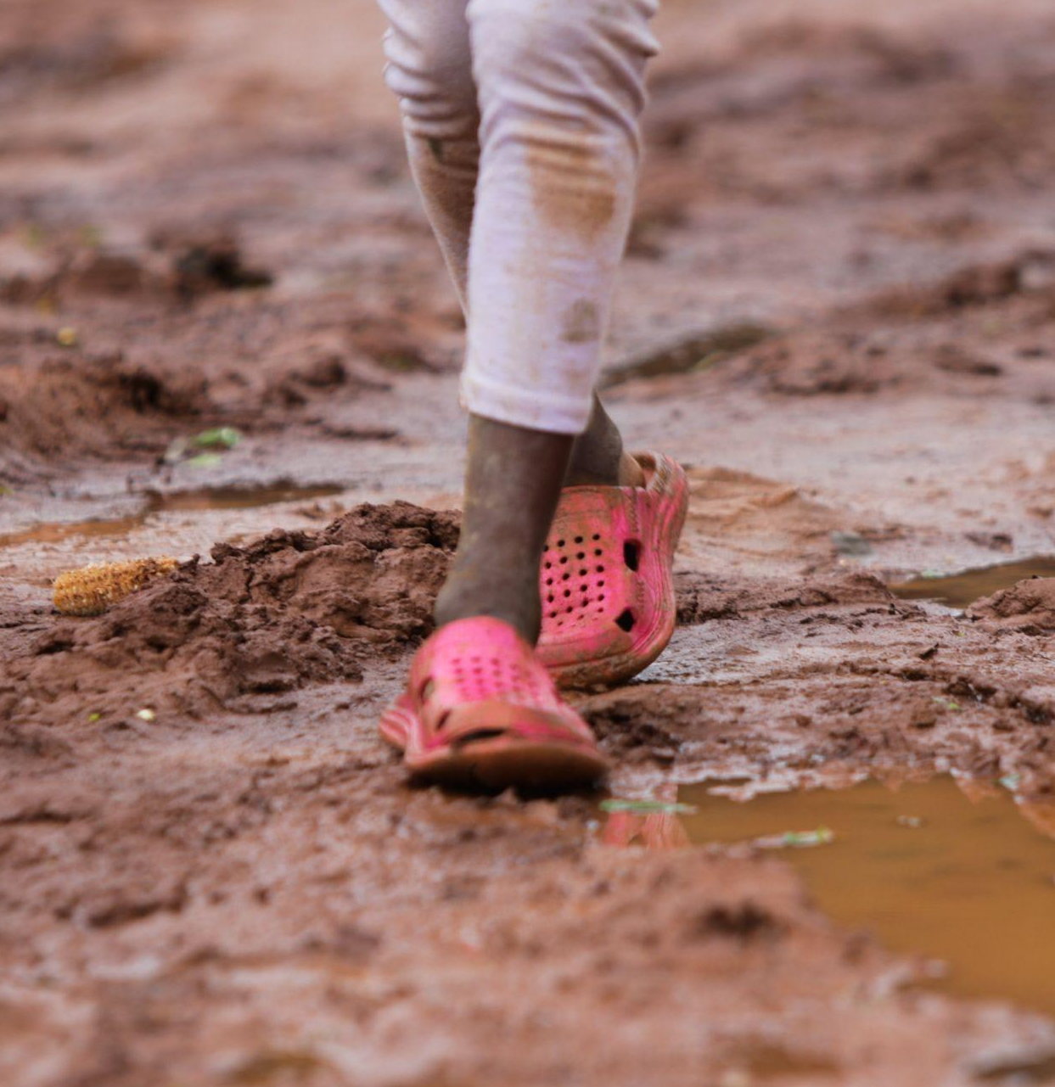
Keeping ourselves and each other safe
The topics we will cover may trigger uncomfortable emotions or memories
If you experience this, you are welcome to step out of the training for some time
Let the organizers know if you need support to access more services or if we can refer you to local resources
© UNFPA
0.14

Slide 15


Contact numbers
Facilitators
Local mental health and psychosocial support (MHPSS) resources
0.15
Notes:
> Facilitator Action: Enter contact details for the facilitators as well as local mental health and psychosocial support (MHPSS) resources, such as hotlines, an agency mental health counsellor if available on the mission, or local mental health resources, before the start of the first day of training.
Address any other housekeeping matters such as location of toilets, prayer facilities, safety/security protocols, etc.

Slide 16
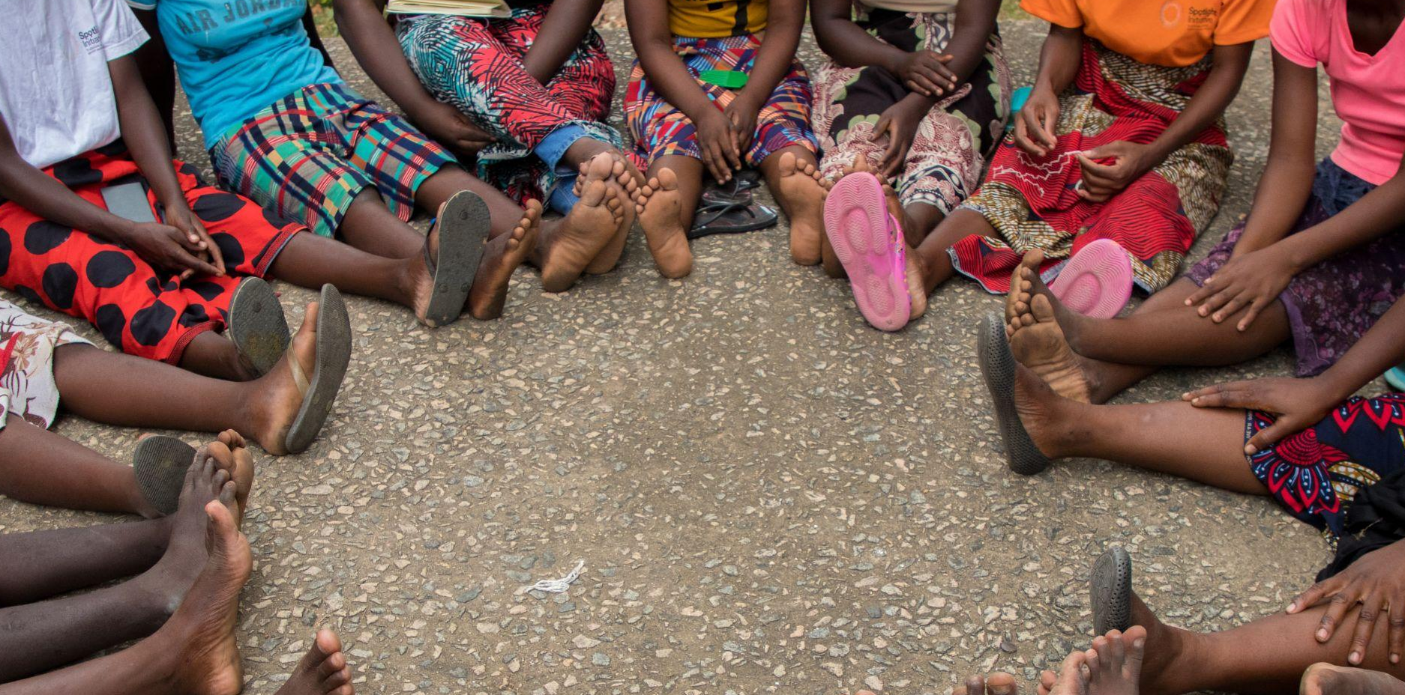
If you want to go fast,
go alone…
If you want to go far,
go together
© UNFPA
0.16
Notes:
Facilitator notes:
Let participants know that:
they may be arriving with different expectations, fears or experience, but if we move forward as a group, everyone will get more out of our time together.
Ask participants to share and record their expectations for the training in large writing on flip chart or poster paper at the front of the room.
If participants are reluctant, you can share an expectation to break the ice. For example: I expect that everyone will take this training seriously, but also find moments for us to have fun together. I hope everyone will be respectful of time and arrive in the morning and from breaks at the scheduled times.

Slide 17

Fears and motivations in a hat
Exercise 0.1
Instructions
Write down one fear or worry you have about providing care to survivors
Write down one thing that motivates you to provide high-quality, survivor-centred care
Place the pieces of paper in the respective hats being passed around
0.17
Notes:
Facilitator notes:
Remind participants that this is anonymous. They should not write their names on the pieces of paper.
Remind participants that their fear and their motivation should be written on two separate pieces of paper.
Let participants know which facilitator has the “fear” hat and which facilitator has the “motivations” hat.
Introduce participants to their Facilitator guide and let them know the reminders in Job aid 1b can be valuable to review, especially in their first year or two of providing first-line support, when they will still be gaining comfort and confidence.

Slide 18

Group rules and norms
Timeliness – both in attendance and in expressing your point of view
Learn and work together
Participate actively
Respect each other
Listen with an open mind
Let everyone participate
Be present
Express disagreements respectfully
Give feedback in a constructive way (starting with the positive)
Do not interrupt when people are talking
Respect confidentiality – any personal information shared stays in the room
Only use electronic devices such as mobile phones or laptops for emergencies
0.18
Notes:
Facilitator notes:
If any of the norms on this slide were not included in the group brainstorm, add them to the flip chart paper. Keep the “group norms” hanging in the training space throughout all sessions.

Slide 19
Key points
  Many health workers have concerns about talking about GBV, particularly IPV, with their patients. They may feel inadequate to respond to violence.
  Many of us are passionate about providing care and ensuring health and justice for our clients. This positive energy can fuel how we apply this training in our clinical practice.
  Providing survivor-centred, first-line sexual violence and IPV support is an essential service during humanitarian emergencies.
0.19

