Slide 1

WHO recommendations and guidelines on Hepatis C virus self-testing
WHO Global HIV Hepatitis and STI Programmes
18 July 2021

Slide 2
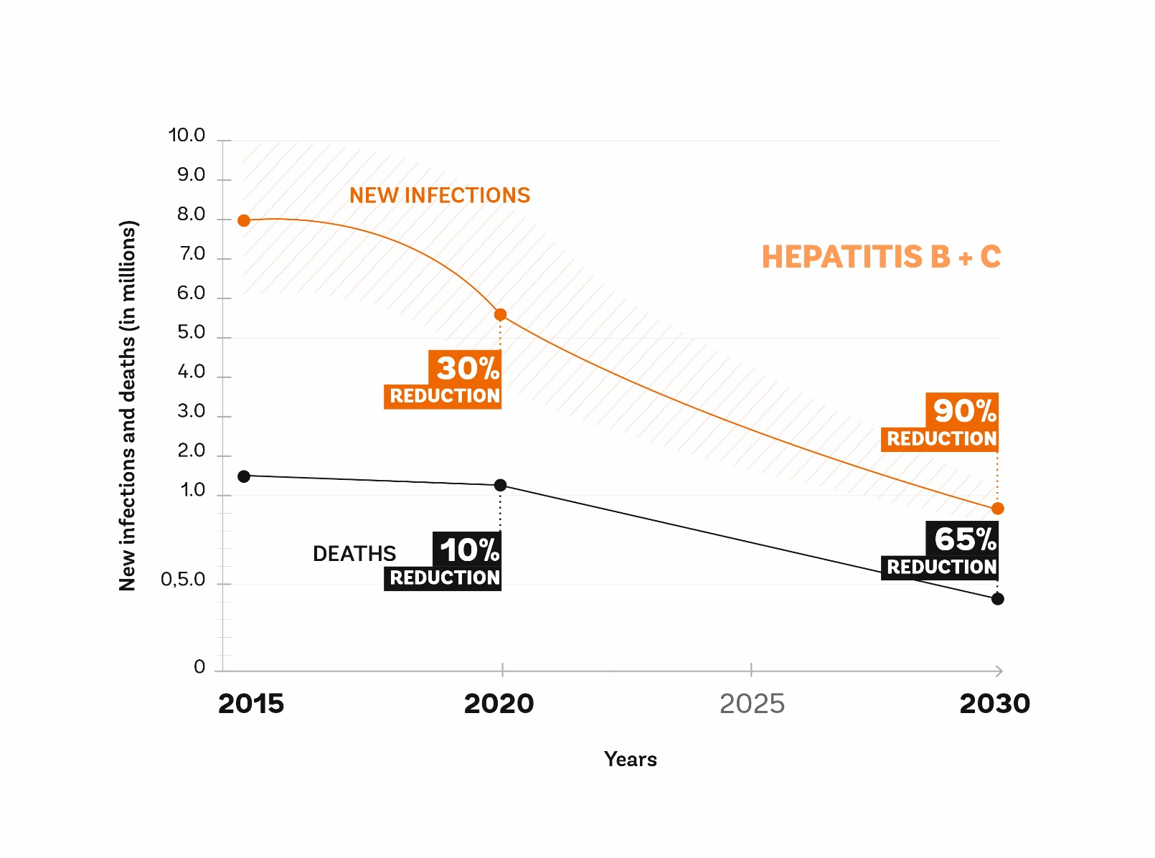

WHO’s goal is to eliminate viral hepatitis as a major public health problem by 2030
6-10 million infections (in 2015)
to 900,000 infections (by 2030)
1.34 million deaths (in 2015) to under 500,000 deaths (by 2030)

Slide 3
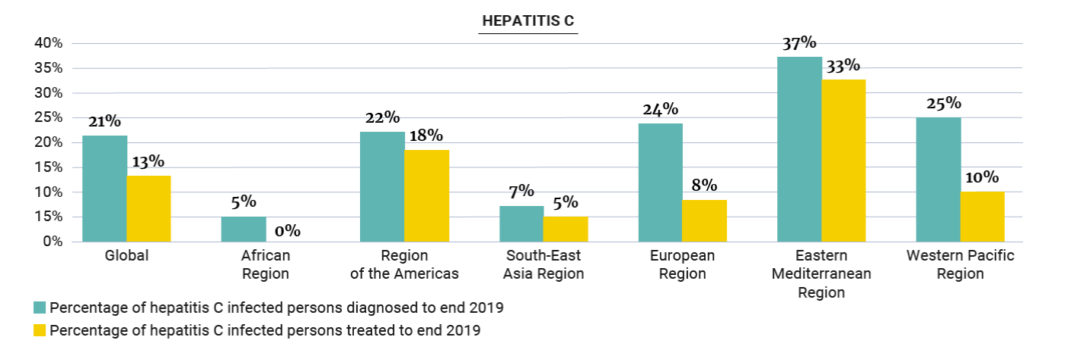
Only 21% of estimated 58 million people with chronic HCV infection were diagnosed in 2019 with variation by regions
Source: Global progress report on HIV, viral hepatitis and sexually transmitted infections, 2021

Slide 4



WHO Hepatitis testing guideline recommendations 2017
Topic | Recommendation
Who to test? | Focused testing for most affected populations*, those with a clinical suspicion of chronic viral hepatitis, family members/children, and sexual partners (HBV), healthcare workers. General population testing: In settings with ≥2% or ≥5% (intermediate/high) HBsAg or HCV Ab prevalence. Birth Cohort testing (HCV): where specific identified birth cohorts of older persons at higher risk of HCV infection Routine antenatal clinic testing (HBV) * PWID, people in prisons, MSM, sex workers, HIV-infected, tattoos, transfusions, some migrant pops from endemic countries, some indigenous populations, children of HBV/HCV +ve mothers
How to test? | A single serological assay (EIA or RDT) that meets minimum performance standards with prompt NAT testing + linkage to care
Confirmation of HCV viraemia | Nucleic acid testing (NAT) (quantitative or qualitative RNA) or core HCV antigen assay, with comparable clinical sensitivity
Promoting uptake and linkage | Use of DBS specimens for virology ± serology On-site or immediate RDT testing with same day results Trained peer and lay health workers Clinician reminders to prompt provider initiated, facility-based testing Testing as part of integrated services at a single facility
https://bmcinfectdis.biomedcentral.com/articles/supplements/volume-17-supplement-1

Slide 5
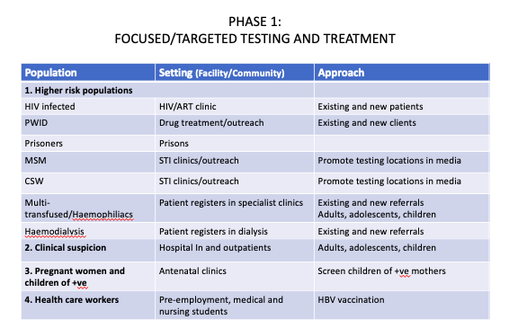
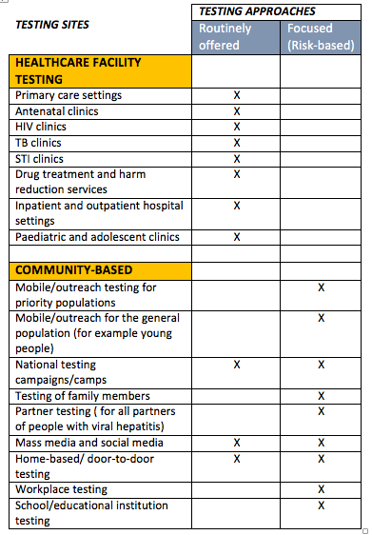
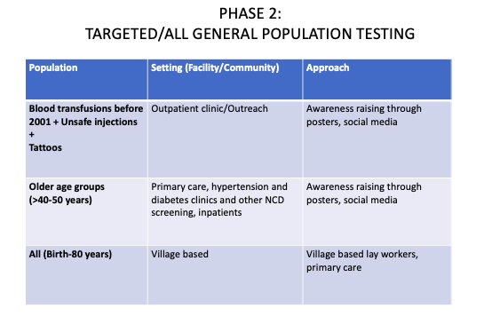
WHO recommends facility- and community-based testing approaches for viral hepatitis (2017): Who to test and Where to focus testing services?

Slide 6

New Recommendation (2021)
Hepatitis C virus (HCV) self-testing should be offered as an additional approach to HCV testing services
(strong recommendation, moderate-certainty evidence)
Remarks
HCV self-testing needs to be followed by linkage to appropriate post-test services, including confirmation of viraemic infection, treatment, care and referral services, according to national standards.
It is desirable to adapt HCV self-testing service delivery and support options to the national and local context, which includes community preferences.
Communities, including networks of key and vulnerable populations and peer-led organizations, need to be meaningfully and effectively engaged in developing, adapting, implementing and monitoring HCV self-testing programmes.

Slide 7
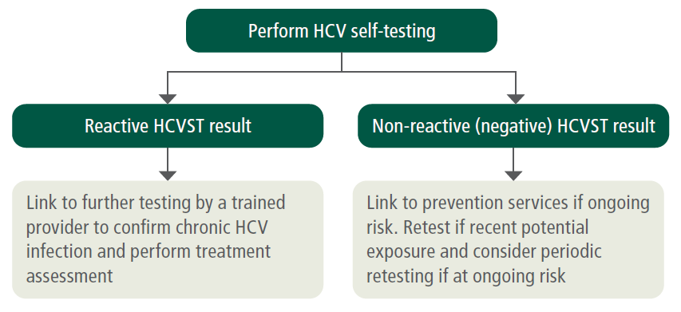
HCV self-testing does not provide a definitive diagnosis of chronic HCV infection – all reactive HCVST results need to be followed by further testing to confirm viraemic infection as well as further clinical assessment before starting treatment
HCV self-testing strategy

Slide 8

Approach to guidelines update – multiple sources and use of HIVST evidence for effectiveness
Benefits/Harms
HCVST systematic review
HIVST systematic review (indirect evidence)
Values and Preferences, acceptability
HCVST systematic review
Community-led V&P studies
Feasibility
HIVST policies, programs, implementation
Resource Use
HIVST V&P Review (indirect evidence)
Special usability & acceptability studies
Used multiple complementary sources of evidence to provide a complete picture
HCVST systematic review
HCVST costs and cost-effectiveness (HCVST systematic review and mathematical modeling analysis)
Equity – Discussion by the Guideline Development Group

Slide 9
Key findings and summary of evidence
No direct evidence on HCVST effectiveness was identified.
From HIVST systematic reviews, evidence from 27 RCTs showed that:
HIVST increases the uptake of HIV testing.
Proportion of people diagnosed with HIVST is greater than facility-based testing.
Proportion linked to care with HIVST is comparable to facility-based testing.
Misuse of HIVST and social harms associated with HIVST are rare.
No suicides were reported.
HCVST values and preferences, usability and cost-effectiveness studies in a range of settings and populations showed that:
Many people are willing and able to perform HCVST with minimal support.
HCVST is acceptable and feasible in a range of populations and settings.
HCVST has the potential to increase equity by reaching those who may not otherwise test.
HCVST may cost more per diagnosis than facility-based testing, but more cases would be diagnosed.

Slide 10

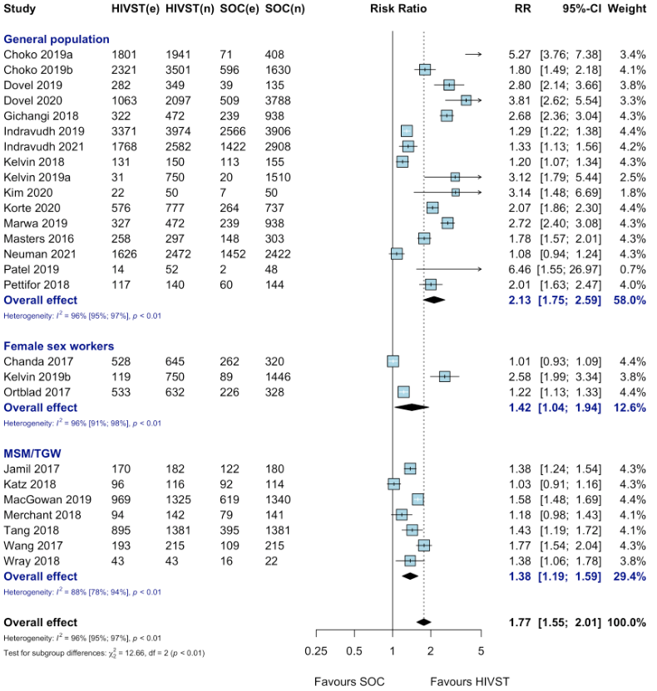
Uptake consistently increased with HIVST in both general and key populations

Slide 11
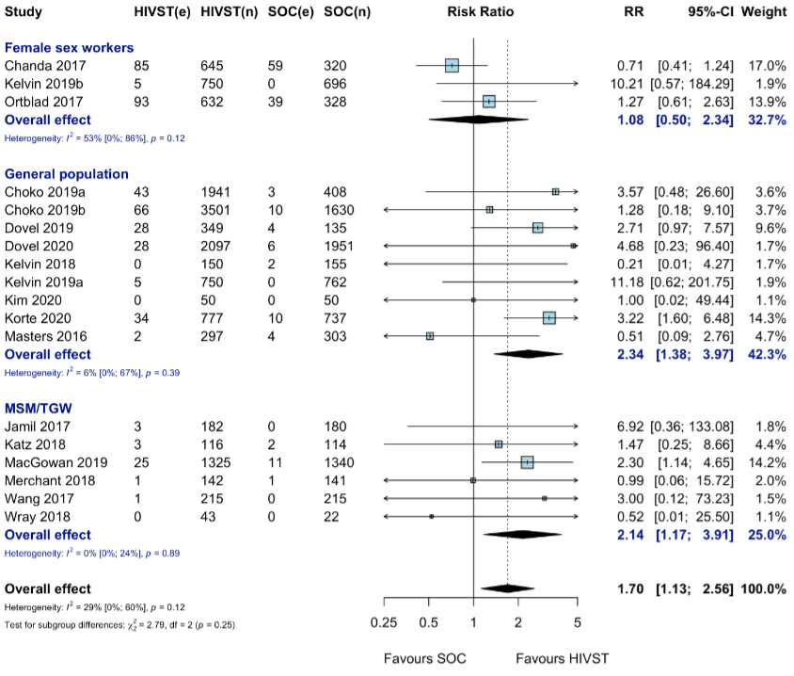
Overall greater positivity with HIVST compared to standard HTS
* Cluster RCT

Slide 12
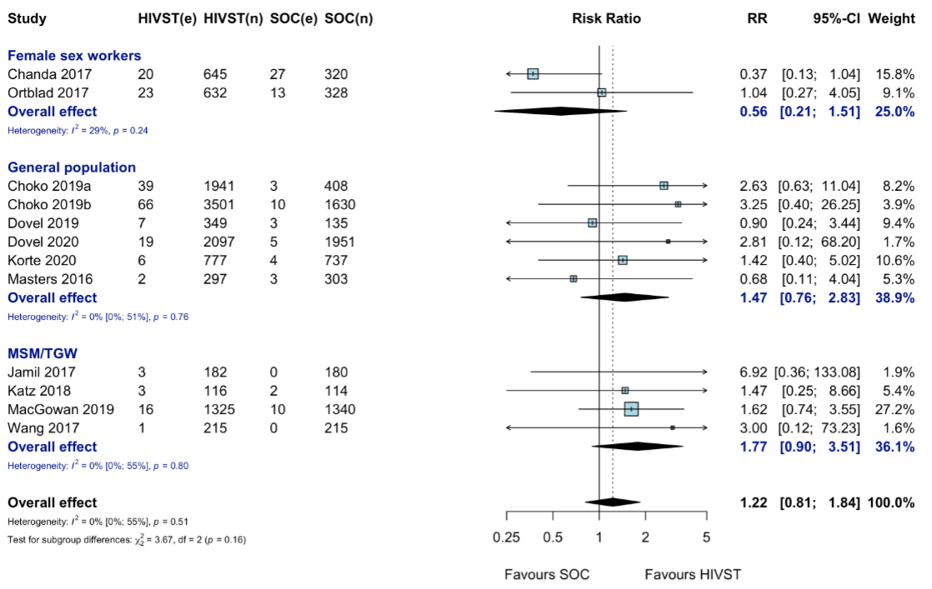
Linkage with HIVST comparable to that with standard HTS
(Linkage support with HIVST can improve linkage (e.g., home ART initiation, peer navigation, provider incentive)
* Cluster RCT

Slide 13
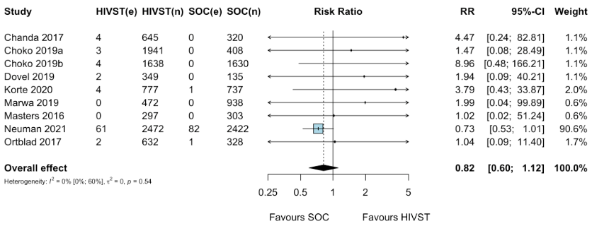
Harms or adverse events with HIVST are rare and rates are similar to standard HTS
* Cluster RCT

Slide 14
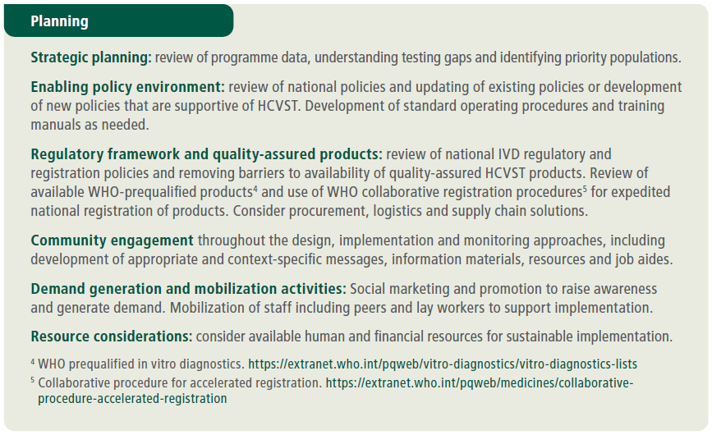
Implementation considerations (1)

Slide 15
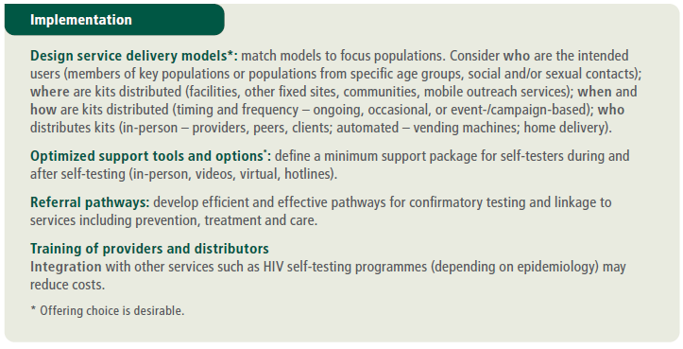
Implementation considerations (2)

Slide 16
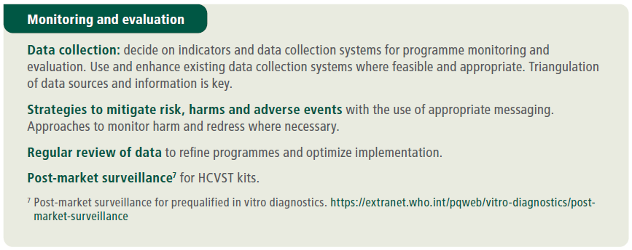
Implementation considerations (3)

Slide 17
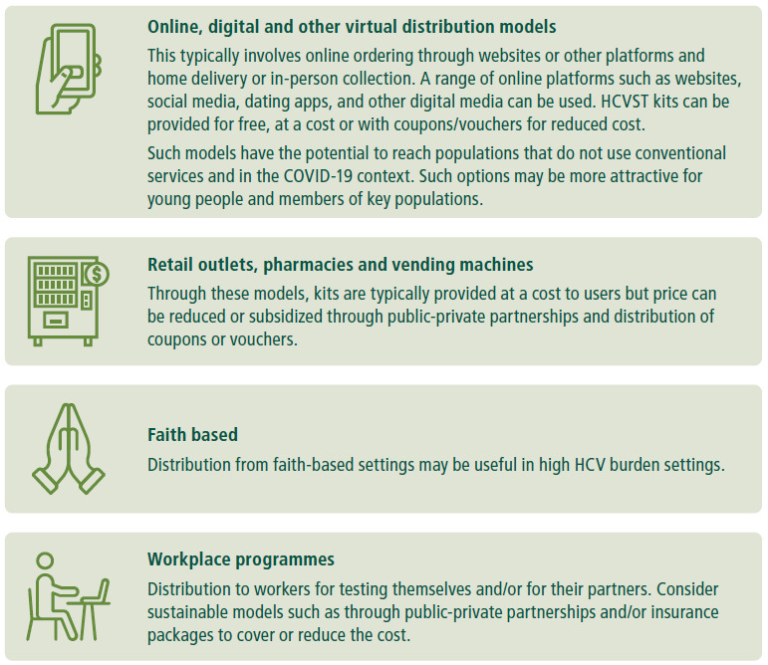
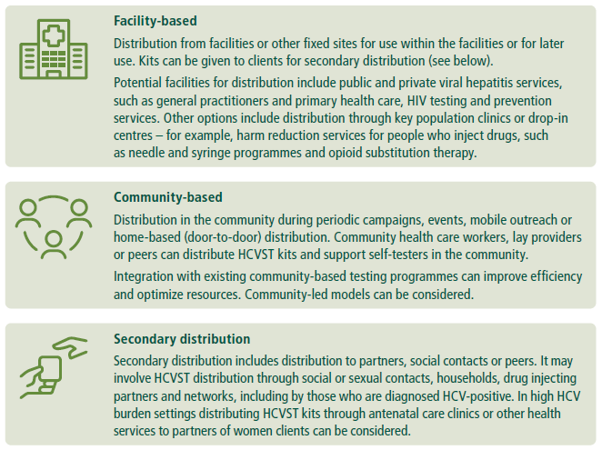
Many service delivery models can be used and adapted

Slide 18

Variety of support tools for HCVST – can be adapted for local context and community preferences
Programmes should define a minimum support package for implementation
In-person demonstration, training or observation (one-on-one, with partners or in groups). Consider peer support/led options for key populations.
Video instructions or demonstration (including online links to videos, QR codes, virtual real time support).
Telephone hotline (can be integrated into existing national hotline services).
Messaging platforms (short message service through telephone, Internet, social media).
Educational information via radio, television, leaflets, brochures, the Internet, social media and applications for smartphones/tablets.
Local information and resources (for example, on counselling services, testing sites, treatment centres and where to access prevention services).

Slide 19
Acknowledgements
WHO Headquarter: Rachel Baggaley, Olufunmilayo Lesi, Muhammad Shahid Jamil, Niklas Luhmann, Cheryl Johnson, Philippa Easterbrook, Maggie Barr-DiChiara, Emmanuel Fajardo, Belen Dinku.
WHO Steering Group
Guideline Development Group
External peer reviewers
Key partners
Community members and networks
All systematic review teams and mathematical modellers
FIND for evidence generation
Unitaid for providing funding for the guidelines

Slide 20
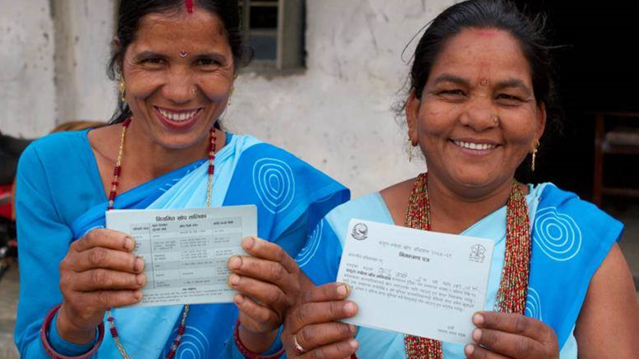

Thank You
Contacts
Muhammad Jamil: mjamil@who.int amilwho.int
Niklas Luhmann: luhmannn@who.int
Global Hepatitis Programme
20, avenue Appia
1211 Geneva 27
Switzerland
who.int/teams/global-hiv-hepatitis-and-stis-programmes/hepatitis/overview

