Slide 1

Summary of the
verification toolkit
Emmanuel Fajardo
Céline Lastrucci
Cheryl Johnson
HIV Testing Services (HTS)
Testing, Prevention and Populations (TPP) Unit
Global HIV, Hepatitis, STI Programmes (HSS)
Anita Sands
Incidents and Substandard/Falsified
Medical Products Team
Regulations and Prequalification Department
WHO/UCN/HHS/21.02
© World Health Organization 2021. Some rights reserved. This work is available under the CC BY-NC-SA 3.0 IGO licence

Slide 2

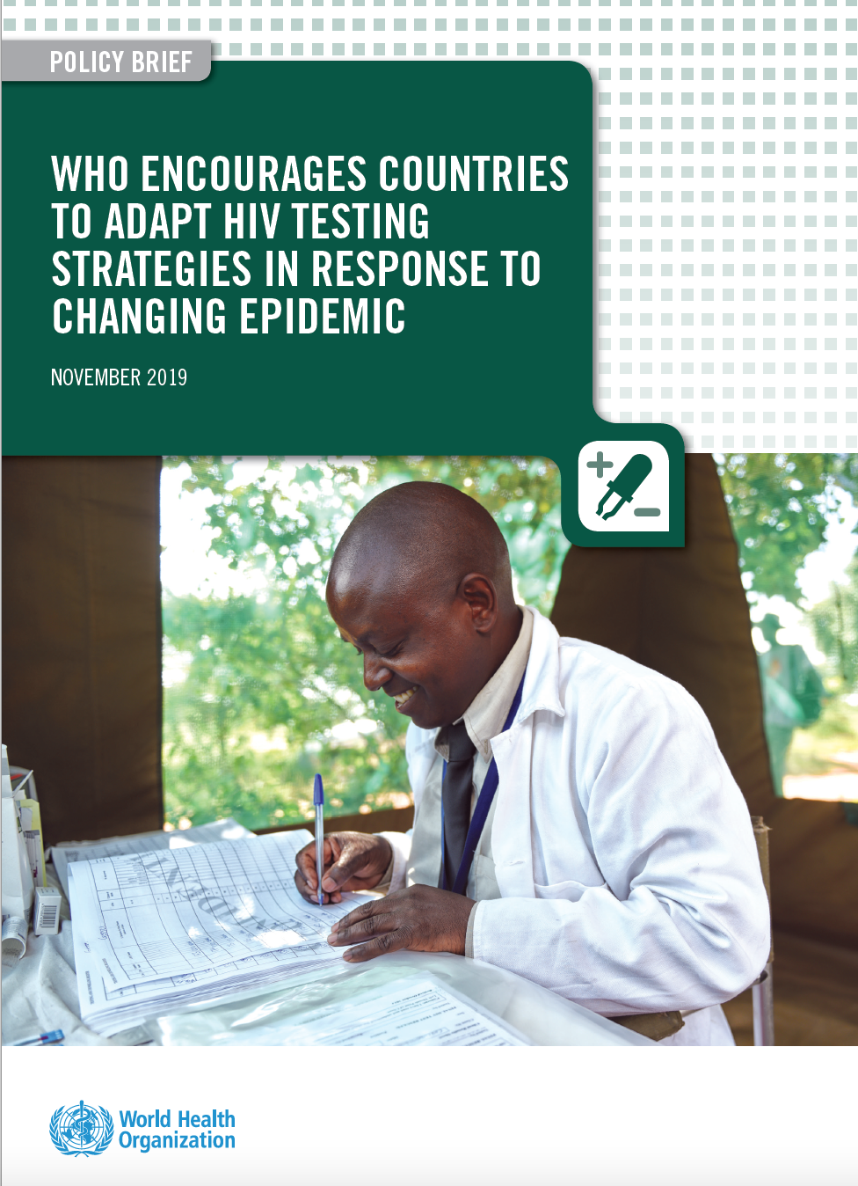
Adapting National HIV Testing Strategies
.
WHO is encouraging countries currently using two consecutive reactive tests for an HIV-positive diagnosis to move torward using three consecutive reactive tests for an HIV-positive diagnosis. This is increasingly important as treatment-adjusted HIV prevalence and national HTS positivity continue to decline over time.
Ensure that the testing strategy has a positive predictive value ≥99% (PPV)
  Meaning of the persons classified as HIV+, ≥99% will truly be living with HIV
  PPV depends on positivity rate among testing population
Quality assured assays, such as WHO prequalified, should be used:
  >99% sensitivity: fewer than 1 ‘false negative’ for 100 truly positive
  >98% specificity: fewer than 2 ‘false positive’ for 100 truly negative
  Either rapid diagnostic tests (RDTs) or enzyme immunoassay (EIA, CLIA, ECL)

Slide 3
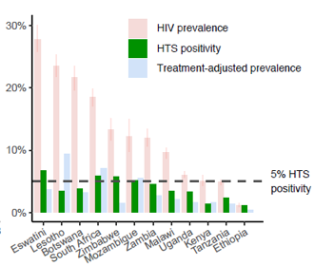
HIV testing and treatment scale-up has led to
declining HTS positivity in many settings
.
(% testing positive in national HTS programme)
East and Southern Africa
In 2018, in countries with ≥20% national HIV prevalence, HTS positivity was generally ~ or <5%.
National HTS positivity was much closer to the HIV prevalence among those not on treatment (treatment-adjusted prevalence) than to overall national prevalence.
In 2020, HTS positivity dropped from 9% in 2000 to 2.8% in 2020 in SSA¹
¹Giguere et al 2021 https://www.thelancet.com/action/showPdf?pii=S2352-3018%2820%2930315-5

Slide 4
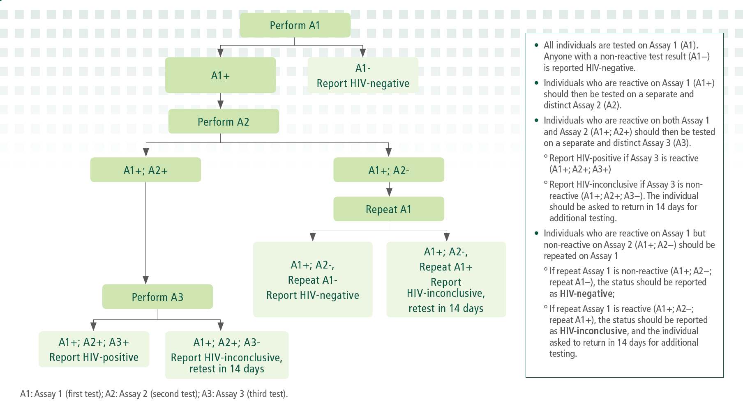
WHO 3-assay HIV Testing Strategy
.

Slide 5
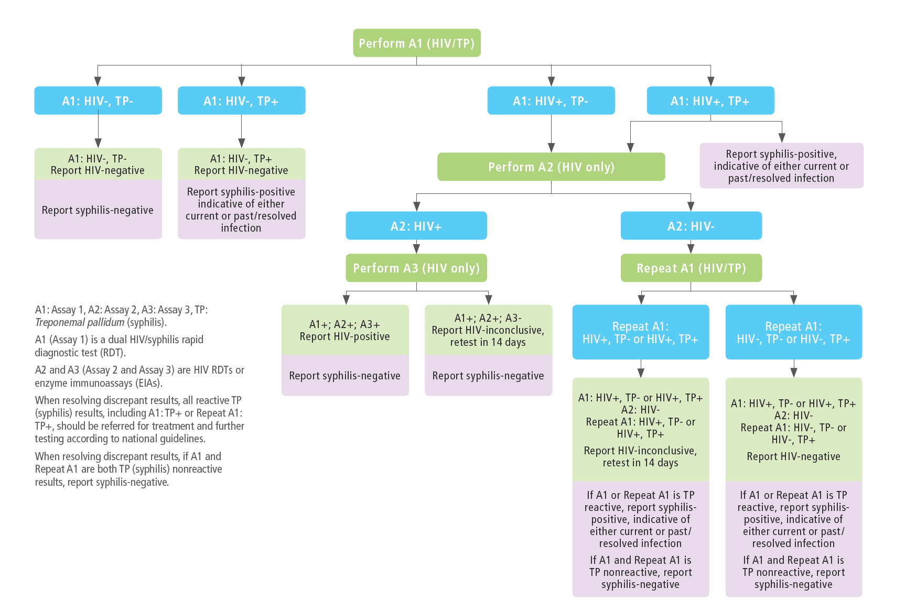
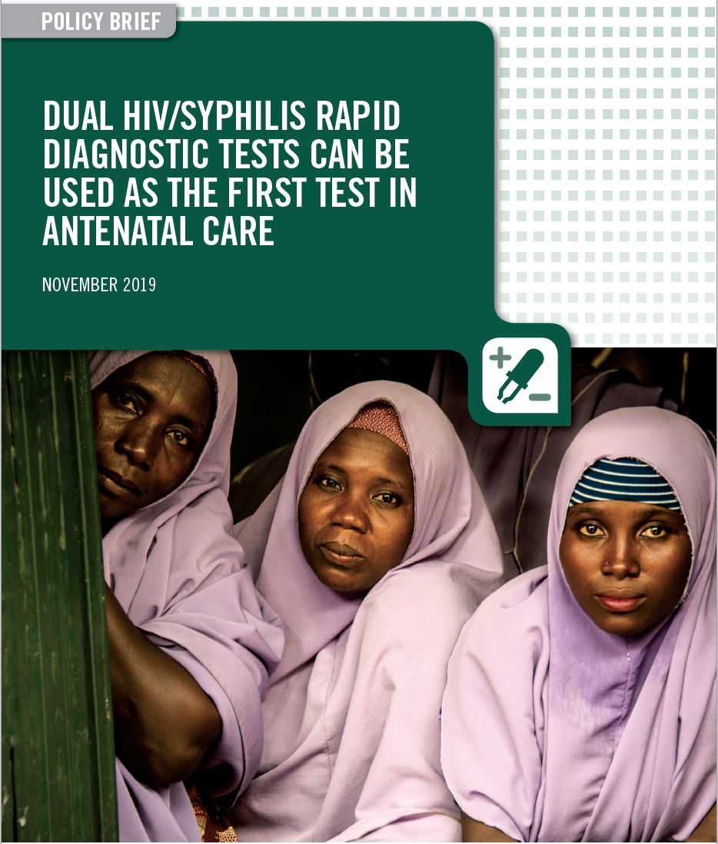
WHO Dual HIV/Syphilis Testing Strategy
for ANC Settings
.
Dual HIV/Syphilis
used as A1
Dual HIV/Syphilis strategy
aligned with national
HIV testing strategy
for A2 and A3

Slide 6
Principles for the selection
of HIV Testing Algorithms
.
Performance characteristics
Highest sensitivity (to rule in all positives [true + false]) | A1
Highest specificity (to rule out all false positives) | A2 and A3
Correctness of the final HIV status is dependent on:
  Specificity of the individual products used (for A1, A2, A3), and
  Probability that any specimen that is falsely-reactive on the first assay (A1) is not also falsely-reactive on the second assay (A2) and third assay (A3)
It is suggested to conduct a verification study of the new testing algorithms with the purpose to:
Identify the combination of products which have minimum possible common cross-reactivity to reduce the risk of false HIV-positive diagnosis. (Note: Products from the same manufacturer should not be used as part of the testing algorithm to minimize common cross-reactivity)
Not intended to reevaluate sensitivity and specificity of individual products!

Slide 7
Verification Study Process
.
Preparation
Conducting verification
Pilot
(at the discretion of the country)
Develop study protocol, seek ERB approval
Shortlist candidate products
Request/order test kits
Select study sites (collection and testing sites)
Develop study tools (SOPs, data collection, training material, etc)
Establish verification panel (n=250 negative specimens)
Test each candidate product with the verification panel
Interpret and analyze results
Choose HIV testing algorithms (including replacement tests)
Update tools (SOPs, training modules, data collection, etc)
Run new HIV testing algorithm
  High-volume sites: 2 weeks
  Low-volume sites: 4 weeks
Assess feasibility and acceptability
Roll out HIV testing algorithm more widely
Ordering time
6- 8 weeks
6- 8 weeks
6-8 weeks
Ordering time
Timeline will be context specific and will vary country by country

Slide 8
Selecting quality-assured products
.
Select Quality-assured products: HIV assays that have undergone stringent regulatory assessments:
– WHO prequalied products (performance and operational characteristics are well documented)
– Those approved by SRAs e.g. Australia, Canada, Europe (CE-mark), Japan or USA (FDA).
1
Number of quality-assured products eligible for procurement through WHO and Global Fund
 | WHO | Global Fund
Dual HIV/Syphilis RDTs | 3 | 3
HIV RDTs | 19 | 27
HIV EIAs | 4 | 17
WHO Prequalified IVDs List: https://extranet.who.int/pqweb/vitro-diagnostics/vitro-diagnostics-lists
Global Fund Product List: https://www.theglobalfund.org/media/5878/psm_productshiv-who_list_en.pdf
Consider products already approved by the National Regulatory Agency (NRA) in your country
2

Slide 9
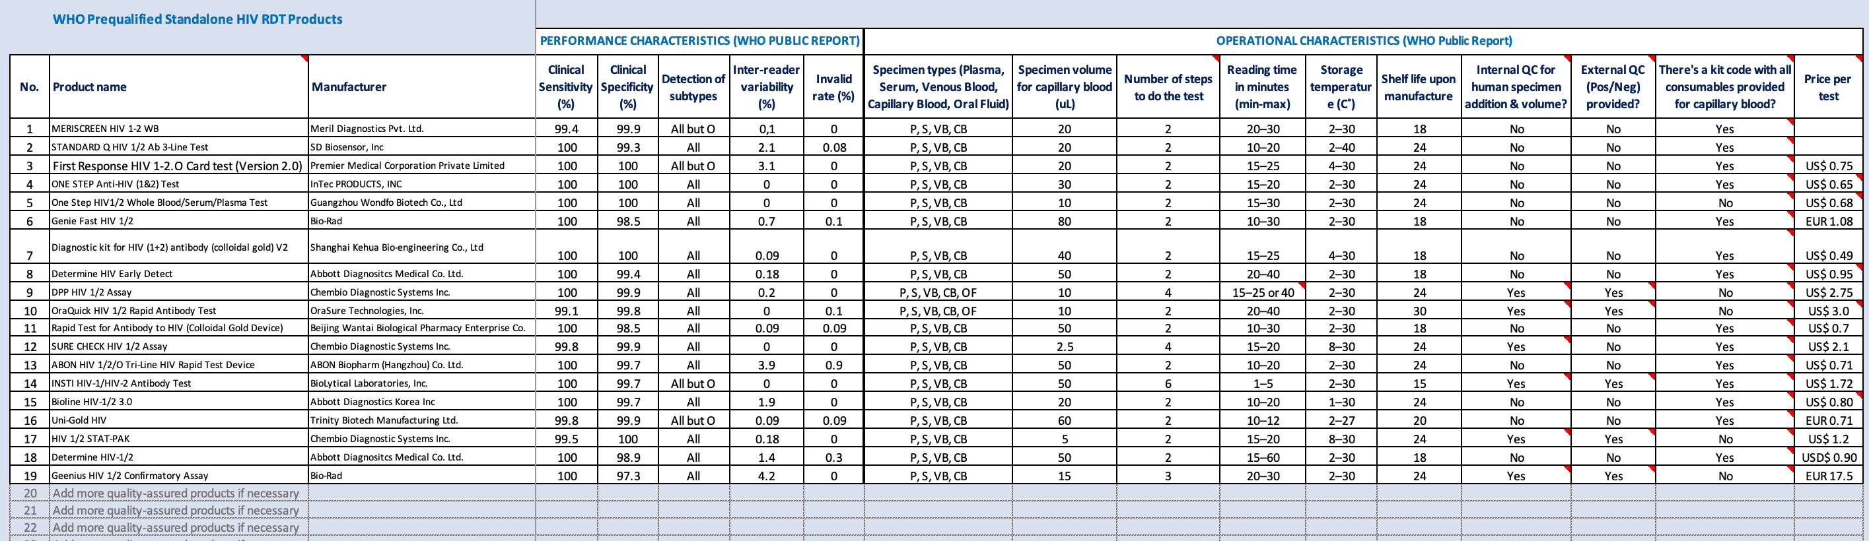
Shortlisting candidate assays based on
performance and operational characteristics
.

Slide 10
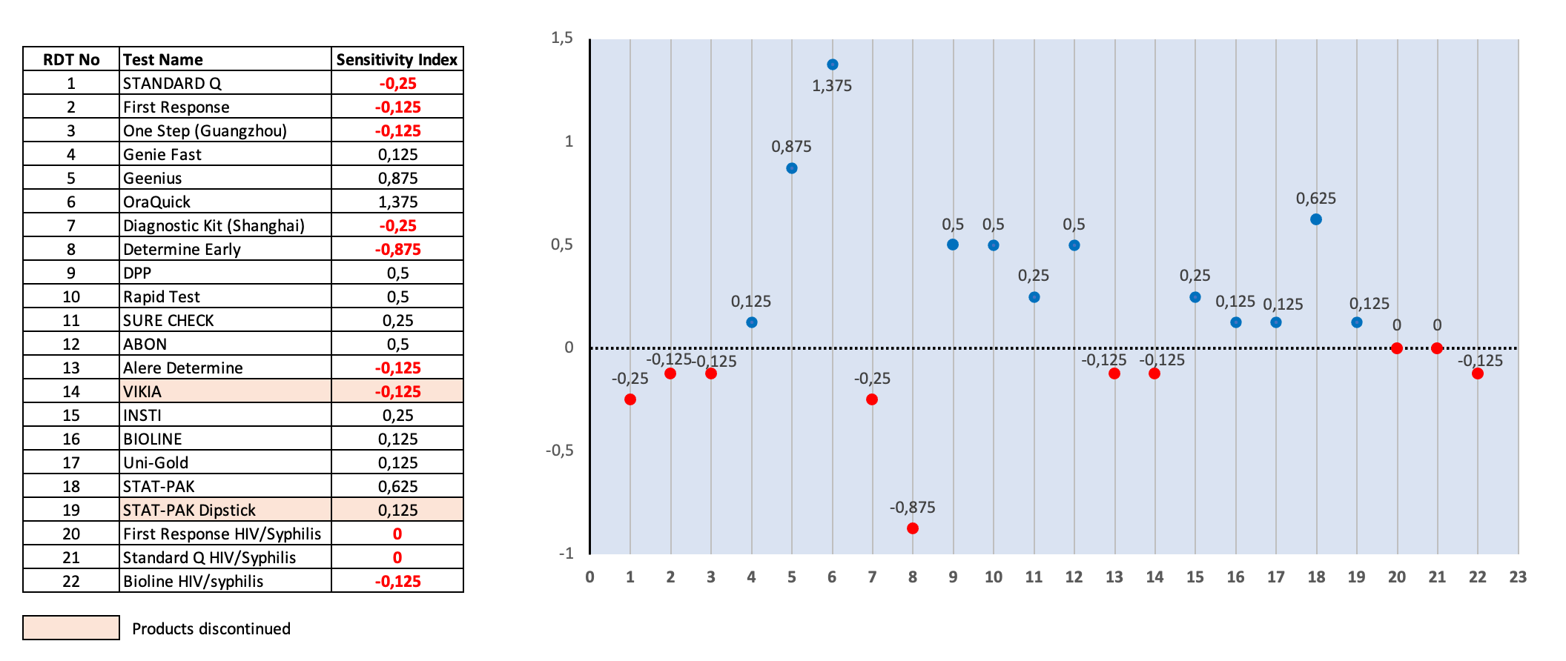
.
Selection of A1 based on analytical sensitivity
List of WHO Prequalified professional
HIV and dual HIV/syphilis RDTs
All WHO-prequalified RDTs have a clinical sensitivity* >99% but differ in analytical sensitivity**
OraQuick
RDTs with an Index above 0 indicate that the RDT becomes reactive specimens later compared to the reference assay
Sensitivity Index
RDTs with an index below 0 indicate that the RDT becomes reactive specimens earlier compared to the reference assay. This may be optimal
tests to be used as A1
Determine Early Detect
Rapid Diagnostic Tests
*Clinical sensitivity: ability of an assay to identify the presence of a target marker associated with a particular disease
**Analytical sensitivity: also known as limit of detection, is the ability of an assay to detect the lowest amount or concentration of a target marker

Slide 11
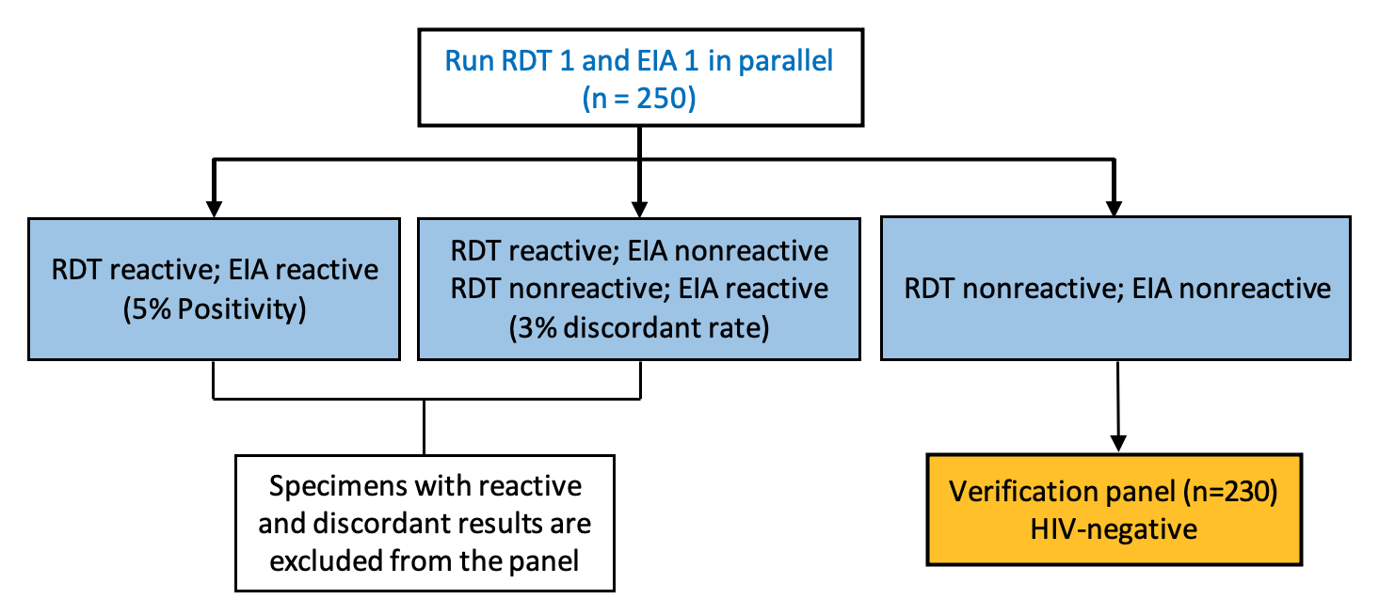
Establishing the Verification Panel
.
For practical reasons, plasma specimens can be used to ensure large volumes (6 mL) are available
Specimens (n=250) can be collected from clinic settings, antenatal care clinics, etc.
Specimens should be adequately characterized for the absence of HIV using a reference testing algorithm composed of
one RDT and one EIA:
The RDT should not be part of the
candidate products under evaluation!

Slide 12
Ordering Test Kits
.
Purpose | Tests | No of Lots | No of specimens | 1% repeat testing* | Total No of Tests
Specimen characterization | Single HIV RDT | 1 | 250 | 3 | 253
 | Enzyme Immunoassay | 1 | 250 | 3 | 253
Verification | Single HIV Test 1 | 2 | 230 | 5 | 465
 | Single HIV Test 2 | 2 | 230 | 5 | 465
 | Single HIV Test 3 | 2 | 230 | 5 | 465
 | Single HIV Test 4 | 2 | 230 | 5 | 465
 | Single HIV Test 5 | 2 | 230 | 5 | 465
 | Single HIV Test 6 | 2 | 230 | 5 | 465
 | Single HIV Test 7 | 2 | 230 | 5 | 465
 | Single HIV Test 8 | 2 | 230 | 5 | 465
 | Dual HIV/Syphilis Test 9 | 2 | 230 | 5 | 465
 | Dual HIV/Syphilis Test 10 | 2 | 230 | 5 | 465
*In case of invalid or indeterminate test results.

Slide 13
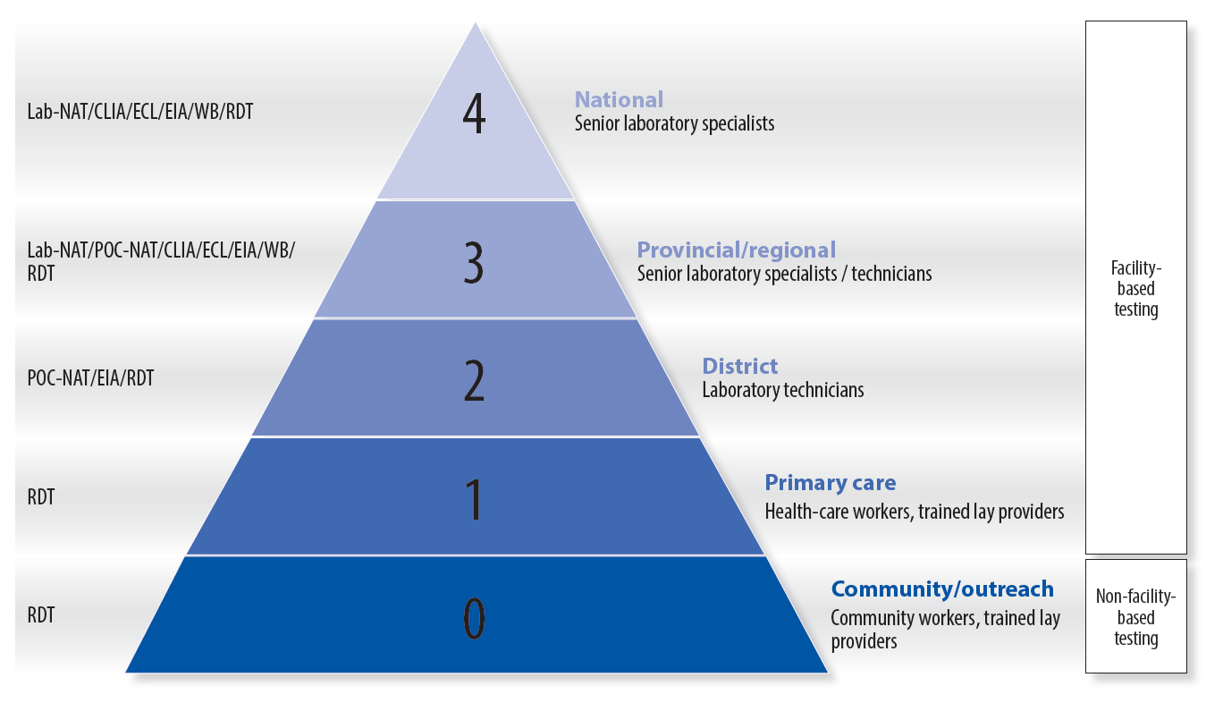
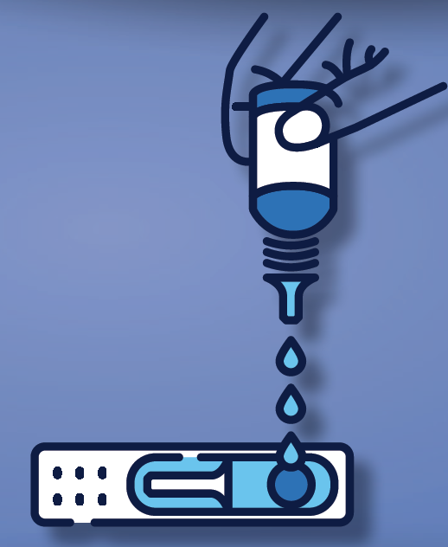
Selecting study sites and training staff
.
Study Site
Staff Training
The verification study may be conducted in any setting (laboratory or at point of use), as designated by national authorities
Logistically, it may be easier to conduct the verification study at the National Reference Laboratory
All test operators should be trained on the relevant
study standard operating procedures (SOPs),
Including on how to handle specimens, how to
perform each assay, and how to read and record test
results. Training should be documented in the
training records. All test operators should be able to
demonstrate proficiency before participating in the
study.

Slide 14


Conducting the verification study
.
Verification Panel (n=230)
Data analysis
RDTS (n=8–12)
1
1
1
1
1
1
1
1
1
1
1
1
1
1
1
1
1
1
1
1
1
1
1
1
Products | Total False+ | No of samples with shared false-reactivity
 |  | RDT 1 | RDT 2 | RDT 3 | RDT 4 | RDT 5 | RDT 6 | RDT 7
RDT 1
RDT 2
RDT 3
RDT 4
RDT 5
RDT 6
RDT 7
Total
Identify the products displaying the lowest false reactivity
Identify the products sharing the least number of false-reactive results
Choose HIV testing algorithms for the general population and ANC settings, if applicable

Slide 15


Preparing for Implementation
.
Run new 3-test algorithms for 1 month
(in selected low-volume and high-volume sites)
Pilot study
New verified HIV 3-Test Algoritms
Assess feasibility
Assess acceptability
Share lessons learnt
Adapt local policy
Register products
Scale up
Algorithm | Assay 1 | Assay 2 | Assay 3 | Intended testing population
1 |  |  |  | General population
2 |  |  |  | General population (alternate for A1)*
3 |  |  |  | General population (alternate for A2 or A3)*
4 |  |  |  | ANC settings (dual HIV/syphilis for A1)
5 |  |  |  | ANC settings (dual HIV/syphilis alternate for A1)**
*Alternate testing algorithms in the event of stock ruptures for a specific assay
**Alternate single syphilis RDT may be considered in the absence of a second
dual HIV/syphilis RDT

Slide 16
WHO Verification Toolkit
.
WHO has developed the following tools to assist countries plan and execute a verification study:
Generic study protocol: to assist developing local protocol to seek ethics approval
Test selection tool: to assist with the selection of WHO prequalified HIV products
Checklist of lab consumables and reagents: of tests and consumables to be purchased
Study database: to support data analysis
Budget template: to assist developing a budget of core activites
Gantt chart: to assist with the planning of the verification study with timelines
https://www.who.int/tools/optimizing-hiv-testing-algorithms-toolkit

Slide 17
Acknowledgements
.
WHO: Anne-Laure Page, Rachel Baggaley, Muhammad Jamil, Maggie Barr-Dichiara, Anne Bekelynck, Peter Cherutich, Purvi Shah, Belen Dinku, Yann Siegenthaler
CDC: Bharat Parekh, Ernest Yufenyuy
USAID: Vincent Wong, Dianne Edgil, Jason Williams
Global Fund: Jean-Frederic Flandin, Fatim Cham Jallow, David Maman, Obinna Onyekwena
CHAI: Shaukat Khan, Gillian Leitch, Emi Okamoko
GSS Health: Ekaterina Milgotina, Rémi Charlebois
Thanks also to the members of the Quality HIV Testing Services (QuEST) Technical Working Group for their support, inputs and ideas over the last years
Thanks to Mary Henderson for her assistance in formatting and editing the generic protocol

