Slide 1
WHO, Unitaid, and UNAIDS meeting on HIV self-testing and innovative testing approaches in Asia and the Pacific Region:
Country progress and plans
7-8 December, 2020

Slide 2
Participating countries
WHO region | Countries
Eastern Mediterranean Region | Pakistan
South-East Asian Region | Bangladesh, Bhutan*, India**, Indonesia**, Myanmar, Timor Leste*, Sri Lanka*, Thailand
Western Pacific Region | Cambodia, Lao PDR*, Malaysia*, Mongolia*, Papua New Guinea*, Philippines*, Viet Nam
* Part of Global Fund’s Sustainability of HIV Services for Key Populations in Asia Program (SKPA) implemented by the Australian Federation of AIDS Organizations (AFAO)
** Part of Unitaid’s STAR-III Initiative

Slide 3

Global HIV self-testing policy uptake and implementation status: 2015-2020
WHO HIVST guidelines released
Between 2017 and 2020
three times as many countries implemented HIVST
Updated WHO HTS/HIVST guidelines released
Note: Total number of countries is lower in 2020 because of fewer reporting countries
Source: GAM WHO, UNAIDS, UNICEF July 2020
Notes:
Total 197 countries provide GAM data but WHO reports for 194 countries

Slide 4
National HIVST policy and implementation 2020, by WHO region
45% (88/194) reporting countries have HIVST policies, of these 47% (41) are implementing
% Implementing
30%
6%
5%
38%
0%
15%
# countries
N=47
N=35
N=21
N=53
N=11
N=26
Source: GAM WHO, UNAIDS, UNICEF July 2020
Notes:
Total 197 countries provide GAM data but WHO reports for 194 countries

Slide 5

Policy uptake of WHO-recommended HIV testing approaches
Country | Community-based testing | Lay provider testing | HIV self-testing | Social network based testing | Provider-assisted referral (index testing)
Bangladesh
Cambodia
India
Lao PDR
Malaysia
Mongolia
Myanmar
Pakistan
Papua New Guinea
Philippines
Sri Lanka
Viet Nam
Legend: Green=Yes; Orange=No
Information not available: Bhutan, Indonesia, Thailand, Timor Leste
Source: GAM WHO, UNAIDS, UNICEF July 2020

Slide 6
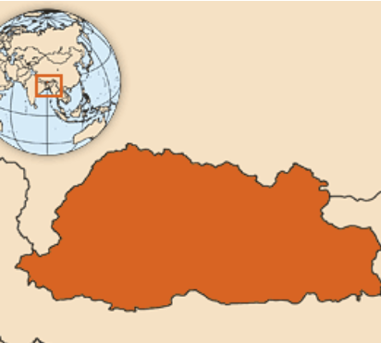
Bhutan: progress and plans
Progress | Plans
Facility-based HIV testing under utilized by key populations National Technical Working Group chaired by NACP formed to advise on addressing testing gap A national and an international consultant recruited to support implementation of differentiated HTS approaches | Plans to adopt and implement differentiated HTS approaches: Community-based testing Advocacy for lay provider testing HIVST including prevention package for key populations Register an HIVST product
HIV self-testing Policy: No Implementation: Planned Product registration: Planned

Slide 7

Lao PDR: progress and plans
Progress | Plans
Ongoing support from partners on training, M&E and procurement of products to support implementation of differentiated HTS approaches | Plan to introduce HIVST to test approximately 2000 individuals Test approximately 4000 key population members in 2021 using a range of differentiated HTS approaches
HIV self-testing Policy: Yes Implementation: Planned Product registration: Planned

Slide 8


Malaysia: progress and plans
Progress | Plans
An online HIVST pilot (JOMTEST) hosted by Malaysian AIDS Council launched HIVST kits being distributed using digital platforms and social media HIVST programme linked to My PrEP locater service Demand creation through social media and partner websites | Improve and expand JOMTEST programme after early lessons learned and further collaboration with other partners and NGOs Register an HIVST product blood-based HIVST kit Expand the scope of JOMTEST to include Hepatitis C self-testing
HIV self-testing Policy: Yes Implementation: Piloting, scale up planned Product registration: planned

Slide 9


Mongolia: progress and plans
Progress | Plans
Protocol for HIVST demonstration project developed and approved by the MOH/NCCD Ethical clearance in process HIVST oral test kits procured through special permission | HIVST programme to target testing 1000 men who have sex with men using different models: With assistance provided Online distribution e.g. test4ub.org Register an HIVST product
HIV self-testing Policy: No Implementation: Planned Product registration: Planned

Slide 10

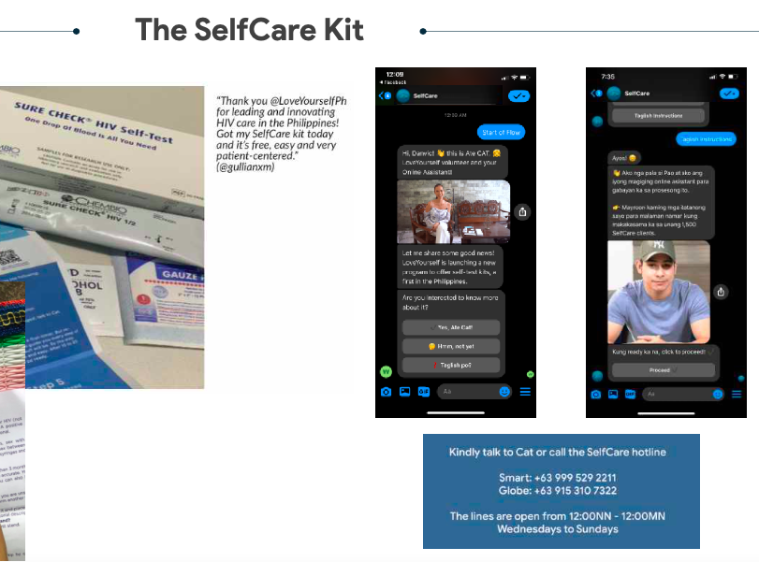
Philippines: progress and plans
Progress | Plans
Two HIVST demonstration projects underway HIVST service delivery models modified to online approaches due to the COVID-19 context HIV prevention combination campaign (#SaferNowPH) launched which includes promotion of HIVST | HIVST pilot project results to inform development of national guidelines Self-care campaign planned for 2021 to expand HIVST as well as messaging for health and wellness
HIV self-testing Policy: No Implementation: Piloting Product registration: Planned

Slide 11


Papua New Guinea: progress and plans
Progress | Plans
Ongoing work and advocacy to introduce differentiated HTS approaches including trainings | Partners supporting introduction of community based testing Ongoing advocacy for introducing HIVST
HIV self-testing Policy: No Implementation: No Product registration: No

Slide 12
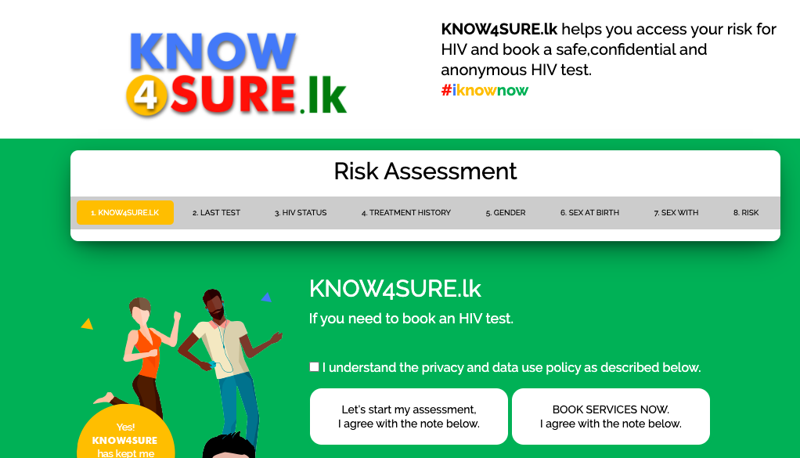
Sri Lanka: progress and plans
Progress | Plans
HIVST pilot project protocol finalized NSACP addressing delays caused by COVID-19 Demand creation via NSACP website, Know4sure App, STI clinics, internet, peer educators and social media | Development of national HIVST guidelines Scale up HIVST in 2021-22 including diversifying distribution options Video-based tools to support HIVST use 20,000 HIVST kits to be procured within Global Fund country grant
HIV self-testing Policy: Yes Implementation: Planed Product registration: Planned

Slide 13
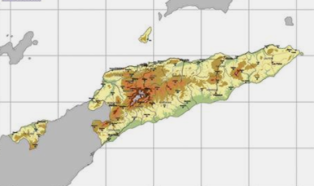
Timor Leste: progress and plans
Progress | Plans
A national and an international consultant to be recruited (TORs finalized) to strengthen community-based testing and conduct a demonstration project | Plan to implement a community based testing demonstration project Advocacy for lay provider testing and HIVST Register a HIVST product
HIV self-testing Policy: No Implementation: Planned Product registration: No

Slide 14
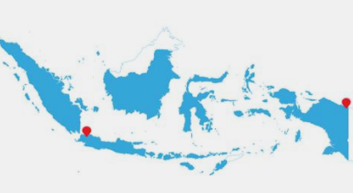
Indonesia: progress and plans
Progress | Plans
HIVST pilots underway in the country HIVST products undergoing evaluations for registration HIVST distribution models being assessed in STAR III Initiative | National HTS policy being updated including HIVST HIVST to be scaled up through procurement and implementation within Global Fund country grant Register an HIVST product WHO Collaborative Registration Procedure workshop planned
HIV self-testing Policy: Yes Implementation: Planned Product registration: Planned

Slide 15
India: progress and plans
Progress | Plans
Acceptability studies ongoing to understand local community and key populations perspective on HIVST National technical working group established to support introduction of differentiated HTS approaches including HIVST Discussions and advocacy ongoing to register HIVST products | Update national HTS policy to include HIVST – more advocacy needed Product registration efforts to continue Small implementation planned within STAR III Initiative Advocacy with government and stakeholders ongoing needed HIVST manufacturers workshop planned in 2021
HIV self-testing Policy: No Implementation: Planned Product registration: Planned

Slide 16
Bangladesh: progress and plans
Progress | Plans
In 2017-22 health sector planning, government allocated funds for 60,000 HIVST kits Decision on product registration awaited National HIV testing algorithm updated (2019) COVID-19 response: 6,000 additional HIVST kits requested through Global Fund | Ongoing efforts to register an HIVST product HIVST implementation using kits procured
HIV self-testing Policy: Yes Implementation: Planned Product registration: Planned

Slide 17
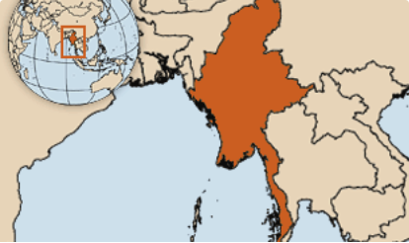
Myanmar: progress and plans
Progress | Plans
HIVST introduction included in National Strategic Plan (2021-2025) HIVST demonstration project planned but delayed due to COVID-19 Resource constraints delaying implementation | HIVST implementation to reach 2,000 key population members (mem who have sex with men and transgender people) in 2021 HIVST expansion and scale up with support from other partners
HIV self-testing Policy: Yes Implementation: Planned Product registration: Planned

Slide 18
Pakistan: progress and plans
Progress | Plans
HIVST demonstration project started focusing on key populations HCV self-testing usability and feasibility study commenced | Expand HIVST implementation within Global Fund country grant with procurement of 7,000 HIVST kits focusing on men who have sex with men and transgender people Lessons learned from demonstration projects to inform implementation and national policy
HIV self-testing Policy: Yes Implementation: Planned Product registration: Planned

Slide 19

Viet Nam: progress and plans
Progress | Plans
HIVST included in national policy and scaled up Distribution models being adapted in COVID-19 context with more focus on online distribution Both oral and blood based HIVST kits in use | Further scale-up of HIVST with adaptation of models HCV self-testing usability and acceptability study completed Plan to integrate HCV self-testing in HIV testing programmes
HIV self-testing Policy: Yes Implementation: Yes Product registration: Yes

Slide 20

Cambodia: progress and plans
Progress | Plans
HIVST pilots conducted among key populations in 2018-19 SOPs for HIVST developed in July 2020 Capacity building of implementers for HIVST distribution and implementation in November 2020 Scale up in capital city (Phnom Penh) and three provinces in 2020 | HIVST scale up within Global Fund country grans planned
HIV self-testing Policy: Yes Implementation: Yes Product registered: Yes

