Slide 1

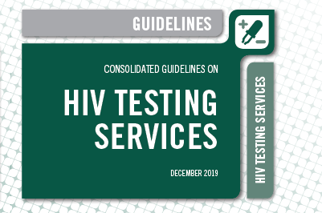
WHO HTS guidelines – presentation part 1
WHO HTS: https://bit.ly/2RQiW4M
HTS Info on the Go: https://apple.co/2LAB8vt
WHO HTS Data Dashboards: http://hts.hivci.org/

Slide 2
Consolidated guidelines on HIV testing services
ISBN 978-92-4-155058-1
© World Health Organization 2019
Some rights reserved. This work is available under the Creative Commons Attribution-NonCommercial-ShareAlike 3.0 IGO licence (CC BY-NC-SA 3.0 IGO; https://creativecommons.org/licenses/by-nc-sa/3.0/igo).
Under the terms of this licence, you may copy, redistribute and adapt the work for non-commercial purposes, provided the work is appropriately cited, as indicated below. In any use of this work, there should be no suggestion that WHO endorses any specific organization, products or services. The use of the WHO logo is not permitted. If you adapt the work, then you must license your work under the same or equivalent Creative Commons licence. If you create a translation of this work, you should add the following disclaimer along with the suggested citation: “This translation was not created by the World Health Organization (WHO). WHO is not responsible for the content or accuracy of this translation. The original English edition shall be the binding and authentic edition”.
Any mediation relating to disputes arising under the licence shall be conducted in accordance with the mediation rules of the World Intellectual Property Organization.
Suggested citation. Consolidated guidelines on HIV testing services. Geneva: World Health Organization; 2019. Licence: CC BY-NC-SA 3.0 IGO.
Cataloguing-in-Publication (CIP) data. CIP data are available at http://apps.who.int/iris.
Sales, rights and licensing. To purchase WHO publications, see http://apps.who.int/bookorders. To submit requests for commercial use and queries on rights and licensing, see http://www.who.int/about/licensing.
Third-party materials. If you wish to reuse material from this work that is attributed to a third party, such as tables, figures or images, it is your responsibility to determine whether permission is needed for that reuse and to obtain permission from the copyright holder. The risk of claims resulting from infringement of any third-party-owned component in the work rests solely with the user.
General disclaimers. The designations employed and the presentation of the material in this publication do not imply the expression of any opinion whatsoever on the part of WHO concerning the legal status of any country, territory, city or area or of its authorities, or concerning the delimitation of its frontiers or boundaries. Dotted and dashed lines on maps represent approximate border lines for which there may not yet be full agreement.
The mention of specific companies or of certain manufacturers’ products does not imply that they are endorsed or recommended by WHO in preference to others of a similar nature that are not mentioned. Errors and omissions excepted, the names of proprietary products are distinguished by initial capital letters.
All reasonable precautions have been taken by WHO to verify the information contained in this publication. However, the published material is being distributed without warranty of any kind, either expressed or implied. The responsibility for the interpretation and use of the material lies with the reader. In no event shall WHO be liable for damages arising from its use.

Slide 3
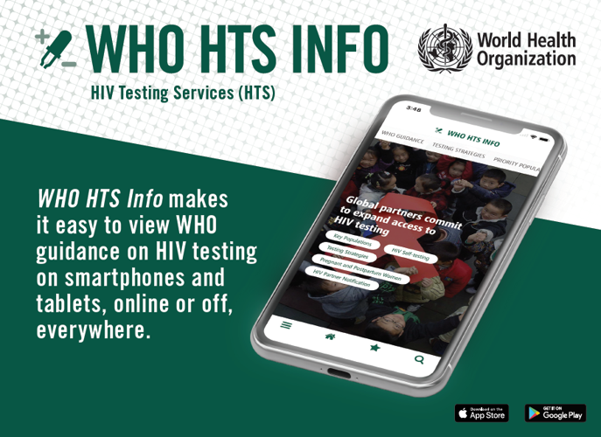
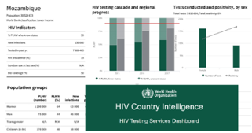
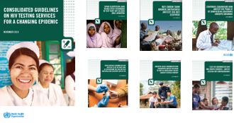
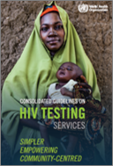
Access the full guidelines on the WHO HTS APP!
Search ‘WHO HTS Info’ wherever you get Apps
Notifications when new content is available
Search, save, send
Country HTS data in one place w/ guidelines
Language updates: French on the way!
Available online and off
Videos coming for 2020

Slide 4
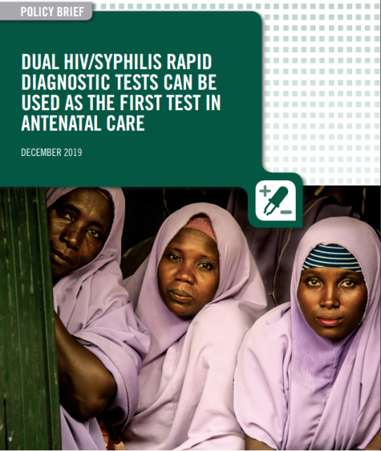
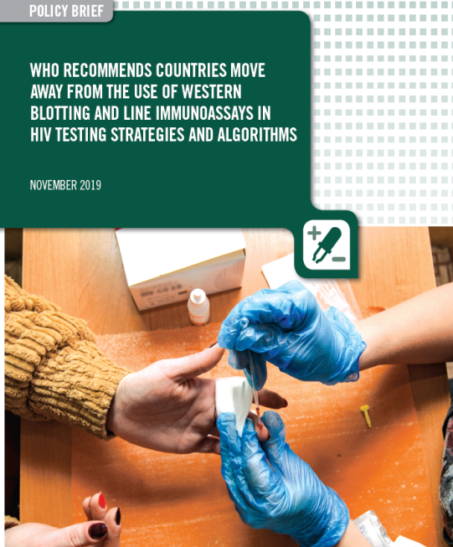
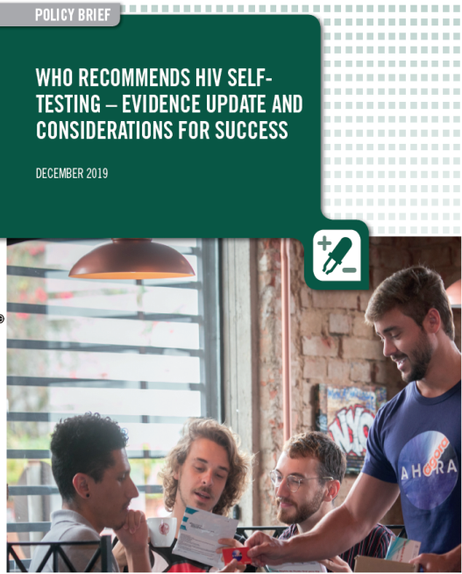
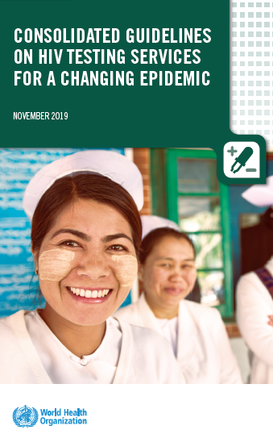
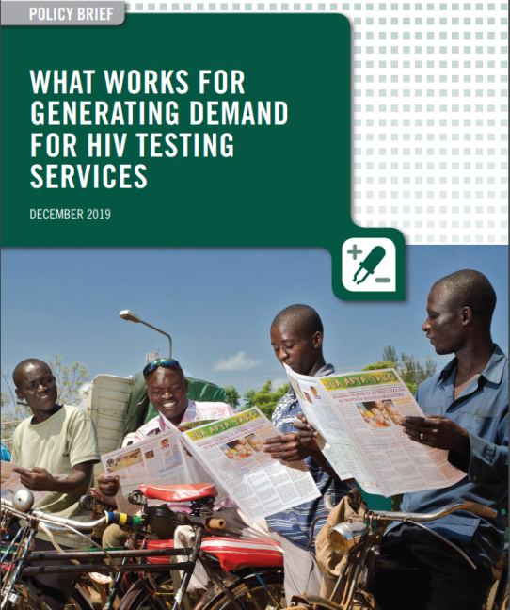
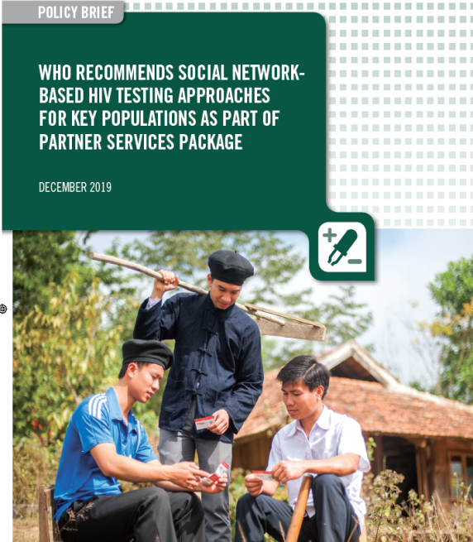
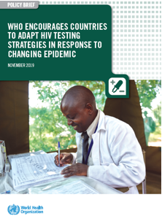
New WHO HTS Guidelines for a changing epidemic
Notes:
WHO guidance is now available online and on WHO’s HTS Info App.

Slide 5
Outline
Background – changing epidemic
New guidelines – highlights
New ways to access WHO guidance

Slide 6
Progress toward the 90-90-90, 2015-2018
8.1 million PLHIV remain undiagnosed, globally
Source: WHO/UNAIDS 2018

Slide 7
Progress toward the 90-90-90, by region, 2018
90-90-90
-85% undiagnosed PLHIV
Nearly all represent KP and partners missed by standard services
3.1 million
undiagnosed
1.8 million undiagnosed
1.9 million undiagnosed
100,000
undiagnosed
500,000
undiagnosed
130,000 undiagnosed
400,00
undiagnosed
20.6 million PLHIV
5 million PLHIV
5.9 million PLHIV
340,000 PLHIV
1,700,000 PLHIV
240,000 PLHIV
1.9 million PLHIV
Source: WHO/UNAIDS 2019

Slide 8
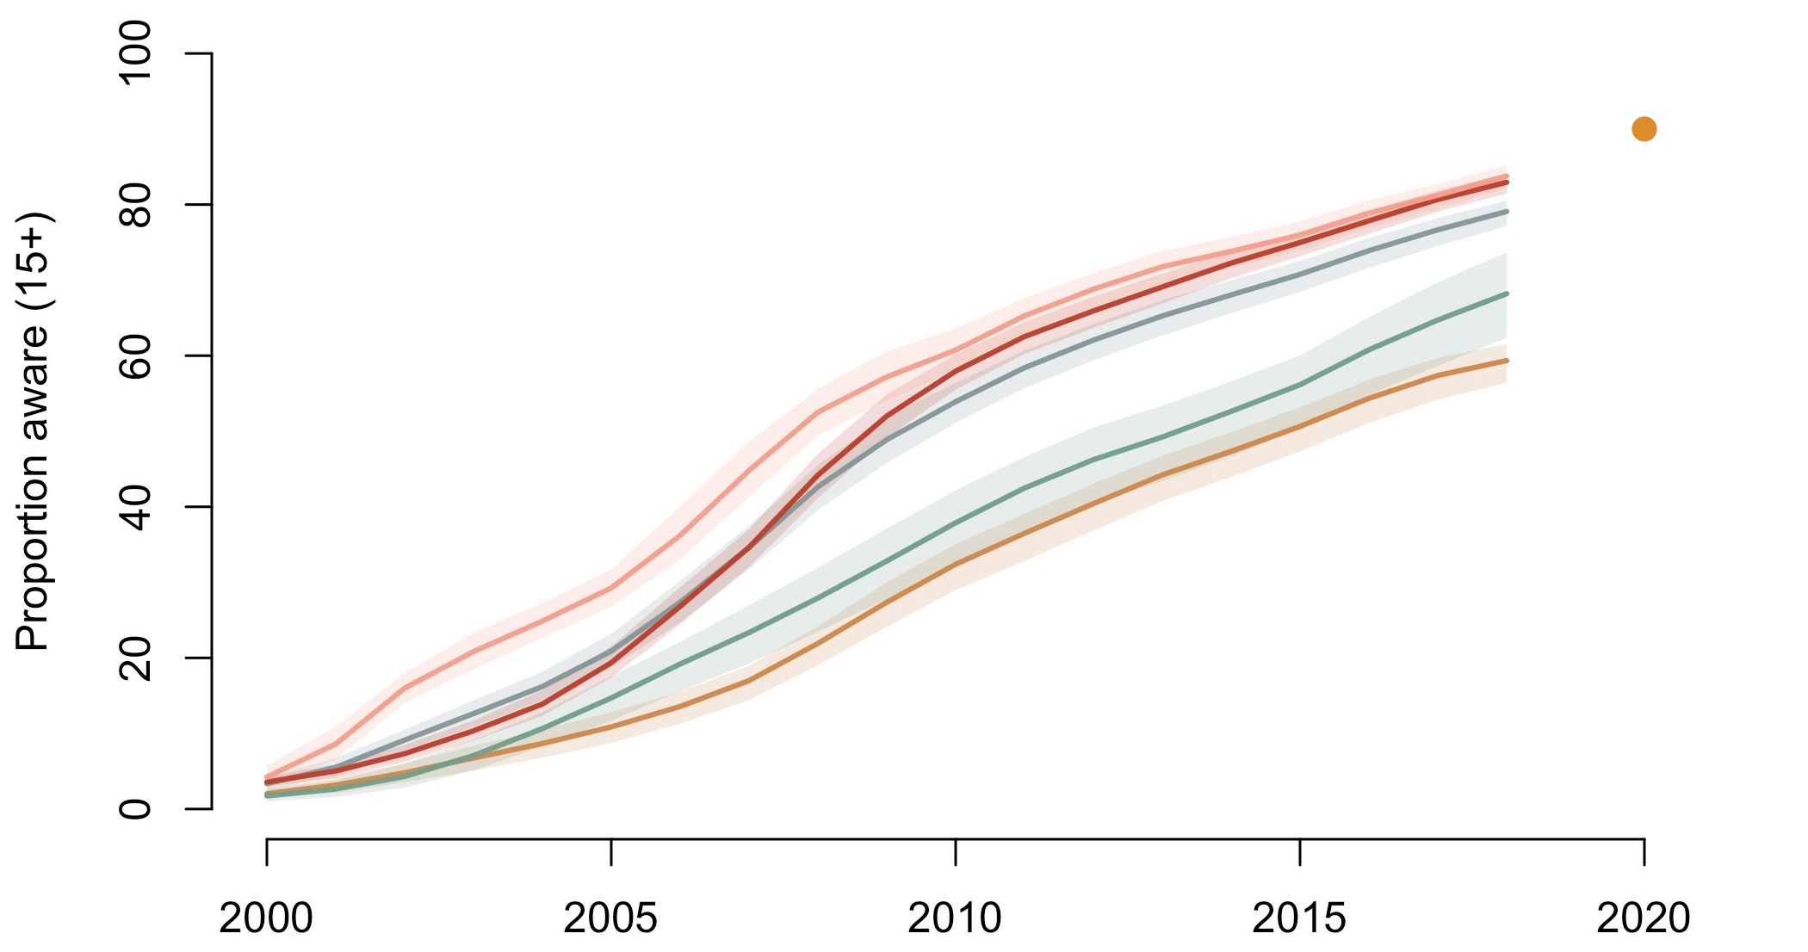
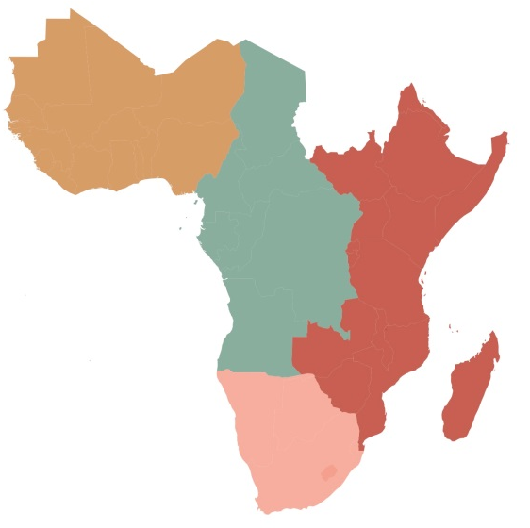
Regional trends in proportion of PLHIV in Africa aware of their HIV status (2000-2018)
2020 90% target
Southern Africa
All of SSA
Central Africa
Western Africa
Eastern Africa
Slide courtesy of Maheu-Giroux 2019, ICASA
Notes:
WAF: 60%
CAF: 68%
EAF: 83%
SAF: 84%
WAF: West of Nigeria and Niger (including them)
CAF: Cameroon and Chad to the north, to DRC, to Angola
EAF: From South Sudan and Ethiopia to Uganda, Rwanda, Burundi, Zambia, Zimbabwe and Mozambique
SAF: South Africa, Botswana, Namibia, Lesotho, Eswatini.

Slide 9
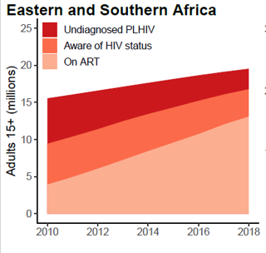
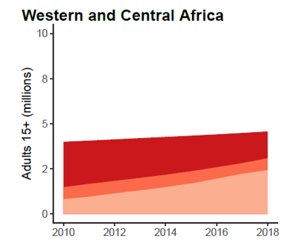
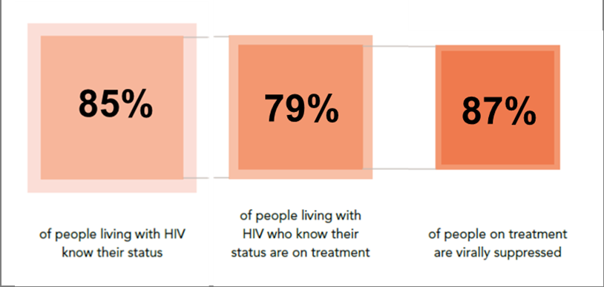
Number of people with HIV who do not know their
HIV-positive status is declining but gaps remain
Trends in the distribution of diagnosis and treatment status among PLHIV, Africa, by sub-region, 2010-2018
64%
76%
The number of adult PLHIV aware of their status but not on ART is higher than the number who do not know their HIV status
The number of adult PLHIV unaware of their HIV status decreased from 2.5 to 1.5 million
Source: Estimates shared in personal communication from K Giugere, M Maheu-Giroux, JW Eaton, October 2019; UNAIDS/WHO, 2019; Marsh K et al AIDS. 2019, doi: 10.1097/QAD.0000000000002355
Notes:
PLHIV: People living with HIV; ART: antiretroviral therapy;
HTS positivity presented in this figure is based on national programme data reported to 2018 UNAIDS Global AIDS Monitoring. National HTS positivity refers to the number of tests conducted where an HIV-positive result was returned to a person in the calendar year.
Treatment-adjusted prevalence refers to the estimated national HIV prevalence, adjusted to exclude people with HIV who are on ART from the numerator and the denominator. Treatment-adjusted prevalence includes: people with HIV who are undiagnosed, people with HIV who know their status but have not initiated treatment, and people with HIV who previously initiated treatment but have disengaged from care.
Source: Estimates shared in personal communication from K Giugere, M Maheu-Giroux, JW Eaton, October 2019; UNAIDS/WHO, 2019; Marsh K, Eaton JW, Mahy M, Sabin K, Autenrieth C, Wanyeki I, Daher J, Ghys PD. Global, regional and country-level 90-90-90 estimates for 2018: assessing progress towards the 2020 target. AIDS. 2019; 33 (Suppl 3): S213. doi: 10.1097/QAD.0000000000002355.

Slide 10
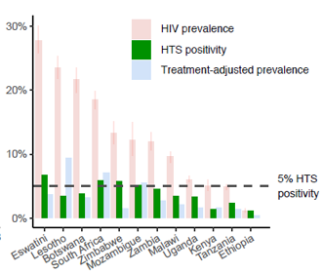
HIV testing and treatment scale-up has led to
declining HTS positivity in many settings
(% testing positive in national HTS programme)
East and Southern Africa*
In 2018, in countries with ≥20% national HIV prevalence, HTS positivity was generally ~ or < 5%.
National HTS positivity was much closer to the HIV prevalence among those not on treatment (treatment-adjusted prevalence) than to overall national prevalence.
But gaps remain…
*Tanzania = United Republic of Tanzania
Notes:
HTS: HIV testing services; HTS positivity presented in this figure is based on national programme data reported to 2018 UNAIDS Global AIDS Monitoring. National HTS positivity refers to the number of tests conducted where an HIV-positive result was returned to a person in the calendar year through the HTS programme.
Treatment-adjusted prevalence refers to the estimated national HIV prevalence, adjusted to exclude people with HIV who are on ART from the numerator and the denominator. Treatment-adjusted prevalence includes: people with HIV who are undiagnosed, people with HIV who know their status but have not initiated treatment, and people with HIV who previously initiated treatment but have disengaged from care.
Source: UNAIDS/WHO, 2019
Giguère, Maheu-Giroux, Eaton, 2019

Slide 11

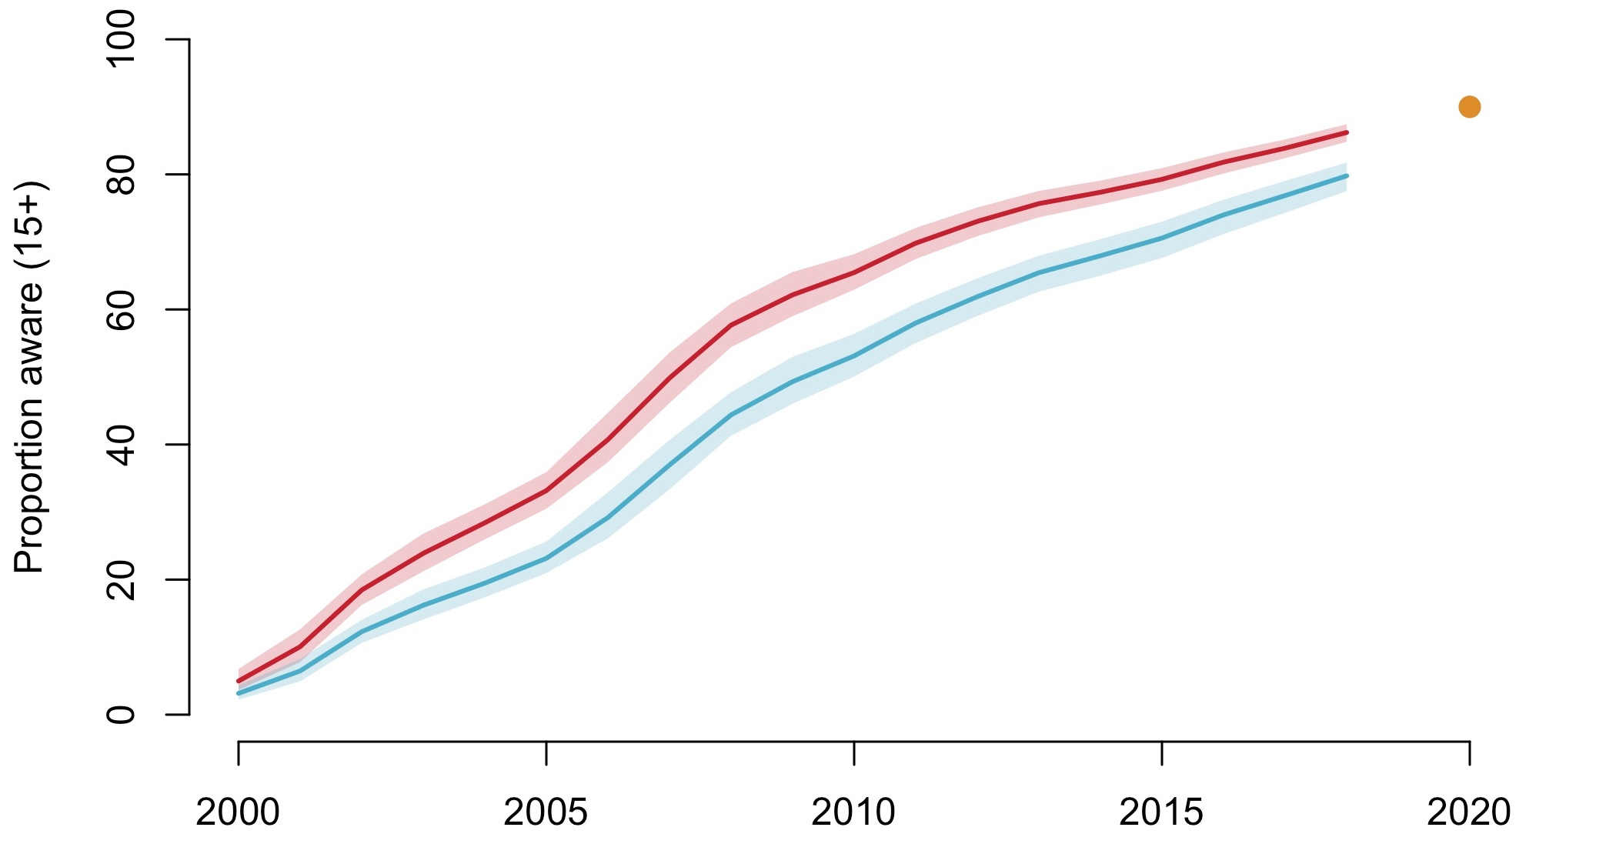
Gender differences in proportion of PLHIV aware (2000-2018)
All sub-Saharan Africa
2020 90% target
Women (15+)
Men (15+)
Slide courtesy of Maheu-Giroux 2019, ICASA
Notes:
Women: 83%
Men: 73%

Slide 12
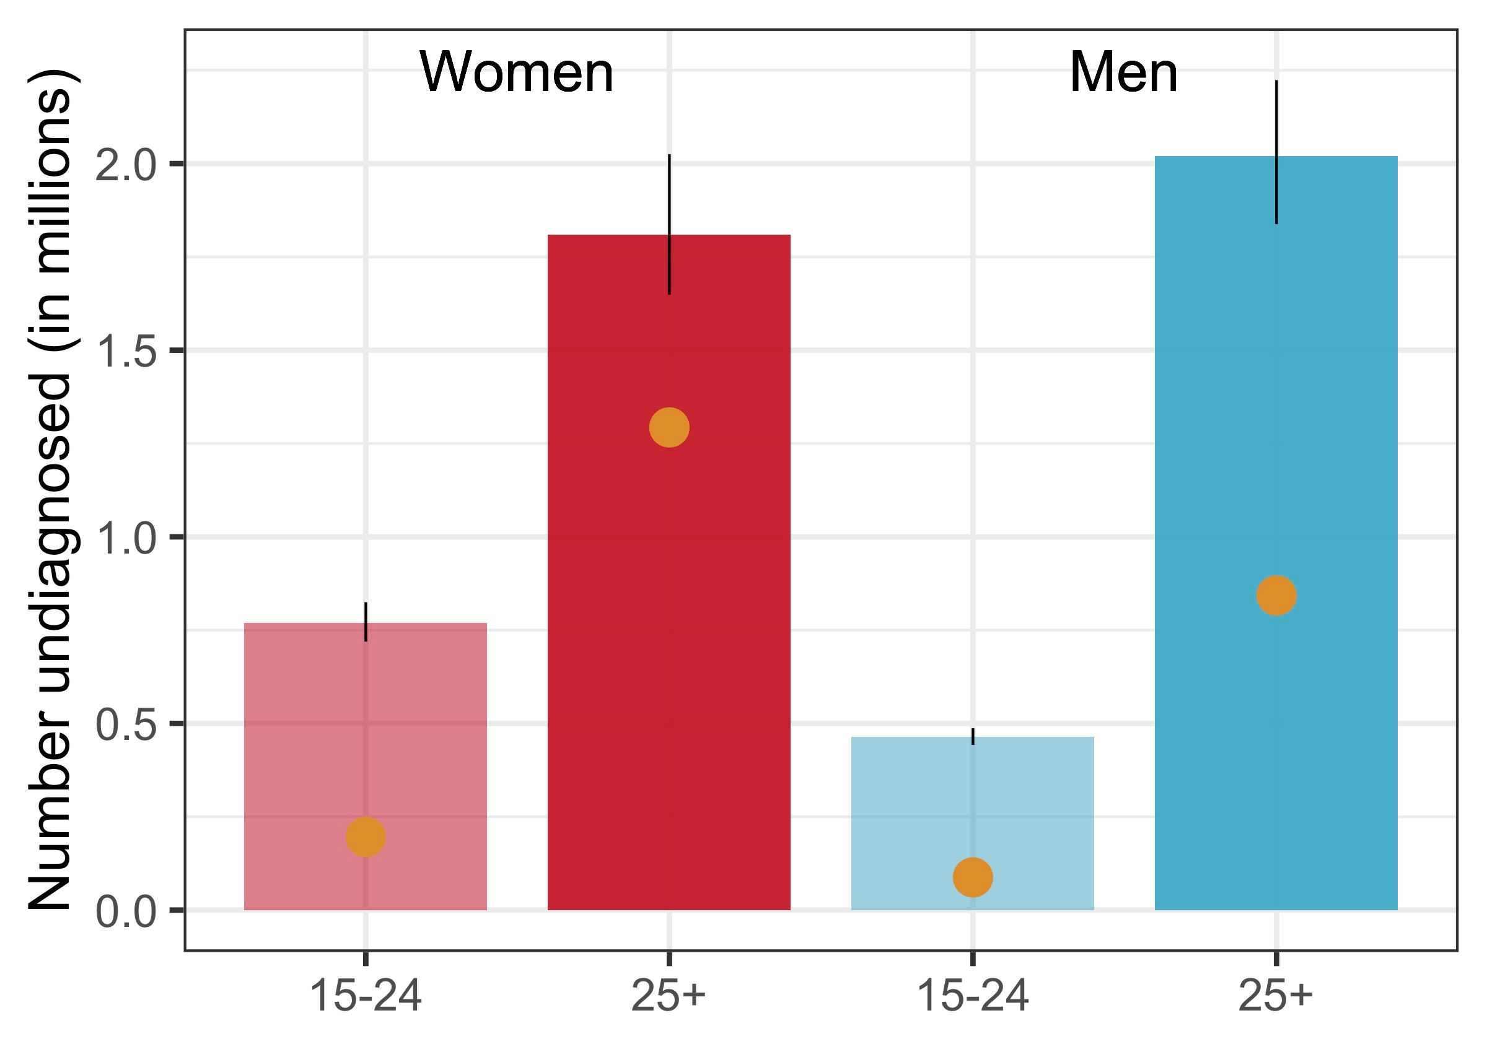
Absolute diagnosis gaps in 2018
Number to diagnose to reach 90% target
All sub-Saharan Africa
2020 90%
target
Slide courtesy of Maheu-Giroux 2019, ICASA
Notes:
2 million undiagnosed men overall.
More than 1.25 million men aged 25+ years to diagnose to reach target.

Slide 13
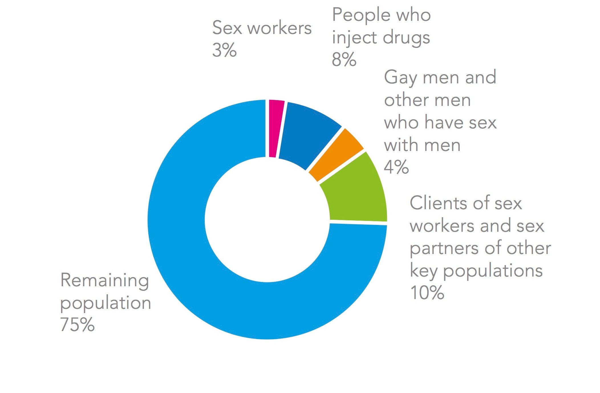
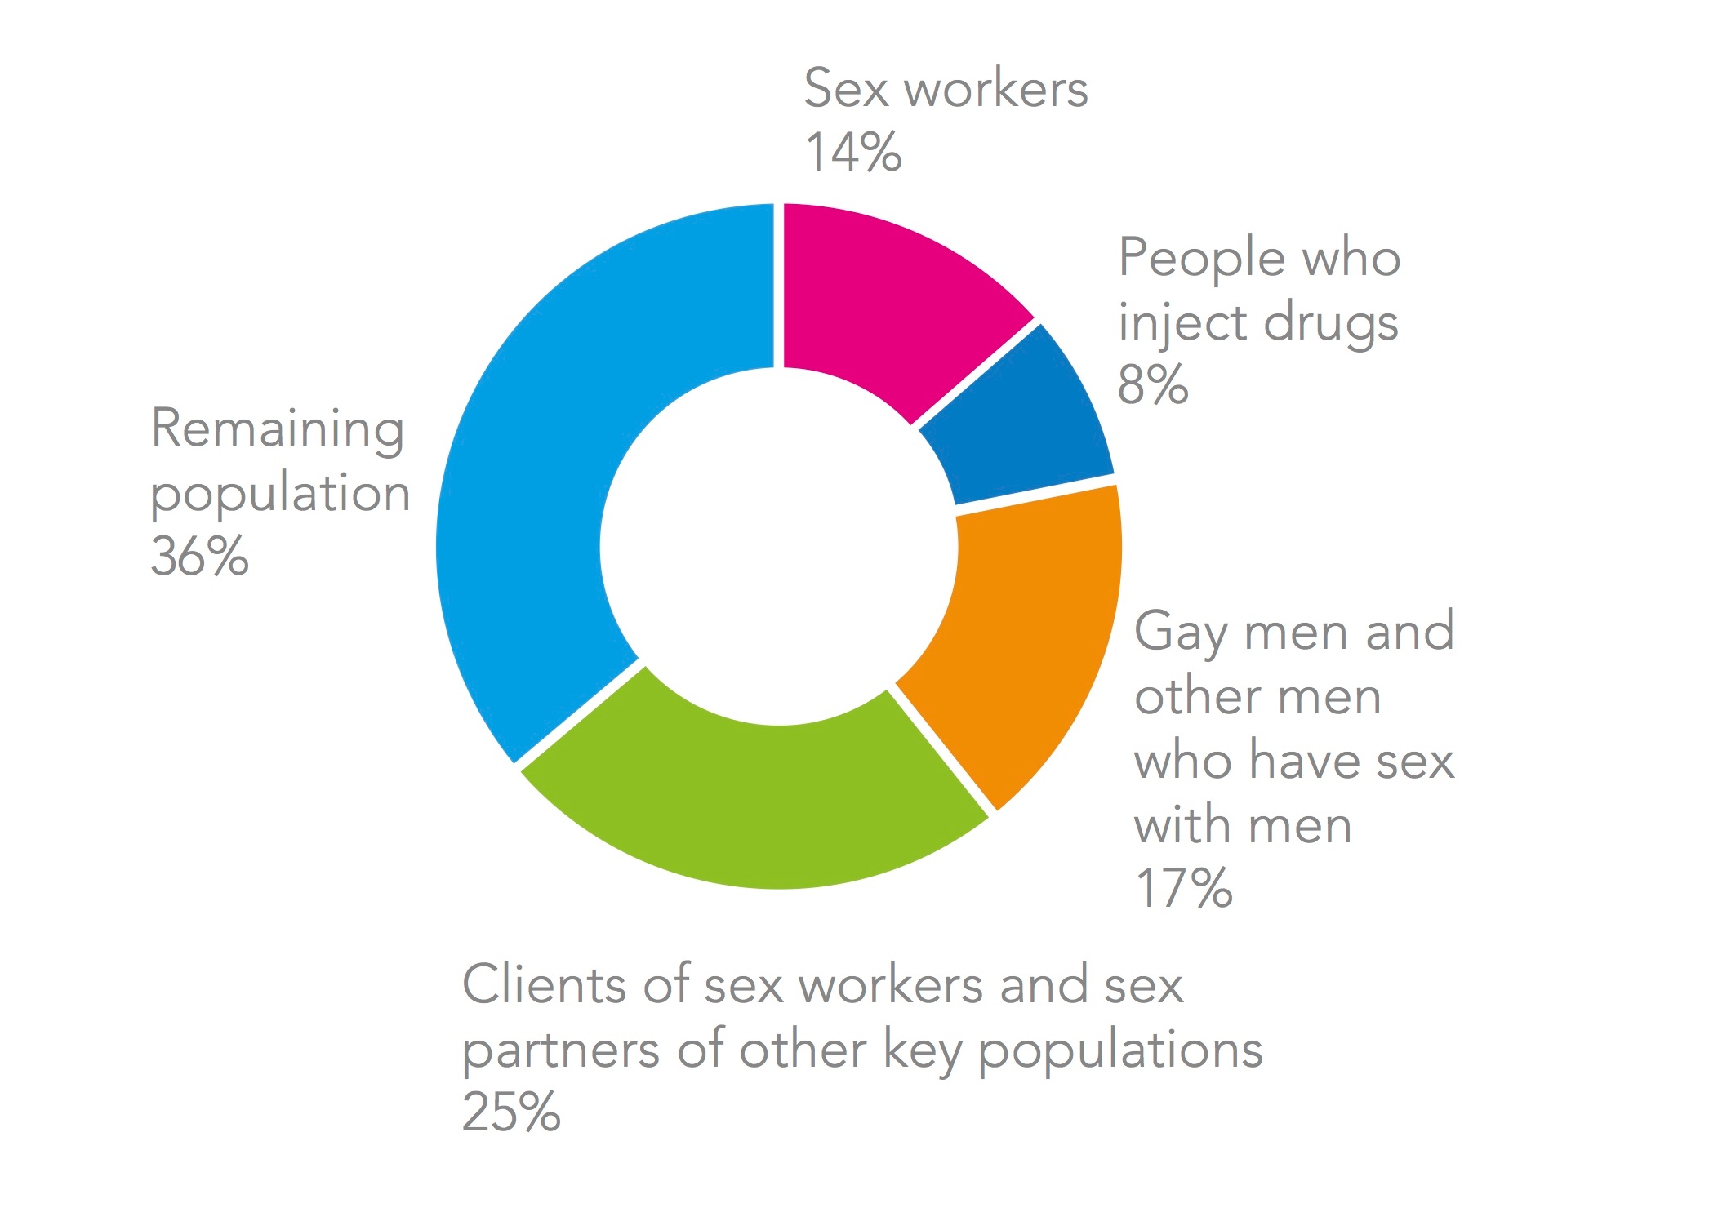
Distribution of new HIV infections (2018)
West and Central Africa (among 15-49 years)
Eastern and Southern Africa
(15-49 years)
Source: UNAIDS 2019 Estimates

Slide 14
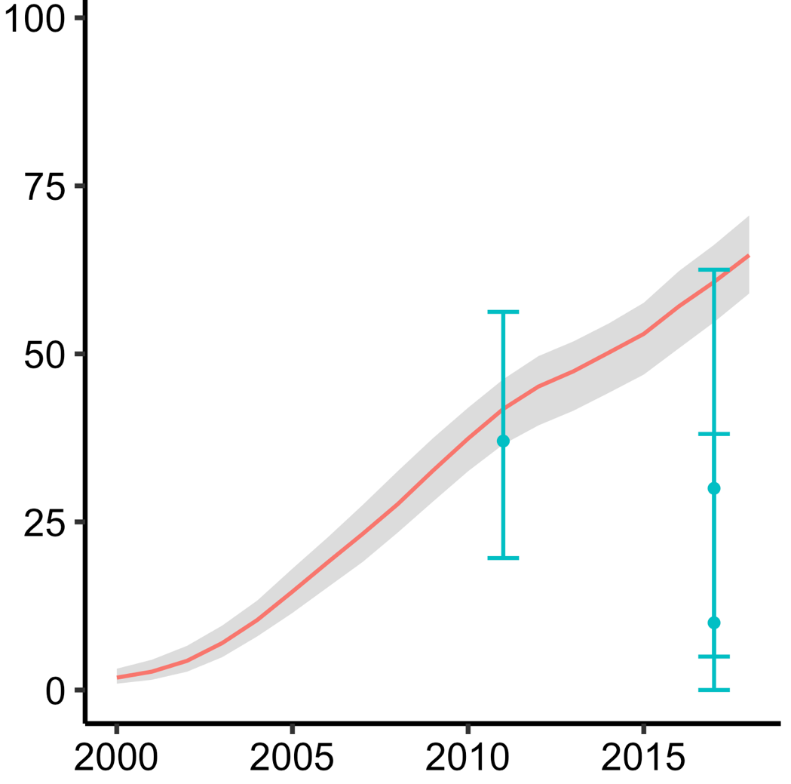
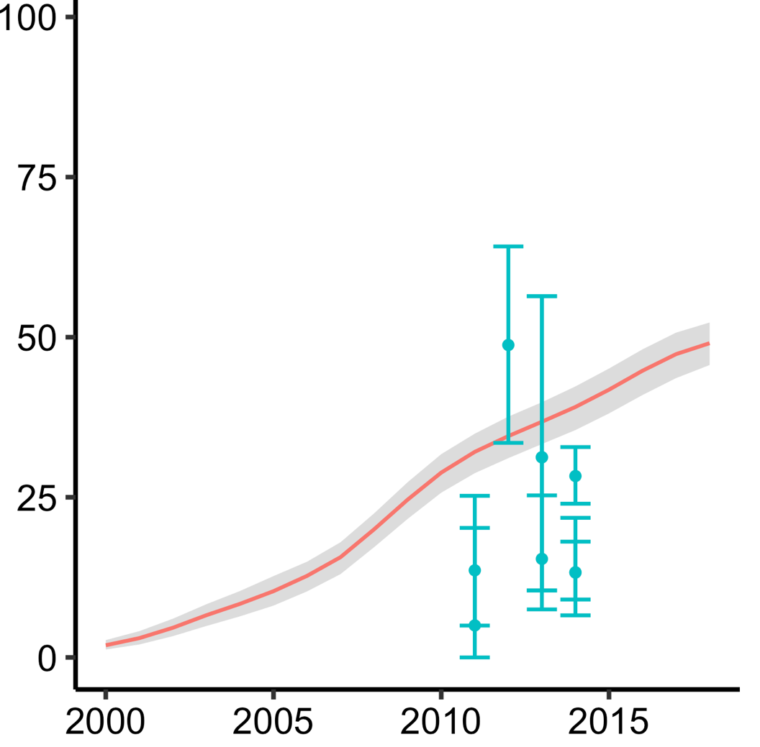
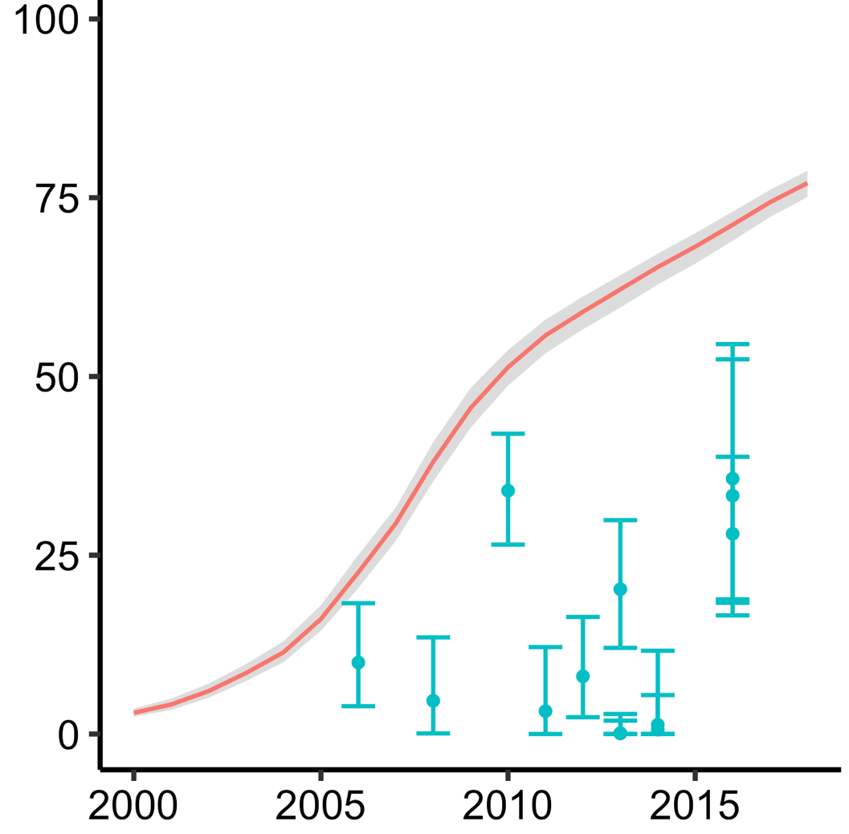
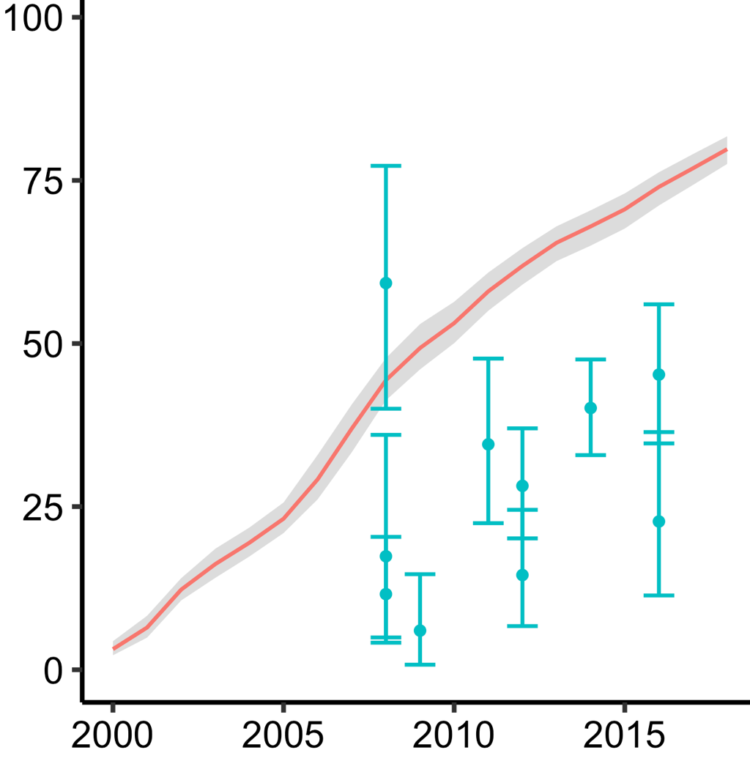

Comparison of awareness of HIV status:
men and men who have sex with men
Central Africa
Western Africa
Eastern Africa
Southern Africa
Proportion Aware (%)
Men (15+)
MSM
Men : Modeled Shiny90 estimates for men aged 15+ years.
MSM: Systematic review of empirical estimates of self-reported HIV awareness. Points correspond to specific survey estimates conducted at different times in different locations (Stannah et al. 2019. Lancet HIV).

Slide 15

Understanding gap: Who is missing?
Globally the 21% of PLHIV undiagnosed are primarily
Biggest gaps in
  Key populations (KP) and their partners
  Men in high HIV burden settings
  Young people (age 15-24) from KP and in high HIV burden settings
  FP service attendees in high HIV burden settings
  Partners of PLHIV
  STI patients
LTFU PLHIV (also need to be tested to be re-engaged in care)

Slide 16
Understanding gap: Who is
Many of these populations are also
a high priority for HIV prevention – including PrEP
Globally the 21% of PLHIV undiagnosed are primarily
Biggest gaps in
  Key populations (KP) and their partners
  Men in high HIV burden settings
  Young people (age 15-24) from KP and in high HIV burden settings
  FP service attendees in high HIV burden settings
  Partners of PLHIV
  STI patients
LTFU PLHIV (also need to be tested to be re-engaged in care)

Slide 17
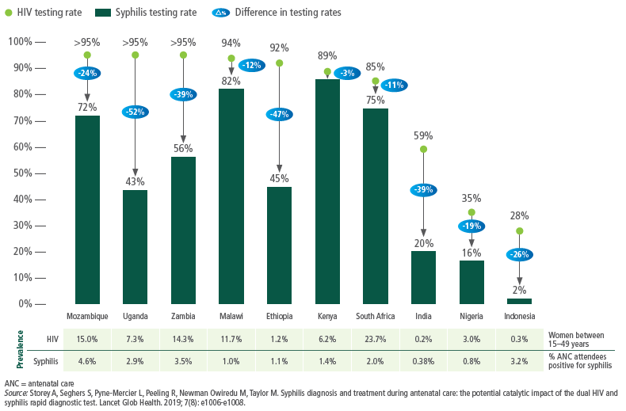
Differences in coverage of testing for HIV and syphilis in pregnant women visiting ANC in 10 countries, 2016–2018
Not just HIV, but STIs
Syphilis testing, which has considerably low coverage than HIV

Slide 18
Uptake and implementation of WHO HIV testing services guidelines, 2018
90% (n=130) countries report fully or partial adoption of WHO guidelines in 2018
91 countries with policies, of which 73 are using partner services
77 countries with policies, of which 38 are fully implementing
PITC based on reported use, 2018=126/130 countries reporting; ANC HTS based on reported use, 2018=125/130 countries reporting; Community HTS based on reported use, 2018=107/130 countries reporting; Partner notification or index testing based on reported policy and use, 2018=73/128 countries reporting; Lay provider HTS based on reported use, 2018=71/130 countries reporting; HIVST based on policy and full implementation, 2018=77/194.

Slide 19
Number of countries with a provider-assisted referral policy
(often called partner notification or index HIV testing), 2017-2018
61% and 70% of countries reporting had an assisted partner notification or index HIV testing policy in 2017 and 2018, respectively
68%
61%
59%
40%
71%
72%
94%
79%
91%
83%
50%
50%
GAM – WHO, UNAIDS, UNICEF, 25 June 2019; reported by WHO region
2017 = 72/118 countries reporting; 2018=91/130 countries reporting

Slide 20
National HIVST policy and implementation 2018, by region
40% (77/194) reporting countries have HIVST policies, of these only 49% (38) are implementing
% Implementing
8%
46%
0%
48%
6%
5%
4%
19%
# Reporting
N=40
N=16
N=21
N=16
N=17
N=21
N=25
N=41
Source: GAM WHO, UNAIDS, UNICEF 15 July 2019

Slide 21
Priorities for first 95
  Tremendous progress over last decade:
  Closer to achieving first 90 – but priority populations still missed.
  Achieving high awareness of status is challenging:
    Key populations are more likely to be undiagnosed.
    Partners of PLHIV, STI patients missed
    In southern Africa, men (25+) missed and AGYW incidence high and no standard HTS in FP services.
  WHO policy gaps
    Significant gaps in implementation of WHO HTS guidelines – particularly high impact differentiated HTS approaches.
  2030 target is 95% awareness – how to achieve it:
    Additional challenges, decreasing positivity.
    Need to optimize HIV testing services to focus on priority populations.
    Reduce both absolute and relative gaps.

Slide 22
Access the full guidelines on the WHO HTS APP!
Search ‘WHO HTS Info’ wherever you get Apps
Notifications when new content is available
Search, save, send
Country HTS data in one place w/ guidelines
Language updates: French on the way!
Available online and off
Videos coming for 2020

Slide 23
New WHO HTS Guidelines for a changing epidemic

Slide 24
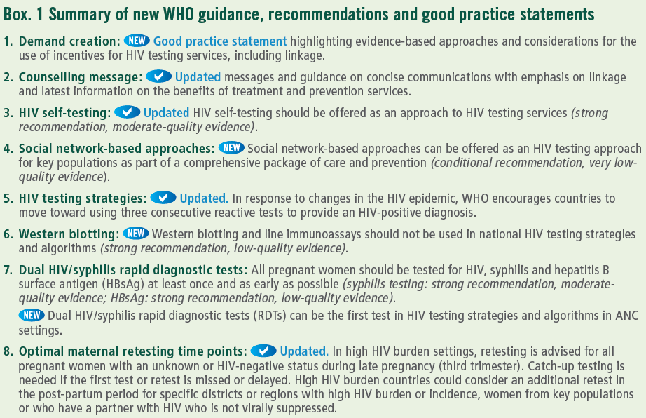
New WHO guidelines on HTS for a changing epidemic
8 updates and new recommendations/guidance

Slide 25
Prioritizing population: Reaching who is missing?
Globally the 21% of PLHIV undiagnosed are primarily
Biggest gaps in
  Key populations (KP) and their partners
  Men in high HIV burden settings
  Young people (age 15-24) from KP and in high HIV burden settings
  FP service attendees in high HIV burden settings
  Partners of PLHIV
  STI patients
PLHIV lost to follow-up (also need to tested to be re-engaged in care)

Slide 26






WHO recommended HIV testing service delivery approaches
HTS is an important gateway to treatment and prevention for individuals, partners, couples and families
Facility-based: Offering HIV testing in a facility, e.g. VCT, in-patient and out-patient clinics, ANC, TB, STI, family planning/contraceptive services
Community-based: Offering HIV testing in natural setting of the community, e.g. outreach, CBOs, workplace, clubs, bars.
UPDATED Provider-assisted referral (i.e. index testing or assisted partner notification): Assisting individuals with HIV by contacting their sexual and/or drug injecting partners and offering them HIV testing services.
NEW Social network-based approaches: whereby key populations offer HTS to their social, sexual and drug injecting partners at risk of HIV. Includes HIV+ and HIV- key populations
UPDATED HIV self-testing: Offering self-test kit for individual, and/or their partner, enabling them to collect their sample (oral or blood), perform test, and interpret results in private. All reactive results need confirmation.
Notes:
HIV testing services provide an important gateway to treatment and prevention. Following an HIV test: Those who test negative can be linked to effective HIV methods, e.g. voluntary male medical circumcision, pre exposure prophylaxis, harm reduction and condoms; Those who test positive can be linked to lifesaving treatment.
There are many WHO-recommended approaches for HTS: In facility settings, community-settings or through self-testing.
As programmes scale up testing, they are increasingly facing the issue of balancing resource needs and efficiency and maximizing impact.
HTS approaches need to focus on reaching those who remain undiagnosed and those at ongoing risk through a strategic mix of HTS approaches. New approaches may be needed for reaching hard to reach populations. At the same time it is critical to maintain quality of HTS, improve linkage to post-test services and optimize service delivery.

Slide 27
Key definitions for considering HTS delivery
High HIV burden settings considered ≥5%
Low HIV burden settings considered <5%
Generalised epidemic
Concentrated epidemic

Slide 28
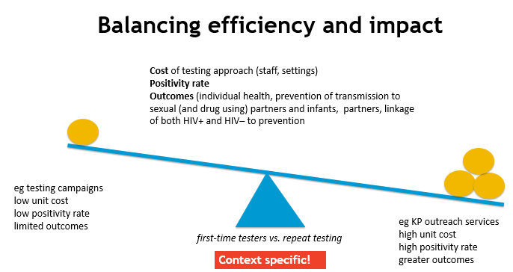
High impact HTS implementation that is focused on reaching undiagnosed PLHIV and facilitating linkage to care is essential
Effective Focused Facility-based HTS
High burden settings: HTS in every health contact – integration | Low burden settings: HTS in hotspots/select services (TB, STI, key pops)
HIVST & Community Approaches
High burden settings: outreach for key pops, partners PLHIV, hotspots, consider workplace, strategic outreach | Low burden settings: outreach to key pops, partners PLHIV
Reorienting HTS to reach the most PLHIV (#) who don’t know their status as effectively and efficiently as possible (%)
A strategic mix of HTS approaches and options needed to reach priority populations
  Key populations and their partners
  Partners PLHIV
  Young people (15-24) and men in ESA
Couples and Partners
High burden settings: offer all, and for partners of KP and PLHIV | Low burden settings: offer to KP and partners of PLHIV

Slide 29
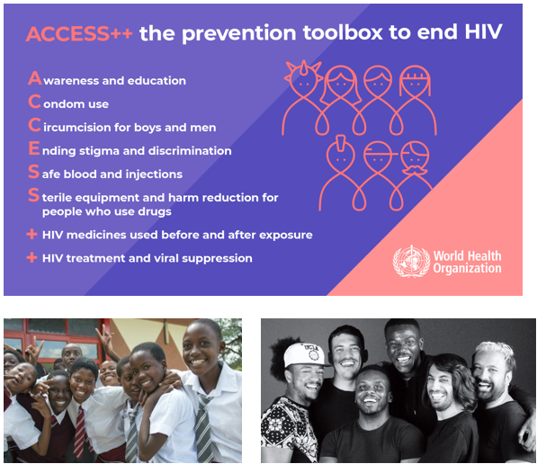
HIV testing as prevention monitoring
HIV prevention packages
  HIV testing services are also part of implementing and monitoring prevention services to help:
  HIV-negative ppl stay negative (monitoring)
  Diagnose PLHIV at high risk and start ART as soon as possible
  Core HIV Prevention packages with HTS:
  PMTCT (1st ANC visit test for all, late pregnancy 3rd trimester only for KP or in high burden settings)
  VMMC – 1 test or self-test
  PrEP – quarterly testing
  Key populations testing at least annually (up to 3-6 month based on risk )
  Serodiscordant couples package of services annually (up to 3-6 month based on risk )
  AGYW package of services

Slide 30
Frequency of HIV testing people (HIV-negatives)
Primary retesting goals:
Enable people who are HIV-negative to stay HIV-negative (link or stay engaged in prevention)
Identify new PLHIV as early as possible so that they can start treatment.
Annual retesting, in high HIV burden setting, advised for:
sexually active individuals in high HIV burden settings and;
people who have ongoing HIV-related risks in all settings.
More frequent retesting, e.g. every 3–6 months
based on individual risks and as part of broader HIV prevention interventions, e.g. quarterly testing while taking PrEP, or KP with risks such as an STI.
(Not recommended to advise retesting every 3-months e.g. “window period for all”)
Retesting in specific groups
People presenting with a diagnosis or receiving treatment for STIs or viral hepatitis
People with a confirmed or presumptive TB diagnosis
outpatients presenting with clinical conditions or symptoms indicative of HIV
individuals with recent HIV risk exposure or who are concerned that they may have been exposed.

Slide 31
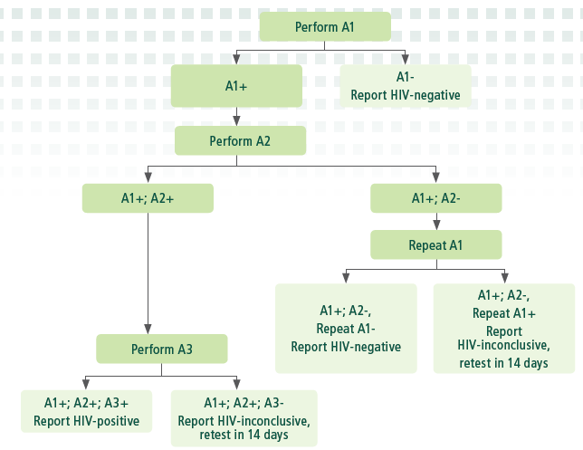
Accurate HIV diagnosis
WHO standard HIV testing strategy for changing HIV epidemic
UPDATED GUIDANCE
WHO recommends national testing strategies achieve at least 99% PPV (that is less than 1 false positive per 100)
When national HTS positivity drops below 5% the PPV of testing strategies, with only 2 consecutive reactive tests, drops below 99% PPV
Important to simplify as the HIV epidemic becomes more mixed across sites and subnationally and across populations
WHO guidance:
High HIV burden countries need to monitor HIV prevalence among those untreated to plan and determine when and how to transition to using 3 consecutive reactive tests for accurate HIV+ diagnosis
Low HIV burden countries reminded to use
3 consecutive reactive tests for accurate HIV+ diagnosis

Slide 32
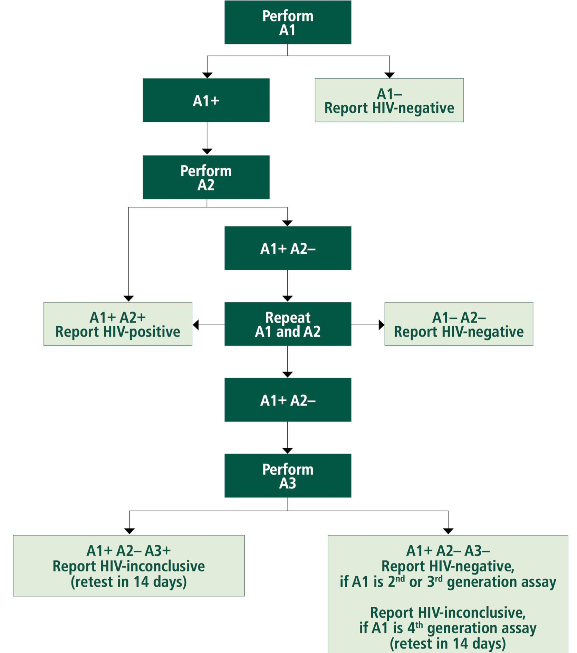
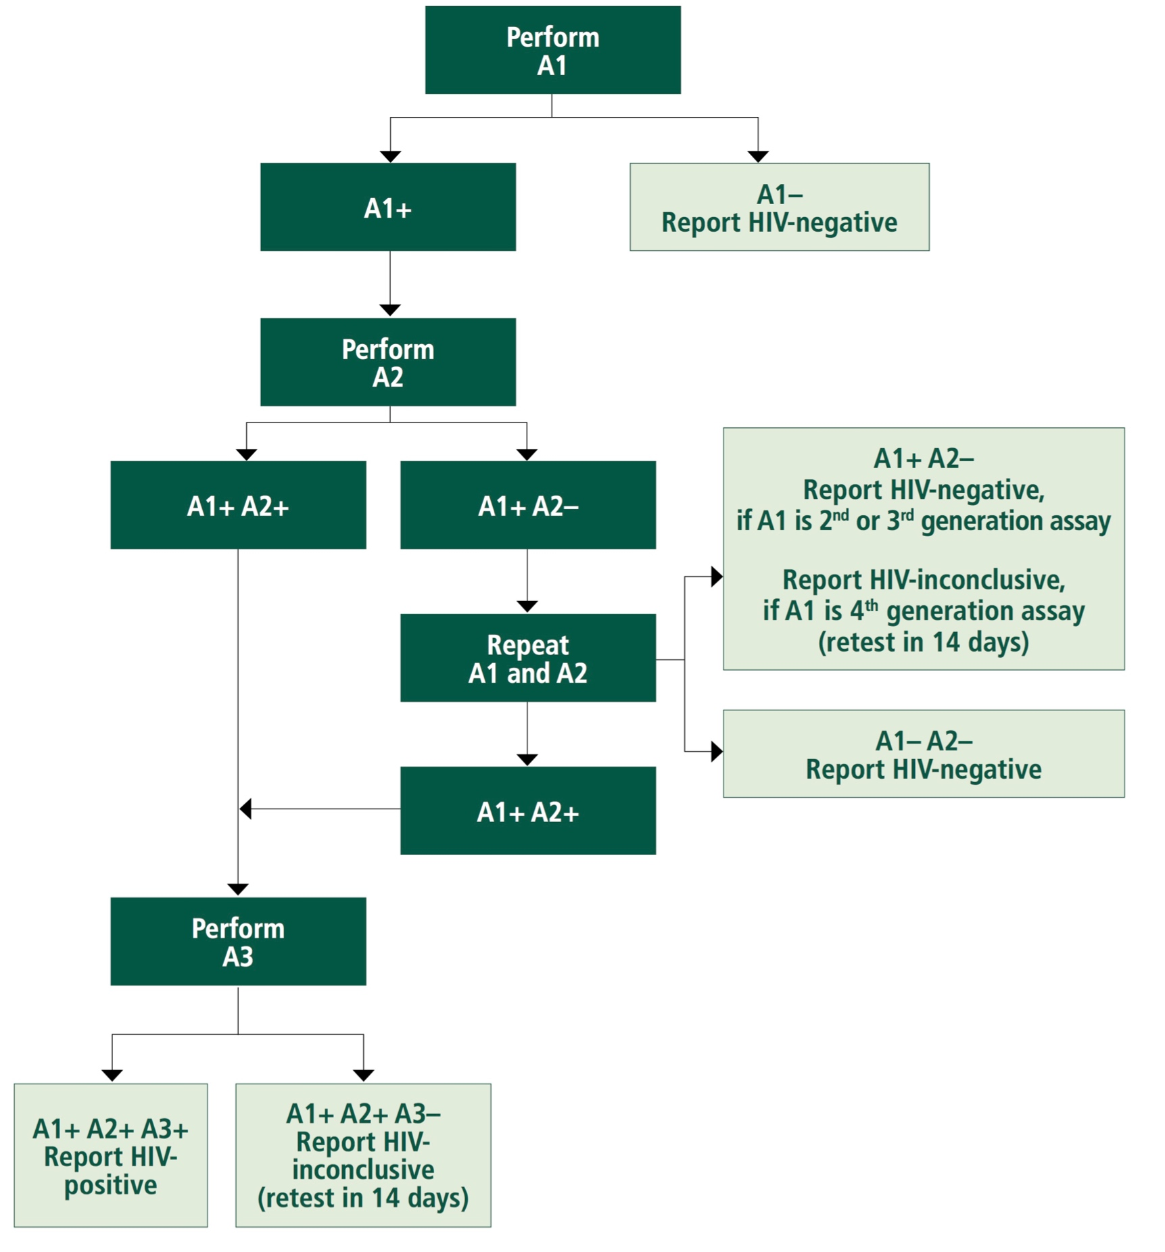
WHO 2015 guidelines: testing strategies
High prevalence among testers
≥5%(2-Test)
Low prevalence
Among testers <5%(3-Test)
2- or 3-test strategy refer to number of consecutive reactive tests to diagnose HIV
both strategies require 3 assays (A3)

Slide 33
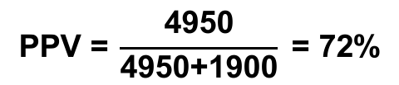


Positive predictive value and number of tests
Probability of being classified as HIV positive (assuming 99% sensitivity; 98% specificity)
After 1 assay
After 2 assays
After 3 assays
5,000 HIV+ specimens
x 0.99
4950 reactive
x 0.99
4901 reactive
4851 reactive
x 0.99
100,000 specimens tested;
5% prevalence
95,000 HIV– specimens
x (1-0.98)
1900 reactive
x (1-0.98)
38 reactive
x (1-0.98)
0.8 reactive
$$\text{PPV}\text{ =} \frac{\text{4950}}{\text{4950+1900}}\text{ = 72\%}$$
PPV = $\frac{\text{49}\text{01}}{\text{49}\text{01}\text{+}\text{38}}$= 99.2%
PPV = $\frac{\text{4851}}{\text{4851}\text{+}\text{0.}\text{8}}$>99.9%
**Simplified algorithm - consecutive reactive HIV tests only

Slide 34
Positive predictive value depends on positivity
Outcomes per 100,000 tested
Assuming 99% sensitivity; 98% specificity; simplified algorithm -- consecutive HIV+ tests only.
Prevalence | Per 100,000 tested | After 1 assay | After 2 assays | After 3 assays
10% | 10,000 HIV+ 90,000 HIV- | 9900 true+ (99%) 1800 false+ (2%) 85% PPV | 9801 true+ 36 false+ 99.6% PPV | 9703 true+ 0.7 false+ 99.9% PPV
5% | 5000 HIV+ 95,000 HIV- | 4950 true+ 1900 false+ 72% PPV | 4901 true+ 38 false+ 99.2% PPV | 4851 true+ 0.8 false+ 99.9% PPV
1% | 1000 HIV+ 99,000 HIV- | 990 true+ 1980 false+ 33% PPV | 980 true+ 40 false+ 96% PPV | 970 true+ 0.8 false+ 99.9% PPV
0.1% | 100 HIV+ 99,900 HIV- | 99 true+ 1998 false+ 5% PPV | 98 true+ 40 false+ 70% PPV | 97 true+ 0.8 false+ 99.1% PPV

Slide 35
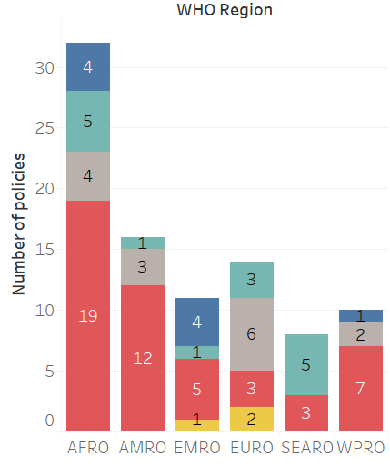
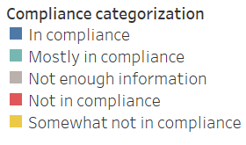
Challenges in operationalizing diagnosis guidance
Current guidance on choosing 2-test vs 3-test strategy:
  Countries experienced challenges in adopting WHO’s diagnostic guidance.
  Should reflect positivity amongst tested population (not national prevalence).
  Requires clarification in 2019 HTS GL revision.
Typically, national HIV prevalence has been used as proxy for positivity among testers to select 2-test or 3-test strategy.

Slide 36
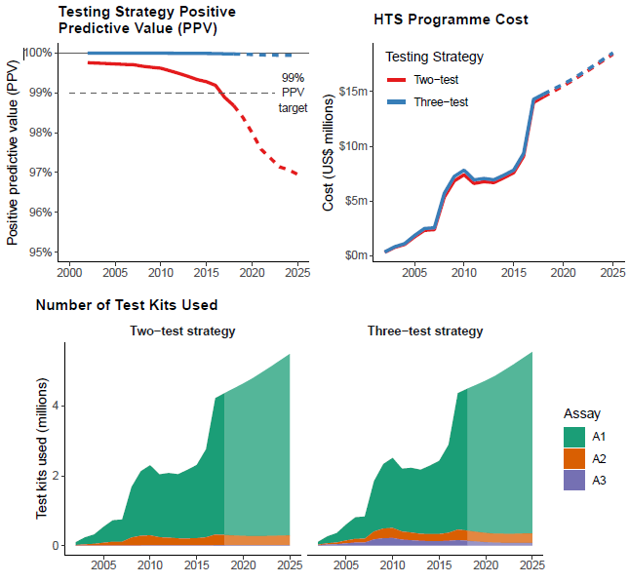
Implications for moving to the
WHO standard HIV testing strategy?
Estimates and projections for HIV rapid test kit usage (2000-2025), Malawi, and implications for HIV testing
More accurate HIV+ diagnoses
  Increases inconclusive results:
    A1+/A2+/A3- ruled inconclusive… but most will be confirmed negative at day 14 (a good thing, otherwise, they would go on ART).
  Important for treat all and rapid initiation
Cost-effective overall
  Without even considering cost of misdiagnosis and unnecessary ART initiation
HTS programme costs are comparable – see Malawi example
  Incremental cost of 3-test vs. 2-test algorithm <2.5% for positivity below 5%
  Continued efforts to minimize costs are needed, by having good coordination and exploring ways to reduce cost of delivering first test
Need to consider ways to ease implementation
  Greater expansion of test for triage and HIV self-testing
Source: WHO GL 2019; WHO/UNAIDS/Malawi Department of HIV/AIDS, 2019 derived from Maheu-Giroux M et al AIDS 2019. DOI: 10.1097/QAD.0000000000002386.

Slide 37
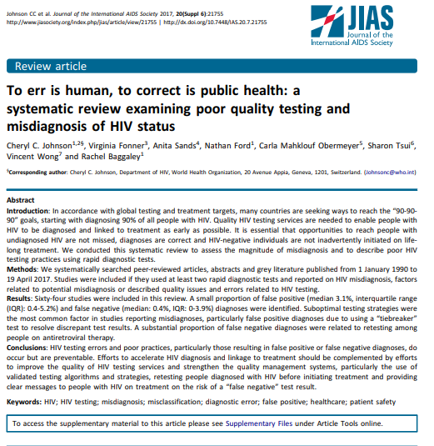
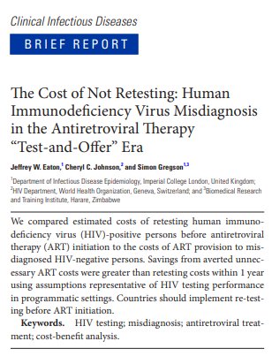
It remains important to retest:
People with HIV-inconclusive test results after 14 days; and
People diagnosed with HIV to verify an HIV-positive diagnosis before initiating care and/or ART.
This is quality assurance measure, e.g. rule out human errors, and prevent initiation of life long treatment.
Retesting people who are already on ART is not recommended.

Slide 38
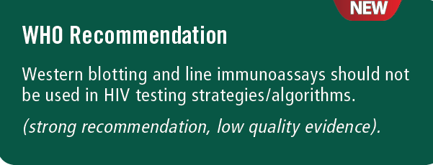
NEW RECOMMENDATION
Summary of key evidence
Performance: Sensitivity and specificity is comparable, but a substantially higher number of indeterminate results with an algorithm containing WB (nearly half were among HIV+).
Programmatic outcomes: Significantly longer time to diagnosis, higher loss to follow-up, and lower linkage to care with algorithms containing WB.
Values and preferences: Generally both clients and provider favor algorithms without WB.
Feasibility: Difficult to implement treat all, rapid ART initiation and offer prevention (PrEP) to those at substantial HIV risk when utilizing a WB algorithm. Testing with a WB requires more skilled staff and infrastructure.
Resources use: More resources required for WB-based testing, all studies reported RDT to be substantially less costly than WB-based testing. One programme that stopped WB-based algorithms reported cost savings.
Equity: Moving away from WB likely to improve equity and uptake among people with HIV who do not know their status

Slide 39




Gaps in HIV and syphilis screening during pregnancy
UPDATED GUIDANCE FOR HTS IN ANC
Syphilis is the 2nd leading cause of still birth globally
HIV
Syphilis
1.4 M
930,000
2-23%
11%
MTCT
150,000
New infections (2015)
102,000
Congenital infections (2012)
UNAIDS Global Plan, 2016; Wijesooriya NS, Lancet 2016; Johnson LF, JAIDS 2012.
Notes:
Maternal HIV and syphilis cause substantial morbidity and mortality globally, with 1.4 million maternal HIV infections and 930,000 maternal syphilis infections annually. The burden of these infections is most pronounced in sub-Saharan Africa. Despite the success of effective maternal treatment to prevent MTCT, between 2-23% of HIV-infected mothers will transmit HIV to their infant, and 11% of infants exposed to syphilis will develop congenital syphilis.
Overall, this leads to 150,000 infant HIV infections and 102,000 congenital syphilis infections each year, with the majority from Sub-Saharan Africa.
To move towards global goals of elimination of MTCT of both infections, we will need to universally screen pregnant women for both HIV and syphilis

Slide 40
UPDATED GUIDANCE FOR HTS IN ANC
Differences in coverage of testing for HIV and syphilis in pregnant women visiting ANC in 10 countries, 2016–2018
Syphilis testing coverage considerably low coverage than HIV
Introducing dual HIV/syphilis rapid tests as first test in ANC is cost-saving in both high and low HIV burden settings
Dual HIV/syphilis RDs can help close the gap!

Slide 41
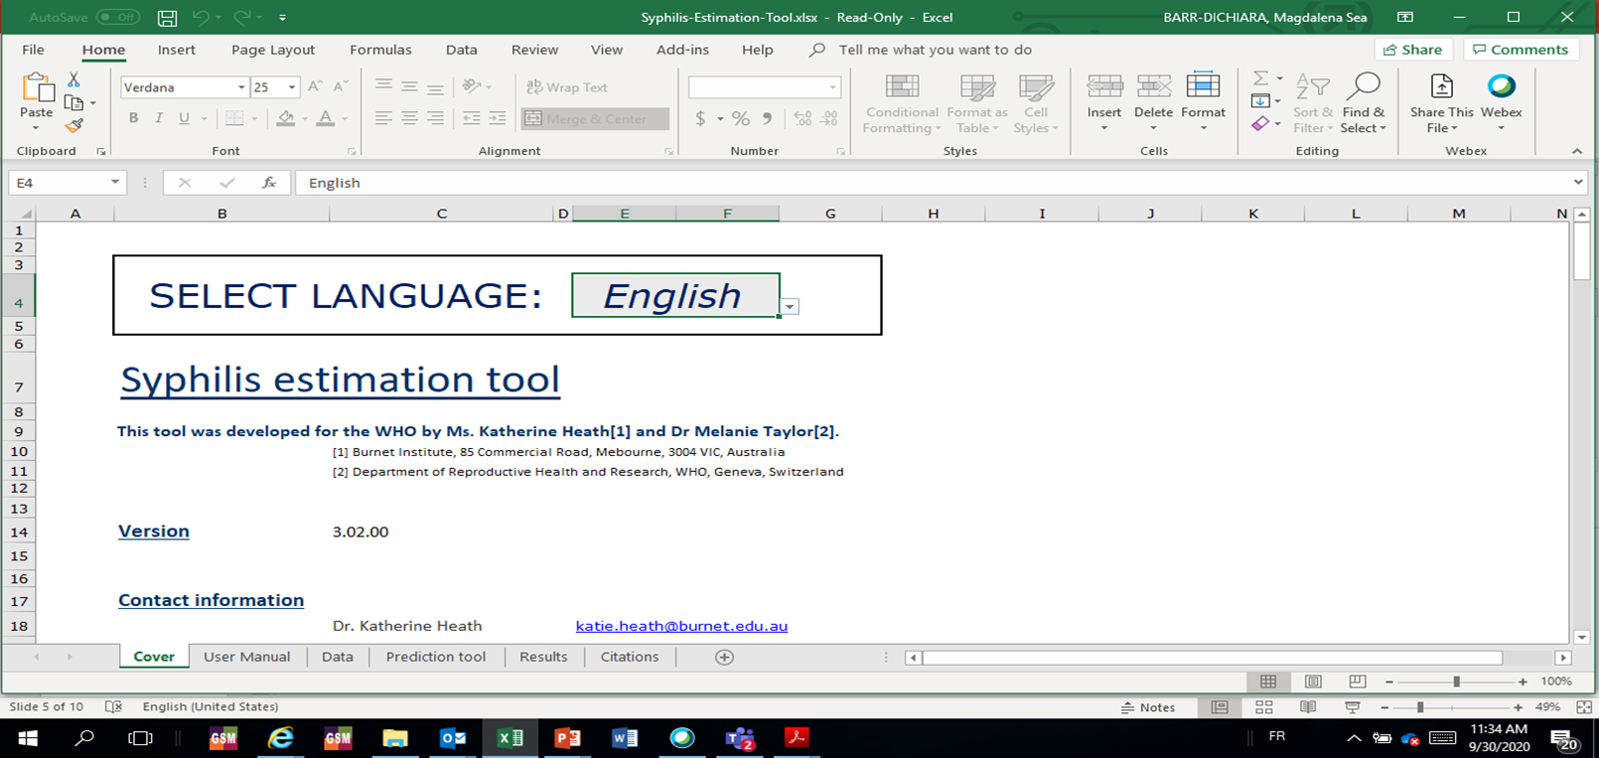
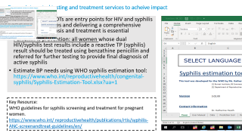
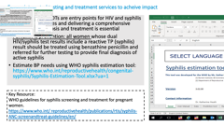
Ensure integrated testing and treatment services to acheive impact
Single and dual RDTs are entry points for HIV and syphilis prevention services and delivering a comprehensive package of diagnosis and treatment is essential
Penicillin is prevention: all women whose dual HIV/syphilis test results include a reactive TP (syphilis) result should be treated using benzathine penicillin and referred for further testing to provide final diagnosis of active syphilis
Estimate BP needs using WHO syphilis estimation tool: https://www.who.int/reproductivehealth/congenital-syphilis/Syphilis-Estimation-Tool.xlsx?ua=1
Key Resource:
WHO guidelines for syphilis screening and treatment for pregnant women.
https://www.who.int/ reproductivehealth/publications/rtis/syphilis-ANC-screenandtreat-guidelines/en/
Notes:
Integrated testing and treatment services require careful supply planning to prevent missed opportunities for testing and treatment for syphilis and HIV
Single syphilis RDTs are still recommended. So, if programmes are not using dual RDTs single rapid tests offer a fast and simple to use tool for diagnosis of syphilis. With types of test, a complete package of testing, prevention, and treatment services must be considered.
Penicillin is prevention: all women whose test results include a reactive TP (syphilis) result should be treated using benzathine penicillin and referred for further testing to provide final diagnosis of active syphilis
To estimate a programme’s penicillin needs one can use the WHO syphilis estimation tool. A web link is included here.
Tests that can diagnose active an past syphilis infection, or treponemal/non treponemal tests are an emerging innovation that may be useful in the future.

Slide 42
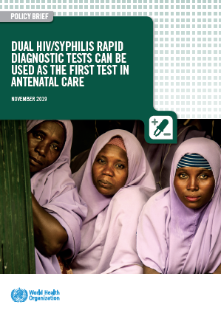
Dual HIV/syphilis rapid diagnostic tests can be used as the first test in antenatal care
UPDATED GUIDANCE FOR HTS IN ANC
WHO recommendation and NEW implementation guidance
All pregnant women should be tested for HIV, syphilis and hepatitis B surface antigen (HBsAg)* at least once and as early as possible, ideally at the first antenatal care visit
Dual HIV/syphilis rapid diagnostic tests (RDTs) can be considered as the first test in HIV testing strategies and algorithms in ANC settings.
*Particularly in settings with a ≥2% HBsAg seroprevalence in the general population.
https://www.who.int/publications/i/item/dual-hiv-syphilis-rapid-diagnostic-test
Notes:
Elimination of mother-to-child transmission (EMTCT) of HIV and syphilis is a global health priority. It is estimated that there are 1.4 million new maternal HIV infections and nearly a million new maternal syphilis infections every year.
While we have seen remarkable progress toward elimination of mother to child transmission of HIV, syphilis remains the second most common cause of stillbirth globally.
All pregnant women should be tested for HIV, syphilis and hepatitis B surface antigen (HBsAg)* at least once and as early as possible, ideally at the first antenatal care visit (syphilis: strong recommendation, moderate-quality evidence; HBsAg*: strong recommendation, low-quality evidence).
Use of dual HIV/syphilis RDT is cost saving in both high and low burden settings

Slide 43
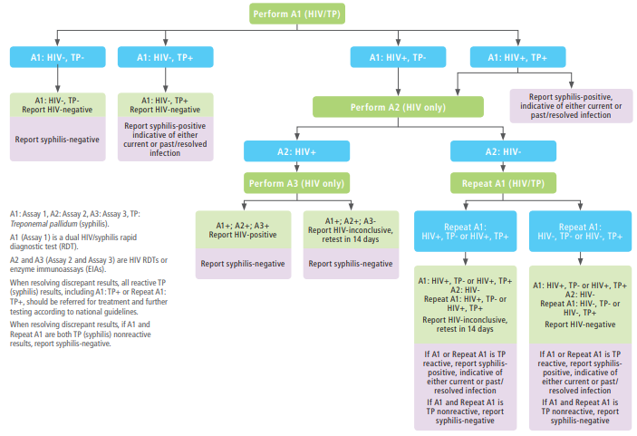
Testing strategy for dual detection of HIV and syphilis infection for ANC settings
Notes:
As programmes undertake the review and updating of national testing algorithms, introduction of dual HIV/syphilst tests should be considered as a cost saving approach to reducing mother to child transmission of hiv and syphilis.
Multiple, inexpensive rapid dual HIV/syphilis RDTs and single rapid tests for syphilis are currently available. They are accurate, can provide results in minutes, and are easy to use with minimal training. Rapid syphilis tests have been shown to increase the number of pregnant women tested for syphilis. However, increased efforts are still needed in most low- and middle-income countries to ensure that all pregnant women receive a syphilis test.
There are a number of important implementation considerations for programmes introducing dual HIV/syphilis RDT within testing algorithms at antenatal care, these include:
Need to verify that the new dual rapid test works well in combination with the other two HIV tests in the algorithm. We will discuss how to verify this later on during this session.
Rapid dual HIV/syphilis test cannot be used for:
1. women with HIV taking ART;
2. women already diagnosed with and treated for syphilis during their current pregnancy; and
3. retesting for HIV before ART initiation.
Countries should review and consider WHO prequalified products

Slide 44

Implementation considerations for dual HIV/syphilis RDT in ANC
UPDATED GUIDANCE FOR HTS IN ANC
Use of dual HIV/syphilis tests are cost-saving in high and low HIV burden settings*
Dual HIV/syphilis tests are not for retesting pregnant women on with know HIV+ status and/or those on ART
Dual HIV/syphilis tests may be used to deliver testing for sexual partners
Procurement of dual HIV/syphilis RDT for pregnant women may be supported by HIV funding mechanisms including GF and PEPFAR
Ethical imperative to provide and assure treatment for HIV and syphilis
Opportunities to offer hepatitis B testing alongside the dual test in pregnancy -- towards triple ETMCT
* https://www.thelancet.com/journals/langlo/article/PIIS2214-109X(20)30395-8/fulltext

Slide 45
WHO prequalified rapid dual HIV/syphilis tests
UPDATED GUIDANCE FOR HTS IN ANC
As of May 2021, three dual HIV/syphilis rapid tests have been WHO prequalified
Prices for these products range from $1.15 to $1.50 per test through WHO, Global Fund, PEPFAR/USAID (opportunities for pooled procurement)
Year PQed | Product Name | Manufacturer | Product Code | No. of tests per kit | WHO evaluation Final sensitivity | WHO evaluation Final specificity
Oct 2015 | Bioline HIV/Syphilis Duo | Abbott Diagnostics Korea Inc (Republic of Korea) | 06FK30 06FK35 | 25 T/kit 25 T/kit | HIV: 100% Syphilis: 87% | HIV: 99.5% Syphilis: 99.5%
June 2019 | First Response HIV 1+2/Syphilis Combo Card Test | Premier Medical Corporation Pvt Ltd (Gujarat, India) | I20FR25 I20FR30 I20FR50 I20FR60 I20FR100 | 25 T/kit 30 T/kit 50 T/kit 60 T/kit 100 T/kit | HIV: 100% Syphilis: 99% | HIV: 99.5% Syphilis: 100%
May 2020 | Standard Q HIV/Syphilis Combo Test | SD Biosensor Inc (Republic of Korea) | 09HIV20D | 25 T/kit | HIV: 100% Syphilis: 95.5% | HIV: 99.5% Syphilis: 99.5%
Source: https://www.who.int/diagnostics_laboratory/evaluations/pq-list/hiv_syphilis/en/

Slide 46
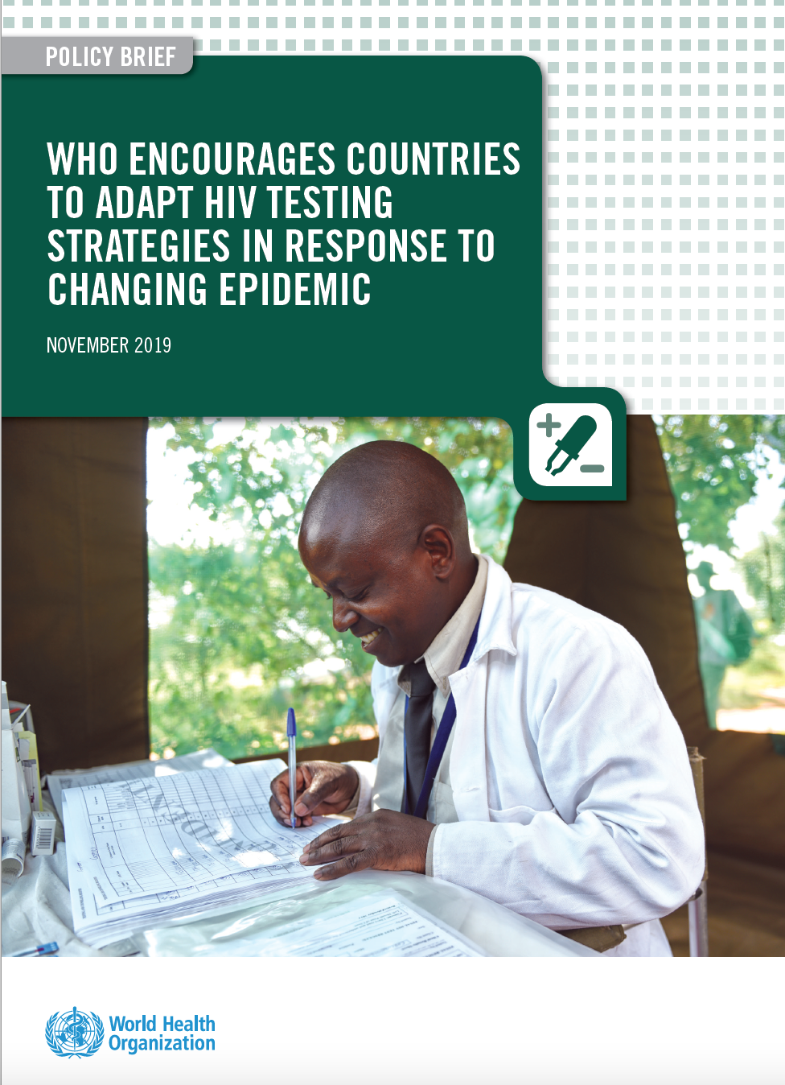
Adapting National HIV Testing Strategies
WHO is encouraging countries currently using two consecutive reactive tests for an HIV-positive diagnosis to move torward using three consecutive reactive tests for an HIV-positive diagnosis. This is increasingly important as treatment-adjusted HIV prevalence and national HTS positivity continue to decline over time.
Ensure that the testing strategy has a positive predictive value ≥99% (PPV)
  Meaning of the persons classified as HIV+, ≥99% will truly be living with HIV
  PPV depends on positivity rate among testing population
Quality assured assays, such as WHO prequalified, should be used:
  >99% sensitivity: fewer than 1 ‘false negative’ for 100 truly positive
  >98% specificity: fewer than 2 ‘false positive’ for 100 truly negative
  Either rapid diagnostic tests (RDTs) or enzyme immunoassay (EIA, CLIA, ECL)

Slide 47
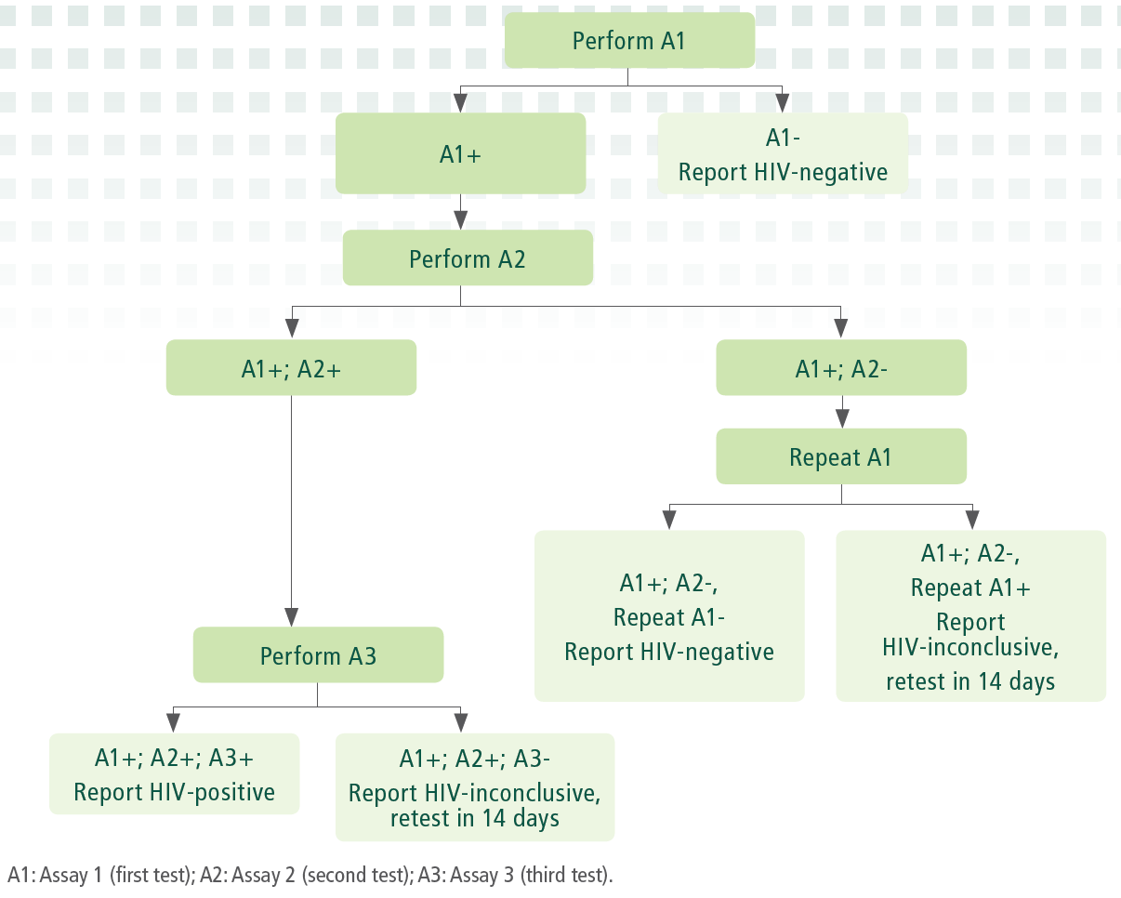
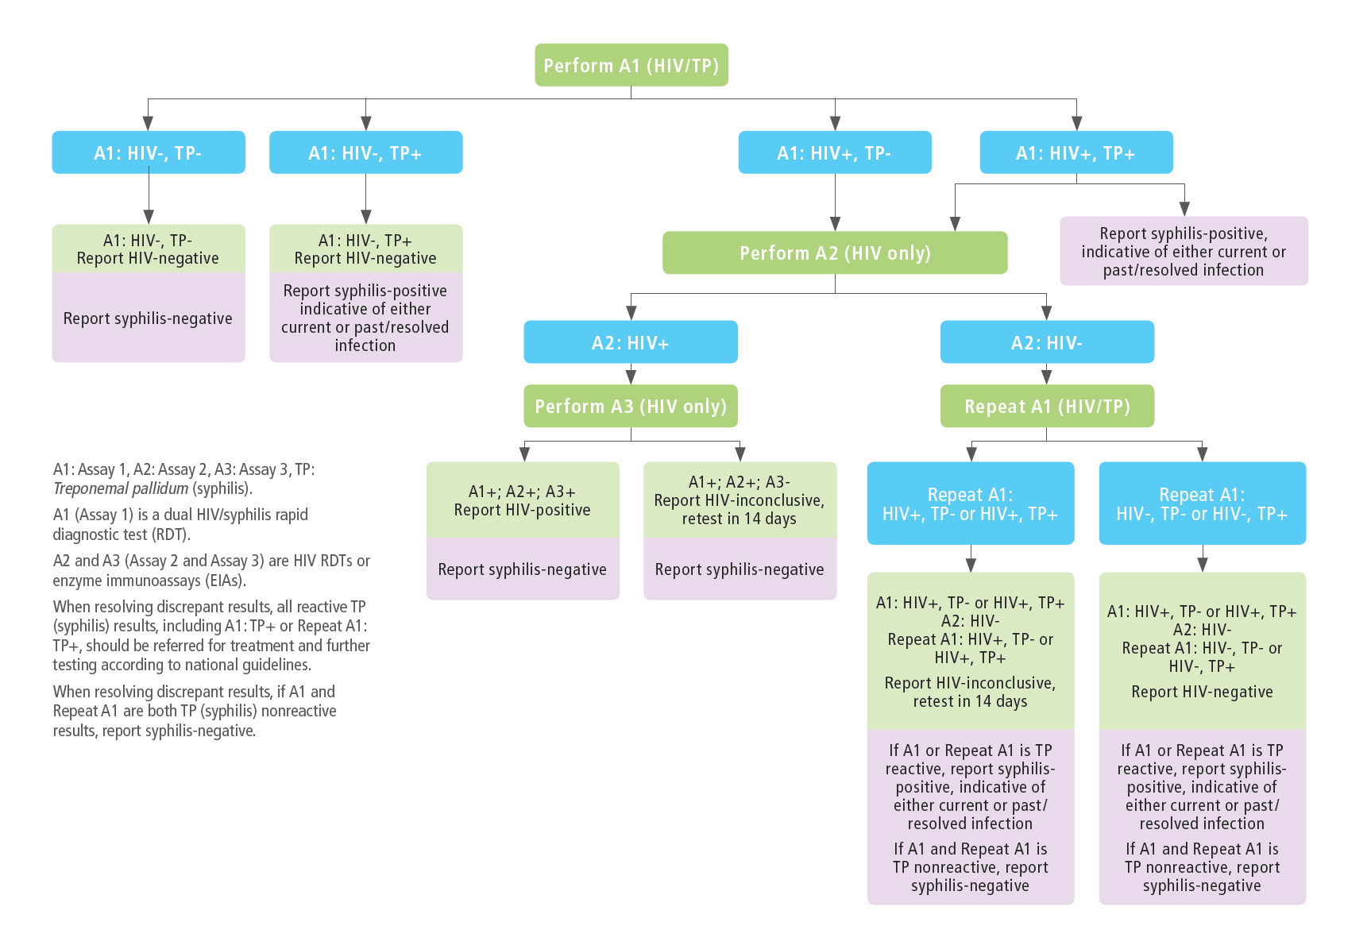
WHO 2019 HIV Testing Strategies
3 consecutive reactive tests for an HIV-positive diagnosis
National HIV Testing Strategy
Dual HIV/Syphilis Testing Strategy in ANC settings
Inconclusive results
Retest in 14 days
A1, A2, A3: standalone HIV tests
Retesting A1, A2, A3 prior to ART initiation
A1: dual HIV/Syphilis and alignment with A2, A3: standalone HIV tests
TP+: initiate treatment and further testing (RPR) where feasible

Slide 48
Principles for the selection of HIV products
–Verification study–
Performance characteristics
Highest sensitivity (to rule in all positives [true + false]) | A1
Highest specificity (to rule out all false positives) | A2 and A3
Correctness of the final HIV status is dependent on:
  Specificity of the individual products used (for A1, A2, A3), and
  Probability that any specimen that is falsely-reactive on the first assay (A1) is not also falsely-reactive on the second assay (A2) and third assay (A3)
It is suggested to conduct a verification study of the new testing algorithms in order to:
Identify the combination of products which have minimum possible common cross-reactivity to reduce the risk of false HIV-positive diagnosis. (Note: Products from the same manufacturer should not be used as part of the testing algorithm to minimize common cross-reactivity)
Not intended to reevaluate sensitivity and specificity of individual products!

Slide 49
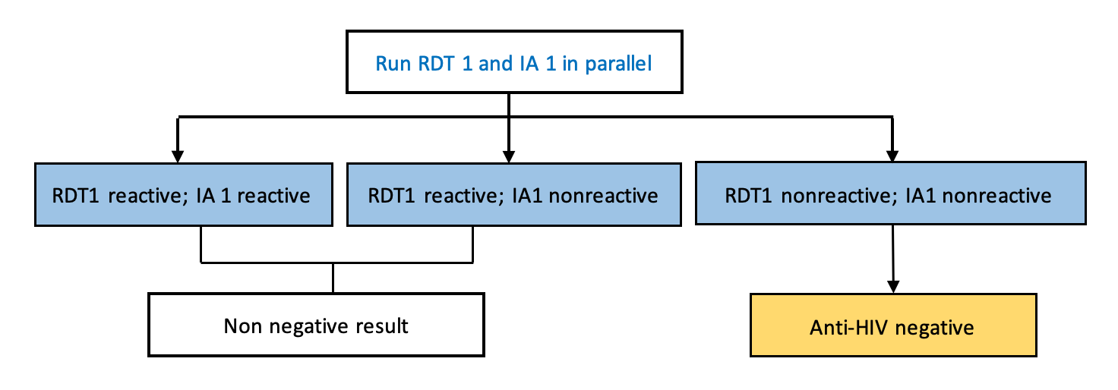
Phases of the Verification Study
PHASE 1
Preparing verification
PHASE 2
Conducting verification
PHASE 3
Pilot prior to implementation
Develop study protocol, seek ERB approval
Shortlist candidate products
Request/order test kits
Establish verification panel
Select study sites
Train staff on verification study
Implement data quality practices
Test each candidate product with the verification panel
Interpret and analyze results
Choose HIV testing algorithms
Run in parallel new and existing HIV testing algorithm
High-volume sites: 2 weeks
Low-volume sites: 4 weeks
Analyze the data: >1% discrepancy rates requires investigation of the root cause
Adapt job aids, SOPs, train staff, etc
Roll out HIV testing algorithm more widely
 | Total False+ | No of samples with shared false-reactivity
 |  | RDT1 | RDT2 | RDT3 | RDT4 | RDT5 | RDT6 | RDT7
RDT1
RDT2
RDT3
RDT4
RDT5
RDT6
RDT7
Current Algorithm vs. New Algoritm
Test
Test
Test
Test
Test
Test
Test
Test
Test
Test
Test
Test
Month 1
Month 2
Month 3
Month 4
Month 5
Month 6

Slide 50




Verification Toolkit HIV Testing Algorithms
–Forthcoming–
.
Multilingual
English, French, Spanish
Reference Documents
Implementation Considerations
Test selection tool
Order Checklist
Budget Checklist
Briefer Verification toolkit
Generic Verification Protocol
Human Resource planning
Responsibility matrix
Site assessment checklist
Verification
Toolkit
Lab Requisition form
Sample referral log book
Database
Cross-reactivity analysis
HIV Testing Algorithm

