Slide 1


HiAP implementation at global, regional and local levels
9
MODULE 9
HiAP implementation at local,
regional and global levels
Notes:
Title slide

Slide 2


9
LEARNING OBJECTIVES
Discuss examples of HiAP implementation at the local, regional and/or global level
Notes:
Briefly summarize the key objectives for this lecture. This lecture is about exploring the lessons and experiences of HiAP at local, regional and global levels.

Slide 3
What supports Health in All Policies implementation?
9
HiAP facilitates intersectoral relationships and policy development to address health and equity issues while
also contributing to other sectors’ policy goals.
HiAP has now been implemented in various
forms in over 20 countries, working at different
levels of government.
While there is no single or simple model for HiAP, there is a growing evidence base of conditions that support HiAP, and distinguish the approach from other forms of collaborative action.
There is increasing interest in how the effectiveness of the approach can be optimized, including the enablers and barriers to HiAP implementation.
Notes:
Health in All Policies facilitates intersectoral relationships and policy development to address health and equity issues while also contributing to other sectors’ policy goals. HiAP has now been implemented in various forms in over 20 countries, working at different levels of government. While there is no single or simple model for HiAP, there is a growing evidence base of conditions that support HiAP and distinguish it from other forms of collaborative action. As such there is increasing interest in how the effectiveness of the approach can be optimized.
The interest has also stimulated a growing body of literature and case studies, which examine the enablers and barriers to HiAP implementation. As one might expect, HiAP has been implemented differently in different contexts reflecting local social and political cultures as well as government structures. It is important to share experiences and lessons learned to understand how HiAP can be most effective.

Slide 4


Learning from hiap experiences – an analytic framework
9
Opportunities
for initiation
Key drivers of
implementation
Key domains
of equity lens
Social,
economic
and political
context
Overview
of health
and society
Orientation
for equity lens
in policies and
interventions
Organization
and structure
of the
government
Mechanisms
of
sustainability
Areas for learning in Health in All Policies
based on experiences of HiAP practice
Key drivers of sustainability
Source: WHO (2013) Health in All Policies
– Analytic Framework for Learning from Experiences
Notes:
This slide shows an analytic framework for Health in All Policies with an equity lens. The framework is useful in helping us to understand the various phases for HiAP implementation and how HiAP intersects with mechanisms for decision-making across government, the importance of relationships between actors, and the capacity of intervention design to address health equity, among others.
The framework includes four stages that are important to consider for HiAP implementation:
Opportunities for initiation – this includes the contextual factors that are conducive for HiAP work, in particular the policy change window and international influences – or the entry points for HiAP initiation;
Key drivers of implementation – this includes considerations of political commitment, governance, resources, partnerships and relationships with actors within and outside of government;
Key domains of an equity lens (in policies and interventions) – this includes a focus on the design of policies and programmes as part of HiAP work that have an impact on equity. HiAP experiences to date have been lacking a strong link to health equity in terms of how equity gaps and gradients are addressed in HiAP processes;
Key drivers of sustainability – HiAP practice is not linear and sustaining HiAP work requires embedded mandates, governance arrangements and supportive mechanisms in organizational structures to facilitate ongoing HiAP work.

Slide 5
9
Real-life experiences
of hiap practice
Initiate
HiAP
Sustain
HiAP
Implement
HiAP
Notes:
We will now examine the enablers and barriers to HiAP implementation, illustrating real-life experiences of HiAP practice. We will largely follow the structure presented in the HiAP analytic framework we just looked at to illustrate the learning from different HiAP cases, with health equity referenced across each of the key phases for HiAP practice – initiate HiAP, implement HiAP and sustain HiAP.

Slide 6
How to INITIATE
Health in All Policies
9
Initiate
HiAP
Presence of political will –
political support or interest
Find the right entry point for your situation – context specific
Align HiAP with core business
and strategic priorities – build
on what already exists
Be opportunistic
Seek co-benefits and
define shared goals
Find “HiAP champions”
or policy entrepreneurs
Begin to establish
trust and credibility
Sustain
HiAP
Implement
HiAP
Notes:
This slide illustrates the key conditions or considerations for the successful initiation of HiAP.
Political will
Key lessons from case studies point to having political will as a key factor for the success of HiAP. The presence of political support or interest usually makes starting HiAP more credible as it provides the legitimacy for the approach from the outset and helps to drive intersectoral cooperation.
Entry points
Entry points for HiAP are context specific. Many actions can be taken, and these are dependent on timing and both the local or national context in conjunction with political, organizational and situational context.
For example, if the entry point is NCD prevention and control, HiAP can be applied from three different entry points: risk factors or conditions, population groups (including life course), and sectors. If we look at major risk factors, entry points could be tobacco use, harmful alcohol use or unhealthy diet and physical inactivity. One could begin to initiate HiAP action by working with the urban planning sector, as the social determinants of health relevant to NCDs include targeting housing density, public transportation and the provision of green space, which can encourage active transport and walkable cities, and hence, incidental physical activity, if urban development policies are shaped with health impacts in mind and a co-benefits approach is taken. Such policies can be targeted to favour disadvantaged localities or vulnerable population groups.
Another example for an entry point may be improving education outcomes while improving health of children, given the clear and strong links between education and health.
As is evident, the starting point is often about identifying the co-benefits for the different sectors.
Strategic priorities
It may be beneficial to scan the policy and administrative environment to determine entry points and levers which may already exist to avoid duplication and additional burden on strategic and operational structures. For example, in South Australia the State Strategic Plan provided the entry point; joint policy initiatives were identified for relevant sectors based on the intersection of interest between health and other sectors. National or Country Development Plans provide a similar opportunity to align HiAP with the goals and targets of whole-of-government policy objectives.
Be opportunistic
Use an opportunity-driven approach to start HiAP by taking advantage of policy windows and other strategic opportunities that can help to facilitate early HiAP progress and engagement with policy-makers in other sectors. Taking action may be a matter of being opportunistic. For example, piggybacking on existing political imperatives to deliver results or building on shared interests.
Seek co-benefits and define shared goals
Developing a common understanding of the policy problems and potential solutions is necessary to build and expand the collective understanding of the relationship between health and physical, social, and economic environments. It is necessary to share quantitative and qualitative data with partners across sectors to determine the co-benefits for action and help define shared goals for the HiAP work.
Find “HiAP champions” or policy entrepreneurs
Start to create a network of engaged policy actors to champion HiAP. This can help to open up traditional organizational boundaries and support coordination when initiating HiAP and for moving into sustained ways of working.
Begin to establish trust and credibility
Any type of partnership takes time to establish and immediate success is not always assured. Taking the time to listen, to agree on how to work together and to understand the views and imperatives of the partners you are working with are ways to foster strong partnerships, which need to be nurtured from the beginning.

Slide 7
How to initiate Health in All Policies: Real-life experiences
9
Leveraging strategic and
reform opportunities
Namibia and Zambia are using the Sustainable Development Agenda as an entry point to more
closely link health with other sectors’ work.
Country Development Plans have enabled existing strategic priorities to be aligned with HiAP and helped to shape a whole-of-government agenda e.g. Sudan and Suriname
Bhutan is exploring how HiAP can be applied using the existing governance and processes of their Gross National Happiness (GNH) strategy, where policies are shaped and vetted through specific GNH mechanisms.
Notes:
This slide illustrates the different drivers and entry points for HiAP initiation using examples of HiAP practice from around the world. These galvanize depending on windows of opportunity, the political environment, momentum from engaged policy actors or other champions and influencers (e.g. academics, donor agencies), and existing agendas that can be leveraged. Further detail can be found in the book on HiAP case studies, linking the practice to the achievement of the Sustainable Development Goals: https://www.who.int/social_determinants/publications/Hiap-case-studies-2017/en/

Slide 8
How to initiate Health in All Policies: Real-life experiences
9
Health issues/increasing burden of disease
Climate and obesity action were important drivers to introducing HiAP to California – key priorities for the then Governor Arnold Schwarzenegger. Californian HiAP Task Force established as the governance body through the introduction
of an Executive Order.
Influencers
South Australia’s “Thinker in Residence” programme provided for an international expert to explore how health and well-being could be improved in the state. HiAP was recommended as an approach to collaborative policy-making, using the government’s strategic plan as an overarching governance framework.
Notes:
This slide illustrates the different drivers and entry points for HiAP initiation using examples of HiAP practice from around the world. These galvanize depending on windows of opportunity, the political environment, momentum from engaged policy actors or other champions and influencers (e.g. academics, donor agencies), and existing agendas that can be leveraged. Further detail can be found in the book on HiAP case studies, linking the practice to the achievement of the Sustainable Development Goals: https://www.who.int/social_determinants/publications/Hiap-case-studies-2017/en/

Slide 9
How to IMPLEMENT Health in All Policies: Governance and leadership
9
Initiate
HiAP
Commitment and leadership
at the highest level
Strong mandate
Formal structures
Considerations of the
political context
A different role for the health sector / Ministries of Health
Sustain
HiAP
Implement
HiAP
Notes:
This slide illustrates the key conditions or considerations for the successful implementation of HiAP, particularly in regards to governance and leadership.
Governance and leadership
Putting in place a governance structure to oversee HiAP as a whole-of-government and whole-of-society approach is needed to ensure long-term benefits. Without these arrangements in place it is difficult for HiAP to progress to a more sustainable model and may cause early implementation failure. These structures support accountability and transparency of HiAP actions and enable a process for engaging with stakeholders within and outside government. Governance is a key condition which must be present to provide the mandate for cross-sector partnerships. Good governance drives the implementation of work across sectors, builds ownership and increases exposure to collaborative opportunities. It promotes the alignment of policy priorities and provides an authorizing environment for HiAP action. An intersectoral governance mechanism to work across a wide range of determinants is an application of the HiAP approach, which distinguishes it from other forms of collaborative action.
As will be discussed in Module 11, the role of the health sector is changing; it is becoming more diverse and flexible considering the changing nature of policy issues and the regional and global context. The health sector must increasingly take on multiple roles (depending on the context) – that of a leader, partner, negotiator, facilitator, broker and advocate for health. To advance HiAP, the health sector must learn to work in partnership with other sectors and be able to cross policy boundaries and provide systems leadership. Health departments should provide analytical support for other sectors, advocate for policy development, and strengthen capacity to generate and use evidence on health impacts.

Slide 10
How to IMPLEMENT Health in All Policies: PROCESSES, STRATEGIES
AND TOOLS
9
Initiate
HiAP
Different ways of working
– context specific
Successful partnerships
and building relationships
Human and financial resources
e.g. core HiAP team
Use of research and evidence
Dedicated methods
– Health Lens Analysis, Health Impact Assessment, 90-Day Projects, policy briefs
Meetings and events
– information sharing and creating visibility
Informal networks
Sustain
HiAP
Implement
HiAP
Notes:
This slide illustrates the key conditions or considerations for the successful implementation of HiAP, particularly in regards to the processes, strategies and tools which support HiAP practice.
Processes, strategies and tools
The ways of working to implement HiAP are highly context-specific. Different strategies can also be used at different points in time throughout the policy-making process to enable the co-creation of policy solutions and help to navigate complex policy issues.
Partnerships and relationship building
Effective partnerships and relationship building is central for HiAP practice; ultimately effective policy-making is about the people. Genuine partnerships lead to a greater understanding of unintended consequences of policies and interventions across sectors. By engaging and collaborating with partners in sectors outside of health, you can identify and avoid the unintended impacts of public policies that can be detrimental to the health of populations or subgroups of the population, therefore, reducing risk. This can lead to the formulation of potentially wiser solutions, strengthened policy coherence, and better considerations of health and well-being. Strong partnerships also help to maintain trust and credibility and facilitate the emergence of policy champions to promote HiAP principles.
Resources and investment
HiAP relies on appropriate resources and organizational capacity to sustain efforts. In particular, dedicated personnel are crucial given the importance of collaborative partnerships to HiAP processes. A core HiAP team with a range of skills and competencies that are necessary to implement HiAP (e.g. value of soft skills) provides a foundation for which to support and grow HiAP action. Budgets to support HiAP activity are ideal, however, it has been shown through case studies that HiAP implementation is possible with minimum budgets.
Use of research and evidence
Helps to identify and present evidence on health impacts so that the information speaks to the goals of the partnering sectors (i.e. the collaborating departments can see why their business objectives align with health and well-being). The use of evidence is important in demonstrating the links between health and the work of other sectors and reinforces the value of evidence informed activities.
Dedicated methods
There are a range of methods which can be used to support HiAP implementation to gain a richer understanding of policy problems and their potential solutions. Ultimately, these methods help to inform decision-making processes. Some notable examples include Health Lens Analysis, Health Impact Assessment, 90-Day projects and the use of policy briefs to distil evidence, key messages, and recommendations.
Meetings and events
The use of meetings and events cannot be underestimated in creating visibility for a HiAP agenda and the value these forums have in bringing partners together, sharing information, learning about different policy perspectives in order to reach common goals and shared outcomes, as well as building trust.
Informal networks
Whilst formal networks support the mandate and authorizing environment for HiAP, informal networks are also useful in helping to navigate HiAP processes and activities because they can be more flexible and adaptable to time constraints and shifting policy and political landscapes. Emphasis on forming and maintaining informal structures should be as important as the investment in establishing formal mechanisms for HiAP action.

Slide 11
How to implement Health in All Policies: Real-life experiences
9
GOVERNANCE, MANDATE AND LEADERSHIP
California – Executive Order by the Governor mandated the establishment of a HiAP Taskforce
Partnership with Central Government in South Australia provides a clear statement of the Government’s commitment to a HiAP approach
The Leadership Group that oversees the Canterbury
HiAP Partnership (New Zealand) is a city-/regional-level
example of good governance
Québec, Canada – HiAP supported
by the Council of Ministers
HiAP is integral to the Finnish Government program
with “promoting well-being and health” as one of
five overall objectives
Notes:
This slide illustrates the different governance arrangements for supporting HiAP implementation using examples of HiAP practice from around the world. Governance structures and ways of working to facilitate HiAP action are context-specific and these examples show the diversity of mechanisms which can be applied to guide and embed a HiAP approach. Without an overarching governance arrangement and mandate, it is difficult for HiAP to operate in a systematic and sustained way.
Further detail can be found in the book on HiAP case studies, linking the practice to the achievement of the Sustainable Development Goals: https://www.who.int/social_determinants/publications/Hiap-case-studies-2017/en/

Slide 12
How to implement Health in All Policies: Real-life experiences
9
PROCESSES, STRATEGIES AND TOOLS
Scotland – Health Impact Assessments (HIA) and the production of evidence reviews are widely promoted and applied to different policy areas
California has a dedicated HiAP team to coordinate HiAP work, and support cross sector partnerships
Relationship building and partnerships across sectors are actively supported, including with community members by the Metropolitan District of Quito, Ecuador, to progress the Healthy Neighbourhoods – closing the gap in health inequality policy initiative
Notes:
This slide illustrates the different processes, strategies and tools for supporting HiAP implementation using examples of HiAP practice from around the world. Ways of working to facilitate HiAP action are context-specific and these examples show the diversity of mechanisms which can be applied to guide and embed a HiAP approach.
Further detail can be found in the book on HiAP case studies, linking the practice to the achievement of the Sustainable Development Goals: https://www.who.int/social_determinants/publications/Hiap-case-studies-2017/en/

Slide 13
How to SUSTAIN
Health in All Policies
9
Initiate
HiAP
Respond and adapt to changing political, administrative and cultural environments - sustaining HiAP
requires agility
Institutionalizing HiAP e.g. use of
public health legislation/legal tools
Monitor progress and evaluate
Continue to invest in and find HiAP
champions and policy entrepreneurs
Acknowledge achievements,
reflect and share lessons
Capacity building to
work in new ways
Sustain
HiAP
Implement
HiAP
Notes:
This slide illustrates the key conditions or considerations forHiAP.
Respond and adapt to changing contexts – HiAP requires agility
The HiAP model is not fixed; it is dynamic and needs to respond and adapt to changing political, administrative and cultural environments to remain relevant to the policy and operational structures and strategic priorities in place at any given time. Changes in government, organizational restructures, budgetary adjustments and changing policy priorities need to be analysed to ensure the HiAP model is best aligned to the current environment it is operating in and be adapted if necessary. Therefore, sustaining HiAP requires agility – HiAP is a continually evolving model that is carefully shaped and opportunity-driven to respond to changing contexts.
Institutionalizing HiAP
The role of the law in fostering collaborations to achieve a HiAP approach for the development of public policy has in recent years received growing recognition. Public health legislation is an important tool for institutionalizing an infrastructure for HiAP. Law can support intersectoral collaboration around health in many ways. Fostering intersectoral collaboration through law signals that government agencies must work together regardless of budgets, politics and competing priorities. In this way, legal requirements can further embed collaborative norms and decision-making. Laws should provide the legitimacy for collaboration and be conducive to HiAP ways of working by providing agencies with discretion to decide when and how to collaborate. However, legal tools cannot guarantee genuine collaboration, especially if the powers provided through the legislation are executed in a way which is detrimental for building trust and relationships. Thus, the use of legislation for HiAP requires care. It is important to remember that HiAP is underpinned by the concepts of mutuality and reciprocity. Careful planning and consultation is required as legal mandates for HiAP should not over-prescribe processes at the expense of flexibility or damage the intention of good-faith collaboration that HiAP action is based on. In addition, HiAP supported by legislation, with clearly defined mandate and authority, is more likely to function despite changes in government or in technical staff and provides an avenue to advocate more effectively for resources.
Monitor progress and evaluate
The long-term monitoring and evaluation of HiAP work is necessary to show the value of the approach and its potential for demonstrably improving population health. In order for policy-makers to make arguments for HiAP action, evidence of progress is needed to show that HiAP has improved health and well-being and their determinants in the general population or in targeted population groups. Monitoring and evaluation enables a justification for the investment in establishing, fostering and sustaining HiAP.
Continue to invest in HiAP champions or policy entrepreneurs
Investing in HiAP champions or policy entrepreneurs enables a wider network outside of the core HiAP team and outside of the health sector to advocate and argue for HiAP. Creating and nurturing this network can provide a supportive mechanism to overcome threats and take advantages of opportunities that arise.
Acknowledge achievements, reflect and share lessons
It is important to celebrate and share successes. This includes reflecting on what has worked, and the challenges experienced. Documenting processes, critical success factors and outcomes in a way that speaks to decision-makers and multiple agencies can support buy-in by demonstrating the benefits of HiAP and how it can satisfy shared intersectoral goals. In addition, sharing lessons with other regions can promote further exchange of information and widen networks and help to build a global HiAP community of practice.
Capacity building to work in new ways
New skills are required of all actors involved in generating health and well-being. Different skill sets are needed for HiAP action, where ‘soft’ skills are just as important (if not more important) as ‘hard’ skills. Ministries of health must also learn to successfully operate outside of the boundaries of their sector and integrated systems established as part of the overall public health system.

Slide 14
How to sustain Health in All Policies: Real-life experiences
9
Respond and adapt to changing contexts
Finland with a long-standing history of HiAP implementation is adapting its approach to better align with the global Sustainable Development Agenda and the Government’s national approach to combining health, well-being and equity objectives.
Institutionalizing HiAP – use of legal tools
The law can be a powerful tool for guiding
long-term policy goals and sustaining HiAP:
  The Well-being of Future Generations (Wales) Act 2015
  Québec Public Health Act 2001
  Thailand – National Health Act 2007
  South Australian Public Health Act 2011.
Notes:
This slide illustrates some of the key considerations and mechanisms for sustaining HiAP using examples of HiAP practice from around the world. Sustaining HiAP requires agility to ensure the HiAP model can respond and adapt to changing contexts. Several countries and regions have begun to consider and implement legal tools for HiAP to facilitate the institutionalization of the approach, for example through the enactment or amendment of legislation that provides powers for HiAP.
Further detail can be found in the book on HiAP case studies, linking the practice to the achievement of the Sustainable Development Goals: https://www.who.int/social_determinants/publications/Hiap-case-studies-2017/en/

Slide 15
How to sustain Health in All Policies: Real-life experiences
9
Monitor progress and evaluate
To support the ‘Healthy Shandong’ initiative (China), which includes a HiAP approach, the Shandong province incorporates strong monitoring and evaluation mechanisms, including an annual white paper on the health status of the region’s population every year to track progress and engage partners across the district in health and well-being.
Namibia plans a ‘determinants of health of the nation’ report every two years.
Notes:
This slide illustrates some of the key considerations and mechanisms for sustaining HiAP using examples of HiAP practice from around the world. Sustaining HiAP requires agility to ensure the HiAP model can respond and adapt to changing contexts. Monitoring and evaluating HiAP action, including routine reporting, is useful for tracking progress and important for demonstrating the value of investment for health and well-being and policy collaborations.
Further detail can be found in the book on HiAP case studies, linking the practice to the achievement of the Sustainable Development Goals: https://www.who.int/social_determinants/publications/Hiap-case-studies-2017/en/

Slide 16
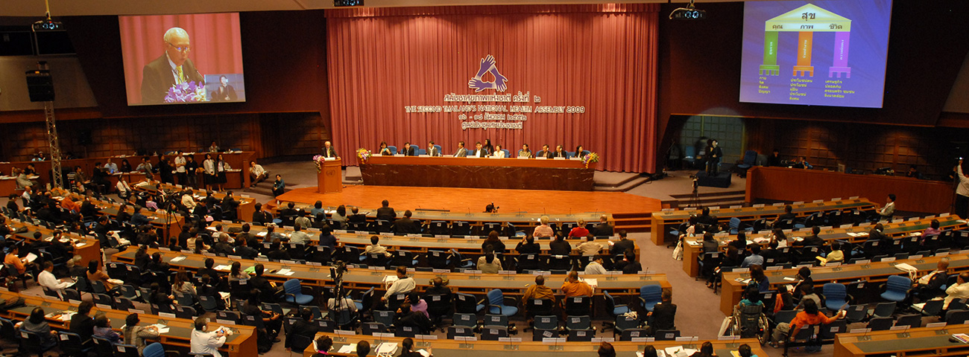
The role of broader society and citizens for action on the determinants of health
9
Thailand’s National Health Assembly demonstrates
participatory governance in action
Notes:
One of the major challenges for HiAP is how to involve not only other sectors but a broader range of stakeholders and representatives of the public. Enabling the engagement of citizens in decision-making processes, especially of vulnerable groups, is necessary for inclusive governance for health and well-being. Community members can share important information about assets and needs in their communities, challenges that may impact the effectiveness of proposed strategies, and ideas on how to support and facilitate community efforts to promote health.
The Thailand Government’s mechanism of the National Health Assembly provides an exceptional example of participatory governance in action. The National Health Assembly is a process in which the public, state agencies, academia and non-government organizations participate, exchange knowledge, and learn from each other through an organized forum leading to recommendations of healthy public policies. While the convening of this major stakeholder forum occurs once a year, it is a continual policy process, not only a one-time annual event.

Slide 17
Threats to Health in
All Policies action
9
The dominance of siloed decision-making and
narrow definitions of core business
Resource constraints
Weak governance structures and arrangements
Lack of support from senior officials
HiAP requires agility
Notes:
This slide illustrates the threats to HiAP action. Ultimately, HiAP requires agility to prevent implementation failure and to help seize opportunities.
In addition, governance and a mandate for HiAP are essential conditions for the success of HiAP action.

Slide 18
First Global Status Report on Health in All Policies
9
Designed and published by The Global Network
for Health in All Policies (GNHiAP) in 2019
Provides baseline information on HiAP practice and describes different HiAP models from around the world
Notes:
The first Global Status Report on Health in All Policies was published in 2019 by the Global Network for Health in All Policies – a capacity building forum for advancing HiAP implementation comprising a number of institutions from around the world, including from the academic sector, government and international organization representation. The report provides baseline information on HiAP practice and describes the current situation of HiAP approaches from around the world. It considers key thematic trends for HiAP action, including enablers and barriers to implementation. As it is the first global status report on HiAP, the analysis provides a collection of comprehensive information on HiAP implementation in one source, which can be useful for furthering advocacy for HiAP as a critical approach to governance and joined-up policy-making.

Slide 19
Survey and data
9
48 question, on-line survey between October 2018
and January 2019
Distributed to known HiAP implementers and
circulated via ‘snowball sampling’ technique
41 valid survey responses
22 countries captured including different levels of government – national, subnational, local
Design comprised questions on key conditions
that support successful HiAP practice
Notes:
This slide describes the survey used to collect the data for the development of the first Global Status Report on HiAP.
The 48 question, on-line survey was distributed from October 2018 to January 2019 to national, subnational and local entities implementing a HiAP approach in their jurisdiction. After assessment there were 41 suitable responses for analysis, covering 22 countries, including different levels of government (national, subnational and local). The survey was distributed to known HiAP implementers from around the world and a ‘snowball sampling’ technique was used to capture additional HiAP models to achieve the best possible diversity of respondents. The survey design comprised of questions aligned to the key conditions that support successful HiAP practice, whilst also enabling specific ways of working and innovative processes to be drawn out from individual HiAP models.

Slide 20
First Global Status Report on Health in All Policies
9
Methodological considerations
Survey captured a range of HiAP models, although known to be some missing models due to sampling method
Responses by individual respondents may not fully represent the breadth of HiAP activity in their respective jurisdiction
Some countries provided responses for different levels of government – each response was accounted for separately
WHO definition of HiAP used as a key screening criterion (systems level approach rather than general or issue-specific intersectoral/multisectoral action for health)
Notes:
The survey captured a range of HiAP models, although there are known to be some missing models due to the sampling method and time limitations of the data collection period. Some responses may not fully represent the activity within jurisdictions or provide a skewed account of HiAP work due to the potential for response bias. Responses by individual respondents reflect their role and relationship with the HiAP practice occurring in their jurisdiction (i.e. are they deeply involved in the work or observing it from an academic perspective; is their role operational or does it involve high-level decision-making). In addition, some countries provided responses for different levels of government and each response was accounted for separately in the analysis. For example, Finland provided a response at the country (national) level and two responses at the city (local) level.
The WHO definition of HiAP, “an approach to public policies across sectors that systematically takes into account the health implications of decisions, seeks synergies, and avoids harmful health impacts in order to improve population health and health equity”, was used as a key screening criterion to ensure respondents were providing information about HiAP practice – a systems level approach rather than general or issue-specific intersectoral or multisectoral action for health.

Slide 21
First Global Status Report on Health in All Policies
9
Data analysis
Thematic Analysis
Governance and leadership
Resources for HiAP
(personnel and monetary)
Entry points
Ways of working
Capabilities (individual
and organizational)
HiAP priorities and outcomes
Monitoring, reporting
and evaluation
Data analysed by
two key factors:
Phase of maturity
  Emerging
  Progressing
  Established
Level of government
  National
  Subnational
  Local
Notes:
The survey was structured to draw out information on the key themes and conditions for HiAP practice based on the substantial evidence base for HiAP action. Therefore, data from questions were sorted into groupings based on the following conditions that support HiAP:
- Governance and leadership
- Resources for HiAP (personnel and monetary)
- Entry points
- Ways of working
- Capabilities (individual and organisational)
- HiAP priorities and outcomes, and
- Monitoring, reporting and evaluation.
Results were analysed by two key factors:
Phase of maturity (emerging, progressing and established), and, where appropriate, level of government (national, subnational and local). Analysis by maturation elicited stronger themes.

Slide 22
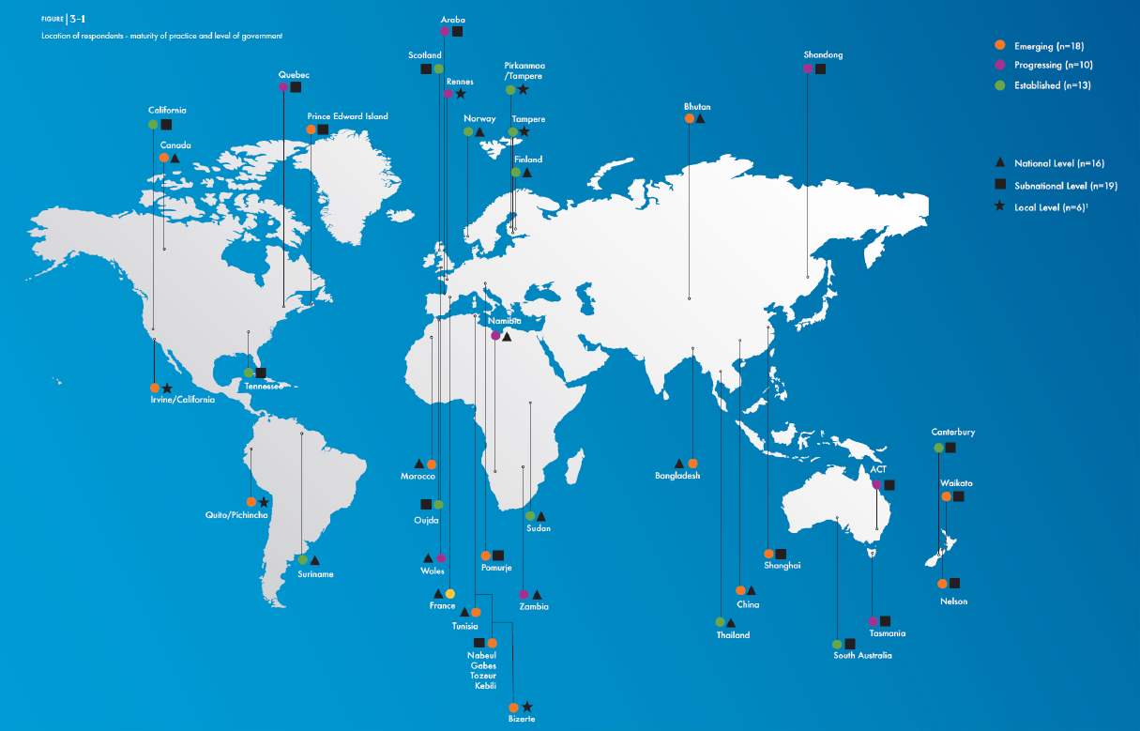
Location of respondents showing maturity of practice and level of government
9
Notes:
This slide shows a map of all responding jurisdictions, indicating practice maturity, and level of government for that jurisdiction.

Slide 23
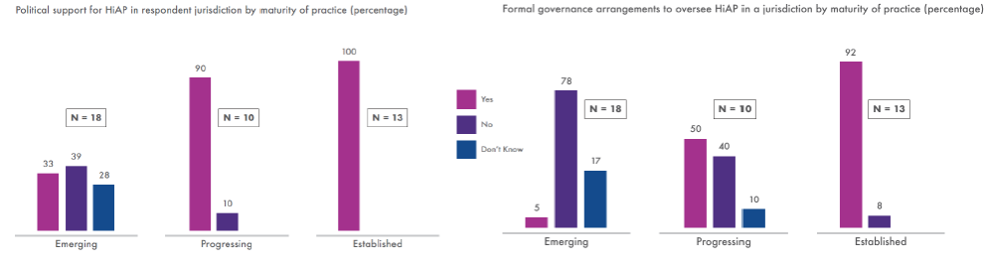
First Global Status Report on Health in All Policies
9
KEY FINDINGS: GOVERNANCE AND LEADERSHIP
The more established models of HiAP were more likely to have:
a strong authorising environment with political support
governance mechanisms or formal structures to oversee HiAP
Most respondents had some level of governance arrangements or formal structures in place to support their HiAP approach
Political support for HiAP in respondent jurisdiction
by maturity of practice (percentage)
Formal governance arrangements to oversee HiAP
in a jurisdiction by maturity of practice (percentage)
100
92
90
78
Yes
N=18
N=10
N=13
N=18
N=10
N=13
No
50
39
Don’t
know
40
33
28
17
10
5
10
8
Emerging
Progressing
Established
Emerging
Progressing
Established
Notes:
The results indicate that most respondents had some level of governance arrangements or formal structures in place. It was found that with the more established models of HiAP practice, a strong authorising environment with political support and governance mechanisms or formal structures to oversee HiAP were in place.

Slide 24
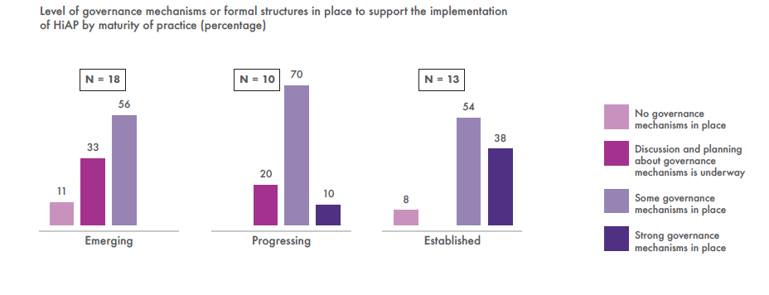
First Global Status Report on Health in All Policies
9
Key findings: Governance and leadership
Jurisdictions with more established HiAP practice are more likely to have governance mechanisms or formal structures in place to support the implementation of HiAP
Governance structures to facilitate intersectoral action is a key feature of HiAP, which distinguishes the practice from other forms of collaborative action
Level of governance mechanisms or formal structures in place to support the implementation
of HiAP by maturity (percentage)
N=18
N=10
70
N=13
No governance
mechanisms in place
56
54
Discussion and planning
about governance
mechanisms is underway
33
38
20
Some governance
mechanisms in place
11
10
8
Strong governance
mechanisms in place
Emerging
Progressing
Established
Notes:
The results indicate that jurisdictions with more established HiAP practice are more likely to have governance mechanisms or formal structures in place to support the implementation of HiAP.
This finding, together with the findings on the previous slide demonstrate the critical importance of governance and leadership for HiAP in (1) enabling the authorising environment and oversight for HiAP, and (2) supporting mechanisms for implementation action. These findings are supported by the governance literature and case studies on HiAP practice, which demonstrate governance and leadership as core conditions for maintaining and sustaining HiAP. Therefore, a key feature of HiAP, which distinguishes the practice from other forms of collaborative action is governance structures to facilitate intersectoral action.
The HiAP approach can be seen as a model of good governance for health. Through good governance, HiAP operates to ensure that policy-making is harmonised, that is, efforts do not undermine other priorities and conflicts of interest can be resolved in a timely and transparent manner. Importantly, good governance in HiAP processes facilitate accountability, leadership and supportive structures for sectors to work together on policy issues.

Slide 25
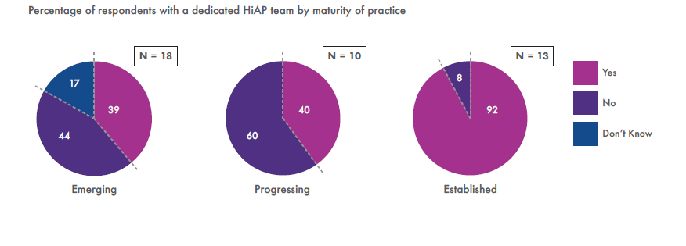
First Global Status Report on Health in All Policies
9
Key findings: Resources (personnel)
The greatest dedication of personnel resources occurs in HiAP models that are more established, and investment in personnel is also most common at the subnational level of government
Percentage of respondents with a dedicated HiAP team by maturity of practice
N=18
N=10
N=13
8
Yes
17
39
40
92
No
Don’t know
44
60
Don’t know
Emerging
Progressing
Established
Notes:
Organisational capacity, such as dedicated personnel, is a key building block for success in HiAP, given the significance of partnerships and relationships in HiAP practice. A dedicated HiAP team is most common in HiAP models that are more established. Interestingly, investment in personnel is most common at the subnational level of government. This finding could be an indication of the complexities in obtaining resource commitment, where at the subnational level there is typically more flexibility than at the national level to secure investment.
Dedicated staff in the emerging and progressing phases may be lower due to importance being placed on navigating the political and policy environments to find or link HiAP to a sustainable platform and so the use of informal networks in these initial phases may drive the HiAP agenda and HiAP action. It may also be the case that in the early stages of HiAP, the model must demonstrate proof of concept to justify to decision-makers its feasibility and success in delivering better public policy outcomes for the health sector and other sectors before investment can be allocated.

Slide 26
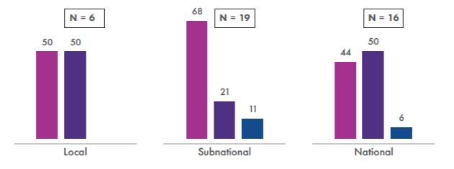
First Global Status Report on Health in All Policies
9
Key findings: Resources (personnel)
Dedicated personnel are key given the significance
of partnerships and relationships in HiAP
Percentage of respondents with a dedicated HiAP team that support HiAP action by level of government
N=6
68
N=19
N=16
50
50
50
44
Yes
No
21
11
Don’t know
6
Local
Subnational
National
Notes:
Organisational capacity, such as dedicated personnel, is a key building block for success in HiAP, given the significance of partnerships and relationships in HiAP practice. A dedicated HiAP team is most common in HiAP models that are more established. Interestingly, investment in personnel is most common at the subnational level of government. This finding could be an indication of the complexities in obtaining resource commitment, where at the subnational level there is typically more flexibility than at the national level to secure investment.
Dedicated staff in the emerging and progressing phases may be lower due to importance being placed on navigating the political and policy environments to find or link HiAP to a sustainable platform and so the use of informal networks in these initial phases may drive the HiAP agenda and HiAP action. It may also be the case that in the early stages of HiAP, the model must demonstrate proof of concept to justify to decision-makers its feasibility and success in delivering better public policy outcomes for the health sector and other sectors before investment can be allocated.

Slide 27
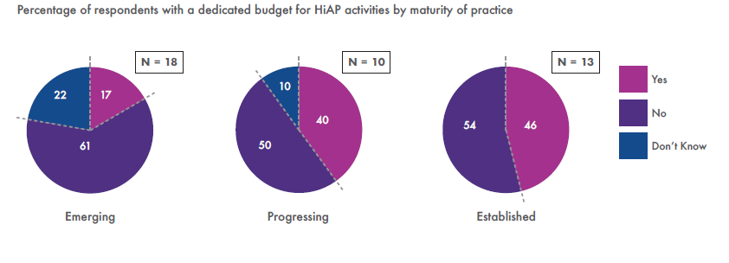
First Global Status Report on Health in All Policies
9
Key findings: Resources (monetary)
As with a dedicated team, a dedicated budget is most common in the ‘established’ phase and at the subnational level of government
Percentage of respondents with a dedicated budget for HiAP activities by maturity of practice
N=18
N=10
N=13
10
Yes
22
17
40
No
54
46
61
50
Don’t know
Emerging
Progressing
Established
Notes:
As with a dedicated team, a dedicated budget is most common in the ‘established’ phase and at the subnational level of government.
The results of the survey show that HiAP implementation is possible with minimum budgets regardless of the level of practice maturity. The data show that dedicated budgets are less common than dedicated staff, reinforcing that relationships and partnerships are integral to sustainable and effective HiAP practice. The results may also indicate that staffing resources are easier to fund than other resources and activities.

Slide 28
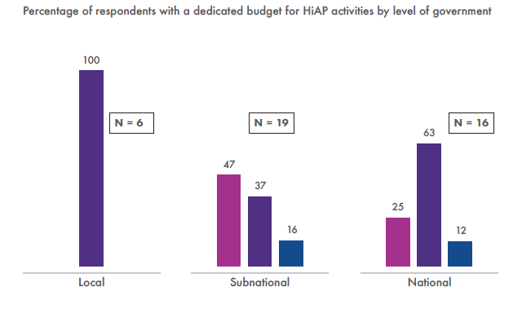
First Global Status Report on Health in All Policies
9
Key findings: Resources (monetary)
Having a dedicated HiAP budget is not a measure of the quality or commitment of HiAP practice
HiAP implementation is possible with minimum budgets
100
Percentage of respondents with a dedicated budget for HiAP activities by level of government
N=6
N=19
63
N=16
47
Yes
37
25
No
16
12
Don’t know
Local
Subnational
National
Notes:
As with a dedicated team, a dedicated budget is most common in the ‘established’ phase and at the subnational level of government.
The results of the survey show that HiAP implementation is possible with minimum budgets regardless of the level of practice maturity. The data show that dedicated budgets are less common than dedicated staff, reinforcing that relationships and partnerships are integral to sustainable and effective HiAP practice. The results may also indicate that staffing resources are easier to fund than other resources and activities.

Slide 29
First Global Status Report on Health in All Policies
9
Other conditions for success
Entry points and ways of working are context-specific, reflecting local social and political cultures as well as government structures. This speaks to the context-specific nature of policy-making. Many actions can be taken; these are dependent on timing
(e.g. windows of opportunity) and contextual factors
Health diplomacy and negotiation skills are critical capabilities to support HiAP, as is the ability to respond and adapt in the face of changing political, administrative and cultural landscapes
Monitoring, reporting and evaluating processes are complex, but important,
and more likely to occur once practice
has matured
Establishing priorities provides strategic direction. Determining short- and long-term outcomes will become increasingly important as the evaluation of HiAP global practice evolves
Notes:
This slide illustrates other conditions for success of HiAP, which were also key findings from the survey for the first Global Status Report on HiAP.
The entry points for HiAP and ways of working to implement cross sector action are context-specific. This speaks to the context-specific nature of policy-making as well as to the complexities of a country’s constitution or the laws and regulations of a particular area. Many actions can be taken to implement HiAP; these are dependent on timing (e.g. windows of opportunity), the political and organisational environment, and an array of situational factors. Survey respondents described a number of driving factors for initiating or adopting their HiAP practice, which broadly fit into the following categories:
- Health sector/major health issues/increasing burden of disease
- Health protection (e.g. Anti-microbial resistance)
- Political drivers/opportunities (e.g. major structural or political reform)
- Social equity and human rights (e.g. universal health care, gender equality)
- International influences.
The findings in regard to the Ways of Working related survey questions demonstrate the complexity and diversity of HiAP models from the use of tools, engagement with partners and relationship building and other processes which are applied to HiAP practice. Depending on the policy issue being explored, different strategies can be used at different points in time throughout the policy-making process to enable the co-creation of policy solutions. As expected, the ‘established’ phase respondents report a more comprehensive range of approaches to implementing HiAP in their jurisdiction. Some ways of working which are noted by respondents include: Health Lens Analysis, Health Impact Assessment, use of informal structures and groups (not only relying on formal mechanisms), research, policy briefs, strategic meetings, and an explicit dialogue around a co-benefits approach. Notably, the ‘delivery of strategic or “Big P” policy’ was the most common policy-related focus for HiAP practice, which reiterates the that policy impact is the ultimate goal of a HiAP approach. Ultimately, HiAP ways of working enable a richer understanding of the policy problem and help to co-create more sophisticated policy solutions that are based on a mutual understanding of the issues at hand.
Health diplomacy and negotiation skills are critical capabilities to support HiAP, as is the ability to adapt in the face of changing political, administrative and cultural landscapes. As the need to integrate population health concerns into the goals of other sectors grows, health actors and policy-makers must acquire the skills to shape the policy environment for health, while also achieving mutual objectives. It is recognized that health diplomacy and policy negotiation require a delicate combination of technical expertise, specialized knowledge, and diplomatic skills to be used effectively. The survey respondents generally reported high personal and organizational skills in HiAP.
Monitoring, reporting and evaluation enables a justification for the investment in cross-sector action. Evaluation generates evidence of effectiveness, showing the links between cross-sector action, policy changes, and intermediate and longer-term health outcomes. These processes also enable changes to be efficiently built into policy implementation as needed. Generally, HiAP research focus has mainly examined the process of cross-sector policy development, rather than their health-related impacts or outcomes. The survey results demonstrate clear links between the maturity of HiAP practice and any reporting and evaluation mechanisms in place; they are more common for ‘established’ HiAP approaches.
Establishing priorities provides strategic direction. The survey results indicate that priority setting is important in all phases of maturity. While some jurisdictions reported on priorities related to evolving their practice and processes, others reported on specific health issues they intend to tackle in the next two to five years.
Determining short and long-term outcomes will become increasingly important as the evaluation of HiAP global practice evolves. Outcomes reported tended to cluster around key categories including: an increase in political commitment and multisectoral action on health and social determinants of health issues, to the scale-up of HiAP through the introduction of legislation and policy to support the systematization of the approach.

Slide 30
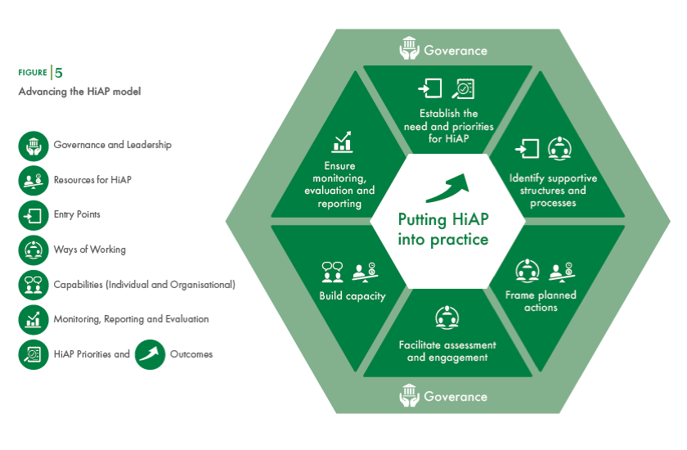
First Global Status Report on Health in All Policies
9
Advancing the HiAP model
Conditions for success
Governance
Establish the
need and priorities
for HiAP
Governance and Leadership
Ensure
monitoring,
evaluation and
reporting
Identify supportive
structures and
processes
Resources for HiAP
Putting HiAP
into practice
Entry Points
Ways of Working
Build capacity
Frame
planned
actions
Capabilities (Individual and Organisational)
Monitoring, Reporting and Evaluation
Facilitate assessment and engagement
HiAP Priorities and
Outcomes
Governance
Notes:
As you will recall, the WHO HiAP framework was presented in the Module 3 slides. This slide illustrates the adapted WHO HiAP model to reflect the conditions for successful HiAP practice that were unpacked through the findings presented in the HiAP Global Status Report. Integrating the conditions for success into the model demonstrates the important role of governance and leadership as an overarching requirement for effective and sustained HiAP action.

Slide 31
End of
Module 9
Please continue to Module 10

