Slide 1


The Determinants of Health
1
MODULE 1 PART 2
Introduction and the Determinants of Health
Notes:
Title slide

Slide 2


1
Learning Objectives
1
Explain the concepts of health
and well-being
2
Recognize the responsibility of states to uphold the health of their population
3
Identify the socioeconomic, biological and behavioural factors that influence health
4
Explain the social determinants
of health
Notes:
Briefly summarize the key objectives for this lecture.

Slide 3

1
Definition of Health
Health is a state of complete physical, mental
and social well-being, and not merely the
absence of disease or infirmity (World Health Organization, 1948).
Health is an individual right and a social justice issue. It is also a public good.
Governments have a responsibility for the health of their peoples which can be fulfilled only by the provision of adequate health and social measures.
Notes:
The Constitution of the World Health Organization (1948) conceptualises health as being more than the absence of disease, illness and physical health. Fundamentally, health is about physical, mental, and social well-being, and it is understood that health and well-being can be adversely affected by social policies.
There are different ways of viewing health as articulated in different international agreements. Often the WHO definition is cited. Other examples of where a definition of health is stated include: the United Nations Universal Declaration of Human Rights (1948), the International Covenant on Economic, Social and Cultural Rights (1966), and the Ottawa Charter for Health Promotion (1986).
The enjoyment of the highest attainable standard of health is one of the fundamental rights of every human being without distinction of race, religion, political belief, economic or social condition.
Governments have a responsibility for the health of their peoples. Health is a priority for the whole of society.
Additional note of interest: The Constitution of the World Health Organization was adopted by the International Health Conference held in New York from 19 June to 22 July 1946, signed on 22 July 1946 by the representatives of 61 States and entered into force on 7 April 1948. The WHO definition of health has not been amended since 1948.

Slide 4
1
Factors Determining Health
Clinical care is less important than many people think
whereas socioeconomic factors and the physical environment
are quite influential on health and well-being.
Genetic characteristics are also less significant
than many people think.
Whether people are healthy or not, is determined by their circumstances and environment – the social, economic and environmental conditions which affect the health of the population.
Notes:
Many factors combine to affect the health of individuals and communities. People’s health is affected by their living conditions not just their genetic or behavioural choices.
Factors such as where we live, the state of our environment, genetics, our income and education level, and our relationships with friends and family all have considerable impacts on health, whereas the more commonly considered factors such as access and use of health care services often have less of an impact.
The earlier mentioned definition of health supports the focus on the wider context of health and well-being, beyond just ill health and disease (and curative health care).

Slide 5
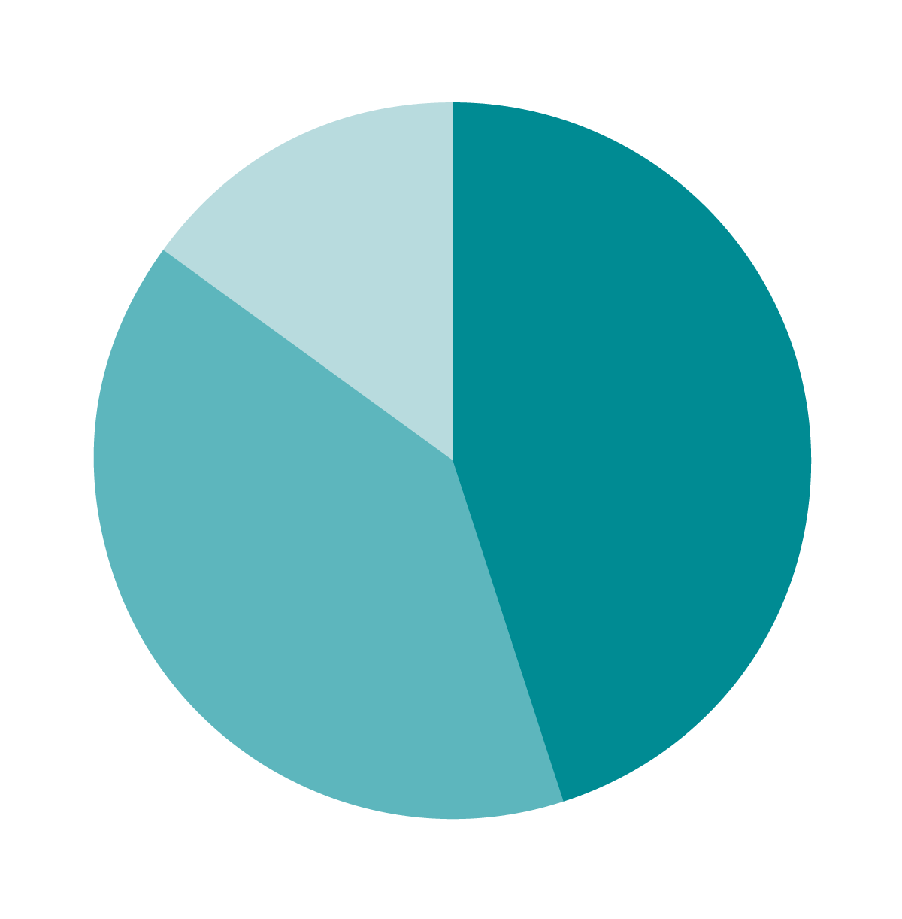
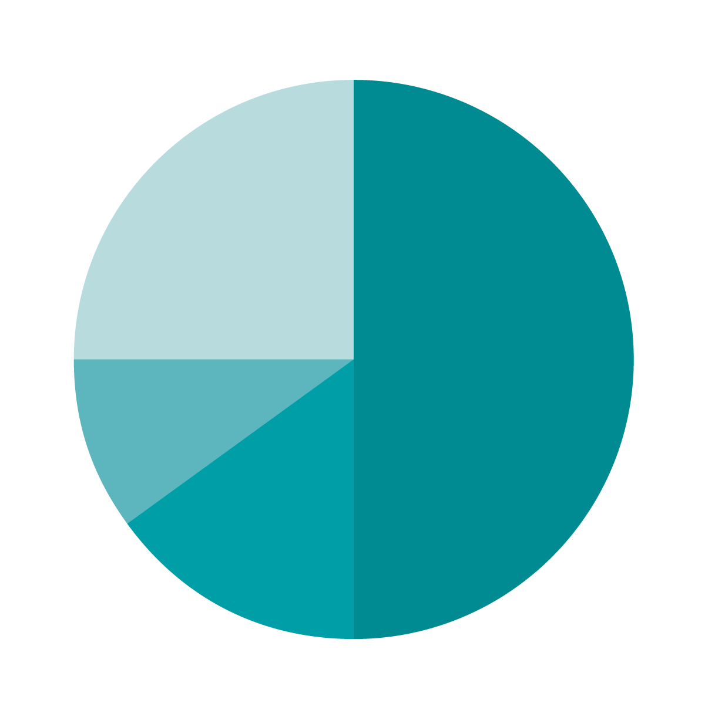
1
Why frame health in terms of societal conditions?
Impact: 30 - 50% or more
Mc Giniss
et al (2002)
Canadian Institute of Advanced Research (2012)
Health care
(up to 15%)
Social circumstances
& environmental exposure (45%)
Health behaviour patterns (40%)
Health care
(up to 25%)
Socioeconomic (50%)
Environmental (10%)
Genetics (15%)
Figure: Estimates of the contribution of the main drivers of health status.
Source: Donkin, A., P. Goldblatt, J. Allen, V. Nathanson and M. Marmot (2017).
"Global action on the social determinants of health." BMJ Global Health.
Notes:
Societal conditions have a direct impact on health, accounting for an impact of 30-50% or more on levels of the populations’ health, as outlined in this slide.

Slide 6
1
WHAT ARE THE Social Determinants
of Health?
The social determinants of health are the conditions in which people are born, grow, live, work and age. These circumstances are shaped by the distribution of money, power and resources at global, national and local levels.
The social determinants of health are mostly responsible for health inequities – the unfair and avoidable differences in health status seen within and between countries.
The social determinants of health are multi-layered
and range from societal to individual factors.
Notes:
The social determinants of health matter because they set the conditions for the health of individuals, communities and populations, and if the social determinants of health are not distributed fairly, they can lead to health inequities.
Dahlgren and Whitehead describe layers of influence on health, as presented on the following slide.

Slide 7
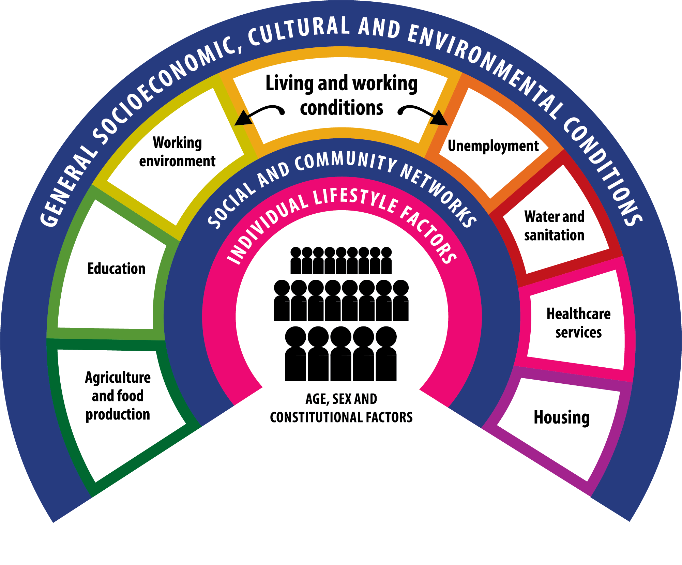
1
THE Social Determinants
of Health
Source: Dahlgren G and Whitehead M (1991)
Policies and strategies to promote social equity in health. Stockholm, Institute of Future Studies.
Notes:
All of these factors are what we refer to collectively as the social determinants of health.
Dahlgren and Whitehead’s model maps the relationship between the individual, their environment and disease. Individuals are at the centre with a set of given genes. Surrounding them are influences on health that can be modified. The Dahlgren and Whitehead social determinants of health framework is a widely cited model of the main determinants of health, and a recognized framework which identifies the range of social determinants.
The first layer is personal behaviour and ways of living that can promote or damage health (e.g. choice to smoke or not). Individuals are affected by friendship patterns and the norms of their community. The next layer is social and community influences, which provide mutual support for members of the community in unfavourable conditions but they can also fail to provide support or have a negative effect. The third layer includes structural factors: housing, working conditions, access to services and provision of essential facilities. The fourth layer captures the broader political, cultural and environmental conditions in which all these other factors occur.
Importantly, many of the determinants of health lie outside of the control of the health care system – so the health sector does not have control of these determinants.
This creates an opportunity for us to think more broadly about the complexity of health issues such as climate change and obesity and highlights the need to work across sectors to tackle these kinds of issues.
Other models have been developed to describe the social determinants of health and these are outlined in the next few slides.

Slide 8
1
Social Determinants of Health
Conceptual FrameworkS
Global
Commission
on SDH
(2008)
PAHO Equity
Commission
(2019)
Dahlgren
& Whitehead
(1991)
Notes:
In response to increasing concern on the impact of social conditions on health and disparities in health status, the World Health Organization established the Commission on Social Determinants of Health in 2005 to provide advice on how to reduce them. The Commission’s final report, ‘Closing the gap in a generation’, included a conceptual framework through which to understand the social determinants of health (published 2008).
In 2016, the WHO Regional Office for the Americas (one of the six WHO regions) created a commission specific for their region to address the need to reduce inequalities in health in the Americas. The Pan American Health Organization (PAHO) Equity Commission’s conceptual framework on social determinants of health (published 2019) built on the foundations laid by the Global Commission on Social Determinants of Health. It, however, extends beyond it in important ways, outlined in an upcoming slide.
As outlined in the previous slide, the Dahlgren and Whitehead model (1991) continues to be relevant in describing the social determinants of health – the ways in which elements of the social, economic and physical environments interact with individual biological factors and behaviours and shape health status.

Slide 9










1
Global Commission on Social Determinants of Health Conceptual Framework (2008)
SOCIOECONOMIC
POLITICAL
CONTEXT
Governance
Macroeconomic
Policies
Social Policies
Labour market,
Housing, Land
Public Policies,
Education, Health,
Social protection
Culture and
Societal value
SOCIOECONOMIC
POSITION
SOCIAL CLASS
GENDER
ETHNICITY (RACISM)
Material Circumstances
(Living and Working, Conditions, Food Availability, etc.)
Behaviours and Biological Factors
Psychosocial Factors
IMPACT ON
EQUITY IN
HEALTH AND
WELL-BEING
EDUCATION
OCCUPATION
INCOME
Social cohesion & Social capital
HEALTH SYSTEM
STRUCTURAL DETERMINANTS
OF HEALTH INEQUITIES
INTERMEDIARY DETERMINANTS OF HEALTH
Notes:
This slide illustrates how the socioeconomic and political context, including governance, policy and cultural and societal values, has a role in determining the position of an individual in society.
In this model, there are two categories of social determinants -
a) Structural determinants: two main components;
1. Socioeconomic and political context: consists of components of governance, macroeconomic and social policy, public policy, social culture, and values;
2. Socioeconomic position: such as education, occupation, income, social class, ethnicity/race and gender.
These two groups have a reciprocal interaction and can be affected by each other.
b) Intermediary determinants: including environmental condition, psychosocial factors, behavioural factors, biological factors, and health system.
In this model, bridging the structural and intermediary determinants are concepts of social cohesion and social capital mentioned as a cross-cutting determinant, and the structural factors affect health and well-being through affecting on intermediate factors, and the likelihood of exposure to health-compromising conditions.
Illnesses caused by poor living conditions can then circle back to the structural determinants if, for example, a person experiences a loss of employment or income, thereby lowering his or her socioeconomic status.
Therefore, there is constant feedback and interaction across the different levels of determinants.

Slide 10


1
PAHO Conceptual Framework on Social Determinants of Health and Health Equity (2019)
INTERSECTIONALITY: SOCIAL AND ECONOMIC INEQUITIES,
GENDER, SEXUALITY, ETHNICITY, DISABILITY, MIGRATION
STRUCTURAL DRIVERS
Political, Social, Cultural and Economic Structures
Natural Environment,
Land and Climate Change
History and Legacy,
Ongoing Colonialism,
Structural Racism
CONDITIONS OF DAILY LIFE
Early Life and Education
Working Life
Older People
Income and Social Protection
Violence
Environment and Housing
Health Systems
HEALTH EQUITY
AND DIGNIFIED
LIFE
TAKING ACTION
Governance
Human Rights
Source: Pan American Health Organization. Just Societies: Health Equity and Dignified Lives. Report of the Commission of the Pan American Health Organization on Equity and Health Inequalities in the Americas. Washington, D.C.: PAHO; 2019.
Notes:
In the PAHO framework there is greater emphasis on structural racism, colonialism, and importance of relationships to land. There is also greater emphasis on the environment and climate change; there is a more explicit focus on human rights; and greater emphasis on inequities according to gender, ethnicity, sexual orientation, life stage, and disability. The PAHO Equity Commission also recognizes the interrelations between these, with emphasis on leading a dignified life as a desired outcome – aligned with greater health equity. In addition, it highlights governance for health equity as critical for taking action on the social determinants of health.
The PAHO Equity Commission’s conceptual framework recognizes that the conditions of daily life and the systems in place to deal with illness are shaped by a wider set of forces – the socioeconomic, political and cultural context – which highlights the deep and powerful role these structural determinants have on health. These drivers include governance, policy, and dominant cultural and societal norms and values.
Daily living conditions represent the everyday circumstances in which people live. The quality of these conditions affects people’s material circumstances, psychosocial control and social connection, and can be protective or damaging to health.
Each pillar of the framework represents a possible entry point for action. Action can be taken at any or all the pillars and there is no correct place to start. However, a comprehensive approach to tackling health inequities must include actions that address the social structures and processes that systematically distribute the determinants of health unequally in society. It is recognized that working at this level is not always possible for several reasons. For example, some organizations are better placed to influence structural determinants and/or daily living conditions than others.

Slide 11
1
Action recommendations
Global Commission on SDH (2008) –
3 overarching recommendations
PAHO Equity Commission (2019) –
12 recommendations
Notes:
The recommendations established by the Global Commission on Social Determinants of Health and the PAHO Equity Commission on measures to be taken are outlined in the forthcoming slides.

Slide 12
1
Priority recommendations:
The Global Commission
The World Health Organization’s Commission on Social Determinants
of Health final report (2008) contains three overarching recommendations -
1
Improve daily living conditions:
the circumstances in which people are born, grow, live, work, and age
2
Tackle the inequitable distribution of power, money and resources:
the structural drivers of those conditions of daily life
– globally, nationally, and locally
3
Measure and understand the problem and assess the impact of action: expand the knowledge base, develop a workforce that
is trained in the social determinants of health, and raise public awareness about the social determinants of health
Notes:
The final report of the Global Commission on Social Determinants of Health (2008) contained three overarching recommendations, outlined in this slide.

Slide 13
1
Priority recommendations:
PAHO Commission
The 12 recommendations include priority objectives
and specific measures in the following general categories:
Structural drivers: Inequities in power, money, and resources
1
Achieving equity in political, social, cultural, and economic structures
2
Protecting the natural environment, mitigating climate
change, and respecting relationships to land
3
Reversing the health equity impacts of ongoing
colonialism and structural racism
Notes:
The final recommendations of the PAHO Commission include priority objectives and specific measures in 12 general categories, which cover structural drivers, conditions of daily life, and governance for health equity.
This slide outlines the recommendations in regard to structural drivers.

Slide 14
1
Priority recommendations:
PAHO Commission
Conditions of daily life
4
Equity from the start: Early life and education
5
Decent work
6
Dignified life at older ages
7
Income and social protection
8
Reducing violence for health equity
9
Improving environment and housing conditions
10
Equitable health systems
Notes:
The final recommendations of the PAHO Commission include priority objectives and specific measures in 12 general categories, which cover structural drivers, conditions of daily life, and governance for health equity.
This slide outlines the recommendations in regard to conditions of daily life.

Slide 15
1
Priority recommendations:
PAHO Commission
Governance for health equity
11
Governance arrangements for health equity
12
Fulfilling and protecting human rights
Notes:
The final recommendations of the PAHO Commission include priority objectives and measures in 12 general categories, which cover structural drivers, conditions of daily life, and governance for health equity.
This slide outlines the recommendations in regard to governance for health equity.

Slide 16
End of
Module 1 Part 2
Please continue to Module 2 Part 1

