Slide 1

Building Key Messages

Slide 2
Scientists & Experts are trained to build a systematic argument
THIS IS HOW SCIENTISTS TALK
Rationale
Background
Methods
Findings
Limitations
Main message
Notes:
Main Idea: We are trained to be logical, complete, accurate and fear being misunderstood.
This is how scientists and experts speak….like an upside-down triangle, giving the long explanation first, backed by evidence and statistics then eventually getting to the main point at the end.
VISUALIZE with an example…(create a narrative where the facilitator gives a long explanation finally arriving at the point).
Examples:
Handwashing…
TB in Bhutan – top country priorities for health, improvement in Bhutan and child survival from diarrheal disease, maternal
H1N1 pandemic… WHO has confirmed an outbreak of flu-like illness…with the following symptoms…in the following countries… and we believe that… and lab analysis confirms that it is a new virus… and this means that people have low or no immunity…and…and…. We are in a pandemic!

Slide 3
This is how a Key Message looks
How audience listens…
Main message
Background, Evidence & Data
Notes:
Main Idea: However, the audience listens like this, a right-side-up triangle, with the main message grabbing their attention – then following with the longer explanation/statistics/evidence.
Get to the POINT! Start with your conclusion or the “most important piece of information” then back it up with supporting information in decreasing order of importance.
Now, continue the example from the previous slide, but re-do the narrative where the facilitator gets to the point first (gives the main idea first), followed by the longer explanation.
Examples that can be used:
- Scientific evidence confirms that the world is experiencing the first influenza pandemic of the Century. We are working closely with experts from around the world to understand this new disease, prevent illnesses and deaths and take action to stem its affects on society.
- We will continue to share information with you as we confirm it. Be assured that world is better prepared than ever before for such an event. We are all in this together, and together we will do our best to prevent suffering and save lives as the pandemic unfolds.

Slide 4

Knowing your audience
Shrinking attention span
9 seconds
Notes:
Use this slide to introduce the topic & grab attention by discussing Microsoft’s goldfish analogy to attention span –then explain information overload.
Main Idea: The audience is exposed to an enormous amount of information - all of which is competing with YOUR message. Therefore, it is important to spend time understanding who the audience is so that communication can be tailored to cut through the competing information and reach the audience.
Goldfish - Interesting anecdote: Time magazine article: The average attention span for the notoriously ill-focused goldfish is 9 seconds, but according to a new study from Microsoft Corp., people now generally lose concentration after 8 seconds, highlighting the affects of an increasingly digitalized lifestyle on the brain. http://time.com/3858309/attention-spans-goldfish/
Information overload: Explain that there is an extraordinary amount of information competing with anything you want to convey.
There are an ever increasing number of sources of information in today’s world. Some of these sources contradict one another.
In general, your audience is distracted, overloaded with information, and struggles to unravel contradictions.
If you do manage to get your messages out, the media, politicians, lobbyists and those with other interests will amplify and distort your message.
The erosion of trust in health experts, institutions, governments and authority in general is also affecting how WHO’s messages are perceived and acted upon.

Slide 5
We are wired to forget.
Ebbinghaus Forgetting Curve
Elapsed time since learning
Elapsed time since learning
Source: Image: https://krystaljem.files.wordpress.com/2015/08/the-forgetting-curve.jpg
Notes:
The main idea: Explain a theory of why we forget using the Ebbinghouse curve. We forget half of the information we learn in just a matter of days unless we continuously review or work regularly with the material.
The Ebbinghouse forgetting curve hypothesises the decline of memory retention in time. This curve shows how information is lost over time when there is no attempt to retain it. A related concept is the strength of memory that refers to the durability that memory traces in the brain. The stronger the memory, the longer period of time that a person is able to recall it. A typical graph of the forgetting curve shows that humans tend to halve their memory of newly learned knowledge in a matter of days or weeks unless they consciously review the learned material.
The forgetting curve supports one of the seven kinds of memory failures: transience, which is the process of forgetting that occurs with the passage of time. http://www.ncbi.nlm.nih.gov/pmc/articles/PMC4492928/
Having a Multisensory learning experience (hearing, reading, seeing, doing) will better enable the learner to retain new information

Slide 6
Primacy and Recency
Advertisers, writers, entertainers and teachers know this secret.
Beginning
End
Vast cognitive wasteland
Reference: University of California, San Francisco – Brain 101: Topics in Neuroscience
Notes:
Main idea: Another tip we can do to help people remember our messages.
People tend to remember the first thing and the last thing they hear, and often forget what’s said in the middle.
Great educators, entertainers and salespersons know that people remember the beginning and the end. The middle is often a vast cognitive wasteland.
Compelling, new or surprising info help memory in the cognitive wasteland: – a surprising statistic, a story, an analogy, etc.
Tip:
Say what you’re going to say, say it, say what you just said.
Other info:
People remember what is outstanding or things that have particular meaning to them.
The human brain chunks information into manageable sizes. Most people cannot retain more than seven plus or minus two pieces of information. It is safe not to expect people to remember more than five things. Three is optimal.
People understand and retain information if there are regular “breaks”. Present one idea at a time and take physical breaks if possible. This could mean presenting an idea and inviting questions or reflection before going on to the next.

Slide 7






SUCCESS model for effective messages
SIMPLE
UNEXPECTED
CONCRETE
CREDIBLE
EMOTIONAL
STORY
SUCCESs Model of Communication: Made to stick: Why some ideas survive and others die. Heath, C., & Heath, D. (2007). New York: Random House.
Notes:
Display the principle of the group speaking.
Reiterate that more info can be found on the website at the bottom of the page. Full access to principles and resources/log-in details can be granted if requested.

Slide 8

Simple
Decide on your core message
The most important decision you have to make
What is the one thing you want your audience to do?
What is the one thing you want your audience to remember?
Source: Heath, C., & Heath, D. (2007). Made to stick: Why some ideas survive and others die. New York: Random House.
Notes:
Main Idea: Decide. What is your message? Messages are easier to remember if they explain the key concept in a short and compact manner. Making a message simple does not mean dumbing it down – it is essentially getting to the point by prioritizing the main message and explaining it in an easy to understand way. It is helpful to use analogies, metaphors or comparisons.
TIP: to get to the core of what you want to communicate, imagine you are in WWII sending your messages through telegraph. You know the transmission frequently cuts off prematurely, therefore, you need to write the most important thing first to ensure your message gets across. The lesser information, coming second or third, is still important but won’t jeopardize your message if it doesn’t get through right away.
WHO Example of a simple/core message:
“Protect yourself from mosquito bites”. From Risk communication in the context of Zika virus Interim guidance 1 March 2016 (http://apps.who.int/iris/bitstream/10665/204513/1/WHO_ZIKV_RCCE_16.1_eng.pdf?ua=1)
http://www.who.int/emergencies/zika-virus/articles/mosquito-control/en/

Slide 9

Unexpected
Get the audience to pay attention. Once you have their attention, you must keep it
Generate curiosity
Say something surprising
Reveal a fact
Break a pattern
Notes:
Main Idea: In order for people to remember your messages, you must first get their attention – then keep their attention. Unexpected messages can convey surprise, interest, shock, revelation, curiosity…in your audience. You don’t get what you expect, so you remember!
WHO Example: World Water Day, March 2013. “Out of the world’s estimated 7 billion people, 6 billion have access to mobile phones. Only 4.5 billion have access to working toilets.”
1.1 billion defecate in the open – which leads to disease, assault and death
The call to action: which comes on the eve of World Water Day, aims to focus on improving hygiene, changing social norms, better managing human waste and waste-water, and, by 2025, completely eliminating the practice of open defecation, which perpetuates the vicious cycle of disease and entrenched poverty.
This message is unexpected – comparing cell phones to toilets. It is surprising, it arouses curiosity, it’s a fact – and it breaks a pattern…talking about toilets is not so common for the UN. This message got people to pay attention – and made them want to know more – which educated them about the real problem the lack of toilets has on sanitation, health and safety.
World Water Day Reference: http://www.un.org/apps/news/story.asp?NewsID=44452#.V_1PHyv8KUk

Slide 10
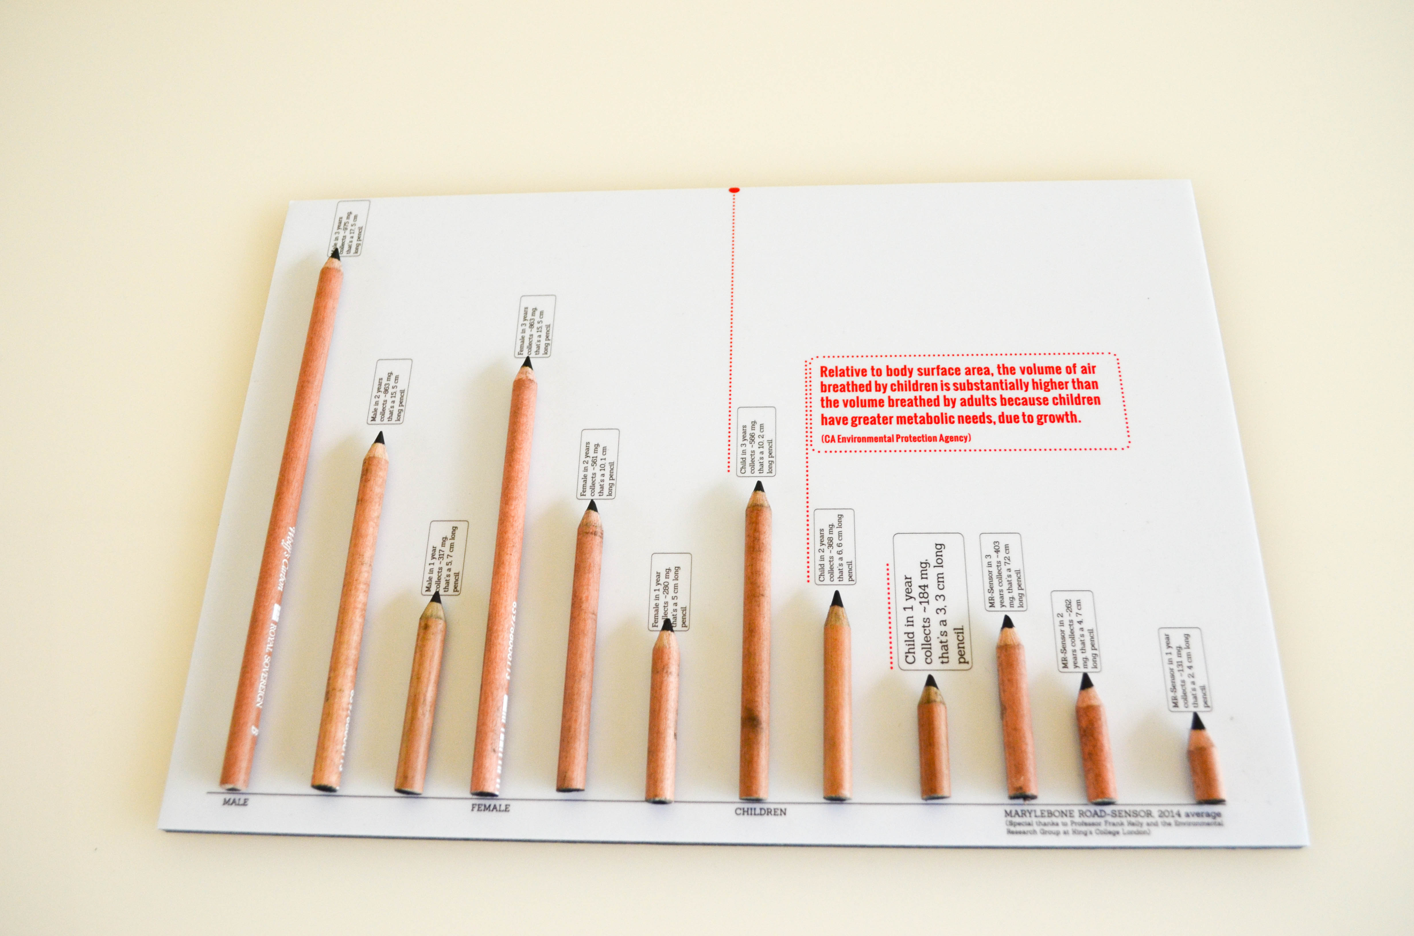
Concrete - Measurable
Carbon Pencils – How much
Air pollution you breathe each
Year
Make your messages understandable so that they mean the same thing to everyone in your audience
Using actual things to explain concepts
Paint a mental picture
Use similes (like, as)
Give examples
Quantify deaths
Quantify costs to health care system
Notes:
Main Idea: You need to connect a diverse audience to your communication. To get your message across you must be clear and your message must be memorable. Being concrete is using real objects (concrete nouns /actual things like: cat, water, teacher) vs abstract nouns (truth, excellence, adulthood) in your communications. Concrete nouns are easy to visualize which in turn are easier to remember.
Tip: Making numbers concrete:
More than 80% — not 82%
Two-thirds — not 67%
Almost one hundred years ago — not 95 years ago
More than 6,000 people — not 6,300 people
Reference: Numbers: Jeremy Porter Communications: http://www.jrmyprtr.com/great-key-messages/
WHO example: 1 can of Coke has 40 grams of sugar, that’s 9 tsp! – this is a concrete message using what we know (teaspoons) to explain the number of grams in a can of coke.
References: http://who.int/dietphysicalactivity/publications/fiscal-policies-diet-prevention/en/
http://iris.paho.org/xmlui/handle/123456789/18391

Slide 11

Credible
The audience needs to believe you
Champions - someone else’s credibility
Tell stories of real people
Use evidence
Use self-experience
Give detail
Notes:
Main Idea: Messages need to be credible so that people believe & act upon them. As a function of working at WHO – we have an advantage. Our work is evidence based and as the global authority on health, the WHO brand brings with it credibility.
Other ways to bring credibility to our messages is to:
Use self-experience: talk about how an event affected you and why you believe in the message you are delivering
Borrow someone else’s credibility: cite someone else’s work, experiment, document, etc. to bring credibility to your message
Tell stories of real people: talking about events that have occurred to other people provide an example that the audience can relate to.
Use evidence: state the evidence that proves your message is sound
Give detail: using detail and adjectives brings credibility to your messages because it allows the audience to visualize what you are talking about. Makes it seem more relevant to them with the additional detail.
WHO Example: The WHO Logo gives credibility all by itself.

Slide 12

Emotional
We are wired to connect with people, not ideas
Talk about people
Make them care – "WIIFM"
Connect the audience to how they are affected by the topic
Ask the audience to visualize or imagine
Make them feel something – hope, excitement, horror, disgust…
Notes:
Main Idea: If people feel emotion toward a topic they are more likely to act. If they can “see themselves in their shoes” they will be more compelled to do something about the messages you are sending. Using emotion is all about getting people to care about our messages so that they will do something about the issue. Point out the WIIFM (What’s in it for me) for the audience & how they too are affected by the topic. Make the audience feel something – horror, hope, excitement etc. Talk about the child, the grandmother – etc. people we can all connect to.
People will forget what we say and how we said it, but they will never forget how we made them feel.
Example: Good Health Adds Life to Years. World Health Day 2012. This messaging is emotional because it is about people – Grandparents. Even if ageing seems too remote to affect us now, we can all relate to grandparents. Further, when we get old, we all want to “add life to our years.” The WIIFM is in this message for our audience – if I am healthy now, than I can be more active in my older years. This makes us care and pay attention, remember…and be more likely to act.
Reference: http://www.who.int/world-health-day/2012/en/

Slide 13
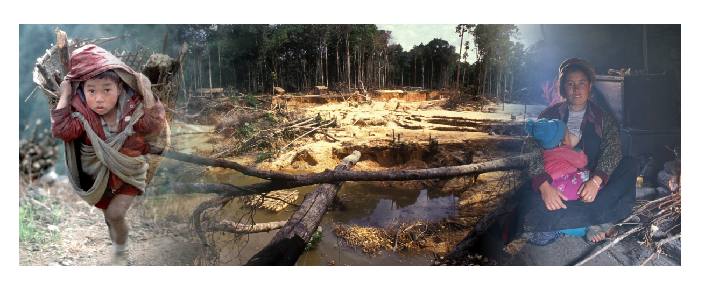
Stories
As you hear a story, you live it in your own mind…like experience
Paint a visual picture
Inspire
Challenge
Connect
Notes:
Main Idea: Stories paint a visual picture which helps us to remember. Stories are interesting and often make a point – they give people something to connect the messages to. They provide an example of what works/doesn’t work. Create mental images for recollection.
Research shows that storytelling increases brain activity in the listener, strengthens the connection between the communicator and the receiver, and increases the recall rate on detail and core messaging. As you hear a story, you live it in your own mind…like experience, and we are more likely to remember experiences than someone else talking. Use stories to illustrate your messages and bring them to life, to make them relevant to and connect with your audience.
Example: WHO WR Barbados. Tax introduced on sugary drinks in Barbados. When he speaks about it, he talks about how his office window looks out onto a school. Everyday he hears the recess bell ring and the sound of children fill the air. In the midst of the joy of hearing children playing, he is saddened when he looks out his window and sees how many of the children are obese…. And then he launches into his sugary tax convincing argument…..
For an overview of one of the leading researchers in this field see:
http://blog.ted.com/what-happens-in-the-brain-when-we-hear-stories-uri-hasson-at-ted2016/

Slide 14
Rule of three
Speaking in threes:
Easy to remember
Catchy
Repeatable
"Life, liberty, and the pursuit of happiness"
US Declaration of Independence
Liberté, Égalité, Fraternité
French motto
Stop, drop, and roll
Fire safety moto
I came, I saw, I conquered
Julius Caesar
Past, present, future
Time
Positive, negative, neutral
Components of an atom
3
Notes:
Main Idea: 3 is easy to remember and repeat. Rule of threes – 3 key messages that always tie back to your SOCO.
That’s the truth, the whole truth, and nothing but the truth
“Life, liberty, and the pursuit of happiness”, US declaration of Independence
Liberté, Égalité, Fraternité, French motto
Stop, Drop, and Roll, Fire safety moto
I came, I saw, I conquered, Julius Caesar
Past, present, future
Positive, negative, neutral
Stop, look, listen
Beginning, middle, end

Slide 15

27/9/3
Speak in sound bites
Print quote
TV quote
All media
    27 words
    9 sec sound bite
    3 key messages
Tweet
    140 characters
    takes 9 sec to read
Source: WHO Media Team, Sound Bite
Notes:
Main Idea: Each of the three messages we write should be clear and short – around 27 words or 9 seconds. Following the 27/9/3 format, based off of creating sound bites, is a great way to structure messages because it helps the messages to be quick, simple and memorable.
27 Words
The average length of a sound bite in the print media is 27 words;
9 Seconds
The average duration of a sound bite in the broadcast media and to read the average tweet, takes nine seconds
3 Messages
The average number of messages reported in both the print and broadcast media is three.

Slide 16
BUST JARGON AND ACRONYMS
Jargon | Alternative
Interventions | Strategies, Changes
Elucidate | Explain, Make clear
Empower | Allow, Let
Endeavour | Try
Enumerate | Count
Envisage | Expect, Imagine
Equitable | Fair, Equal, Balanced
Erroneous | Wrong, Incorrect
Evidenced | Showed, Shown
Evince | Show, Prove
Exhibit | Show
Exhibits a tendency to | Tends to
Expeditiously | Quickly, Immediately
Notes:
Main idea: This slide highlights some examples of jargon and how the words can be replaced with clearer, more accessible alternatives.
Note: in science based, expert driven organizations, there is often a refusal to adopt clearer, more accessible terms for fear that there will be a lack of precision and a compromise to the scientific credibility of the expert and the organization. In response to this concern, we need to remind ourselves of what we’ve already discussed asking: What is our objective? What is the target audience? What is the health literacy level of that group?
In scientific journals, highly technical terms may be accepted, but in the world of health communication, they threaten our success.

Slide 17

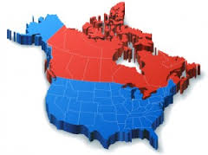
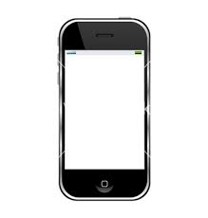
Numbers
Break numbers down by:
Time: 7 million people a year die from Air pollution. That’s 800 people and hour.
Place: In 2008, an estimated 347 million people in the world had diabetes. That many people would fill the population of the USA + Canada combined.
Comparison: Only 4.5 billion people have access to working toilets, yet 6 billion have access to mobile phones.
Notes:
Main idea: Another technique in trying to communicate complex number based messages it to apply something called Social math.
This is the practice of translating statistics and other data so that they become interesting to the receiver, meaningful to the audience, and helpful in advancing public policy.
Note: as effective as this technique can be, communicators need to ensure that their “social math” examples are sending the message they intend. In this, a rapid testing – even with colleagues, friends, or people in the street – can be useful in ensuring success.

Slide 18
People are more likely to trust information,
they can easily understand.
!

Slide 19
Use SHORT, ACTIVE SENTENCES,
CLEAN OUT JARGON
NOUN- VERB – DIRECT OBJECT
"Effective air pollution interventions include transit-oriented and walkable cities, resulting in a triple health return in terms of better cardiovascular health, reduced injury risks and increased opportunities for physical activity.
To reduce air pollution we need walkable cities with great transit systems and clean cars, motorcycles & trucks. Not only will there be fewer air pollution deaths, but less traffic injury. And people will be able to get more physical activity. A triple health return.
Notes:
Note: this slide offers the chance to engage the participants asking for their own views on the strengths and weaknesses of the messages.
This sort of sentence works well within WHO – among public health experts. It won't always work with the people who make policies and the people who give us funding. It certainly won't work with the media.

Slide 20
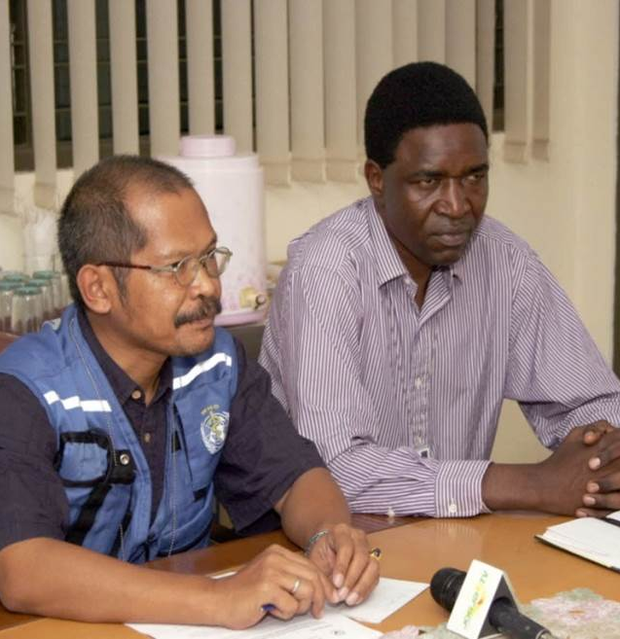
Your turn!
KEY MESSAGES GRID HANDOUT
Using the Key Messages grid, write key messages & supporting evidence for your public health topic
Notes:
Note: organize participants into groups and have them complete the exercise based on an issue with which they are familiar and will be relevant to the full workshop.

Slide 21
Key messages grid
SOCO:
Audience:
 | Key message #1 | Key message #2 | Key message #3
Supporting Facts/data
Supporting Facts/data
Supporting message Facts/data
Ref. Jeremy Porter Communications: http://www.jrmyprtr.com/27-9-3-message-grid/
Notes:
Main Idea: This Message Map will help to organize your 3 key messages utilizing the 27/9/3 rule, and help you to deliver them in a conversational manner. (each Key Message and Supporting Message can be a maximum of 27 words).
The key messages are the CORE of the communication (remember Simple from the Success model). The supporting messages include evidence, examples, statistics, analogies, similes, calls to action.
When filled in, the messages can be read in a conversational manner such as:
Read Key message 1, 2 and 3 in sequential order.
Now read Key message 1 again along with its 3 supporting messages.
Read Key message 2 and its 3 supporting messages.
Finally, read Key message 3 and its 3 supporting messages

Slide 22

YOUR TURN – BUILD YOUR OWN CAMPAIGN
SEE HANDOUT
1. FINALIZE YOUR SOCO
2. Choose your Target Audience - map supporters, blockers.
3. Create Key Messages & Comms Tools & Tactics you will use based on:
-Creative thinking about audience’s tastes, needs & values;
-Types of information that are convincing for target audience;
-Sources of Information believed/trusted
Notes:
Note: In groups have the participants review the messages they developed in the last exercise. Have them critically review and assess whether or not there are examples of jargon and have them come up with alternatives and share them with the full group.

