Slide 1
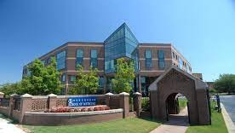


A scientific approach to pandemic preparedness
WHO R&D Blueprint Consultation
A Scientific Framework for Epidemic and Pandemic Research Preparedness
Scientific opportunities to achieve fast and equitable access to
high-quality and trusted vaccines for future pandemics
October 24, 2023
Barney S. Graham, MD, PhD
Director of David Satcher Global Health Equity Institute
Professor of Medicine and Microbiology, Biochemistry, Immunology
Morehouse School of Medicine
Atlanta, GA

Slide 2
Disclosures
Vaccine Inventor
  Coronaviruses
  Respiratory syncytial virus
  Influenza virus
  Nipah and other paramyxoviruses
  Zika
Monoclonal Antibody Inventor
  Ebola
  SARS-CoV-2 and other coronaviruses
  Scientific Advisory Boards
    Icosavax
    Vaccine Company, Inc.
    Third Rock Ventures, Inc. Foundry
  Consultant
    GSK
    Pfizer
    Janssen
    Sanofi
    Merck
    AstroZeneca
    Exevir
Notes:
My disclosures include being an inventor on vaccines and mAbs for several viruses and consulting for several companies.

Slide 3
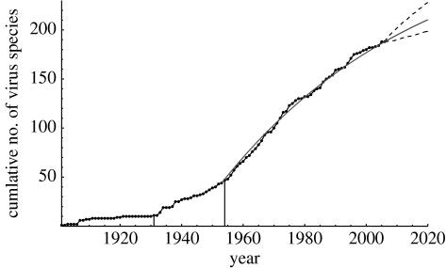
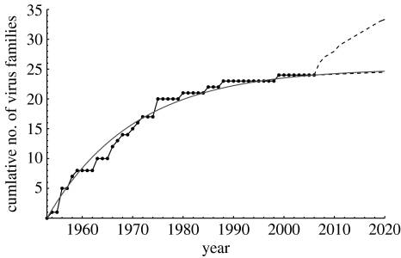
New Human Viral Pathogens in the 20th Century
New species
linear
New families
plateauing
Woolhouse MEJ et al Proc R Soc B 2008; 275:2111

Slide 4
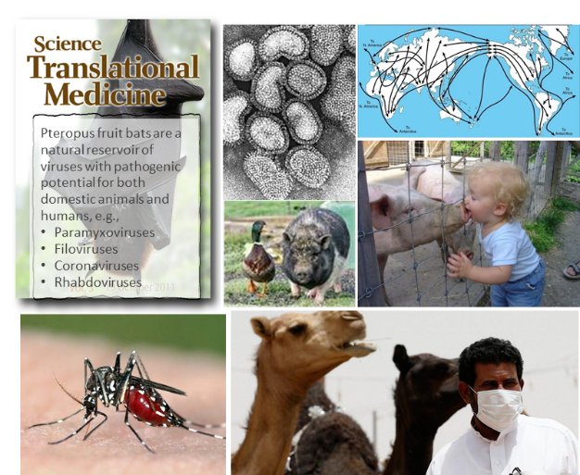
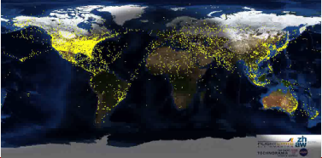
21st Century Viral* Threats and Needs
Outbreaks
SARS-CoV-1
H5N1 influenza
H1N1 influenza
MERS
Chikungunya
Ebola
Marburg
Zika
Nipah
EV-D68
SARS-CoV-2
Monkeypox
Unsolved Problems
HIV
HCV
Dengue and other flaviviruses
Alphaviruses
Norovirus and other nonenveloped viruses
Bunyaviruses
CMV and other herpesviruses
Rapid response approach for Paramyxoviruses
Polyomaviruses
Other emerging infections
Could be better
Influenza
Mumps
Yellow Fever
Filoviruses
*Not to mention malaria, Tb, and all the virulent or untreatable bacteria, fungi, and parasites

Slide 5
Viral Taxonomy 2023
6 realms
10 kingdoms
17 phyla
2 subphyla
40 classes
72 orders
8 suborders
264 families
182 subfamilies
2818 genera
84 subgenera
11273 species
  ~150 viruses from 26 families recognized as human pathogens with potential for person-to-person spread

Slide 6
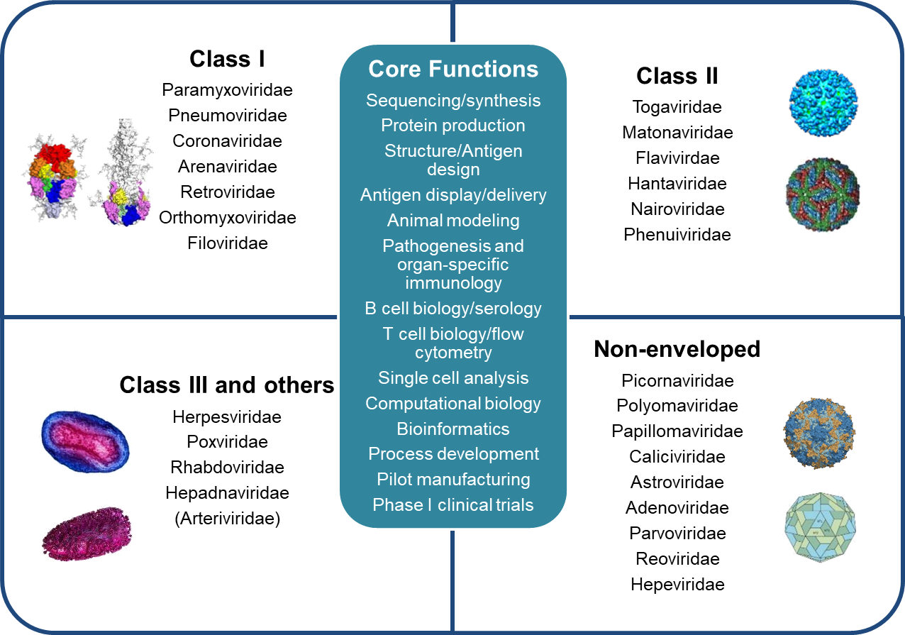
Prototype Pathogen Approach for Pandemic Preparedness
  Pathogen biology, product development, preclinical and clinical evaluation supported by global governance and pre-established relationships with industry, regulatory authorities, and public health systems
  ~150 viruses from 26 families known to infect humans with some potential for increased human-to-human transmission and virulence
  Develop vaccines for ~30 prototype viruses through phase 1
  Develop vaccine candidates (& reagents) for other ~120 through animal testing
Graham & Sullivan. Nature Immunology 2018

Slide 7
Pandemic Preparedness
Know what’s coming
  Virus discovery
  Surveillance – humans, animals, and vectors
Know what to do
  Virus characteristics including pathogenesis
  Basis of immunity – identify antigen target
  Antigen design and delivery
Know how to make biomedical countermeasures
  Reagents including rapid mAb identification and production
  Diagnostics
  Antivirals – preventive and therapeutic
  Vaccines
  Animal models
Know how to deploy interventions rapidly on a global scale
  Maintenance and geographic distribution of manufacturing and clinical facilities – scale-up capacity
  Organization of governments, agencies, industry, academia, and nonprofit organizations
  Coordination of regulatory processes and requirements
  Communication with the public

Slide 8


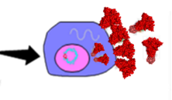
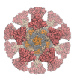










Global COVID-19 Vaccine Landscape
199 Vaccine Candidates in Pre-clinical Evaluation
178 Vaccine Candidates in Clinical Evaluation
Nucleic acid
Nanoparticle display of structurally defined proteins
Whole-inactivated virus
Live-attenuated virus
Recombinant Vectors
Recombinant or chimeric viruses
Virus-like particles
Recombinant proteins or subdomains
Peptides
Source: WHO 14 February 2023

Slide 9
Finding Generalizable Approaches and Breakthroughs
Successes
Structure-based antigen design
Self-assembling nanoparticle display
Nucleic acid, vector, or protein delivery
Single-cell analysis
Targeting antibody lineages
Barriers to Pandemic Preparedness
Antigenic diversity
Immunodominance
Durable responses
Mucosal immunity
Immune evasion
Potential for enhanced disease
Glycan shield
Integration and latency

Slide 10
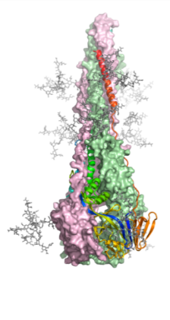

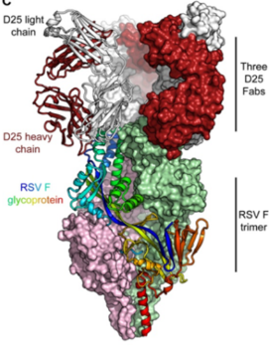
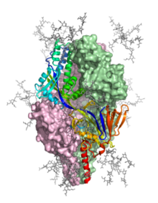
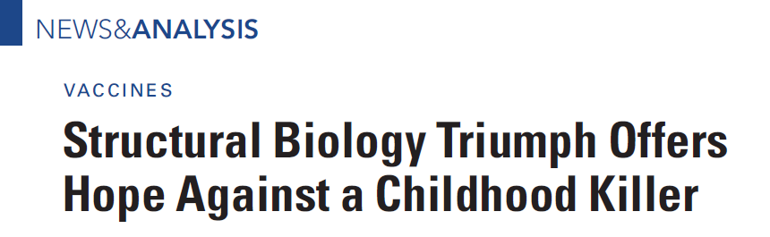
Structure of Prefusion RSV F Glycoprotein
Prefusion
Postfusion
Notes:
10

Slide 11

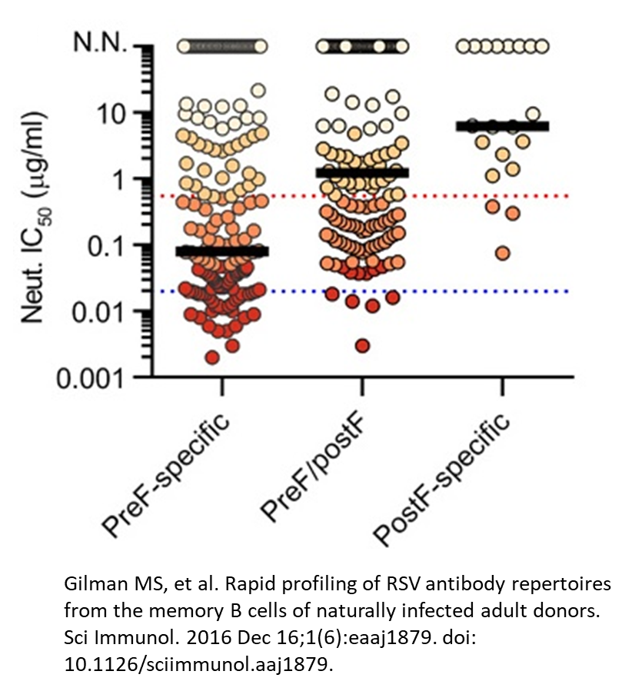
Targeting right antigenic site matters
Week 0
Week 1
Pre-F
Dual
DS-Cav1
(Pre-F)
Post-F
MEDI7510
(Post-F)
Pre-F
Post-F
Emily Phung, Lauren Chang
Notes:
To demonstrate

Slide 12
Finding Generalizable Approaches
Successes
Virus-like particles
Whole-inactivated
Live-attenuated
Barriers to pandemic preparedness
Multiple serotypes
Structure and antigen definition
Mucosal immunity

Slide 13
Finding Generalizable Approaches
Successes
Replication-defective virus
Live-attenuated
Protein subunit
Barriers to pandemic preparedness
Structure and antigen definition
Mucosal immunity
Integration and latency

Slide 14
Finding Generalizable Approaches
Successes
Live-attenuated
Virus-like particle
Barriers to pandemic preparedness
Antigen structure
Antibody-dependent enhancement

Slide 15
Pandemic Response
Early detection
  Sequence availability
Epidemiology
  Point of care diagnostics
  Maintenance of public health infrastructure and reporting
Rapid production of fit-for-purpose products
  Use strain-matched antigens for vaccines
  mAbs for diagnostics and therapy
  Antivirals
  Agent-specific animal models
Deploy
  Will require prior planning and agreements between governments, between agencies within governments, between governments and non-government organizations with methods of coordination and communication
  Public-private agreements between nonprofits, philanthropists, academia, and industry

Slide 16
Take Home Messages
We have the science and technology to solve most future problems but are lacking in the areas of policy and practice
Need consensus on global coordination, communication, and governance
Equitable distribution of basic science, translational science and manufacturing is critical to solve local problems before they become global
  Investment in basic research
  Surveillance needs support for prospective cohorts and sequencing facilities
  Distributive manufacturing is feasible but needs small market business models
Pandemic response will usually require strain-matched products
  Prior generalizable solutions
  Emphasis on speed and global coverage

