Slide 1
A global effort to identify viral and bacterial families that are anticipated to threaten public health
Marie-Paule Kieny
Chair of the Rhabdoviridae WG
Notes:
Good morning, today I will present on our efforts to identify pathogens with epidemic and pandemic potential and will share with you the main actions that we will foster as part our global pandemic preparedness efforts

Slide 2
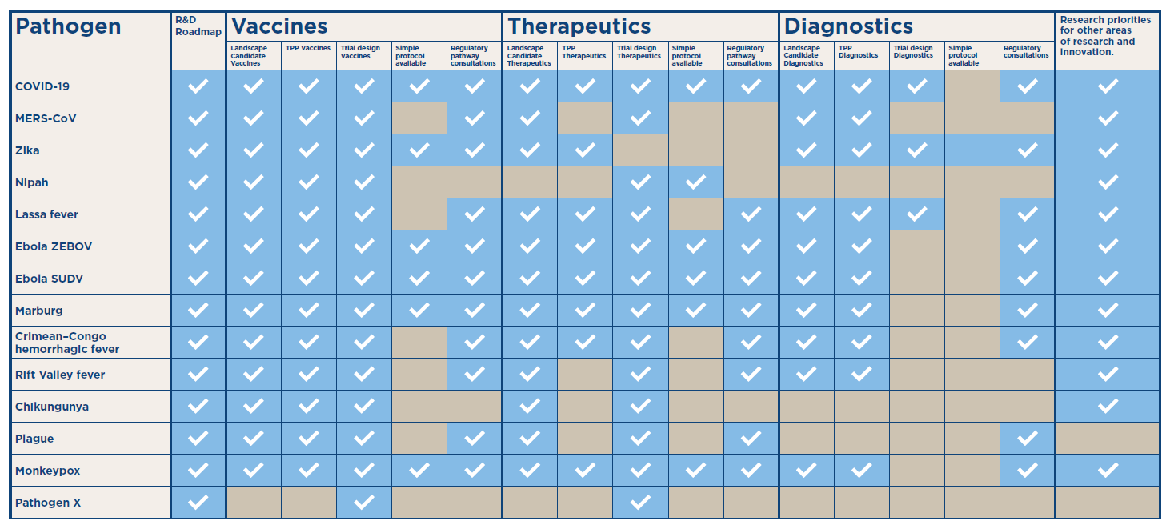



Background
Approach for EACH priority pathogen and medical countermeasure
The R&D Blueprint leads research to accelerate the availability of safe and effective medical countermeasures for diseases that can cause a health emergency due to their epidemic or pandemic potential.
Since its inception in 2015, an official list of priority diseases is regularly published to guide research priorities in WHO and the work of the R&D Blueprint.
It was time for a rethink of the overall strategy.
Priority Pathogen Identification
Research Roadmaps, TPPs, global coordination
Pipeline Monitoring
Clinical trials and global toolbox (protocols, SOPs)

Slide 3





PREVIOUSLY… Pathogen, Products and Outbreak-Specific
MCMs
R&D Roadmaps
TPPs
Landscape of MCMs
Pathogen-specific trial design
Broader Research and Innovation
Collaborative networks
Trials integrated into the outbreak response
List of priority pathogens
Pathogen-specific actions
Pathogen-specific trials during outbreaks

Slide 4
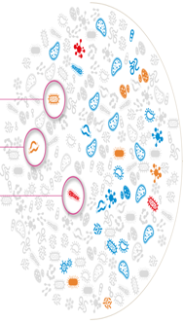

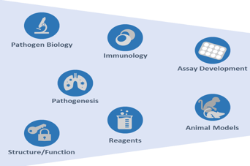
NOW… Viral and Bacterial Family approach
Trials integrated into the outbreak response
1400 pathogens
30 viral families
1 bacteria family
MCMs – prototype vaccines & therapeutics/Family
R&D Roadmaps
TPPs
Landscape of MCMs
CORE protocols /family trial design
Broader Research and Innovation
Collaborative networks
Trials to reduce UNCERTAINTY for important public health questions
Seamless trial design
Simple trial
Randomization during deployment
Priority Families
Prototype pathogens
ALL Families regardless of perceived pandemic potential
Phase 1- 2
Phase 3
Notes:
The new approach is predicated upon pathogen-specific research initiatives aimed at advancing the understanding of priority pathogens either identified as, or potentially emerging as significant public health threats.
Encouraging the development of a comprehensive foundational research agenda and promoting translational science concerning these defined viral families and prototype pathogens stands as a fundamental step for effective pandemic research preparedness.
Beyond recognized threats (families with known or suspected pandemic potential), comprehensive preparedness mandates acknowledgment and provision for unforeseen emergent disease threats, commonly denoted as Pathogen X.
To mitigate the inherent risks stemming from uncertainty associated with unknown pathogens, an emphasis will be placed on identifying and promoting prioritizing preparatory research on prototype pathogens, chosen from viral families with a known potential to cause pandemics.

Slide 5
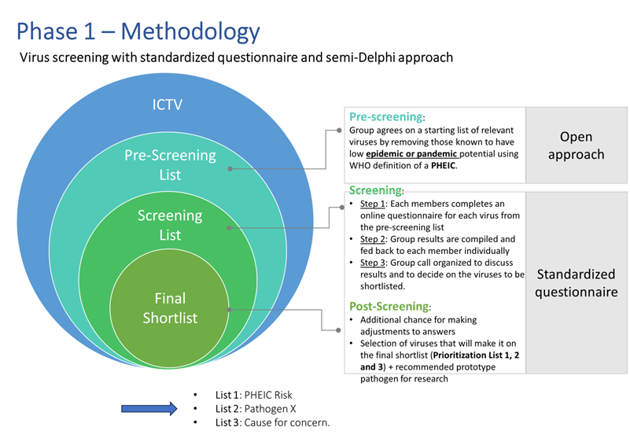
A new (agnostic) pathogen family approach
A pathogen family approach has the advantage of encouraging research efforts on entire classes of viruses of concern, instead of on individual strains.
The identification of a representative (or prototype) pathogen by family is a key component of the approach and used as pathfinder pathogen to prioritize research and the development of a vaccine or treatment that can apply to other pathogens in the same family.

Slide 6
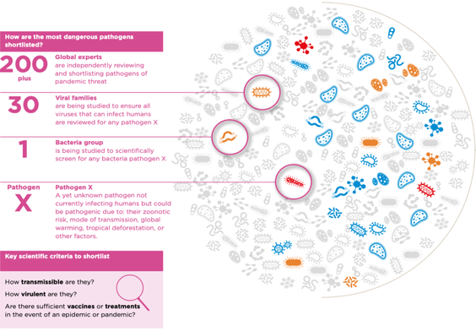

Prioritizing the world’s greatest pathogen threats
There are over 1,400 species of human pathogens in the world. These include virus, bacteria and fungi
Family reviewed and not shortlisted
Not likely to cause epidemic or pandemic, or already equitable access to safe & effective MCMs
Family reviewed and not shortlisted
Have epidemic or pandemic potential, but there is equitable access to safe & effective MCMs
→
Family reviewed and shortlisted
Have epidemic or pandemic potential, and
there are no or insufficient MCMs
Family reviewed and shortlisted
Epidemic or pandemic potential is unknown, but shortlisted as potential Pathogen X
Notes:
Numerous virus and bacterial families lack licensed vaccines, encompassing many viruses capable of inflicting significant human disease.
Fully characterizing the approximately 120 viruses causing human illnesses and devising Medical Countermeasures (MCMs) for each is impractical.
Instead, identifying viral families with pandemic potential and selecting prototype viruses from each family offers a feasible avenue to gather knowledge that might apply to the entire family or its parts. These selected viruses are termed prototype pathogens.
For instance, within the Arenaviridae family, identifying a prototype pathogen such as Lassa, Junin, or similar viruses becomes crucial. The ideal Arenavirus prototype isn't solely one with potential outbreak risk but one that shares crucial functional and structural traits with viruses across the Arenaviridae family.

Slide 7

Process for prioritizing the world’s greatest pathogen threats
Phase 1
Scientific Prioritization
Process: 30 independent viral family and 1 bacterial Working Groups
Output: Not shortlisted and shortlisted viral and bacterial families
200+ international experts
(incl. prototype pathogen(s))
Dec 2022 – early 2024
  Public Health Prioritization
  Process: Prioritization Advisory Committee (PAC)
  40 – 50 experts (including Chairs of WGs)
  Output: Final shortlist of viral and bacterial families with pandemic potential (incl. prototype pathogen(s)
Phase 2
Early 2024
Notes:
The first phase- the scientific prioritization- started in Dec 2022 and will be completed in early 20024. The second phase the public health prioritization will be completed in early 2024

Slide 8
Next steps – 1/4 - A scientific approach to pandemic preparedness
Scientific opportunities to achieve fast and equitable access to high-quality and trusted vaccines for future pandemics.
Scientific research priorities for all viral and bacterial families, regardless of perceived pandemic potential
Defining the scope of emerging virus treats through the discovery
Expanding generalizable basic research that would support the development of vaccines and therapeutics for future threats
Translational research and product development with an eye on the potential for generalizability
Large, simple randomized trials CORE protocols per family
Additional scientific research priorities for viral and bacterial families with pandemic potential
Monitoring transmission of pathogens known to cause outbreaks
Translational research and product development with an eye on potential for generalizability
Continue R&D projects for identified pathogens with generalizability in mind
Large, simple randomized trials integrated into the outbreak response
Additional scientific research priorities for an unknown pathogen (disease x) causing a pandemic
Contemporary viral isolates that have been well characterized.
Identifying antigens: scientific challenges
Collaborative basic research to study viral structures for MCM development
Evaluation of candidate MCMs using simple trials OR randomization during deployment, integrated into the outbreak response
GLOBAL COLLABORATION TO RESPOND TO AN UNKNOWN PATHOGEN
(DISEASE X) CAUSING A PANDEMIC
Notes:
As I mentioned on Monday, the research priorities will include actions for all viral families regardless of the perceived epidemic potential and for the pathogen X

Slide 9

Next Steps – 2/4 - Prototype pathogen approach - for each viral family
11. Detailed Knowledge of viral characteristics
Natural immunity, correlates of protection, vaccine targets, atomic-level structures
2. Preclinical & clinical development of prototype vaccines & therapeutics
Vaccine/therapeutics modalities; phase 1, 2 immunogenicity, dose, schedule
3. Manufacturing and storage
Platform engineering, formulation, scale, cold chain requirements
Notes:
In brief, there are 3 main areas where efforts should be focalized..

Slide 10
Next Steps – 3/4 - Study design options to reduce UNCERTAINTY during an epidemic
For candidate products that may have evidence on safety and may likely be effective against outcomes important for public health, but for which there is remaining uncertainty
Studies of biomarkers
Animal Rule
Immunobridging
Comparisons using immunomarkers
Randomized clinical trials
Placebo controlled trials
Simple large randomized trials
Open-label randomized trials
Randomization during deployment
Observational studies

Slide 11








Next Steps – 4/4 - An approach to fast-track assessment of candidate MCMs
and support pandemic prevention and control
1
2
3
Prioritization
Availability
Clinical trials
4
5
Agreements
Funding
  WHO Independent expert process to prioritize candidate vaccines
  Agreement on availability and access to candidate vaccines and therapeutics
  CORE protocols and platforms to promptly initiate trials with equitable access to research
  Prior agreement on legal collaboration, insurance, indemnity and liability
  Access to readily available funding through committed financing mechanism
Blueprint pathogen
A WHO process for prioritization of candidate vaccines by an independent WHO Technical Advisory Groups on candidate vaccine and treatments prioritization
Decisions are informed by outcomes of the prioritization process on minimum number of candidate product doses required for research during outbreaks and that need to be available.
Ministries and researchers in affected countries are in the driving seat and integrated into the response. CORE protocols for viral and bacterial families design and approved in advance
A partnership model and signed agreements with Ministries of Health and developers with access to MCMs considered, and a framework for insurance and liability arrangements.
Signed agreements with contributors; aimed at a simple approval process for releasing of funds and simplifying financial reporting.
6
6. Collaborative approach
Including pathogen and trial experts, local researchers, and outbreak response teams to help adjust and implement research as needed
To foster an open flexible collaborative mechanism that allows a variety of contributors

Slide 12

The current challenges of Research and Innovation are a problem that can be solved.
Let’s solve it together!

