Slide 1
COP26 Initiatives on Climate Resilient and Sustainable Low-carbon Emission Health Systems

Slide 2

COP26 Health Leadership Initiative
Commitment area 2: Sustainable low carbon health systems
▪ High ambition/high emitters: Commitment to set a target date by which to achieve health
system net zero emissions (ideally by 2050).
▪ All countries: Commitment to deliver a baseline assessment of greenhouse gas emissions
of the health system (including supply chains)
▪ All countries: Commitment to develop an action plan or roadmap by a set date to develop
a sustainable low carbon health system (including supply chains) which also considers
human exposure to air pollution and the role the health sector can play in reducing
exposure to air pollution through its activities and its actions.
Commitments sought: Public, non-binding statements that each government makes at a ministerial level on behalf of their respective health sectors. Commitments to COP26Health@fcdo.gov.uk

Slide 3

Australia
Ambulance Victoria
Hunter New England Local Health District
Race to Zero participants – 26 May 2021 launch
Spain
Galician Health Service
Hospital General La Mancha Centro
France
Centre Hospitalier de Niort
Germany
Evangelische Elisabeth Klinik
Evangelisches Krankenhaus Hubertus
Fachklinik Gaißach
Krankenhaus Havelhöhe
Brazil
Sociedade Beneficente Israelita Brasileira Hospital Albert Einstein
Sociedade Beneficente de Senhoras Hospital Sírio Libanês
Santa Casa BH Medical Specialties Center
Santa Casa de Misericórdia da Bahia - Hospital Santa Izabel
SDPM - Associação Paulista para o Desenvolvimento da Medicina
Rede D'Or São Luiz S.A.
Sweden
Region Västra Götaland
Taiwan
Dalin Tzu Chi Hospital
Greece
General Hospital of Syros
United Kingdom
Sussex Community NHS Foundation Trust
Manchester University NHS Foundation Trust
Newcastle upon Tyne Hospitals NHS Foundation Trust
NHS Highlands
Chile
Servicio de Salud de Valdivia
India
Amrita Hospital, Faridabad
Aravind Eye Care System
Bhagat Chandra Hospital
PSG Institute of Medical Sciences & Research
Colombia
Hospital San Rafael de Pasto
United States
Providence
University of California Davis Health
University of Vermont Medical Center
Costa Rica
Hospital Clínica Bíblica
Mexico
Centro Estatal de Vigilancia
  Epidemiológica y Control de
  Enfermedades
Hospital VECE Municipal Hermenegildo Galeana Jiquipilco
Hospital Municipal Villa del Carbón
Denmark
Capital Region of Denmark

Slide 4
Carbon footprint calculation tool
Global carbon footprint calculation tool for facilities and systems
Scope 1. On site combustion, mobile combustion,cooling, anesthetics
Scope 2. Purchased electricity
Scope 3. Business travel, employee commuting, patients commuting, inhalers
Waste treatment Incineration, compost, landfill on site or off site
Graphics, benchmarking and metrics to understand the data
Representatives from all regions collaborated in the development, including hospitals and health care systems
Guidelines
Training
Community of practice
Online and offline tool
Global development

Slide 5
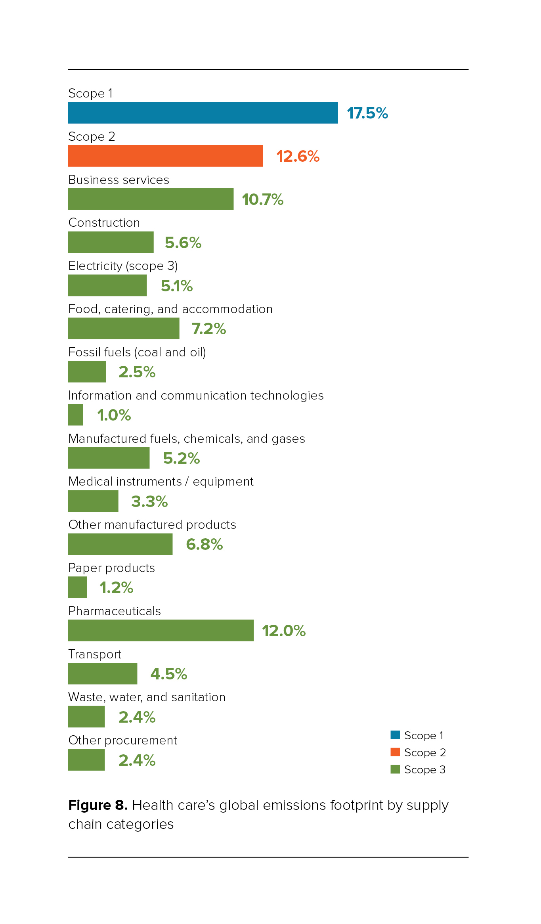
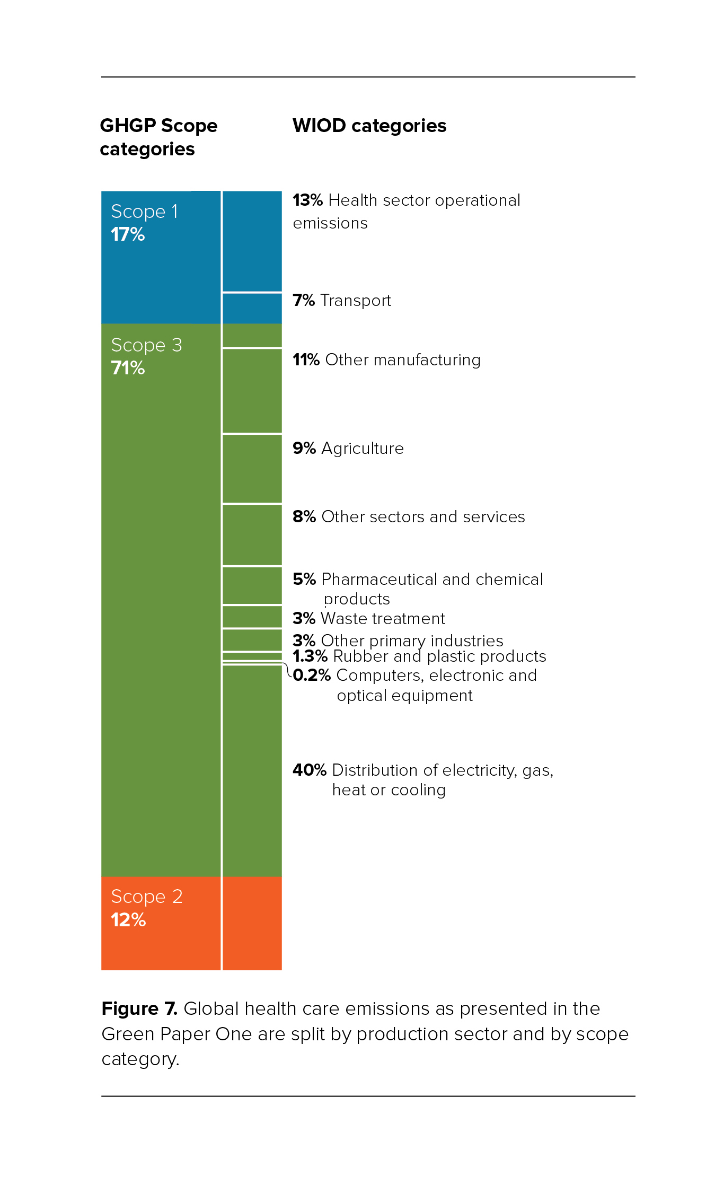
Carbon footprint topography

Slide 6

Global Road Map for Health Care Decarbonization
A navigational tool for achieving zero emissions with climate resilience and health equity
www. healthcareclimateaction.org/roadmap
Notes:
Roll-outs around the world:
Australia: 16 April
LAC: Regional launch in Latin America (including Brazil) in June - 23rd TBC. We will also be presenting the Road Map at the HCWH workshop next week, within the framework of the PAHO Regional Consultation on Climate Change and Health
SE Asia: June 10. We shared the Road Map at the WHO WPRO regional consultation yesterday in a workshop session
South Africa: June 17th with the Public Health Assoc of SA and Health Academics
US: we presented the Road Map to our national Health Care Climate Council. We are highlighting the Road Map at our annual CleanMed conference next week and integrating the findings into a number of our presentations.

Slide 7
Charting a course to zero| Three pathways
Notes:
This is the heart of the Roadmap based on modelling and methodologies that are described more fully in the document and its annexes. I will not address those here as I want to focus on the key pathways and actions described.
The RoadMap highlights three pathways and seven high impact actions - they are interrelated and cover the reductions required over and above the NDCs
- The First pathway is what the health sector needs to do within its own operations, clinical services and facilities for instance through clinical practice, the way buildings are used and segregating waste
- The second is what the supply chain can do by making sure healthcare products are zero carbon
- The third is making sure that the wider economy and society match the same pace of reductions across agriculture, the energy, transport and housing infrastructure because these will all influence the health sector footprint. And healthcare can make sure this happens by advocating for it
NB: They do not follow scopes of GHG because we are trying to focus on who can take action in these pathways.
I am now going to talk you through the seven high impact actions - and as I am talking about them, please remember that each one contributes to all three pathways as I just described so they include actions within healthcare’s own operations, what the supply chain can do and what wider society and economical changes are also needed.

Slide 8
Charting a course to zero| Seven high-impact actions = 44.8 gigatons emission reduction over 36 years = the entire world’s GHG emissions in 2017
Notes:
The first action relates to
-1. Renewables - we have already mentioned this as cornerstone action as part of a wider energy transition and also to bring energy to health facilities and communities who do not have sufficient access now.
-2. Buildings ( could overall contribute 17.8 Gigatons - which is the same as all US and China emissions in 2018).
Developing sustainable zero emission buildings that are fit for purpose for health care in the 21st Century is a corner stone action - in the way they are used and designed, the way they are built and the materials used, as well as the wider infrastructure they rely on. This links to where they are located and how they support communities.
Many are doing this already - For instance, the NHS has committed to making sure their 40 new hospitals will be net zero;
Health clinics in India and Africa are solarizing their roofs so they can have access to resilient power and can operate at night,
and hospitals in Latin America are considering how to achieve effective and sustainable cooling through natural ventilation and less potent refrigerants.
Of course building refurbishments are key too as most buildings that will be in place in 2050 are already built - so achieving zero emissions in existing buildings becomes paramount.
3 -Travel including active and sustainable travel as well as electrification
4- Food that is local, sustainable and plant forward can ensure a contribution of close to 1 gigaton - equivalent to the emissions of two countries like France and Germany in a year
5- Pharmaceuticals (2.9 gigatons similar Russia and India) emissions in one year
This is one of the health specific interventions. The way medicines are prescribed, to greener pharmaceuticals and the infrastructure that supports the manufacture, dissemination and waste management of these products.
From developing greener pharmaceuticals to prescribing lower impact medicines or increasing the levels of social prescribing, every health professional and the entire pharmaceutical industry have a role to play.
Inhaler propellants and anesthetic gases are dentified as ‘hotspots’ because of the potency of the gases and because there are clinically sound ways of switching to less harmful products.
This is likely to apply to most medicines and medical products and so we must choose to make sure that zero carbon and sustainability are a central thread. This means our task is to make sure we prescribe sustainably, focus manufacture on zero emissions, and also as a society consider the ways we use and dispose of medicines and their packaging - including covid vaccine waste and PPE - so that it is done in zero carbon, sustainable and equitable ways.
6 - And so, of course we need to pay attention to all the products that are purchased, used and disposed of - and wherever possible medical products should be reprocessable or designed for re-use, that any left over waste is managed sustainably by segregating it and recycling as much as possible and choosing the appropriate disposal mechanism Indeed many medical devices can be autoclaved safely rather than incinerated and gloves are generally not needed for many procedures such as vaccination or pushing a wheelchair. Paying attention to the circular economy in this way could contribute a further 4.9 gigatons.(nearly twice the EU in a year).
7- Effectiveness is also key so that we make sure that the money spent on healthcare actually goes to addressing the right health care goals - so everyone can benefit. This is particularly recognisable in some very high spend countries such as the US. (Another half dozen countries like Canada, Mexico, France, Korea)

Slide 9
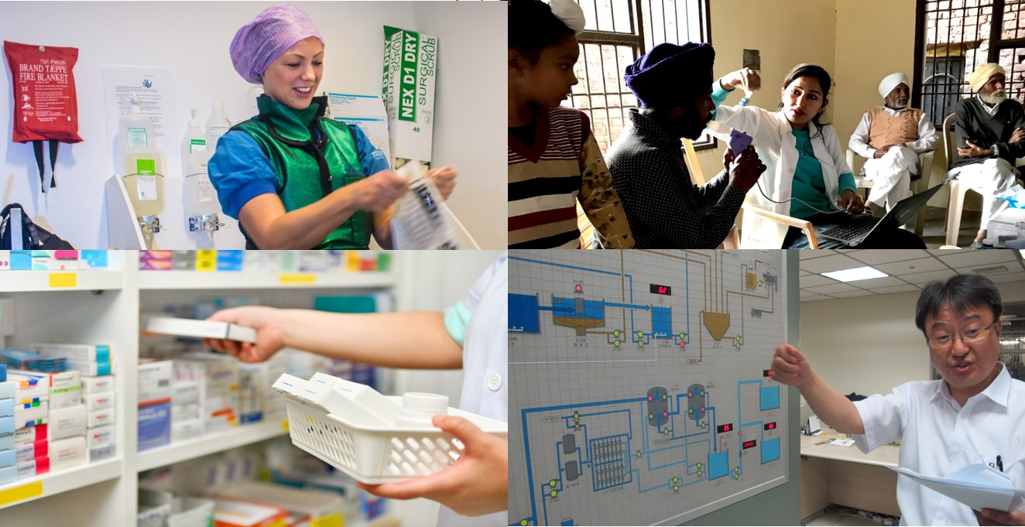
Uncharted territory | Transforming health care
Green Universal Health Coverage.
Telehealth.
Emergency response and pandemic preparedness.
Disease prevention as climate change prevention.
Green health financing.
Health sector-based residual management solutions.
Notes:
Sonia
Green UHC
Disease prevention
Green health financing

Slide 10
Country Factsheets – 68 nations

Slide 11
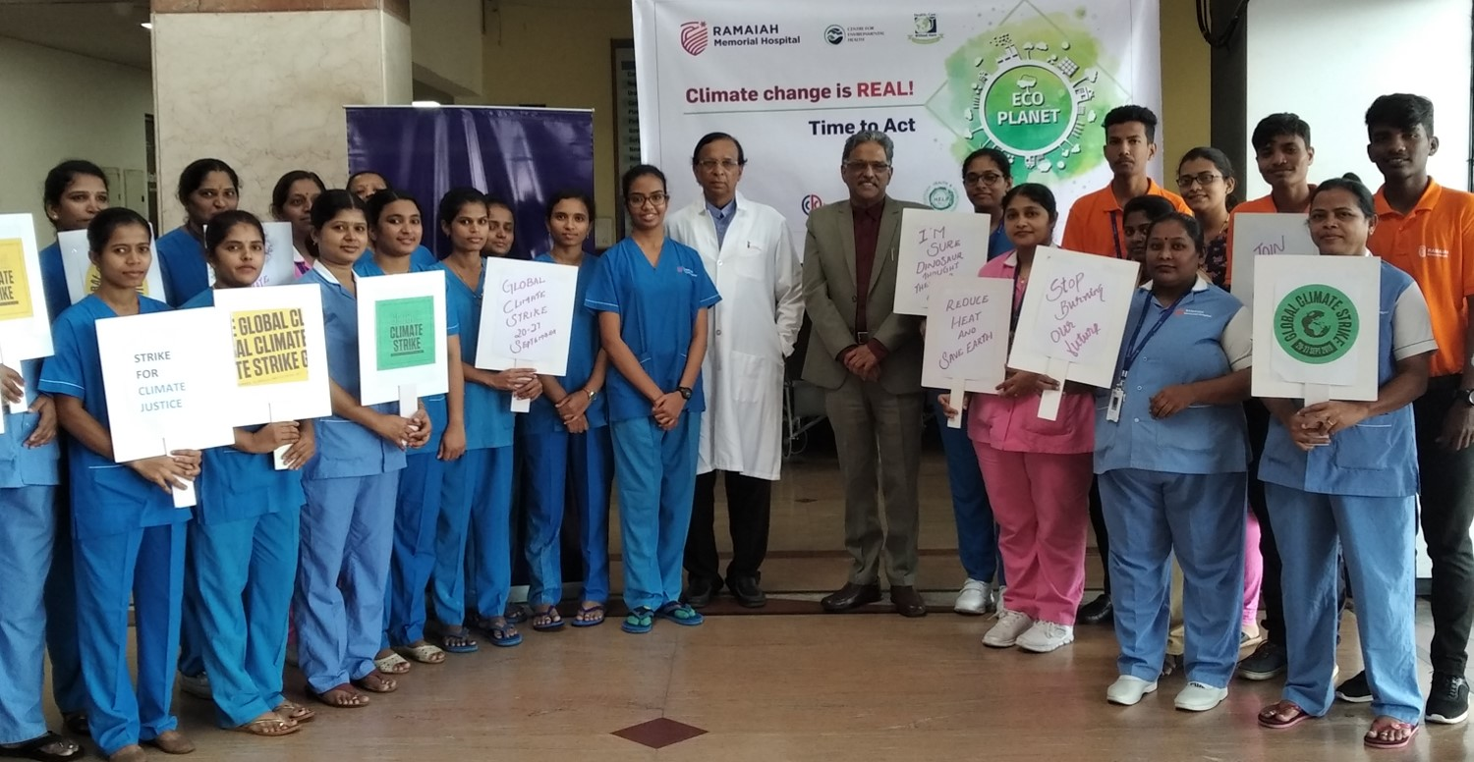
www.healthcareclimateaction.org/roadmap|
Notes:
Thank you and I hope we can count on you all to play your part on this healing journey. I am certainly in!

Slide 12
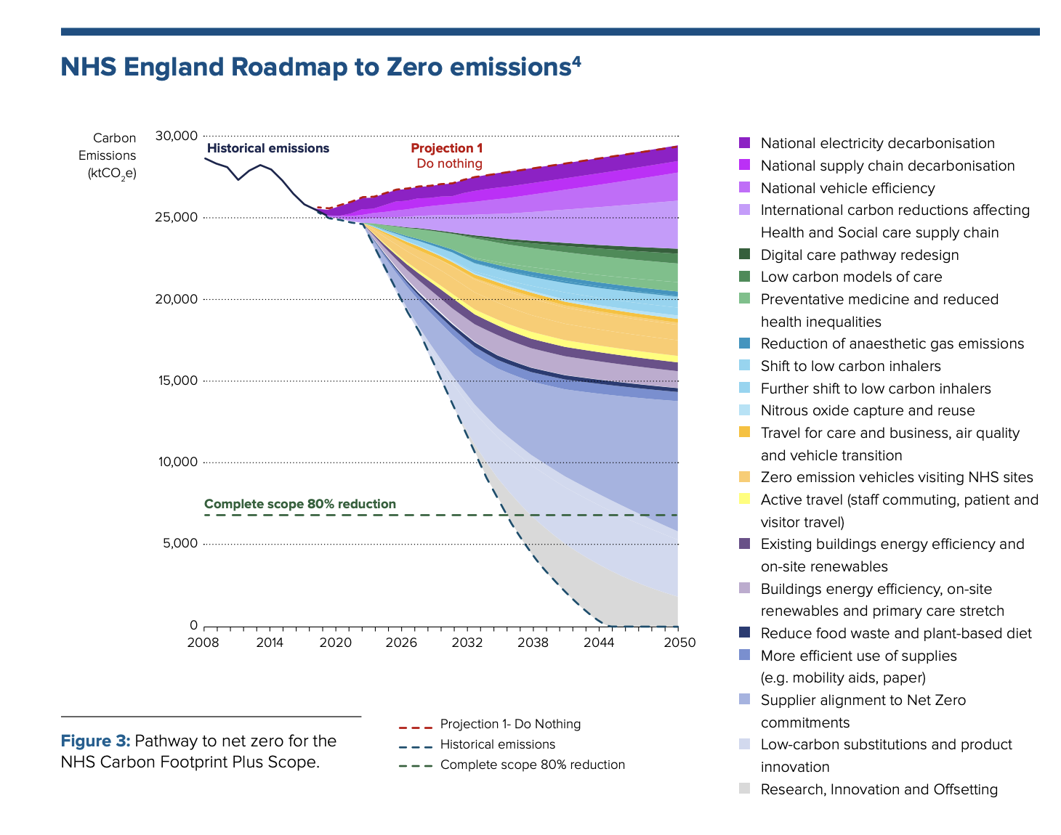
Examples
NDC – Argentina – including health
NHS Net zero plan
Many countries taking action including:
Race to Zero

