Slide 1
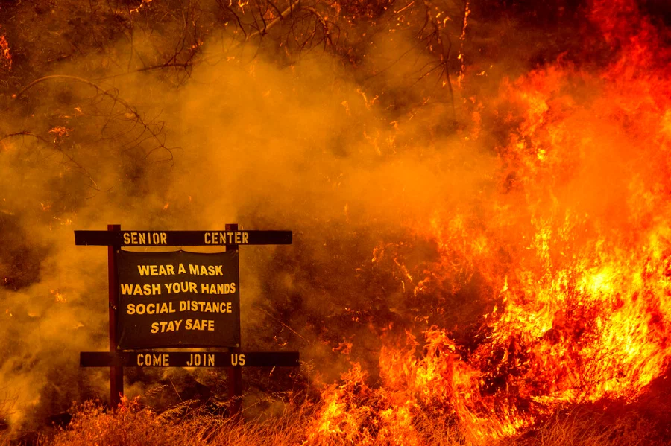

Building Climate Resilient Health Systems
Diarmid Campbell-Lendrum, WHO
Noah Berger/AP

Slide 2
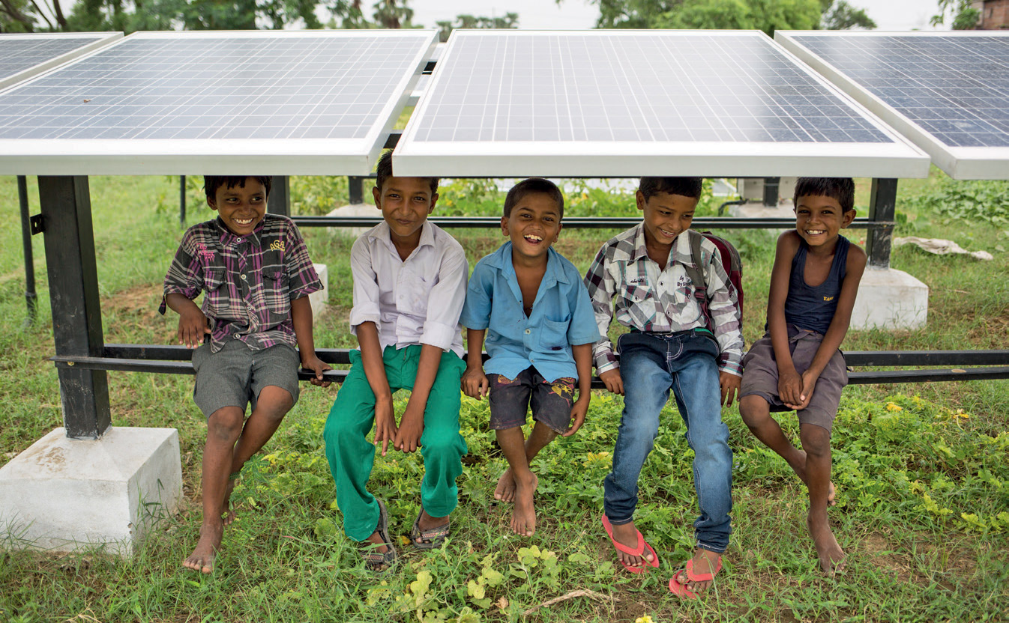
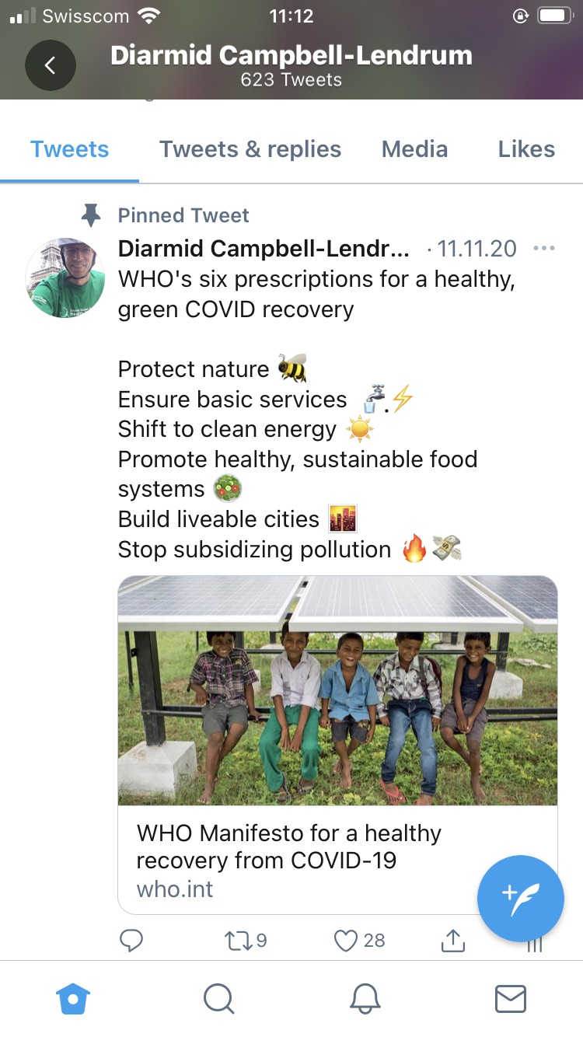
WHO Manifesto for a healthy recovery from COVID-19
Six Prescriptions for a healthy and green recovery

Slide 3
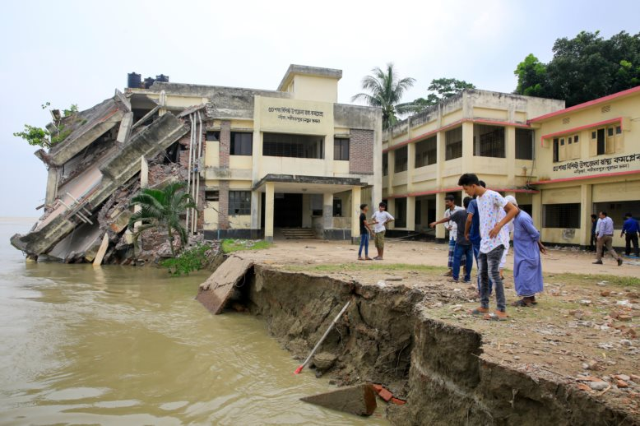

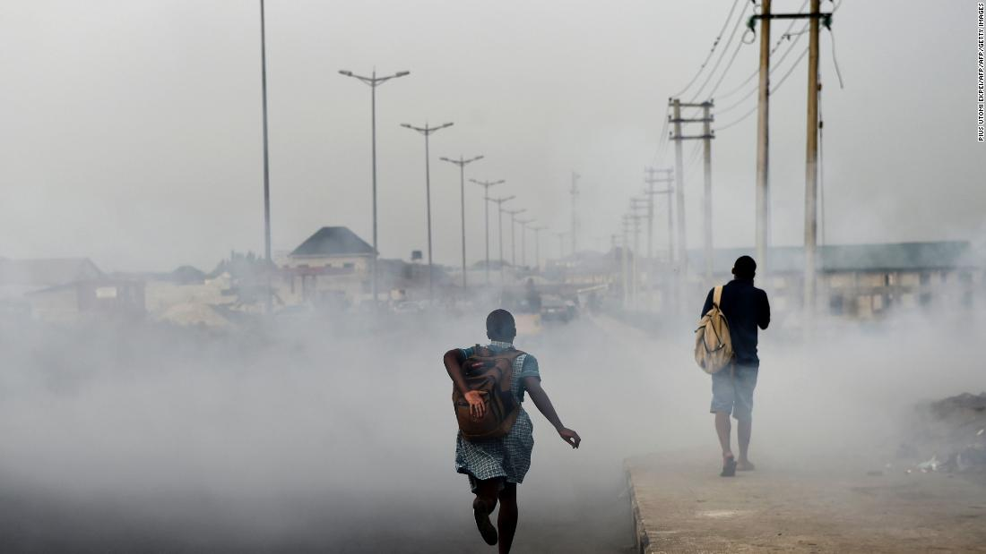
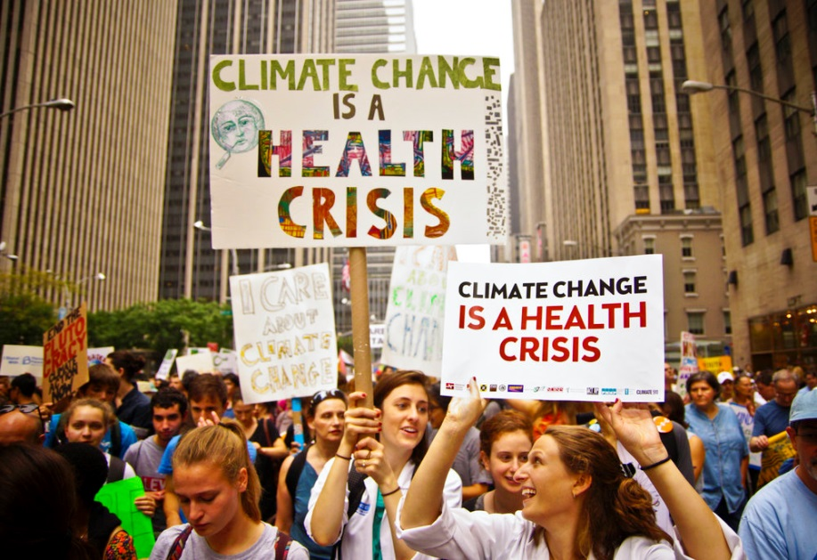
Health initiatives are central to COP26
Building climate-resilient health systems
Health Leadership in Emissions Reduction
Promoting healthy NDCs
Mobilizing health voices for climate action

Slide 5
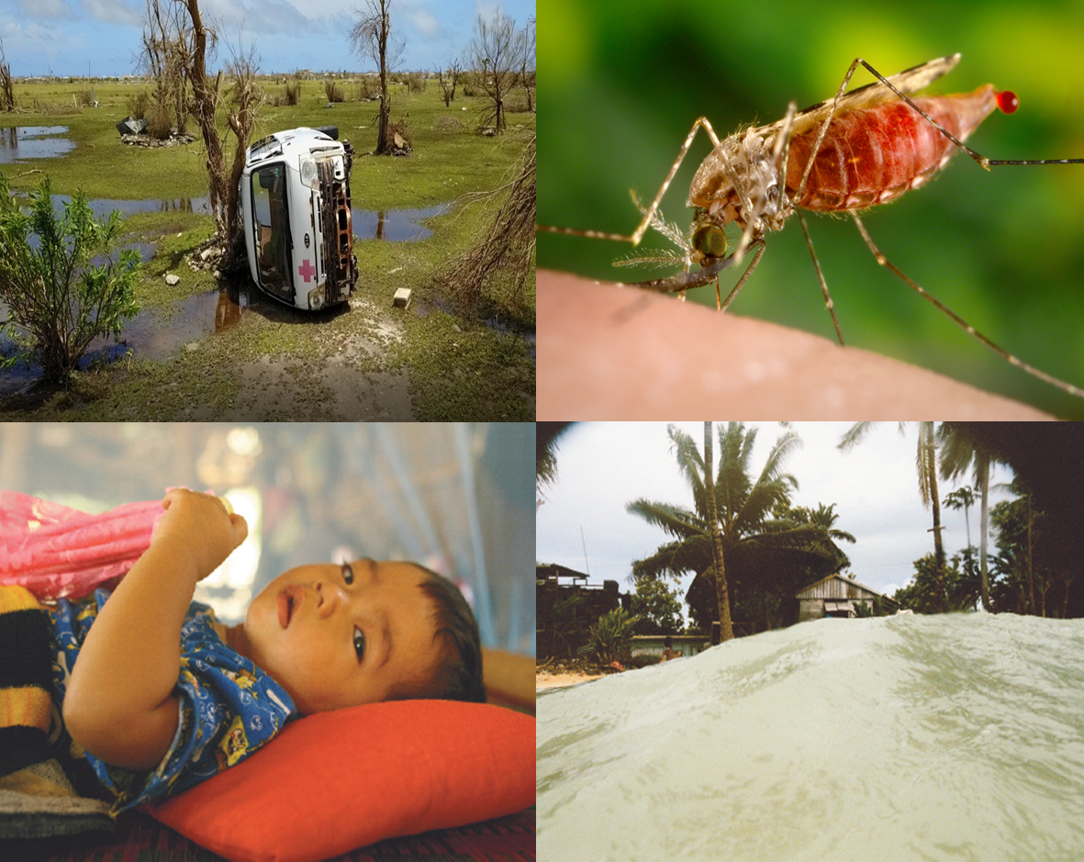
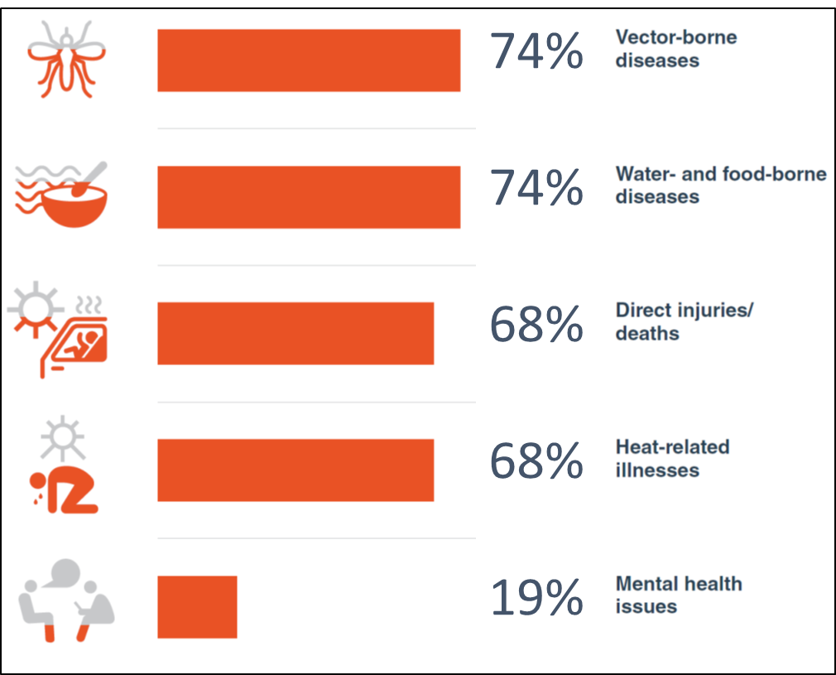
Climate change undermines the determinants of health, increasing disease and deaths
Countries Identifying different health issues in National Health Vulnerability and Adaptation Assessments. 31 V&As reviewed. WHO Climate and Health Survey Report: Tracking Global Progress (2019)

Slide 6
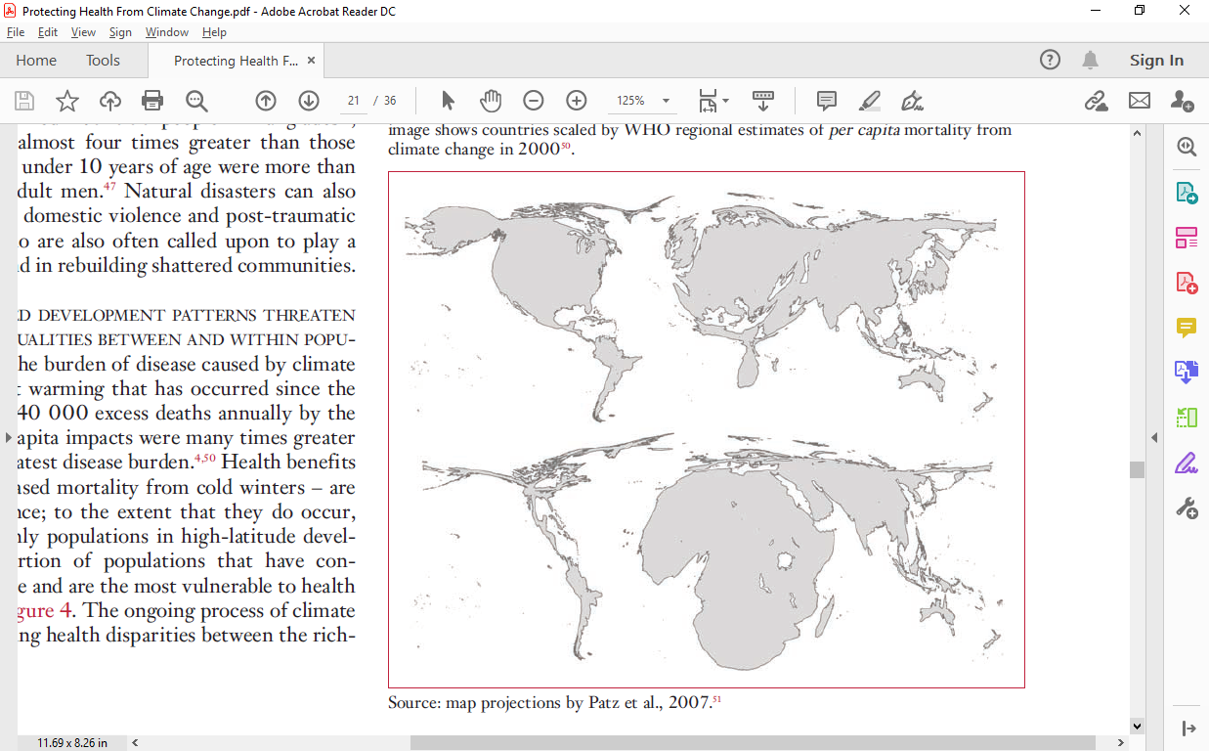
Those who have contributed least to the problem are most impacted
Estimates of cumulative carbon emissions per capita
WHO estimates of deaths attributable to climate change in 2000
Estimates of deaths attributable to climate change for the year 2000, from World Health Report 2002. Cumulative emissions per capita to 2002, and map projections, from Patz et al, 2007.

Slide 7

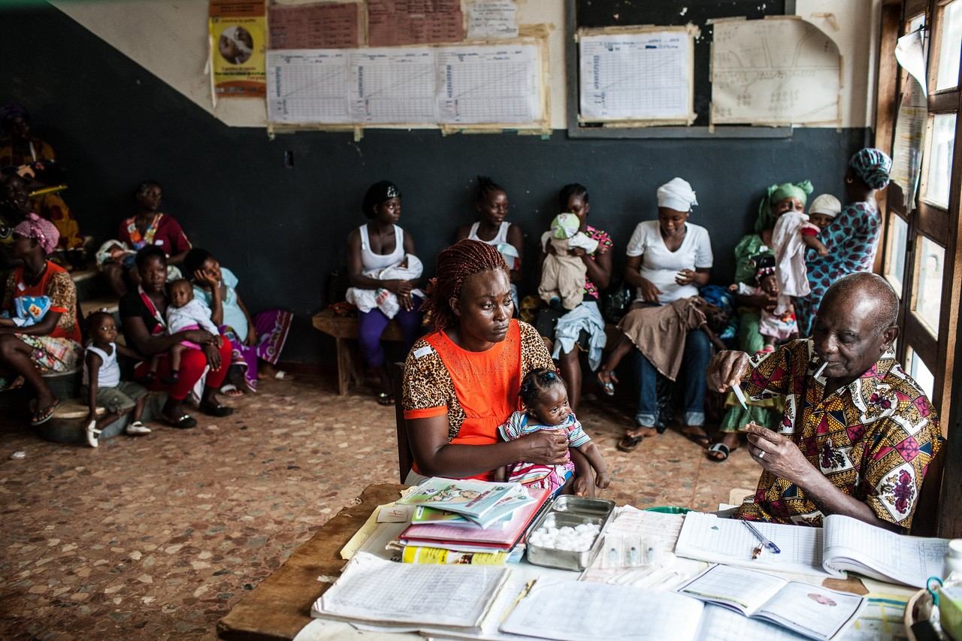
Healthcare is now a significant emitter of carbon –
while some facilities have no energy access at all

Slide 8

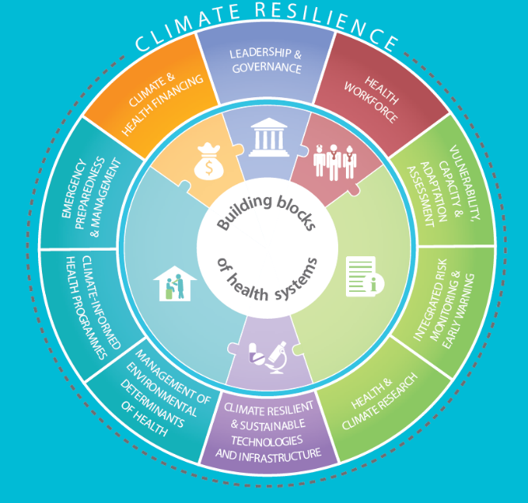
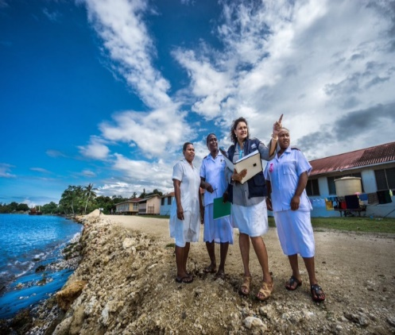
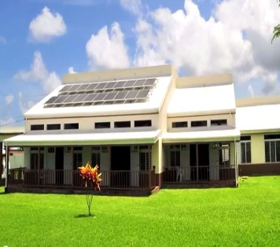
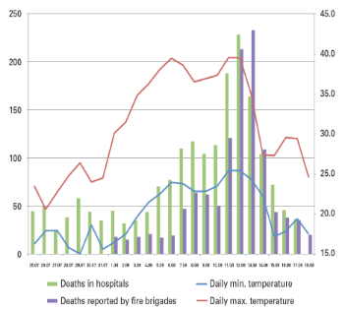
Strengthen health system resilience to climate change
10 components to build
climate-resilient health systems
Health access to climate finance
Health workers trained, engaged on climate
Resilient, sustainable health facilities
Climate informed surveillance systems
WHO Operational Framework for Building Climate-Resilient Health Systems (2015)

Slide 9
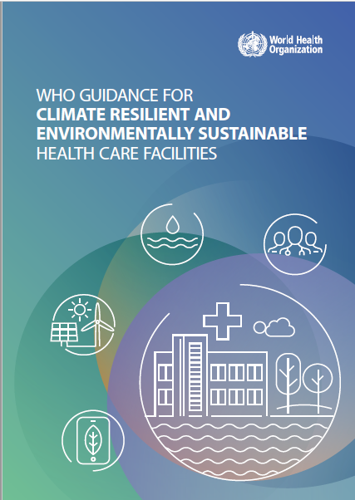
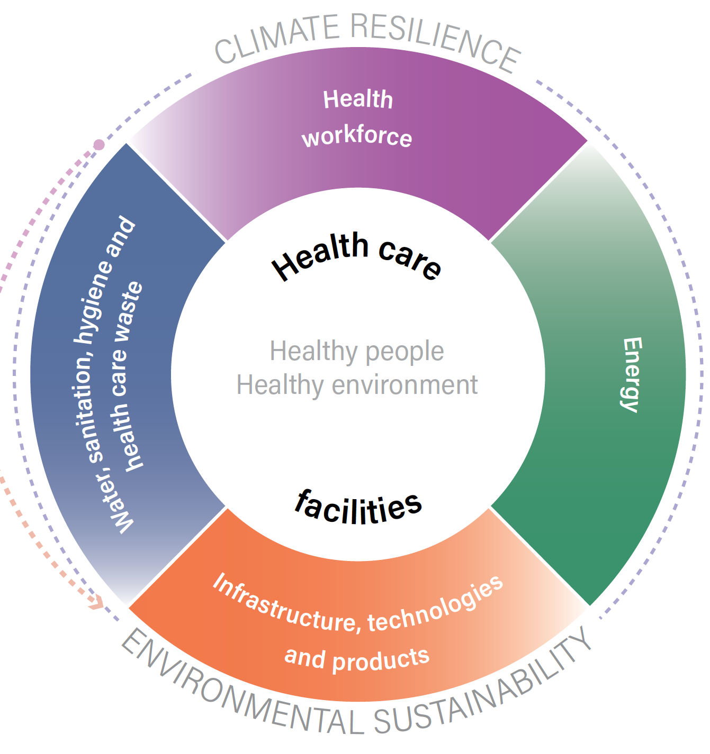
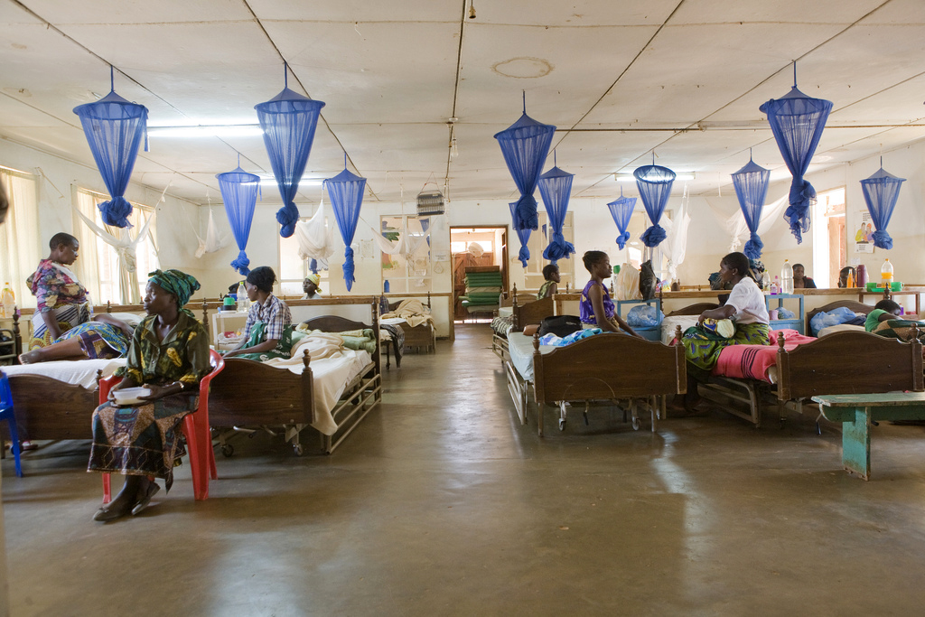
Strengthen health facility resilience to climate change

Slide 10
About half of countries have some form of climate change and health strategy or plan
10 components to build
climate-resilient health systems
WHO Climate and Health Survey Report: Tracking Global Progress (2019):101 respondents

Slide 11
Few countries have funding to implement their climate & health plans
10 components to build
climate-resilient health systems
WHO Climate and Health Survey Report: Tracking Global Progress (2019):45 respondents

Slide 12
Multilateral climate finance does not protect health from climate change
10 components to build
climate-resilient health systems
Review of “Climate Funds Update” database for multilateral climate finance projects with objective to protect human health

Slide 13
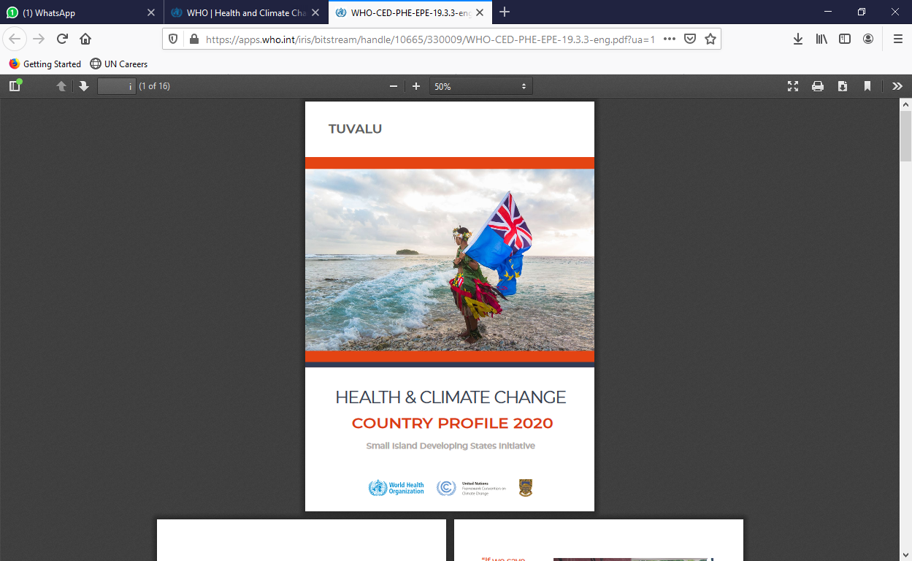


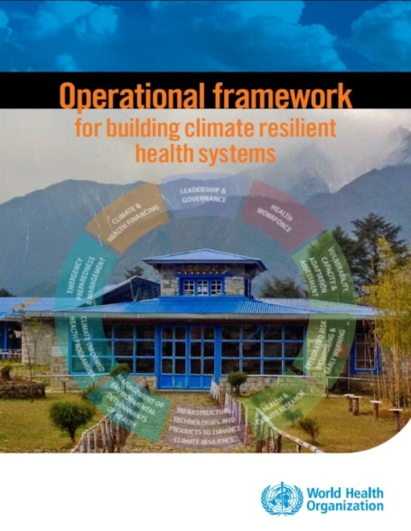
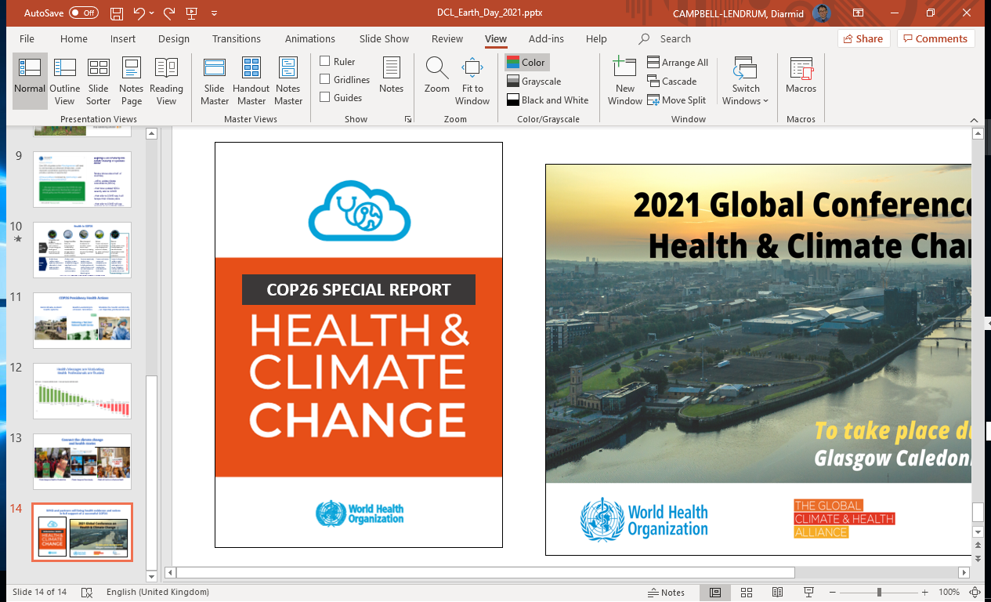
Adaptation Action Coalition Initiative:
Building Climate Resilient Health Systems
10 components to build
climate-resilient health systems
Countries commit to:
Conduct climate change and health vulnerability and adaptation assessments (V&As) at population and/or health facility level;
Develop a Health National Adaptation Plan (HNAP) informed by the V&A, for inclusion in the National Adaptation Plan;
Use the V&A and HNAP to facilitate health access to climate change funding (e.g. submission to Global Environmental Facility, Green Climate Fund or Adaptation Fund).

Slide 14
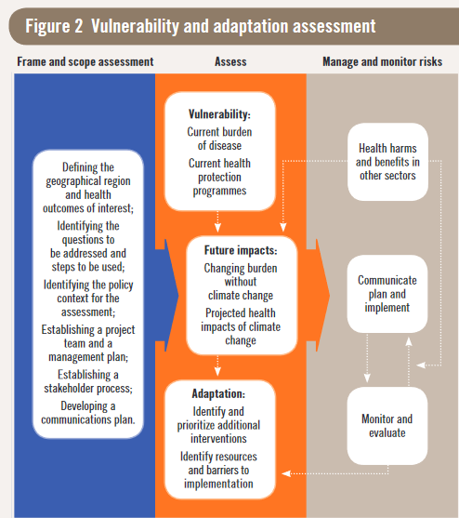
What is a V&A and why is important?
National or subnational assessment1 of current and future vulnerability to the health risks of climate change, and of policies and programmes that could increase resilience, taking into account the multiple determinants of climate-sensitive health outcomes;
Iterative process that builds capacity at country level;
Opportunity to strengthen collaboration between researchers and policy makers;
Inter-sectoral process led by Ministry of Health;
Basis to manage the health risks of climate change.

Slide 15


What is an HNAP and why is it important?
Evidence-based tool to guide health systems adaptation;
Health sector’s contribution to overall (national) adaptation planning process;
Builds on National Adaptation Programmes of Action (NAPAs);
Provides guidance for longer-term adaptation measures;

Slide 16
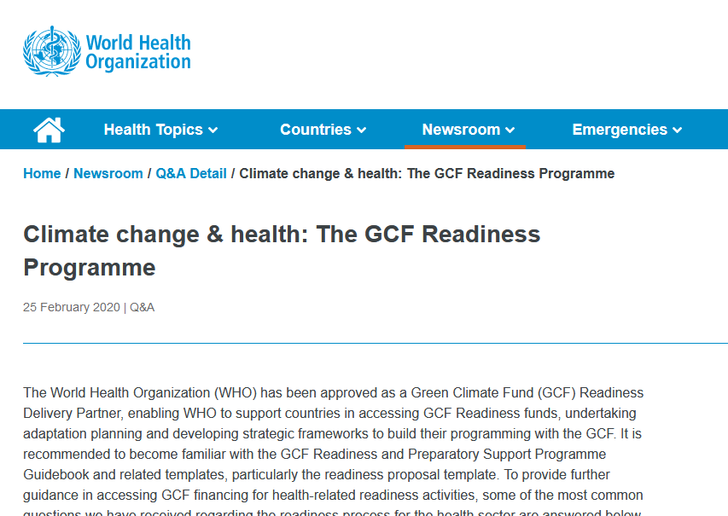
V&As and HNAPs as the starting point for greater and longer-term investments in climate resilience & environmental sustainability
10 components to build
climate-resilient health systems
Countries commit to:
Use the V&A and HNAP to facilitate health access to climate change funding (e.g. submission to Global Environmental Facility, Green Climate Fund or Adaptation Fund).

Slide 17

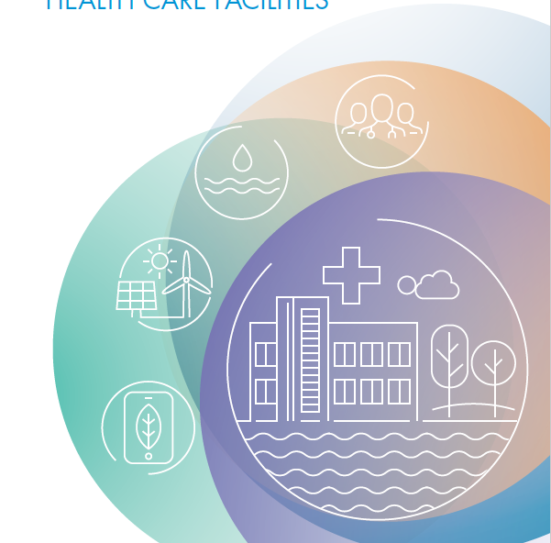
شكر
Thank you
Gracias
Merci
Спасибо
谢谢
Vielen Dank
More initiative information and resources
https://tinyurl.com/nazn825h
© Photo by Yoshi Shimizu - Fiji

