Slide 2

Global report on ageism
Summarizes the best available evidence on ageism
Outlines 3 strategies to address ageism
Includes 3 recommendations for action

Slide 3
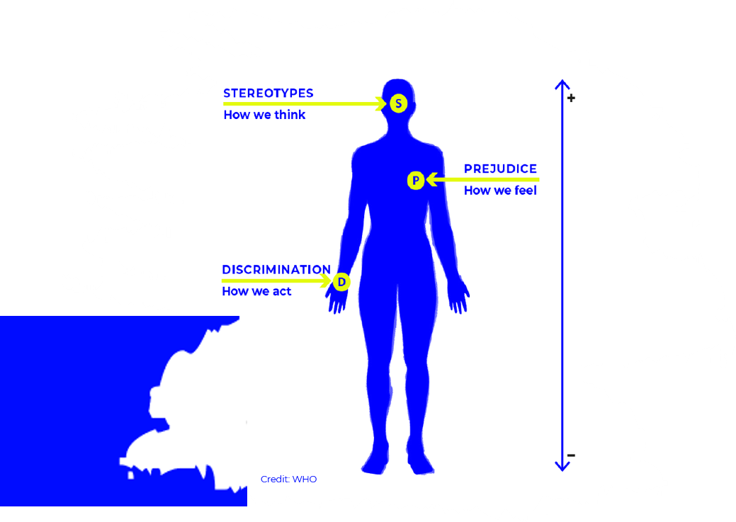
Ageism
Ageism refers to how we think (stereotypes), feel (prejudice) and act (discrimination) towards others or ourselves based on age

Slide 4
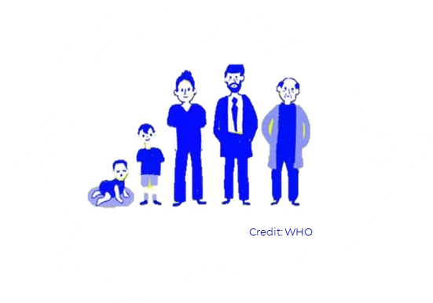
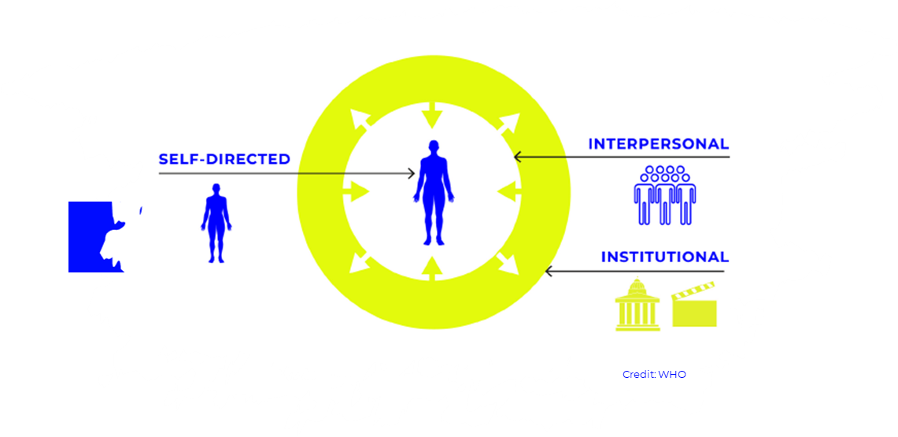
Ageism is everywhere
Ageism affects people of all ages
Ageism exists in our institutions, our relationships and ourselves

Slide 5
Ageism is prevalent
1 in 2 people are ageist towards older people
In Europe, younger people report more ageism than other age groups

Slide 6
Ageism is harmful and costly
Ageism has far-reaching impacts on all aspects of people’s health - their physical health, their mental health and their social well-being.
Ageism intersects and exacerbates other forms of disadvantage including those related to sex, race and disability
Ageism takes a heavy economic toll on individuals and society

Slide 7
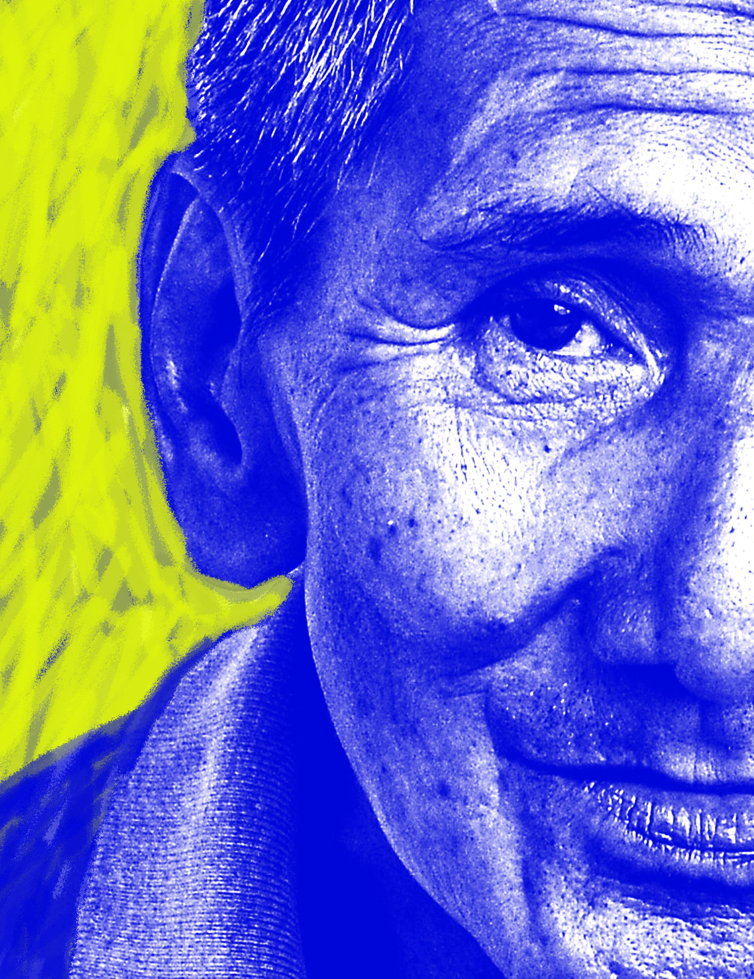
Ageism can be combatted
3 strategies work in addressing ageism:
Policy and law
Educational activities
Intergenerational interventions
19/03/2021
Global report on ageism
7

Slide 8
Policy and law
Policy and law can address discrimination and inequality based on age and protect the human rights of everyone, everywhere
Policy and law can be used to reduce or eliminate ageism against any age group
Different mechanisms are used to implement and monitor policies and laws, including human rights agencies, courts, ombudspersons and bodies working to uphold treaties

Slide 9
Educational activities
Educational interventions include instruction that transmits information, knowledge and skills, as well as activities to enhance empathy through role-playing, simulation and virtual reality
Educational interventions are among the most effective strategies for reducing ageism against older people. Little is known about their effectiveness for reducing ageism against younger people

Slide 10
Intergenerational interventions
Intergenerational interventions aim to foster interaction between different generations
Intergenerational interventions are effective interventions for reducing ageism against older people, and are promising for reducing ageism against younger people
Interventions that combine education and intergenerational contact have a slightly larger effect on attitudes than intergenerational interventions used alone

Slide 11

3 recommendations for action
Invest in the 3 evidence-based strategies to address ageism
Improve data and research to gain a better understanding of ageism and how to reduce it
Build a movement to change the narrative around age and ageing
19/03/2021
Global report on ageism
11

Slide 12

For more information:
http://bit.ly/combatageism
Full report: English
Executive summary: English, Spanish, French

