Slide 1

Session 9.
Clinical practice: Positioning a baby at the breast
© WHO/Yoshi Shimizu

Slide 2
Session 9. Objectives
Clinical practice: Positioning a baby at the breast
After completing this session, participants will be able to:
explain the four key points of positioning of the baby;
describe how a mother should support her breast for feeding;
demonstrate the main breastfeeding positions for the mother: sitting, lying, underarm and across;
demonstrate how to breastfeed in special cases: after caesarean section, and for low-birth-weight baby;
help a mother to position her baby at the breast using the four key points of positioning of the baby.

Slide 3
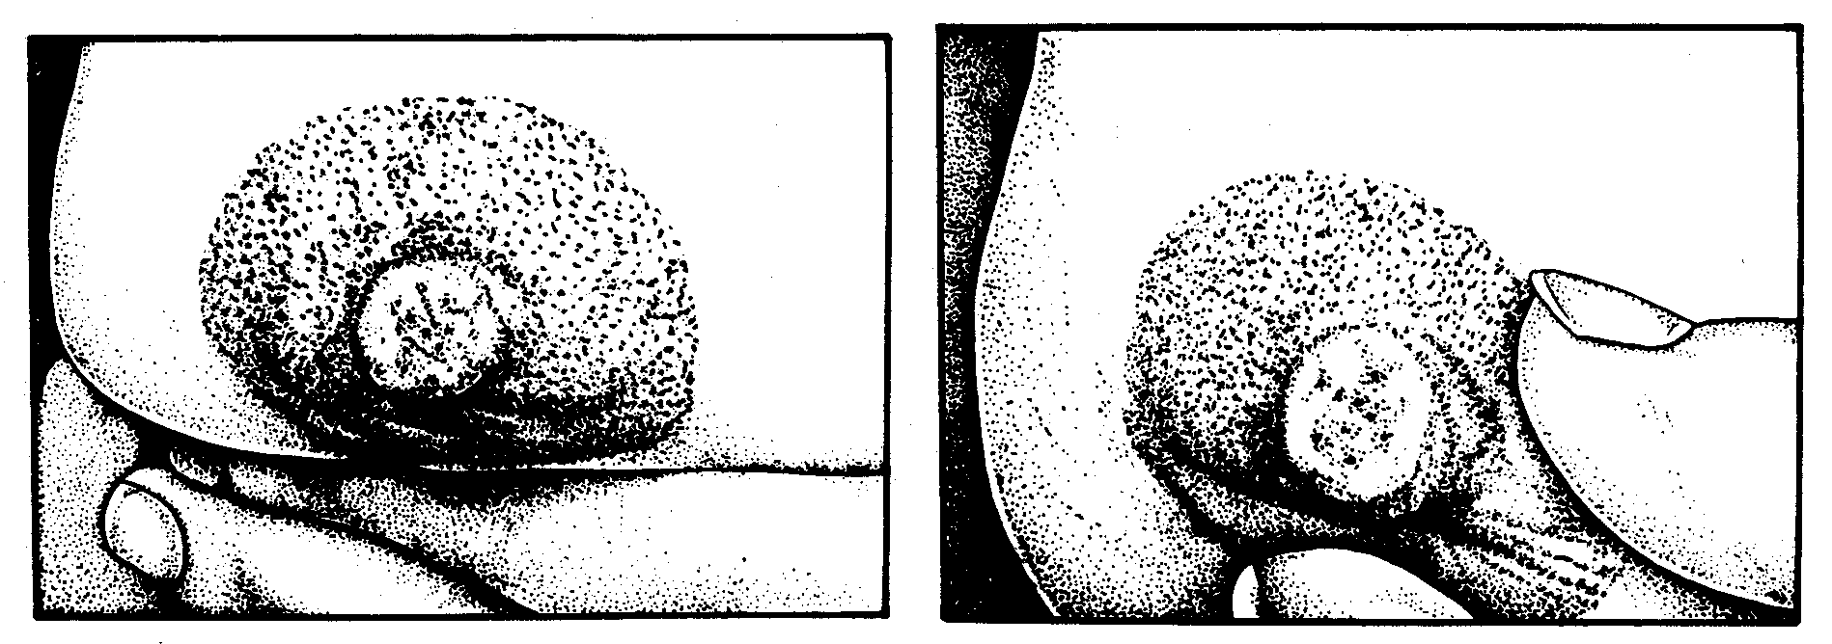
How should a mother hold her breast?
GOOD POSITION
Resting her fingers on her chest wall so that her first finger forms a support at the base of the breast
B. BAD POSITION
Holding her breast too near the nipple
© Felicity Savage

Slide 4
Other sitting positions
Underarm position
Useful for:
twins
to remove milk from all areas of the breast
low-birth-weight, small and sick babies.
Cross-cradle position – holding with arm opposite of breast
Useful for:
small babies
low-birth-weight babies, sick babies.
© Felicity Savage

Slide 5

Breastfeeding lying down

