Slide 1
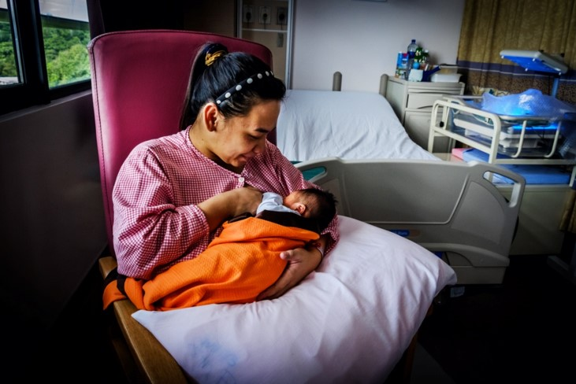
Session 8.
Classroom clinical practice: Assessing a breastfeed
© WHO/Yoshi Shimizu

Slide 2
Session 8. Objectives
Classroom clinical practice: Assessing a breastfeed
After completing this session, participants will be able to:
recognize the four key points of attachment;
assess a breastfeeding session by observing a mother and baby;
identify a mother/parent/caregiver who may need assistance;
explain the contents and arrangement of the Job aid: Breastfeeding session observation;
recognize signs of good and poor attachment and positioning.

Slide 3
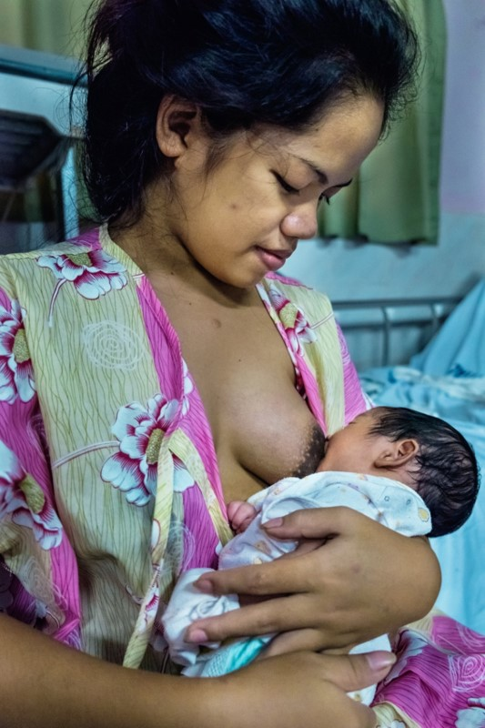
Practise:
Assessing a breastfeed
Please use Job aid: Breastfeeding session observation
© WHO/Yoshi Shimizu

Slide 4
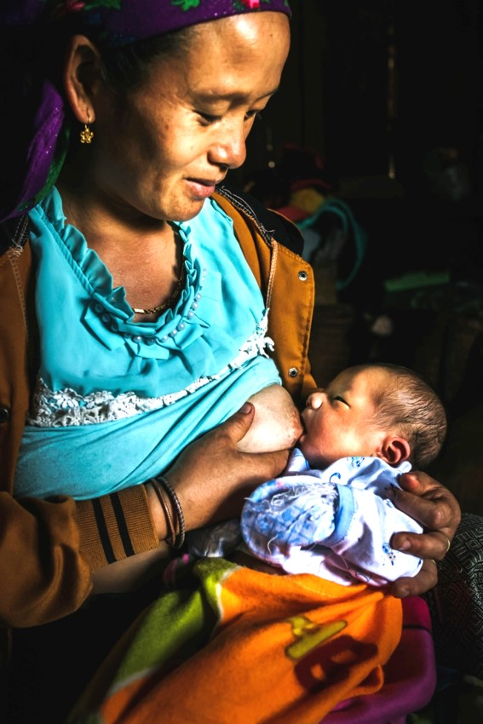
Assessing a breastfeed 1
Please use Job aid: Breastfeeding session observation
© WHO/Yoshi Shimizu

Slide 5
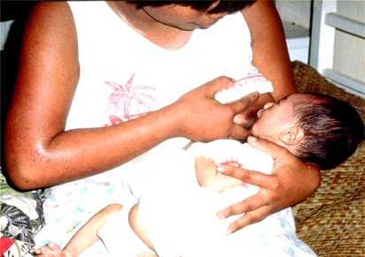
Assessing a breastfeed 2
Please use Job aid: Breastfeeding session observation
© Felicity Savage

Slide 6
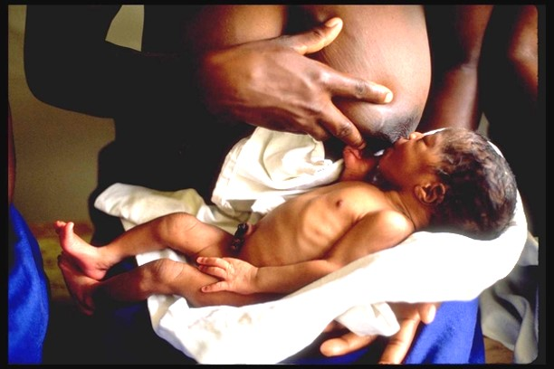
Assessing a breastfeed 3
Please use Job aid: Breastfeeding session observation
© UNICEF/UNI51384/Press

