Slide 1

Session 7.
Postnatal practices to support breastfeeding
© WHO/Yoshi Shimizu

Slide 2
Session 7. Objectives
Postnatal practices to support breastfeeding
After completing this session, participants will be able to:
describe the importance of avoiding prelacteal feeds and unnecessary supplementation
outline advantages of rooming-in
describe responsive feeding and why it is important
answer common postnatal questions.

Slide 3
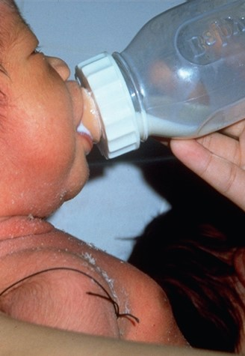
Prelacteal feeds
Artificial feeds given before breastfeeding is established
By any feeding method (e.g. cup, spoon, bottle)
What are examples in your context/setting?
© Felicity Savage

Slide 4
Dangers of prelacteal feeds
Replace colostrum:
  greater risk of infection
  risk of intolerance or allergy.
Interfere with suckling
  satisfy baby’s hunger so they suckle less
  less breast stimulation
  if bottle fed can interfere with attachment
  more difficult to establish breastfeeding.

Slide 5

Rooming-in: Mothers and babies together day and night
© WHO 2020

Slide 6

Advantages: Rooming-in
Mother can respond to baby and feeding cues
Mother more confident
about breastfeeding
Babies gain weight more quickly
Breastfeeding continues
longer
Helps bonding
and breastfeeding
© Felicity Savage

Slide 7


Early feeding cues
Opening their mouth and turning their head trying to find the breast
Wakeful and restless
Making small noises
Hand-to-mouth movements
Sucking fingers
© UNICEF/UN0155819/Zammit (Top)
© UNICEF/UN0232291/ (Bottom)

Slide 8
Pacifier (dummy) usage
Remember: Step 9
  “Counsel mother on the use and risks of feeding bottles, teats and pacifiers.”
Pacifiers undermine breastfeeding for the first 6 months
Infants who use pacifiers breastfeed less in 24 hours
Pacifiers should not be used at least until breastfeeding is well established and after 4 weeks of age, and caution is advised about their use regarding hygiene, oral formation, and recognition cues.
Wambach K, Spencer B. Breastfeeding and human lactation, 6th ed. 〔e-book〕. Burlington (MA): Jones & Bartlett;2019:262–3.

Slide 9
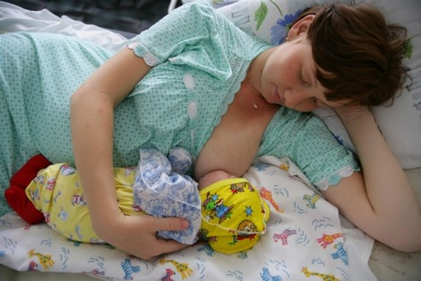
Advantages of responsive feeding
Breast milk comes in sooner
Baby gains weight more quickly
Fewer difficulties like engorgement
Breastfeeding more easily established
© UNICEF/UNI43420/Pirozzi

