Slide 1
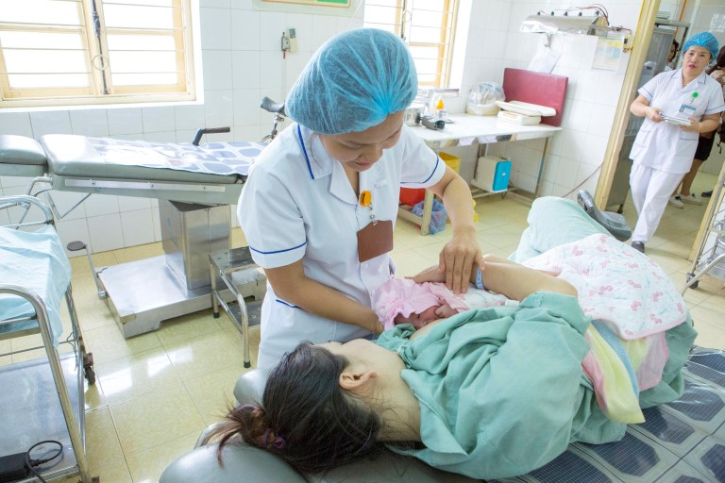
Session 6.
Impact of birth practices
© UNICEF/UN0289057/Viet Hung

Slide 2
Session 6. Objectives:
Impact of birth practices
After completing this session, participants will be able to:
discuss the importance of early contact and the initiation of breastfeeding;
describe the procedure of placing the baby in skin-to-skin contact immediately after birth;
explain how a baby moves to the breast and attaches by themselves, and how to help the baby if needed;
describe how health-care practices affect initiation of breastfeeding.

Slide 3
Birth practices: Impact on breastfeeding
Birth practice | Impact on breastfeeding
Requiring mother to lie flat on her back during labour and delivery (moving around, walking or kneeling or reclining in a position of her choice) | Mother’s discomfort can have an impact on her ability to initiate breastfeeding
Lack of support | Support is one of the biggest keys to early initiation and continued feeding, from medical staff and birth companions
Withholding food and fluids during labour | Mother’s fatigue and dehydration can have an impact on her ability to initiate breastfeeding
Pain medications that sedate mother or baby, episiotomy, intravenous lines, continuous electronic fetal monitoring and other interventions used as routine without medical reasons | Pain medications and interventions for the mother will have an effect on the baby’s alertness and ability to breastfeed
Wrapping the baby tightly after birth | Babies cannot use their reflexes and movement to begin breastfeeding in the first hour
Separating the mother and baby after birth | Mother and baby need to be together to breastfeed early and often
Baby-Friendly Hospital Initiative: revised, updated and expanded for integrated care, Session 5, 2009.

Slide 4
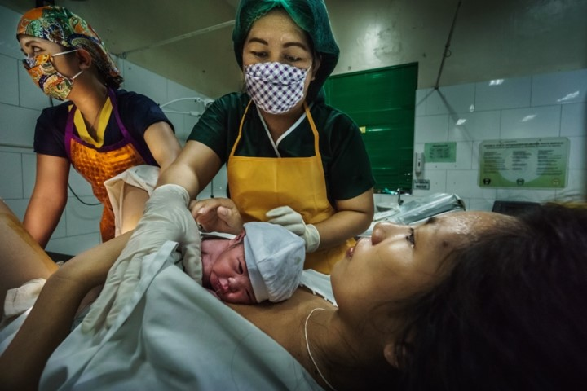
Early initiation:
Immediately after birth
Early skin-to- skin contact:
promotes bonding
maintains warmth
lowers infection and mortality
© WHO/Yoshi Shimizu

Slide 5
Benefits of early skin-to-skin contact:
allows the baby to find the breast and self-attach;
helps a mother to bond with her baby (develop a close, loving relationship);
a mother will more likely start to breastfeed and will breastfeed for longer;
helps to stimulate maternal milk production and supply;
calms the mother and baby;
helps to regulate the baby’s breathing, heart rate, temperature, and glucose levels, which is especially valuable for low-birth-weight babies and premature babies;
enabling the colonization of the baby with microbes from the mother’s skin, mucosal surfaces and intestine, which helps to protect the baby from infection.

Slide 6
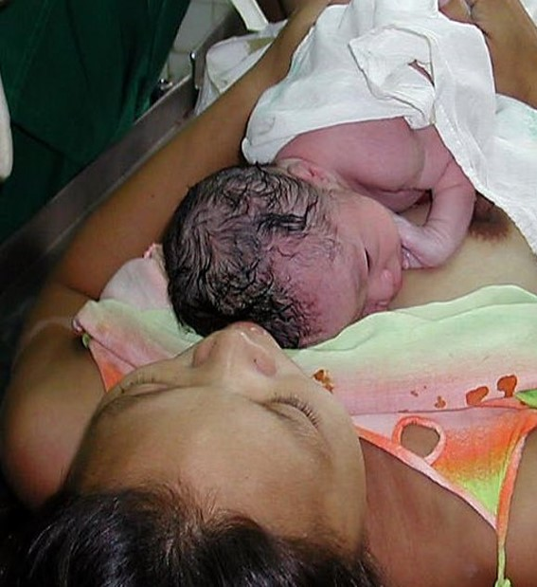
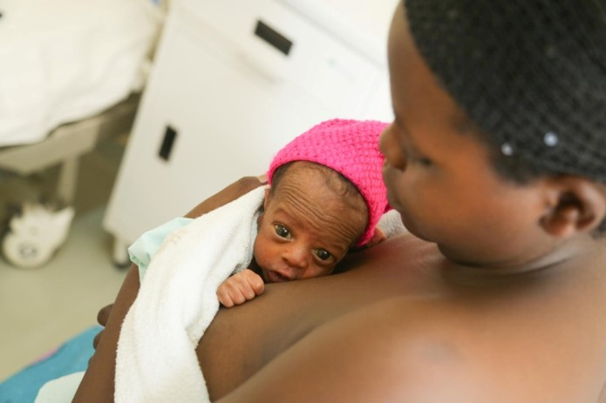
Skin-to-skin contact
© Prashant Gangal
© UNICEF/UN0319780/Kanobana

Slide 7
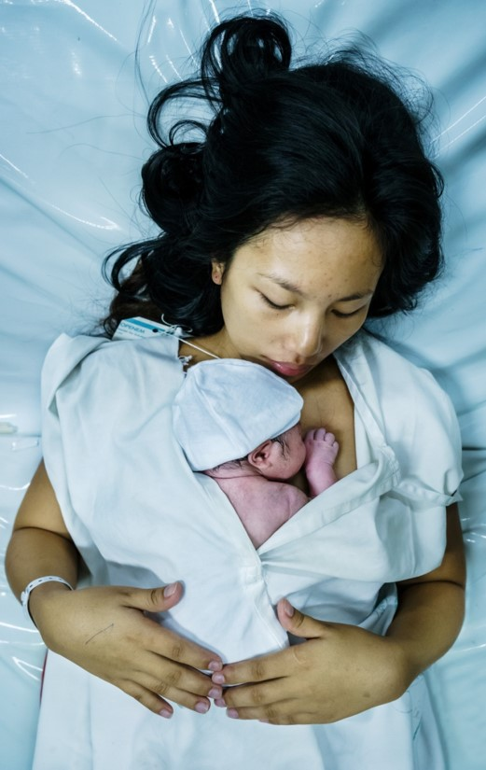
Risks of not practising skin-to-skin contact
If skin-to-skin contact is not practised:
  risk of infection from surroundings;
  less stable respiratory and cardiac signs;
  more difficulty learning to breastfeed;
  unstable temperatures;
  shorter duration of exclusive breastfeeding;
  more maternal stress and less satisfaction with breastfeeding;
  more infant stress, more crying;
  less desire for mother to hold infant;
  less ability for infant to smell mother’s milk;
  greater pain, more crying during procedures.
Wambach, K., & Spencer, B. (2021). Breastfeeding and Human Lactation (Sixth ed.). Burlington, MA: Jones and Bartlett Learning
© WHO/Yoshi Shimizu

Slide 8
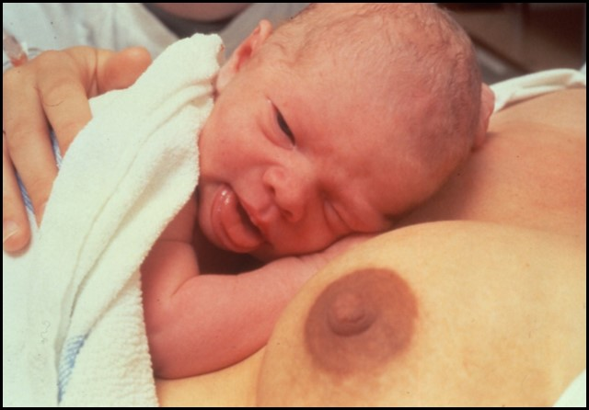
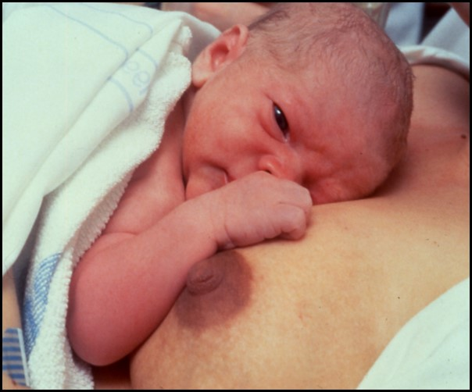
Readiness to breastfeed
Initial resting period, followed by response to the “scent” of the breast

Slide 9

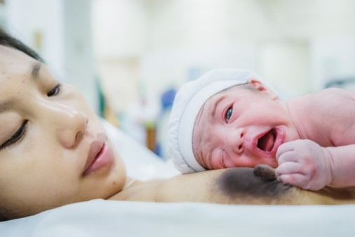
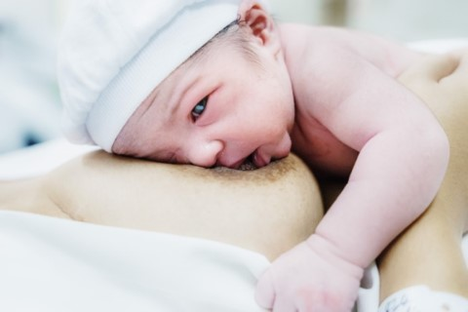
Breast crawl
First breastfeed: The baby is moving his whole body to reach the nipple and breast
All images: © WHO/Yoshi Shimizu

Slide 10
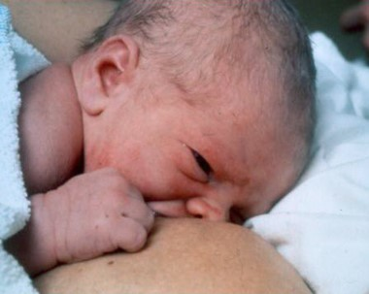
Self-attachment
© Sandra Lang
A baby may take 10–60 minutes before starting to breastfeed

Slide 11
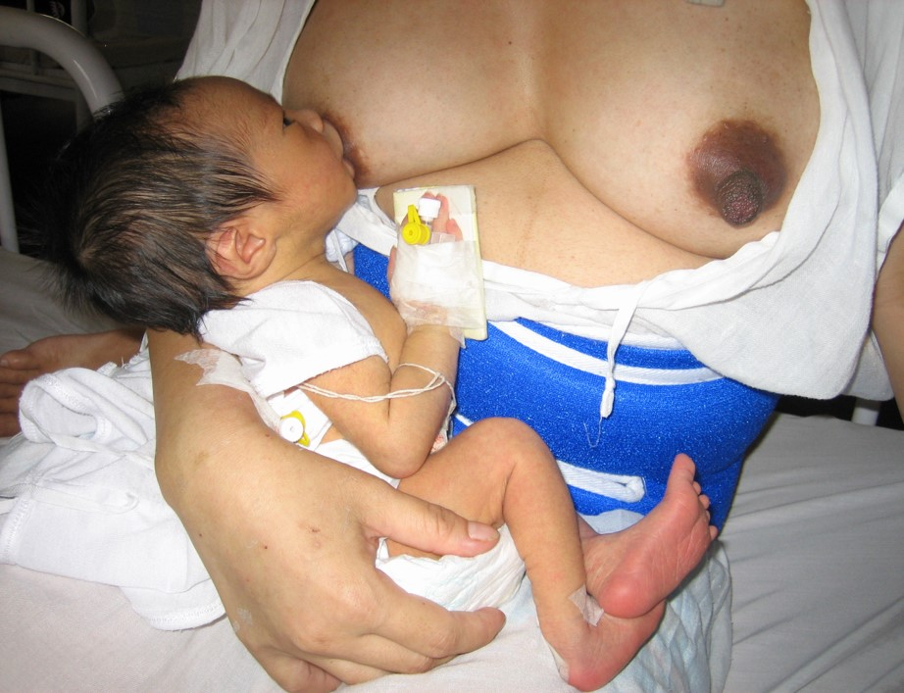
Special cases: Preterm

Slide 12
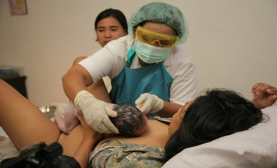
First hour after delivery
Encourage the mother to have a companion
Also ensure skin-to-skin contact for mothers who will not breastfeed
If the baby is in a special care unit, arrange for skin-to-skin contact as soon as possible
Continue skin-to-skin contact in the postpartum ward if the labour ward is busy
© Felicity Savage

Slide 13
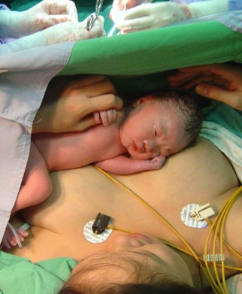
Special cases: After caesarean section
Skin-to-skin contact is possible after caesarean section with epidural anaesthesia
© WHO/Yoshi Shimizu

Slide 14
effects of a caesarean section on breastfeeding
The mother is
likely to:
be frightened and stressed;
be confined to bed and restricted in movement;
be deprived of energy to care for her baby;
receive anaesthesia and analgesia for pain, which can affect the responses of both the mother and baby.
The baby is
likely to:
be at high risk of not breastfeeding or of breastfeeding for only a short duration;
have more breathing problems;
need suction of mucus, which can hurt the baby's mouth and throat;
be sedated from maternal medications.

