Slide 1
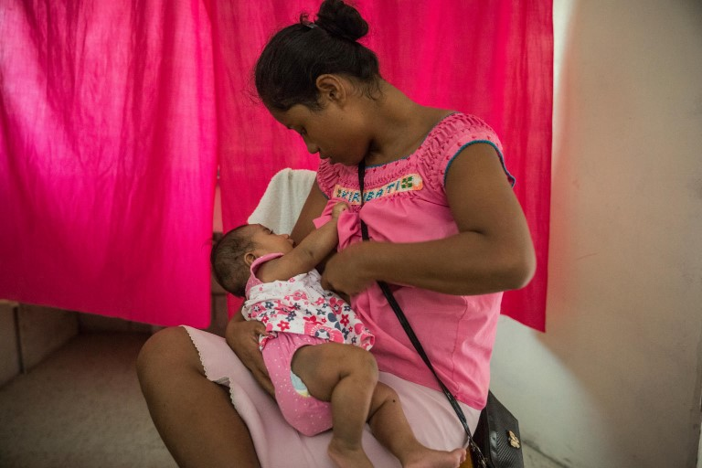
Session 5.
How breastfeeding works
© UNICEF/UN0202182

Slide 2
Session 5. Objectives:
How breastfeeding works
After completing this session, participants will be able to describe:
the parts of the breast involved in lactation and their function;
the physiology of the lactation hormones;
the physiology of breast-milk production and flow;
the difference between good and poor attachment of a baby at the breast;
the four key points of attachment;
the suckling action of the baby when well attached or poorly attached.

Slide 3
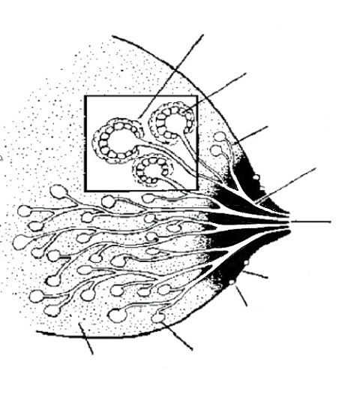
Anatomy of the breast
Oxytocin makes them contract
Muscle cells
Milk-secreting cells
Prolactin makes them secrete milk
Ducts
Large ducts
Nipple
Areola
Montgomery’s glands
Supporting tissue and fat
Alveoli
© Felicity Savage

Slide 4
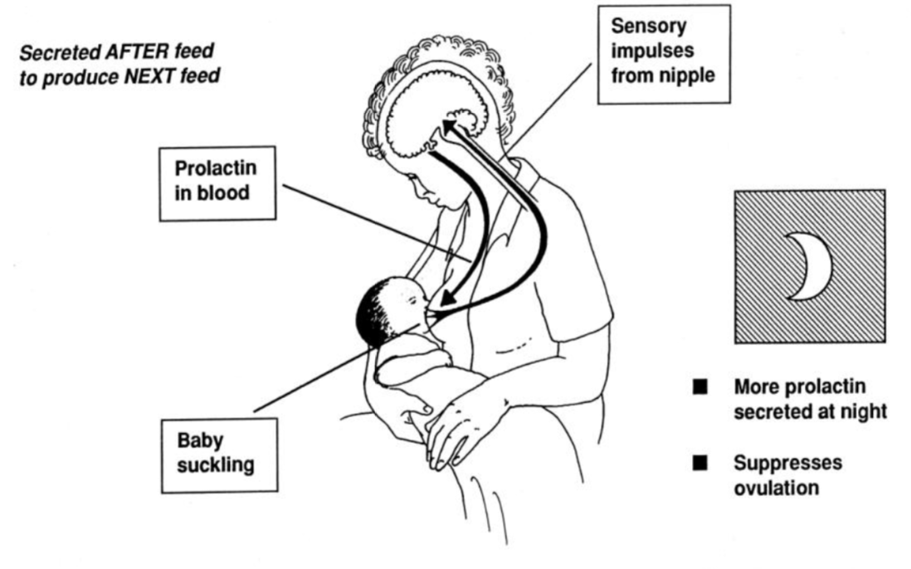
Prolactin
© Felicity Savage

Slide 5
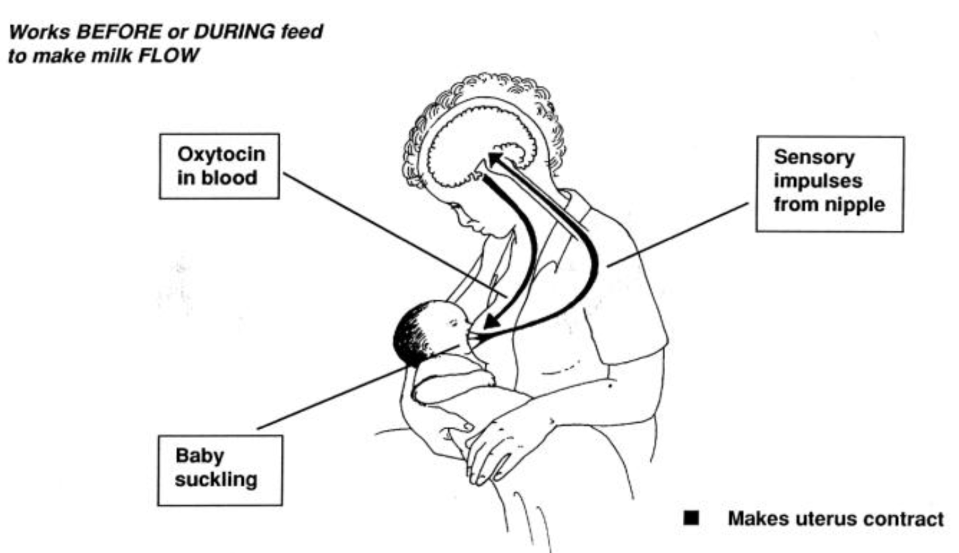
Oxytocin reflex
© Felicity Savage

Slide 6

Helping and hindering the oxytocin reflex
These help the reflex
These hinder the reflex
Thinks lovingly of baby
Sounds of baby
Sight of baby
Touches baby
Confidence
Worry
Stress
Pain
Doubt
© WHO/Yoshi Shimizu

Slide 7
Signs and sensations of oxytocin reflex:
a squeezing or tingling sensation in her breasts just before she feeds her baby, or during a feed;
milk flowing from her breasts when she thinks of her baby or hears the baby crying;
milk dripping from her other breast, when her baby is suckling.
milk flowing from her breast in fine streams, if her baby comes off the breast during a feed;
pain from uterine contractions, sometimes with a rush of blood, during feeds in the first week;
slow deep sucks and swallowing by the baby, which show that breast milk is flowing into their mouth.
5/7

Slide 8
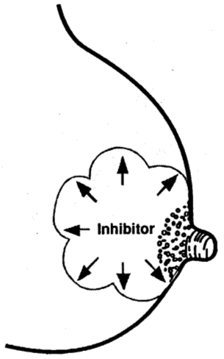
Inhibitor in breast milk (FIL)
If breast remains full of milk, secretion stops.
© Felicity Savage

Slide 9
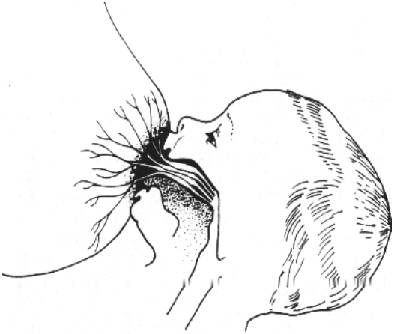
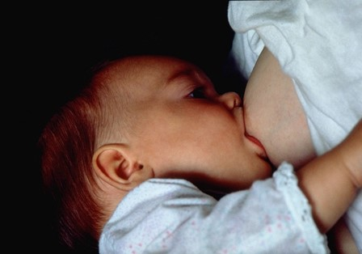
Attachment to the breast
© Felicity Savage

Slide 10
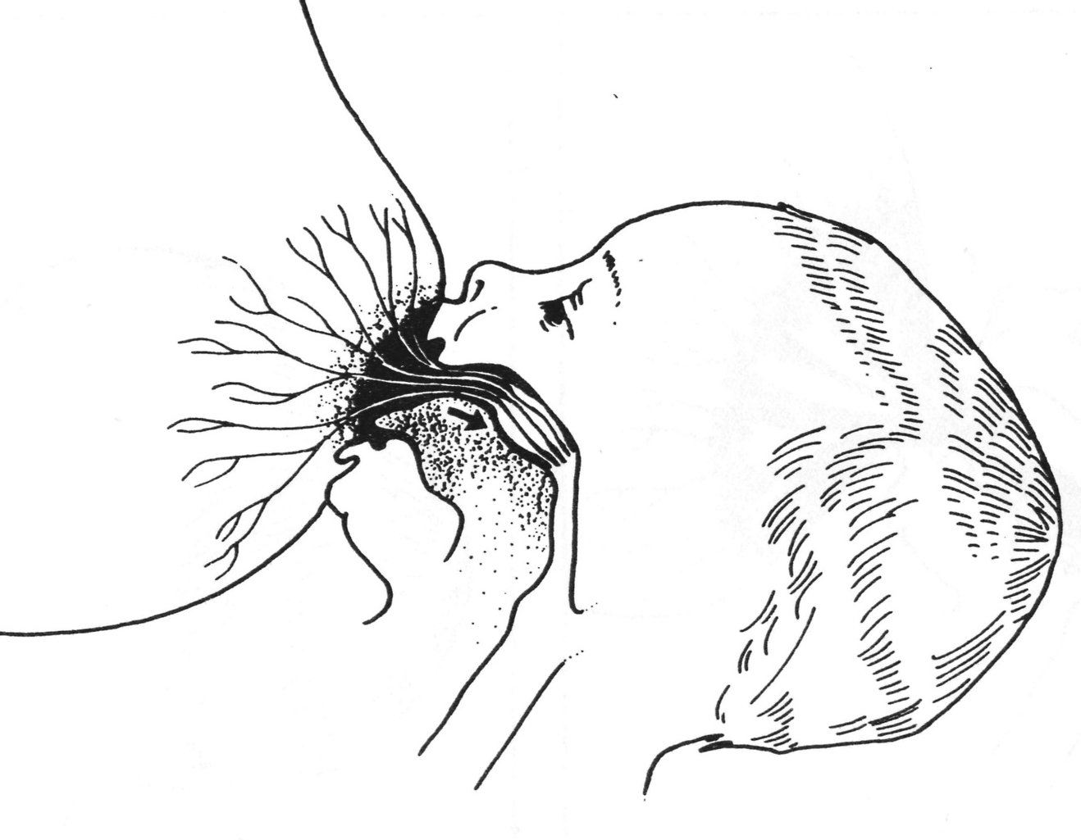
Notice the arrow
© Felicity Savage

Slide 11
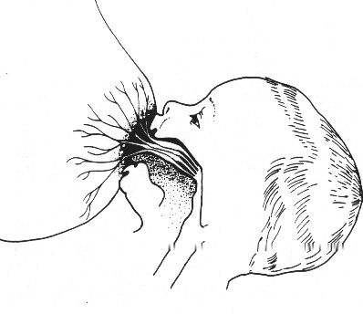
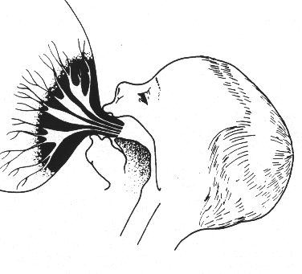
Good and poor attachment
What do you observe?
1
2
© Felicity Savage

Slide 12
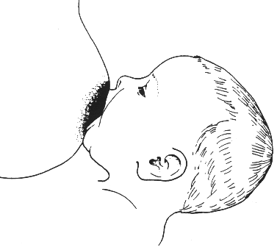
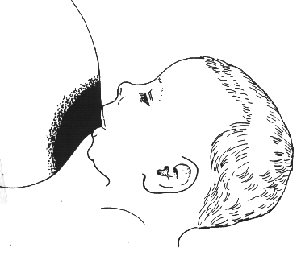
Attachment: External appearance
What do you observe?
1
2
© Felicity Savage

Slide 13
Good attachment
More areola is visible above the baby’s mouth than below
The baby’s mouth is wide open
The lower lip is turned out
The chin is touching the breast (or nearly so)

Slide 14
Poor attachment
Less areola is visible above the baby’s mouth than below (you might see equal amounts of areola above and below the mouth)
The mouth is not wide open
The lower lip is pointing forward or turned in
The chin is away from the breast

Slide 15
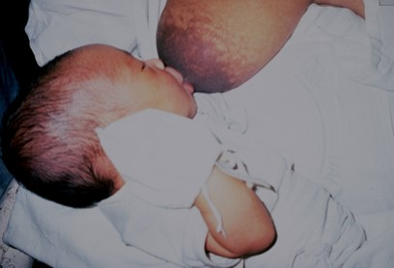
Results of poor attachment
Painful nipples
Damaged nipples
Engorgement
Baby unsatisfied and cries a lot
Baby feeds frequently and for a long time
Decreased milk production
Baby fails to gain weight
© Felicity Savage

Slide 16
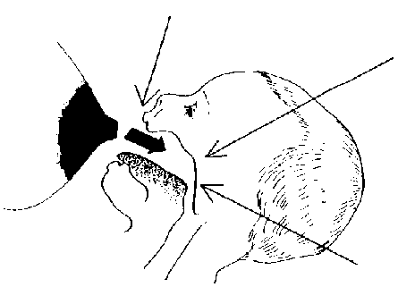
Reflexes in the baby
Rooting reflex
When something touches the lips, the baby opens the mouth and puts the tongue down and forward
Skill
The mother learns to position the baby
The baby learns to take the breast
Sucking reflex
When something touches the palate, the baby sucks
Swallowing reflex
When the mouth fills with milk, the baby swallows
© Felicity Savage

