Slide 1

Session 21.
Facility practices: Implementing the Ten Steps
©UNICEF/UN0202896

Slide 2
Session 21. Objectives
Facility practices: Implementing the
Ten Steps
After completing this session, participants will be able to:
describe quality improvement in a facility, as part of the Ten Steps;
explain the importance of infant feeding policies;
explain the global standards from each of the Ten steps to successful breastfeeding;
outline the health-care practices summarized by the Ten steps to successful breastfeeding.

Slide 3
Quality-improvement process
The triad of planning, improvement and control is central to the approach
Active participation of the main service providers or front-line implementers
Engagement of leadership personnel
Measurement and analysis of progress over time
External evaluation or assessment

Slide 4
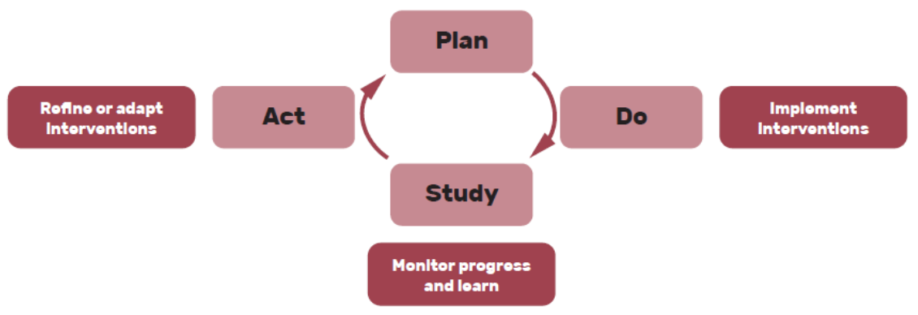
PDSA Cycle

Slide 5
Step 1a: The international code of marketing of breast-milk substitutes and relevant world health assembly resolutions
“Comply fully with the International Code of Marketing of Breast-milk Substitutes and relevant World Health Assembly resolutions.”

Slide 6
Global standards:
Step 1a
All infant formula, feeding bottles and teats used in the facility have been purchased through normal procurement channels and not received through free or subsidized supplies.
The facility has no display of products covered under the Code or items with logos of companies that produce breast-milk substitutes, feeding bottles and teats, or names of products covered under the Code.

Slide 7
Global standards:
Step 1a
The facility has a policy that describes how it abides by the Code, including procurement of breast-milk substitutes, not accepting support or gifts from producers or distributors of products covered by the Code and not giving samples of breast-milk substitutes, feeding bottles or teats to mothers.
At least 80% of health professionals who provide antenatal, delivery and/or newborn care can explain at least two elements of the Code.

Slide 8
Step 1b: Infant feeding policy
“Have a written infant feeding policy that is routinely communicated to staff
and parents.”

Slide 9
Global standards:
Step 1b
The health facility has a written infant feeding policy that addresses the implementation of all eight key clinical practices of the Ten Steps, Code implementation, and regular competency assessment.
Observations in the facility confirm that a summary of the policy is visible to pregnant women, mothers and their families.
A review of all clinical protocols or standards related to breastfeeding and infant feeding used by the maternity services indicates that they are in line with BFHI standards and current evidence-based guidelines.
At least 80% of clinical staff who provide antenatal, delivery and/or newborn care can explain at least two elements of the infant feeding policy that influence their role in the facility

Slide 10
Step 1c: Monitoring and data management systems
“Establish ongoing monitoring and data-management systems.”

Slide 11
Global standards:
Step 1c
The facility has a protocol for an ongoing monitoring and data-management system to comply with the eight key clinical practices.
Clinical staff at the facility meet at least every 6 months to review implementation of the system.

Slide 12
Step 2: Staff competency
“Ensure that staff have sufficient knowledge, competence and skills to support breastfeeding.”

Slide 13
Global standards:
Step 2
At least 80% of health professionals who provide antenatal, delivery and/or newborn care report they have received pre-service or in-service training on breastfeeding during the previous 2 years.
At least 80% of health professionals who provide antenatal, delivery and/or newborn care report receiving competency assessments in breastfeeding in the previous 2 years.
At least 80% of health professionals who provide antenatal, delivery and/or newborn care are able to correctly answer three out of four questions on breastfeeding knowledge and skills to support breastfeeding.

Slide 14
Step 3: Antenatal information
“Discuss the importance and management of breastfeeding with pregnant women
and their families.”

Slide 15
Global standards:
Step 3
A protocol for antenatal discussion of breastfeeding includes at a minimum:
  the importance of breastfeeding;
  global recommendations on exclusive breastfeeding for the first 6 months, the risks of giving formula or other breast-milk substitutes, and the fact that breastfeeding continues to be important after 6 months when other foods are given;
  the importance of immediate and sustained skin-to-skin contact;
  the importance of early initiation of breastfeeding;
  the importance of rooming-in;
  the basics of good positioning and attachment;
  recognition of feeding cues.

Slide 16
Global standards:
Step 3
At least 80% of mothers who received prenatal care at the facility report having received prenatal counselling on breastfeeding.
At least 80% of mothers who received prenatal care at the facility are able to adequately describe what was discussed about two of the topics mentioned above.

Slide 17
Step 4: Immediate postnatal care
“Facilitate immediate and uninterrupted skin-to-skin contact and support mothers to initiate breastfeeding as soon
as possible after birth.”

Slide 18
Global standards:
Step 4
At least 80% of mothers of term infants report that their babies were placed in skin-to-skin contact with them immediately or within 5 minutes after birth and that this contact lasted 1 hour or more, unless there were documented medically justifiable reasons for delayed or interrupted contact.
At least 80% of mothers of term infants report that their babies were put to the breast within 1 hour after birth, unless there were documented medically justifiable reasons not to do so.

Slide 19
Step 5: Support with breastfeeding
“Support mothers to initiate and maintain breastfeeding and manage common difficulties.”

Slide 20
Global standards:
Step 5
At least 80% of breastfeeding mothers of term infants report that someone on the staff offered assistance with breastfeeding within 6 hours after birth.
At least 80% of mothers of preterm or sick infants report having been helped to express milk within 1–2 hours after birth.
At least 80% of breastfeeding mothers of term infants are able to demonstrate how to position their baby for breastfeeding and that the baby can suckle and transfer milk.

Slide 21
Global standards:
Step 5
At least 80% of breastfeeding mothers of term infants can describe at least two ways to facilitate milk production for their infants.
At least 80% of breastfeeding mothers of term infants can describe at least two indicators of whether a breastfed baby consumes adequate milk.
At least 80% of mothers of breastfed preterm and term infants can correctly demonstrate or describe how to express breast milk.

Slide 22
Step 6: Supplementation
“Do not provide breastfed newborns any food or fluids other than breast milk, unless medically indicated.”

Slide 23
Global standards:
Step 6
At least 80% of infants (preterm and term) received only breast milk (either from their own mother or from a human milk bank) throughout their stay at the facility.
At least 80% of mothers who have decided not to breastfeed report that the staff discussed with them the various feeding options and helped them to decide what was suitable in their situations.
At least 80% of mothers who have decided not to breastfeed report that the staff discussed with them the safe preparation, feeding and storage of breast-milk substitutes.

Slide 24
Global standards:
Step 6
At least 80% of term breastfed babies who received supplemental feeds have a documented medical indication for supplementation in their medical record.
At least 80% of preterm babies and other vulnerable newborns that cannot be fed their mother’s own milk are fed with donor human milk.
At least 80% of mothers with babies in special care report that they have been offered help to start lactogenesis II (beginning plentiful milk secretion) and to keep up the supply, within 1–2 hours after their babies’ births.

Slide 25
Step 7: Rooming-in
“Enable mothers and their infants to remain together and to practise rooming-in
24 hours a day.”

Slide 26
Global standards:
Step 7
At least 80% of mothers of term infants report that their babies stayed with them since birth, without separation lasting for more than 1 hour.
Observations in the postpartum wards and well-baby observation areas confirm that at least 80% of mothers and babies are together or, if not, have medically justifiable reasons for being separated.
At least 80% of mothers of preterm infants confirm that they were encouraged to stay close to their infants, day and night.

Slide 27
Step 8: Responsive feeding
“Support mothers to recognize and
respond to their infants’ cues for feeding.”

Slide 28
Global standards:
Step 8
At least 80% of breastfeeding mothers of term infants can describe at least two feeding cues.
At least 80% of breastfeeding mothers of term infants report that they have been advised to feed their babies as often and for as long as the infant wants.

Slide 29
Step 9:
Feeding bottles, teats and pacifiers
“Counsel mothers on the use and risks of feeding bottles, teats and pacifiers.”

Slide 30
Global standards:
Step 9
At least 80% of breastfeeding mothers of preterm and term infants report that they have been taught about the risks of using feeding bottles, teats and pacifiers.

Slide 31
Step 10: Care at discharge
“Coordinate discharge so that parents and their infants have timely access to ongoing
support and care.”

Slide 32
Global standards:
Step 10
At least 80% of mothers of preterm and term infants report that a staff member has informed them where they can access breastfeeding support in their community.
The facility can demonstrate that it coordinates with community services that provide breastfeeding/infant feeding support, including clinical management and mother-to-mother support.

