Slide 1
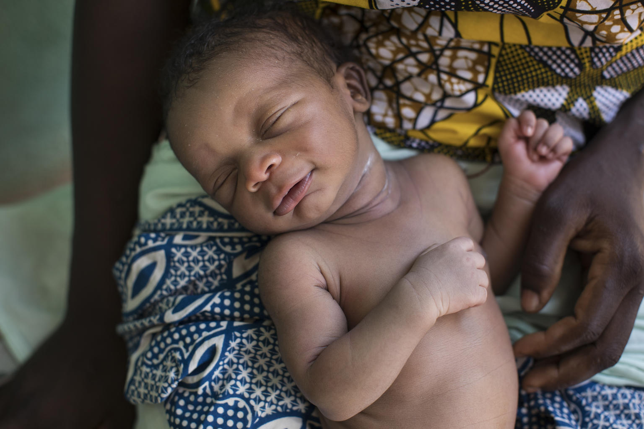
Session 20.
The International Code
© UNICEF/UN0205733/Njiokiktjien VII

Slide 2
Session 20. Objectives
The International Code
After completing this session, participants will be able to:
explain how manufacturers promote breast-milk substitutes;
outline the major provisions of the International Code of Marketing of Breast-milk Substitutes and subsequent relevant World Health Assembly resolutions (the Code);
explain the difficulties with donations and samples of breast-milk substitutes milk;
recognize violations of the Code and indicate actions when violations are identified.

Slide 3
The Code
1981 World Health Assembly adopted the Code, which aims to regulate promotion and marketing of breast-milk substitutes.
The Code is a code of marketing.
Covers all breast-milk substitutes, including infant breast-milk substitutes, follow-up breast-milk substitutes, growing-up milks and any other milk products marketed for babies up to the age of 36 months.
Also includes other food such as water, teas and cereals sometimes marketed as suitable for infants under 6 months of age, and also feeding bottles and teats.

