Slide 1
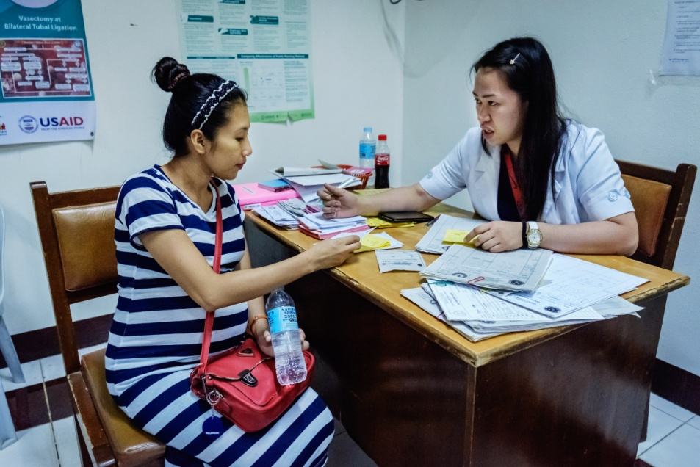
Session 17.
Antenatal preparation for breastfeeding
© WHO/Yoshi Shimizu

Slide 2
Session 17. Objectives
Antenatal preparation for breastfeeding
After completing this session, participants will be able to:
outline information to be discussed with pregnant women;
explain the difference between individual and group antenatal sessions;
practise counselling skills to discuss breastfeeding with a pregnant woman.

Slide 3
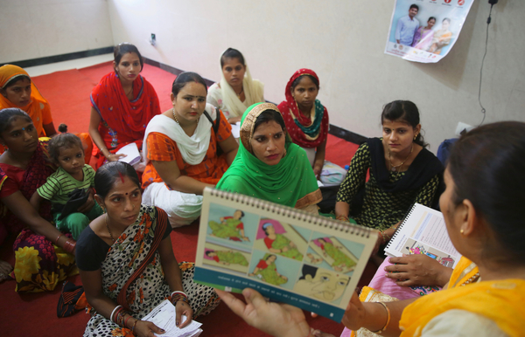
Antenatal Care (ANC) topic:
Importance and management of breastfeeding
Counsel all pregnant women and show you want to help them
Counsel young women or those having first baby
Counsel all women at least twice antenatally about breastfeeding
Remember: Antenatal breast preparation is not necessary
© UNICEF/UN077916/Kapoor

Slide 4
Group session:
Topics to cover
Importance of breastfeeding and colostrum
Global recommendations for exclusive breastfeeding until 6 months and continued breastfeeding
Risks of formula and other breast-milk substitutes
What happens after delivery
  Immediate and sustained skin-to-skin contact
  Early initiation of breastfeeding
  Rooming-in
How to breastfeed
  Position and attachment
  Responsive and unrestricted feeding
  Feeding cues
Let women ask questions and discuss in the group
Encourage them to share concerns, doubts and feelings

Slide 5
Individual session:
Topics to cover
Give each woman a change to talk privately with you
What was her previous experience of breastfeeding? Did she have any difficulties?
Does she have any questions or worries?
Examine her breasts, if she has concerns
Build her confidence in her ability to breastfeed
Consider the possibility of HIV, provide counselling about testing, protection and feeding her baby according to national recommendations

Slide 6
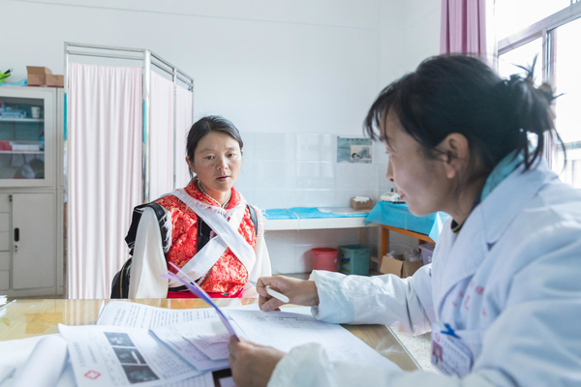
Antenatal counselling
© UNICEF/UN0219972/Yuyuan

