Slide 1
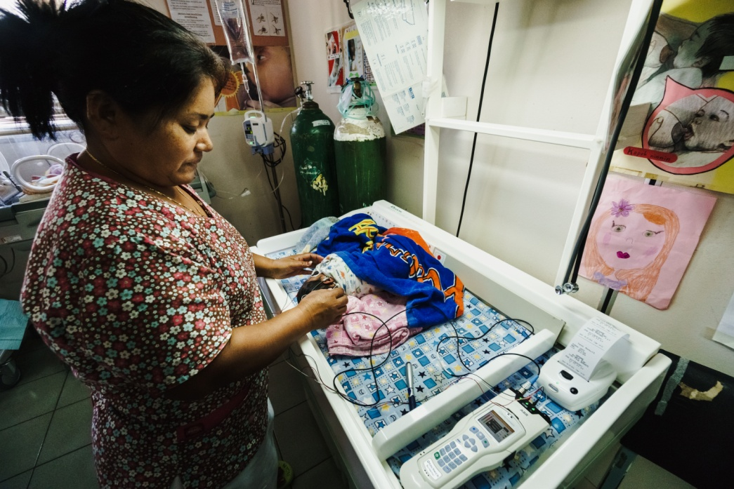
Session 14.
Medical indications for supplementary feeding
© WHO/Yoshi Shimizu

Slide 2
Session 14. Objectives
Medical indications for supplementary feeding
After completing this session, participants will be able to:
list the possible medical indications and reasons for supplementation;
explain how to choose an appropriate supplement;
discuss how to support mothers who have decided to feed their babies with infant formula;
describe the safe preparation of the supplementation.

Slide 3
Infant indications
Low-birth-weight (<1500 g)
Preterm (born before 32 weeks)
Hypoglycaemia
  Low-blood glucose levels which do not respond to breast milk
Signs/symptoms indicating poor breast-milk intake
High bilirubin
  Associated with poor breast-milk intake
Metabolic disorders
Kellams A, Harrel C, Omage S, Gregory C, Rosen-Carole C, Academy of Breastfeeding Medicine. ABM Clinical Protocol #3: Supplementary feedings in the healthy term breastfed neonate, revised 2017. Breastfeed Med. 2017;12:188–98. doi:10.1089/bfm.2017.29038.ajk

Slide 4
Maternal indications
Delayed milk production with poor intake by the infant
Hormonal conditions
Poor milk production due to breast pathology or breast surgery
Pain with breastfeeding unrelieved by other interventions
Severe illness preventing a mother from caring for her infant
Herpes simplex virus type 1 with open lesions
Kellams A, Harrel C, Omage S, Gregory C, Rosen-Carole C, Academy of Breastfeeding Medicine. ABM Clinical Protocol #3: Supplementary feedings in the healthy term breastfed neonate, revised 2017. Breastfeed Med. 2017;12:188–98. doi:10.1089/bfm.2017.29038.ajk

Slide 5
Breast-milk insufficiency
Insufficient milk production, transfer and intake can be prevented and managed (as discussed in detail in Session 12)
If the challenge still persists, make sure the baby is adequately fed. Evaluate and consider the option of supplementation.

Slide 6
Maternal preferences
Mothers who have made a fully informed decision not to breastfeed, exclusively, or have chosen to mixed feed, may consider supplementary feeding with infant formula
It is important to ensure that:
  all mothers are informed about the risks and management of various feeding options and have been helped to decide what is suitable in their circumstances;
  all mothers have received factual information in a sensitive and respectful manner, including the importance of exclusive breastfeeding, and basic management of breastfeeding related to their concerns.
14/6

Slide 7
Options of supplementation (when medically indicated)
Supplementation: Food other than mother’s own milk fed to the infant following or in place of a breastfeeding
Type | Purpose
Donor breast milk | Breast milk donated by mother’s with excess to cover needs especially for low-birth-weight (LBW), preterm and sick infants
Formula: Ready-to-feed Concentrated Powdered | Most expensive, does not introduce water issues More costly than powdered, but easier to mix Least expensive, commonly used, can pose water issues
Formula: Cow’s milk base | Powdered milk, cow’s milk based
Formula: Soy base | Powdered milk, soy base
Formula: Hypoallergenic | Powdered milk, hydrolysed for infants with allergies or health concerns
Human milk fortifiers (HMF) | Formula-based to complement breast milk, especially for LBW, preterm and sick infants
Kellams, A., Harrel, C., Omage, S., et al. (2017). ABM Clinical Protocol #3: Supplementary Feedings in the Healthy Term Breastfed Neonate, Revised 2017. Breastfeed Med.

