Slide 1

Session 13.
Challenges of feeding at the breast and alternative methods of feeding
© WHO/Yoshi Shimizu

Slide 2
Session 13 Objectives
Barriers to breastfeeding
After completing this session, participants will be able to:
describe the challenges for a baby to feed at the breast;
list different reasons why a baby may cry often;
discuss the alternative feeding methods until the baby can feed at the breast again;
help a mother to overcome these difficulties and help her feed her baby using different methods.

Slide 3
Why babies may be reluctant to feed at the breast
Possibility | Description
Illness, small or weak | Difficult delivery (e.g. brain damage) Infection Preterm
Pain or sedation | Pain from bruise (vacuum, forceps) Blocked nose Sore mouth (thrush) Sedation (due to medications given to mother during labour)
Difficulty with breastfeeding technique | Separation from mother after delivery Not getting much milk (e.g. poor attachment) Poor technique for positioning and attachment Conditions such as engorgement, or mastitis Oversupply of milk Use of bottles / artificial teats for preterm infants
Perceived reluctancy | Newborn reflexes – rooting

Slide 4
Reasons why baby may cry
Reason | Description
Discomfort | Dirty diaper/ nappy, hot, cold
Tiredness | too many visitors and stimulation
Illness or pain | pain from delivery, reflux in babies who have been tube fed
Hunger | poor attachment, not getting enough milk
Mother’s food | Any food, check mother’s cow’s milk intake
Mother’s drugs | caffeine, cigarettes
Can you think of other reasons?

Slide 5
Baby who cries often:
Supporting the mother/parent/caregiver
Listen and learn
If baby is crying frequently, look for a cause
Take a history
Assess a breastfeeding session
Examine the baby
Build the mother’s confidence and give support in her ability to care for her baby
Accept what mother is feeling
Praise what the mother and baby doing well
Give relevant information, depending on situation
Make one or two simple suggestions
Give practical help

Slide 6
Management of the challenges to feed at the breast
Treat the cause, where possible
Breast, nipple conditions (candida, mastitis, engorged breasts and other conditions) and other challenges as discussed in Session 11
Treat a sore mouth or blocked nose
Stop using anything that is causing an unpleasant taste or smell to the breast
Help the mother to do these things
Let her hold the baby close in skin-to-skin as much as possible
Let the baby explore the breast and learn to feel comfortable there, but do not try to attach him too soon
Express her breastmilk to feed the baby and keep up her milk supply
Feed the baby her expressed milk with a cup or spoon NOT with a bottle
Care for the baby in a gentle and confident manner
Offer her breast whenever her baby is willing to suckle
  When her baby is sleepy, or after a cup feed
  In different positions
  When she feels her oxytocin reflex working ("let down")

Slide 7
Management of the challenges of feeding at the breast
Help her baby to take the breast
  Let her position her baby in a calm and unhurried way
  Show her the reclining position
  Avoid pressing the back of the baby’s head, or pressing on a painful place
  If the baby is rooting let the baby continue and explain that the baby is trying to find the breast
  When the baby is near the breast, express a little milk into his mouth
  When the baby seems interested, help the baby to attach to the breast – be patient – do not hurry

Slide 8

Hand expression
© WHO/Yoshi Shimizu

Slide 9
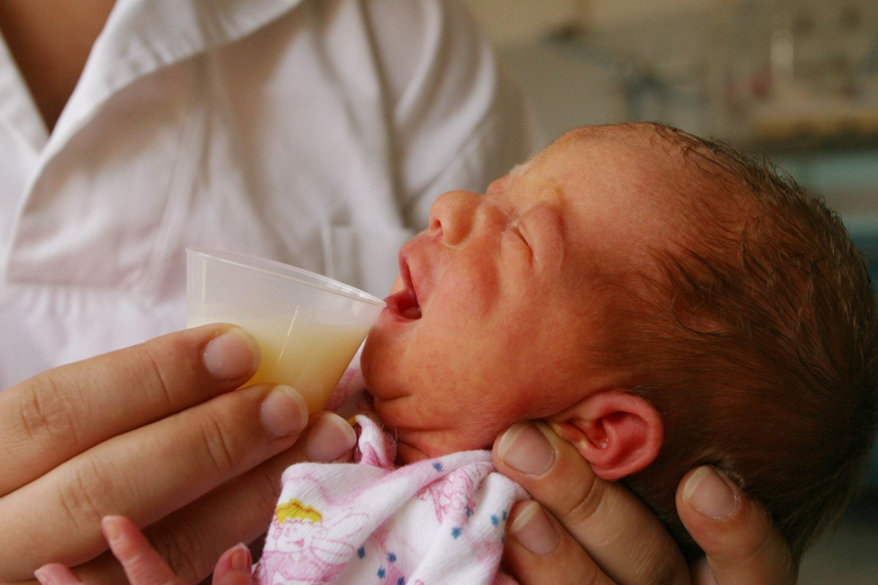
Cup feeding
© UNICEF/UNI11841/Pirozzi

Slide 10

Hand expression
How can you help this mother put the right amount into the cup for feeding?
© UNICEF/UNI51380/Press

