Slide 1

Session 12.
Milk supply challenges
© WHO/Yoshi Shimizu

Slide 2
Session 12. Objectives
Milk supply challenges
After completing this session, participants will be able to:
explain normal newborn feeding behaviour and intake;
list the signs and symptoms a newborn may not be getting enough milk;
explain the common reasons why a newborn may not get enough breast milk;
explain how to prevent and manage milk insufficiency in newborns;
explain the difference between perceived and actual milk insufficiency;
help a mother whose baby is not getting enough breast milk;
help a mother who thinks her baby is not getting enough milk.

Slide 3
First weeks of newborn’s life
Day 1-3
  Baby gets colostrum
  Breasts feel soft
Day 3-4
  Milk “comes in”, changes
  Volume produced increases
  Breasts feel full
Day 6-7
  Baby loses weight
  Fluid and glucose needs covered by extra in infant’s body from before birth
  Once breastfeeding established, weight increases
Day 10-14
  Infant regains birth weight

Slide 4

Newborn stomach:
Size and volume
Day 1
5-7 mL
Day 2
22-27 mL
1 Week
45-60 mL
1 Month
80-150 mL
Bergman NJ. Neonatal stomach volume and physiology. Acta Paediatrica. 2013;102:773–7.
Zangen S, DiLorenzo C, Zangen T, Mertz H, Schwankovsky L, Hyman PE. Rapid maturation of gastric relaxation in newborn infants. Pediatr Res. 2001;50:629–32.
Best Start Resource Centre: Ontario's Maternal Newborn and Early Child Development Resource Centre

Slide 5
Normal newborn feeding behaviour
First 24 hours
  Breastfeed in the first hour, may be followed by a long sleep
  Breastfeed then 5-12 times in the first 24 hours - babies vary and can depend on skin-to-skin and rooming-in
Day 2-3
  Frequency often increases to 10–12 times, still variable
After day 3
  Milk “comes in,” changes
  Maybe longer intervals between feeds, as feeds become larger
  Feeds on average about 8 times in 24 hours
  Mothers should keep babies close and respond as they show signs of readiness
  Alert and moving, turning head, hand to mouth, moving mouth
  A baby who rooms-in with a mother who responds, gains more weight over the first 7 days
Wight N, Marinelli KA, and the Academy of Breastfeeding Medicine (2014). ABM clinical protocol #1: Guidelines for blood glucose monitoring and treatment of hypoglycemia in term and late-preterm neonates. Breastfeeding Medicine, 9 (4), 173-179.
Kellams A, Harrel C, Omage S, et al. (2017). ABM clinical protocol #3: supplementary feedings in the healthy term breastfed neonate. Breastfeed Medicine, 12 (3), DOI: 10.1089/bfm.2017.29038.ajk.
Holmes AV, McLeod AY, and Bunik M. (2013). ABM clinical protocol #5: peripartum breastfeeding management for the healthy mother and infant at term. Breastfeeding Medicine, 8(6), 469-473. doi:10.1089/bfm.2013.9979.

Slide 6
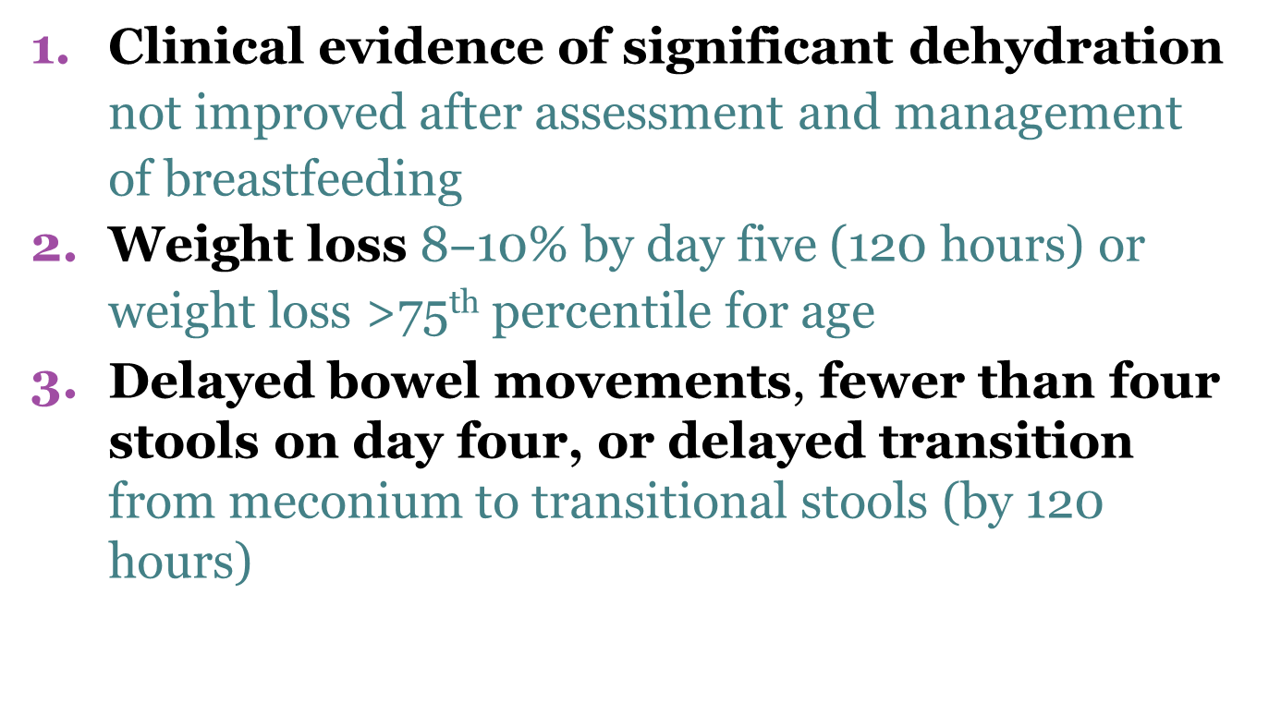
Signs and symptoms:
Newborn not getting enough milk
Clinical evidence of significant dehydration not improved after assessment and management of breastfeeding
Weight loss 8$‒$10% by day five (120 hours) or weight loss >75th percentile for age
Delayed bowel movements, fewer than four stools on day four, or delayed transition from meconium to transitional stools (by 120 hours)
Adapted from: Kellams A, Harrel C, Omage S, Gregory C, Rosen-Carole C. Academy of Breastfeeding Medicine. ABM Clinical Protocol #3: Supplementary feedings in the healthy term breastfed neonate, revised 2017. Breastfeed Med. 2017;12:188–98. doi:10.1089/bfm.2017.29038.ajk.

Slide 7
Signs mothers think they do not have enough milk
Baby
  Not satisfied at breast
  Cries often
  Refuses to breastfeed
  Breastfeeds frequently
  Breastfeeds for long periods
  Hard, dry or green stool
  Infrequent, small stool
Mother
  Breasts did not enlarge during pregnancy
  Milk did not “come in” after delivery
  No milk comes with expression

Slide 8
Common causes:
Insufficient milk in first weeks
Delay initiating breastfeeding
None or little skin-to-skin contact
Milk “coming in” delayed due to:
  complications of delivery
  maternal illness
  diabetes
Poor attachment and ineffective suckling

Slide 9

Common breastfeeding factors
Feeding at fixed times
Short feeds
Supplementary feeding
No nighttime feeding
Infrequent feeds

Slide 10

Psychological factors
Lack of confidence
Worry and stress
Dislike of breastfeeding
Tiredness
Lack of bonding, rejection of newborn
© WHO/Yoshi Shimizu

Slide 11
After 2 weeks of age:
Actual or perceived insufficiency
Perceived insufficiency
  The most common reason for a mother giving up exclusive breastfeeding is because they think they do not have enough milk.
  Almost all mothers are able to produce as much milk as their baby needs.
  Often there is an issue in the interaction between mother and infant
  How many mothers could continue breastfeeding if they had skilled support and help?
Actual insufficiency
  In some cases, the mother does have a supply issue.
  Assess the possible causes: physical, psychological or other causes.

Slide 12

Practices:
To prevent and manage insufficient milk intake and transfer
Early skin-to-skin contact at delivery and initiation of breastfeeding as soon as possible
Skilled support of breastfeeding after delivery to ensure good attachment and effective suckling
Practice rooming-in 24 hours a day
Exclusive breastfeeding, unless supplements medically indicated

Slide 13
Not enough milk:
Helping the mother
Listen to the mother and take a detailed history
  If she is doubting her milk supply, try to learn why. In this way, you can help her to build her confidence.
  Explore the mother’s ideas and feelings about her milk and pressures she may be experiencing. This pressure can come from family and friends.
Assess the infant’s health
  Determine whether the baby is getting milk or not, using the signs and symptoms we have discussed.
  Determine whether the baby is being fed exclusively at the breast or is being supplemented.
Adapted from: LEAARC. Core curriculum for interdisciplinary lactation care. Burlington (MA): 2019.

Slide 14
Not enough milk:
Helping the mother
Assess the big picture
  Is the baby’s weight within the expected range?
  Has supplementation played a role?
  Is baby removing milk from the breast?
  What is the baby's output (urine and stooling pattern)?
Assess the mother’s health
  Does the mother have risk factors for lactation problems?
Observe one or more feeds
  Assess latch, milk transfer and positioning to check positioning and attachment, as well as the condition of the mother and baby.
Adapted from: LEAARC. Core curriculum for interdisciplinary lactation care. Burlington (MA); 2019.

Slide 15
Not enough milk:
Helping the mother
If there is a problem
  Make sure baby is adequately fed. This may require supplementation.
  Try to determine the cause. Has the problem been present since birth? When did the problem become apparent?
  Screen for breastfeeding management problems and factors related to the mother.
  If milk remained in the breast after feeding, determine the cause for the baby’s inability to remove milk.
Support milk production as needed and address any problems as soon as possible
Adapted from: LEAARC. Core curriculum for interdisciplinary lactation care. Burlington, MA; 2019.

