Slide 1

Session 11.
Breast and nipple conditions
© WHO/Yoshi Shimizu

Slide 2
Session 11. Objectives
Breast and nipple conditions
After completing this session, participants will be able to recognize and describe how to manage these common breast and nipple conditions:
flat or inverted nipples
engorgement
mastitis
sore or cracked nipples
also, participants will identify when to refer to advanced medical staff for further treatment.

Slide 3
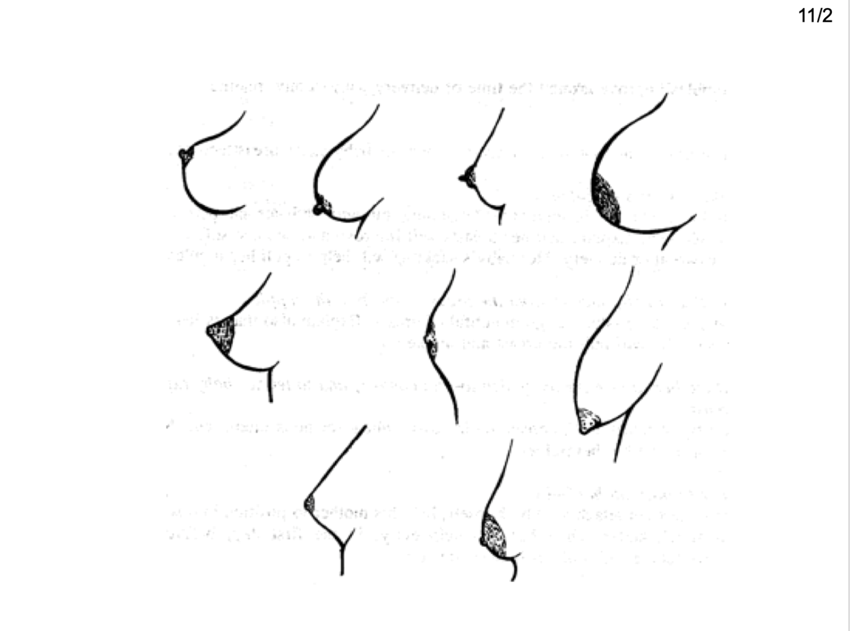
Breast and nipples shapes:
Which is the best breast for feeding?
© Felicity Savage
Notes:
This is marked in the image as 11/2. It is in fact 11/3. Please change image.

Slide 4
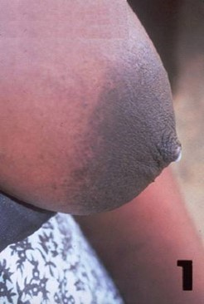
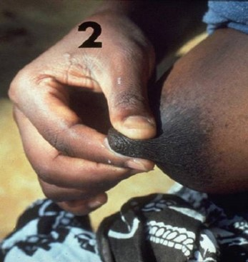
What do you observe?
© Felicity Savage
Notes:
Placement of numbers in the images needs adjusting.

Slide 5
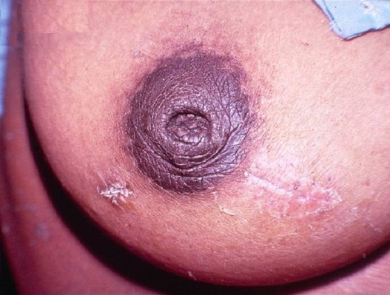
What do you observe?
© Armida Fernandes

Slide 6
Clinical management:
Flat and inverted nipples
Time period | Management
Antenatal | Not helpful
Soon after delivery | Build the mother’s confidence, her breasts will improve Explain that the baby suckles BREAST not nipple Let the baby explore the breast skin-to-skin Help the mother to position her baby on the first day Try different positions, e.g. underarm Help her to make the nipple stand out more Use a pump, syringe
First weeks, if necessary | Express breast milk and feed with a cup Express breast milk into the baby’s mouth

Slide 7
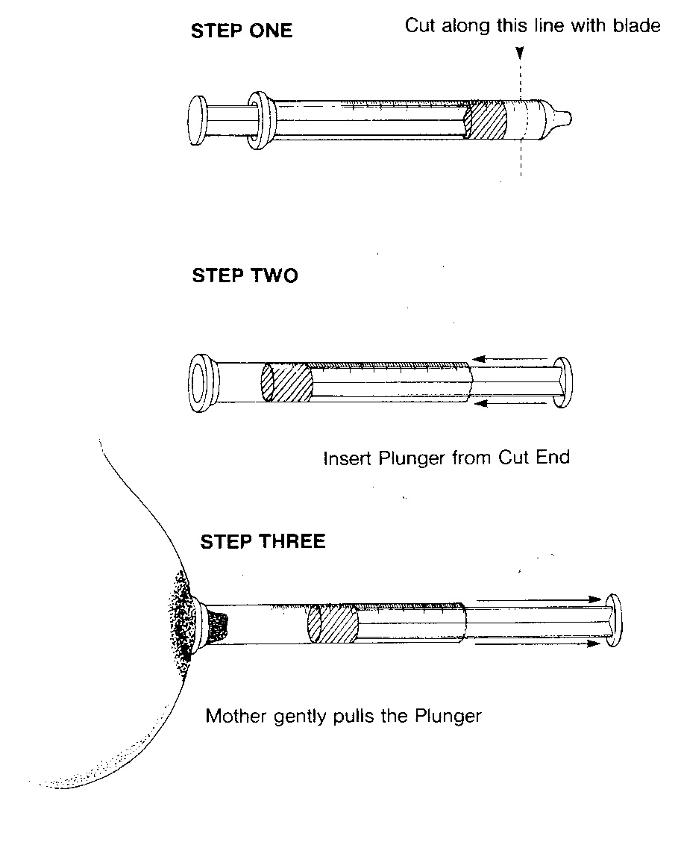
Clinical Management:
Syringe treatment
© Felicity Savage

Slide 8
Differences:
Full vs. engorged breasts
Full | Engorged
Hot | Painful
Heavy | Oedematous
Hard | Tight, especially nipple Shiny May look red
Milk flowing | Milk NOT flowing
No fever | May be fever for 24 hours

Slide 9
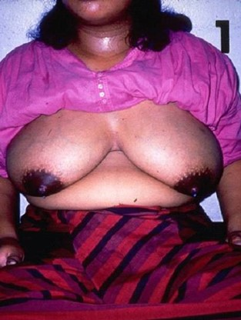
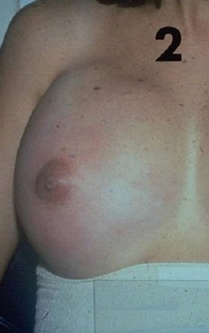
What do you observe?
© UNICEF/UNI51384/Press

Slide 10
Engorgement:
Causes and Prevention
Causes | Prevention
Plenty of milk | Frequent removal of milk, early initiation
Delayed start to breastfeed | Start breastfeeding soon after delivery
Poor attachment to breast | Ensure good attachment
Infrequent removal of milk | Encourage unrestricted breastfeeding
Restriction of length of feeds | Encourage unrestricted breastfeeding

Slide 11
Treatment:
Breast engorgement
Do not “rest the breast”
Assessment | Treatment
If baby is able to suckle | Hold baby skin-to-skin, help with attachment and allow to suckle frequently. This stimulates oxytocin.
If baby is unable to suckle | Express milk by hand or with a pump
Before feed to stimulate oxytocin reflex | Warm compresses or warm shower Massage to neck and back Light massage of breast Stimulate nipple skin Help mother to relax
After feed to reduce oedema | Cold compress

Slide 12
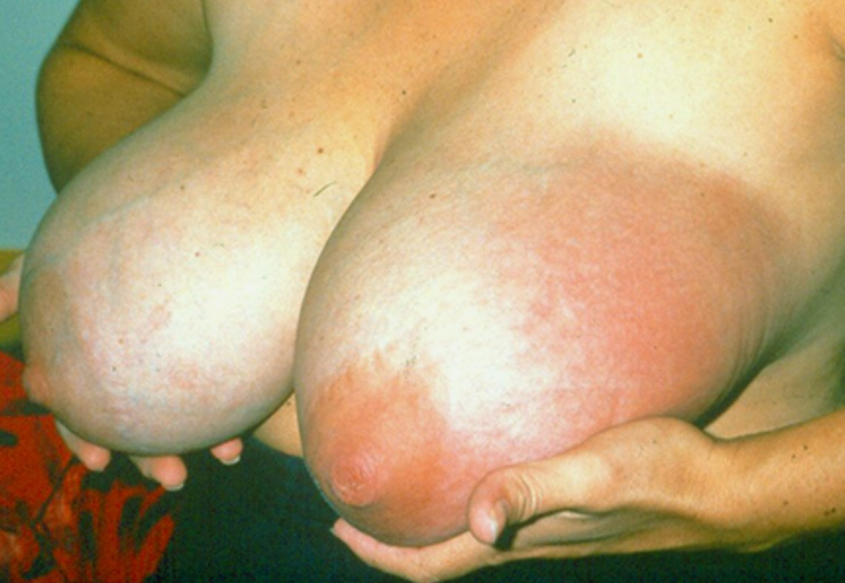
What do you observe?
© UNICEF C107-39

Slide 13
© Felicity Savage
Notes:
Right-hand top corner of image, “28/14” needs deleting.

Slide 14
Causes:
Blocked ducts and mastitis
Symptom | Causes
Infrequent or short breastfeeds | Mother being very busy Baby sleeping through night Changed routine Mother stressed
Inefficient removal of milk from part or all the breast | Ineffective suckling Pressure from clothes Pressure from fingers during feeds Large breast draining poorly
Damaged breast tissue | Trauma to breasts
Bacteria gaining entry | Nipple fissure

Slide 15
Treatment:
Blocked ducts and mastitis
Improve milk removal
Look for cause and correct
  Poor attachment
  Pressure from clothes
  Large breast draining poorly
Advise
  Frequent breastfeeds
  Gentle massage towards nipple
  Warm compress
  Analgesics (ibuprofen)
Suggest, if helpful
  Vary position

Slide 16
Treatment:
Blocked ducts and mastitis
If any of these symptoms continue:
  Symptoms severe (high fever, large area affected)
  Fissure
  No improvement in 24 hours
Advanced treatment required
  Complete rest
  Refer to an appropriate medical provider for antibiotic treatment

Slide 17
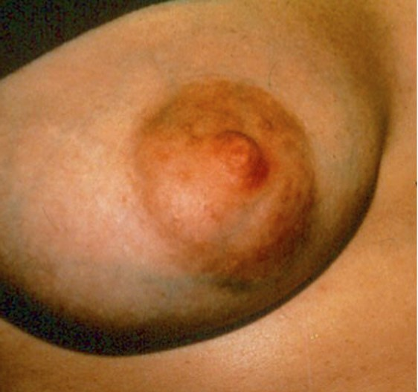
What do you observe?
© UNICEF C107-32

Slide 18
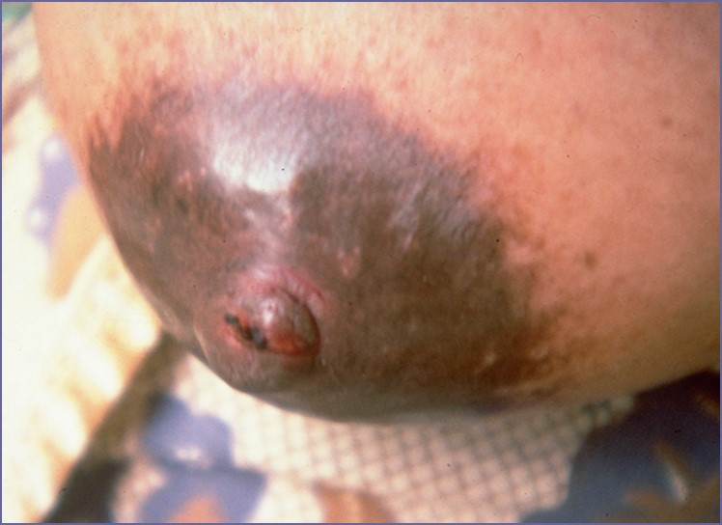
What do you observe?
© Felicity Savage

Slide 19
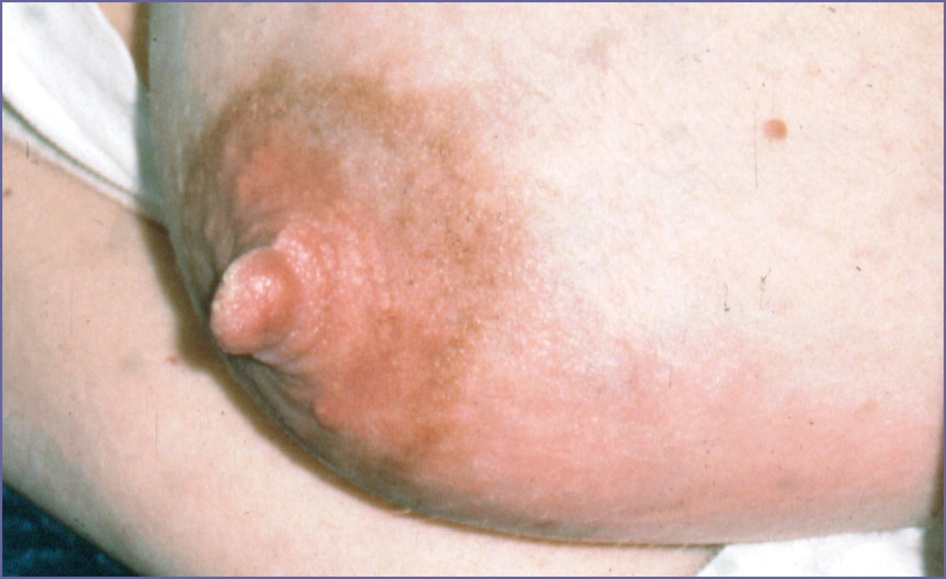
What do you observe?
© Felicity Savage

Slide 20
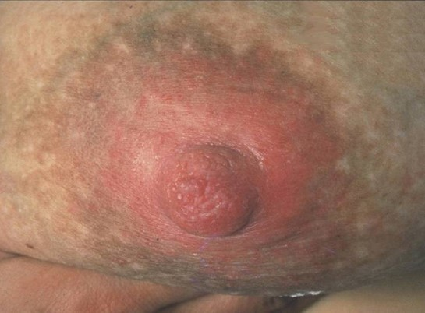
What do you observe?
© Chloe Fisher

Slide 21
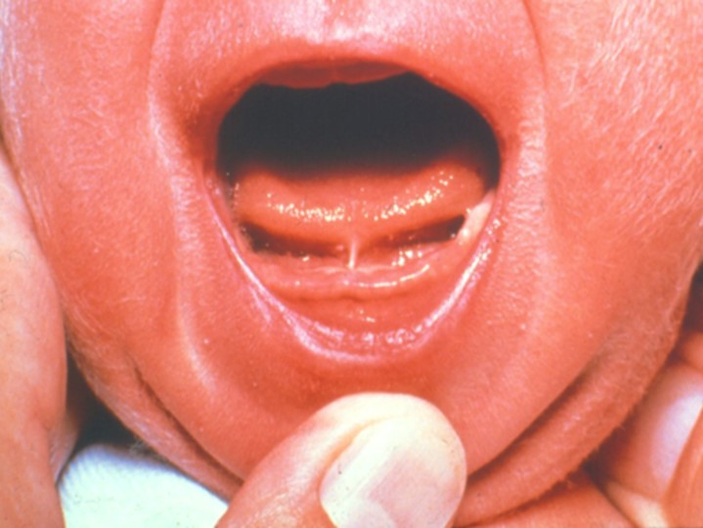
What do you observe?
© Felicity Savage

Slide 22
Clinical management:
Sore nipples
Look for a cause
  Check attachment
  Examine breasts (engorgement, fissure, Candida)
  Check baby for Candida or tongue tie
Give appropriate treatment
  Build mother’s confidence
  Improve attachment and continue breastfeeding
  Reduce engorgement (suggest frequent feeds, expression)
  Apply moist wound healing if fissure is open or ulcerated
  Treat for Candida if symptoms present or if the mother has pain between feeds

