Slide 1

Session 4.
Counselling skills: Building confidence and giving support
© UNICEF/UN0289070/Viet Hung

Slide 2
Session 4. Objectives
Counselling skills: Building confidence and giving support
After completing this session, participants will be able to:
list the six skills for building confidence and giving support
give an example of each skill
demonstrate the appropriate use of the skills when counselling a new mother on feeding her baby.

Slide 3
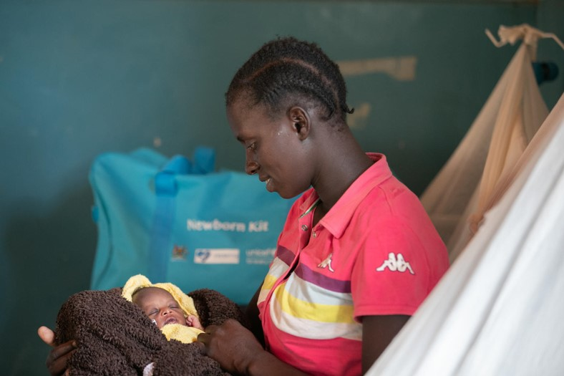
Let’s practice:
Case scenario
I am expressing milk during the day for him while I am at work, and I breastfeed at night. Am I breastfeeding enough?
© UNICEF/UN0306359/Abdul

Slide 4
Which response is most helpful?
“You need to breastfeed your baby more often.”
“It is better to breast feed rather than give your baby a bottle during the day.”
“It is good that you are continuing to breast feed your baby at night.”

Slide 5

Let’s practice:
Case scenario
No, I have not breastfed my baby yet. My breasts are empty and it is too painful to sit up!
© UNICEF/UNI130644/Vishwanathan

Slide 6
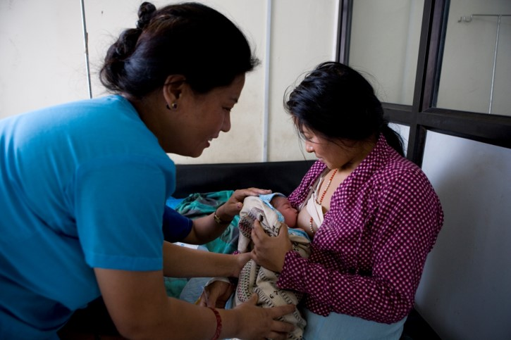
Which response is most helpful?
“You should let your baby suckle now to help your breast milk to come in.”
“Let me try to make you more comfortable, and then I’ll bring you a drink.”
© WHO/Christopher Black

Slide 7
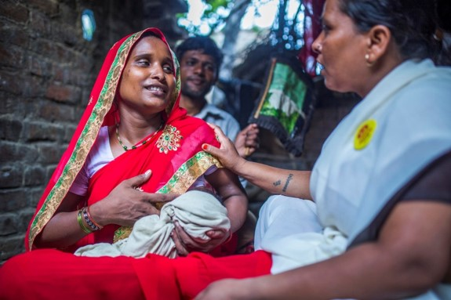
Which response is a command and which is a suggestion?
“You must feed Aahana at least 10 times a day.”
“It might help if you feed Aahana more often.”
© UNICEF/UN0281006/Vishwanathan

Slide 8
Counselling skills:
Building confidence and giving support
Accept what a mother/parent/caregiver thinks and feels
Recognize practices and praise a mother/parent/caregiver
Give practical help
Provide relevant information
Use simple language
Offer suggestions, not commands

