Slide 1

Session 3.
Counselling skills: Listening and learning
© WHO/Yoshi Shimizu

Slide 2
Summary:
Six listening and learning skills
Use helpful non-verbal communication
Ask open questions
Use responses and gestures that show interest
Reflect back what the mother/parent/caregiver says
Empathize – show you understand how the mother/parent/caregiver feels
Avoid using judging words

Slide 3
Session 3. Objectives
Counselling skills: Listening and learning
After completing this session, participants will be able to:
list the listening and learning skills
give an example of each skill
demonstrate the appropriate use of the skills when counselling a new mother on feeding her baby.

Slide 4
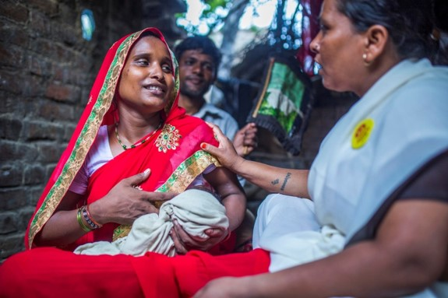
Examples of non-verbal communication
Posture: Sit at the same level and close to the mother.
Eye contact: Pay attention to the mother, avoid getting distracted, and show you are listening.
Barriers: Remove any physical barriers.
Taking time: Take time without hurrying or looking at your watch or mobile phone.
Touch: Only touch her in an appropriate way. Do not touch her breasts or her baby without her permission.
© UNICEF/UN0281006/Vishwanathan

